Slide 1
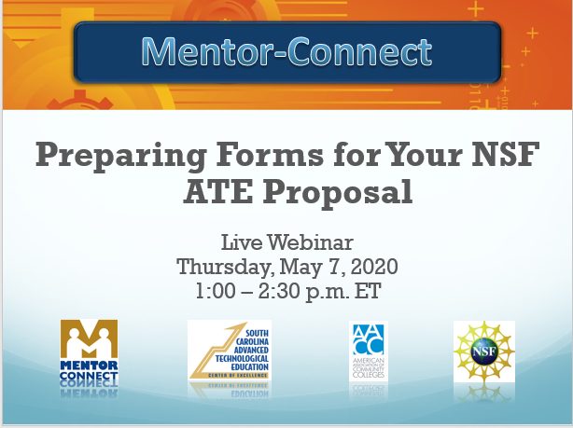
Mentor-Connect
Preparing Forms for Your NSF ATE Proposal
Live Webinar
Thursday, May 7, 2020
1:00 – 2:30 p.m. ET

Slide 2
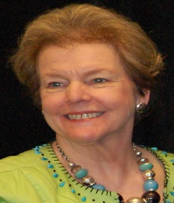
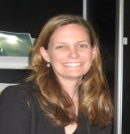
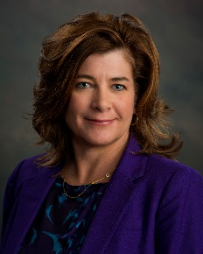
Welcome & Introductions
Elaine Craft, Principal Investigator
Mentor-Connect: Leadership Development and Outreach for ATE
Florence-Darlington Technical College, SCATE Center of Excellence
Email: Elaine.craft@fdtc.edu
Ellen Hause, Co-Principal Investigator
Mentor-Connect: Leadership Development and Outreach for ATE
Program Director, Academic and Student Success
Email: ehause@aacc.nche.edu
Emery DeWitt, Project Manager/Co-Principal Investigator Mentor-Connect: Leadership Development and Outreach for ATE
Florence-Darlington Technical College, SCATE Center of Excellence
Email: emery.dewitt@fdtc.edu

Slide 3
Using the chat box, tell us how many viewers are in the room with you.

Slide 4
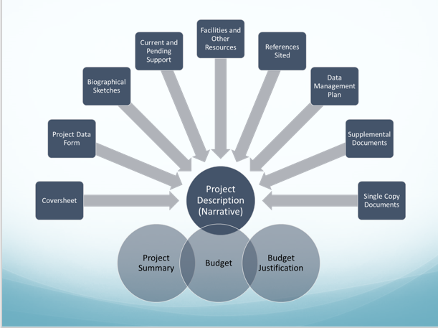
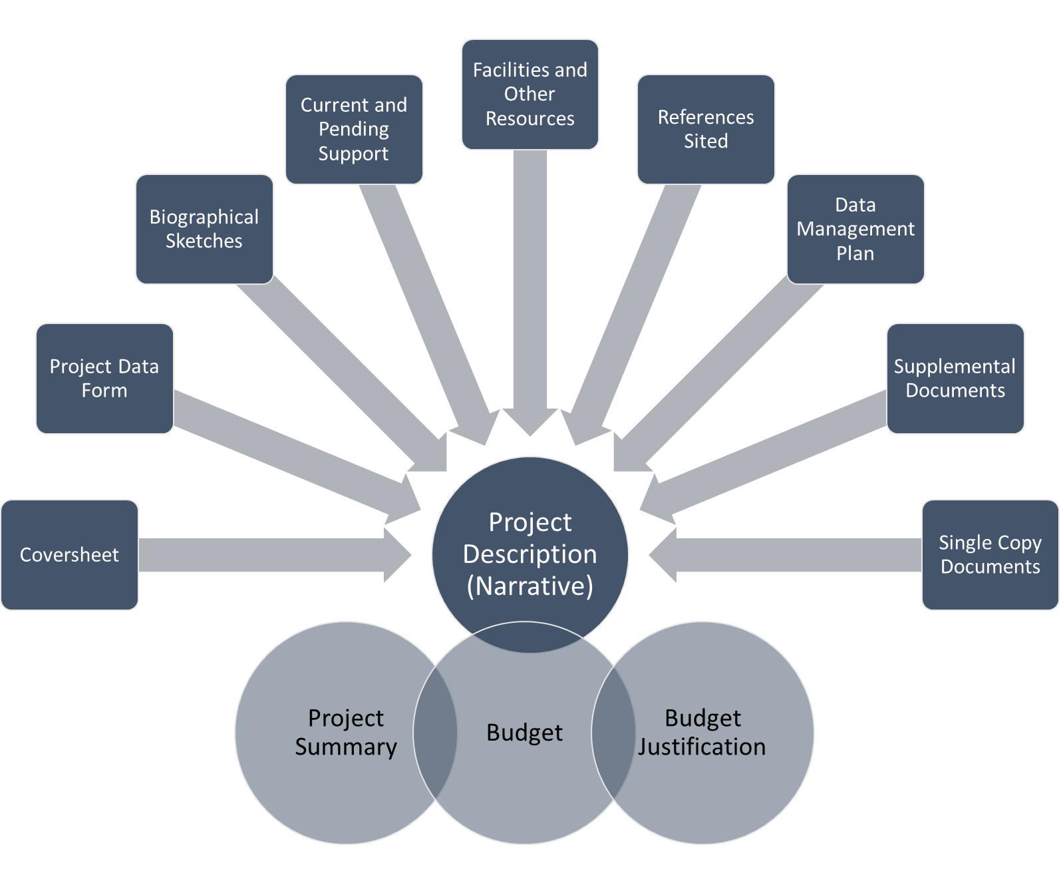

Slide 5
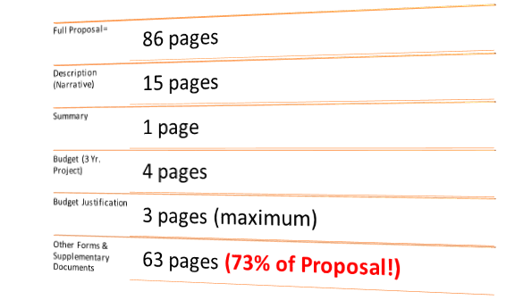
Webinar Overview

Slide 6
Poll Question: Are you now or have you been a
Mentor-Connect participant?
(mentor, faculty team, or other college personnel)

Slide 7
Read First & Read Often
ATE Program Solicitation
https://www.nsf.gov/pubs/2018/nsf18571/nsf18571.pdf
Proposal and Award Policies and Procedures Guide (PAPPG) : Effective June 1, 2020 (NSF 20-1)
https://www.nsf.gov/pubs/policydocs/pappg20_1/index.jsp
FastLane:

Slide 8
Before you Think about Forms…
Who is your SRO (Sponsored Research Officer)?
Register your institution within the FastLane System (FastLane ID)
Register all Principal Investigators, Co-Principal Investigators and Senior Personnel within FastLane
Items can be “parked” in FastLane! Nothing is FINAL until you click “submit”
Get started SOONER rather than later!

Slide 9
Real Deal Tips and Tricks
Throughout the webinar you will see this icon:
These TIPS and TRICKS come from the Mentor-Connect Team (not NSF) to promote your success

Slide 10
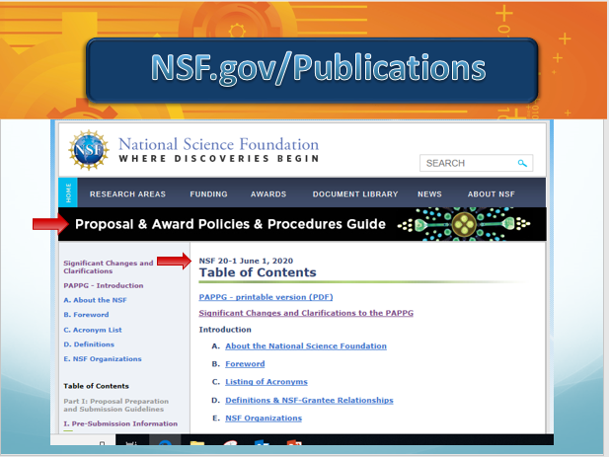
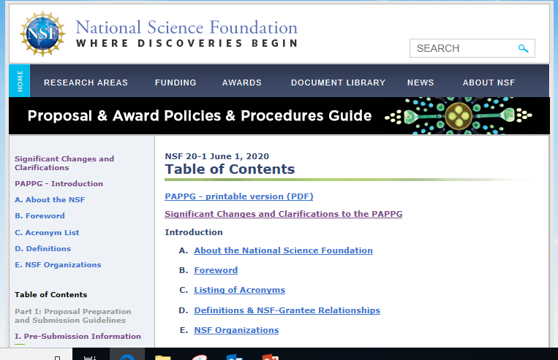
NSF.gov/Publications

Slide 11
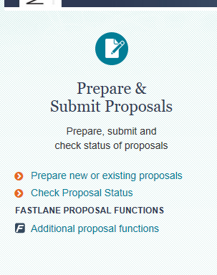
NSF Proposal Submission
Still
FastLane for 2020

Slide 12
Forms in FastLane…Step by Step
All of these sections will need to be completed for your ATE proposal

Slide 13
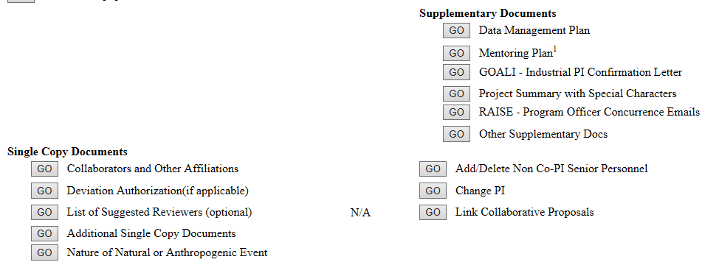
Forms in FastLane…Step by Step
3 Additional Sections to be completed for ATE Proposals

Slide 14
Cover Sheet
Provides NSF with a concise summary of all of the administrative data about the proposal
Certifies that all statements in the proposal are true
Certifies that the college is following the appropriate federal grant regulations
Requires verification “signature” for the institution

Slide 15
Cover Sheet
Thereafter, select ATE Projects

Slide 16
Cover Sheet
Enter your campus location if not the same as the Awardee Organization

Slide 17
Cover Sheet
Select RESEARCH not RAPID or EAGER
as Funding Mechanism
Select Beginning Investigator if
1st-time Principal Investigator
Be realistic about project length
Be careful of total amount of request

Slide 18
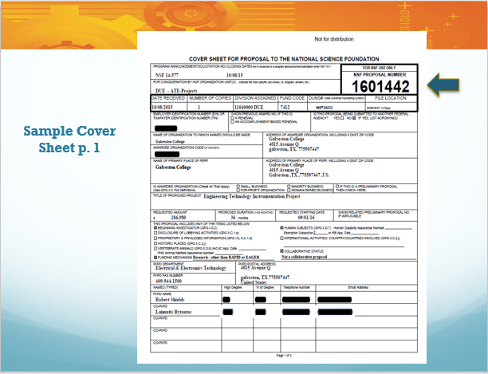
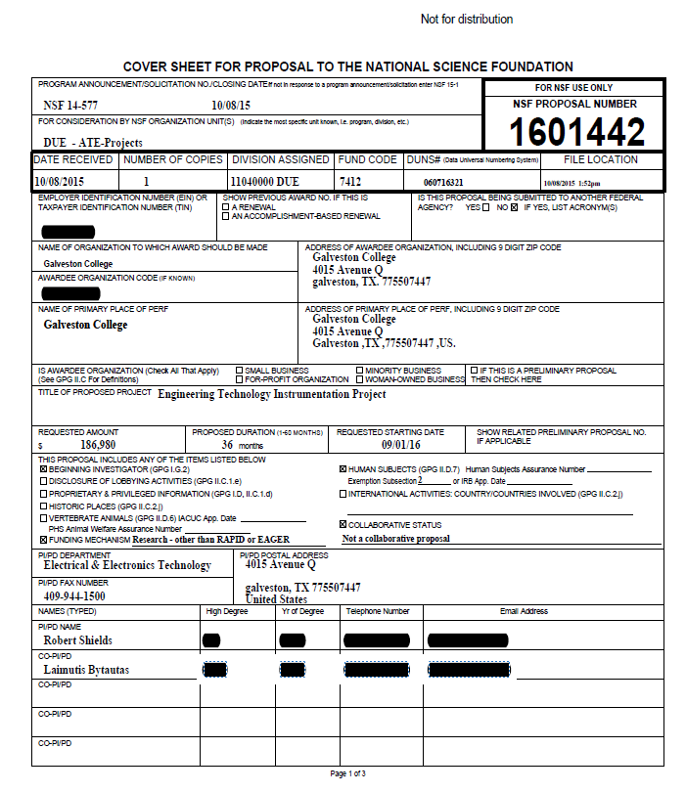
Sample Cover Sheet p. 1

Slide 19
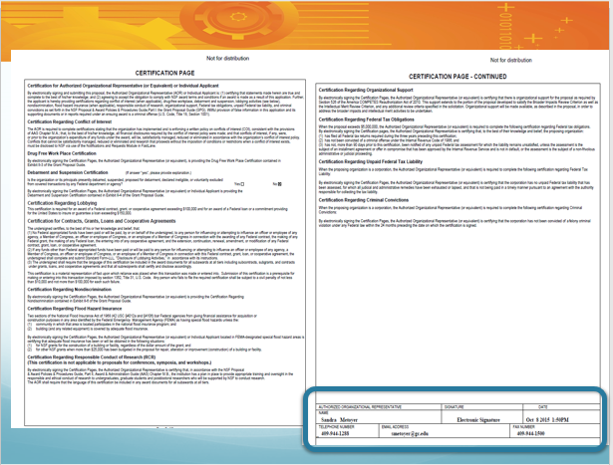
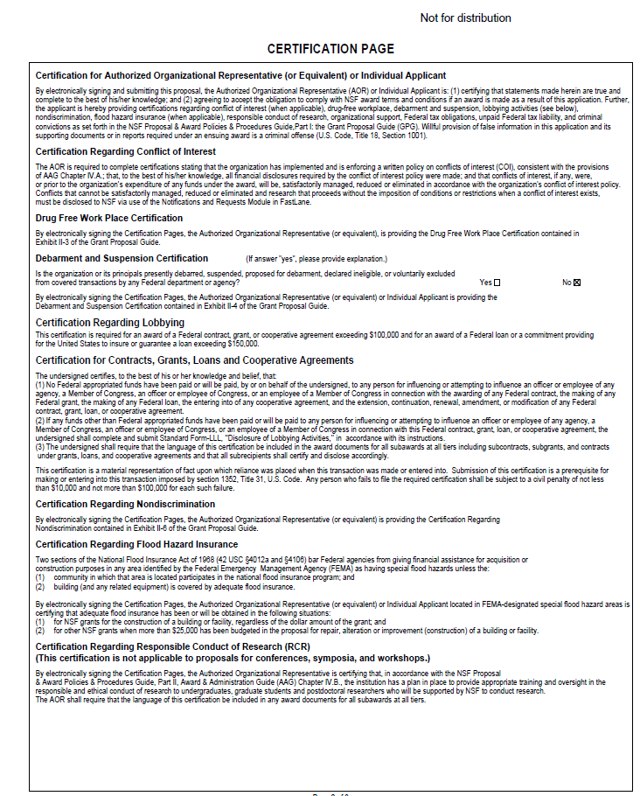
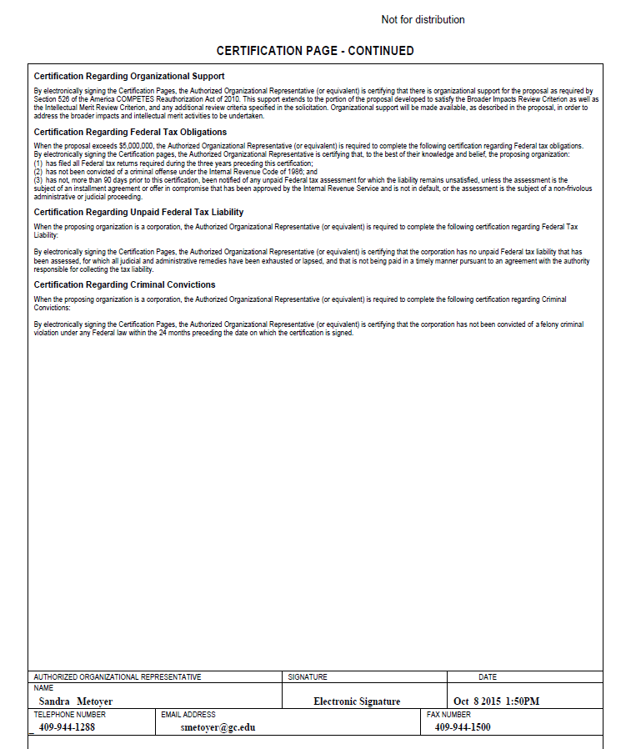

Slide 20
Cover Sheet Takeaways…
Choose the right program track---ATE Projects Track & Funding Mechanism ---Research, Not EAGER or RAPID
Enter project length as months
Carefully select & request your start date
Review this page prior to submitting to NSF
Be thoughtful about your project title

Slide 21
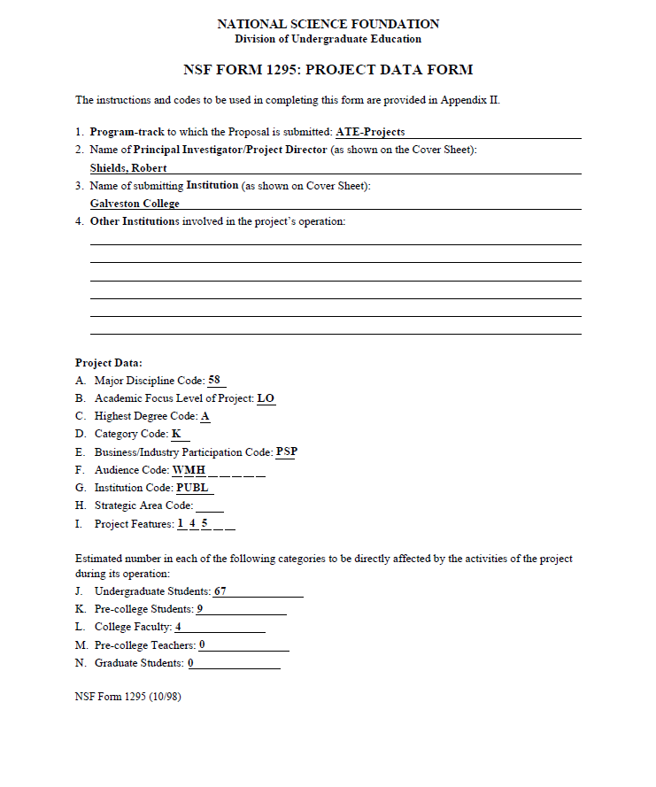
Project Data Form
Be mindful about how you record data about students and faculty
If you have partners or collaborators, add them to #4

Slide 22
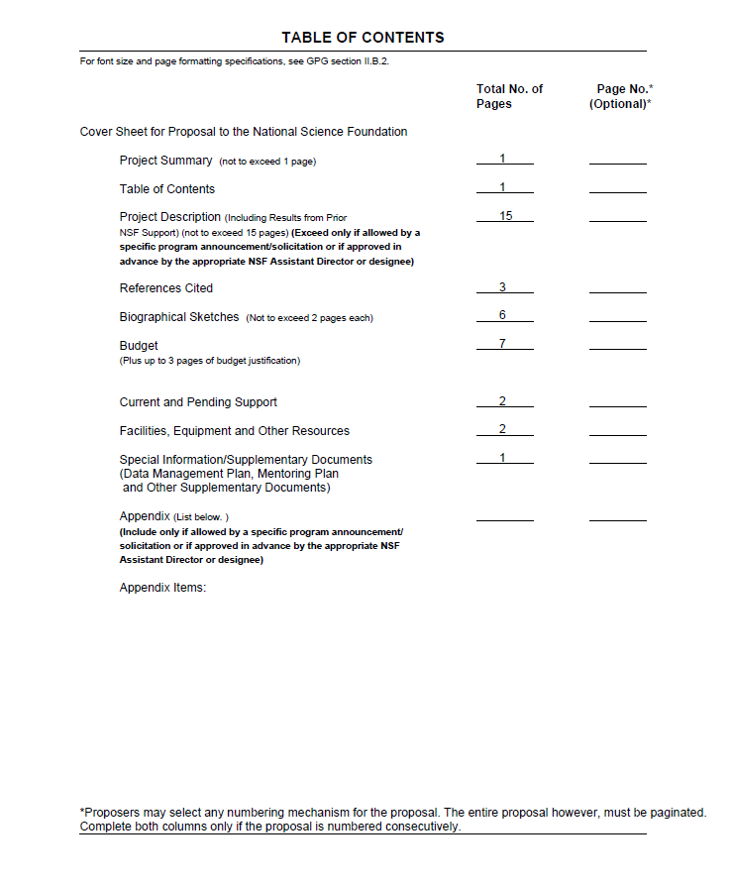
Created by FastLane

Slide 23
QUESTIONS

Slide 24
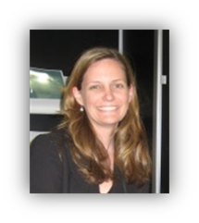
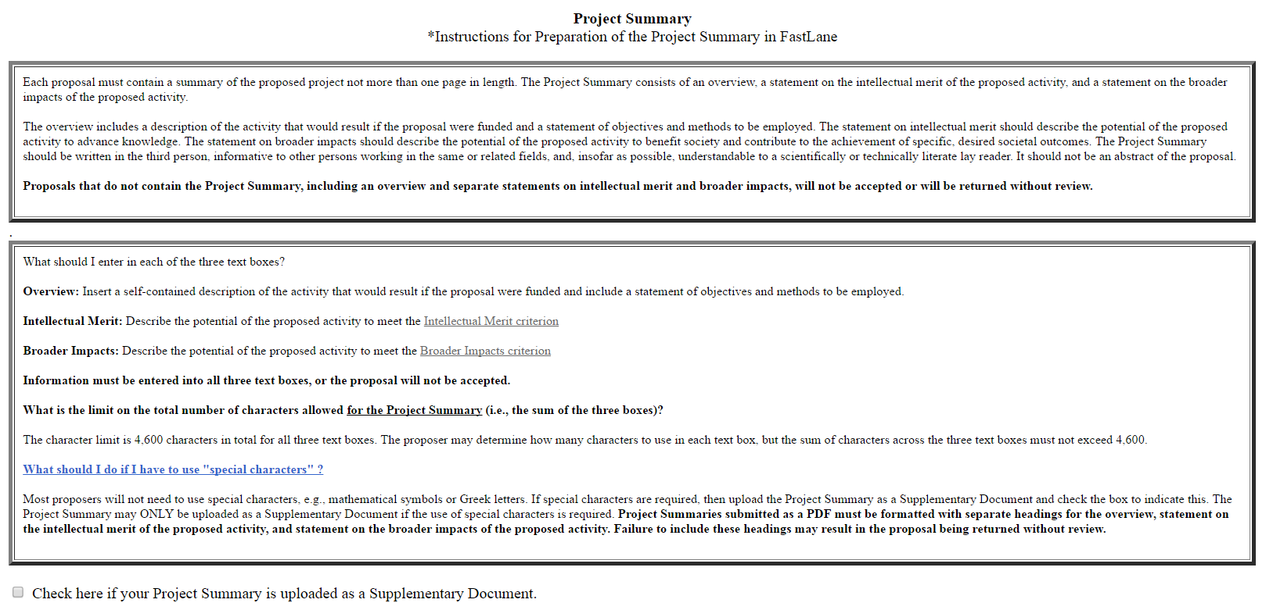
Project Summary

Slide 25
Project Summary
Project Summary p. 2

Slide 26
Project Summary Takeaways…
A Project Summary is your “elevator speech.” If this is all someone ever reads about your project, will they understand what it is you are proposing to do and the desired outcome of your work?
Intellectual merit and broader impacts should be developed for your project in the context of NSF & ATE definitions of the terms.

Slide 27
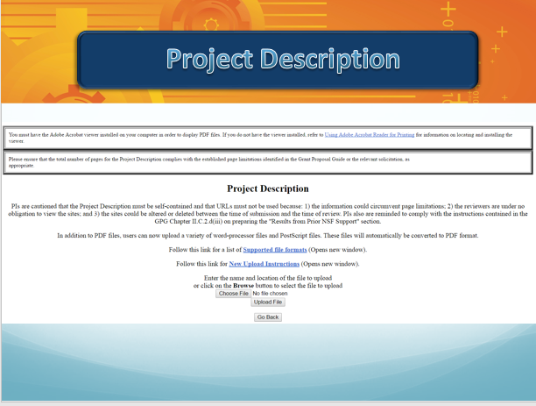
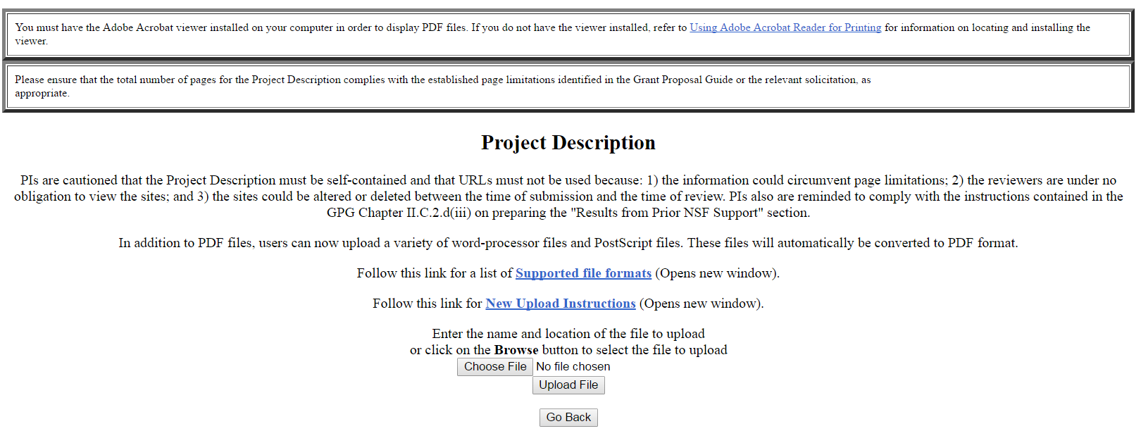
Project Description

Slide 28
Project Description Takeaways…
Follow acceptable font styles, font size, and margins! Automatic compliance checks are in force.
Use section headings, bullets, charts and tables, etc. to support your narrative.
Check and double check your final proposal after uploading. Print to ensure that you have not exceeded the 15 page limit.
Do not use automated endnotes. This will place your references within your 15 page limit. References belong in a separate section provided for this purpose, which does not count towards the 15 page limit.

Slide 29
Biographical Sketches
NOTE: New rules for biosketch format will be effective June 1, 2020 with two options for submission. Expect updates to this page in FastLane!

Slide 30
Biographical Sketches
Read the very specific PAPPG guidelines
New PDF Fillable Format
Biosketches should be no more than 2 pages; one per Senior Personnel required and uploaded as separate documents
Have one person check and upload all biosketches for consistency & complete early
https://www.nsf.gov/bfa/dias/policy/biosketch.jsp

Slide 31
Biographical Sketches
Include no personal contact information.
Required components include
Professional Preparation
Institution, Location, Major/Area of Study, Degree (if applicable), Year (YYYY)
Appointments
From – To, Position Title, Organization and Location
Products
Products most closely related to the proposed project; Other significant products whether or not related to the proposed project
Synergistic Activities
List up to five distinct examples that demonstrate the broader impact of the individual’s professional and scholarly activities

Slide 32
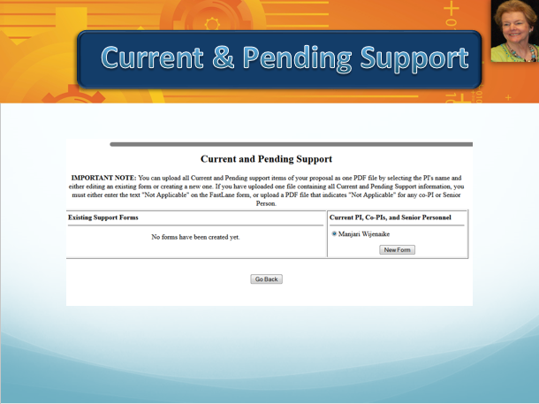
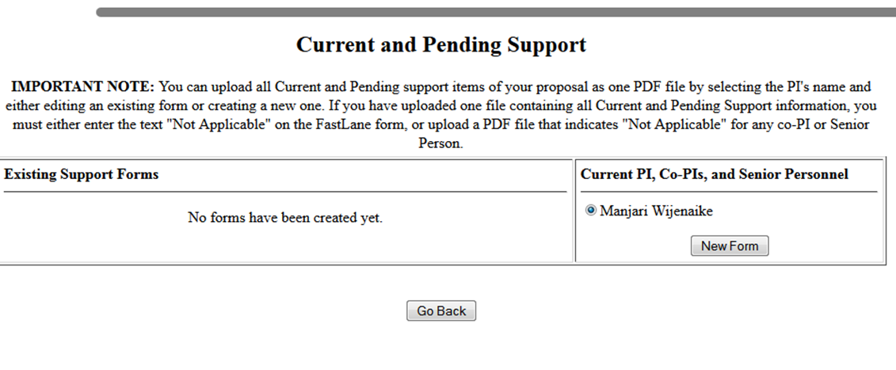
Current & Pending Support

Slide 33
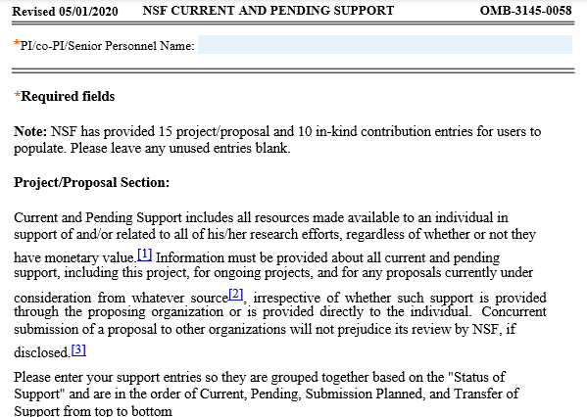
Current & Pending Support

Slide 34
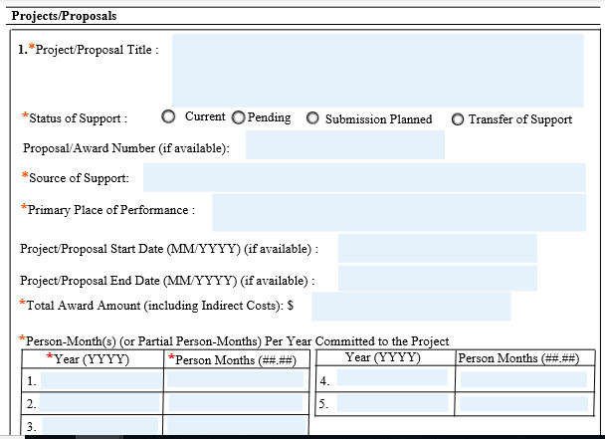
Current & Pending Support
New!
Time per year reporting

Slide 35
Current & Pending Support
Information that you will need to provide
Project/Proposal title
Support Type: Current or Pending
Award # if known
Source of Support
Project Location
Starting Date: (MM/YYYY)
Ending Date: (MM/YYYY)
Total Award Amount (including indirect costs)
Person-months per year & by year committed to the Project, ##.##

Slide 36
Current & Pending Support
Scenario #1: 12-month employee devotes 10% of time (10% FTE) in each year of the project:
10% of 12 months is 1.2 months
NOTE: Part-time work over 12 months is not to be reported as working 12 months on the project

Slide 37
Current & Pending Support
Scenario #2: Faculty member has 1 course
released time for fall and spring. Normal full-time
teaching load is 5 courses:
1/5 or 20% of 9 months is 1.8 months

Slide 38
Current & Pending Support
Scenario #3: Faculty member has 1 course release time fall and spring semesters and works ½ month in the summer in Project Years 1 & 2 only.
Faculty is working 0.5 of a summer month added to 1.8 months release time in Years 1 & 2 = 2.3 mo.

Slide 39
Current & Pending Support
The new Current & Pending Support Form for download:
https://www.nsf.gov/bfa/dias/policy/cps.jsp
URL to access the NSF PowerPoint covering changes in PAPPG 20-1
https://www.nsfpolicyoutreach.com/wp-content/uploads/2020/04/BS_CPS_SciENcv-Webinar.pdf

Slide 40
Current & Pending Support
Faculty time on grants not limited to 2 months on ATE grants. The time on the project should be justified, reasonable for the scope of work, and carefully aligned with each person’s responsibilities and grant duties.
Reviewers and Program Officers alike expect to see realistic time and budget allocations for those who will be doing the work of the project.

Slide 41
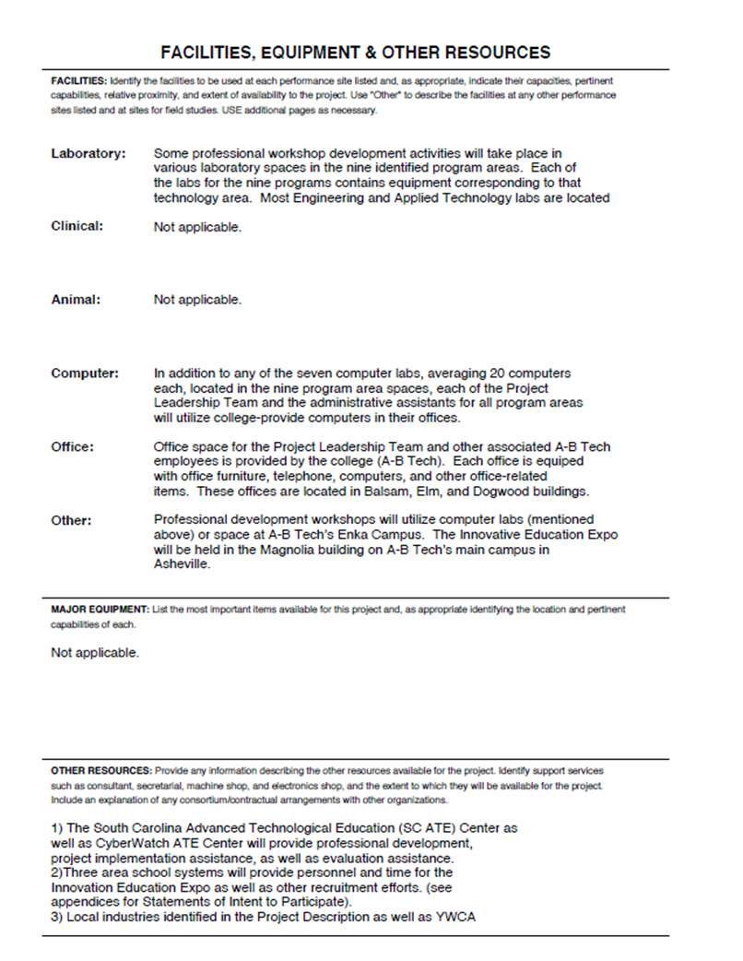
Facilities,
Equipment &
Other Resources

Slide 42
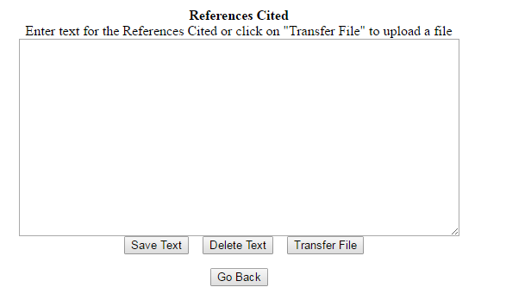
References Cited

Slide 43
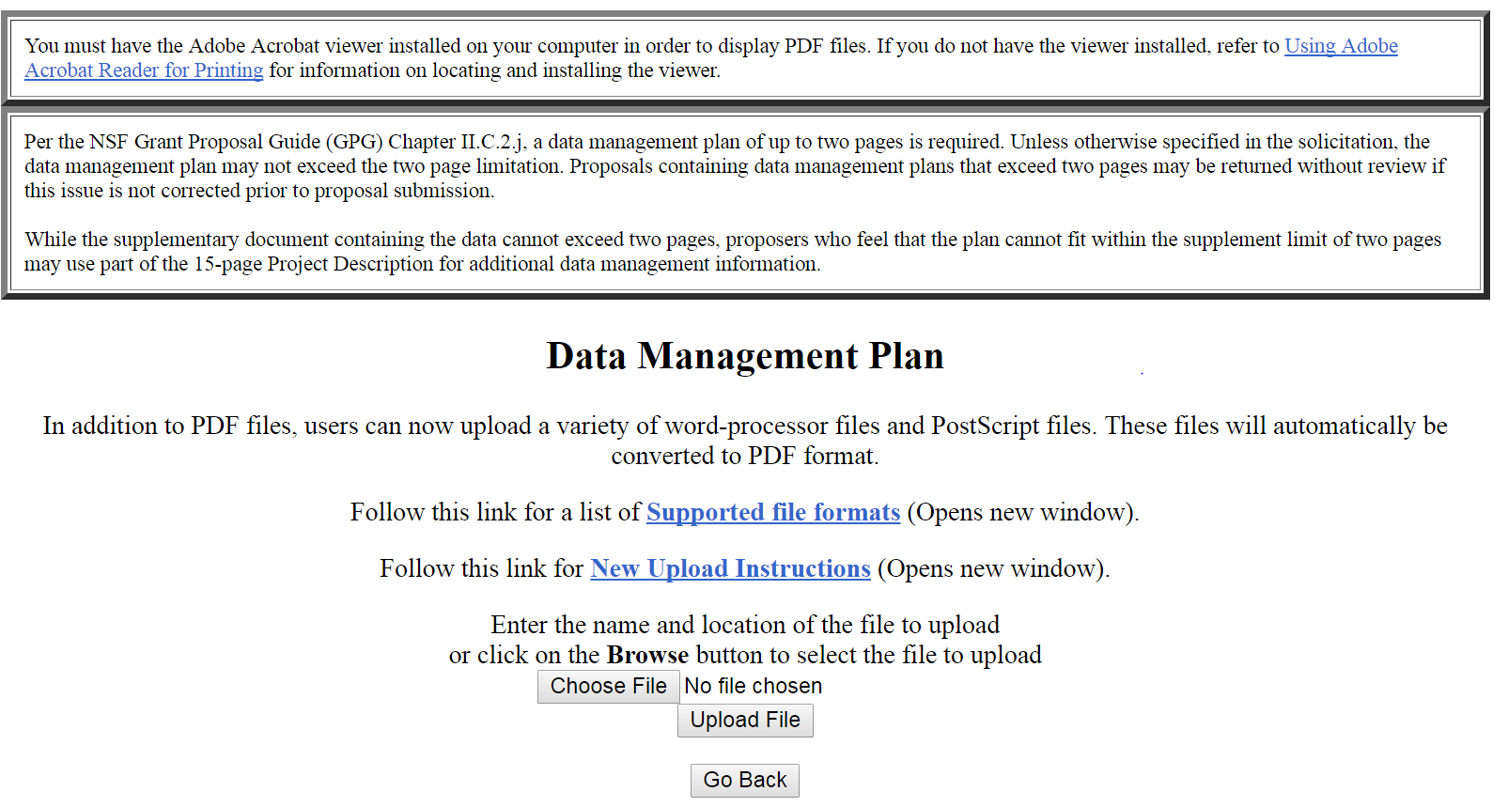
Data Management Plan

Slide 44
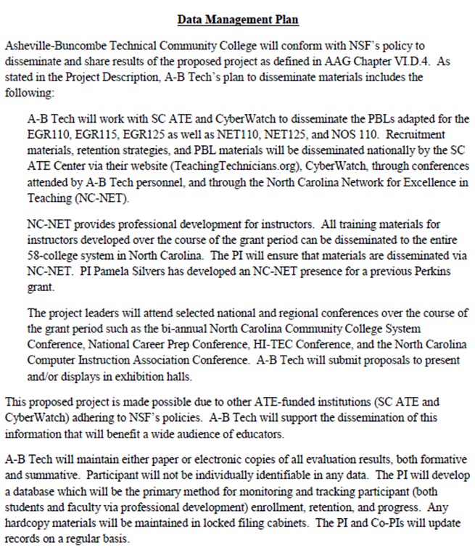
A good source for frequently asked questions about Data Management Plans
https://www.nsf.gov/pubs/2018/nsf18041/nsf18041.jsp

Slide 45
Supplemental Documents
Required
A document listing all of the people receiving compensation from the project and their affiliation (aside from Senior Personnel and participants)
Some of these people may not be from your college
Include name and affiliation
Required through ATE Solicitation
Letters of Collaboration---NOT letters of support
Biosketch of evaluator if named in the proposal

Slide 46
Single Copy Documents
Collaborators and Other Affiliations
Required for all Senior Personnel
Used by NSF to manage reviewer selection process
Template for filling out COA provided by NSF https://www.nsf.gov/bfa/dias/policy/coa.jsp
Fill out template and upload into FastLane

Slide 47
FastLane Advice
Start Early and Review What You Wrote Several Times
Don't Be Afraid to Ask Questions!
Ask mentors and the Mentor-Connect Team questions concerning these forms

Slide 48
QUESTIONS

Slide 49
Project Resources
Samples, templates, FAQs and more related to NSF ATE Proposal Submission
http://library.mentor-connect.org
Resources & Visit Our Library
Help Desk
843-676-8540

Slide 50
Connect with Mentor-Connect
Mentor-Connect@fdtc.edu
ATEMentorConnect
@Mentor_Connect
www.Mentor-Connect.org

Slide 51
Evaluation

