Slide 1




CAAT: Preparing Technicians for Careers in Advanced Mobility
Doug Fertuck
MACET Conference
August 1, 2014

Slide 2
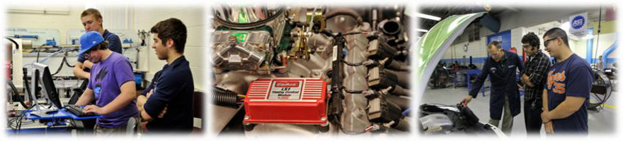
About the Center for Advanced
Automotive Technology (CAAT)
Located at Macomb Community College South Campus
Partnered with Wayne State University
Became an Advanced Technological Education Center in 2010 funded by the National Science Foundation ($2.8M Grant)
ATE Grant renewed until 2017 with additional $2.0M
Mission
  Advance the preparation of skilled technicians for the automotive industry’s more environmentally friendly and safer vehicles.
  Be a regional resource for developing and disseminating advanced automotive technology curricula.

Slide 3
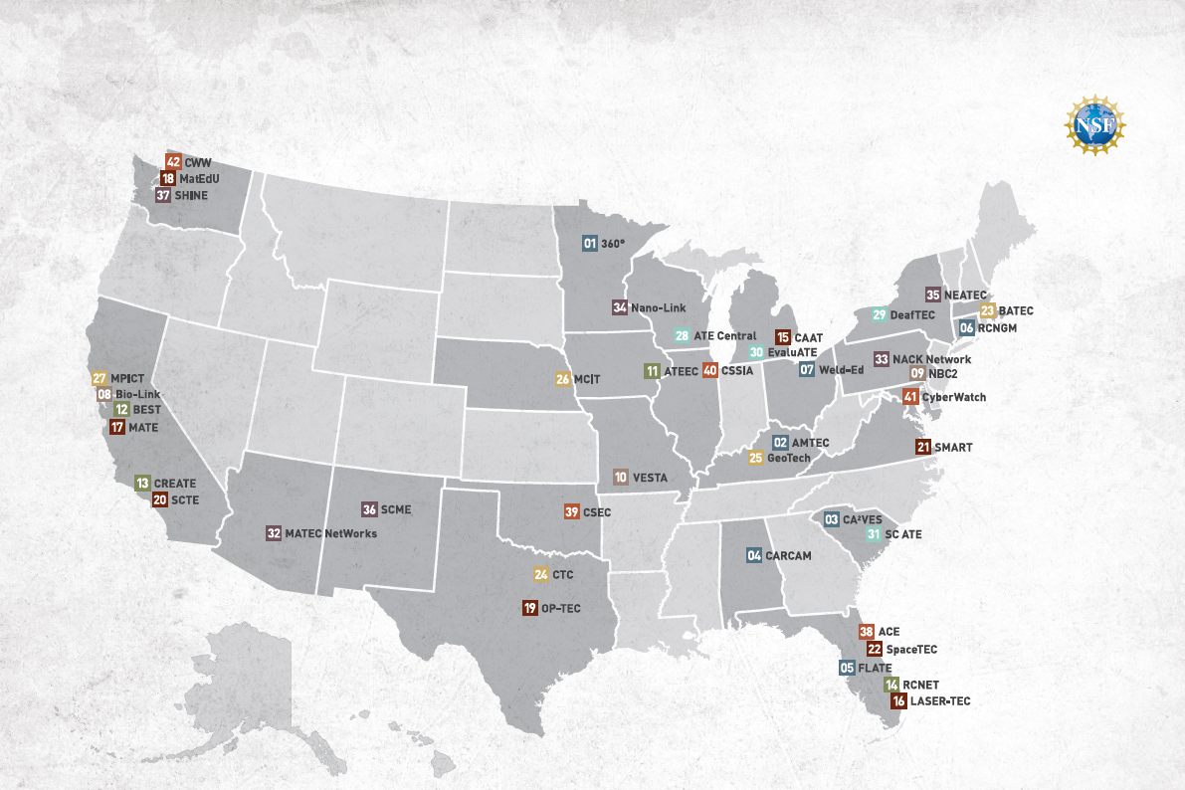
Map of National Science Foundation
Advanced Technological Education (ATE) Centers

Slide 4
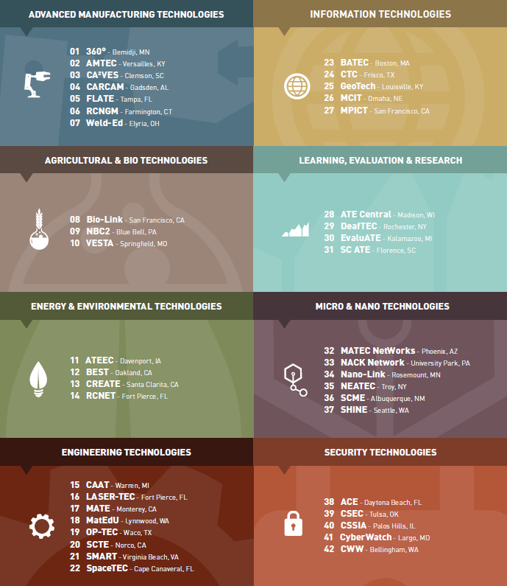
NSF ATE Centers
For further information go to www.atecenters.org

Slide 5
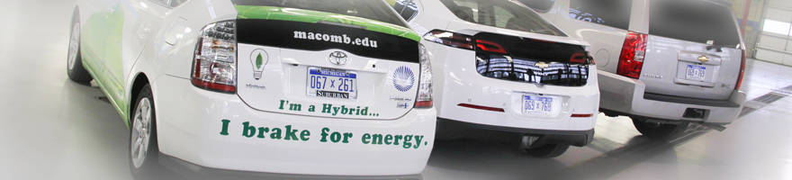
Why CAAT at Macomb Community College?
Long history of preparing many students to work in the industry
Leaders of advanced automotive curriculum development for technicians
Located in the heart of the rejuvenated US auto industry
  Over 215 Automotive R&D Companies in Michigan
  Most (85%) are clustered in southeast Michigan
  60% of the top 150 automotive suppliers to North America are headquartered in Michigan
Executing a number of related Energy and Automotive grants

Slide 6
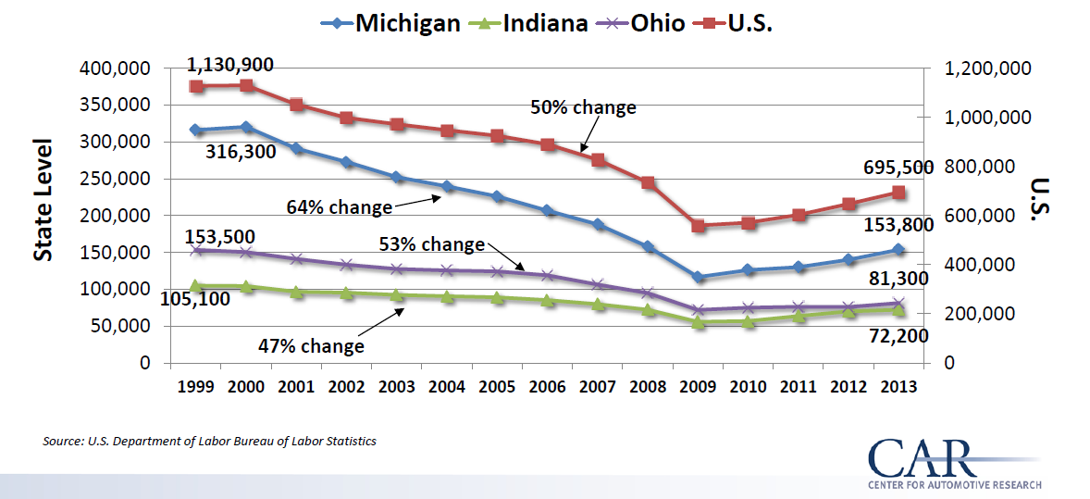
Auto Industry Employment Remains
Huge and is Now Growing

Slide 7
“Auto Jobs go High-Tech”
Nearly half of Michigan’s auto jobs now outside of the factory; will soon be majority.
“Detroit is still the intellectual capital of the auto industry.”
Michigan ranks #1 in concentration of engineers (65,000).
Number of technical jobs expected to grow as industry technology becomes even more advanced.
Many foreign auto makers and suppliers have set up technical centers in Michigan (Toyota, Hyundai, Bosch, et al).
See Detroit News, January 26, 2014, citing multiple sources

Slide 8
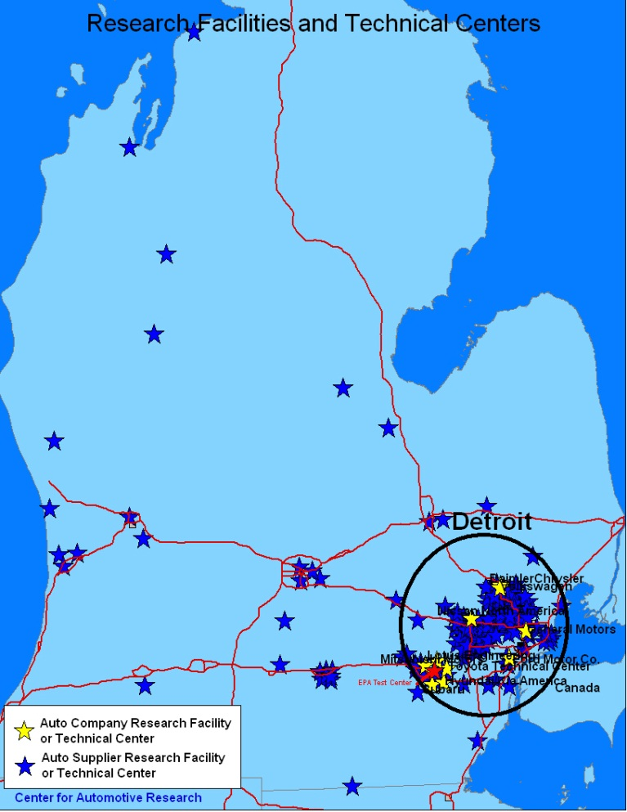
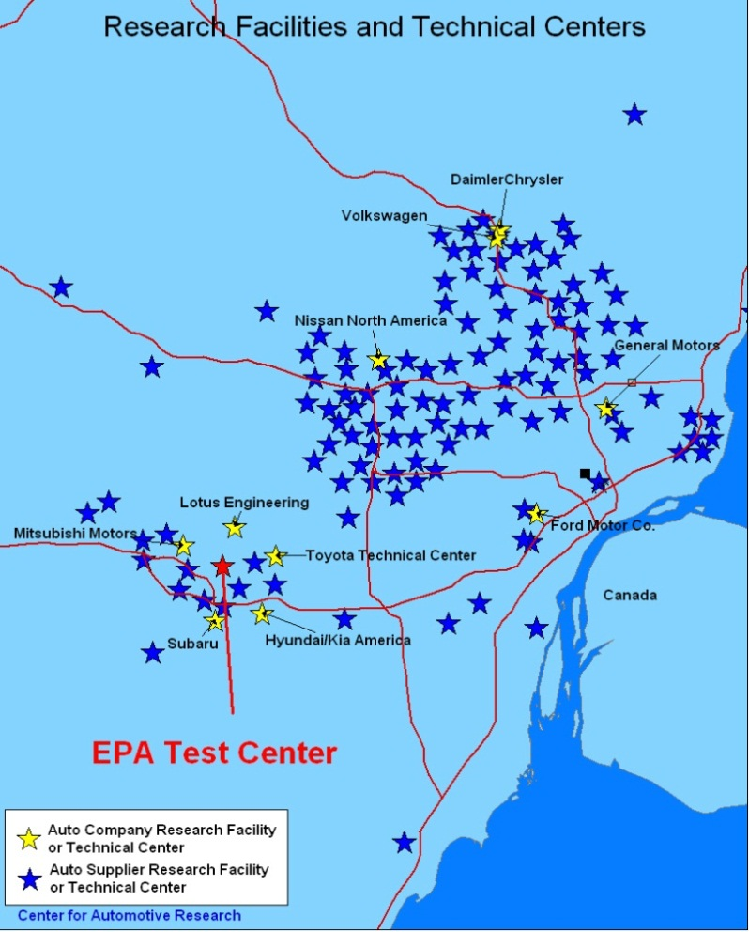
MI: The Auto Research Center
Notes:
The R&D centers in Michigan are concentrated around OEM headquarters and the Environmental Protection Agency located in Ann Arbor

Slide 9
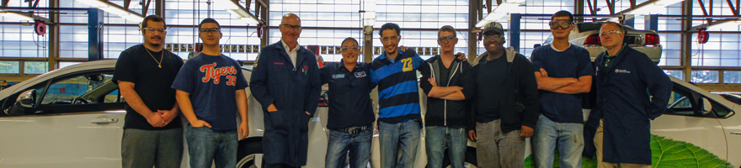
CAAT’s Strategic Priorities
Preparing automotive technicians and designers in community colleges for advanced technology jobs
Increasing the flow of students through the pipeline to jobs
Collaborating and sharing across educational institutions
Partnering with industry to understand their needs

Slide 10
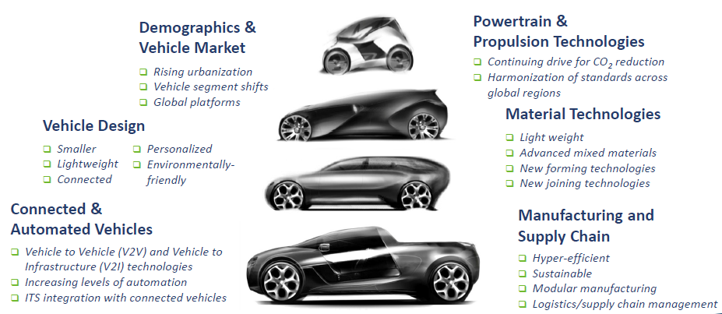
Drivers of the Auto Industry Future within CAAT’s Scope
Source: Automotive Industry Office, Michigan Economic Development Corporation

Slide 11
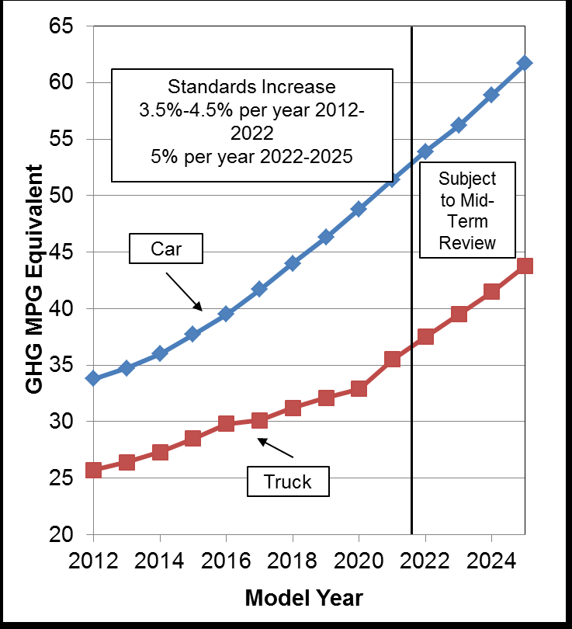
Fuel Economy Standards Getting Tough

Slide 12




Electrification Alternatives
Conventional
Gasoline
Hybrid
Total
Emissions
Plug-in Hybrid
350 miles~
0 miles
Electric
400 miles~
<2 miles
$ 2 to 4 K
400 miles~
20 -40 miles~
$ 6 to 15 K
100 miles~
100 miles~
$ 10 to 20 K
Cost
Battery Size
Petroleum Reduction
Environmental Friendliness
---- Total Range
---- All Electric Range
---- Price Premium

Slide 13
CAAT’s Technical Scope
Propulsion
Automation
Lightweight Design
Energy Efficiency

Slide 14
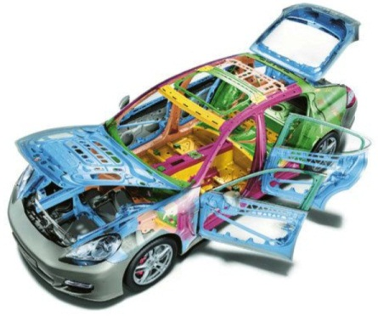
Average Material Content of
North American Light Vehicles
Regular (Mild) Steel
Image: Porsche
Iron Castings
High Strength Steel
Plastics & Composites
Aluminum
Data source: Wards
Notes:
Now, I’d like to shift to technology.
I’d like to introduce a few innovation topics where the auto industry seeks support.
There are many pathways to improve fuel economy. All of the know pathways, whether it’s advanced ICEs, diesels, electric vehicles or fuel cells, are relying on weight reduction.
There are 100s of opportunities for the supply base to help advance material technology and help accelerate innovation, such as with forming and joining.
REVIEW SLIDE

Slide 15

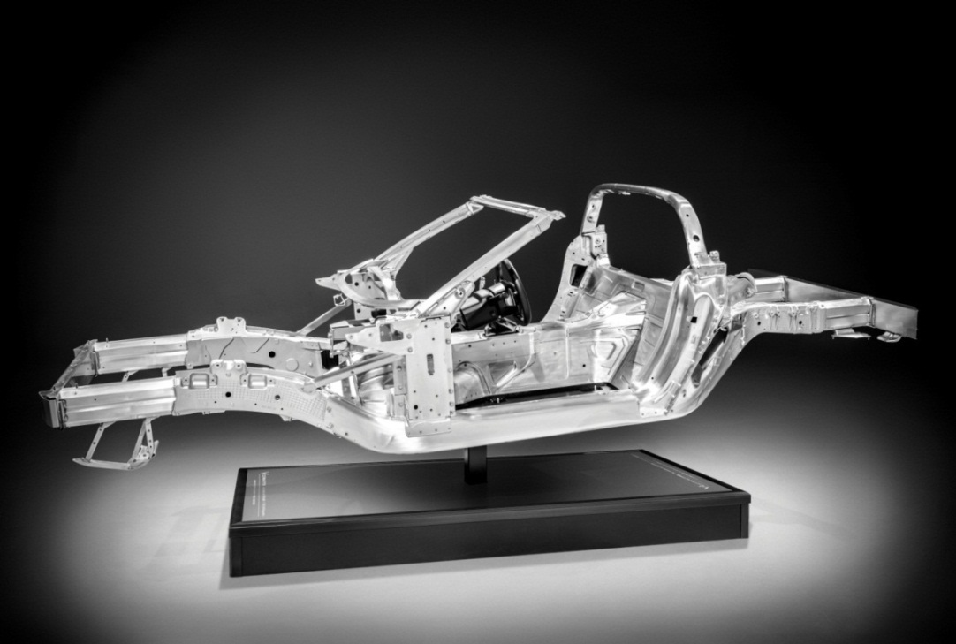
2014 Corvette Stingray:
A Future Direction for Materials
New body shop for aluminum frame
Carbon fiber hood and roof and interior
Carbon-nano composite underbody panels
Magnesium frame seat
SMC fenders, doors and rear
quarter panels & hatch
  Extrusions, castings and sheet
  (castings 2mm – 11mm)
  Hydro formed tubes
Magnesium structural chassis
components
Joining: adhesive, laser welding,
fasteners, spot welding
Photo Source: General Motors

Slide 16
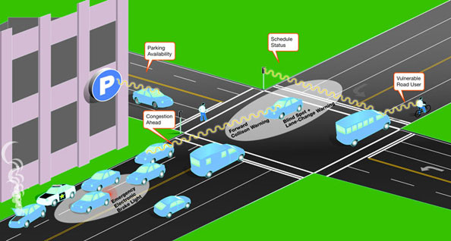
Connected & Automated Vehicles Defined
Connected and automated vehicles use any of a number of different communication technologies to communicate with:
  The driver
  Each other
  Roadside infrastructure
  The “Cloud”

Slide 17








Benefits and Challenges of
Connected & Automated Vehicles
    Crash elimination
    Improved energy efficiency
    Reduced need for new infrastructure
    Data challenges
    Travel time dependability
    New models for vehicle ownership
    Productivity improvements
    New business models and scenarios

Slide 18
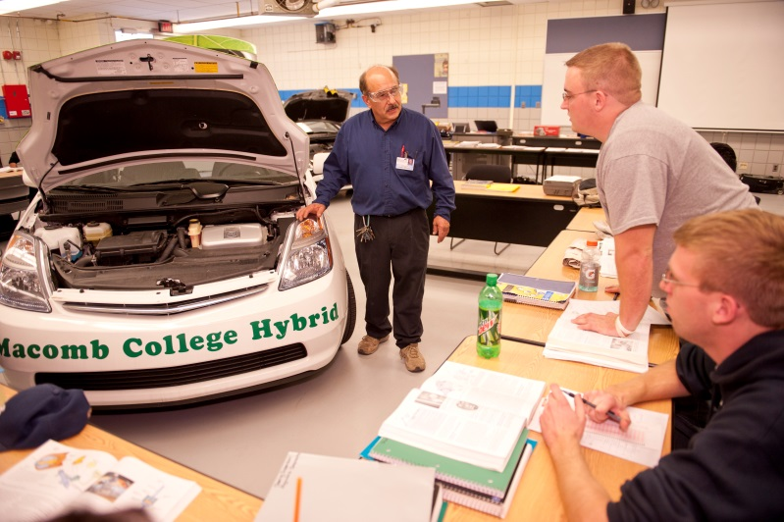
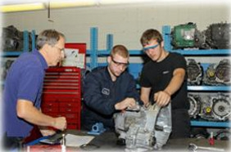
What Can CAAT Do for You?
Curriculum Development (seed funding)
Curriculum Dissemination
Professional Development
Technical and Professional Resources

Slide 19
CAAT Seed Funding
Funding available on a first come, first serve basis for educational institutions to develop or adapt materials:
    From modules and artifacts to courses and complete curricula
    Equipment not to exceed 20% of funding request
CAAT and its partners will identify priority development needs

Slide 20
CAAT Seed Funding Process
Submit funding request using Proposal Template posted online
Proposal reviewed and approved by CAAT
Contract issued with key milestones for:
  Deliverables
  Payments
  Reports

Slide 21
Summary of CAAT Seed Funding Projects
Institution | Title | Contract Date | Completion date | Amount | Status | Contact
Lawrence Technological University | Hybrid-based modules for two mechatronics courses | 5/12/2011 | 11/7/2011 | $22,278 | Completed | Vladimir Vantsevich vantsevi@uab.edu
Lewis and Clark CC | Modified ASE certification courses to include hybrid/EV impacts | 6/1/2011 | 11/7/2011 | $27,540 | Completed | Christopher Reynolds cereynolds@lc.edu
Grand Rapids CC | Curriculum for battery manufacturing job training | 6/1/2011 | 5/22/2012 | $8,403 | Completed | Julie Parks jparks@grcc.edu
Lansing CC | Hybrid and EV overview modules for technician workforce and general public | 2/8/2012 | 7/26/2012 | $13,180 | Completed | Glenys Warner warnerg@lcc.edu
Grand Valley State University | Modules for Li-ion battery reclamation technology | 5/8/2012 | 3/31/2013 | $25,000 | Completed | Charlie Standridge standric@gvsu.edu
Ivy Tech CC | Course module on integrating EV charging stations to “Off Grid” energy center | 5/14/2013 | 5/1/2014 (Targeted) | $22,299 | Progress report submitted 11/2013 | Susan J Ely sely3@ivytech.edu
Kent Intermediate School District | Project-based module for HS based on design, build, test and competition of an EV | 11/4/2013 | 7/31/2014 (Targeted) | $16,000 | 1st report and 2nd payment due 4/30/2014 | Angela Morris AngelaMorris@kentisd.org
Utica Community Schools | Middle school CTE bridge course based on design and build of an EV | 3/10/2014 | 11/30/2014 (Targeted) | $22.000 | Project initiated | Shannon Williams shannon.williams@UticaK12.org
Wayne State University | Course module for technicians and engineers on the analysis and control of electric motors | 2/13/2014 | 1/31/2015 (Targeted) | $16,122 | Project initiated | Wen Chen wchenc@wayne.edu
University of Alabama at Birmingham | Course for technicians and engineers in Energy Efficiency of HEVs and EVs, Labs | 5/1/2014 (Estimated) | 1/31/2015 (Estimated | $25,000 (Proposed) | Awaiting final proposal from UAB | Vladimir Vantsevich vantsevi@uab.edu
Notes:
The CAAT leadership are currently exploring expansion into new areas of automotive technology—including mass reduction and intelligent vehicle and connected transportation systems—that will continue to build out a comprehensive catalog of curricula and other resources for automotive programs at the secondary and post-secondary level. A number of additional organizations must be engaged to support the expanded mission.

Slide 22
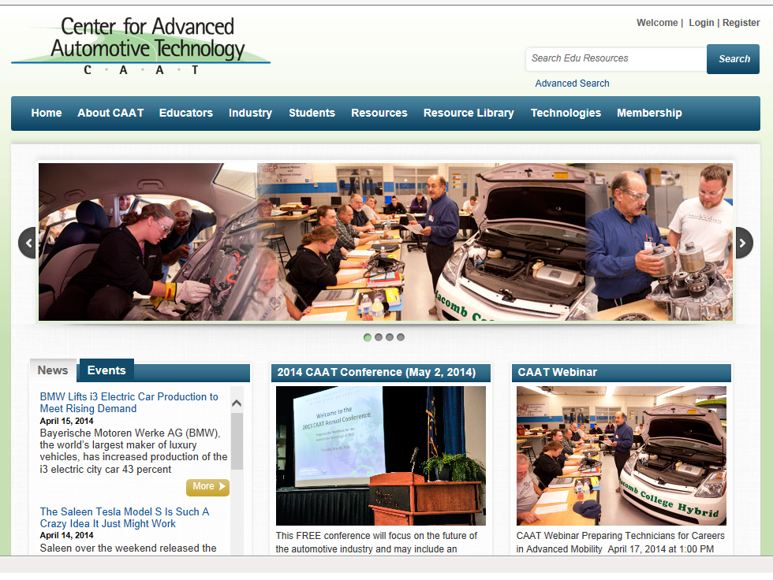
CAAT Website - www.autocaat.org

Slide 23
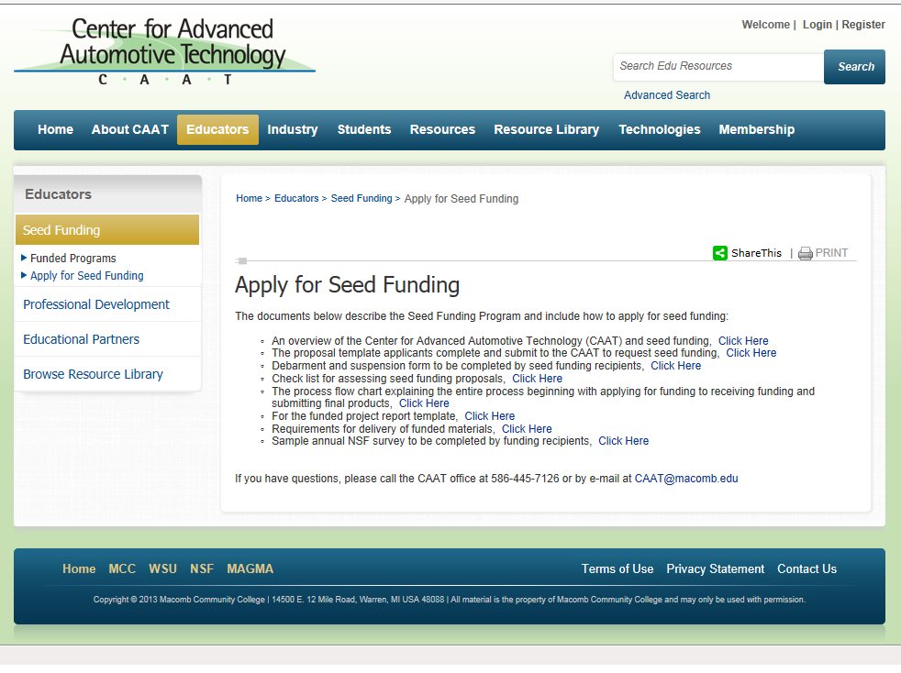
CAAT Website – Educators

Slide 24
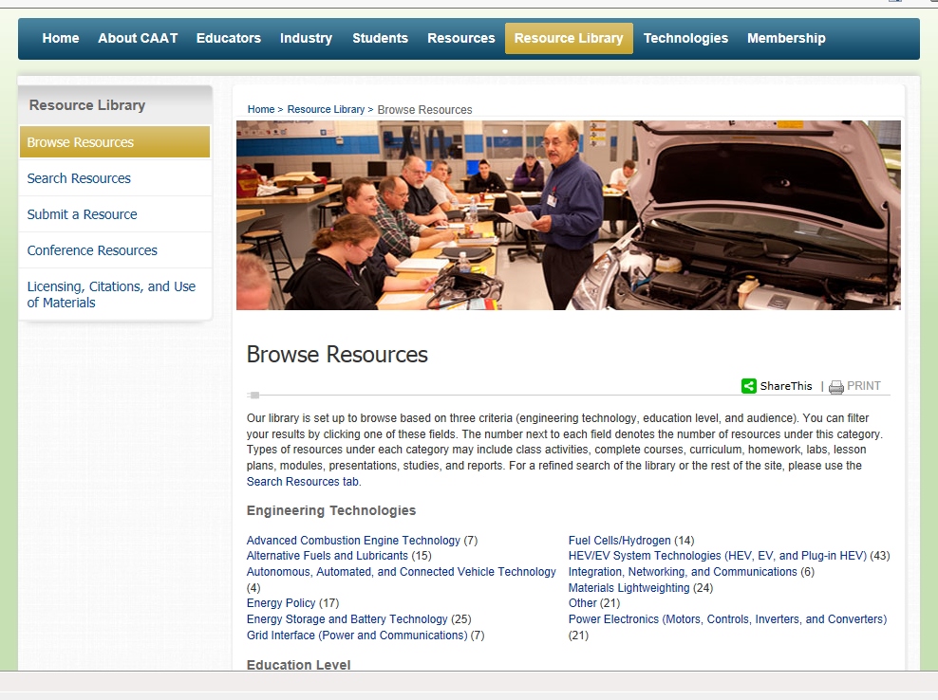
CAAT Website - FREE Resource Library

Slide 25



CAAT Resource Library
FREE educational Resource Library
  Contains nearly 100 classroom ready educational resources:
    Classroom activities, curriculum, homework, labs, lesson plans, presentations, reports, complete modules, courses, industry reports and more
    Conference resources page
  Over 1100 downloads in last year
  Content obtained from:
    Seed funding projects
    Macomb Community College & Wayne State University
    Other sources
  All CAAT Resource Library content is approved by and available through:

Slide 26
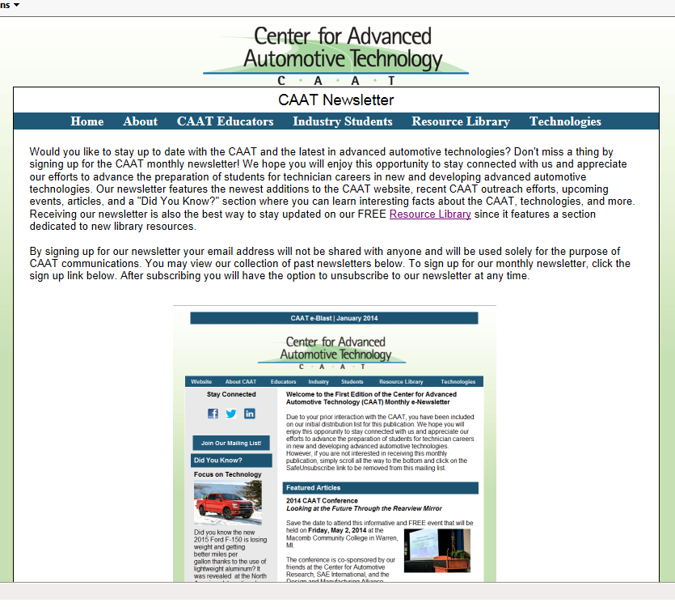
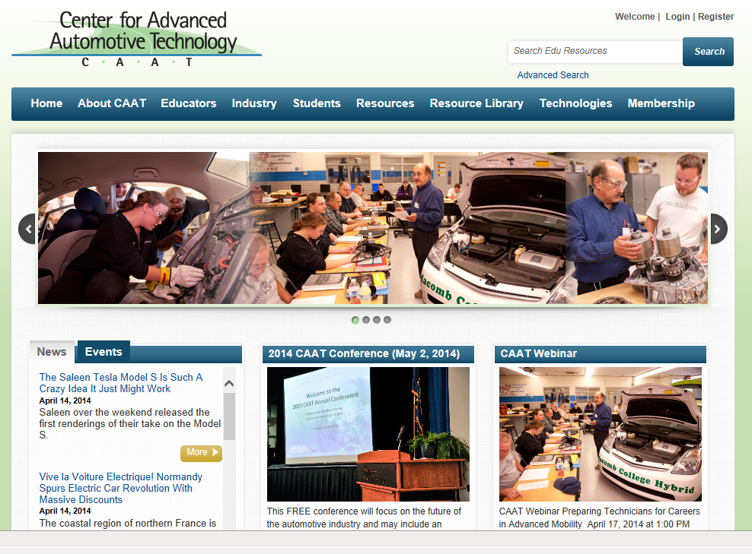
CAAT Monthly Newsletter
Sign up today!
  Visit www.autocaat.org
  Click on Resources
  Click on Newsletter

Slide 27
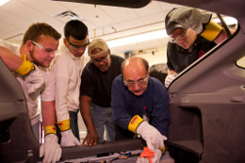
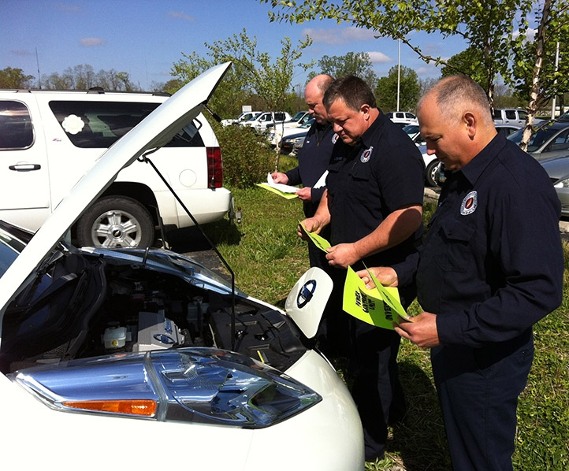
CAAT Professional Development
Wayne State University Electric Drive Vehicle Technology Short Course
  Upcoming dates/locations TBD
Southeastern Michigan Automotive Teachers Association (SEMATA) training sessions
  Hosted by Macomb Community College in late fall
CAAT Conference

Slide 28

2014 CAAT Conference
FREE
Friday, May 2, 2014
MCC South Campus, in Warren, MI
Theme: You Can’t See the Future in the Rearview Mirror
Co-sponsored by :
  Center for Automotive Research (CAR)
  SAE International
  Design and Manufacturing Alliance (DMA)
Hot breakfast & lunch included
Register NOW (seating is limited) at www.autocaat.org

Slide 29
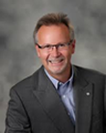

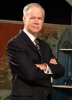
2014 CAAT Conference
Keynote speakers on the future of the automotive industry:
Nigel Francis: Senior Automotive Advisor to the State of Michigan & Senior Vice President, Automotive Industry Office, Michigan Economic Development Council (MEDC)
  Kristen Dziczek: Director, Labor & Industry Group and Assistant Research Director, Center for Automotive Research (CAR)
  John McElroy: Automotive analyst and host of "Autoline Daily," and the television program "Autoline This Week," broadcaster of five radio segments daily on WWJ Newsradio 950, and writer of a weekly blog for Autoblog.com and a monthly op-ed article for Ward's Auto World

Slide 30
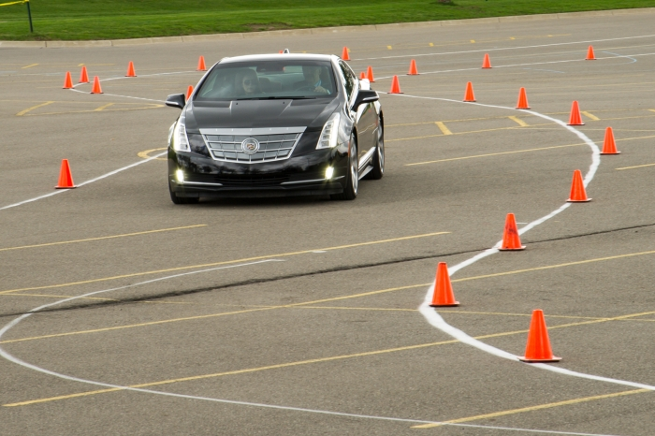
CAAT Electric Vehicle Ride & Drive
Held at Macomb Community College's South Campus on May 2, 2014
Open to the public from 3-8 p.m.
Evaluation Fleet:
  2014 Cadillac ELR
  2014 Chevrolet Volt
  2014 Ford C-MAX Energi
  2014 Ford Focus EV
  2014 Ford Fusion Energi
  2014 Nissan Leaf
  2014 Tesla Model S
  2013 Tesla Model S
  2014 Toyota Prius Plug-in
  2014 Toyota Highlander Hybrid
99% of the 151 ride & drive participants rated the event as “extremely valuable” (79%) or “very valuable” (20%)
65% of respondents indicated their perception of electrified vehicles had changed and 100% of these respondents noted that change was positive

Slide 31
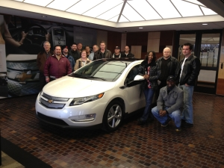
Macomb CC Automotive Programs
Automotive Technology Program
  NATEF Certified Automotive Training
  Manufacturer Programs
    GM ASEP
    Chrysler CAP
  Hybrid Electric Vehicle / Alternative Fuel Courses
Certificate Options
  Certificate in Automotive Technology
  Electric Vehicle Development Technology Certificate

Slide 32
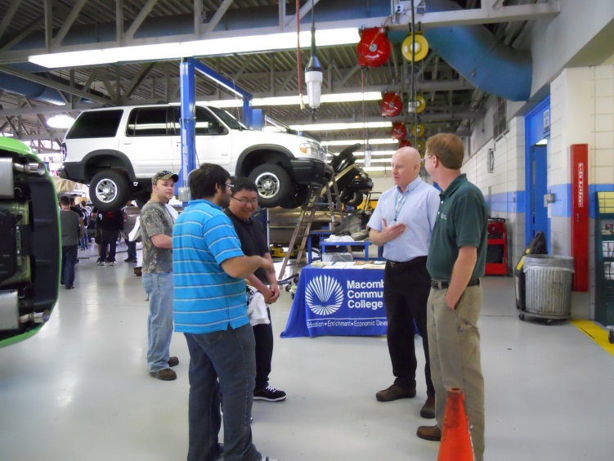
MCC Automotive Programs (Cont’d)
Degree Options
  Associate of Applied Science in Automotive Technology
  Associate of Applied Science in Manufacturing Technology
2+2 Career Pathways
  WSU Bachelor of Science in Electric Transportation Technology

Slide 33
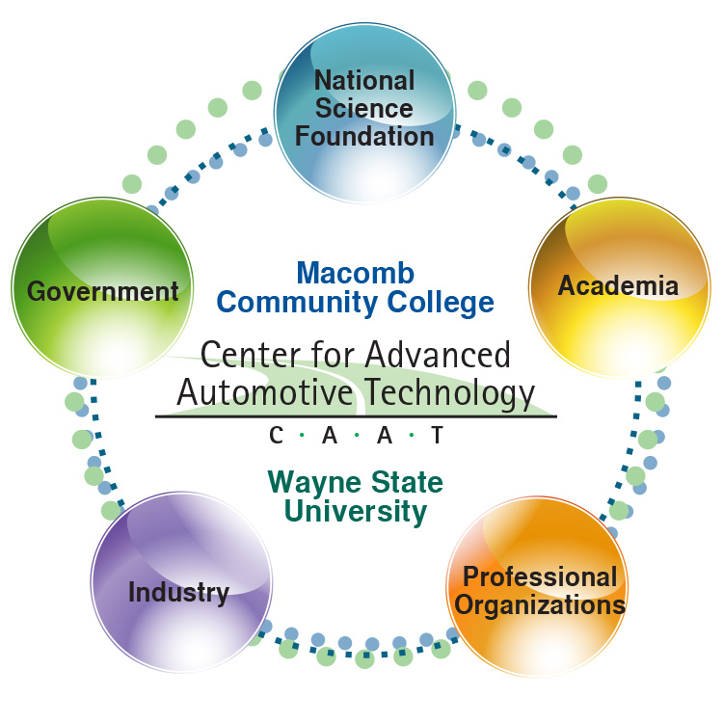
CAAT is All About Partnerships

Slide 34
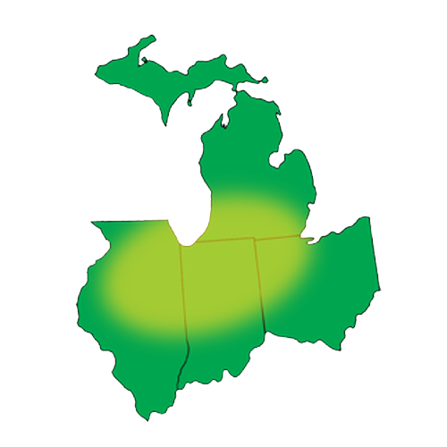

CAAT Affiliations
INDUSTRY
A123 Systems
Chrysler
Continental Automotive Corporation
Denso
Ford Motor Company
General Motors
Johnson Controls SAFT
Kelly Services
LG Chem
Magna E Car
Nissan
Michigan Academy for Green Mobility Alliance (MAGMA)
PROFESSIONAL ORGANIZATIONS
Center for Automotive Research
Design and Manufacturing Alliance
National Alternative Fuel Training Consortium
NextEnergy
SAE International
Workforce Intelligence Network
ACADEMIA
Grand Rapids Community College
Grand Valley State University
Ivy Tech
Lansing Community College
Lawrence Technological University
Lewis and Clark community College
Michigan Technological University
Muskegon Community College
Oakland Community College
Wayne State University
Macomb ISD
GOVERNMENT AGENCIES
Michigan Economic Development Corporation
Michigan Works!

Slide 35

Electric Vehicle Development Technology Certificate
Approved and endorsed by MAGMA and
1-year program, 28-credit hours
Program linked to DOL grant for displaced workers
First cohort started January, 2013
  19 students started
  12 students completed
Second Cohort started August, 2013
  25 started
  22 still in program
  18 completing internships or placements
Third Cohort starts August, 2014
  44 applied
  36 passed screening
  25 accepted

Slide 36
EV Development Technology Certificate
Course # | Class | Credit Hours
AUTO 1000 | Automotive Systems | 3
TMTH 1150 | RCL Analysis | 4
ELEC 1161 | Electronic Technology I | 3
ELEC 1171 | Electronic Technology II | 3
AUTO 2920 | Introduction to EV Propulsion Systems | 3
ELEC 2913 | Motors & Controls for EV’s & Industrial Applications | 3
ELEC 2915 | Advanced Energy Storage | 3
ELEC 2914 | EV Data Acquisition, Sensors and Control Systems | 3
 | Elective | 3
TOTAL |  | 28

Slide 37
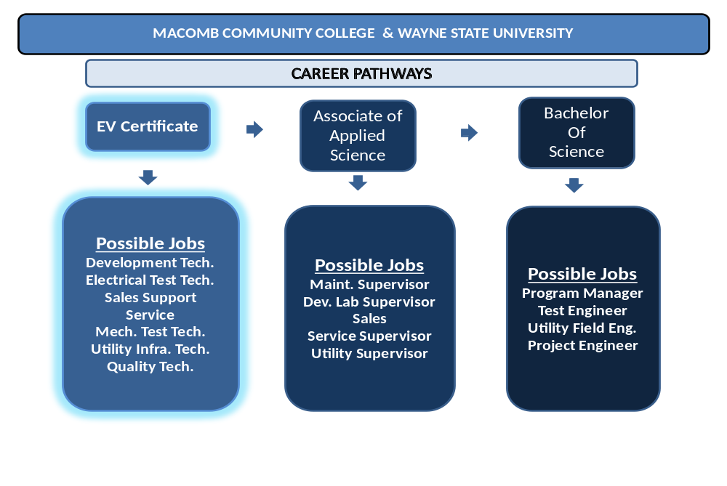
EV Technician Certificate Articulation and Associated Career Paths
Notes:
BILL

Slide 38




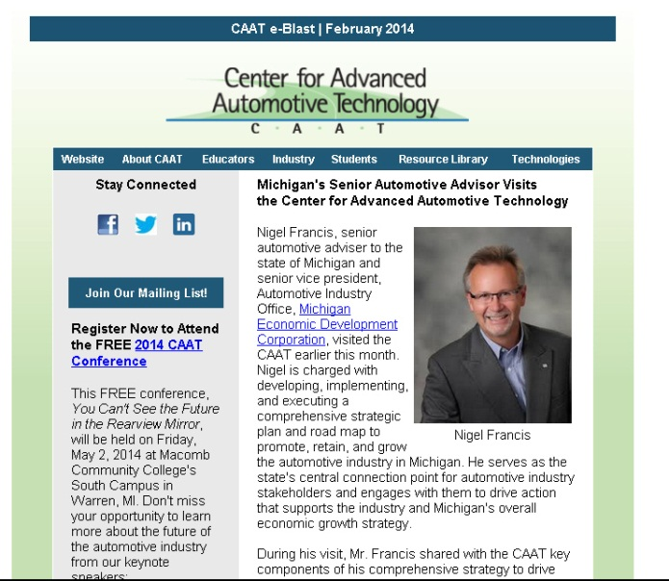
Stay Connected with the CAAT
Visit our website at www.autocaat.org
Follow us on social media
Sign up for our monthly newsletter
Register for one of our webinars
Attend the 2015 CAAT Conference and Ride & Drive

Slide 39

What’s on Our Path to the Future?
Developing stronger industry
relationships
Gathering curriculum for
dissemination
Increasing collaboration with
other schools
Maximizing impact of website
Generating new seed funding projects
Increasing the number of impacted students through the pipeline

Slide 40
Thank You!
Questions?

