Slide 1
Apps for Agriculture - 2017
Precision Agriculture Student Project
Dr. L. Everett

Slide 2
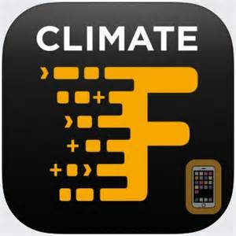
Climate FieldView
Description
Climate FieldView™ offers a comprehensive, connected suite of digital ag tools to help you optimize resources and maximize yield. Using real-time and historical crop and weather data, Climate FieldView™ delivers customized insights that help you make important agronomic decisions with confidence.

Slide 3
FarmLogs
FarmLogs provides field information, alerts, and recommendations to help you prevent unnecessary yield loss and improve profitability across your entire operation.

Slide 4
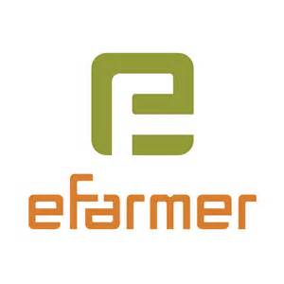
efarmer
eFarmer – A simple farm management software, which allows you to create an electronic fields map, record the history of cultivation at the fields, to take notes as points of interest and to the location of objects on your farm.

Slide 5
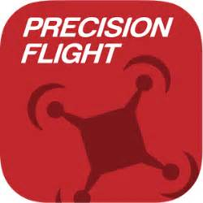
PrecisionFlight
PrecisionHawk’s PrecisionFlight mobile app turns a DJI drone into an advanced remote sensing tool that empowers businesses and consumers to gain actionable aerial data autonomously. This FREE app features a highly-intuitive user interface to easily create flight plans that automatically guide the drone to capture aerial images for 2D/3D maps and advanced analysis.

Slide 6
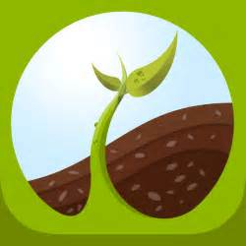
Seed Finder
The FBN Seed Finder app puts advanced analytics on over 1,900 seed varieties, derived from millions of acres of real-world data, on your mobile device.

Slide 7
FARMserver
Precisely monitor crop variables, collect data, analyze the data, and then use the learned information to increase productivity on the farm. Until now, farmers have lacked the centralized and universal tools needed to properly implement precision ag strategies on their farms. Introducing FARMserver, a web-based solution that serves as your farm's foundation for precision ag activities.

Slide 8
encirca
Welcome to the Encirca® services app that helps you monitor crop progress across your operation. Satellite Imagery is automatically delivered to your account to help you monitor crop health from a bird's-eye view and inform your ground level crop scouting efforts. Access the latest images available – updated multiple times each week

Slide 9
Soil Sampler
It's most advanced way in very short time to do effective soil sampling all around your farm fields. The very first step to precision agriculture is right soil sampling with accurate method and tools for accurate soil analyzes. Our app will help to save lot of time navigating straight to soil pick-up position, so avoiding unnecessary movement around the field.

Slide 10
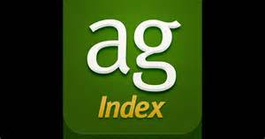
agIndex
From market data to weather news and more, the agIndex app by Monsanto provides growers with agronomic information at their fingertips. The key feature of this app includes notification settings customized to location and crop types, which help growers stay up-to-date on the latest commodity pricing and weather forecasts.

Slide 11
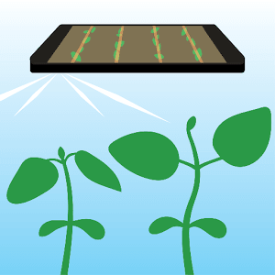
Bean Cam
This app will calculate plant stand (plant population) by averaging five plant count samples randomly taken within a soybean field at the VC, V1 or V2 growth stage. The app will then use your field average stand value to calculate expected percent yield at harvest with and without spring replanting.

Slide 12
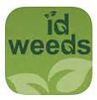
id weeds
ID Weeds, has information on more than 400 plant species that could be encountered as weeds in crop fields, pastures, lawns, gardens or aquatic areas in Missouri and surrounding states

Slide 13
Field Navigator
Being the most popular parallel driving application for Precision Agriculture, it can save money by just installing - no need for additional expensive equipment. Measure the size of your farm, field or grassland easily and hassle-free, even in poor conditions or low visibility.

