Slide 1
Mechatronics Module 1:
Major Concepts of Hybrid Electric
Powertrain Systems
Dr. Vladimir V. Vantsevich
awdrive@comcast.net

Slide 2
HEV Powertrain Configurations

Slide 3
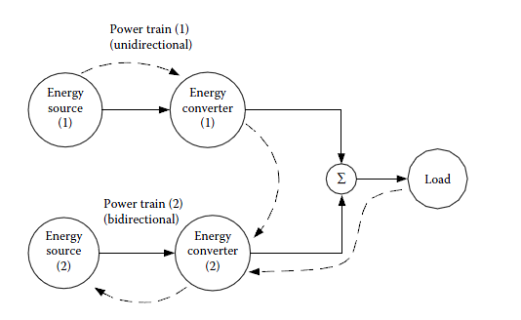
HEV configurations and ground vehicle applications
A vehicle that has two or more powertrains is called a hybrid vehicle.
A hybrid vehicle with an electrical power train is called an HEV.
The drive train of a vehicle is defined as the aggregation of all the power trains.
Conceptual illustration of a hybrid electric drive train [1]

Slide 4
Concept of Hybrid Electric Drive Trains
Any vehicle power train is required to:
(1) develop sufficient power to meet the demands of vehicle performance
(2) carry sufficient energy onboard to support the vehicle driving a sufficient range
(3) demonstrate high efficiency
Conceptual illustration of a hybrid electric drive train [1]
(4) emit few environmental pollutants.

Slide 5
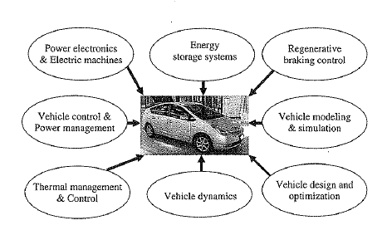
Interdisciplinary Nature of HEVs
HEVs involve the use of electric machines, power electronics converters, and batteries, in addition to conventional ICEs and mechanical and hydraulic systems.
The general nature and required engineering field by HEVs [2]

Slide 6
Powertrain Configuration Types
Hybrid vehicles can be classified into a number of different types based on the configuration of their powertrains.
Series Hybrid
Parallel Hybrid
Vehicles having attributes of both types.
These vehicles may use the same basic types of powertrain components, but the arrangement and usage of them varies with the configuration.

Slide 7
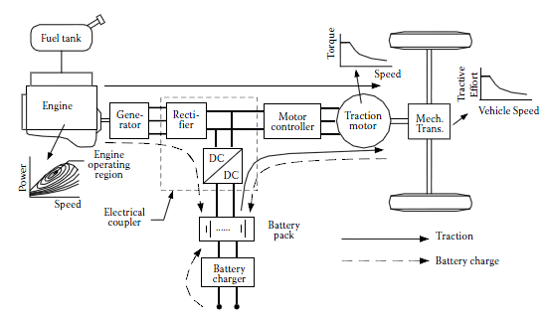
Series HEVs
The key feature of this configuration is that there is no mechanical link between the engine and wheels: The wheels are driven by an electric motor. The engine is used to turn a generator to supply electrical power to the motor or battery.
Configuration of a series hybrid electric drive train. [1]

Slide 8
Series HEVs
Two electrical powers (generator and battery) are added together in the power converter, which functions as an electric power coupler to control the power flows from the batteries and generator to the electric motor, or in the reverse direction.
Fuel tank, IC engine, and generator constitute the primary energy supply and the batteries function as the energy bumper.
Configuration of a series hybrid electric drive train. [1]

Slide 9
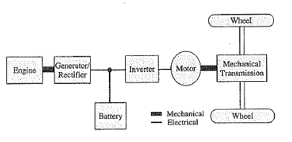
Series HEVs
The vehicle controller will control the IC engine through its throttle, electric coupler, and traction motor to produce the demanded propelling torque or regenerative braking torque with one of the following operation modes:
1. Pure electric traction mode: The engine is turned off and the vehicle is propelled only from the batteries.
The architecture of a series HEV [2]

Slide 10
Series HEVs
2. Pure engine traction mode: The vehicle traction power comes only from the engine–generator, while the batteries neither supply nor accept any power from the drive train. The electric machines serve as an electric transmission from the engine to the driven wheels.
3. Hybrid traction mode: The traction powers are drawn from both the engine–generator and the batteries, merging together in the electrical coupler.
The architecture of a series HEV [2]

Slide 11
Series HEVs
4. Engine traction with battery charging mode: The engine–generator supplies power to charge the batteries and to propel the vehicle simultaneously. The engine–generator power is split in the electric coupler.
5. Regenerative braking mode: The engine–generator is turned off and the traction motor is operated as a generator powered by the vehicle kinetic or potential energy. The power generated is charged to the batteries and reused in later propelling.
The architecture of a series HEV [2]

Slide 12
Series HEVs
6. Battery charging mode: The traction motor receives no power and the engine–generator is operated only to charge the batteries.
7. Hybrid battery charging mode: Both the engine–generator and the traction motor operate as generators in braking to charge the batteries.
The architecture of a series HEV [2]

Slide 13
Series HEVs: Advantages
No mechanical connection between the engine and the driven wheels.
Consequently, the engine can be potentially operated at any point on its speed–torque (power) map.
This advantage, with a sophisticated power flow control, provides the engine with opportunities to be operated always within its maximum efficiency region.
The control strategy of the drive train may be simple, compared to other configurations, because of its fully mechanical decoupling between the engine and wheels.

Slide 14
Series HEVs: Advantages
No mechanical connection between the engine and the driven wheels.
The efficiency and emissions of the engine in this narrow region may be further improved by special design and control technologies, which is much easier than in the whole operating domain.
The mechanical decoupling of the engine from the driven wheels allows the use of high-speed engines where it is difficult to directly propel the wheels through a mechanical link, such as gas turbines or power plants that have slow dynamic responses (e.g., Stirling engine, etc.).

Slide 15
Series HEVs: Advantages
2. Transmission Advantages:
Because electric motors have a torque–speed profile that is very close to the ideal for traction, the drive train may not need multigear transmission.
Therefore, the structure of the drive train can be greatly simplified and is of less cost.

Slide 16
Series HEVs: Advantages
2. Transmission Advantages:
Furthermore, two motors may be used, each powering a single wheel, and the mechanical differential can be removed.
Four in-the-wheel motors may also be used, each one driving a wheel. In such a configuration, the speed and torque of each wheel can be independently controlled.
Consequently, the drivability of the vehicle can be significantly enhanced. This is very important for off-road vehicles which usually operate on difficult terrain, such as ice, snow, and soft ground.

Slide 17
Series HEVs: Disadvantages
1. The energy from the engine changes its form twice to reach its destination—driven wheels (mechanical to electrical in the generator and electrical to mechanical in the traction motor). The inefficiencies of the generator and traction motor may cause significant losses.
2. The generator adds additional weight and cost.
3. Because the traction motor is the only power plant propelling the vehicle, it must be sized to produce enough power for optimal vehicle performance in terms of acceleration and gradeability.

Slide 18
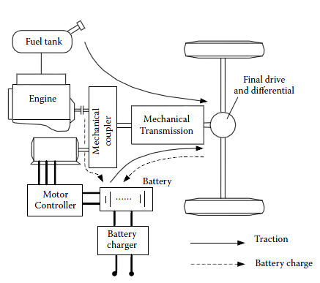
Parallel HEVs
The key characteristic of a parallel configuration is that two mechanical powers are added together in a mechanical coupler.
The IC engine is the primary power plant, and the batteries and electric motor drive constitute the energy bumper.
The power flows can be controlled only by the power plants—the engine and electric motor.
Configuration of a parallel hybrid electric drive train [1]

Slide 19
Parallel HEVs
The parallel hybrid needs only two propulsion devices, the ICE and the electric motor, which can be used in the following modes:
Motor-alone mode: When the battery has sufficient energy, and the vehicle power demand is low, then the engine is turned off, and the vehicle is powered by the motor and battery only.
Configuration of a parallel hybrid electric drive train [1]

Slide 20
Parallel HEVs
Combined power mode: At high power demand, the engine is turned on and the motor also supplies power to the wheels.
Engine-alone mode: During highway cruising and at moderately high power demands, the engine provides all the power needed to drive the vehicle.
Configuration of a parallel hybrid electric drive train [1]

Slide 21
Parallel HEVs
Stationary charging mode: The battery is charged by running the motor as a generator and driven by the engine, without the vehicle being driven.
Regenerative braking mode: The electric motor is operated as a generator to convert the vehicle’s kinetic energy into electric energy and store it in the battery.
Configuration of a parallel hybrid electric drive train [1]

Slide 22
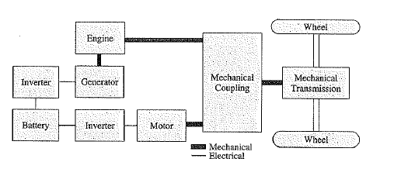
Series-Parallel HEVs
The series-parallel HEV incorporates the features of both series and parallel HEVs:
In comparison to a series HEV, the series-parallel HEV adds a mechanical link between engine and the final drive, so the engine can drive the wheels directly.
Therefore, it can be operated as a series or parallel HEV.
The architecture of a series-parallel HEV [2]

Slide 23
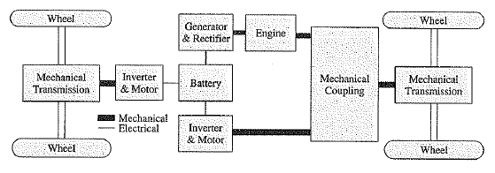
Complex HEVs
Complex HEVs usually involve the use of planetary gears and multiple electric motors.
The generator in this system is used to realize series operation as well as to control the engine operation condition for maximum efficiency.
The two electric motors are used to realize all-wheel drive, and to achieve better performance in regenerative braking.
The electrical four-wheel drive system using a complex architecture [2]

Slide 24
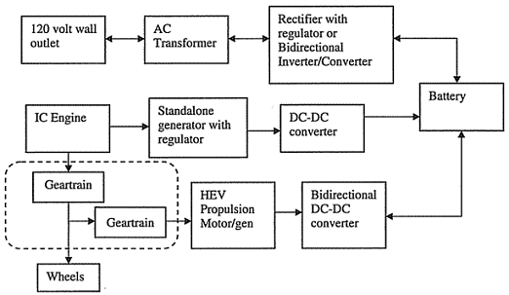
Plug-in HEV (PHEV)
In a standard HEV, the internal combustion engine is the original source of all mechanical and electric power. A PHEV differs from this by allowing a plug-in cable to charge the battery externally.
Some PHEVs are also called “range extended electric vehicles” since they have the capability to drive using only electric power, only burning fuel when the range allowed by the battery alone is exceeded.
Possible architecture for a plug-in hybrid [2]

Slide 25
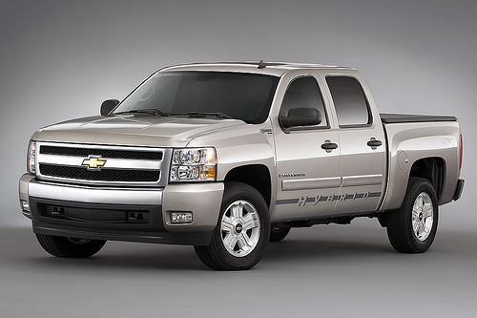
Levels of Hybrid Vehicles: Mild
The term hybrid refers to a type of vehicle. There are different levels of “Hybridization” among hybrids on the market:
Mild Hybrid: A mild hybrid will incorporate idle stop and regenerative braking but not capable of using the electric motor to propel the vehicle on its own without help from the internal combustion engine
GM Silverado pickup truck [3]

Slide 26
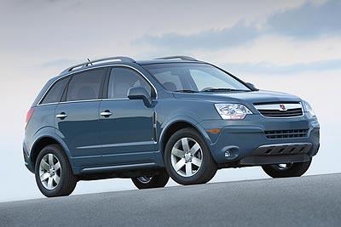
Levels of Hybrid Vehicles: Mild
A mild hybrid system has the advantage of costing less, but saves less fuel compared to a full hybrid vehicle.
It usually uses a 42-volt electrical motor and battery package.
The fuel savings for a mild type design is about 8% to 15%.
Saturn VUE [4]

Slide 27
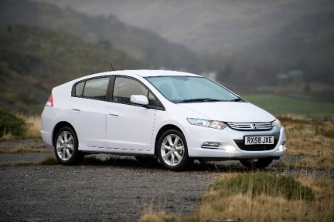
Levels of Hybrid Vehicles: Medium
Medium Hybrid: a medium hybrid uses 144- to 158-volt batteries that provide for engine stop/start, regenerative braking, and power assist.
Like a mild hybrid, a typical medium hybrid is not capable of propelling the vehicle from a stop using battery power.
The fuel economy saving are about 20% to 25% for medium hybrid systems
Honda Insight [5]

Slide 28

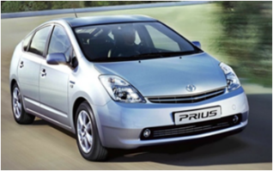
Levels of Hybrid Vehicles: Full
Full Hybrid: A full hybrid, also called a strong hybrid, uses idle stop regenerative braking, and is able to propel the vehicle using the electric motors alone.
Each vehicle manufacturer has made its decision on which hybrid type to implement based on its assessment of the market niche for a particular model.
The fuel economy savings are about 30% to 50% for full hybrid systems
Ford Escape SUV Hybrid [6]
Toyota Prius [7]

Slide 29
HEV Powertrain Components: Mechanical, Electrical, and Hydraulic

Slide 30
Mechanical Power: Overview
The mechanical power path of the HEV includes components that output mechanical power, the power demand at the wheels, and any mechanical connections that transfer power between the two.
Mechanical power is converted from electric power at the electric motors, and from fuel at the engine. Mechanical power is converted into electrical power with a generator, or through a motor in regenerative braking mode.
The architecture of a the mechanical power path varies greatly with the type of vehicle and configuration. A series hybrid or pure-electric vehicle with only an electric motor connected to the wheels may use a single fixed gear ratio or two speed transmission. A parallel or power-split hybrid will use a more complex arrangement.

Slide 31
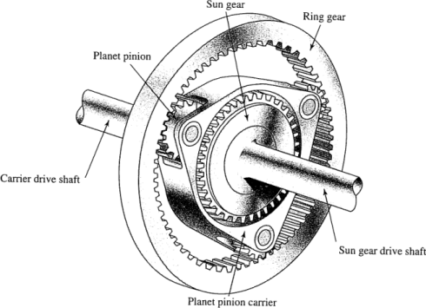
Mechanical Power: Planetary Gears
For HEVs that need to combine mechanical power from more than one source and output that power to the wheels, planetary gear sets are commonly used.
A set of planetary gears has three parts that are able to move relative to each other: the sun gear, ring gear, and planet gears attached to a planet carrier.
Planetary gear set [8]

Slide 32
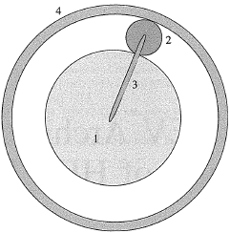
Mechanical Power: Planetary Gears
The gear in the center is the sun gear. One or more planet gears are meshed with the sun gear and with the outer ring gear. Input or output shafts are connected to the sun, ring, and planet carrier. Any of the three can be used as an input, an output, or locked in place to give the system only one input and one output.
Sun (1), planet(2), carrier (3), and ring (4) in a planetary gear set [2]
Planetary gear set [8]

Slide 33
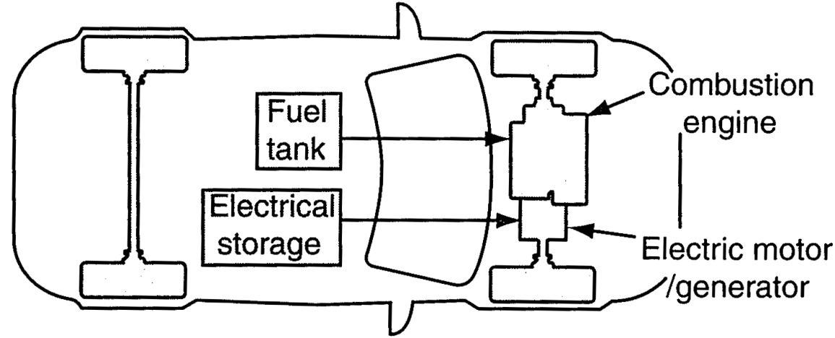
Electric Power: Overview
The electric power in a HEV is used as an intermediary storage mechanism. Electric power is stored in a battery, which is charged either externally in the case of a plug-in hybrid, or through an electric generator converting mechanical energy from the engine or recaptured from regenerative braking into electrical energy.
When demanded, energy from the battery is converted into mechanical energy using an electric motor.
Vehicle with ICE and electric motor propulsion[9]

Slide 34
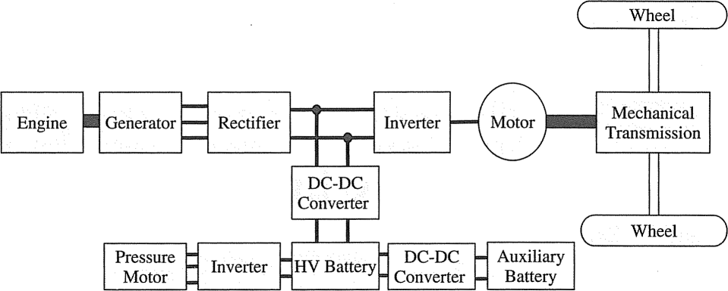
Electric Power: Components
The following is the main electrical components of the vehicle used in electric power conversion and storage:
Generator: converts excess mechanical power produced by the ICE or from regenerative braking into electric power
Motor: using electric power from the battery or generator to produce mechanical power
Energy Storage: stores electric power for later
use in a battery or ultracapacitor
Components and power electronics used in a series HEV [2]

Slide 35
Electric Power: Components
Batteries store and output direct current power while many motors run on alternating current. The electrical architecture of an HEV contains several types of power electronics that convert electrical power from one form to another.
Inverter: converts direct current into alternating current. An inverter is used to control voltage input to an AC motor.
Rectifier: converts alternating current from
an AC generator to DC
Components and power electronics used in a series HEV [2]

Slide 36
Electric Power: Components
Converter: converts DC to DC of another voltage. When a motor switches from motoring to regenerative braking mode, there will be a fluctuation in the DC bus voltage during the transition, making control of the motor difficult. A DC/DC converter can be used to maintain relatively constant voltage in the DC bus. It is also used to match battery voltage to motor voltage when the motor is designed to use a higher voltage than the battery.
Components and power electronics used in a series HEV [2]

Slide 37
Electric Power: Motors and Generators
Electric motors and generators operate on the same principle, and in many configurations, a motor can act as a generator or vice-versa.
For example, in one situation a motor is being supplied with electric current from the battery to drive the wheels. In regenerative braking, the motor acts like a generator and converts excess mechanical energy from the wheels into electric current which is stored in the battery. In some vehicles, a device primarily used as a generator can be switched to act as a motor to supplement the engine and second motor when the torque demand on the vehicle is high.
Because of this electric motors or generators in hybrid vehicles can be referred to as “motor-generator units”.

Slide 38
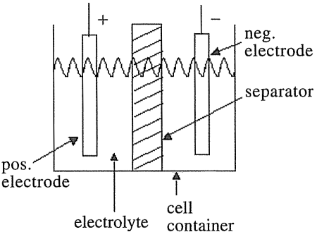
Battery Basics
A battery contains a number of cells that can convert chemical energy into electrical energy. Components of a battery cell are the electrodes, electrolyte, and separator.
The battery terminals allow a circuit to be connected between the two electrodes.
Chemical reactions at the electrodes bond or release electrons.
When an external circuit is connected across the terminals, electrons flow from one electrode to the other through the circuit.
Components of a battery cell [10]

Slide 39
Battery Basics
The electrolyte is the substance between the positive and negative electrodes of the cell. It allows for conductivity of ions involved in the chemical reactions at the electrodes.
The separator is an electrically-insulating layer between the electrodes that is permeable to the ions
The electrolyte and separator are nonconductive to electrons to avoid self-discharge, so that energy is only released when a load is connected. In some batteries, there is a slow self-discharge due to diffusion effects.
Components of a battery cell [10]

Slide 40
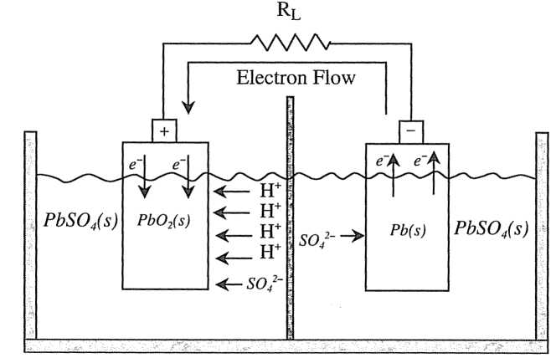
Battery Basics
The chemical reactions that take place at the electrodes are oxidation and reduction processes, which bond or release electrons.
The positive electrode is a compound that reduces during discharge. The electrode consumes electrons from the external circuit during discharge
The negative electrode is a metal or alloy that oxidizes during discharge, releasing electrons to the external circuit
Discharge operation of a lead acid battery [10]

Slide 41
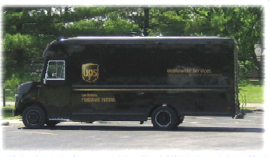
Hydraulic Power: Overview
Another type of hybrid system is a hydraulic hybrid. In a hydraulic system, energy is stored in a compressed fluid. An internal combustion engine can be used to pressurize the fluid using a hydraulic pump, and the energy can be used through a hydraulic motor.
In essence, this system uses hydraulics in place of the electrical system: the pump takes the place of a generator and compressed fluid replaces a battery.
Hybrid hydraulic UPS delivery vehicle [11]

Slide 42
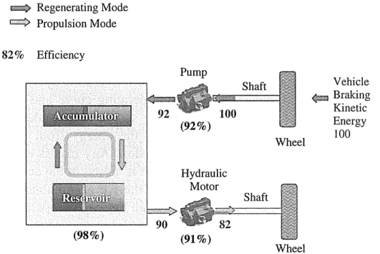
Hydraulic Power: Components
Pump: converts mechanical power into hydraulic power
Motor: converts hydraulic power into mechanical power
Accumulator: stores power using a high-pressure gas
Reservoir: stores fluid at low pressure after being used by the motor
As with the connection between electric motors and generators, the same device can act as a pump or a motor.
This allows regenerative braking to also be used in hydraulic hybrids.
Hydraulic hybrid efficiency distribution including regenerative braking [2]

Slide 43
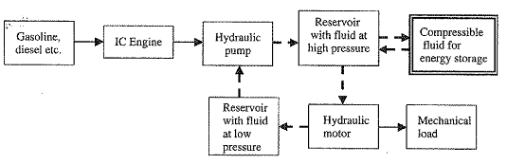
Hydraulic Power: Components
The system-level scheme for a hydraulic energy storage and extraction mechanism is shown below, with the dashed lines indicating the fluid flow path:
The dashed fluid flow path forms a closed loop system.
Fluid can be bidirectional between the accumulator and the high-pressure fluid reservoir.
Generic scheme for hydraulic energy storage and extraction [2]

Slide 44
Hydraulic Hybrid Operation
The engine drives a hydraulic pump which draws an incompressible fluid from a low-pressure reservoir and increases its pressure.
The high-pressure incompressible fluid is used to drive a hydraulic motor which can drive some mechanical load. The mechanical fluid enters at high pressure and exits at low pressure, doing mechanical work in the process.
The now low-pressure fluid flows to the low-pressure reservoir and the fluid flow circuit is completed.
Generic scheme for hydraulic energy storage and extraction [2]

Slide 45
Hydraulic Hybrid Operation
The high-pressure reservoir fluid also moves a piston or similar mechanism which in turn can push against a compressible gas.
This compression will cause energy to be stored in the gas. Once some predefined pressure has been achieved, a valve can be used to prevent further pressurization of the gas.
To extract energy from the accumulator, a valve is opened and the compressed gas works against some piston to pressurize the fluid in the high-pressure reservoir, which will drive the hydraulic motor.
Generic scheme for hydraulic energy storage and extraction [2]

Slide 46
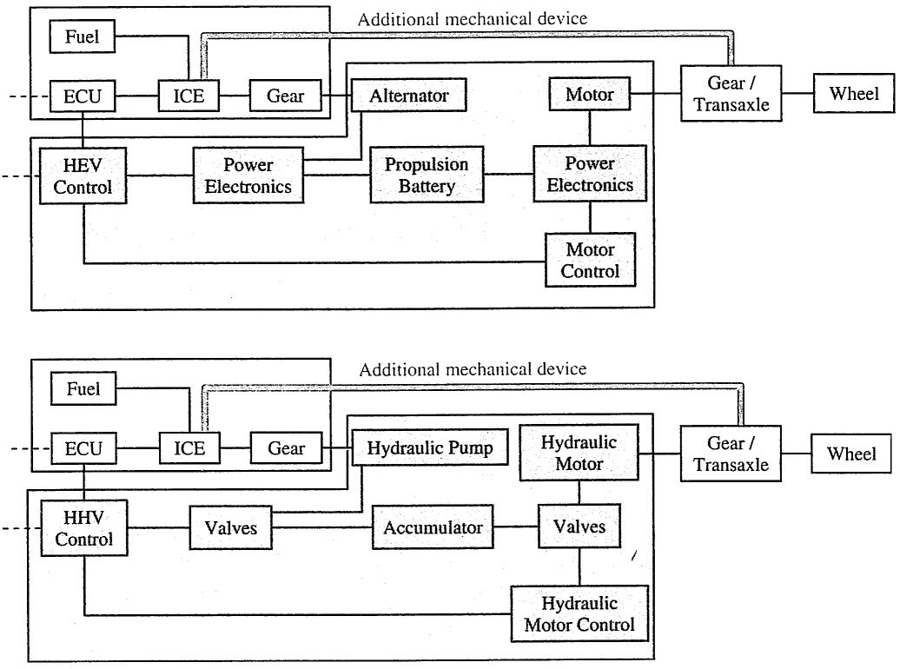
Hydraulic Power: Comparison with Electric Power
Parallel HEV[2]
Hybrid Hydraulic Vehicle [2]

Slide 47
Electric Motor Usage
Depending on the configuration of the hybrid vehicle and the power requirements of the vehicle motion, the electric motor can perform different functions:
Power Assist: the motor provides extra power to supplement the engine power, for example when high acceleration is required. This can increase fuel efficiency by allowing a smaller engine to be used.
Engine-off Mode: the engine is turned off and the electric motor alone drives the vehicle. In this mode, the engine is using no fuel and the vehicle is operating as an electric vehicle.

Slide 48
Optimizing Engine Operation
Since an engine’s efficiency changes with its speed and torque, a vehicle loses some efficiency by needing to run the engine under a wide selection of operating conditions.
The addition of the electric motor allows the engine usage to be optimized:
In a parallel or power-split hybrid, the motor can be used to add power to keep the engine out of regions of low efficiency.
In a series hybrid, the engine speed is independent of the wheel speed. This gives more flexibility in controlling the engine, allowing it to be run at optimal conditions.

Slide 49
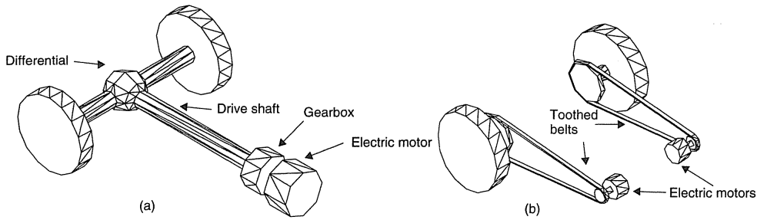
Transmission Efficiency
Inefficiency in the transmission connecting the motor or engine to the wheels causes some power loss. In a parallel hybrid, a complex transmission is needed to combine mechanical power from the engine and electric motor. For a series hybrid or pure electric vehicle, a simpler transmission, often a single fixed gear, can be used since the electric motor can provide torque from zero speed.
Arrangements for electric vehicle transmission: drive using (a) single motor and transmission and (b) geared drive to each wheel [12]

Slide 50
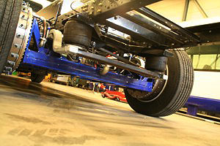
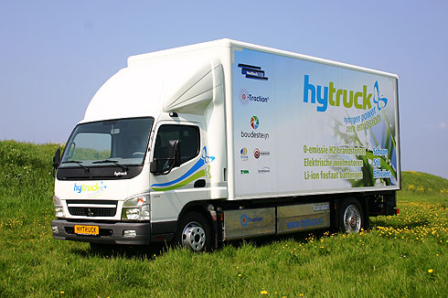
Transmission Efficiency
A differential can be omitted if separate motors are used to drive each wheel, however this increases complexity of the controller needed. Connecting the motors directly to the wheels or placed in the wheel hub will have a 100% transmission efficiency and saves space in the vehicle. The disadvantage is that it will increase the vehicle’s unsprung mass. Also the motor must be designed to run at the same speed as the vehicle wheels, which results in a heavier motor.
Transport truck using two in-wheel motors [13]

Slide 51
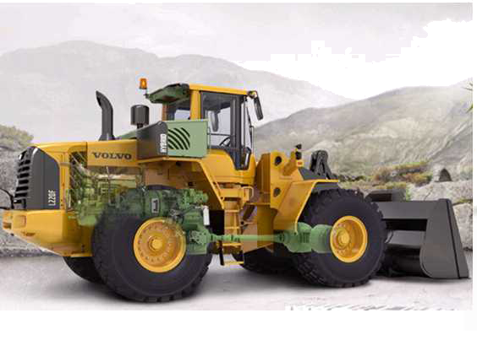
Engine Stop-start
A hybrid can have its internal combustion engine turn off when the driver applies the brakes and then only restarting when needed, avoiding losses from idling. This can be especially important in construction vehicles such as wheel loaders, which may spent up to 40% of their time with the engine idling.
Volvo’s L220F hybrid wheel loader [14] has an electric motor between the engine and transmission which uses power from a lithium battery. Its diesel engine can be shut off and quickly restarted by using the motor to spin the engine back up to optimum speed.

Slide 52
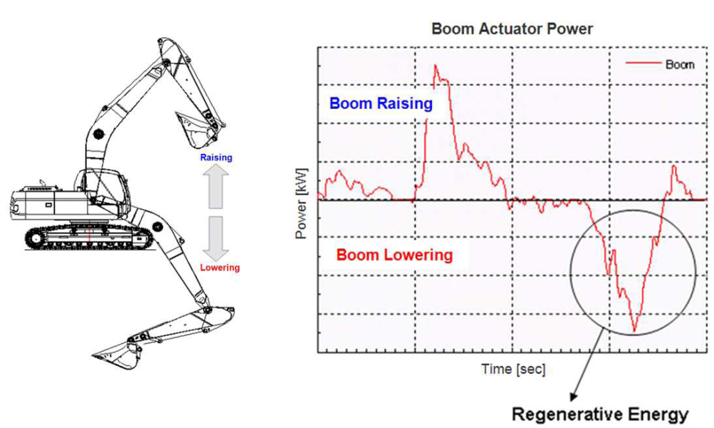
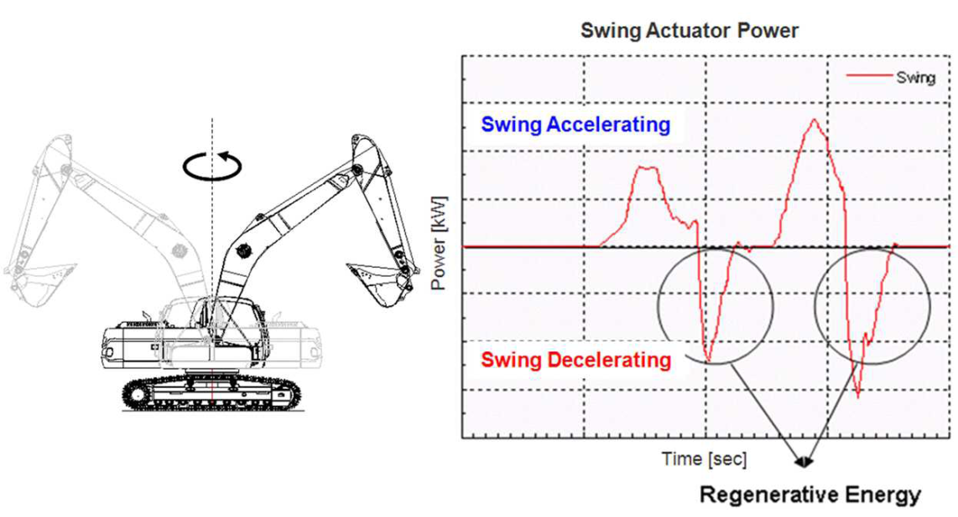
Energy Regeneration
Along with regenerative braking in an automobile, energy can be recovered from other operations such as the lowering of the boom of an excavator or braking of the swinging cab.
When the boom is moved upward, some of the energy is stored as potential energy. When it drops, some energy can be recovered if the hydraulic motor is replaced with an electric one or if a hydraulic pump-motor is used to recover hydraulic energy which would otherwise be dissipated in the valve.
Sources of regenerative energy in an excavator [14]

Slide 53
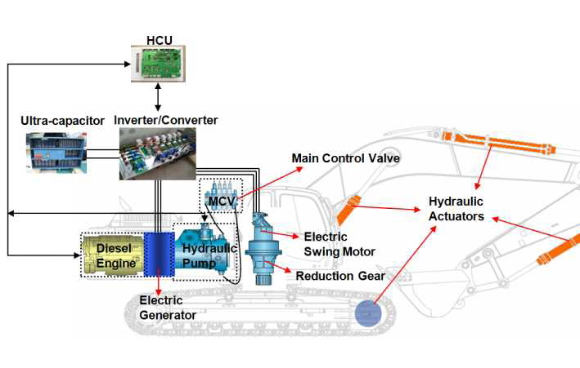
Energy Regeneration
In construction equipment, power demand can change very rapidly. Many designs omit a battery for long-term storage of recovered energy and store energy in ultracapacitors instead. Batteries have a limit to how fast they can discharge power but energy stored in a capacitor can be discharged quickly to meet sudden peak power needs.
Structure of a hybrid excavator [14]

Slide 54
References
[1] Ehsani, Mehrdad, Yimin Gao, and Ali Emadi. Modern Electric, Hybrid Electric, And Fuel Cell Vehicles, Fundamentals, Theory, And Design. 2nd ed. CRC, 2010.
[2] Mi, Chris, Abul Masrur, and David Gao. Hybrid Electric Vehicles, Principles And Applications With Practical Perspectives. Wiley, 2012.
[3] http://gm-volt.com/2009/03/02/gm-considering-extended-range-electric-pickup-truck/
[4] http://www.autobytel.com/saturn/vue/reviews/
[5] http://www.automotive-insight.net/cars-news/honda-insight.html

Slide 55
References
[6] http://autocarreviews.net/2011/06/24/2011-ford-escape-hybrid-suv.html
[7] http://www.toyota-lawsuit.com/news/2011/06/02/faulty-steering-mechanism-prompts-toyota-prius-recall/
[8] Scott, Thomas E. Power Transmission, Mechanical, Hydraulic, Pneumatic, And Electrical. Pearson College Div, 2000.
[9] Erjavec, Jack, and Jeff Arias. Hybrid, Electric, And Fuel-cell Vehicles. Delmar Pub, 2007.
[10] Husain, Iqbal. Electric And Hybrid Vehicles, Design Fundamentals. CRC, 2003.

Slide 56
References
[11] http://www.epa.gov/otaq/technology/420f06043.htm
[12] Larminie, James, and John Lowry. Electric Vehicle Technology Explained. West Sussex, England: J. Wiley, 2003.
[13] http://www.e-traction.eu/
[14] Doo-Yearn Jo; Sangyeop Kwak; , "Development of fuel-efficient construction equipment," Power Electronics and ECCE Asia (ICPE & ECCE), 2011 IEEE 8th International Conference on , vol., no., pp.31-37, May 30 2011-June 3 2011
doi: 10.1109/ICPE.2011.5944374

