Slide 1





Low Cost Manufacturing Trainer
Alan Zube - Florida State College at Jacksonville
Mike Tanner - Waukegan High School

Slide 2
Low Cost Manufacturing Trainer
An NSF TAACCT funded grant - 6 objectives
To adopt and adapt current Mechatronics Associates degrees.
To create low-cost, hands-on, easily replicable and buildable
mechatronics trainer.
To create high school career ladder pathways especially for first
generation students, minorities, and women.
To develop professional development for high school and
college teachers in the area of mechatronics.
To assess and align national industry certifications.
To establish a mechatronics community of practice.

Slide 3
Low Cost Manufacturing Trainer
Project Team
College of Lake County
Margie Potter - PI Gary Morgan
Anne Arundel Community College
Beth Baran - CoPI Tim Callinan Susan Gallagher
Florida State College of Jacksonville
Alan Zube - CoPI Lance Wallace Belinda Potter

Slide 4
Low Cost Manufacturing Trainer
Summer Working Connections
2017
Level I Training - 10 participants
2018
Level I Training - 16 participants
Level II Training - 10 participants
2019
Level I - 16 (anticipated)
Level II / III - 16 (anticipated)

Slide 5
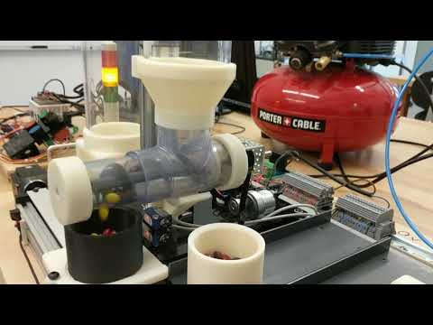
Low Cost Manufacturing Trainer
The Trainer

Slide 6
Low Cost Manufacturing Trainer
The Trainer - Documents and Curriculum
https://www.maryland.design/lcmt

Slide 7
Low Cost Manufacturing Trainer
The Trainer - Resources
Automation Direct
Open Builds
ServoCity
McMaster Carr
Wolf Automation
Shapeways

Slide 8
Low Cost Manufacturing Trainer
Ideas for LOWER cost (under $1500)
Ebay
Local company donations
PLC Place (sensors)
Lower cost stepper controller
VEX built conveyor
Arduino stepper control

Slide 9
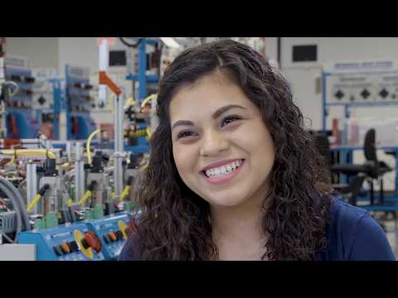
Low Cost Manufacturing Trainer
Mechatronics Video

Slide 10
Trains & PLCs
Mike Tanner
Intro to Technology/Engineering (Freshmen)
Waukegan High School

