Slide 1
Biotechnology at Shoreline Community College / Immunotherapy Biohub
InnovATEBIO Project Talk, April 11th 2025
Orlando de Lange

Slide 2
Contents
About Me
Biotechnology at SCC – Overview
Introducing the Immunotherapy BioHub ATE grant
Cell and immunotherapy technician workforce reports.
The Kit Loan program.
Essentials of Biomanufacturing certificate.
Questions

Slide 3
1. About Me

Slide 4
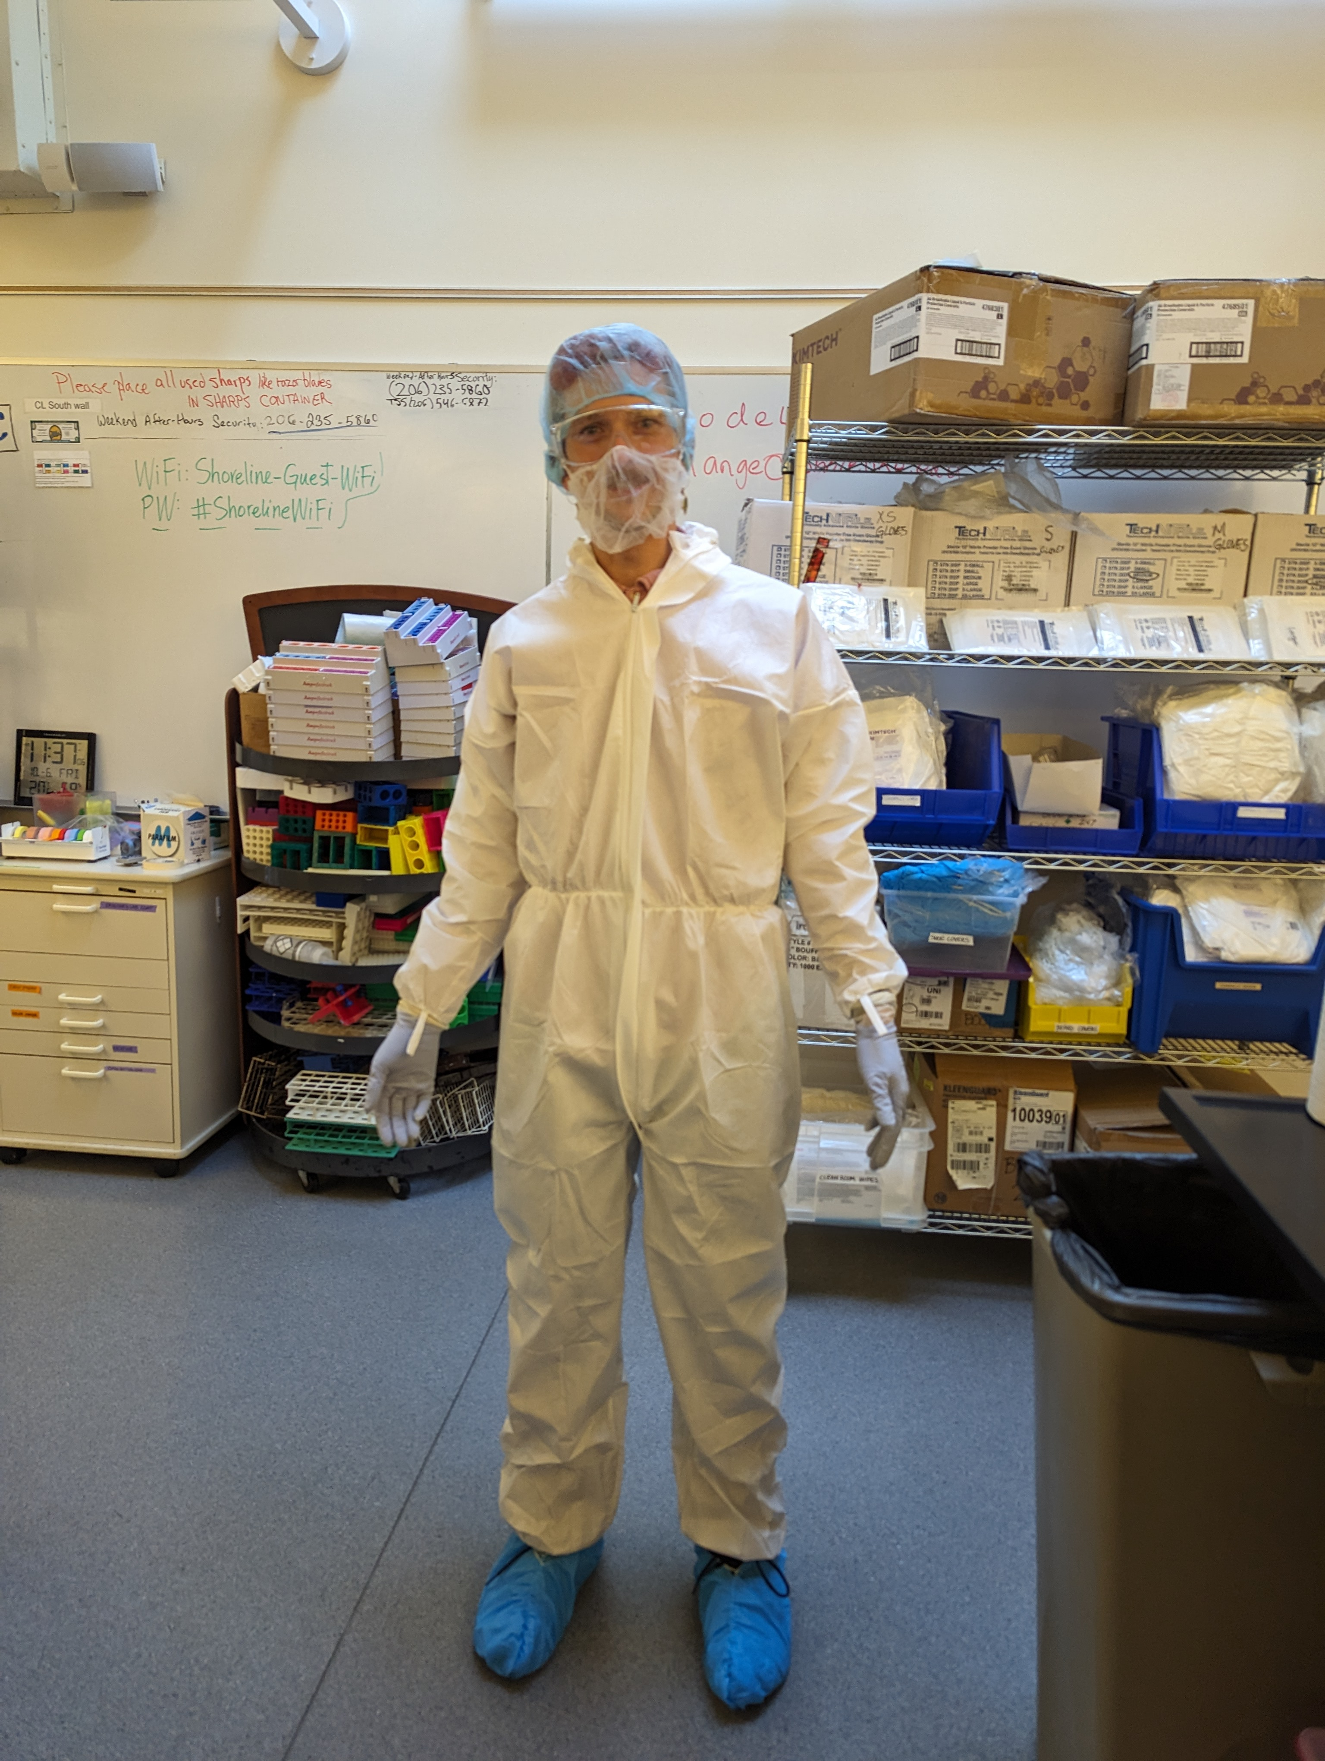
Dr. Orlando de Lange
PhD at LMU Munich, studying plant molecular biology (TAL effectors).
Postdoctoral research at University of Washington 2016 – 2022 studying plant synthetic biology and laboratory automation.
President of SoundBio Lab 2019-2024, Seattle’s Community biology lab.
Shoreline Community College Biotechnology full-time faculty since Fall 2022.
Acting Dean of Career Technical Education 2024-5.
PI of Immunotherapy ATE grant since Sept 2024.

Slide 5
2. Biotechnology at SCC

Slide 6
The Shoreline Biotechnology dept
Shoreline is just North of Seattle, WA.
Program dates back to the 1990s.
Offers only 2-year degree in Biotechnology in WA.
Bellevue College offers a BAS in Molecular Biosciences. Nearby UW Bothell entering into Biotech education space.
4 dedicated teaching labs with high-end equipment.

Slide 7
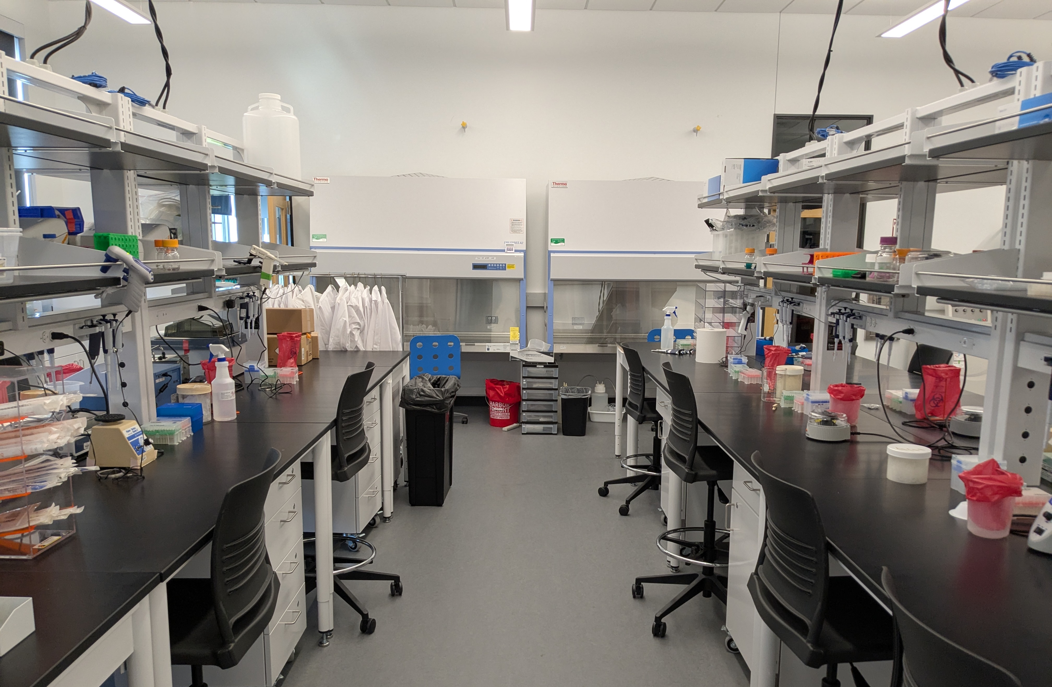
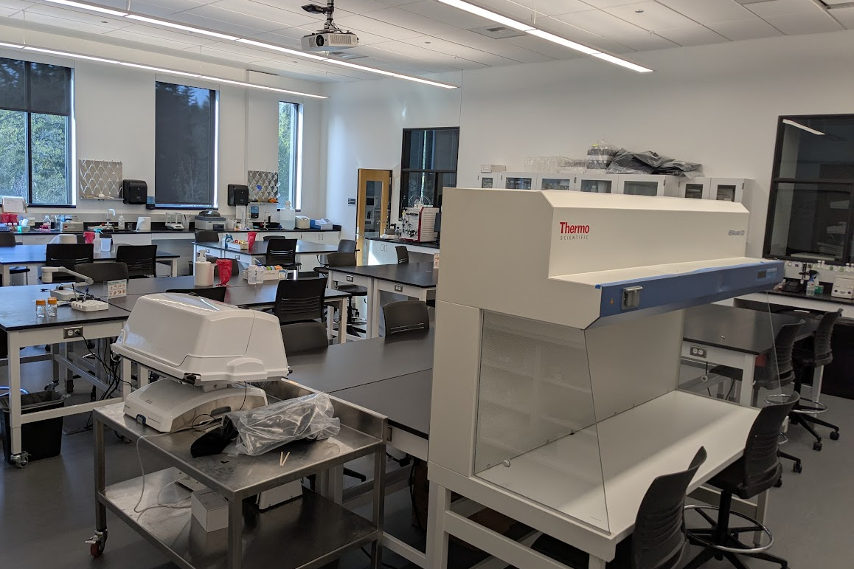
Teaching labs

Slide 8
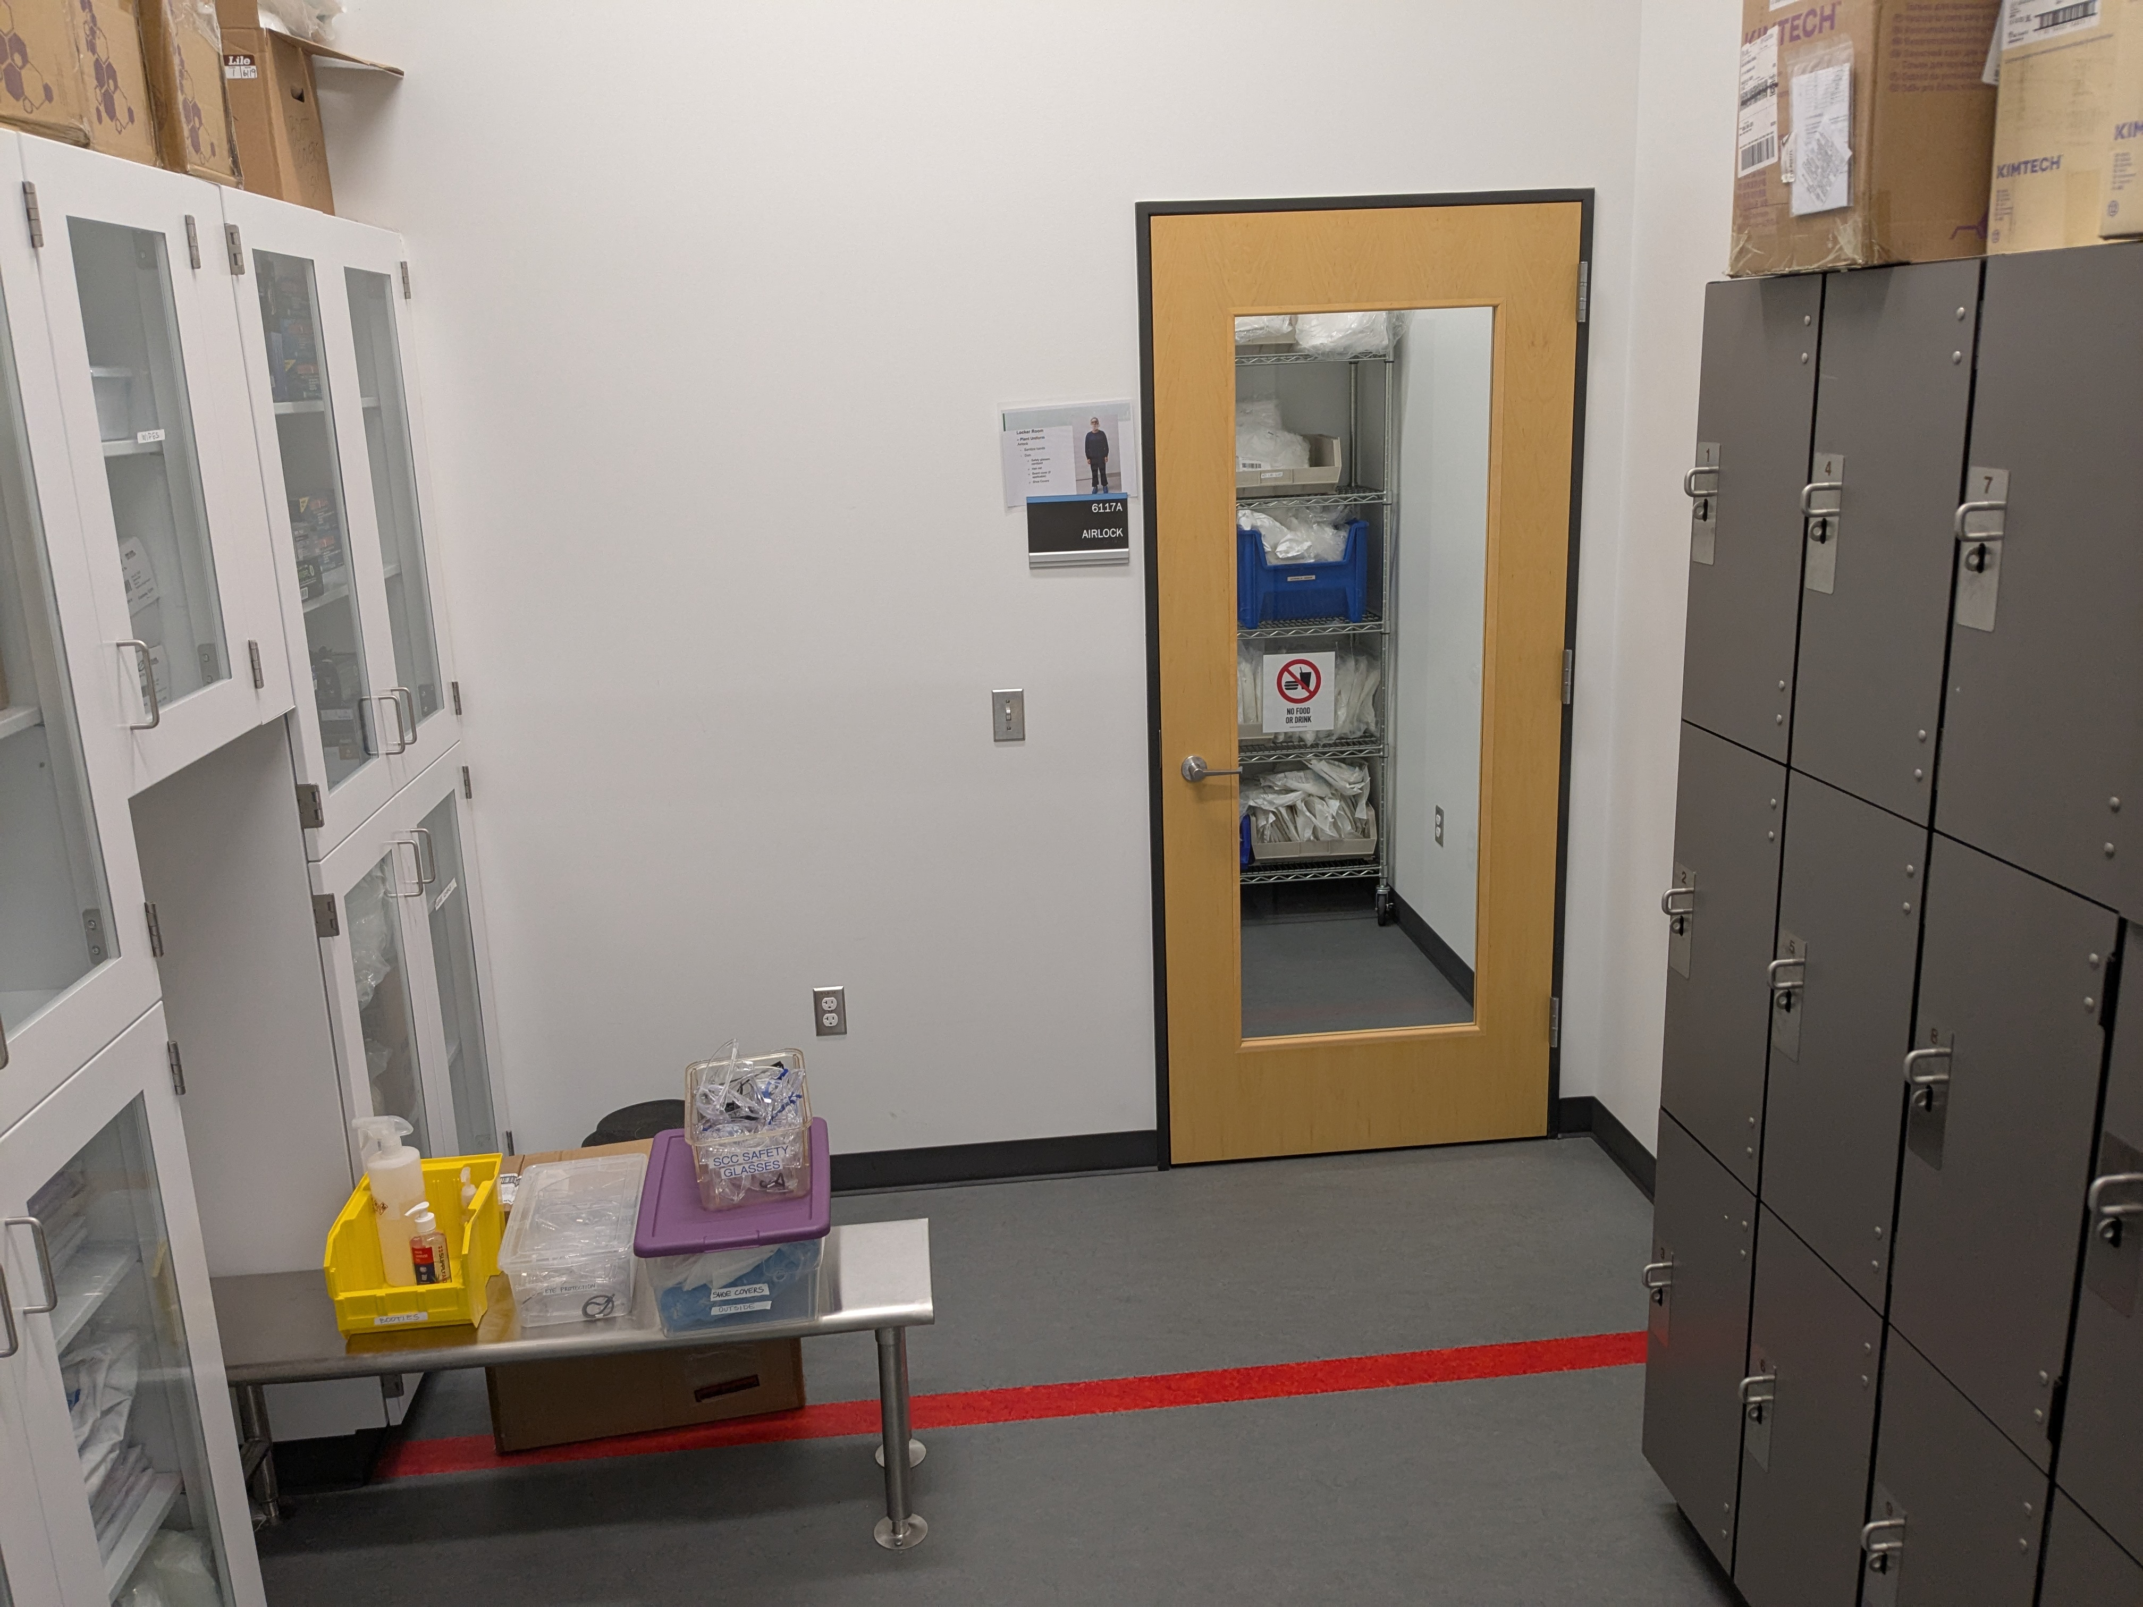
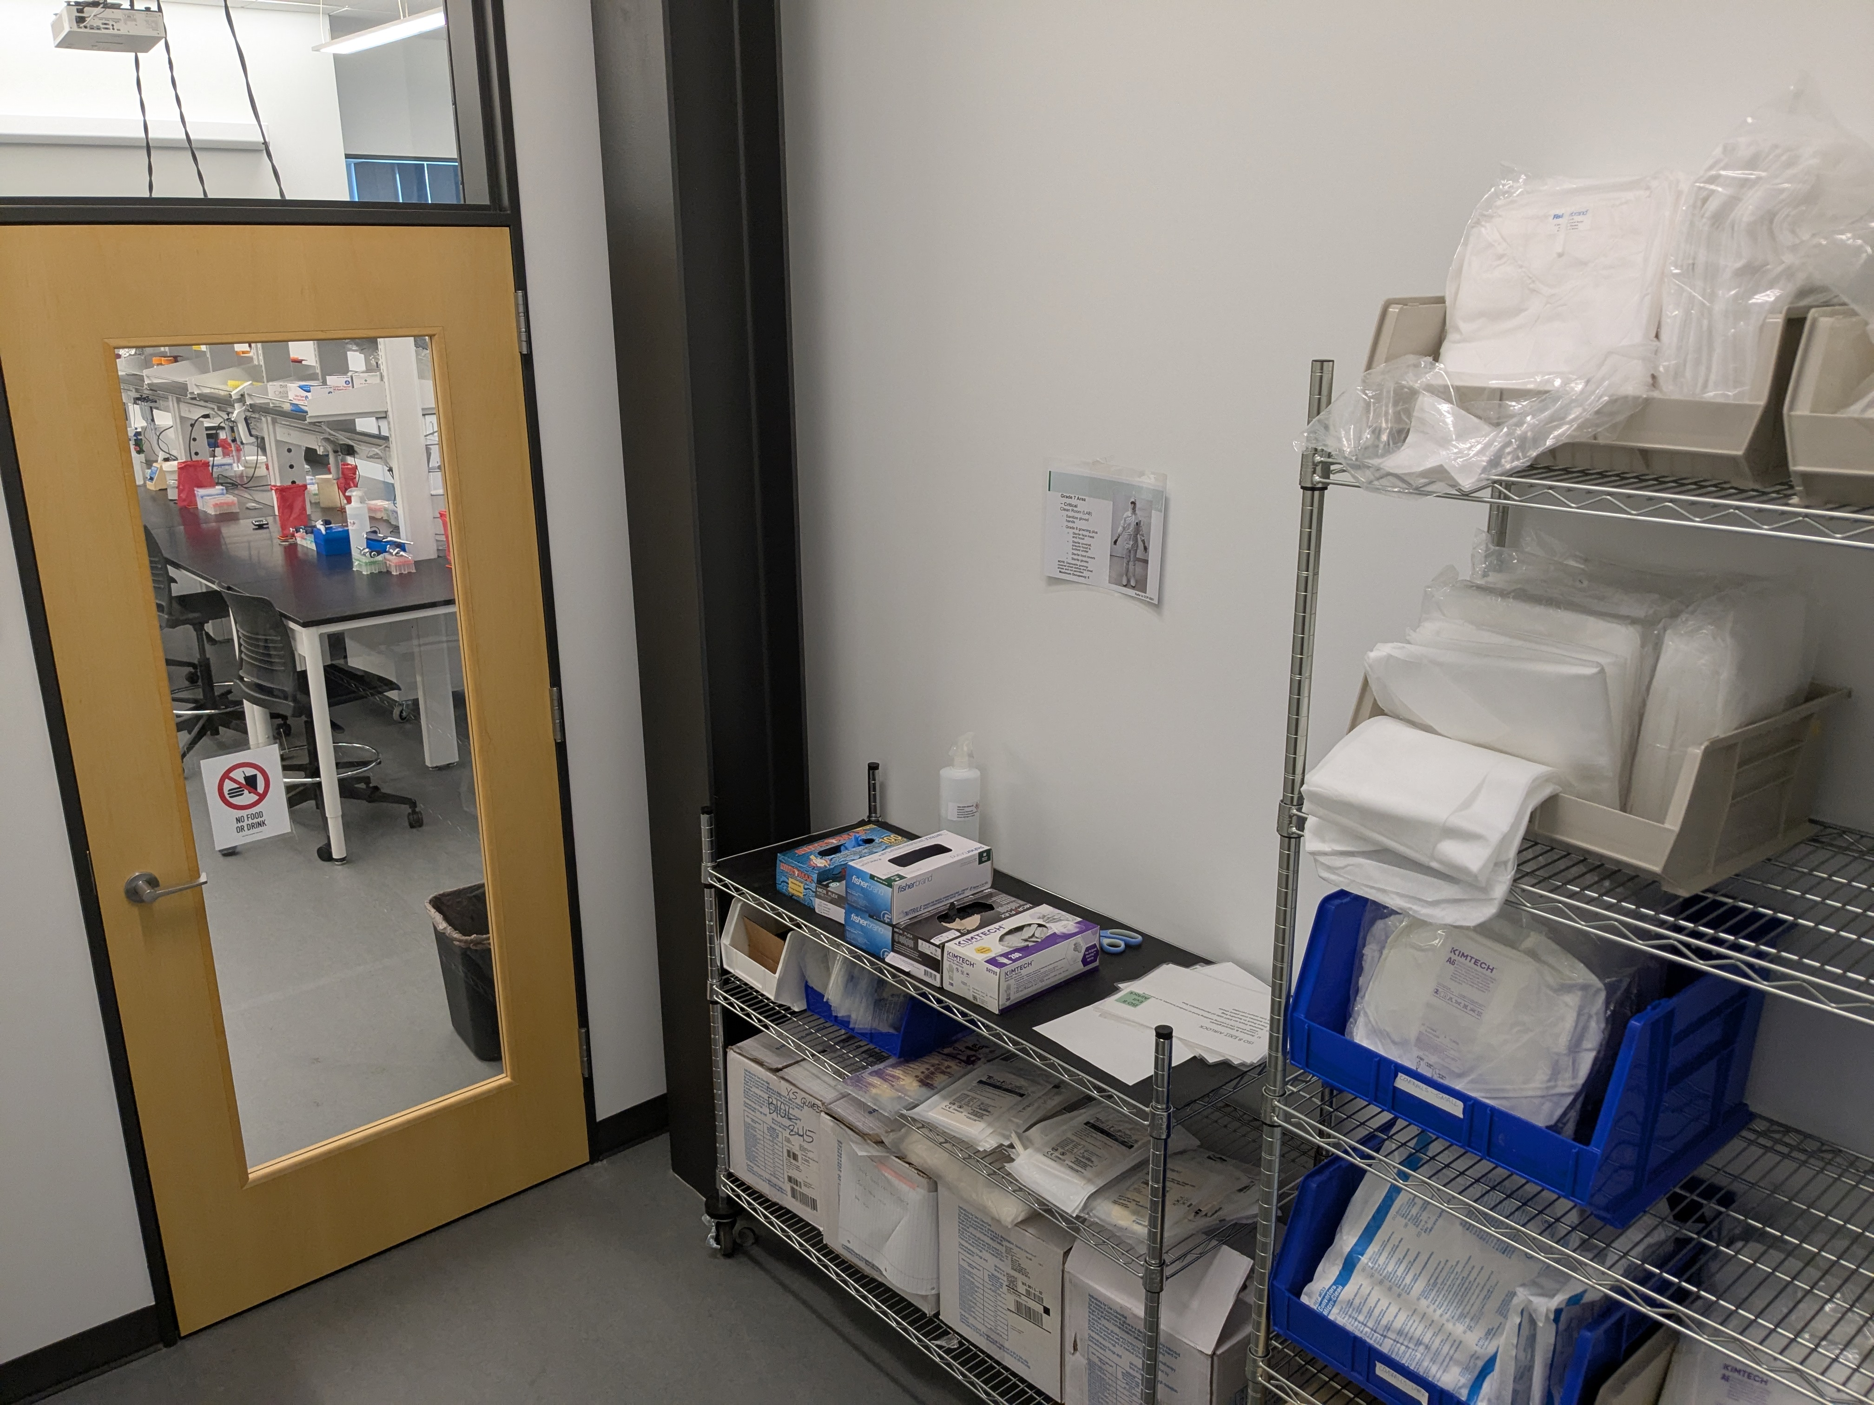
Simulated airlock

Slide 9
Biotechnology & Bioman Programs at SCC
Biotechnology Lab specialist
2 year AAAS or 1 year post-back certificate. Hands-on laboratory curriculum (mol bio, biochem, tissue culture) and theory courses. For entry level positions in biomedical R&D labs.
Essentials of Biomanufacturing
10 week certificate for adults. Hands-on curriculum. Aseptic Technique, Regulatory Affairs, QA/QC, Bioreactors. For entry level positions in biotherapeutic manufacturing.
Opportunities for High Schoolers
Biomanufacturing Training Program – running start program, no employable credential at end. Accelerated Lab Tech Training Certificate = Running start program + paid summer internship + 1 year of classes at Shoreline. Guaranteed interview for lab tech position at end.

Slide 10
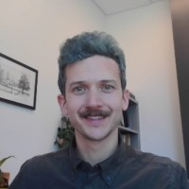
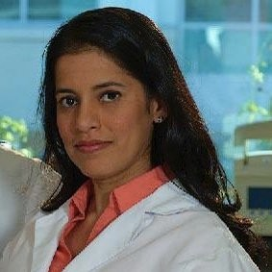
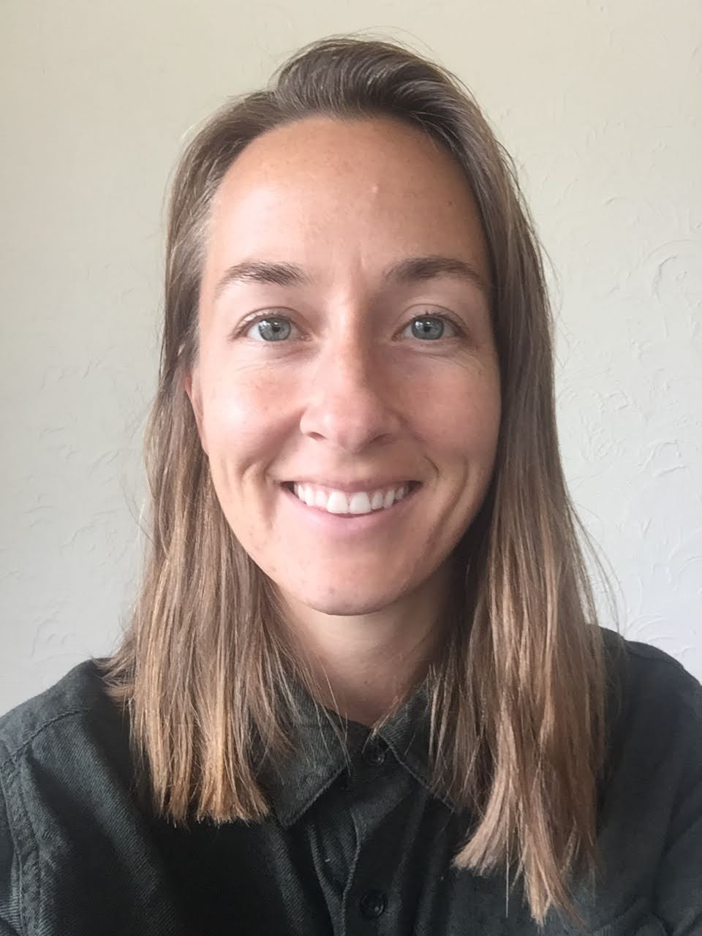
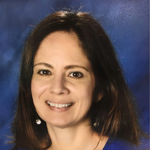
Who’s who – Current personnel
Faculty / Interim Dean
Orlando de Lange
Faculty
Vasudha Sundaravaradan
Faculty, Department Chair
Rachel Rawle
Instructional Lab Tech
Diana Ensenat

Slide 11
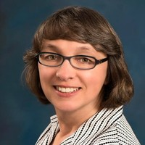
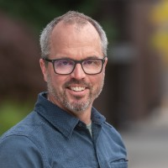
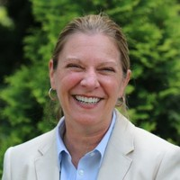
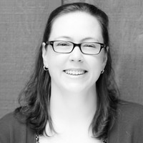
Who’s who – Past personnel
Jan Chalupny
Kit Loan Program manager.
Now at Institute for Systems Biology
Guy Hamilton
Biotech program director.
Now at UW Bothell
Louise Petruzzella
Biotech program director.
Now at BioMADE
Dina Kovarik
Long-time sole Full-time faculty member.
Passed away 2022

Slide 12
3. Immunotherapy biohub ate grant

Slide 13
Grant overview
Awarded in 2021.
Significant disruption from personnel turnover.
No-cost extension till Nov 2025.
Goal was to grow the US cell and immunotherapy workforce.
Support allowed for expansion of program offerings (already described).

Slide 14
Grant goals and projects
Goal 1: On a national level, identify the gaps that exist between workforce demand in the immunotherapy sector and the supply of skilled technicians from community college training programs, and disseminate findings among stakeholder
Goal 2: Increase the number of individuals from underrepresented groups and high school students who are exposed to immunotherapy careers.
Goal 3: Become a knowledge-source of emerging trends in the immunotherapy sector and community college workforce development

Slide 15
4. Cell and immunotherapy technician workforce reports.

Slide 16
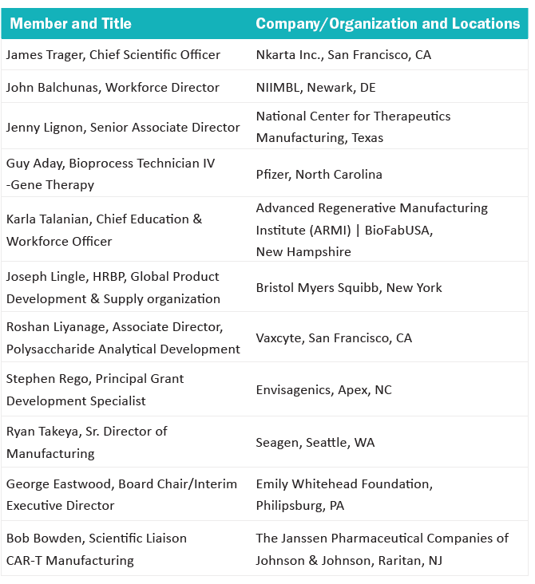
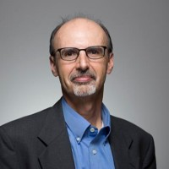
Industry reports
John Carrese
Labor market Information & Research regional director – Center of excellence for labor market research, Cabrillo College
Guy Hamilton
Ex SCC Biotechnology program director.
Now at UW Bothell
Previously PI of ATE grant.

Slide 17
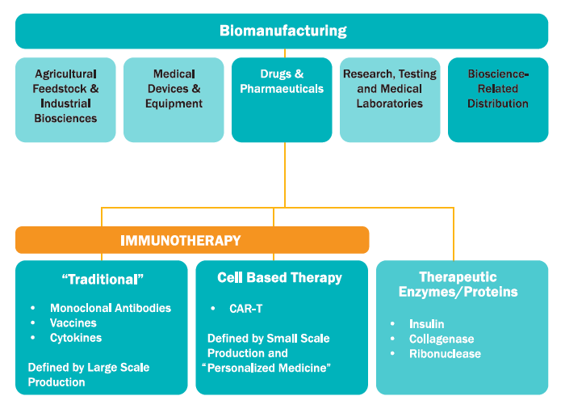
What is the cell and immunotherapy industry?
Cell therapies = Treatments that involve transplanting cells into a patient.
Immunotherapies = Therapies that target the immune system rather than the diseased cells / pathogens. Products are almost always biologics.
Production pathways often focused on smaller batches, from mammalian cells.

Slide 18
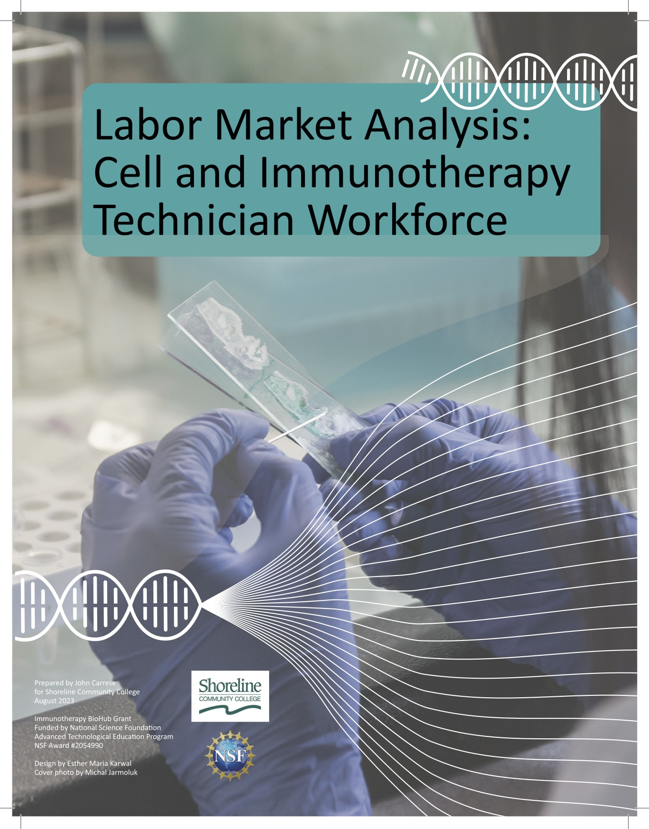
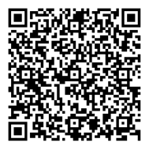
Labor market analysis
Report. Labor Market Analysis: Cell and Immunotherapy technician workforce
https://innovatebio.org/publication/labor-market-analysis-cell-and-immunotherapy-technician-workforce

Slide 19
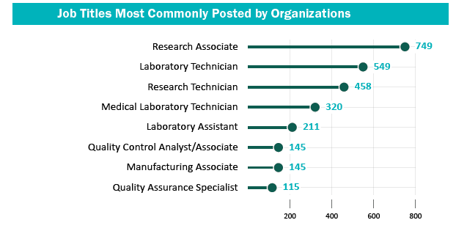
A range of job types and titles exist under “Cell and immunotherapy technician”
Titles validated by advisory committee.
Note that Medical Laboratory Technicians play important roles in cell and immunotherapy R&D and product delivery.

Slide 20
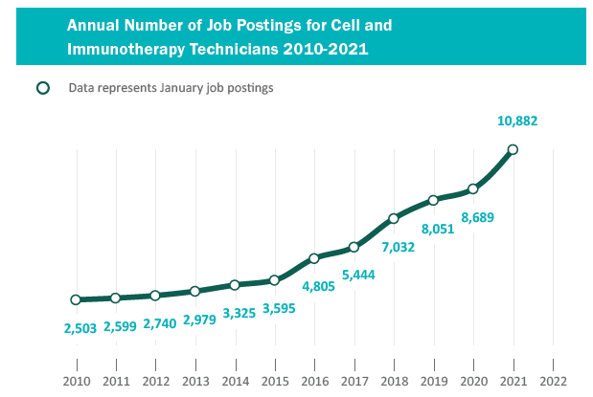
Jobs growth of 30% per year
National data for relevant job titles at companies identified as hiring technicians for cell and immunotherapy work.
Current reductions in government research funding may slow growth in near time but trajectory seems likely to be maintained long term.

Slide 21
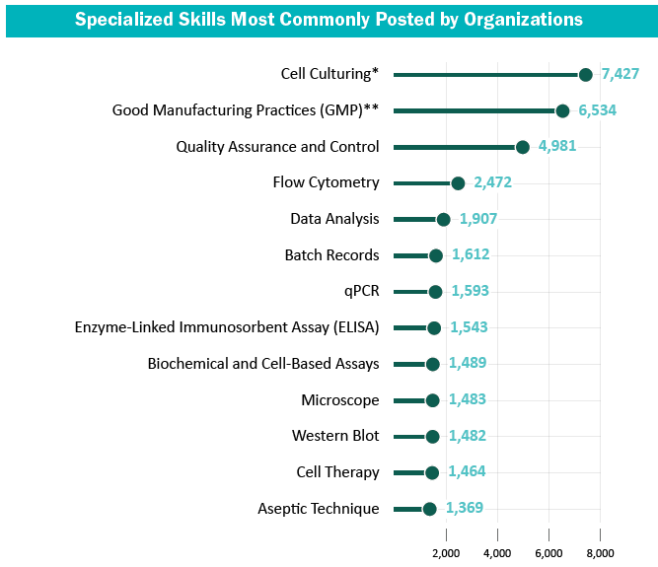
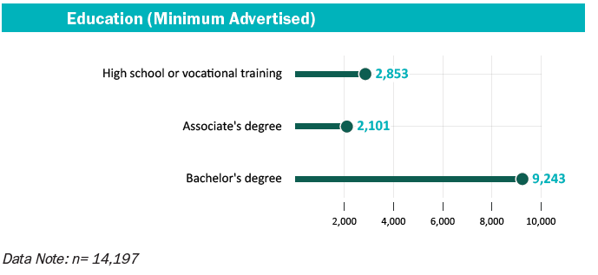
What are employers looking for?

Slide 22
Follow up report coming soon: How to link community college science courses to the skills needed for Cell & Immunotherapy Technician Jobs
Report details
Guidance on how colleges and universities can nimbly develop cell and immunotherapy technician training programs.
Does not recommend developing cell and immunotherapy specific Skills Standards.
Will be released next month.
Contents to include
How to combine existing STEM courses and short certificates to create pathways into cell and immunotherapy jobs.
How to engage with local industry.
Case study – UW Bothell Biotechnology center.

Slide 23
5. Kit Loan program

Slide 24
Kit Loan program
Program dates back to ~2005. Initially as a partnership from Amgen. Offerings expanded with NSF ATE funds to include Cancer Biology and Biomanufacturing.
Goal – expand student interest in pursuing biotechnology carers through hands-on lab activities in high school classrooms
Curriculum, consumables, manipulables, equipment and wetware.
Professional development (workshops).
Relied on a dedicated staff member to manager program. Funding ran out for that position.
Currently handing over all kits apart from Biomanufacturing to Fred Hutch Cancer Center Strategic Education Partnership team. SCC will continue to offer Biomanufacturing kit.

Slide 25
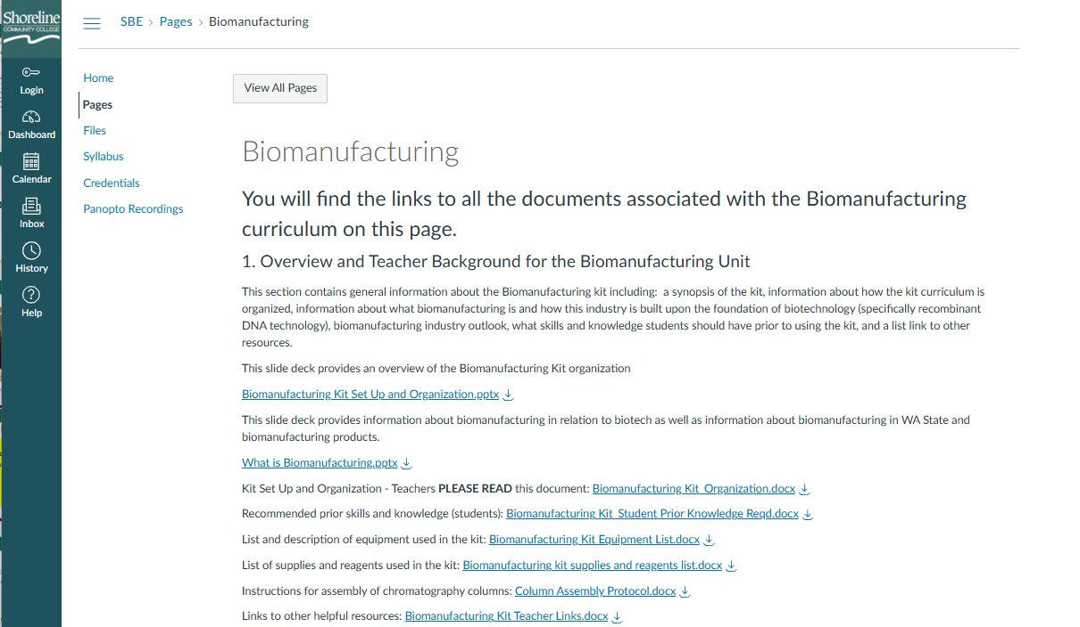
Biomanufacturing kit
Biomanufacturing kit developed as part of ATE grant. Will be retained at SCC.
Modules guide students through simulated onboarding as a biomanufacturing technician extracting and preparing GFP protein. Focus on skills like documentation and QC.
Email Biomanufacturing@shoreline.edu if you are interested in getting access to the materials. Will be published soon - ideas for where? Let me know.

Slide 26
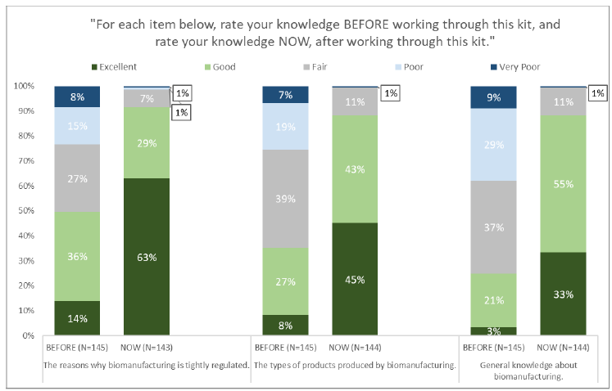
Evaluation data
Evaluation of “Establishing a Hub to Support Education of Biomanufacturing Technicians in Cell Therapy and Immunotherapy”: Grant Year 2023-2024
Adam McKee, J. Michael Schiwart, and Azdren Coma

Slide 27
Some lessons learned
For teacher’s we served primary benefit was saving time not providing missing expertise.
Build it and they will come approach will only ever reach those least in need of support.
Need to actively build out recruitment pipeline e.g. ensure that program faculty visit HS classrooms.

Slide 28
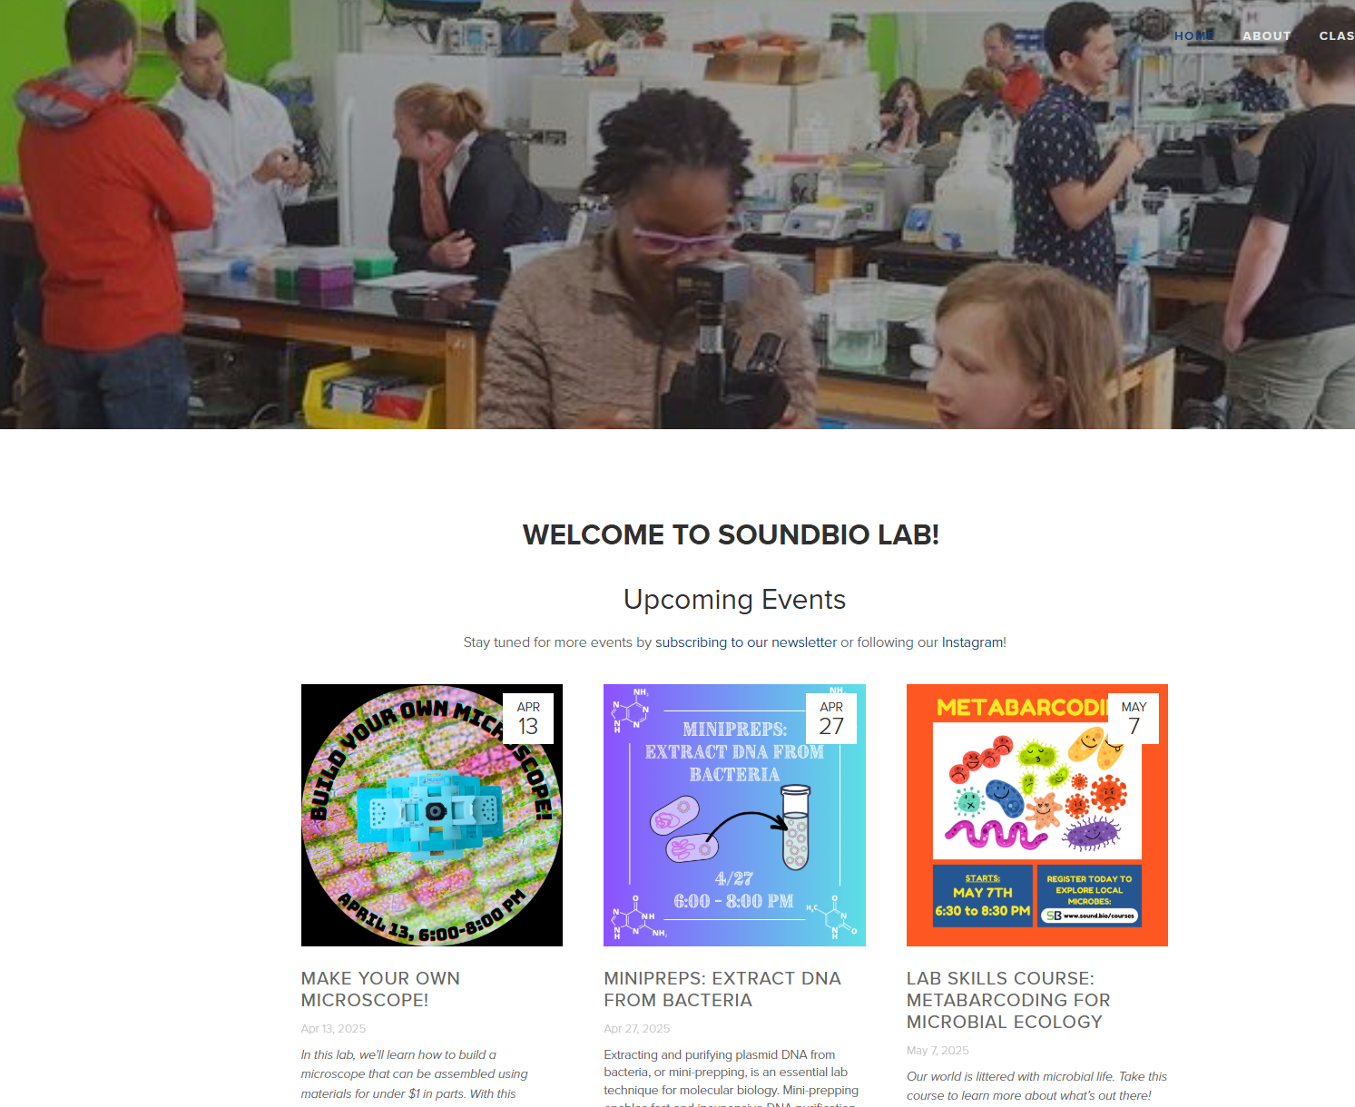
Related venture: Partnering with a local Biotechnology education space
SoundBio Lab - Biotechnology education accessible across ages and with no pre-reqs. One-off workshops and courses.
Partnering to offer a Biomanufacturing course in 2025 – goal of driving enrollment in SCC Biotechnology and Biomanufacturing programs.
Goal is to leverage their outreach work to boost our enrollment, so that we can focus on teaching, and in turn we can share our expertise and host visits.

Slide 29
6. Biomanufacturing certificate

Slide 30
Overview
No degree or science background required
Length of study: 10 weeks (1 quarter, 8 credits)
Paired with a paid internship with local biomanufacturing company (Pfizer, BMS, Sana Biotechnology)
Not specifically a product of ATE grant but has been grown alongside (launched in 2021).

Slide 31
Recent developments
Curriculum enhanced in 2023-4 to focus majority of student time on hands-on lab skills.
Thanks to new dedicated training space students go through airlocked gowning to enter classroom.
I-BEST (Team-teaching) piloted in Winter 2024. Expanding access particularly for ESL students.
Integration of mammalian cell culture skills into training (in progress).

Slide 32
Lessons learned and next steps
Having the classes be taught by Biomanufacturing industry professionals has enriched instruction and can succeed with close attention and support from full-time faculty.
Formal integration of paid internship into offerings not only attracts students but ensures close communication with industry and attention to their needs, and ensures they are bought in and engaged.
Our next steps: Solidify I-BEST model and complete integration of mammalian cell culture skills integration.

Slide 33
Want to join us to learn and collaborate?
We are looking to host folks at Shoreline later this year for a modest 2-3 day symposium focused on Biomanufacturing.
Focus on our region (Pacific Northwest) but others welcome.
What would you want to do / learn about?

Slide 34
Questions?
Thank you!

