Slide 1

Solar Cell Optics

Slide 2
Outline
What is Light?
Light Absorption
Interaction of Light with Matter
Reflection/Refraction
Fabry Perot resonances
Waveguiding
Diffraction / Photonic Crystals
Plasmonics
Mie Scattering

Slide 3
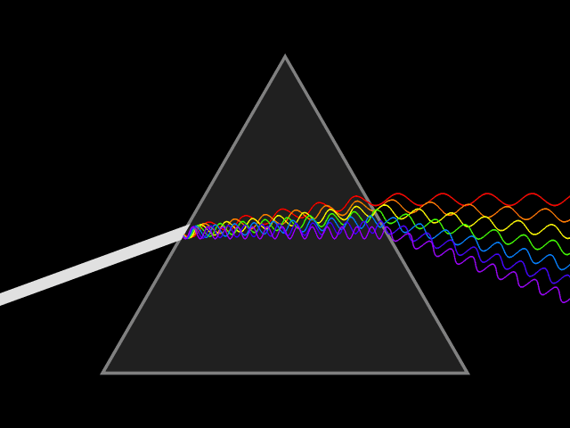
What is Light?
Fig. 1
Light: Electromagnetic wave radiation
- Fig. 1 taken from Wikipedia: http://en.wikipedia.org/wiki/Wavelength#mediaviewer/File:Light_dispersion_conceptual_waves.gif

Slide 4
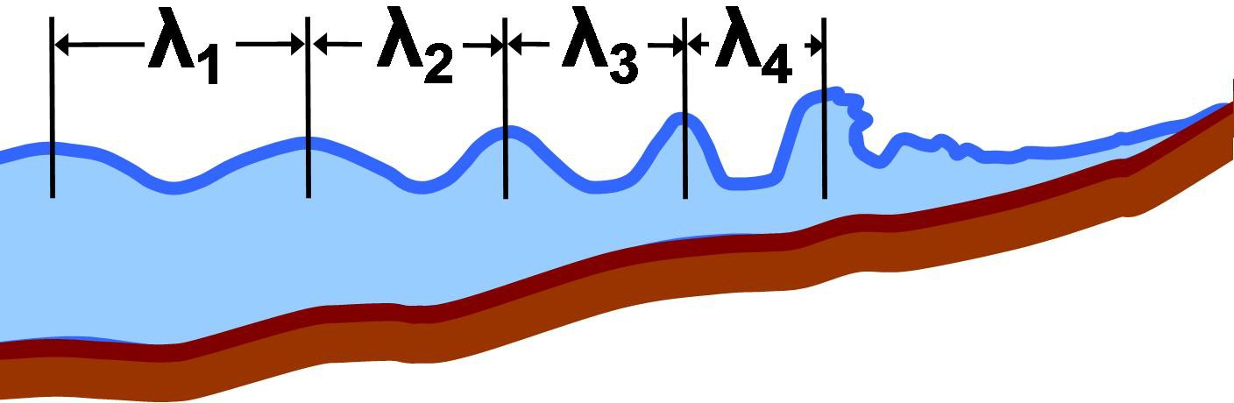
What is Light?
Fig. 2 Resemblance to ocean waves?
- Fig. 2 taken from Wikimedia: http://upload.wikimedia.org/wikipedia/commons/d/d7/Local_wavelength.JPG

Slide 5
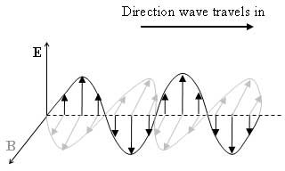
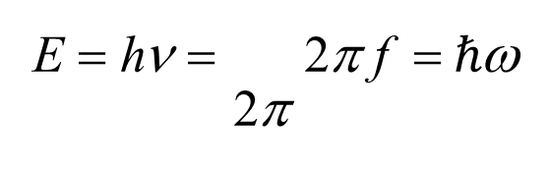
What is Light?
E: Electric field
B: Magnetic flux density c: speed of light
f, ν: frequency of light h: Planck’s constant ω: angular frequency
λ: Distance between successive peaks
f: number of cycles per second passing a fixed point
Fig. 3
λ = ^{c} = ^{c}
f ν
: wavelength
h
E = hν = 2π f = $ℏ$ω
2π
: Energy
- Fig. 3 original: http://www.sipex.aq/access/page/index.html%3Fpage=03040cd0-bfaa-102a-8ea7-0019b9ea7c60.html

Slide 6
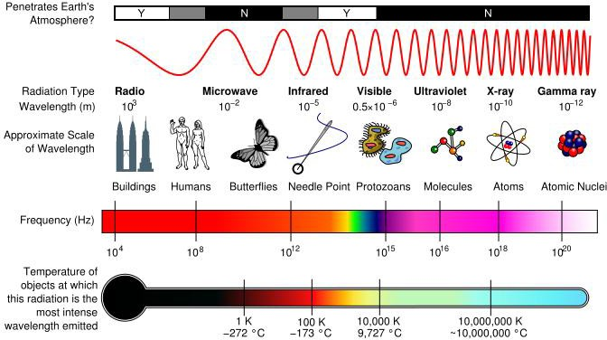
What is Light?
Fig. 4
- Fig. 4 taken from: https://wikis.engrade.com/a121biology2012/visualcommunication

Slide 7
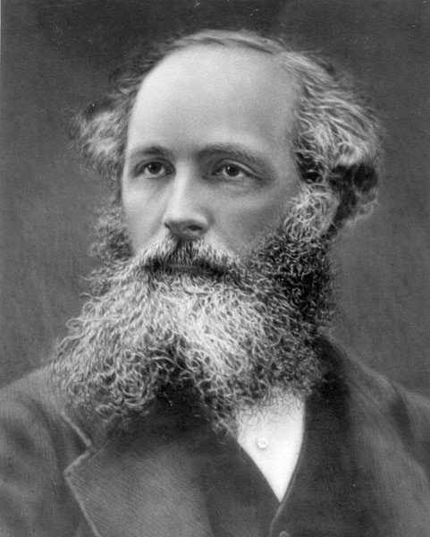







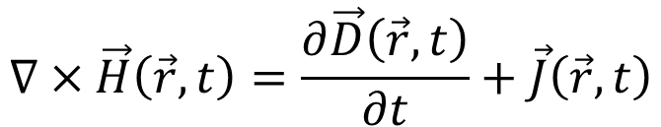
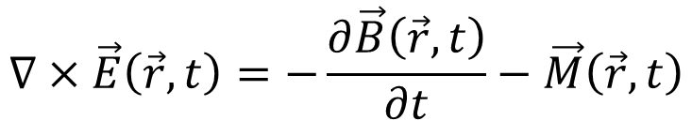
What is Light?
$$∇×\vec{E}\left(\vec{r},t\right)=−\frac{∂\vec{B}\left(\vec{r},t\right)}{∂t}−\vec{M}\left(\vec{r},t\right)$$
$$∇×\vec{H}\left(\vec{r},t\right)=\frac{∂\vec{D}\left(\vec{r},t\right)}{∂t}+\vec{J}\left(\vec{r},t\right)$$
$$∇∙\vec{B}\left(\vec{r},t\right)=ρ_{m}\left(\vec{r},t\right)$$
$$∇∙\vec{D}\left(\vec{r},t\right)=ρ_{e}\left(\vec{r},t\right)$$
Maxwell’s Equations
James Clerk Maxwell
(original image: http://www.st-andrews.ac.uk/~ulf/perfectimaging.html)
r: position (x,y,z) t: time
$$\vec{D}\left(\vec{r},t\right)=ℇ_{0}\vec{E}\left(\vec{r},t\right)+\vec{p}$$
$$\vec{D}\left(\vec{r},t\right)=ℇ_{0}ℇ_{r}\vec{E}\left(\vec{r},t\right)$$
: Light in bulk, homogenous, isotropic media
$$\vec{B}\left(\vec{r},t\right)=μ_{0}\vec{H}\left(\vec{r},t\right)+\vec{m}$$
$$\vec{B}\left(\vec{r},t\right)=μ_{0}μ_{r}\vec{H}\left(\vec{r},t\right)$$

Slide 8
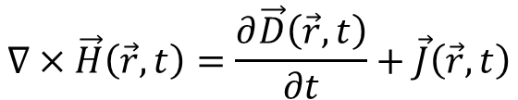

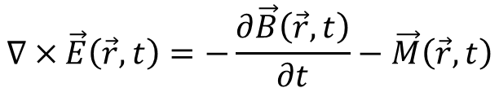



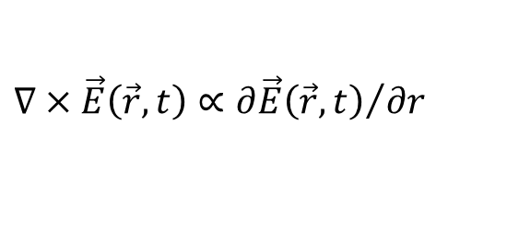

What is Light?
z
c
$$∇×\vec{E}\left(\vec{r},t\right)=−\frac{∂\vec{B}\left(\vec{r},t\right)}{∂t}−\vec{M}\left(\vec{r},t\right)$$
ε_{r} = μ_{r} = 1
$$∇×\vec{H}\left(\vec{r},t\right)=\frac{∂\vec{D}\left(\vec{r},t\right)}{∂t}+\vec{J}\left(\vec{r},t\right)$$
c
c
$$∇∙\vec{B}\left(\vec{r},t\right)=ρ_{m}\left(\vec{r},t\right)$$
y
$$∇∙\vec{D}\left(\vec{r},t\right)=ρ_{e}\left(\vec{r},t\right)$$
x
Simplest example: vacuum
Maxwell’s Equations
: Harmonic, monochromatic fields
$$\overline{F}\left(r, t\right)=Re\left[\overline{F}\left(r\right)e^{jωt}\right]$$
Tip
$$\vec{E}\left(\vec{r},t\right)=Re\left\{E_{0}e^{jωt}e^{−j\vec{k}∙\vec{r}}\right\}$$
: E-field (V/m)
$$∇×\vec{E}\left(\vec{r}, t\right)∝{∂\vec{E}\left(\vec{r},t\right)}/{∂r}$$
$$I\left(\vec{r}\right)=E_{0}^{2}$$
: Intensity (V²/m²)

Slide 9
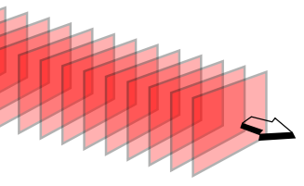
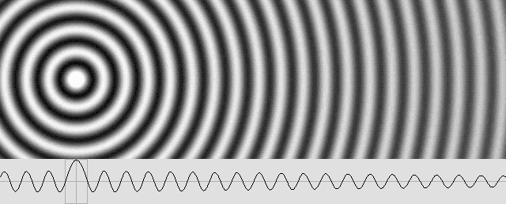




What is light?
$$\vec{E}\left(\vec{r},t\right)=Re\left\{E_{0}e^{jωt}e^{−j\vec{k}∙\vec{r}}\right\}$$
$$\vec{E}\left(\vec{r},t\right)=E_{0}\cos\left(\vec{k}∙\vec{r}−ωt\right)$$
$$I\left(\vec{r}\right)=E_{0}^{2}$$
$$\vec{k}∙\vec{r}−ωt$$
: Phase term
E
H
Plane waves (planar wavefronts)
k: wave vector
k
k
Fig. 5
k
Fig. 6
Fig. 5 original: http://upload.wikimedia.org/wikipedia/commons/2/20/Plane_wave_wavefronts_3D.svg
Fig. 6 original: http://www.mysearch.org.uk/website3/html/12%20The%20Electron%20Phase%20Shift.htm

Slide 10
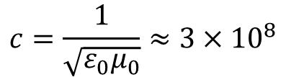


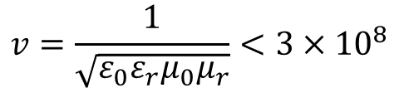
What is Light?
$$k=\frac{ω}{c}=\frac{2π}{λ}$$
: Dispersion relation (ω-k) for plane wave in free space
$$c=\frac{1}{\sqrt{ε_{0}μ_{0}}}≈3×{10}^{8}$$
: speed of light in free space
$$v=\frac{1}{\sqrt{ε_{0}ε_{r}μ_{0}μ_{r}}}<3×{10}^{8}$$
: phase velocity in a medium with ε_{r} or μ_{r} >1
$$\sqrt{ε_{r}μ_{r}}=n\sim \sqrt{ε_{r}}$$
: refractive index of the medium

Slide 11

What is Light?
ω (rad Hz)
air line ε_{r}=1
$$k=\frac{ω}{c}=\frac{2π}{λ}$$
ZnO line ε_{r}≈4
aSi:H line ε_{r}≈16
k (rad/m)
Dispersion lines in bulk material

Slide 12



What is Light?
z
k
x
Spatial domain
λ

Slide 13




What is Light?
k_{z}
IFC :any kx, kz inside
the circule is available
ksinθ
k
$$k=\frac{ω}{c}=\frac{2π}{λ}$$
θ
k_{x}
k-space

Slide 14
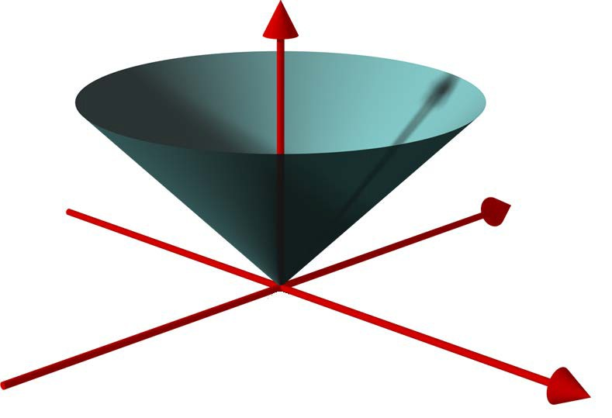




What is Light?
E or ω
$$k=\frac{ω}{c}=\frac{2π}{λ}$$
$$E=ℏω$$
ω₂
k_{x}
ω₁
Fig. 7
k_{z}
- Fig. 7 original: http://upload.wikimedia.org/wikipedia/commons/7/72/DoubleCone.png

Slide 15
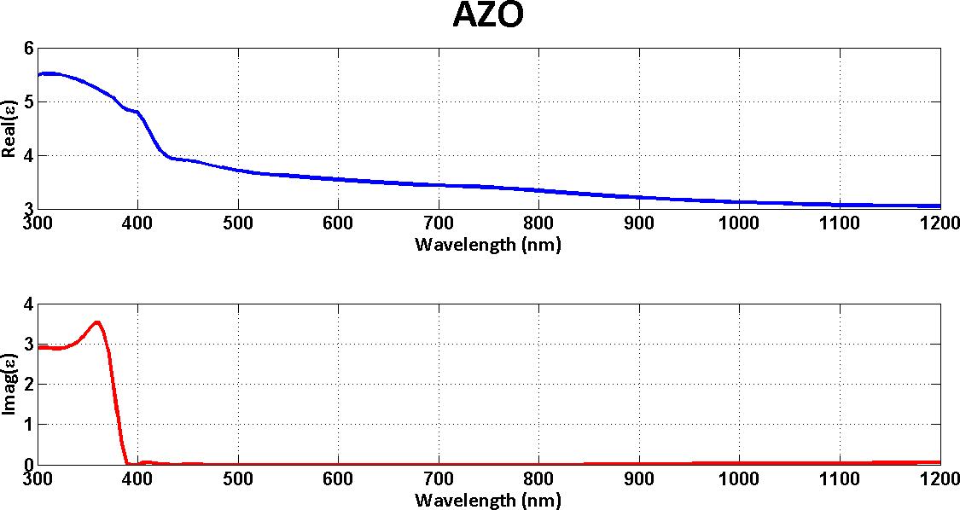


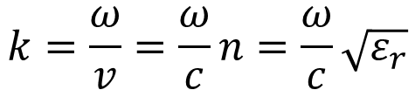

Light Absorption
$$\vec{E}\left(\vec{r},t\right)=Re\left\{E_{0}e^{jωt}e^{−j\vec{k}∙\vec{r}}\right\}$$
$$k=\frac{ω}{v}=\frac{ω}{c}n=\frac{ω}{c}\sqrt{ε_{r}}$$
: What if ε is complex ?
$$I\left(\vec{r}\right)=E_{0}^{2}$$
r
$$\sqrt{ε_{r}}=\sqrt{ε_{real}−{jε}_{imag}}=n^{′}−jk′$$

Slide 16






Light Absorption
Let us assume propagation
along x
$$\vec{E}\left(\vec{r},t\right)=Re\left\{E_{0}e^{jωt}e^{−j\vec{k}∙\vec{r}}\right\}$$
$$\vec{k}∙\vec{r}⟹\frac{ω}{c}n×x=\frac{2π}{λ}\left(n^{′}−jk′\right)x$$
$$I\left(\vec{r}\right)=E_{0}^{2}$$
$$\vec{E}\left(\vec{r},t\right)=Re\left\{E_{0}e^{jωt}e^{−j\vec{k}∙\vec{r}}\right\}=Re\left\{E_{0}e^{jωt}e^{−j\frac{2π}{λ}\left(n^{′}−jk^{′}\right)x}\right\}$$
$$\vec{E}\left(\vec{r},t\right)=Re\left\{E_{0}e^{jωt}e^{−j\frac{2π}{λ}n^{′}}e^{−\frac{2π}{λ}k^{′}x}\right\}$$
$$I\left(\vec{r}\right)=E_{0}^{2}e^{−\frac{4π}{λ}k^{′}x}=E_{0}^{2}e^{−αx}$$

Slide 17

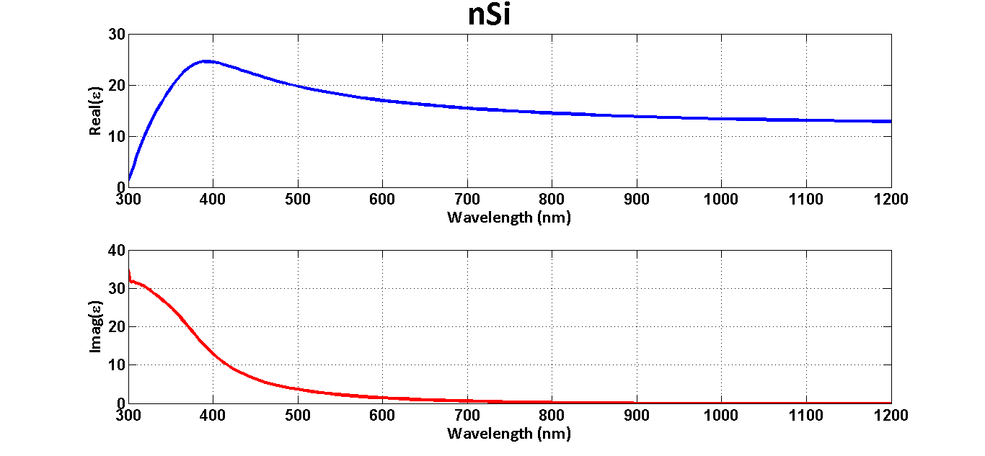
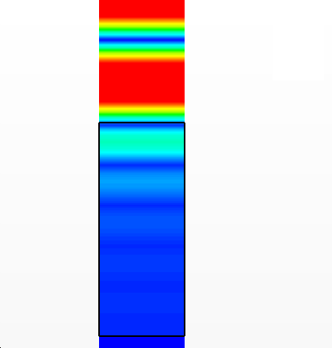
Light Absorption
light
Intensity
− ^{4π} k ' x
_{= E} 2_{e}−α x
I (x) = E ²e
λ
0
0
x

Slide 18
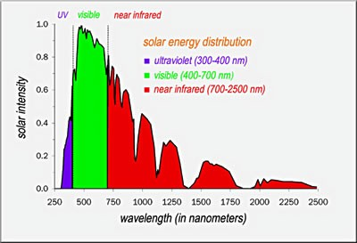


Light Absorption
A(λ) = 1− R(λ) − T (λ)
light
R
φ(λ)
Intensity
Fig. 8
- Fig. 8 taken from: http://solarjourneyusa.com/sunlight.php
cut −off
∫
300nm
J_{sc} ∝
A(λ)ϕ(λ)d λ
: short-circuit
current (mA/cm )
2
x
T

Slide 19
Interaction of Light with Matter Reflection/Refraction
I R
θ
Tangential components
I R
ε₁
boundary
x
ε₂
T
T
_{E = E e} jωt_{e}− jk₁ sinθ x _{, E}
I 0
E_{I} + E_{R} = E_{T}
_{= rE e} jωt_{e}− jk₁ sin φ x _{, E = tE e} jωt_{e}− jk₂ sin ϕ x
0 T 0
R
E₀e e
jωt − jk sinθ x
jωt − jk sin φ x jωt
jk sin ϕ x
1
rE₀e e = tE₀e e
1
2
Must be satisfied for all r and t

Slide 20
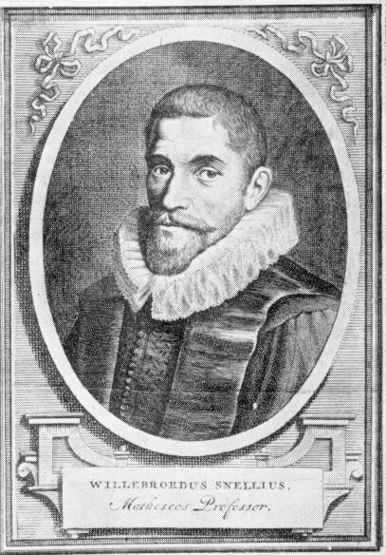
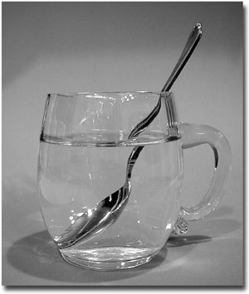
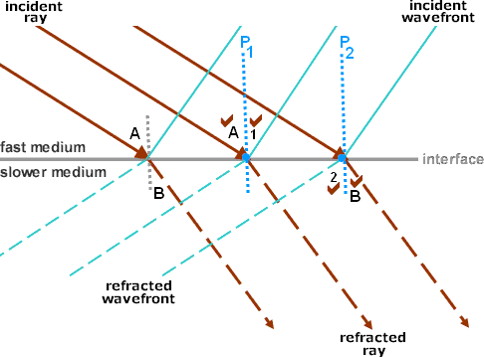
Interaction of Light with Matter Reflection/Refraction
k₁ sinθ = k₁ sin φ = k₂ sin ϕ ⇒ θ = φ
⇒ ^{ω} n sinθ = ^{ω} n sin ϕ ⇒ n sinθ = n sin ϕ
1 2 1 2
c c
Fig. 9 Fig. 10
Fig. 11
Fig. 9 taken from: http://en.wikipedia.org/wiki/Willebrord_Snellius#mediaviewer/File:Willebrord_Snellius.jpg
Fig. 10 taken from: http://mathforum.org/mathimages/index.php/Snell's_Law
Fig. 11 taken from: http://dev.physicslab.org/Document.aspx?doctype=3&filename=GeometricOptics_SnellsLawDerivation.xml

Slide 21
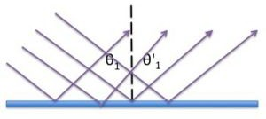
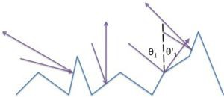
Interaction of Light with Matter Reflection/Refraction
Specular Reflection | Diffuse Reflection
Fig. 12
Fig. 13
- Fig. 12 and 13 taken from: http://mathforum.org/mathimages/index.php/Snell's_Law

Slide 22
Interaction of Light with Matter Reflection/Refraction
Understanding Refraction with IFCs k_{z}
Construction line
Fast medium (ε₁)
θ
k = ^{ω} n
1 1
c
k_{x}
k-space
Slow medium (ε₂)
φ
k = ^{ω} n
k₁: incident wave k₂: refracted wave
2 2
c

Slide 23
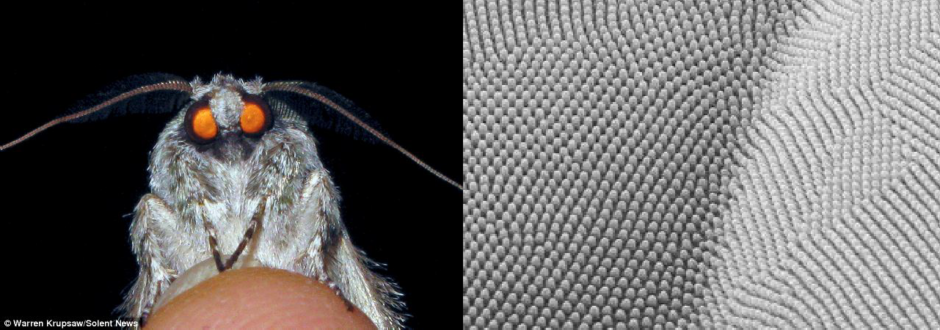
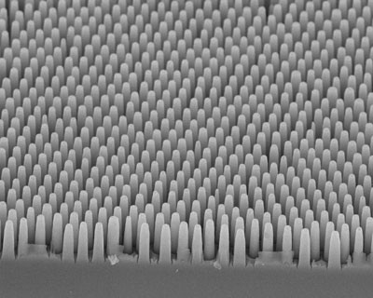
Interaction of Light with Matter Reflection/Refraction
Fig. 14
Fig. 15
Moth’s eye under SEM
Fig. 16 Designs inspired from
moth’s eye
Fig. 14 taken from: http://www.dailymail.co.uk/news/article-2195134/Americas-MOTH-model--Winged-insects-pose-tip-finger-stunning-close-ups.html
Fig 15 and 16 taken from: http://www.nanowerk.com/spotlight/spotid=7938.php

Slide 24



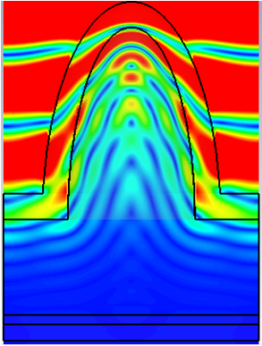
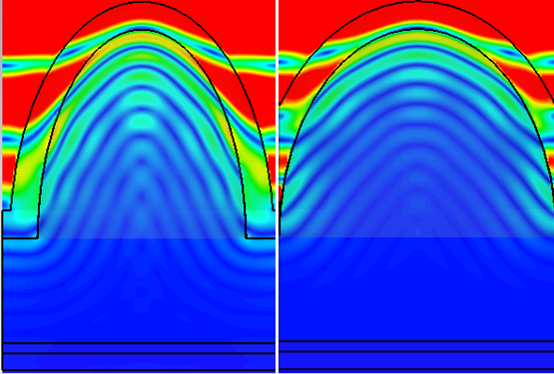





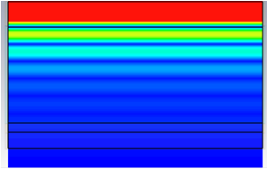
Interaction of Light with Matter Reflection/Refraction
Fig. 17
Thin TCO
scattering
nanolensing (wavefront shaping)
absorber
Same thickness
absorber
absorber
absorber
Flat case Nanodomes/Nanolenses
- Fig. 17 taken from: http://cnx.org/contents/031da8d3-b525-429c-80cf-6c8ed997733a@8.8:204/College_Physics

Slide 25













Interaction of Light with Matter Fabry Perot Resonances
$$1−E_{0}e^{−jk_{1}x}\underset{→}{ x=0 }E_{0}$$
$$2−r_{1}E_{0}e^{+jk_{1}x}\underset{→}{ x=0 }r_{1}E_{0}$$
1
2
6
ε₁
$$3−t_{1}E_{0}e^{−jk_{2}x}\underset{→}{ x=0 }t_{1}E_{0}$$
x=0 _{ε}
2
$$3′−t_{1}E_{0}\underset{→}{ t }t_{1}E_{0}e^{−jk_{2}t}$$
3
4’
7
t
$$4−r_{2}t_{1}E_{0}e^{−jk_{2}t}$$
$$5−t_{2}t_{1}E_{0}e^{−jk_{2}t}$$
3’
4
x=t
ε₁
$$4′−{r_{2}t}_{1}E_{0}e^{−jk_{2}t}\underset{→}{ −t }r_{2}t_{1}E_{0}e^{−jk_{2}t}e^{+jk_{2}\left(−t\right)}$$
5
$$6−{t_{2}r_{2}t}_{1}E_{0}e^{−2jk_{2}t}$$
Total R: 2+6+…
$$7−{r_{2}r_{2}t}_{1}E_{0}e^{−2jk_{2}t}$$

Slide 26
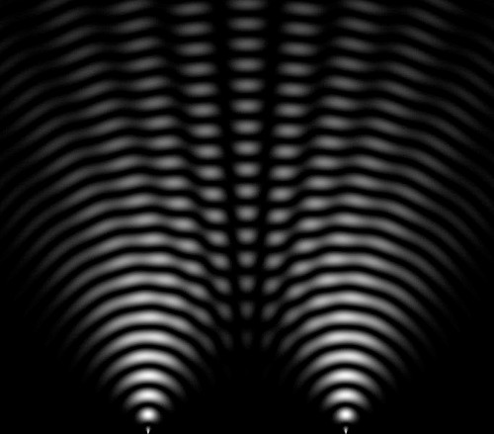
Interaction of Light with Matter Fabry Perot Resonances
Interference
−2 jk t −4 jk t
^{R}x =0 ⁼
r₁E₀ + t₂r₂t₁E₀e + t r r r t E e
+☹
2 2
2 2 2 2 1 0
Dark spots
Bright areas Fig. 18
- Fig. 18 original: http://emfsafetynetwork.org/maine-utility-admits-smart-meters-cause-interference/

Slide 27
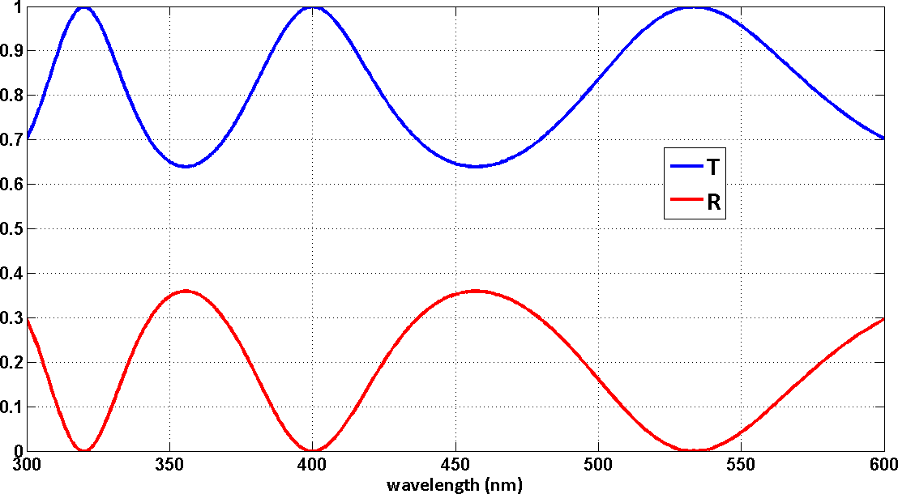
Interaction of Light with Matter Fabry Perot Resonances
320nm
_{400nm} 533.8nm
400nm
533.3nm
356nm

Slide 28

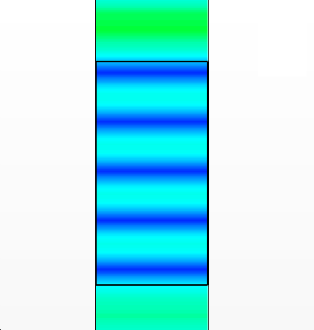
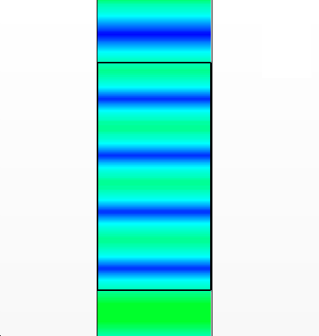

Interaction of Light with Matter Fabry Perot Resonances
356nm
400nm
No reflection
2k₂t = 2π m ⇒ λm = 2n₂t
m ⇒ integer, eg. m=0,1
Standing wave formation
t=400nm
ε =4
2
exp(− jk₂t)
exp(− jk₂t)
x

Slide 29
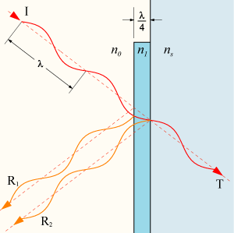
Interaction of Light with Matter Fabry Perot Resonances
Destructive interference at this boundary
Quarter wavelength matching
TCO
Fig. 19
- Fig. 19 original: http://upload.wikimedia.org/wikipedia/commons/8/8c/Optical-coating-2.png/

Slide 30
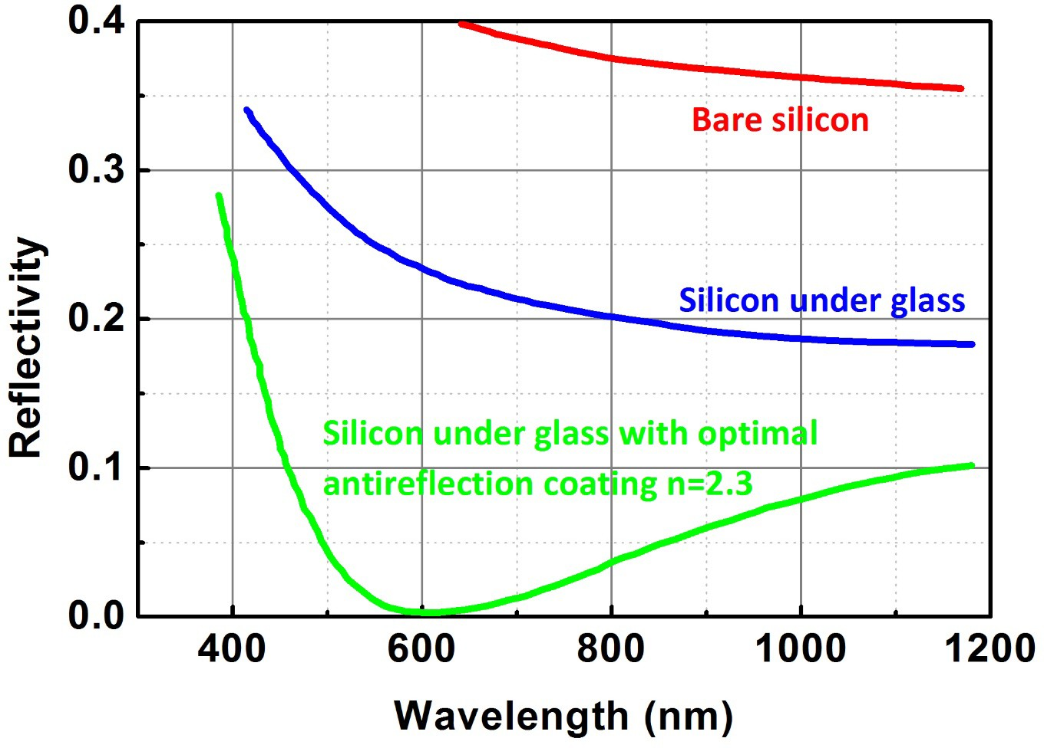
Interaction of Light with Matter Fabry Perot Resonances
Fig. 20
- Fig. 20 recreated with the data collected from: http://pveducation.org/pvcdrom/design/anti-reflection-coatings

Slide 31

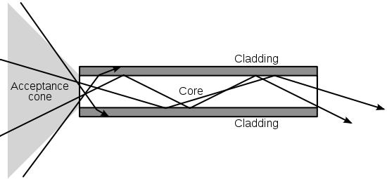

Interaction of Light with Matter Waveguiding
light
Light ?
Standing Waves inside slab
Light guiding
Fig. 21
- Fig. 21 taken from: http://photonicswiki.org/index.php?title=File:Optical-fibre.svg

Slide 32
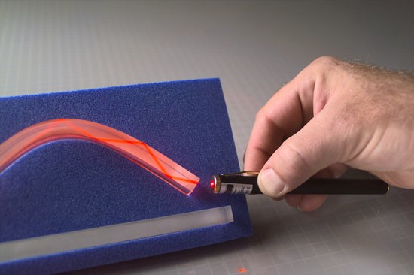
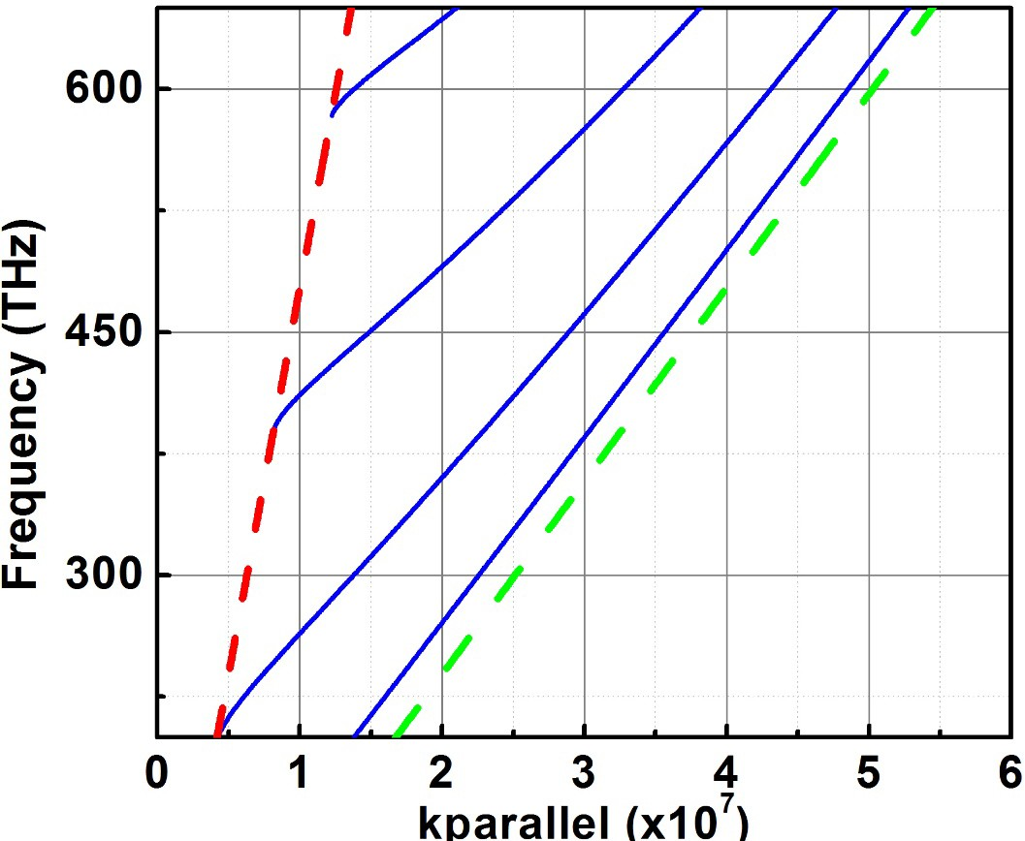
Interaction of Light with Matter Waveguiding
Fig. 22
ε₁=1
Slab (t=200nm) ε₂=16
Green: Slab cone Red: Air cone
ε₁=1
Dispersion results for a dielectric waveguide
- Fig. 22 taken from: http://i-fiberoptics.com/images/if-547-lg.jpg

Slide 33
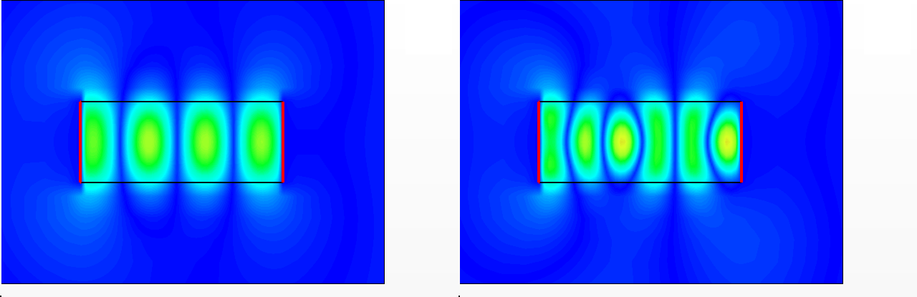
Interaction of Light with Matter Waveguiding
300 THz 450 THz
ε₁=1 ^{k}1//max ^{or k}1max
^{k}2// Slab (t=200nm)
ε₂=16
^{k}2// ^{≥ k}1// max ^{(k}1z
= 0)
^{k}2// ^{= k}1//
k ² + k
2 _{= k} 2
k ² − k
1// max
² = k ² ⇒ k : imaginary
2/ / 2 z
2
2//
1z
1z
ε₁=1

Slide 34
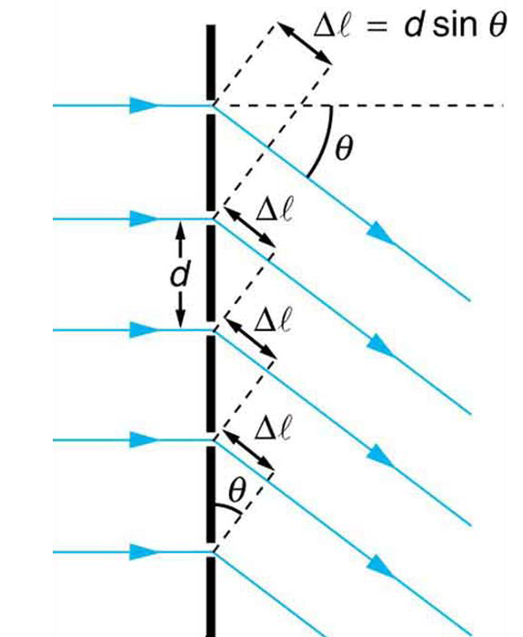
Interaction of Light with Matter Diffraction
φ₁ − φ₂ = ∇φ
∇φ = kΔ = ^{2π} Δ = 2π m
λ
Δ = d sinθ ⇒ sinθ = ^{mλ}
d
A collective action as soon as there is discontinuity along the reflection plane.
1
2

Slide 35
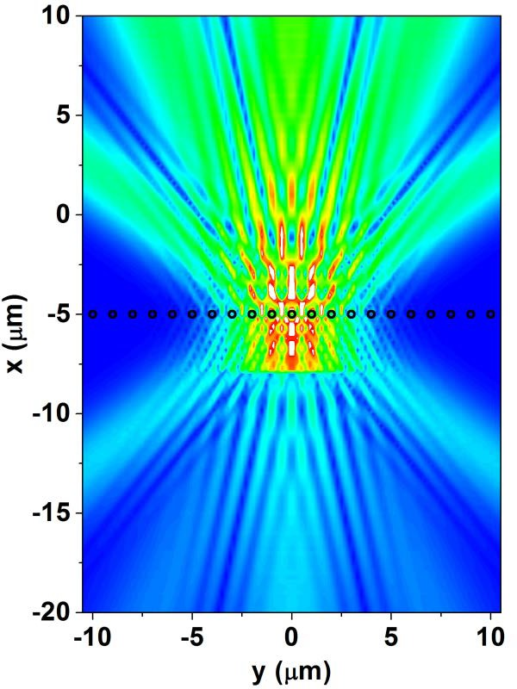
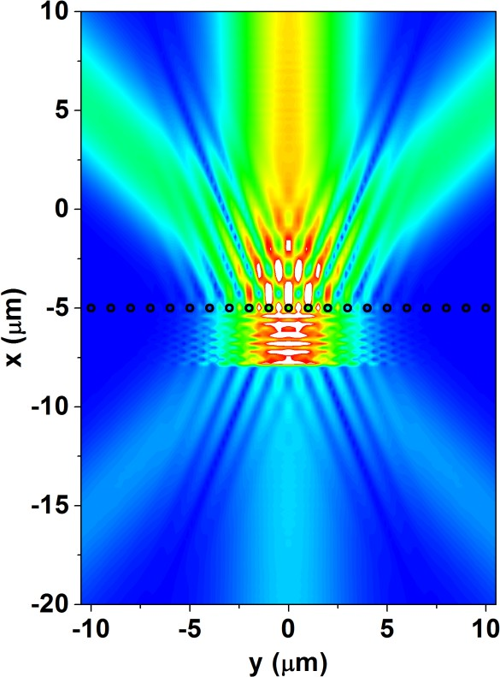
Interaction of Light with Matter
Diffraction
Outgoing modes
Far-field monitor
Light source
Reflected modes
Scatterers in air, ε=9
λ=400 nm d=1000 nm
λ=700 nm d=1000 nm

Slide 36
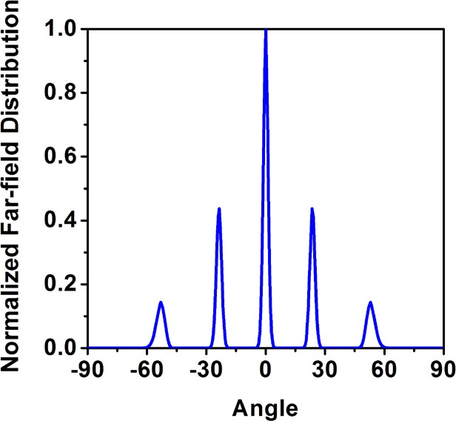
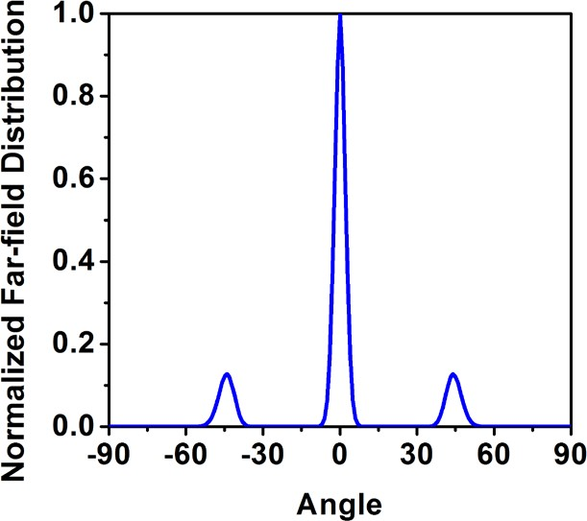
Interaction of Light with Matter Diffraction
1st order 23.5º
2nd order 53º
1st order 44º
(θ)
The higher order diffractions (1st, 2nd , etc.…) are observed at angles that obey the simple formulation λ=400 nm
d=1000 nm
(θ)
e.g. sin⁻¹(700 / 1000) = 44.42º
for +1st order diffraction
λ=700 nm d=1000 nm
** Notice the small deviations (less than 1º) between the simulation results and diffraction formula

Slide 37
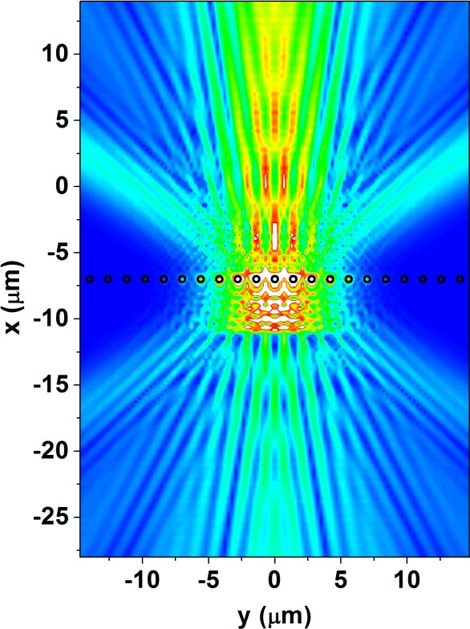
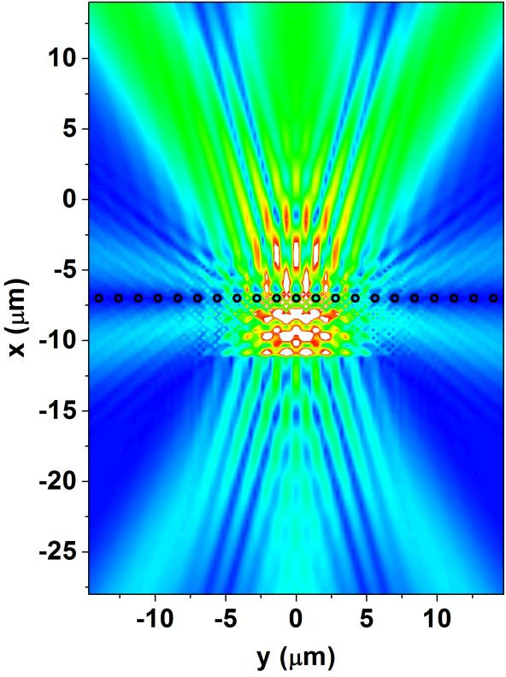
Interaction of Light with Matter Diffraction
Tangential mode
sinθ = ^{mλ}
λ=400 nm d=1400 nm
d
λ=700 nm d=1400 nm

Slide 38
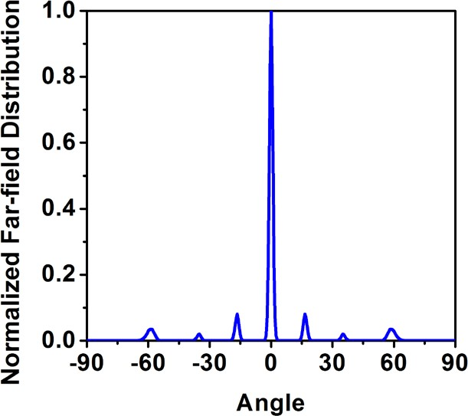

Interaction of Light with Matter Diffraction
16.5º
30º
58.5º
34.9º
(θ)
(θ)
λ=400 nm d=1400 nm
λ=700 nm d=1400 nm

Slide 39


Interaction of Light with Matter Diffraction
sinθ = ^{mλ}
λ=400 nm
d
λ=700 nm
d=500 nm
d=500 nm

Slide 40


Interaction of Light with Matter Diffraction
60º
ε₂=4
ε₁=1
Scatterers: ε=9
sinθ = ^{mλ}
λ=400 nm
n₂d
λ=700 nm
d=700 nm
d=700 nm

Slide 41
Interaction of Light with Matter Diffraction
z
Surface normal
φ₂ − φ₁ = ∇φ_{i}
∇φ = k d sin ϕ = ^{2π} n d sin ϕ
i 1
λ
1
d
d
φ
x
n₁
φ
Incoming wavefront
1
2

Slide 42


Interaction of Light with Matter Diffraction
Surface normal
1
Outgoing wavefront
2
θ
n₂
θ
d
d
x
φ₂ − φ₁ = ∇φ_{i}
φ₁ − φ₂ = ∇φ_{o}
$$∇φ_{i}=k_{1}d\sin{φ}=\frac{2π}{λ}n_{1}d\sin{φ}$$
$$∇φ_{o}=k_{2}d\sin{θ}=\frac{2π}{λ}n_{2}d\sin{θ}$$

Slide 43





Interaction of Light with Matter Diffraction
φ₁ − φ₂ = ∇φ_{o} φ₂ − φ₁ = ∇φ_{i}
$$∇φ_{o}=k_{2}d\sin{θ}=\frac{2π}{λ}n_{2}d\sin{θ}$$
$$∇φ_{i}=k_{1}d\sin{φ}=\frac{2π}{λ}n_{1}d\sin{φ}$$
∇φ_{o} − ∇φ_{i} = 2π m
k₂d sinθ − k₁d sin ϕ = 2π m
k sinθ = k sin ϕ + ^{2π m}
2 1
d
Outgoing tangential
Incoming tangential
Phase term

Slide 44

Interaction of Light with Matter Diffraction

Slide 45

Interaction of Light with Matter Diffraction

Slide 46






Interaction of Light with Matter Diffraction
λ = 700nm
θ = 30º
d = 700nm n₁ = 1
n₂ = 2
(x) 10³ nm
 | sin⁻¹(sinθ/n₂+mλ/n₂d)
0th order | 14 degrees
±1st order | (m=1) 48 degrees, (m=-1) -14 degrees
±2nd order | (m=2) NA, (m=-2) 48 degrees

Slide 47
Interaction of Light with Matter Photonic Crystals
t₁=280nm n₁=3 | t₂=520nm n₂=1 | n₁=3 | n₂=1 | n₁=3 | n₂=1 | n₁=3 | n₂=1
light
What happens if we stack layers along the propagation direction?

Slide 48

Interaction of Light with Matter Photonic Crystals
Γ
X

Slide 49


Interaction of Light with Matter Photonic Crystals
L = 1400nm
n₁ = 3
n₂ = 1
light
Square lattice
L
L
n₁
n₂

Slide 50





Interaction of Light with Matter Photonic Crystals
Periodic Dielectric Bulk Material
Function
Bulk material
$$\vec{E}\left(\vec{r},t\right)=Re\left\{E_{0}e^{jωt}e^{−j\vec{k}∙\vec{r}}\right\},k=\frac{2π}{λ}n$$
Periodic Structure
$$ε\left(\vec{r}\right)=ε\left(\vec{r}+L\right)⟶\vec{E}\left(\vec{r}\right)=\vec{E}\left(\vec{r}+L\right)$$
$$\vec{E}\left(\vec{r},t\right)=Re\left\{u\left(\vec{r}\right)e^{jωt}e^{−j\vec{k}∙\vec{r}}\right\}$$
$$u\left(\vec{r}\right)=u\left(\vec{r}+L\right),k=\frac{2π}{L}$$
Bloch Functions/Waves

Slide 51

Interaction of Light with Matter Photonic Crystals
k_{z}
π/L
M(π/L, π/L)
Irreducible Brillouin Zone
X (π/L,0)
k
x
-π/L
Γ (0,0)
π/L
Brillouin Zone
-π/L
Spatial domain -> k-space

Slide 52

Interaction of Light with Matter Photonic Crystals
1
2
3

Slide 53

Interaction of Light with Matter Photonic Crystals
λ=400 nm L=1400 nm
λ=700 nm L=1400 nm
λ=1000 nm L=1400 nm
Some inherent modes of the PC are coupled good enough to the impinging light, resulting in good transmission results.

Slide 54

Interaction of Light with Matter Plasmonics
Normally:
Metals totally reflect the incoming light
High conductivity=> Electrons react to the
incoming light, almost no penetration. At smaller wavelengths:
The electron cloud and the incoming light interact. They form SPPs.
SPP is attached to the metal, can cover long distances.
metal
Fig. 23
- Fig. 23 taken from: http://en.wikipedia.org/wiki/Surface_plasmon#mediaviewer/File:Sketch_of_surface_plasmon.png

Slide 55


Interaction of Light with Matter Plasmonics
Fig. 24
Silver as PEC
Fig. 25
SPP on Silver
- Fig. 24 and 25 taken from: http://en.wikipedia.org/wiki/Surface_plasmon_polariton

Slide 56

Interaction of Light with Matter Plasmonics
ω_{p}
ω_{p}
ε_{r}>0
ε_{r}>0

Slide 57

Interaction of Light with Matter Plasmonics
ε_{r}<0
Glass or air
Gratings
Prisms
metal

Slide 58

Interaction of Light with Matter Plasmonics
Fig. 26
- Fig. 26 taken from: https://www.thermalfluidscentral.org/encyclopedia/index.php/Surface_plasmon_(or_phonon)_polaritons

Slide 59

Interaction of Light with Matter Plasmonics / Mie Scattering
Incoming light
Localized SPR
ε(λ)
Scattering _{Q(λ) =} ⁸ ₍ ^{2π r} ₎4
ε (λ) −1
3 λ ε (λ) + 2
2
efficiency: r:radius
Fig. 27
- Fig. 27 taken from: http://eniyavaikooral.blogspot.com/search/label/%E0%AE%AE%E0%AE%B0%E0%AF%81%E0%AE%A4%E0%AF%8D%E0%AE%A4%E0%AF
%81%E0%AE%B5%E0%AE%AE%E0%AF%8D#axzz3FPFmWpJb

Slide 60

Interaction of Light with Matter Mie Scattering
Dielectric spheres

Slide 61


Interaction of Light with Matter Mie Scattering
Fig. 29
Fig. 28
Mie Resonances
r≤λ
Fig. 28 taken from: http://www.laserfocusworld.com/articles/2014/03/forming-silicon-into-microscopic-spheres-forces-it-to-absorb-infrared-light- enabling-better-photodetectors-and-solar-cells.html
Fig. 29 original at: http://www.gamedev.net/topic/642193-what-causes-light-scattering-and-absorbtion/

