Slide 1

Environmental Impacts

Slide 2




Environmental Impacts of Nanoparticles:
The Good, the Bad and the Beautiful
Dr. James Kubicki Professor of Geosciences
College of Earth and Mineral Sciences and
The Earth & Environmental Systems
Institute

Slide 3
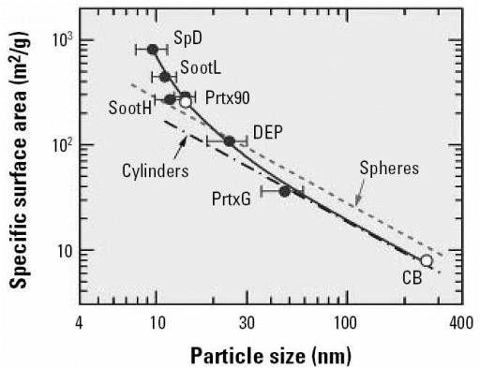
Surface area increases dramatically with size
openi.nlm.nih.gov/detailedresult.php?img=1831520_ehp0115-000187f4&req=4

Slide 4
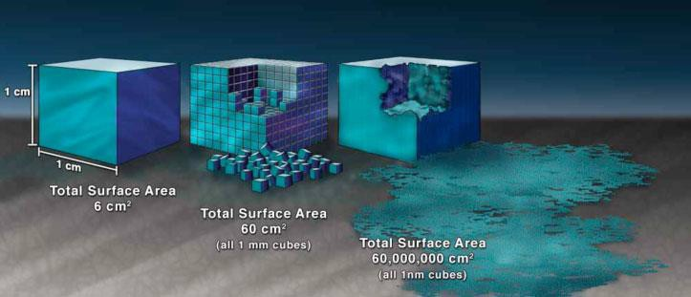
Illustration demonstrating the effect of the increased surface area provided by nanostructured materials
www.nano.gov/nanotech-101/special

Slide 5
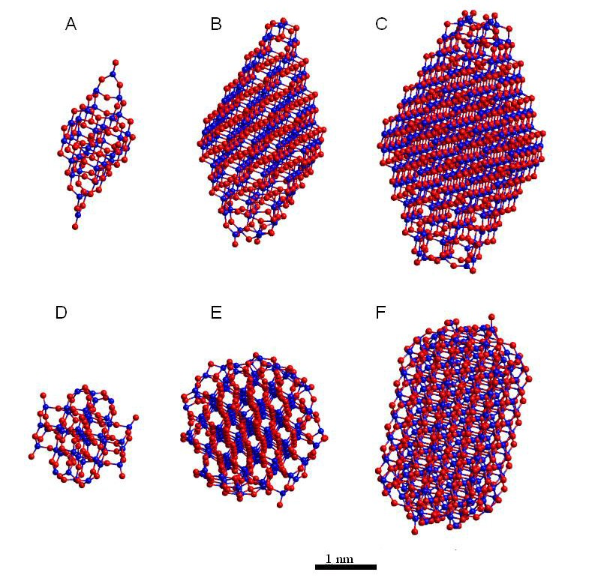
Surface chemistry changes with size
Anatase
1 nm
2 nm
3 nm
Rutile
Hummer et al., 2009, JPC C, 113, 4240-424

Slide 6
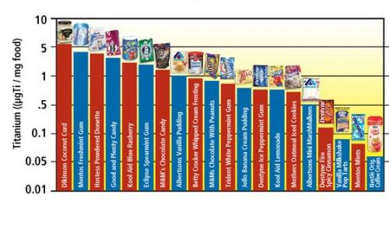
Titanium dioxide is added to a huge swath of products in nano form including paints, paper and plastics but also lends white pigment to most toothpastes and many processed foods, including Mentos, Trident and Dentyne gum, M&Ms, Betty Crocker Whipped Cream Frosting, Jello Banana Cream Pudding, Vanilla Milkshake Pop Tarts and Nestlé Original Coffee Creamer. - See more at: www.emagazine.com/magazine/eating-nano#sthash.W9agPXVz.dpuf
www.emagazine.com/magazine/eating-nano

Slide 7

Titanium dioxide is added to a huge swath of products in nano form including paints, paper and plastics but also lends white pigment to most toothpastes and many processed foods, including Mentos, Trident and Dentyne gum, M&Ms, Betty Crocker Whipped Cream Frosting, Jello Banana Cream Pudding, Vanilla Milkshake Pop Tarts and Nestlé Original Coffee Creamer. - See more at: www.emagazine.com/magazine/eating-nano#sthash.W9agPXVz.dpuf
www.emagazine.com/magazine/eating-nano

Slide 8
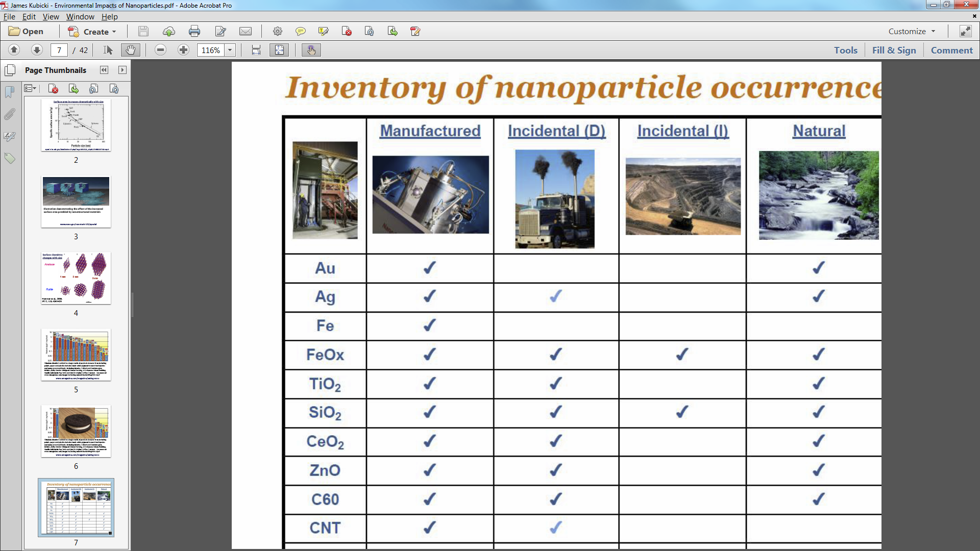

Slide 9
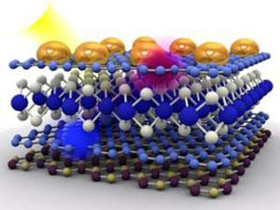
Nanoparticles in solar energy
An international team of researchers has constructed
an atom thin
photovoltaic
device with unusually high quantum efficiency – a measure of the photons converted into charge carrying electrons – of 30%.
The incredibly thin cell. Graphene (light blue); dichalcogenide (white+blue); nanoparticles (gold); boron nitride (purple+beige) © Science/AAAS
www.rsc.org/chemistryworld/2013/05/solar-panel-photovoltaic-slims-down-atom-thick-graphene

Slide 10
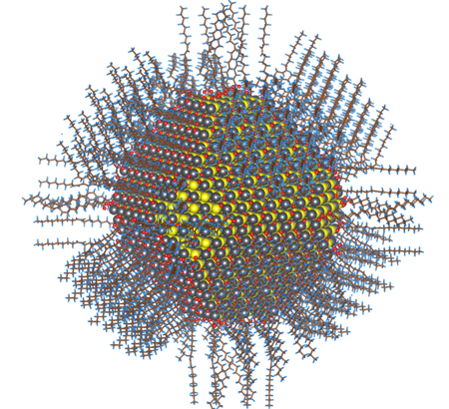
Nanoparticles in solar energy
This new form of solid, stable light-sensitive nanoparticles, called colloidal quantum dots, could lead to cheaper and more flexible solar cells, as well as better gas sensors, infrared lasers, infrared light emitting diodes and more. The work, led by post- doctoral researcher Zhijun Ning and Professor Ted Sargent, was
published this week in the journal Nature Materials.
The image shows complete atomistic model of the colloidal lead sulfide (selenide) nanoparticle also known as quantum dot.
genefan.com/news.php?item.956.11

Slide 11
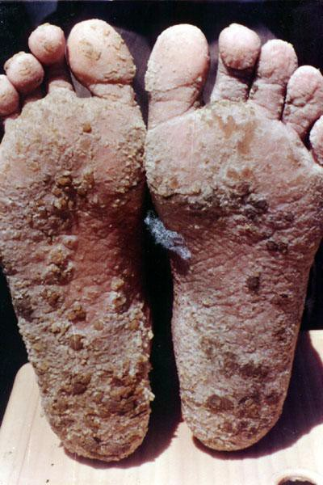
Nanoparticles used for water treatment
Extreme arsenic lesions on feet
http://phys4.harvard.edu/
%7Ewilson/arsenic/
arsenic_project_introduction.html

Slide 12
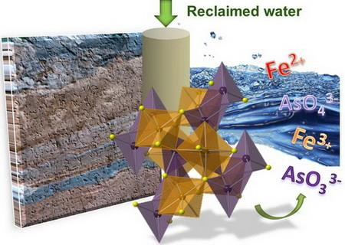
Nanoparticles of iron oxides adsorb arsenic
Neil et al., J. Environ. Monitoring, 2012, 14, 1772

Slide 13
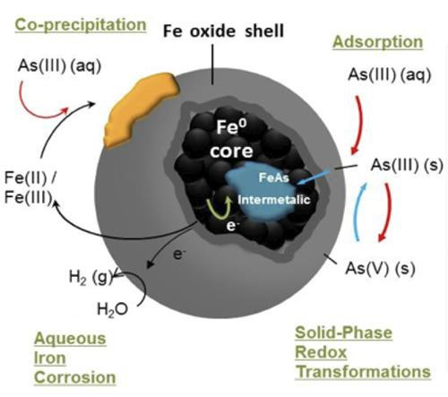
Nanoparticles of iron oxides and metal break down contaminants
Iron oxide nanoparticles can enhance iron- reducing bacteria that also reduce and immobilize uranium.
Fe metal nanoparticles are effective reductants for the dehalogenation of chlorinated solvents and reduction of Cr(VI), and also U(VI) under anoxic conditions.
www.princeton.edu/cbe/people/faculty/koel/group/research/solid-surface-structure/

Slide 14
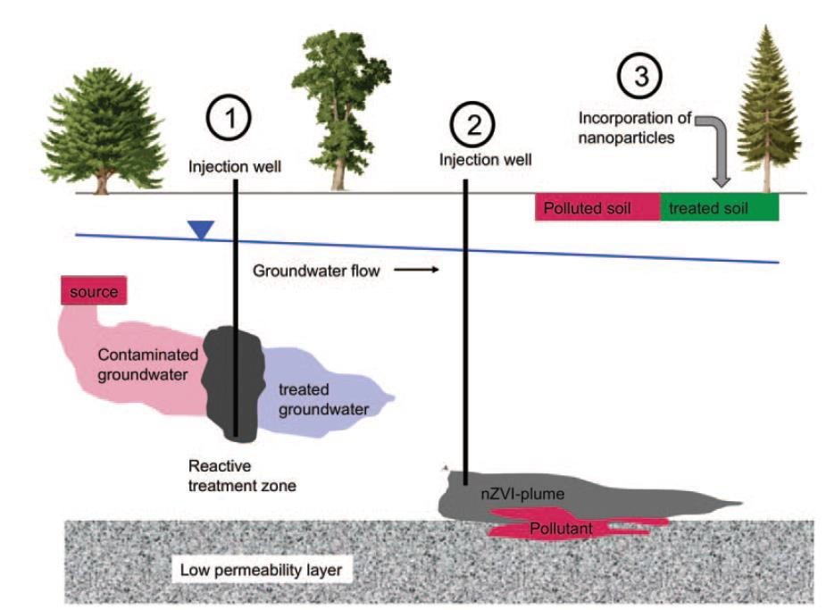
In situ technologies used to treat polluted groundwater and soils: injection of nZVI to form a reactive barrier; injection of mobile nZVI to form an nZVI plume; incorporation of NP into topsoil to adsorb or degrade pollutants
nZVI – Nano zero-valent iron (iron metal NPs) Mueller & Nowack, 2010, ELEMENTS, 6,
395–400

Slide 15
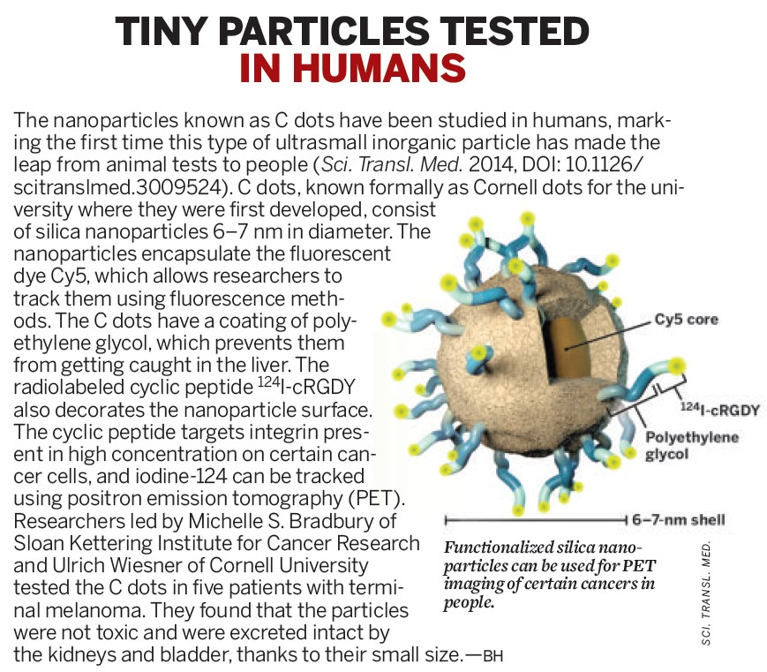
CEN.ACS.ORG NOVEMBER 3, 2014

Slide 16
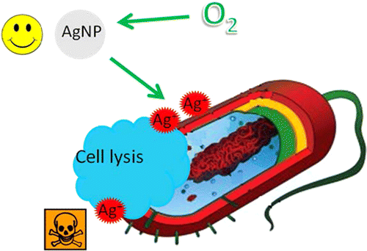
Nanoparticles of silver are anti-bacterial agents
Silver kills germs by ion emission
This work suggests that AgNP morphological properties known to affect antimicrobial activity are indirect effectors that primarily influence Ag⁺ release.
Accordingly, antibacterial activity could be controlled (and environmental impacts could be mitigated) by modulating
Ag⁺ release, possibly through manipulation of oxygen availability, particle size, shape, and/or type of coating.
Xiu et al., 2012, Nano Lett., 12, 4271–4275
DOI: 10.1021/nl301934w
nanoparticle-blog.com/

Slide 17
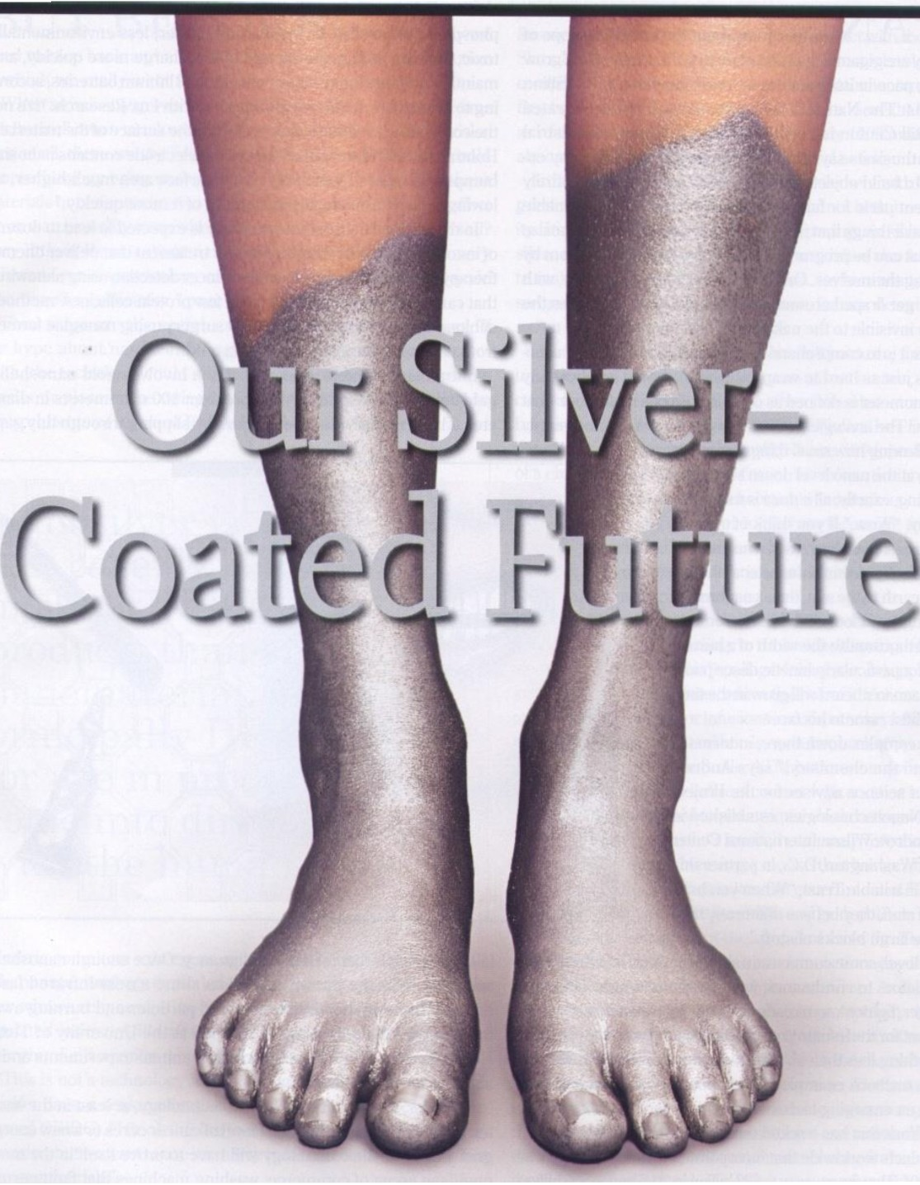
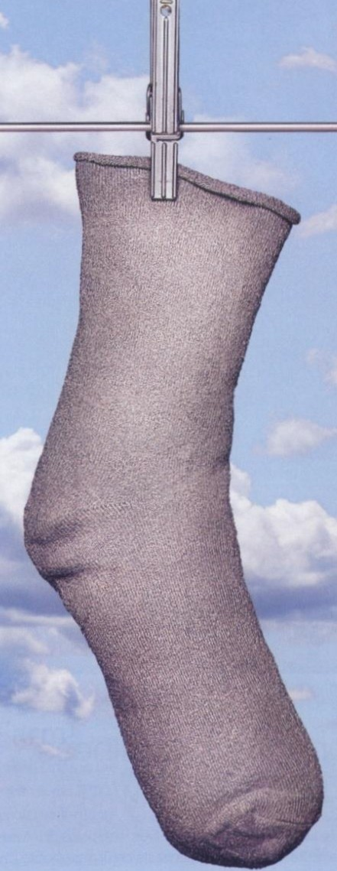
::J BY ROBIN MARANTZ HENIG
PHO TOGRAPHS BY EVA K OLENKO

Slide 18
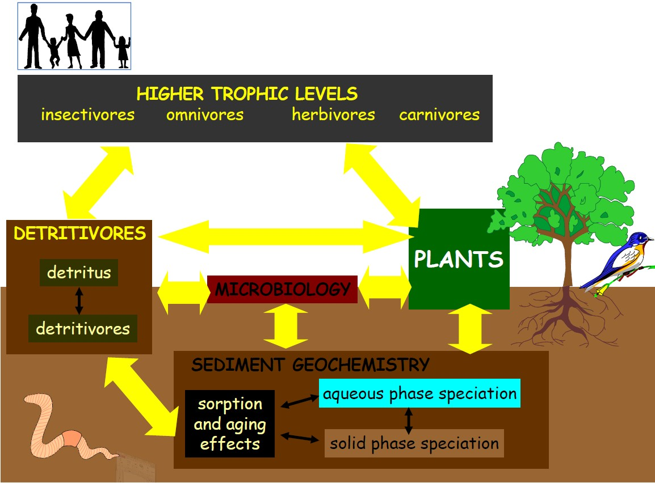
Fate, transport, and, effects of manufactured nanoparticles in the environment

Slide 19
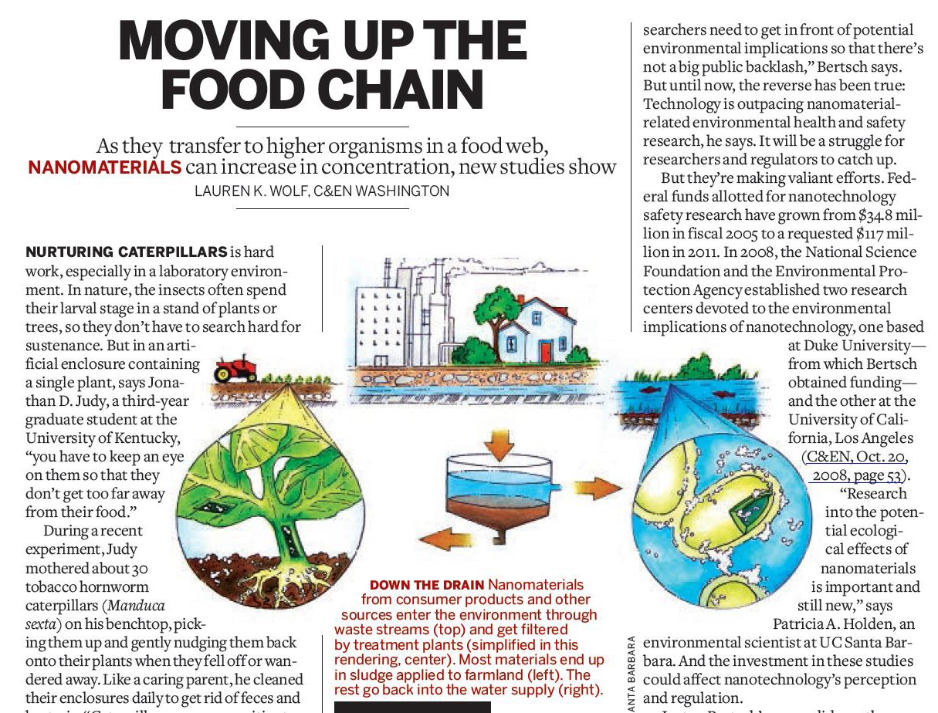
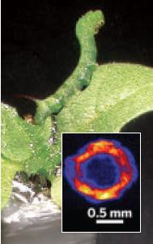
A Manduca sexta
specimen feeds in its lab enclosure. In the inset, an X-ray fluorescence map shows a caterpillar cross section with gold nanoparticles collected in the tissue surrounding its gut.
WWW.CEN-ONLINE.ORG MARCH 14, 2011

Slide 20
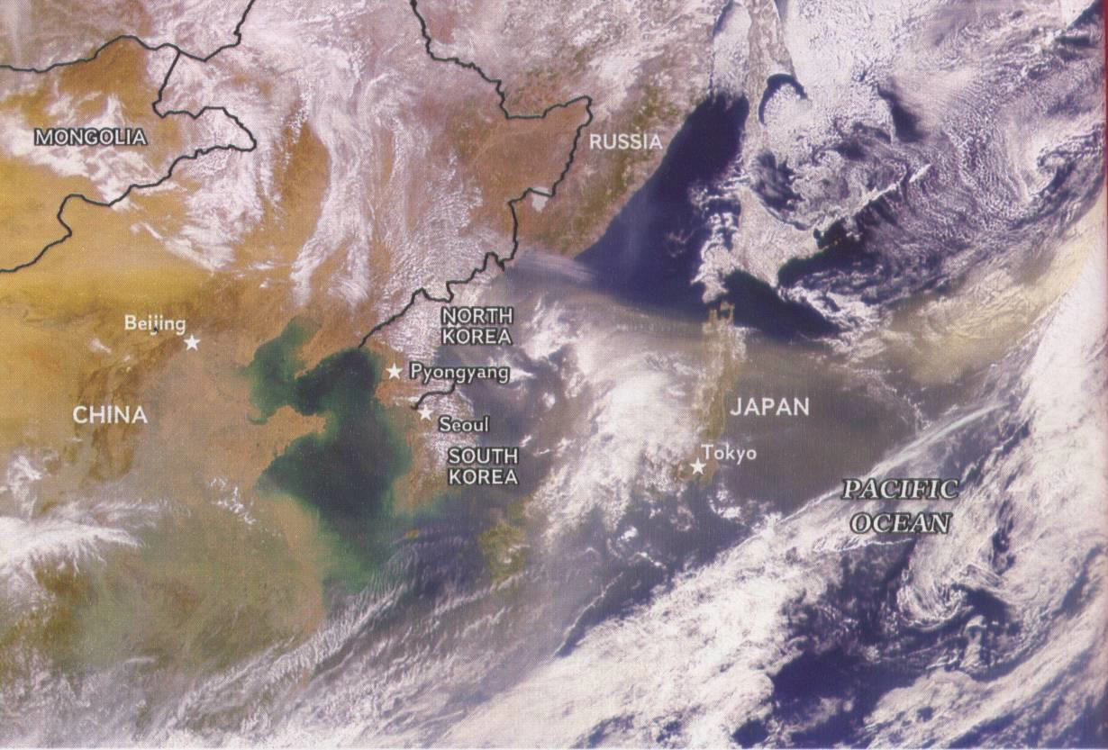
Airborne nanoparticles of mineral dust contribute to air pollution and affect climate

Slide 21


We conclude that late 20th century Sahel climate was significantly dryer than pre-industrial, and at least 30% of the drying was externally forced. Comparison between 20th century runs and runs forced by GHG alone reveals the key role of reflective aerosols: they force a gradient in SST that excites robust drying in the northern edge of the Atlantic Inter-Tropical Convergence Zone (ITCZ) and in the Sahel.

Slide 22
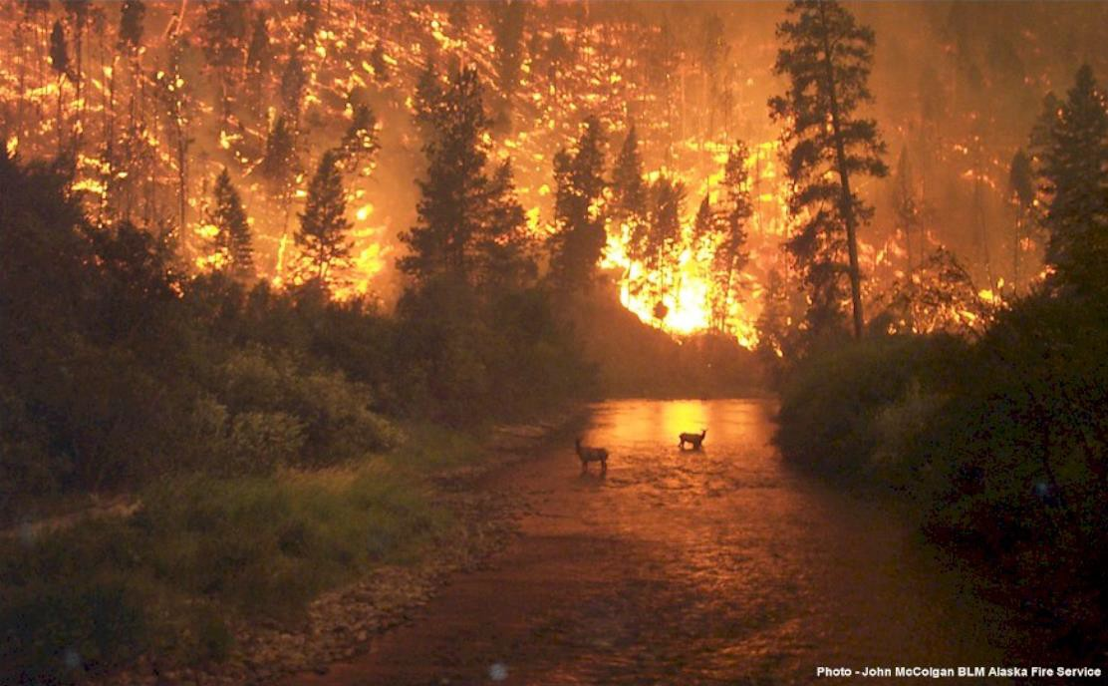
Soot or black carbon produced in fires

Slide 23
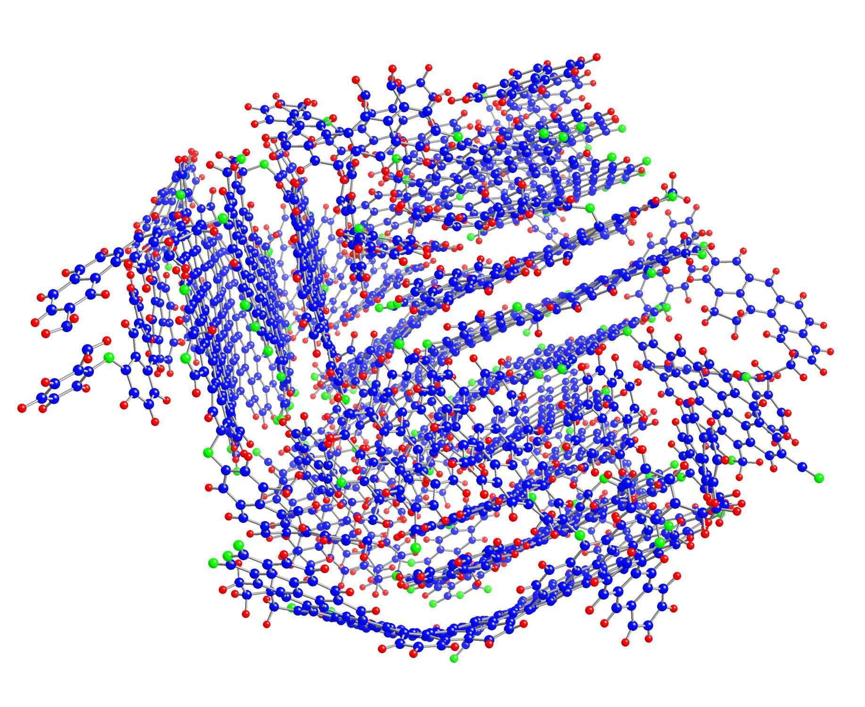
Soot serves as delivery agent for carcinogens to lungs
Compact structure and strong association of pyrene
Pyrene
Layered
48 x 40 Å
= 4.8 x 4.0 nm
Curved surface

Slide 24
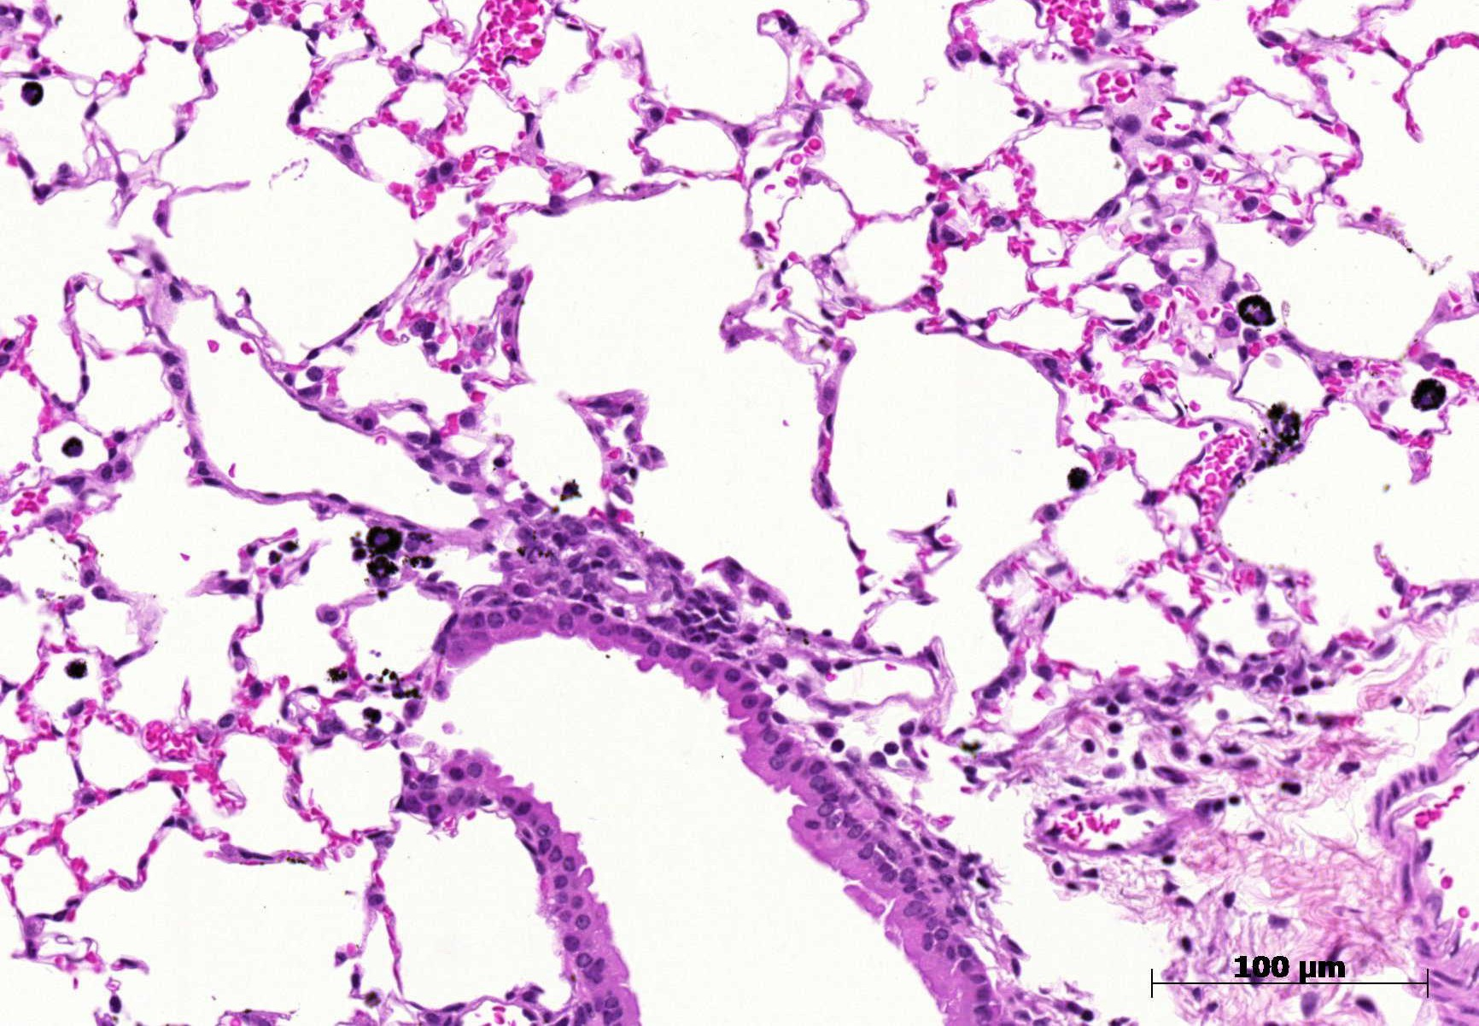
Mouse lung tissue with
carbon black particles
(ingested by macrophages)
www.item.fraunhofer.de/en/press-media/latest-news/PM_Carbon_Black.html

Slide 25
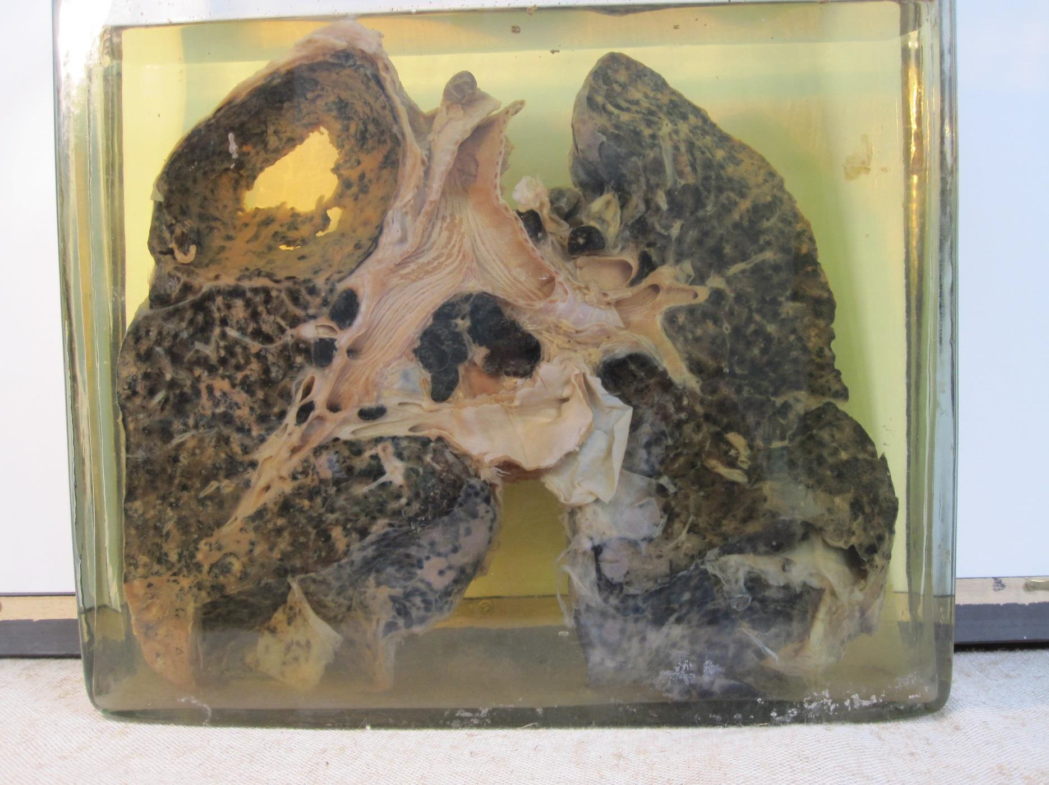
Miner's lung with silicosis and tuberculosis
en.wikipedia.org/wiki/Silicosis

Slide 26
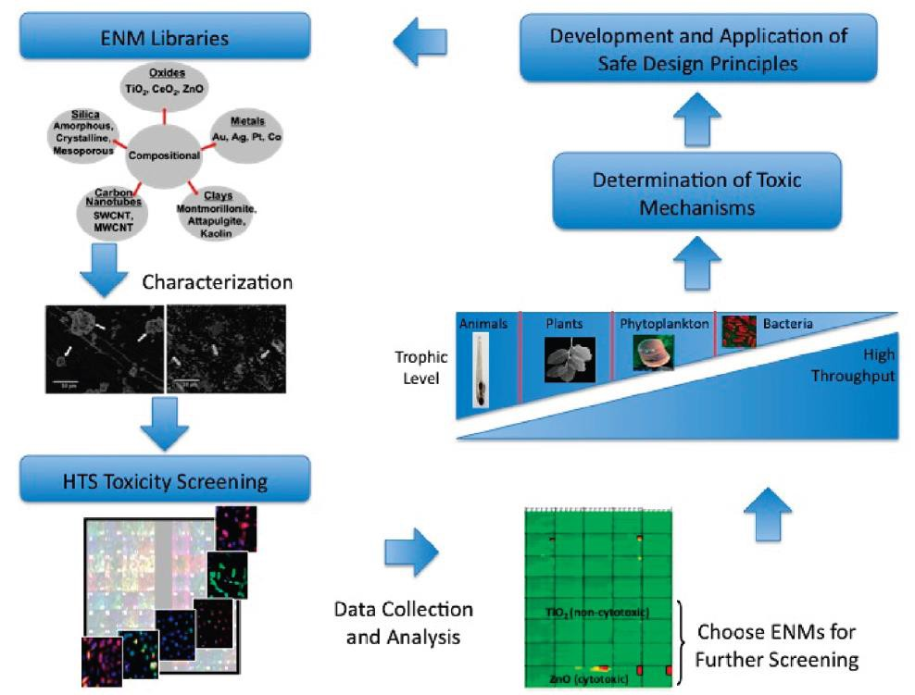
Strategy for determining toxicity of nanomaterials
Thomas et al., 2011, ACS Nano, 5, 13–20

Slide 27
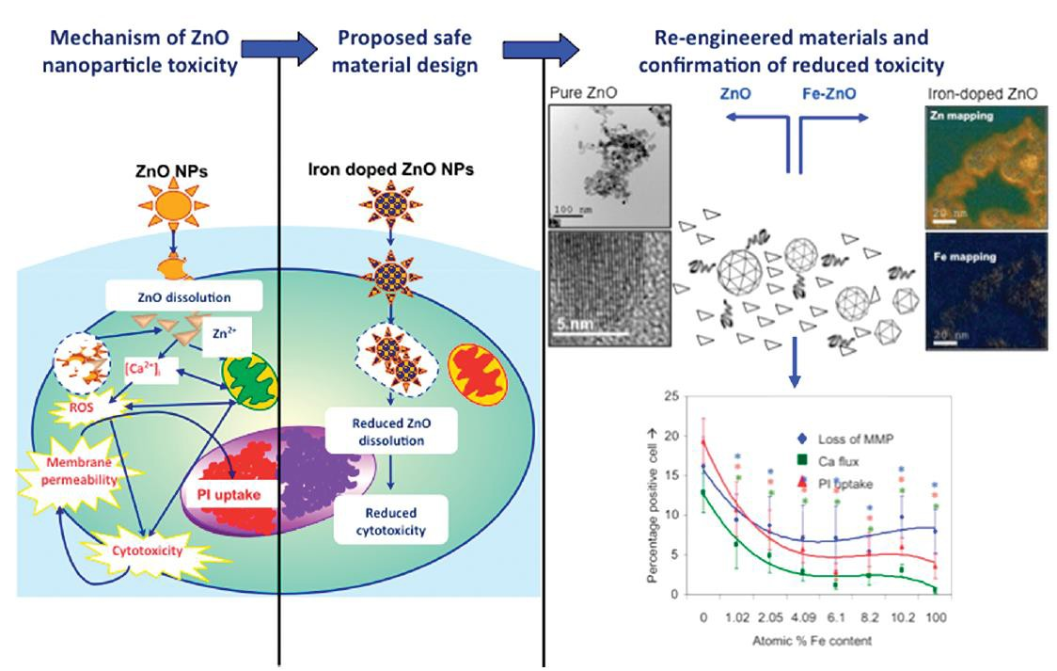
Safer design of environmental nano-materials
Thomas et al., 2011, ACS Nano, 5, 13–20

Slide 28
Toxicity of Ag NPs in medaka
1Onm PVP coated Ag NPs
Silver NP toxicity is coating-dependant I Causes mortality
to medaka larvae at mg 1-¹ levels
Causes spinal malformation
•
0.8
:e
-+- 15 mg r'
--- 5mg r'
......_ 1.5 mg r'
-+- 0.15 mg r¹
•
g_ 0.6
⁰a.
0.2
0.0
0
5
10
Day of exposure
15
20
CE'I"N'T

Slide 29
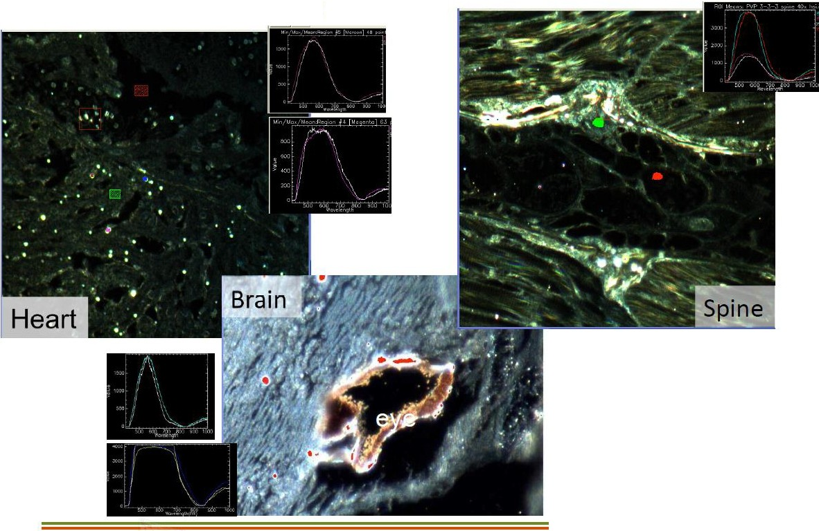
Ag NP tissue distribution
CytoViva
Dark field microscopy Hyperspectral analysis
CE'I"N'T

Slide 30
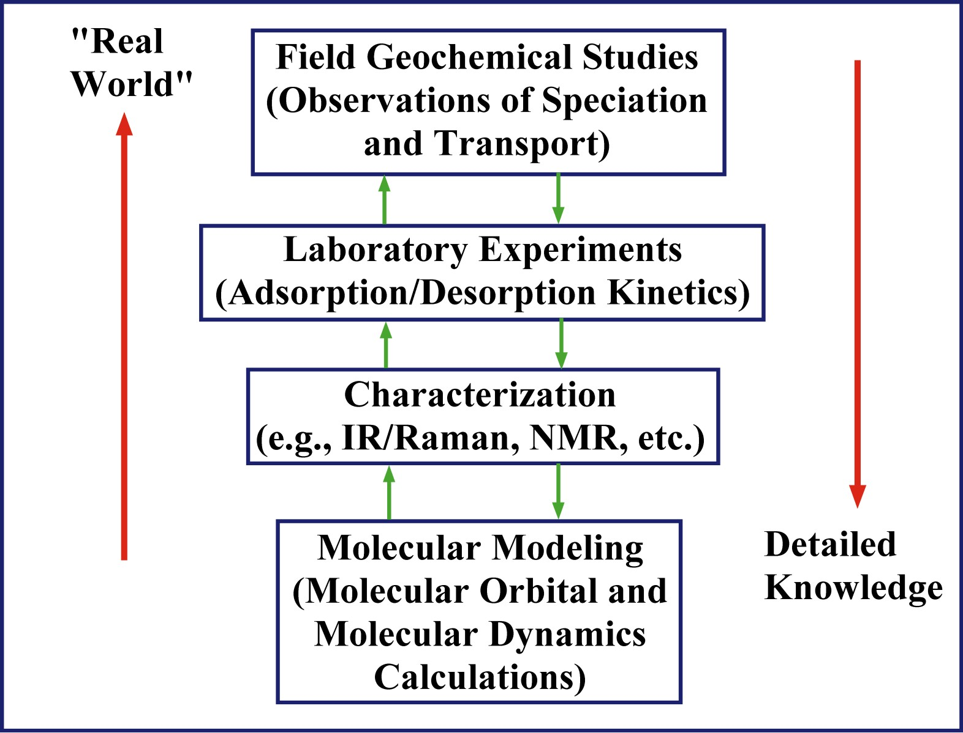
Where does molecular modeling fit in?

Slide 31
Molecular Modeling Matrix
Bulk systems & interfaces
10⁴
Number of Atoms
Clusters
and complexes
10²
Molecules and test systems
MM SE HF DFT MP2 G2 HΨ
Level of Theory ≈ Cost of Calculation

Slide 32




























Molecular Modeling Methods - Classical
E = k₂ (r − r_{o} )
2
2
Bond Stretch
Angle Bend
E = k(1+ cos(nφ −φ_{o} ))
E = k(1+ cos(nχ − χ_{o} ))
Torsion
Out-of-Plane Stretch
N
^{E}nonbond ⁼ ∑
i> j
^{q}i ^{q} j ij
N
⎛ A B ⎞
ij ij
+
∑
⎜
−
⎟
Non-bonded
⎜
12
6
⎟
r
i> j ⎝
r
r
⎠
ij ij
Slide courtesy Randy Cygan – Sandia National Laboratories

Slide 33
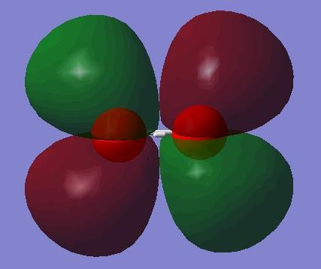
Molecular Modeling Methods – Quantum
Hψ = Eψ
Slater-type orbital
φ = Aexp(−ζr)
Gaussian basis function
φ = ∑ Aexp(−ζr² )
More Gaussians → Higher accuracy & computational expense
Highest Occupied Molecular Orbital for O₂

Slide 34
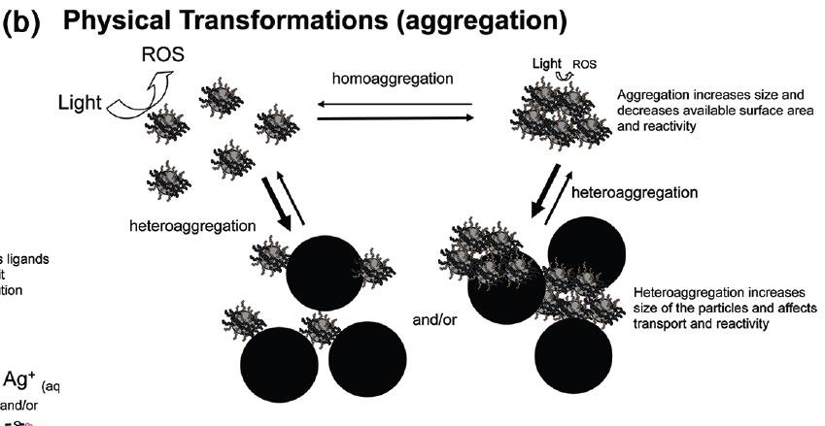
Aggregation of nanoparticles affects surface area & reactivity
Lowry et al., 2012, Environ. Sci. Technol. 46, 6893−6899

Slide 35
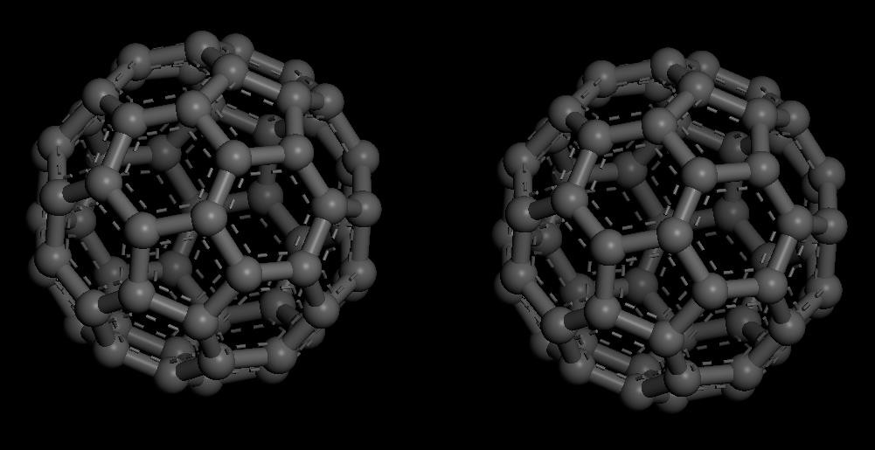
Association of fullerenes (Bucky balls)

Slide 36
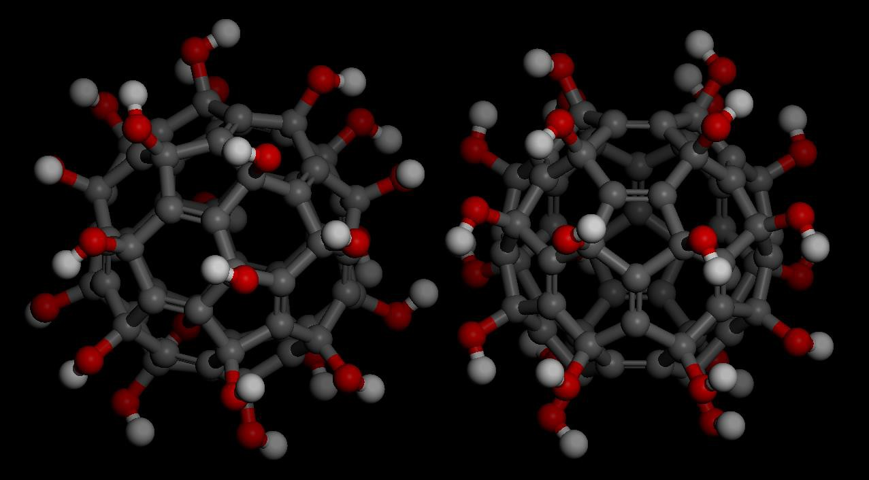
Association of fullerenols (partially oxidized Bucky balls)

Slide 37
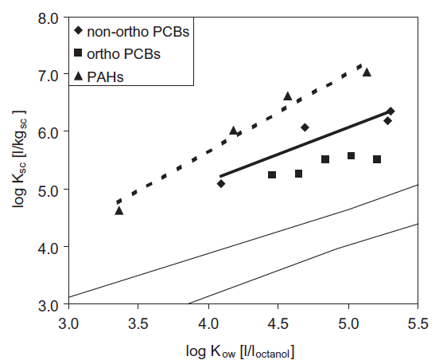
Hydrophobic contaminants (e.g., PCBs)
tend to accumulate in soot
Experimentally determined logK_{sc} values of PCBs
Bucheli and Gustafsson, 2003, Chemosphere 53 (2003) 515–522

Slide 38
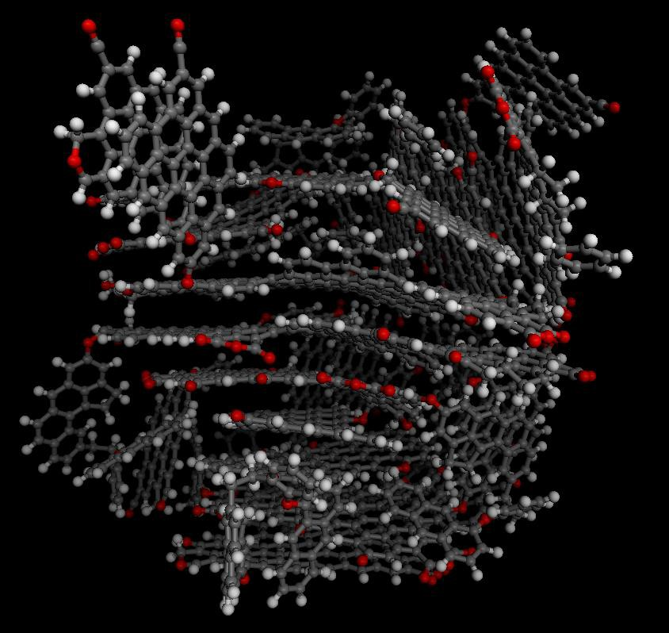
Soot surfaces and micropores are ideal sites for
contaminant adsorption/absorption
Soot Particle

Slide 39
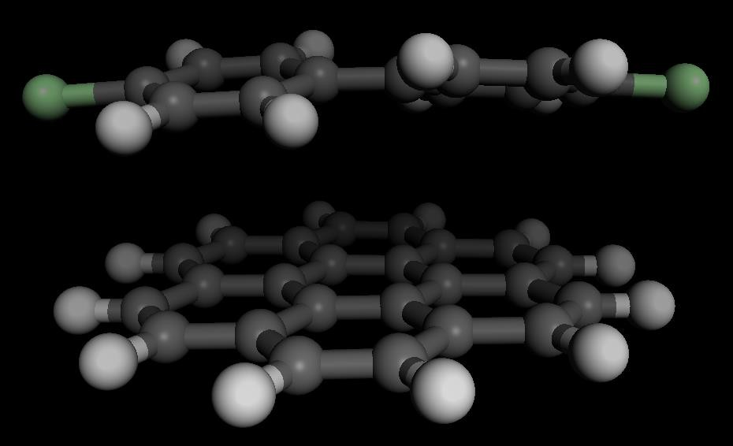
Modeling of interaction energies can predict adsorption
and illustrate mechanism
PCB
“Soot”
Surface

Slide 40
PCB Adsorption onto soot
Calculated Adsorption Energy (kJ/mol)
-45
2266ClBiP
-50
-55
MP2/6-31G(d)//COMPASS
-60
-65
-70
-75
44ClBiP
6.0 6.2 6.4
-80
5.0 5.2 5.4 5.6 5.8
Experimental log(K )
sc
Bucheli & Gustafsson (2003)

Slide 41






Photo-induced Redox Transformation of Chromate and Arsenite on Iron Oxides
Elizabeth Cerkez, Narayan Bhandari & Daniel Strongin
Temple University
Adsorbtion of Analytes
•When Cr(III) is added alone, we see ~70μM adsorbed.
84%
Arsenic Present
100%
•When both Cr(III) and As(V) are added, we see 210 μM adsorption of As(V), and ~100 μM of Cr(III) adsorbed.
As(V) Cr(III)
No Arsenic Present
70%
Adsorption of As(V) facilitates the adsorption of Cr(III) due to the more negatively charged
0
50
100 150
Analyte Adsorbed (uM)
200
250
Cr(III) Added
As(V) Added
surface.

Slide 42
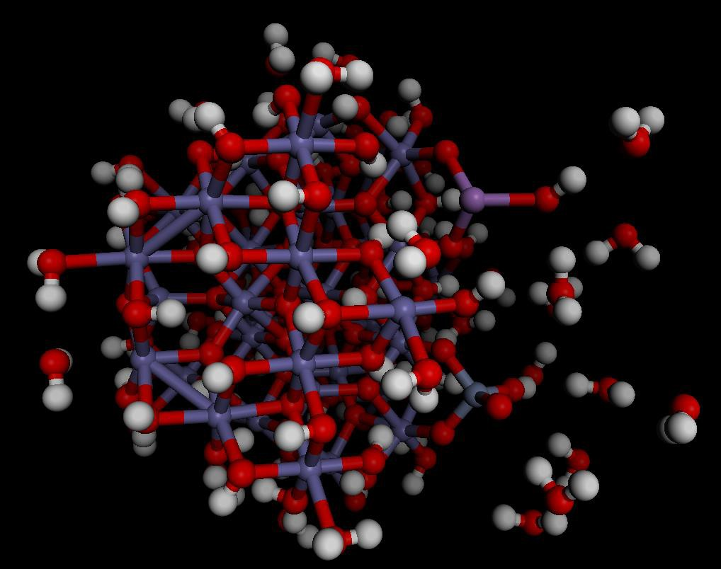
Calculations can elucidate the mechanism of contaminant
electron transfer
As(III)
Cr(VI)

Slide 43
Conclusions
#1. Nanoparticles, natural and man-made, play a significant role in the environment with both positive and negative effects.
#2. Direct roles of nanoparticles are seen in health impacts on plants and animals and can be magnified up the food chain.
#3. The role of nanoparticles in the atmosphere is one of the biggest uncertainties in predicting future climate change.
#4. Combinations of field observations, laboratory experiments & analyses, and computational chemistry can help reveal critical details of nanoparticle behavior.

