Slide 1

Electron Microscopy
Electron Microscopy

Slide 2
Outline
Scanning Electron Microscopy
Field Emission Scanning Electron Microscopy
Transmission Electron Microscopy
Energy Dispersive Spectroscopy

Slide 3
SEM
SEM
A microscope that produces an image by using reflected electrons.
Rudimentary SEM’s use thermionic tungsten emitters.
The electron beam scans the surface of an object and a computer constructs an image from the backscattered or emitted electrons.
Capable of magnifications of up to 100,000 to 300,000X.
Capable of resolutions of 4 to 5 nm.

Slide 4
SEM
SEM
1. Vacuum Chamber
Filament
Columating Lens
Objective Lens
Scan Coils
Sample
Grounded Sample Stage
Penn Sate Center for Nanotechnology Education and Utilization

Slide 5

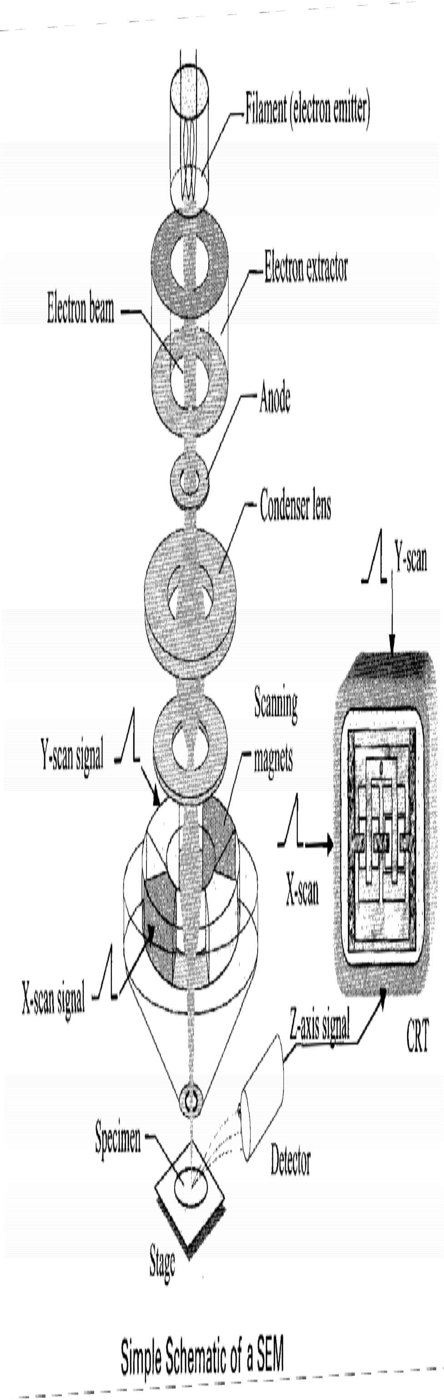




SEM
SEM
Quirk, M., Serda, J. Semiconductor Manufacturing Technology. Prentice Hall, Upper Saddle River. 2001

Slide 6
SEM
SEM
SEM utilizes an electron gun that produces electrons, focusing elements that shape the electrons into a beam, and a focusing system that makes the electrons strike the sample within a small 2 – 6 nm spot

Slide 7
Emission Sources
Rudimentary SEMs utilize heated cathode emission sources that produce electrons by thermionic emission.
The most common and least expensive is the sharpened tungsten tip.
More specialized SEMs such as the FESEM use cold cathode emission sources that produce electrons by field emission.

Slide 8
Thermionic Emission
A high electrical current is passed through a metal or ceramic filament.
Electrons in the filament material gain thermal energy by joule heating.
When the thermal energy is greater than the work function of the material, electrons are emitted from the filament and condensed into a beam.

Slide 9
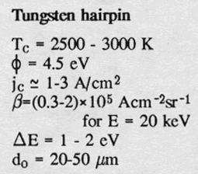
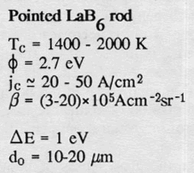
Thermionic Emission
Filament Types:
Tungsten Hair-pin
Inexpensive
Short life (100s of hours)
Very resilient technology
Fast heating
Most common
Lowest resolution
Can be used in poor vacuum systems
Courtesy “Image Formation in Low-Voltage Scanning Electron Microscopy”.(16)
Lanthanum Hexaboride / Cerium Hexaboride
Relatively expensive
Longer life (1000s of hours)
Higher brightness than thermionic tungsten
Smaller Spot size → Higher resolution
Very sensitive to proper positioning in gun
Must be heated slowly to prevent damage
Requires high vacuum
Courtesy “Image Formation in Low-Voltage Scanning Electron Microscopy”.(16)

Slide 10
Field Emmision
Utilizes a potential gradient to overcome the work function rather than thermal energy.
A filament, usually LaB₆ wire sharpened to a fine point with a radius on the order of 100 nm, is placed in a large electric potential gradient (5-10kV).
The large electric field gives the electrons enough energy to overcome the material’s work function and escape from the filament surface.

Slide 11

Untitled: Slide 11

Slide 12
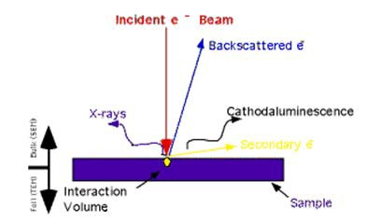
SEM Generated Species Types
These finely focused incident electrons strike the sample with a high voltage (120‐200keV).
The following types of species are created once the electron beam hits the sample:
  Backscattered electrons
  Secondary electrons
  Auger electrons
  X‐Rays
Center for Materials Research and Analysis University of Nebraska-Lincoln

Slide 13
SEM Generated Species Types
Backscattered Electrons
Formed when an incident electron strikes the sample and is bounced back from the sample
Elements with higher atomic numbers absorb more incident electrons allowing fewer to be backscattered
This gives contrast to different materials in the sample

Slide 14

Untitled: Slide 14

Slide 15
SEM Generated Species Types
Secondary Electrons
Formed when an incident electron strikes the sample ejecting an electron from the sample
Several secondary electrons can be produced from one incident electron
Secondary electrons are typically emitted by atoms close (10nm) to the surface of the sample and are highly influenced by the topography of the sample

Slide 16
SEM Generated Species Types
Secondary Electrons continued
Secondary electrons have low energy ~5eV
Since secondary electrons have such a low energy there is often a biased collecting cage (~ +100V) attached to the secondary electron detector so that the electrons are attracted to the detector

Slide 17

Untitled: Slide 17

Slide 18
SEM Generated Species Types
Auger Electrons
These low energy electrons are emitted from the sample to achieve an energy balance after a secondary electron has been dislodged
When an incident electron causes a secondary electron to leave an atom, a vacancy is produce in an orbital near the nucleus
An electron from an outer shell of the atom will fall to fill the vacancy near the nucleus, creating a surplus of energy
This surplus of energy causes an Auger electron to be released

Slide 19
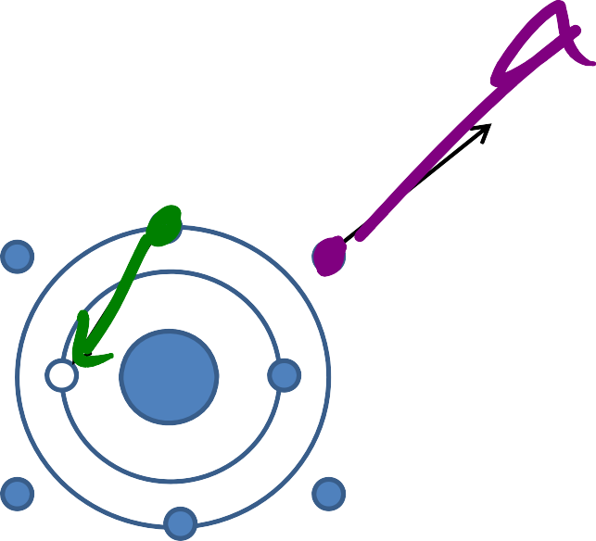
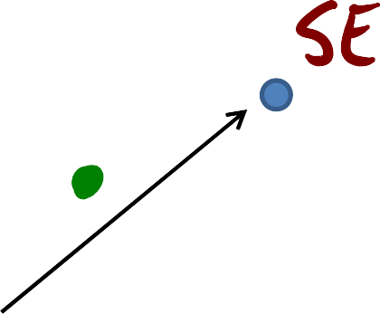


SEM Generated Species Types
Auger Electron Emission
Electron Collision
Auger Emission

Slide 20
SEM Generated Species Types
Auger Electrons continued
Since each element has a different number of orbitals, electrons, and energies, Auger electrons are specific for each atom
Auger electrons are used to determine the elemental composition of the sample
Because Auger electrons have such low energy they cannot be emitted from a depth greater than 3 nm

Slide 21
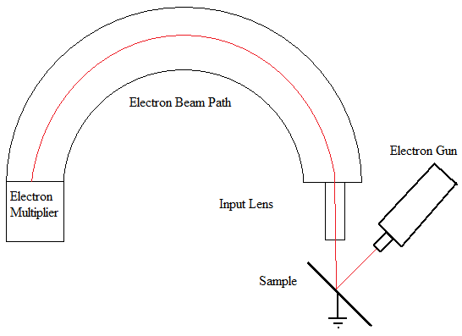


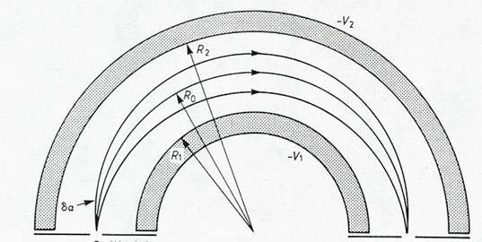
Auger Electron Detectors: Concentric Hemispherical Analyzer
Electron Gun (E‐Beam) strikes sample
Input lens retards the ejected electrons
Electrons enter two precision‐machined stainless steel concentric hemispheres
Electrons exiting concentric path are then multiplied and detected for analysis

Slide 22
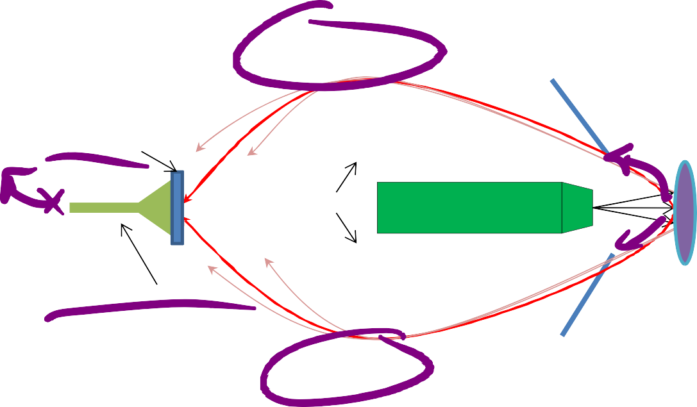
Auger Electron Detectors: Cylindrical Mirror Analyzer
Auger Electron Detectors: Cylindrical Mirror Analyzer
Electrons emitted from the sample are focused by two
concentric cylindrical mirrors.
Outer Mirror
Electrons with energies consistent with auger emission are captured by the detector. Other electrons are reflected by the inner mirror.
The resulting signal is enhanced by the electron multiplier and sent through an amplifier circuit prior to data acquisition.
electron detector
Sample
Inner Mirror
Electron Gun
Electron multiplier
Outer Mirror
“Single pass” Cylindrical Mirror Analyzer

Slide 23
R.J Lee Personal SEM
Specifications | R.J. Lee Personal SEM
Filament | Tungsten Wire
Voltage Range | 2kV - 15kV
Secondary Electron Detector | Everhart-Thornley
Backscattered Electron Detector | Solid State Annular
Magnification | 10x-200,000x
X-Ray Detector | Elemental Analysis
Pressure | 10^{¯6} Torr

Slide 24
Outline
Scanning Electron Microscopy
Field Emission Scanning Electron Microscopy
Transmission Electron Microscopy
Energy Dispersive Spectroscopy

Slide 25
FESEM
The FESEM is similar to the SEM,
  The SEM uses a rather large diameter (60,000nm) thermionic tip
  The FESEM utilizes smaller emission tip with a much smaller diameter (100 – 1000nm)
  Intrinsically smaller beam gives better resolution

Slide 26
Emission
A cold cathode is the emission source.
The emitter has a negative bias of a few kV.
A positive high voltage anode extracts electrons from the emitter, eliminating the need for thermionic emission.

Slide 27
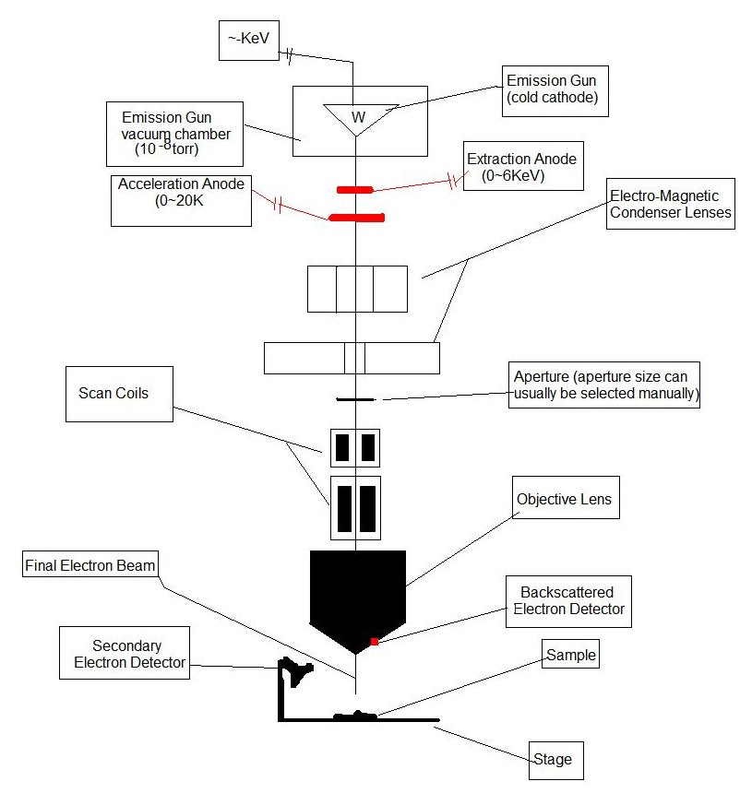




FESEM
Field electron emission source.
Very fine image resolution (~1‐ 2nm).
Samples should be conductive.
Public Domain: Image Generated by Sam Joyce (CNEU) for free use, 2009.

Slide 28


Field Emission Sources
2 types:
Cold Cathode (W)
  Very sharp point, tip diameter is ~100nm
  ~KeV charge, not heated or cooled
  Electrons “tunnel” out of the tip
  Vacuum chamber under very low pressure of at least 10^{‐8} torr, cryo pump is often used
Schottky (W, ZrO2)
  Sharp tip diameter (~1000nm)
  Heated to at least 1500°C
  Vacuum chamber at low pressure (~ 10^{‐5} torr) achieved by roughing and turbo pumps

Slide 29
FESEM Anodes
Extraction Anode:
  0‐6KeV applied to extract or tunnel the electrons from the fine tip
  Located just below the field emission source
Acceleration Anode:
  0‐20KeV applied to accelerate the electrons down through the tube
  Located below the extraction anode
Public Domain: Image Generated by Sam Joyce (CNEU Student) for free use, 2009.

Slide 30
Electro‐Magnetic Lenses
A series of electromagnetic lenses condense the electron beam to its desired size.
Beam must be smaller than the feature being examined.
Beam must maintain a constant current density whilst being condensed.
Avg. FESEM current density is
~17,000A/cm²
Public Domain: Image Generated by Sam Joyce (CNEU) for free use, 2009.

Slide 31
Aperture
Plate with a small hole for the beam to pass through.
Usually can be adjusted by the operator.
Also helps to get the electron beam down to its final diameter and uniformity.
Public Domain: Image Generated by Sam Joyce (CNEU) for free use, 2009.

Slide 32
Scanning Coils
2 separate scanning coils.
First scanning coil
  Deflects the beam back and fourth in a “scanning” fashion over the sample.
Second scanning coil
  Referred to as stigmator coil.
  Corrects problems that may have been caused by the XY deflection of the beam
Public Domain: Image Generated by Sam Joyce (CNEU) for free use, 2009.

Slide 33


Objective Lens
Closest part of the FESEM to the sample.
Focuses the final beam onto the sample.
Distance between lens and sample (working distance) determines resolution. Short working distance yields better resolution and finer beam diameter.
Public Domain: Image Generated by Sam Joyce (CNEU) for free use, 2009.

Slide 34
Electron Detection
Secondary Electron Detector
  Secondary electrons generally provide most of the image.
Backscattered Electron Detector:
  Backscattered electrons reflect back up toward the objective lens
  Give topographical information as well as chemical composition information.
Public Domain: Image Generated by Sam Joyce (CNEU) for free use, 2009.

Slide 35
Outline
Scanning Electron Microscopy
Field Emission Scanning Electron Microscopy
Transmission Electron Microscopy
Energy Dispersive Spectroscopy

Slide 36
Transmission Electron Microscopy
Similar to the SEM, differing in that the electron beam is transmitted through an extremely thin sample.
The interaction of the electrons traveling through the sample is analyzed.

Slide 37
TEM Lens System
Samples thicknesses between 50‐200nm can be viewed with a TEM.
An electron gun produces monochromatic electrons that are finely focused into a beam with magnets.
There are multiple electro‐magnetic lenses that focus the electrons into a fine beam.

Slide 38
TEM Lens System
The second condenser lens determines the brightness or intensity of the beam on the sample.
– This is accomplished by increasing or decreasing the beam diameter that hits the sample.
The beam then passes through an aperture which filters electrons that are not tightly bound in the beam from traveling to the sample.
The first condenser lens determines the spot size or the general diameter of the beam when it hits the sample.

Slide 39
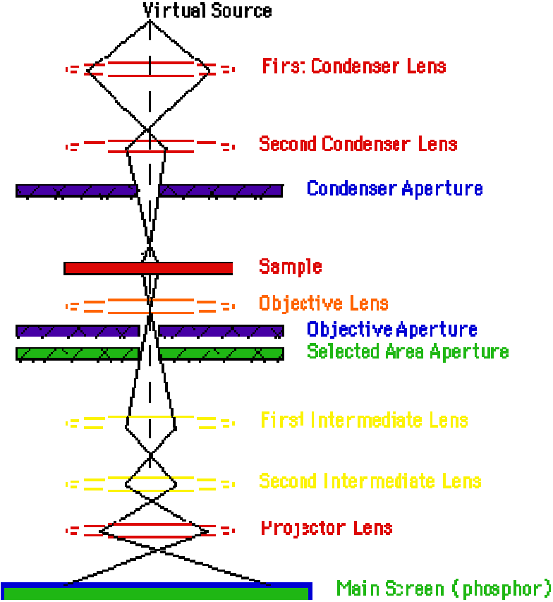



TEM Lens System
TEM Lens System
Center for Materials Research and Analysis University of Nebraska-Lincoln

Slide 40
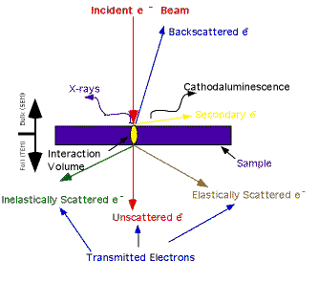


TEM Generated Species Types
These finely focused incident electrons strike the sample with a high voltage (120‐200keV).
The following types of species are created once the electron beam hits the sample
Backscattered electrons
Secondary electrons
Auger electrons
X‐Rays
Unscattered electrons
Elastically scattered electrons
Inelastically scattered electrons
Center for Materials Research and Analysis University of Nebraska-Lincoln

Slide 41
TEM Generated Species Types
The following species are generated in any EM microscope.
  Backscattered electrons
  Secondary electrons
  Auger electrons
  X‐Rays
These however are unique to the TEM
  Unscattered electrons
  Elastically scattered electrons
  Inelastically scattered electrons

Slide 42
TEM Generated Species Types
X‐Rays
X‐rays are produced when an incident electron causes a secondary electron to leave an atom, a vacancy is produce in an orbital near the nucleus
An electron from an outer shell of the atom will fall to fill the vacancy near the nucleus, creating a surplus of energy
This surplus of energy is released as an x‐ray
Emitted x‐rays have unique energies associated with a specific atom and are used to determine elemental composition of the sample.

Slide 43
TEM Generated Species Types
Unscattered Electrons
Incident electrons that pass through, or are transmitted through the sample
Thinner areas yield more unscattered electrons and appear lighter than thicker areas
Generally, electrons cannot be transmitted through samples thicker than 200nm without significantly higher energy

Slide 44
TEM Generated Species Types
Elastically Scattered Electrons
Electrons that pass through the sample, changing course by being deflected by the sample without energy loss
Bragg’s Law states that similar incident electrons are scattered by the same atomic spacing
These electrons are collected and give information on stoichiometry, atomic arrangement, and crystal lattice of a sample

Slide 45
TEM Generated Species Types
Inelastically Scattered Electrons
Electrons that pass through the sample, changing course from being deflected by the sample and losing energy
Electron Energy Loss Spectroscopy
  The amount of energy lost is characteristic of the element that was hit by the incident electron
  This will yield compositional and bonding information from the sample

Slide 46
TEM Sample Preparation
Samples must be thinned to ~100nm
Non‐conductive samples must be coated with a conductive material to prevent charging

Slide 47
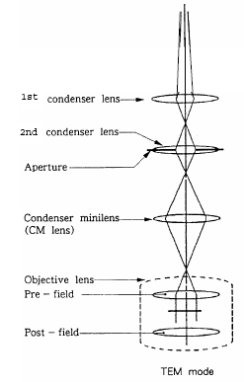
JEOL 2010F 200 kV, Field‐emission TEM/STEM
Condenser aperture sizes
– 150 µm
– 70 µm
– 40 µm
– 30 µm
– 10 µm
1.9 Å resolution
PSU MCL JOEL 2010F Operators Manual

Slide 48
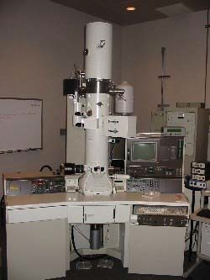
JEOL 2010F 200 kV, Field‐emission TEM/STEM
Can operate between 100‐200kV
Schottky Zirconium Oxide Tungsten (ZrO/W) field emitter
Three apertures
1st condenser
2nd condenser
Condenser mini‐lens
PSU MCL JOEL 2010F

Slide 49
Outline
Scanning Electron Microscopy
Field Emission Scanning Electron Microscopy
Transmission Electron Microscopy
Energy Dispersive Spectroscopy (EDS)

Slide 50
Energy Dispersive Spectroscopy (EDS)
Energy Dispersive X‐ray Spectroscopy (EDS) is an analytical capability that can be used in conjunction with SEM/TEM techniques
This technique is also sometimes referred to as EDXA (energy dispersive x‐ray analysis)
SEM gun electrons collide with the electrons within the sample, causing some of them to be knocked out of their orbits. These electron shell positions are filled by higher energy electrons which emit x‐rays in the process.

Slide 51
Energy Dispersive Spectroscopy (EDS)
Sensitive for low‐Z elements, (B‐U), not appropriate for high Z elements. Elemental detection typically 0.1 – 1 atomic weight percentage
Windows in front of the detector can absorb low‐energy X‐rays, so EDS detectors cannot detect H, He, and Li

Slide 52
Energy Dispersive Spectroscopy (EDS)
The impact of the electron beam on the sample produces characteristic x‐rays that can identify elemental information
Samples must be vacuum compatible, so it may not be possible to interrogate some organic material

Slide 53
Energy Dispersive Spectroscopy (EDS)
Can give quantitative results for samples that are flat and homogeneous. Relative x‐ray intensity varies with the angle of the surface, so irregular surfaces can cause scattered x‐ rays.
Analyzers are then used to characterize the x‐ ray photons for their energy (or wavelength) and abundance to determine the elemental makeup of the area under test

Slide 54
Energy Dispersive Spectroscopy (EDS)
EDS can be used to gather pin point information, or to map the elemental composition of a larger area Typical spot size is 1 micron.
The test is inexpensive and widely available on many SEM/TEM systems
Can be used for a number of industries: aerospace, biomedical/biotechnology, electronics, pharmaceutical , photonics

Slide 55

Untitled: Slide 55

