Slide 1

Confocal Microscopy
Confocal Microscopy

Slide 2
Outline
Introduction
Optical Microscopy
Types of Optical Microscopes
Confocal Microscopy
Laser Scanning Confocal Microscopy
Examples

Slide 3
Optical Microscopy
Optical microscopy is the oldest type of microscope and uses visible light and a system of lenses to create an image of the sample
Although not able to image nanostructures, optical microscopy is important in nanotechnology characterization
Light microscopes can be used to image biological structures and inspection of lithography processes

Slide 4

Optical Microscopy
The resolution of a light microscope (R) is a function of the numerical aperture of the lense (NA), and the wavelength of illumination (λ)
$$R=\frac{0.61λ}{NA}$$
The numerical aperture of a lens is at its maximum close to 1. Wavelength of illumination λ > 380 nm for optical wavelengths. Thus resolution is limited to about 500 nm for an optical microscope
Leng, Yang. Materials Characterization. John Wiley and Sons, Singapore. 2008

Slide 5
Types of Optical Microscopes
Bright-field illumination, light transmission, compound light microscopes
  Light transmitted through a sample forms an image
Dark-field illumination, episodic illumination, reflected light microscopes
  Light reflected by the sample form an image
Fluorescent light microscopes
  Light emitted from the sample form an image

Slide 6
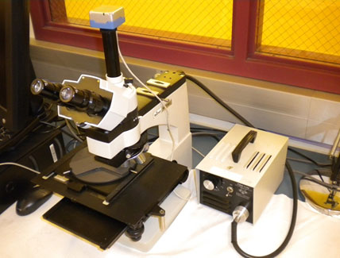
Reflection Microscopy
Episodic illumination or reflective optical light microscope with still camera CCD attachment in the SHINE Nanotechnology Lab
EpiStar 2560 Metallographic Microscope

Slide 7
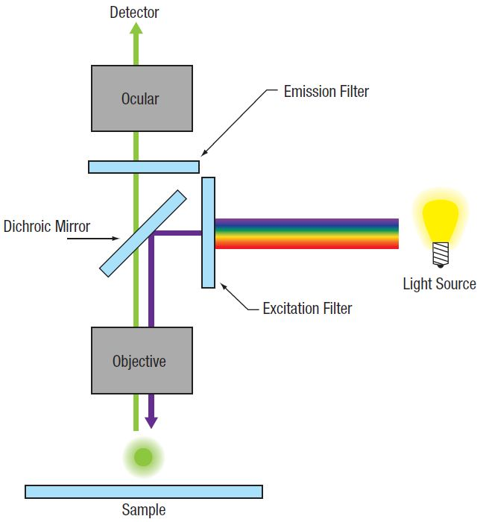
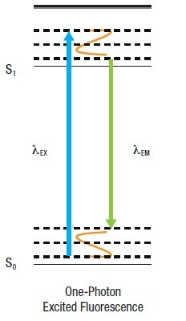
Fluorescence Microscopy
Image used under Creative Commons Licence. LSM Tutorial. Thor Labs, downloaded. 2015

Slide 8
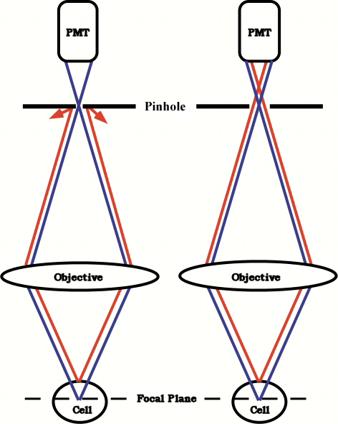
Confocal Microscopy
The only light which reaches the detector is in-focus light from a single focal plane through the sample
Out-of-focus light, from focal planes above and below the in-focus plane is blocked by the pinhole
Image used under Creative Commons Licence. Why use a confocal microscope? University of Washington, downloaded. 2015

Slide 9
How does confocal microscopy use nanotechnology?
Nano particles and quantum dots are used as fluorescent markers
Nanomaterials are used in drug delivery to cells which can be analyzed using confocal microcopy
Nanomaterials are used as anti-bacterial agents. Bacteria can be imaged using confocal microscopy
Nanomaterials are used in many other biological processes.
Image used under Creative Commons Licence. Why use a confocal microscope? University of Washington, downloaded. 2015

Slide 10
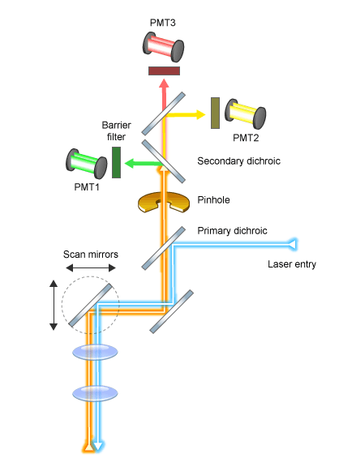
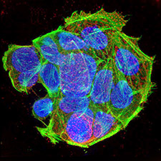
Laser Scanning Confocal Microscopy
Image used under Creative Commons Licence. MyScope Training for Advanced Research. AMMRF, downloaded. 2015

Slide 11
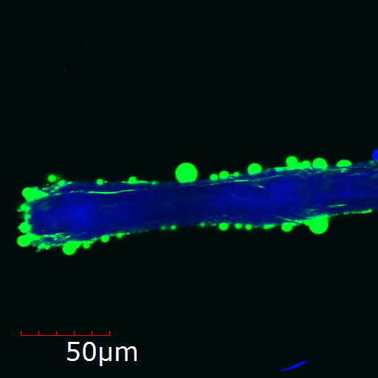
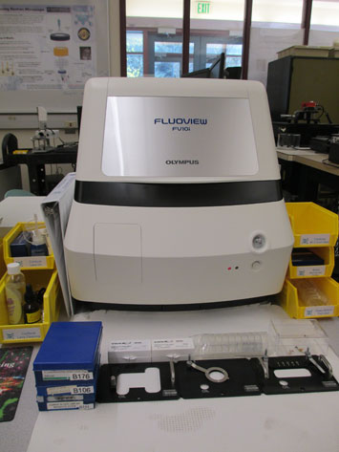
Laser Scanning Confocal Microscopy
SHINE Student Image from a
Laser Scanning Confocal Microscope
Olympus Fluoview FV10i
Laser Scanning Confocal Microscope

Slide 12
SHINE’s LSCM
Specifications | (SHINE Nanotechnology Lab) Olympus Fluoview FV10i Confocal Microscope
Illumination | 450 nm, 535 nm, 570 nm, and 620 nm excitation laser lines
Objective Lenses | 10x and 60x oil-immersion lenses
Detector | Photomultiplier tube fluorescent photon detectors
Chassis | Fully enclosed, vibration isolated bench-mount system
Operating Modes | 2-D images, multiple Z-stack 3-D images, z-stack over time, and multiple-area imaging modes
Advantages
Able to view a variety of samples, living samples | Ease of use, samples on microscope slides or dishes
High resolution optical images | Ability to capture 2D and 3D images
Disadvantages
Limited magnification range (10x – ~1000x) | Sample must be epi fluorescent or labeled with a fluorescent dye
Imaging software requires manual adjustment

Slide 13
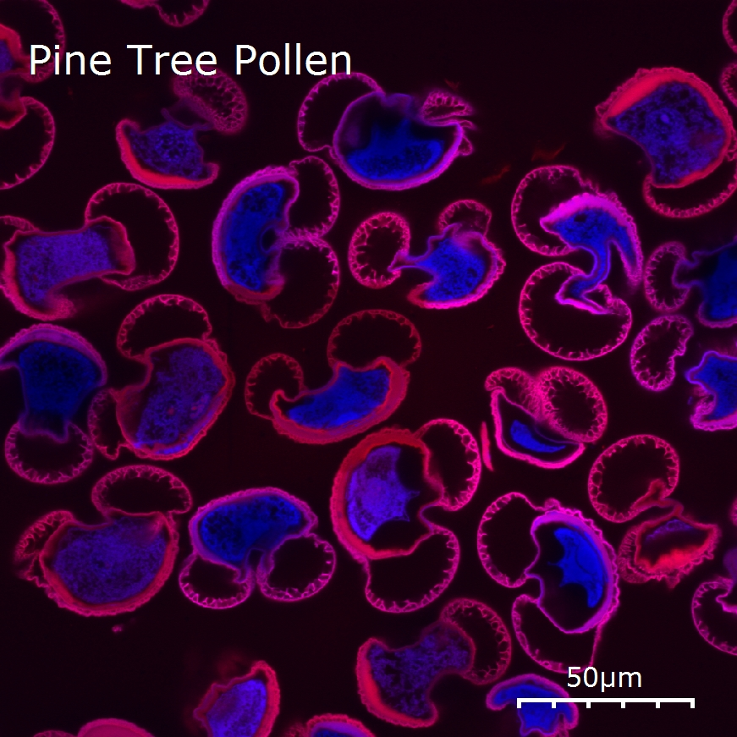
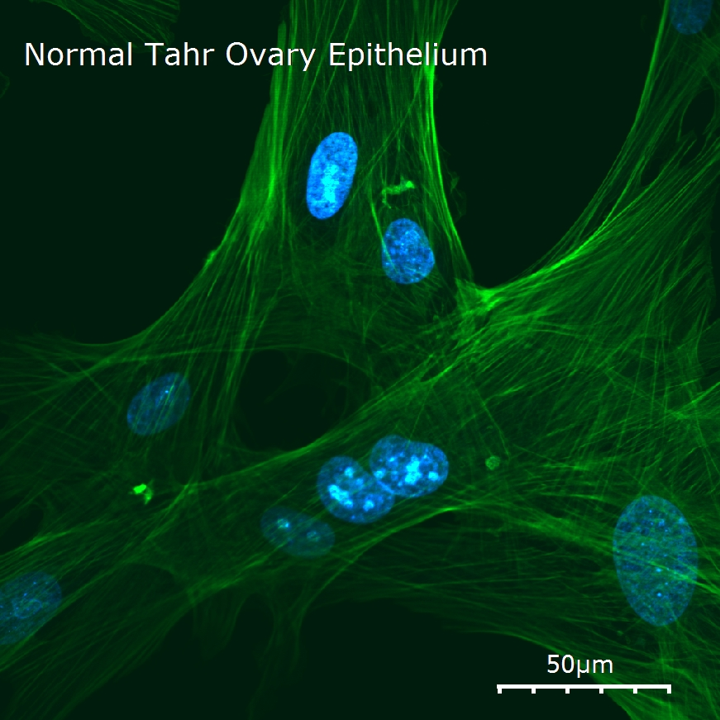
Laser Scanning Confocal Microcopy Images
Student Images from SHINE’s Laser Scanning Confocal Microscope

Slide 14
Confocal Microscopy
Advantages and Disadvantages:
Able to image living samples in situ
Possible to make 3-D images
Can image samples in water or other media. No vacuum required
Requires an epi fluorescent sample or a fluorescent labeled sample
Magnification is limited by the optical excitation wavelength. Practically can image cells, but not individual nanostructures

Slide 15
Confocal Microscopy Resources
http://www.ammrf.org.au/myscope/confocal/introduction/ | Training site on fluorescence microscopy
http://www.microscopyu.com/articles/confocal/index.html | Great website with a lot of resources - theory, prep, comparisons to widefield fluorescence, and simulations
http://www.microscopyu.com/articles/confocal/confocalintropreparation.html | One of the links from above website; a lot more information under the confocal index
http://www.olympusfluoview.com/theory/confocalintro.html | Lots of theory; links to tutorials - similar to Nikon’s MicroscopyU
http://www2.bioch.ox.ac.uk/microngroup/resources/ | PDFs of Advanced Microscopy lectures, as well as other useful resources
http://depts.washington.edu/keck/links.htm | Links from the University of Washington Keck Center that has a list confocal references
http://depts.washington.edu/keck/confocalgate.htm | University of Washington Resource; theory and sample prep
http://www.microscopy-analysis.com/editorials/editorial-listings/confocal-microscopy-re-writes-origin-flowering-plants | Brief introduction, using auto fluorescence of microfossils
http://www.microscopy-analysis.com/editorials/editorial-listings/confocal-microscopy-uncovers-toxic-nanoparticles | LSCM and nanoparticles

Slide 16





Acknowledgements
  This module is one of a series designed to be used by faculty members at post-secondary institutions in workshops, courses, and overview lectures to introduce nanotechnology and its applications.
  This module was funded and supported in part by:
  North Seattle College
  NorthSeattle.edu
  SHINE – Seattle’s Hub for Industry Driven Nanotechnology Education
  A National Science Foundation Advanced Technological Education Regional Center
  (NSF #DUE 1204279)
  SeattleNano.org
  NACK – The Nanotechnology Applications and Career Knowledge Network
  A National Science Foundation Advanced Technological Education
  National Center
  (NSF #DUE 0532646 and DUE#0802498)
  Nano4me.org
  The Pennsylvania Department of Community and Economic Development
  Grant # C000029471 and C000036659
  Any opinions, findings, and conclusions or recommendations expressed in this material are those of the author and do not necessarily reflect the views of the National Science Foundation or the Pennsylvania Department of Community and Economic Development

