Slide 1
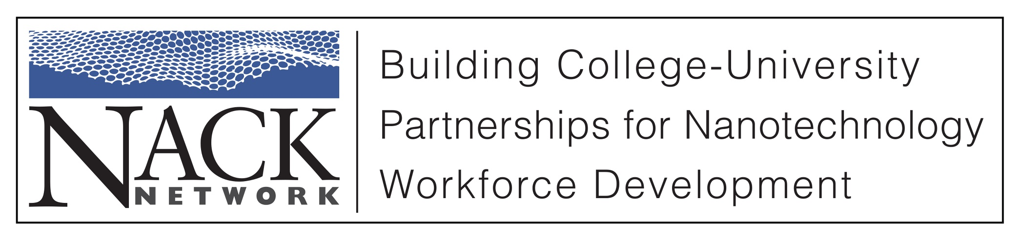
Role of Metal Nanoparticles in Biological Applications:
Biocompatibility and Cellular Overview Part 4

Slide 2
Outline
Biocompatibility
Quick overview of cellular interaction
  Scale, size, generic animal cell
Nanoscale materials for biological interaction
  Liposomes
  Metal Nanoparticles
  Nanoshells
  Examples of bionano applications

Slide 3
Metal Nanoparticles
Since the size of NPs is comparable to biomolecules these NPs can overcome biological barriers.
NPs may be 1/100th to 1/10,000th the size of a cell. The cell may uptake the NP as a result of being tricked into ‘thinking’ this NP is a biomolecule (e.g. enzyme, antibody).
Shape of the nanoparticle also has impact, generally gap junctions accept round shapes more than rods.

Slide 4
Metal Nanoparticles
Au is often used as the metal of choice because has been shown to be relatively inert and Au is a good platform to tether chemistry to the particle.
Au is expensive in bulk, but when using small volumes (e.g. 10 mg) the bulk cost is irrelevant.
Metal nanoparticles can be used to target and destroy disease cells.
There are different functionalities of the particles to perform selected tasks. They can be used as tags to identify, used as energy receptors to “cook” (targeted hyperthermia) tumors, may be used as a delivery platform for drug/RNA delivery.

Slide 5
Metal Nanoparticles
Au NPs can be used as a marker to delineate between healthy tissue and tumors.
In this role the Au NPs are coated with a ligand that will preferentially adhere to tumor cells.
These Au NPs are grown to a specific size so they will exhibit plasmon resonance.
A light source is used to stimulate the plasmons during surgery giving the surgeon a clear boundary between healthy tissue and tumors. This allows the surgeon to minimize trauma to healthy tissue, and locate the unhealthy regions.

Slide 6
Metal Nanoparticles
Au NPs are inert in vivo so side effects are limited or non existent.
Au NPs are relatively nonreactive and they can be coated with PEG so they are very good at moving throughout the circulatory system in the “stealth” mode.
Smaller particles (1-100 nm) are more apt to penetrate into a tumor because they can passively slip between blood vessels (EPR).

Slide 7
Metal Nanoparticles
Au NPs are not good at keeping light in an excited state: so when illuminated with light the excited state energy can be given off as a vibration (heat).
Selective antibodies can be/are attached to Au NPs that is designed to latch onto the receptor of the cancer cell.
Up to 150 different types of antibodies can be conjugated to a Au NP through bifunctional PEG linkers to target specific tumors.

Slide 8
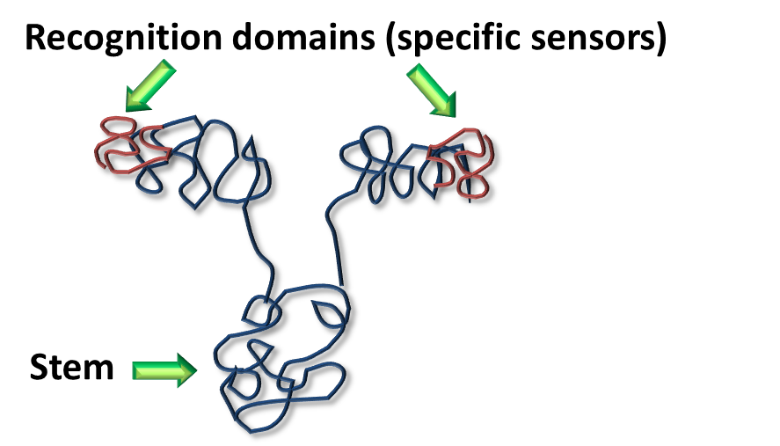
Metal Nanoparticles
Antibodies: A class of proteins that specifically recognize foreign agents in the body and tag them for removal.
Large libraries of slightly different antibodies are used to probe for a vast array of threats. Hundreds are available commercially.
Most antibodies have a Y shape:

Slide 9
Metal Nanoparticles
Selection of the antibody is made so healthy cells will have low levels of the receptor, then Au NPs will selectively seek the cancer cells.
By illuminating Au NPs with light, they give off heat estimated to be ~70-80°C.
This local heating results in the local ablation of cancer cells which have been targeted by Au NPs.

Slide 10
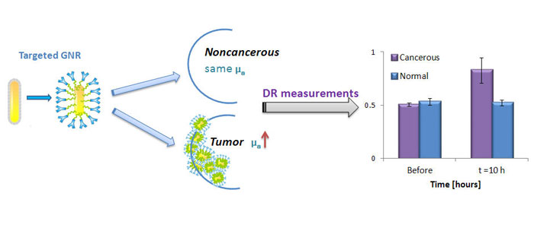
Metal Nanoparticles
http://nanotechweb.org/cws/article/tech/48797

Slide 11
Metal Nanoparticles
The heating is based on the known optical plasmon resonance of gold in the NIR region.
This therapy is currently in phase I clinical trials for the treatment of refractory and/or recurrent head and neck cancer.
Though highly effective for superficial tumors, NIR energy is not suited to target deeper cancers because of its limited penetration depth through human tissue about 3 cm. This is a severe limitation, but it is addressed with other nanoparticles reviewed later in this presentation.

Slide 12
Metal Nanoparticles
A non-gold alternative material approach uses heated magnetic nanoparticles, such as dextran-coated iron oxide. This method uses an inductively coupled magnetic field for an energy source.
However, the high concentrations of iron oxide needed for adequate heat therapy can only be achieved by direct intratumoral injection, which limits practical use.
www.kanziuscancerresearch.org/_files/docs/file_159.pdf

Slide 13
Gold Nanoshells
Blood and tissue will absorb most wavelengths of light (e.g., blue, green, red). However, wavelengths that are invisible to the eye, such as certain ranges in the infrared region, will penetrate through human tissue with minimal absorption.
The nanoshells are manufactured to capture the infrared waves and convert them to heat.
Tuning is done by varing the inner silica core and the thickness of the gold shell.
http://www.ncbi.nlm.nih.gov/pubmed/15826113

Slide 14
Gold Nanoshells
The key innovation with nanoshells is that we can tune their color from the visible using the dimensions of the core and the shell to different regions of the spectrum. So the particles can be tuned into the near-infrared region of the spectrum. Biomedical engineers call that "the water window," because we're mostly made out of water, and water is most transparent in this region of the spectrum. Light can penetrate tissue by as many as 10 centimeters, depending on tissue type.
http://www.ncbi.nlm.nih.gov/pubmed/15826113

Slide 15
Gold Nanoshells
The physics of this structure are unique which allow the particle to absorb or scatter different wavelengths compared to other solid spheres. For example, solid gold nanoparticles will absorb green light. However, an AuroShell particle with a gold shell can be designed to absorb different wavelengths, including the near infrared.
Because light in the near infrared will penetrate through tissue, nanoparticles designed to absorb in the infrared have enabled new therapeutic and diagnostic applications.
http://www.ncbi.nlm.nih.gov/pubmed/15826113

Slide 16
Gold Nanoshells
This differs from conventional gold nanoparticles that are limited to about 2-3 cm of access by light radiation.
Treatment is done with a very simple handheld laser. The nanoshells absorb the light and convert it to heat extremely efficiently, and three minutes is sufficient to kill the cells in the tumor.
Additionally, nanoshells which are nontoxic, progress through the bloodstream to the tumor site, and unlike conventional drugs, do not leave a toxic trail.
http://www.ncbi.nlm.nih.gov/pubmed/15826113

Slide 17
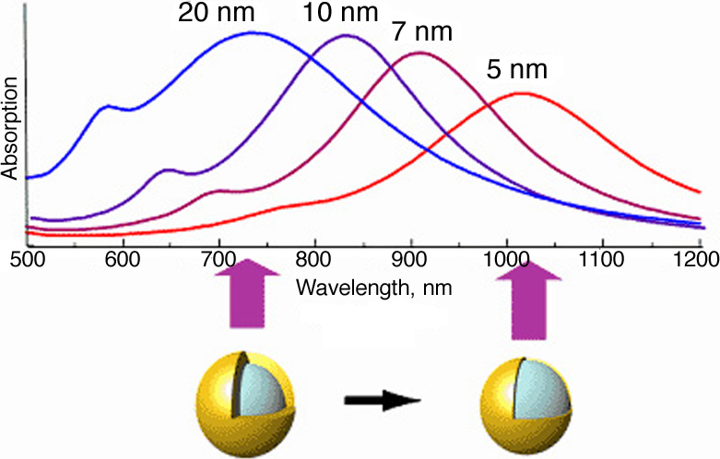
Gold Nanoshells

Slide 18
Gold Nanoshells
Naomi Halas, Professor of Electrical and Computer Engineering at Rice University, known as the inventor of nanoparticles with tunable optical properties controlled by their shape and structure.
Nanoshells known commercially as AuroShells are a novel class of optically tunable nanoparticles that consist of a dielectric core surrounded by a thin gold shell that can scatter or absorb energy dependent upon wavelength. So nanoshells can be used for imaging or heat ablation.
Passive tumor targeting is possible due to a non-specific accumulation of nanoshells at the tumor due to the enhanced permeability and retention (EPR) effect. Again, tumor vasculature is more leaky than normal blood vessels allowing the nanoshells to accumulate.
http://www.ncbi.nlm.nih.gov/pubmed/15826113

Slide 19
Gold Nanoshells
Halas, West and coworkers at Rice University have shown a possible complement to radiation and chemotherapy in cancer therapy, wherein once nanoparticles are at the cancer site they can be heated up in response to a skin penetrating near IR laser.
So a single nanoparticle can offer both diagnostic and therapeutic capabilities as photothermal therapy.
Dual imaging/therapy immunotargeted nanoshells have been used to detect and destroy breast carcinoma cells that overexpress HER2.
http://www.ncbi.nlm.nih.gov/pubmed/15826113

Slide 20
Gold Nanoshells
In an interview Naomi Halas had the following observation of a cancer study.
“In mouse studies, we were able to observe complete remission of all tumors within 10 days. There were two control groups of mice, and their tumors all continued to grow very drastically until their end. But the mice that were treated with nanoshells, they survived the study. The study was actually a 60-day survivability test. That's considered long-term survivability. Well, at the end of that study, there was 100 percent survivability, and the survivability persisted. That test was done in 2003. It's almost two years later. So it looks like most of those mice will be dying of old age”
http://www.pbs.org/wgbh/nova/body/halas-nanoshell.html

Slide 21
Metal Nanoparticles
Professor James C. Dabrowiak “Another possibility is using light excitation to release high concentrations of an anti-tumor drug directly within the tumor.“
Gold nanoparticles have an average diameter of only 15.5 nanometers
A single nanoparticle presents more than 100 Doxorubicin sites and that, when multiplied by millions of the particles, could create a massive and deadly assault on a tumor.
Syracuse laboratory is continuing investigations to check the toxicity of the system
http://oncozine.com

Slide 22
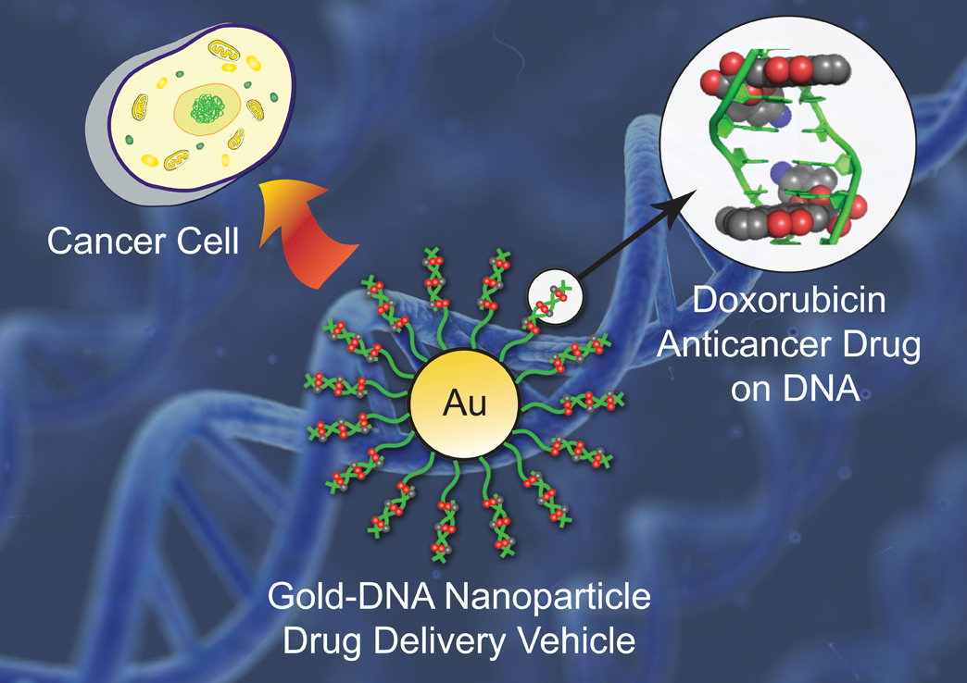
Metal Nanoparticles
Syracuse University's Chemistry Department

Slide 23
Metal Nanoparticles
Quantum dots and plasmons have a wide variety of applications by visually tagging DNA, RNA, proteins, or organelles.
These tags allow researchers to see how cells interact.

Slide 24
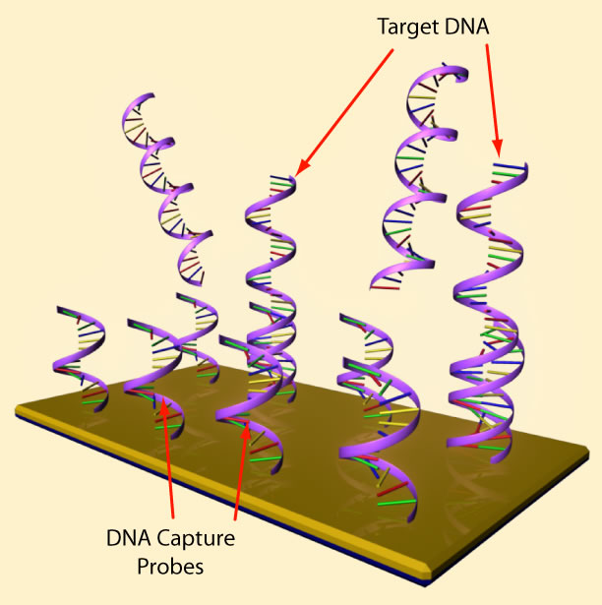
Metal Nanoparticles
Au NP-functionalized DNA
Public Domain: image generated by CNEU Staff for free use

Slide 25
Nanoparticles to Prevent Infection
Silver nanoparticles can be used to prevent bacterial infection during the initial time that the body is accepting the implant.
Race for the surface
Microbes VS Human cells
Generally the silver nanoparticles may increase the healing time, but vastly reduce infection.
Let’s look at some data and select the best treatment.

Slide 26
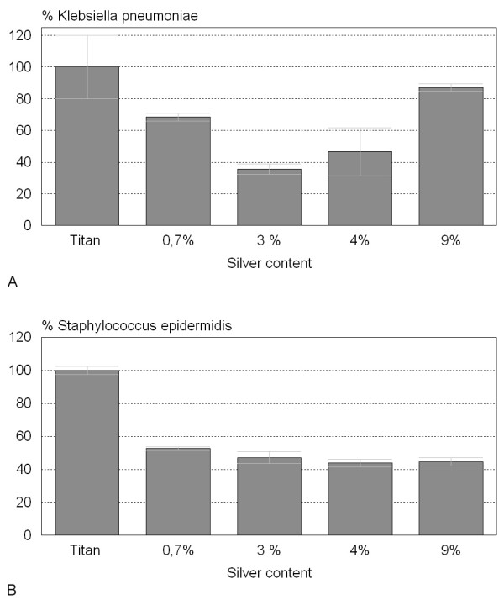
Bacteria Growth on Silver Nanoparticle Treated Surface
Klebsiella pneumoniae adhesion however increases after the coating’s silver content is raised beyond the 3% range. At 9% Ag content the Klebsiella pneumoniae adhesion is 90% of the untreated Ti
Staphylococcus epidermis treated samples that the adhesion continues to decline with increasing Ag content, but that the degree of benefit is quite small after a 3% Ag is achieved in the coating.
DATA from Andrea Ewald, Susanne K Glückermann, Roger Thull , Uwe Gbureck
BioMedical Engineering OnLine 2006, 5:22

Slide 27
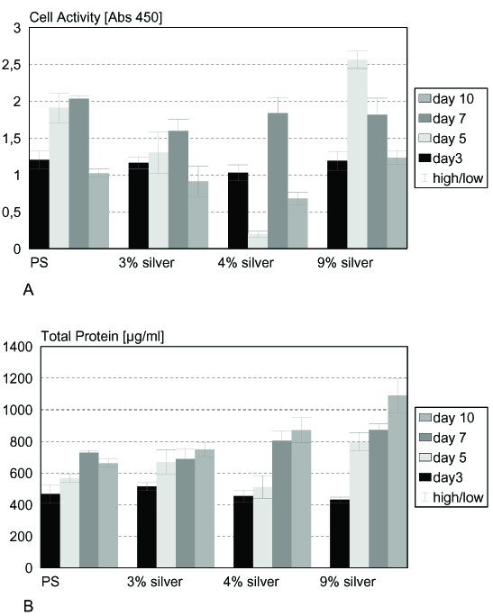
Bone Cell Adhesion with
Silver Nanoparticles
Minimal cell adhesion in the 3-4% range
Higher cell adhesion in the 9% range
BioMedical Engineering OnLine 2006, 5:22

Slide 28
Conclusion
Biological processes set the scale and material processing needs.
Nanoparticles such as liposomes, Au NPs, and nanoshells are of appropriate scale to interact on the cellular level.
Biotech represents a career pathway to use nanotechnology skills.

