Slide 1

Role of Proteins and
Cellular Junctions:
Biocompatibility and Cellular Overview Part 2

Slide 2
Outline
Biocompatibility
Quick overview of cellular interaction
Scale, size, generic animal cell
Nanoscale materials for biological interaction
Liposomes
Metal Nanoparticles
Nanoshells
Examples of bionano applications

Slide 3
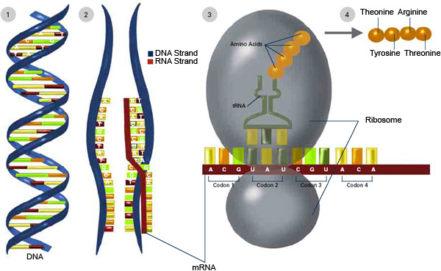
DNA to Protein Synthesis
1) DNA splits to form Pre-mRNA
2) Pre-mRNA code is transcribed to form mRNA
3) The ribosome uses mRNA and tRNA to fashion amino acids into polypeptides
4) The completed polypeptides leave the ribosome to be folded into proteins
Source: http://publications.nigms.nih.gov/thenewgenetics/chapter1.html

Slide 4
Protein Synthesis
Once RNA is synthesized, it leaves the nucleus for the ribosomes in the endoplasmic reticulum.
Transfer RNA, (tRNA) another kind of RNA, transfers amino acids, the building blocks of proteins, from the cell’s cytoplasm to a ribosome.
tRNA, mRNA, and ribosomes function together to synthesize proteins.
Again targeted self assembly.

Slide 5
Protein Background
Proteins are a major class of biomolecules that can directly connect biology to nanotechnology.
Our bodies are 20% protein: this allows us to think, feel, move, and function.
Proteins come in many shapes and sizes, giving them many functions:
Catalysis of chemical reactions within cells
Cellular gatekeepers
Immune system monitoring by recognition of foreign cells
Structural support to cells and tissues
Compare to DNA: 1 structure and 1 function

Slide 6
Protein Background
Proteins are built from 22 types of Amino Acids ~1 nm in size (e.g. tryptophan).
DNA gives the protein information on how to assemble from the amino acid building blocks.
Proteins have highly variable structures and can change their shapes in response to their surroundings in order to provide a signal.
Proteins can provide binding sites for chemical reactions to occur.
Proteins can identify cells. This is important for cancer, because tumors may have identifying proteins.

Slide 7
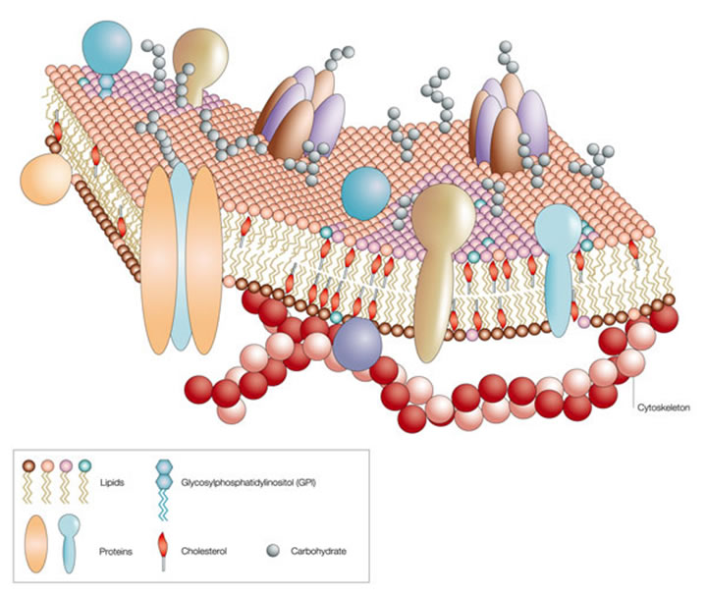
Membrane Structure/Protein Keys
Protein receptors for cell communication
Extracellular environment
Lipid Bilayer:
Excellent example of how “nature” does self assembly
Intercellular region (cytoplasm)
http://neutrons.ornl.gov/conf/dsm2008/registration.shtml

Slide 8
Hydrophobic/Hydrophilic Interaction
Protein interaction establishes the cell’s response to materials
Polypeptides contain both hydrophilic and hydrophobic amino acids.
Polypeptides will fold in aqueous solution. Once folded, polypeptides become proteins, which are a vital part of biological processes.
So the hydrophobic/hydrophilic nature of amino acids give proteins 3 dimensional complexity.

Slide 9
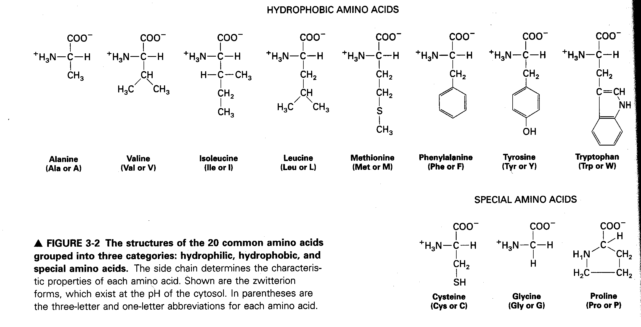
From: Molecular Cell Biology H. Lodish et al

Slide 10
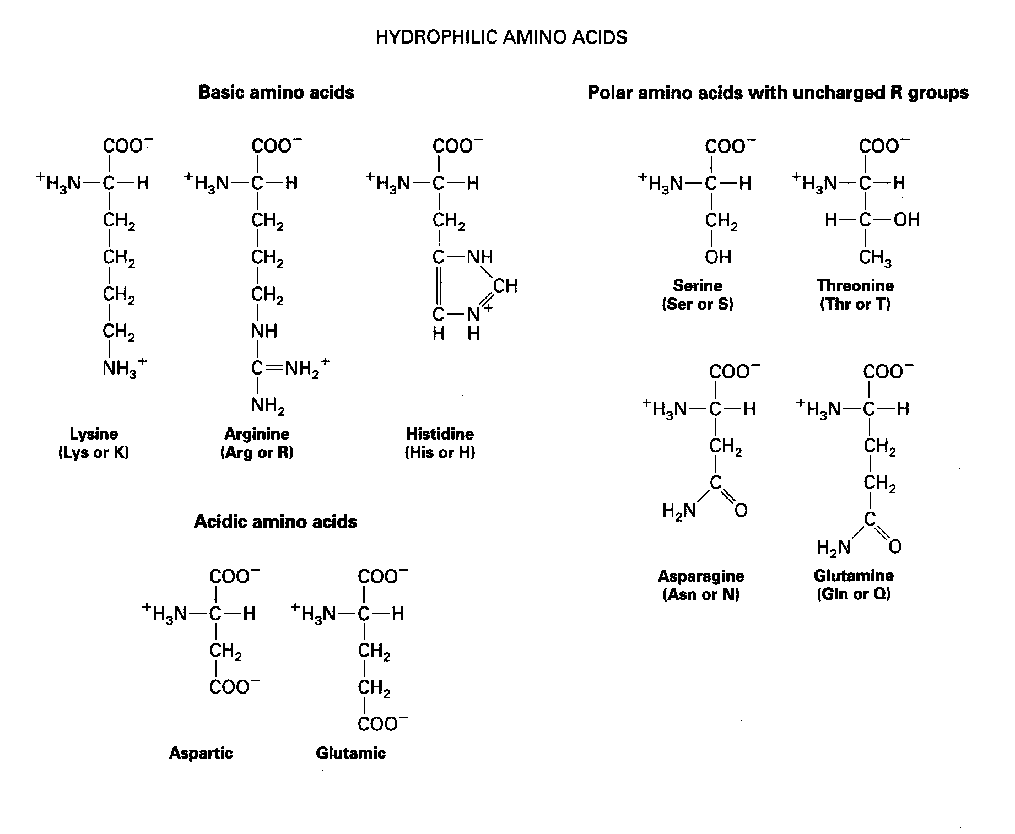
From: Molecular Cell Biology H. Lodish et al

Slide 11
Amino Acids – the Twist
The hydrophobic – hydrophilic nature of amino acids allows polypeptides (proteins), to twist and bend in water.
This twisting and bending often defines the functionality of the proteins.
Material response, and some diseases are defined by lack of a certain twist in a protein…..

Slide 12
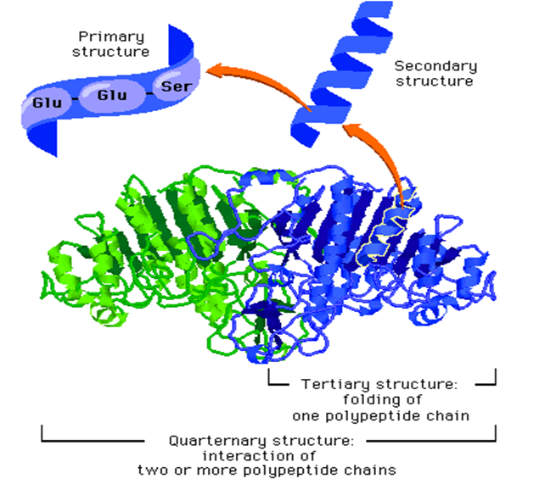
Amino Acids – the Twist

Slide 13
Intercellular Junctions
Neighboring cells often adhere, interact, and communicate through direct physical contact.
There are three main types of intercellular junctions in animal cells.
Tight junctions- fusing connection, prevent leakage of extracellular fluid
Desmosomes- anchor cells together
Gap junctions- pass salts, sugars, amino acids, and other small molecules between cells

Slide 14
Intercellular Junctions
It is interesting to note that cancer tumors often do not follow the rules of normal cells.
Cancer breaks the tight junction rule, and the blood capillaries are often leaky compared to normal tissue.
We will look at how these attributes impact nanotechnology based drugs later in the presentation.

Slide 15
Cell Communication
The cell’s membrane (lipid bilayer) has many receptors which receive chemical signals from other cells and the extracellular matrix.
A ligand is a molecule that binds with a receptor in order to induce a cellular response.
Ligand can be a neurotransmitter, hormone, pharmaceutical drug, toxin, proteins on another cells membrane, etc.
Proteins on the cell membrane serves as a marker identifying one cell to another or a specific environment within the body.
Cell response will vary depending on the type of cell and the signal (ligand) received.

Slide 16
Importance of Cell Communication
Cell-to-cell and cell-to-environment communication is vital for the proper biological functioning.
Therefore an understanding of how cells communicate is just as vital to a nanotechnologist, so material can be properly engineered to achieve the desired cell response.

Slide 17
Intercellular Junctions
Cells adhere, interact, and communicate through chemical signals
Cell function conveys proper environment.
For example, blood cells need to flow, if they bind and clot a stroke can occur
Muscle cells bind, free floating cells should die.
Without these signals, the organism is at risk
Materials must emulate the environment
Hydrophobic – hydrophilic interaction is a material concern

Slide 18
Additional Vocabulary
Cancer, known medically as a malignant neoplasm, is a broad group of various diseases, all involving unregulated cell growth. In cancer, cells divide and grow uncontrollably, forming malignant tumors, and invade nearby parts of the body. There are over 200 different known cancers that afflict humans.
Metastasis, Is the spread of cancer to other locations in the body. They can include enlarged lymph nodes (which can be felt or sometimes seen under the skin and are typically hard), hepatomegaly (enlarged liver) or splenomegaly (enlarged spleen) which can be felt in the abdomen, pain or fracture of affected bones, and neurological symptoms.

Slide 19
Additional Vocabulary
Angiogenesis, is the physiological process through which new blood vessels form from pre-existing vessels. Vascular endothelial growth factor (VEGF) is a signal protein produced by cells that stimulates vasculogenesis and angiogenesis.
Ligand, is a substance (usually a small molecule), that forms a complex with a biomolecule to serve a biological purpose. Ligands can direct particles. Ligands are a signal triggering molecule, binding to a site on a target protein. Selective ligands have a tendency to bind to a very limited types of receptors, whereas non-selective ligands bind to several types of receptors.

Slide 20
Additional Vocabulary
Cancer expression, data from 22 tumor types has identified multiple metabolic expression changes associated with cancer. These expressions can be used to identify and attack tumors.
HER2, epidermal growth factor receptor 2 (HER2), which promotes the growth of cancer cells. This gene mutation and the elevated levels of HER2 that it causes can occur in many types of cancer — not only breast cancer. This is a gene mutation that occurs only in the cancer cells and is not a type of mutation that you can inherit from a parent.

Slide 21
Additional Vocabulary
Prostate-specific antigen (PSA), also known as gamma-seminoprotein or kallikrein-3 (KLK3), is a glycoprotein enzyme. PSA is often over expressed when prostrate cancer is present.
Enhanced Permeability and Retention (EPR) effect, is the property by which certain sizes of molecules (typically liposomes, nanoparticles, and macromolecular drugs) tend to accumulate in tumor tissue much more than they do in normal tissues. Particles can preferentially enter tumors because these newly formed tumor vessels are usually abnormal in form and architecture. They have poorly-aligned defective endothelial cells like a roof missing a shingle. Increased retention is do to the lack of lymphatics around the tumor region which would filter out such particles under normal conditions.

