Slide 1

Basic Characterization Techniques
Basic Characterization Techniques

Slide 2
Outline
Introduction
Optical Microscopes
Profilometry
Ellipsometry
Reflective Spectroscopy
Contact Angle

Slide 3
Metrology
A group of processes used to determine physical and chemical properties of the nanoproduct during and / or after the fabrication process
Metrology tools are essential to determine the quality of fabrication processes and their resultant materials and devices.

Slide 4
Yield
The percentage of quality goods produced out of the total group of goods started.
Yield is enhanced by the ability to measure specific characteristics of a substrate in production. It is used to improve upon manufacturing processes if necessary.

Slide 5
In-situ Characterization
In-situ characterization is a key part of manufacturing today. It provides information about the quality of a device before it is completed.
Improves yield, minimizes waste, monitors processes, provides data for statistical process control.
This process is often non-invasive

Slide 6
In-situ Characterization
The use of characterization tools in-line to gauge the progress of a manufacturing process.
What can be measured in-situ?
substrate temperature, substrate surface quality, film thickness, growth/etch rates, optical constants, residual gas, etc.

Slide 7
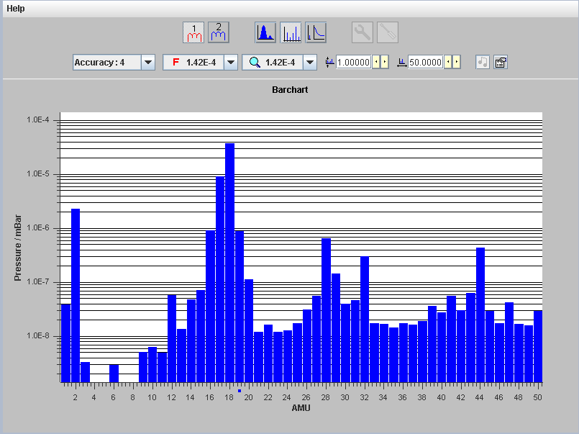
Residual Gas Analyzer Graph

Slide 8
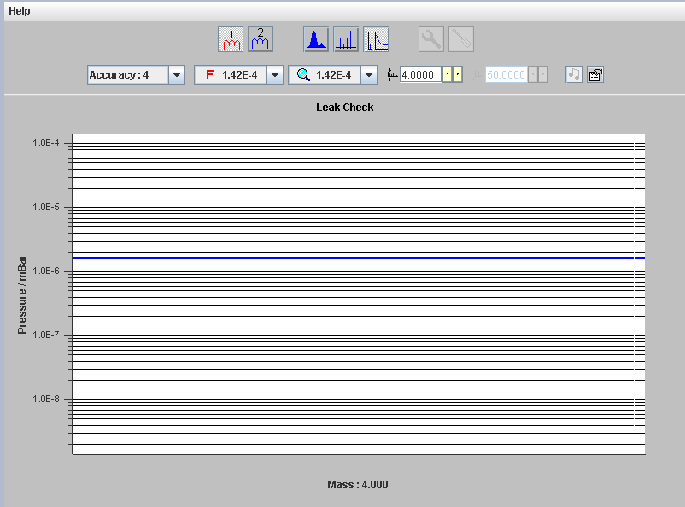
Residual Helium at 1.5x10⁻⁴ T System Pressure

Slide 9
Ex-situ Characterization
This is characterization that necessitates taking a product out of the production line for testing and characterization.
Reasons for performing certain characterization techniques ex-situ:
  May be invasive
  May require special sample preparation
  May be low throughput
Whether or not a characterization method is performed in-situ or ex-situ depends on the production process and may vary from process to process.

Slide 10
Ex-situ Characterization
Some Common Examples:
Structural Characterization Techniques:
  X-ray Diffraction (XRD)
  X-ray Photoelectron Spectroscopy (XPS)
  Auger Electron Spectroscopy (AES)
  Secondary Ion Mass Spectroscopy (SIMS)

Slide 11
Ex-situ Characterization
Some Common Examples:
Microscopy:
  Transmission Electron Microscopy (TEM)
  Scanning Probe Microscopy (SPM) – AFM and STM
  Scanning Electron Microscopy (SEM)

Slide 12
Outline
Introduction
Optical Microscopes
Profilometry
Ellipsometry
Reflective Spectroscopy
Contact Angle

Slide 13
Optical Microscopy
This microscope is the oldest type of microscope and uses visible light and a system of lenses to magnify an image
Due to the size of the wavelength, only low-magnification views and pictures (~1000x) are possible
Some light microscopes can be connected to cameras and computers for simple and cost effective defect detection

Slide 14
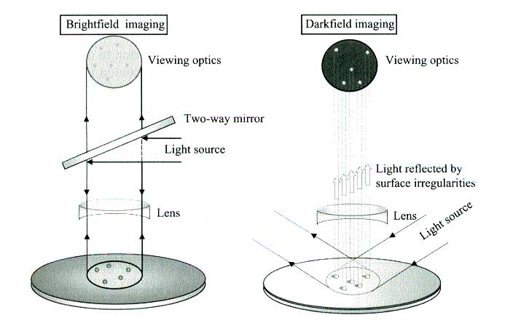
Optical Microscopy
Quirk, M., Serda, J. Semiconductor Manufacturing Technology. Prentice Hall, Upper Saddle River. 2001

Slide 15
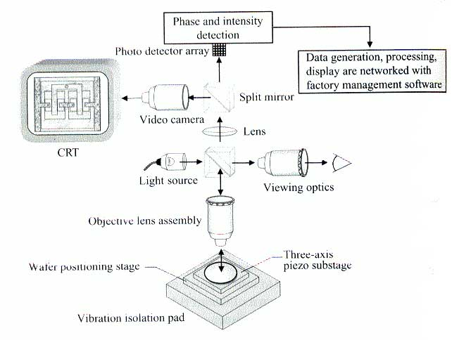
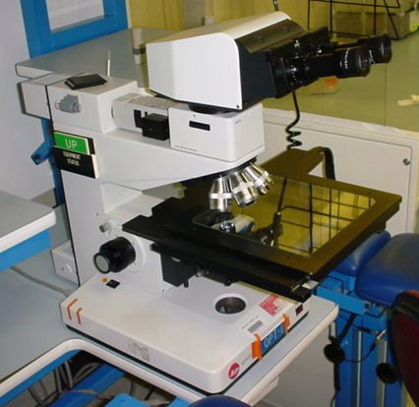
Optical Microscopy
The microscopes in our lab are Leitz Ergolux
Optical Microscopes with video and still camera CCD attachments
Quirk, M., Serda, J. Semiconductor Manufacturing Technlogy. Prentice Hall, Upper Saddle River. 2001

Slide 16
Optical Microscopy
Specifications | (CNEU) Leitz Ergolux
Stand with coarse/fine adjustment | Bright field / dark field vertical illuminator
12v / 100w lamp housing with socket & bulb | Ergonomic tilting trinocular head
Pair of 10x oculars
Motorized 5-Place nosepiece | 5x, 10x, 20x, 50x, 100x BF/DF objectives
6" x 6" X-Y mechanical stage with glass plate | Variable 12v/20w power supply
CCD camera | Photoshop imaging software
Advantages
Able to view a variety of samples | Ease of use
Bright field/dark field modes | Ability to capture images with camera
Disadvantages
Limited magnification range (5 – 1000x) | Cannot measure feature depth on patterned substrates
Imaging software requires manual adjustment

Slide 17
Outline
Introduction
Optical Microscopes
Profilometry
Ellipsometry
Reflective Spectroscopy
Contact Angle

Slide 18
Profilometry
Uses a sharp probe and physically contacts the surface to determine the topography of the substrate’s surface.
Used to measure:
  Film thickness
  Surface topography
  Step heights

Slide 19
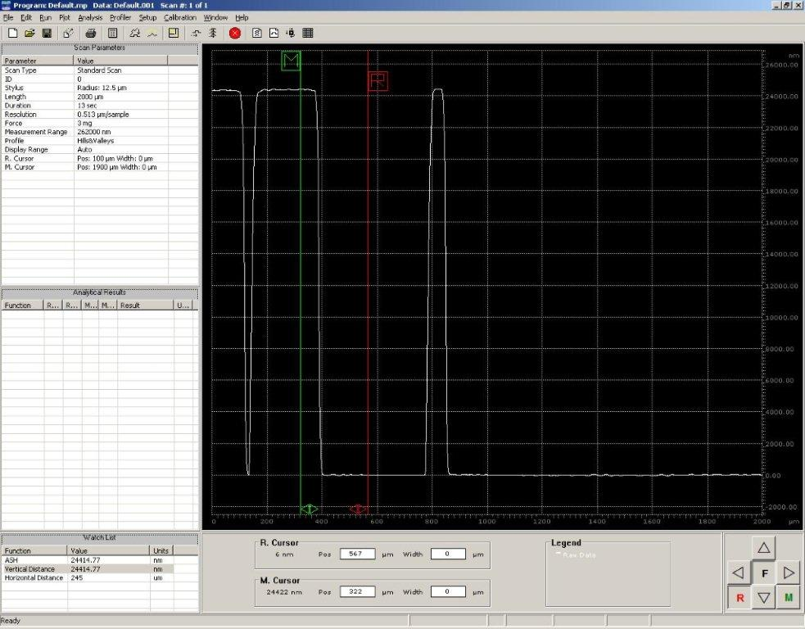
Typical Profilometry Scan

Slide 20
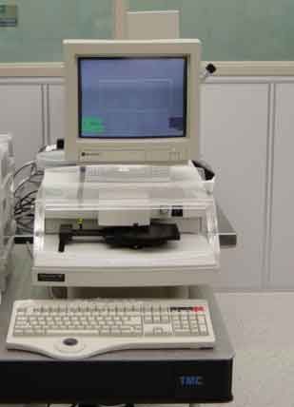
Profilometry
A Tencor 500 Alpha Step Profilometer.

Slide 21
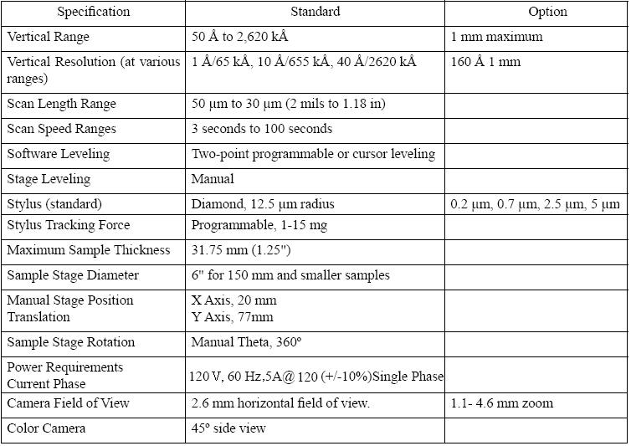
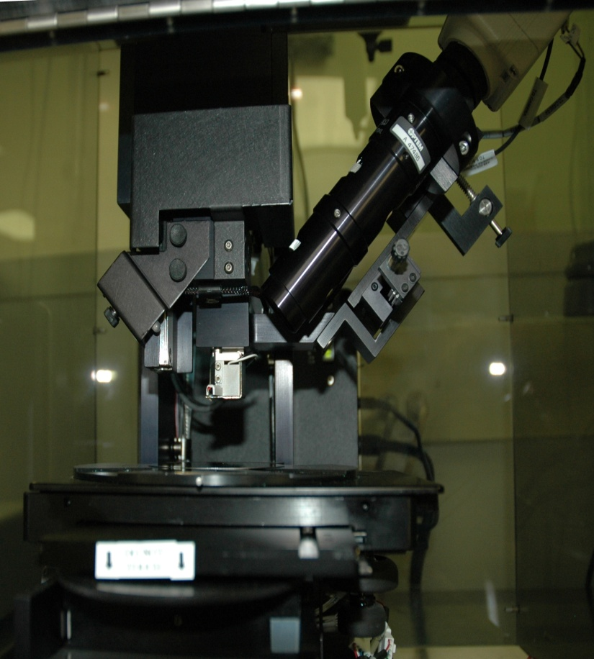
Veeco Dektak 6

Slide 22
Outline
Introduction
Optical Microscopes
Profilometry
Ellipsometry
Reflective Spectroscopy
Contact Angle

Slide 23
Ellipsometry
Ellipsometry is a measurement technique that uses the polarization of laser light to determine film thickness.
Non-destructive and non-contact technique
Very useful method of measuring thickness of materials that are transparent

Slide 24
Ellipsometry
Use a linearly polarized laser light source that when reflected from the sample becomes elliptically polarized
Polarized light, is light that consists of only light rays traveling in one plane
The shape of the reflected ellipse is measured and film thickness is determined based on given information: angle of reflection, index of refraction, etc.

Slide 25
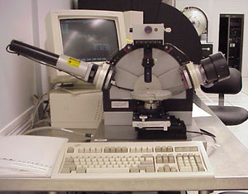
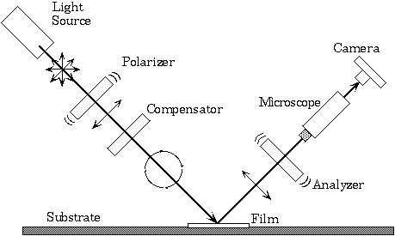
Ellipsometry
The ellipsometer in the Nanofab is a variable
Angle Spectroscopic Ellipsometer
(Gaertner Scientific L116C Ellipsometer ).
This refers to the ability of the machine to
vary the angle of the incident light, optimizing
measurements.
Rensselaer Polytechnic Institute. Joel L. Plawsky
Professor of Chemical Engineering

Slide 26
Ellipsometry
Specifications | Gaertner L115S-8
Laser Light Source | 632.8 nm Helium-Neon (Red)
Incidence Angles | 50º and 70º are used mostly
Beam Diameter | 1.0 x 1.6 mm at 50º and 1.0 x 3.0mm at 70º
Method of Measurement | Four detector-voltages are used to determine state-of-polarization of light of reflected beam. The surface parameters Psi and Delta, and hence film thickness and index of refraction, are calculated.
Film Thickness Range | 0 to 6000 nm
Accuracy | ± 3 Angstroms
Repeatability | ± 1 Angstrom
Refractive Index | ± 0.005
Scanning Modes | Operator selectable; 5 point, 9 point, XY grid or contour map
Scanning Stages | Rotation with translation stages with built in stepping motors
Stepping Motor Drive Source | Two axis, programmable controller; manually or computer controlled
Scanning Increments | 0.01º steps rotation ; 0.01 mm steps to translation

Slide 27
Refractive Index
A property of transparent substance that addresses how much a light beam bends as it travels through the test media
By measuring two unique angles of incidence, the ellipsometer can determine index of refraction and thickness.
Changes in the index of refraction can represent changes in stoichiometry

Slide 28
Refractive Index
Air
n=1.0
SiO₂
n=1.46
θ
SiO₂
n=1.46
Air
n=1.0
θ
Public Domain: Image generated by CNEU Staff for free use

Slide 29
Outline
Introduction
Optical Microscopes
Profilometry
Ellipsometry
Reflective Spectroscopy
Contact Angle

Slide 30
Reflection Spectroscopy
Reflection spectroscopy is the analysis of light that has been reflected or scattered from a solid, liquid or gaseous medium.
Commonly used to determine film thickness and index of refraction.
Non-destructive and non-contact.
Simple and relative low cost

Slide 31
Reflection Spectroscopy
A broadband light source is reflected off the sample at normal incidence.
The intensity of the reflected light is measured over the range of wavelengths.
Computer software utilizes the property of dispersion (the wavelength dependence of a medium’s index of refraction) to determine the film thickness
Detector
Light source

Slide 32
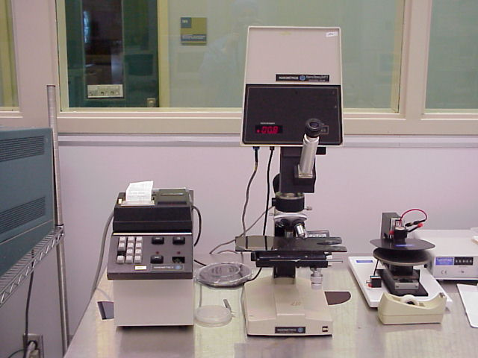
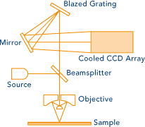
Reflection Spectroscopy
The reflection spectroscopy equipment in the
Lab is a Nanometrics Nanospec AFT
model 010-180.
Nanometrics Inc

Slide 33
Reflection Spectroscopy
Advantages and Disadvantages:
Able to analyze multilayer films.
Can measure organic films like photoresist.
Usually requires a reference sample of known composition and thickness

Slide 34
Outline
Introduction
Optical Microscopes
Profilometry
Ellipsometry
Reflective Spectroscopy
Contact Angle

Slide 35
Contact Angle
Measures the adhesion of liquids to a surface can be used to calculate surface energies or adhesion
tension
Characterizes surface parameters:
  wettability (hydrophobicity), cleanliness, finish, and adhesion
These parameters can be used predict things such as adhesion, corrosion, or biocompatibility

Slide 36
Contact Angle
Contact Angle
Instruments that analyze contact angles are either referred to as:
  Tensiometer
  Contact Angle Analyzer
  Geniometer

Slide 37
Contact Angle
The tangent angle formed between a liquid drop and its supporting surface is relative to the forces at the liquid/solid or liquid/liquid interface.
This angle is representative of surface bonding energy.
Contact Angle
Droplet
Substrate

Slide 38
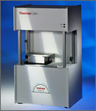
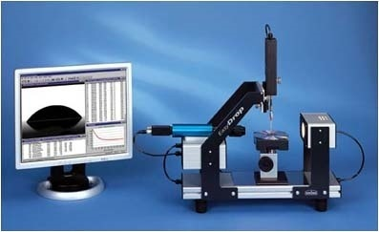
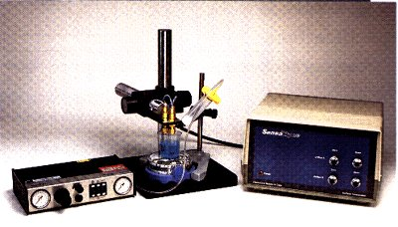
Contact Angle Tools
Contact Angle Tools
Cahn Radian DCA Analyzer
Kruss DSA 10 Contact Angle Analyzer
http://www.qtech.com.pk/thermo.html
http://www.kruss.de/en/products/contact-angle/easydrop.html
SensaDyne Bubble Tensiometer
http://www.sensadyne.com/sts.html

Slide 39
Contact Angle
Contact Angle
Case Study: Biological Applications
C. Dahmen, et al. studied Surface functionalization of amorphous silicon and silicon suboxides for biological applications. There findings were published in Thin Solid Films Vol 427, Issues 1-2 , 3 March 2003, Pages 201-207

Slide 40
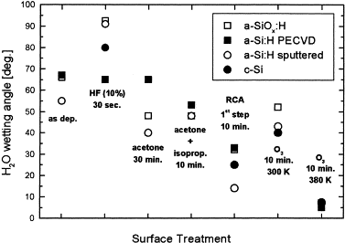
Contact Angle
Contact Angle
Wetting angle for four different silicon and suboxide
samples as a function of surface treatment with HF.
The longer these four samples were treated with HF the more the surface topography changed and the smaller the contact angle became.
C. Dahmen, et al. Surface functionalization of amorphous silicon and silicon suboxides for biological applications. Thin Solid Films Vol 427, Issues 1-2 , 3 March 2003, Pages 201-207

