Slide 1
Remote Access Laboratory Guide
Identification of Unknown Mineral
In this exercise, you will:
Gather minerals
Conduct experiments to determine the material properties
Identify an unknown mineral
Gain experience in nanoscale characterization
Published: Dec 2016, Rev. 1

Slide 2
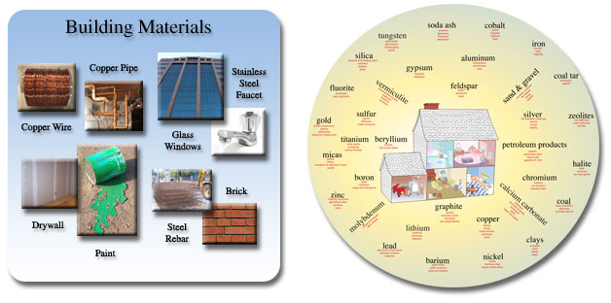
Background
Do we take minerals for granted? Your automobile contains more than a ton of steel, 240 pounds of aluminum, 50 pounds of carbon, 42 pounds of copper, 41 pounds of silicon, 22 pounds of zinc, plus more than thirty other mineral commodities, including titanium, platinum and gold. No wonder the cost of a car is so high. Have you thought of how a battery runs. If not for lead, nickel, cadmium or lithium, batteries don’t exist. No cell phones, computers or X Box Ones. Without nonfuel mineral commodities, many things we take for granted, would no longer work.
Minerals are everywhere and we interact with them on a daily basis (Figure 1). The United States Geological Society (USGS) is an advocate for supporting research efforts in identifying new mineral sources and investigating how these materials interact with the environment to affect human and ecosystem health. As a part of this effort, analytical techniques must be developed to determine the elemental composition of unknown mineral samples. In this lab, you will be given two unknown geological samples to identify. You will than collect a geological sample of your own and as a class, determine the elemental composition of each of your samples.
http://minerals.usgs.gov/granted.html

Slide 3
Background
The Physical and Chemical properties of the minerals will be investigated for the purpose of identifying the unknown mineral.
Experiments to determine Physical Properties
Hardness
Color
Streak
Luster
Cleavage
Specific gravity
Experiments to determine Chemical Properties
Flame test
Precipitation with NaOH
Acid Test

Slide 4
Background
For this lab exercise, you will need the following :
A piece of plain white paper (a blank specimen label works great.)
Your fingernails (preferable still attached to your fingers!)
A copper penny ( pre-1983; or small – ½ inch – piece of copper; or short piece of heavy copper wire.)
A small piece of fluorite (a broken cleavage piece is fine.)
A pocket knife (NOT a Swiss Army knife – the steel in those is harder than in most cheap pocket knives, which can throw hardness tests off.)
A small section of a steel file (a 2 or 3 inch tip from a triangular file for sharpening chain saws works fine.)
A piece of a quartz crystal (with at least one good face and a sharp point - a broken section usually has a sharp point on it somewhere, it doesn’t have to be a crystal termination.)
A small piece of a beryl or topaz crystal (with at least one good face and a sharp point or edge.)
A small piece of a corundum crystal (with at least one good face and sharp point or edge.)
A "streak plate" (unglazed porcelain tile – a 2 inch square is plenty.)
A short candle stub and matches or a cigarette lighter.
A small pair of tweezers.
A needle in a wooden dowel (for generating cleavage, etc.)
A small magnet (a refrigerator magnet is fine, but it should be a fairly strong one.)
A plastic dropper bottle for dilute (10%) HCl acid solution (Please read, understand and follow the label warnings and Material Safety Data Sheets when working with any hazardous material).
A 10x hand lens/jeweler’s loupe.
Additional resources for obtaining information regarding mineral properties including mineral
ID key required for this experiment:
http://www.minsocam.org/msa/collectors_corner/id/mineral_id_keyi1.htm

Slide 5
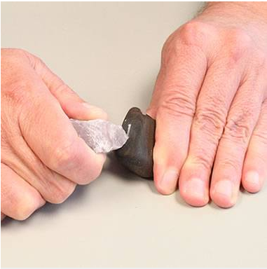
Procedure: Hardness
Hardness: Hardness is the scratchability of a substance. The easiest way to determine hardness is to scratch one mineral with another. If one mineral can scratch another, the one that does the scratching is the harder mineral. A series of 10 common minerals are used as a relative scale known as Moh’s hardness scale with 1 being the easiest to scratch and 10 being the hardest. A mineral’s hardness is where it resides in relation to this scale. For example if a mineral can scratch the Moh’s mineral with a hardness of 4 but cannot scratch the Moh’s mineral with a hardness of 6, its hardness is approximately 5.
Hardness | Mineral
1 | Talc
2 | Gypsum
3 | Calcite
4 | Fluorite
5 | Apatite
6 | Orthoclase
7 | Quartz
8 | Topaz
9 | Corundum
10 | Diamond
Fingernail (2.5)
Copper penny (3)
Pocket knife (~ 5)
Window glass (5.5)
Steel file (6.5)
http://geology.com/minerals/mohs-hardness-scale.shtml

Slide 6
Procedure: Color
Color: While it is still worth noting, for many minerals color is the least reliable of all the physical properties because differences in grain size, minute amounts of impurities and other variations may cause changes in a mineral's normal color. Two specimens of the same mineral can look very different as a result of these variations but will still display the same fundamental properties that are determined by its composition.
Streak: The color of the powdered mineral. It is especially significant when different from the color of the unpowdered mineral. Streak is determined by scratching a mineral on a ceramic streak plate.

Slide 7
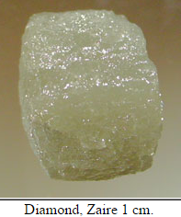
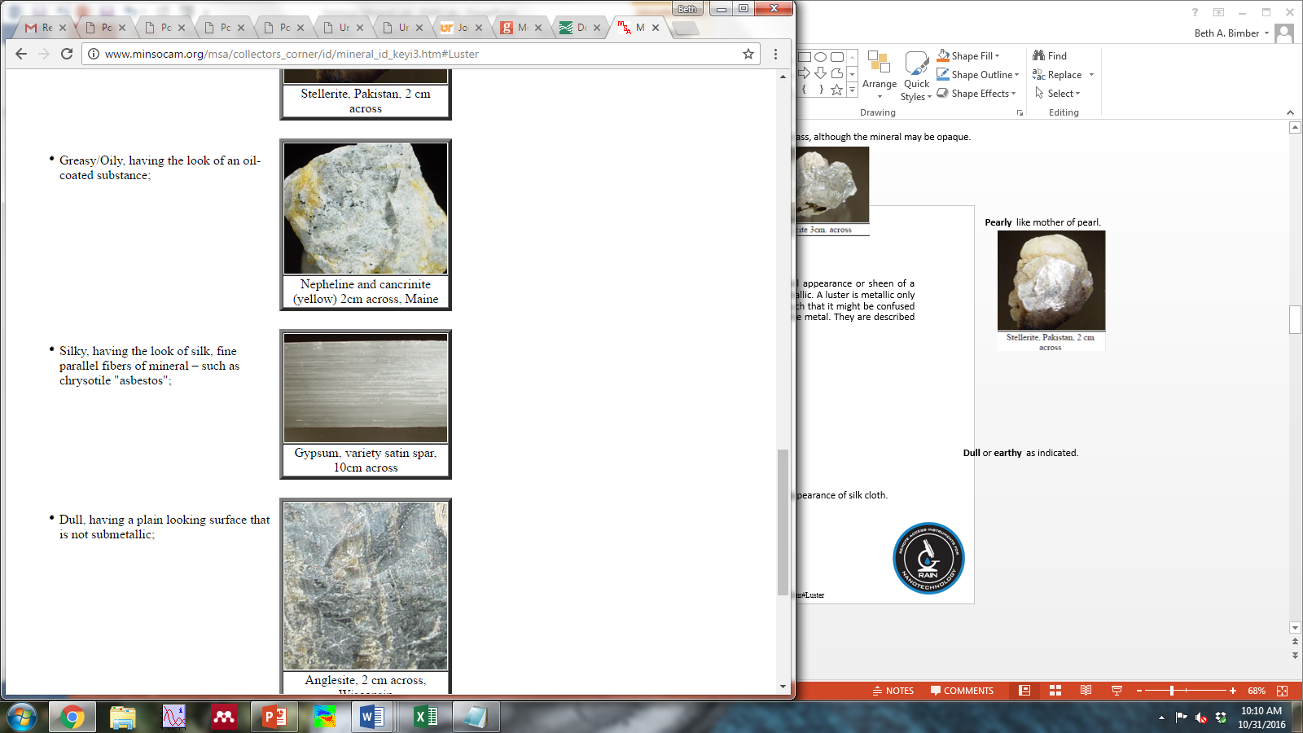
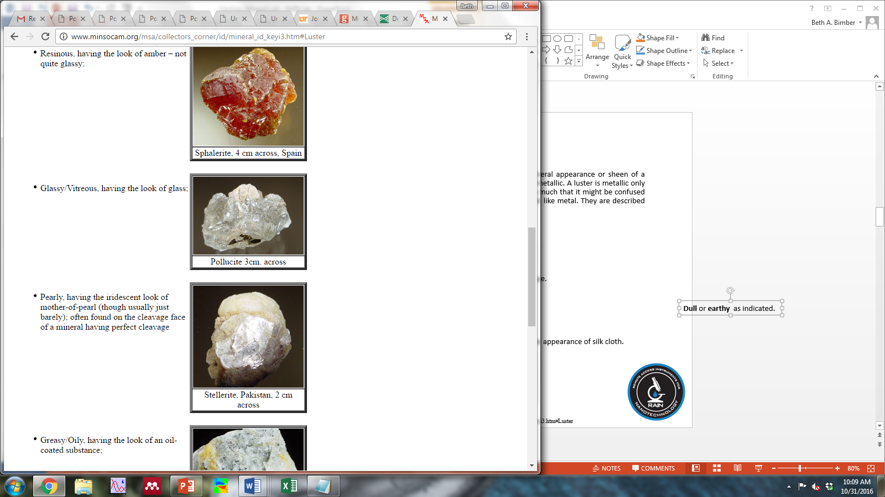
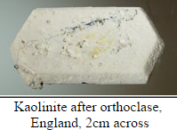
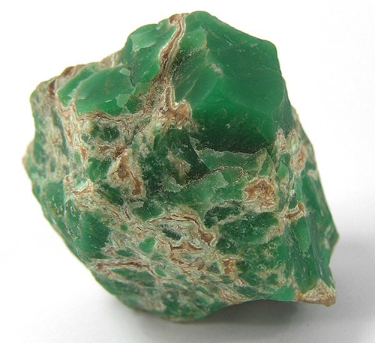
Procedure: Luster
Luster: Luster is the way in which a mineral reflects light; the general appearance or sheen of a mineral. The two main classifications of luster are metallic and nonmetallic. A luster is metallic only if it resembles a metal (such as iron, bronze, lead, silver or gold) so much that it might be confused with it. Nonmetallic minerals are obviously those which do not look like metal. They are described by the following terms:
Adamantine ­ reflects light like a diamond.
Silky ­ the appearance of silk cloth.
Resinous ­ the appearance of dried pitch, or fiberglass resin.
Vitreous/Glassy ­ reflects like glass, although the mineral may be opaque.
Waxy ­ the appearance of a freshly waxed surface, or a broken candle.
Dull or earthy ­ as indicated.
Oily ­ the appearance of oil.
Pearly ­ like mother ­of ­pearl.
http://www.minsocam.org/msa/collectors_corner/id/mineral_id_keyi3.htm#Luster

Slide 8
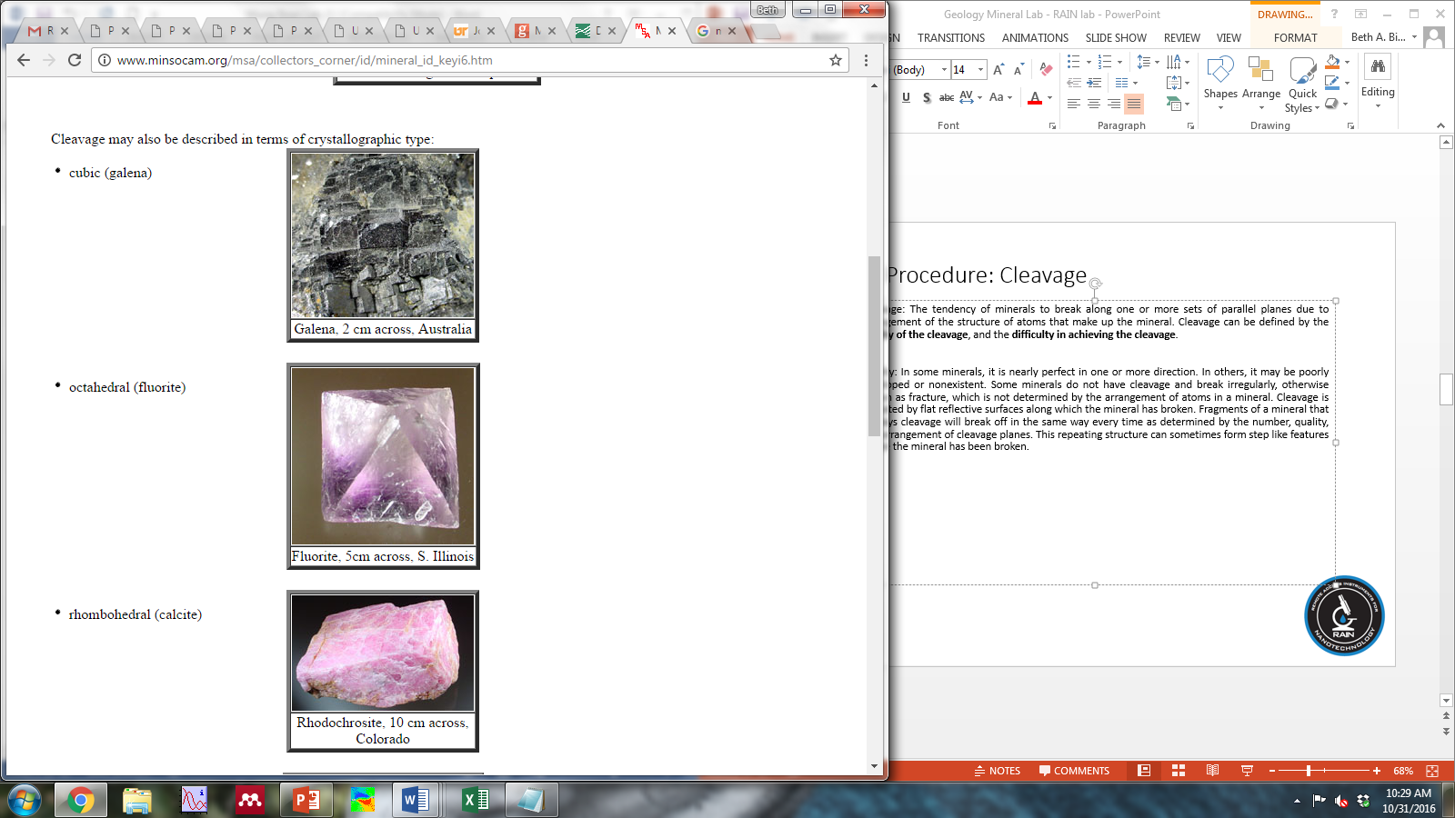
Procedure: Cleavage
Cleavage: The tendency of minerals to break along one or more sets of parallel planes due to arrangement of the structure of atoms that make up the mineral. Cleavage can be defined by the quality of the cleavage, and the difficulty in achieving the cleavage.
Quality: In some minerals, it is nearly perfect in one or more direction. In others, it may be poorly developed or nonexistent. Some minerals do not have cleavage and break irregularly, otherwise known as fracture, which is not determined by the arrangement of atoms in a mineral. Cleavage is indicated by flat reflective surfaces along which the mineral has broken. Fragments of a mineral that displays cleavage will break off in the same way every time as determined by the number, quality, and arrangement of cleavage planes. This repeating structure can sometimes form step like features where the mineral has been broken.
http://www.minsocam.org/msa/collectors_corner/id/mineral_id_keyi6.htm

Slide 9
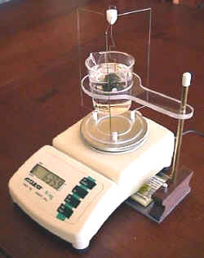
Procedure: Specific gravity
Specific gravity: refers to the weight of the mineral compared to a comparable amount of water. It is a ratio that has no units but has about the same value as density and can therefore be determined in the same manner, by calculating the mass of the mineral over the volume.
http://www.valueerror.com/pennstate/ce_lab/specific-gravity/

Slide 10
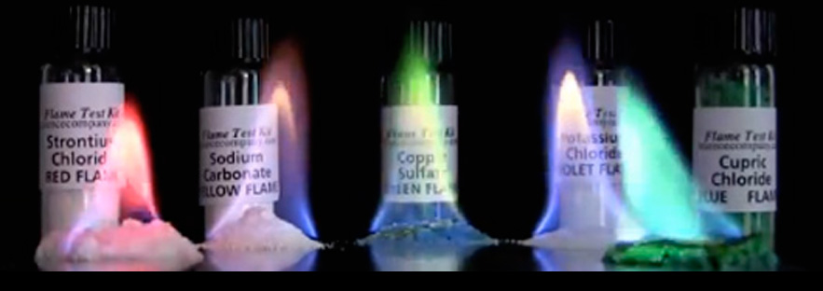
Procedure: Flame Test
Flame test: A flame test can be used to determine the cation present in a mineral, assuming the cation contained in the mineral produces a colored flame when burned. Obtain a nichrome wire and clean it thoroughly using the hottest part of the Bunsen burner flame. Moisten the tip of the wire with a 1.0 M HCl solution and dip it into the pulverized mineral in order to adhere a small amount of the mineral onto the end of the wire. Introduce this end of the wire into the flame. The presence of a specific cation will produce a colored flame. The colored flame doesn’t last long and some colored flames are very similar to the natural color of the flame so pay close attention. A table has been provided for the color a specific cation produces, if any.
http://www.sciencecompany.com/Flame-Test-Chemical-Kit-With-Five-Chemicals-P16517.aspx

Slide 11
Procedure: Precipitation with NaOH
Precipitation with NaOH: In order to test cations for precipitation with NaOH (aq), an initial stock solution should be made using a small amount of the pulverized mineral and dilute nitric acid to dissolve the compound. Once the stock solution is prepared, precipitation can be tested by adding NaOH (aq) drop­wise to the solution. Keep in mind the pH of the solution should reach pH 7 before any precipitation can occur. The pH can be monitored with the use of indicator paper. Precipitation will occur upon the formation of Pb(OH)₂, Al(OH)₃ or Zn(OH)₂. Care must be taken throughout the addition of aqueous NaOH as the precipitate compounds exhibit amphoteric behavior and will dissolve in excess NaOH forming the soluble salts Na₂Pb(OH)₄, NaAl(OH)₄, and Na₂Zn(OH)₄ respectively.

Slide 12
Procedure: Acid Test
Acid Test: Minerals containing a carbonate anion can be tested for by the addition of HCl (aq) to the powdered mineral. If the carbonate anion is present, the reaction between the HCl (aq) and carbonate anion will bubble upon the formation of CO₂ gas.

Slide 13
Procedure:
Determining the unknown mineral
Using the identification methods for both physical and chemical properties of minerals, gather as much data as possible on your provided specimen and attempt to identify it by name and chemical formula. The link provided
(http://www.minsocam.org/msa/collectors_corner/id/mineral_id_keyi1.htm)
will provide additional resources to aid in identifying physical properties. The site also features a mineral ID table which you will need to use to determine what your unknown specimen is. The table asks a series of yes/no questions based on the physical properties you have identified and then provides a list a minerals that display those properties. You will then need to conduct chemical tests to further narrow down your choices by identifying the elements present in the composition of your unknown mineral.
(Note: It is not necessary to conduct both an acid and precipitate test for every specimen. For example If your observations indicate that your specimen is a carbonate, then conduct the appropriate test to obtain results that support those observations. If your observations indicate that your specimen may form a precipitate in a solution, then conduct that test. If you conclude that one of either tests will not yield supporting data, indicate why on the line provided.)

Slide 14
Procedure:
Microscopic determination of the unknown mineral
Using the Scanning Electron Microscope (SEM) and Electron Diffraction Spectrometer (EDS), determine the elemental analysis of your unknown mineral. Using data, determine empirical formula.

Slide 15
Remote Access Connection Instructions
What makes these labs different and unique from other classroom experiments is that we have incorporated a section in each activity to remotely characterize your samples from your classroom. Remote access to a variety of characterization tools can enhance the visualization of micro-/nano-related concepts by allowing students to see the effects of their work first hand. You can choose to mail your samples to our facility to be analyzed at a later date or you can use our samples that have been processed using the same procedure. Please use the following steps to successfully complete a remote session.
Request a remote lab session specifying pertinent information such as: the day, the time, and the instrument you are interested in using by visiting our web site http://nano4me.org/ Go to the Educator’s tab and select the Remote Access tab in that section. You will see the list of partners with the instruments provided to chose from.
You will be contacted by a Remote Access staff member to set up a test run to ensure you are set up properly and have the required infrastructure.
Send samples or verify the in-house sample you would like us to prepare and load for characterization. Send your samples to the Remote Access center that you chose on your request.
There are two communications soft-ware packages, that will allow us to communicate instructions and answer questions during the session.
  Zoom: You can obtain a free download at: https://www.zoom.us/
  TeamViewer: You can obtain a free download at: https://www.teamviewer.com/en/index.aspx

Slide 16
Remote Access Connection Instructions
You will need:
  Computer with administrator access to install plug-ins and software
  An internet connection
  Speakers
  Microphone
  Projector connected to the same computer
  Web browser (Firefox preferred)
During the test run you can refer to this guide to perform the following steps, but it’s very important that you only proceed with these steps during your scheduled times. You may interfere with other remote sessions and potentially damage equipment if you log in at other times.
  Open and logon to your Zoom/Team-viewer account. You will be given the access code to enter at the time of your test and then again during the remote session.
    If you are using the Zoom software, Remote Access staff will give you the access code.
    If you are using the Team-viewer software, Remote Access staff will give you the ID & password.
  You should soon see the Remote Access desktop and at this point you can interact with the icons on the screen as if it were your desktop.
  Switch to full screen mode by selecting the maximize screen option in the top right corner of the screen.
  Upon completion of the session, move your mouse to the top right corner of the screen, and click on the X to disconnect the remote session. It will ask if you want to end the remote session. Click Yes.

Slide 17
Author and Editor References
This remote access laboratory was created thanks to work done primarily at Pasadena City College, Pasadena CA. Two workshops were held at PCC in Aug 2015 and Aug 2016. Contributors to this the creation of this laboratory were:
  Jared Ashcroft Pasadena City College
Editing into RAIN Format was completed by:
  Beth Last The Pennsylvania State University

Slide 18



References and Supplemental Material
A Cooperative Approach to Teaching Mineral Identification; T. L. Constantopoulos; Journal of Geological Education; 1994, 42, 261-263
The Nanotechnology Applications and Career Knowledge (NACK) Center was established at the Penn State College of Engineering in September 2008 through the National Science Foundation (NSF) Advanced Technological Education program.
Please contact a NACK representative today to assist you in increasing the awareness of nanotechnology and education related opportunities across the nation. Visit our website for an expanded contact list.
The work included had been led by the NACK Center and has been partially supported by the NSF under Grant Nos. 0802498, 1205105, and 1601450. Any opinions, findings, and conclusions or recommendations expressed in this material are those of the author(s) and do not necessarily reflect the views of the National Science Foundation.
Nanotechnology Applications and Career Knowledge (NACK) National Center
Pennsylvania State University
118 Research West
University Park, PA 16802
Funded, in part, by a grant from the National Science Foundation.
DUE 1601450

