Slide 1
The Thermostat
How it works and why.

Slide 2
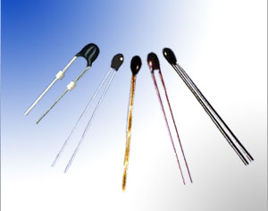
The thermostat uses many instruments to measurer settings and parameters .
One thing that makes a thermostat operate is the resistance of a thermistor, A thermistor is a temperature-sensing element composed of sintered semiconductor material which exhibits a large change in resistance proportional to a small change in temperature. Thermistors usually have negative temperature coefficients which means the resistance of the thermistor decreases as the temperature increases. The thermistor comes in many different shapes and sizes .

Slide 3
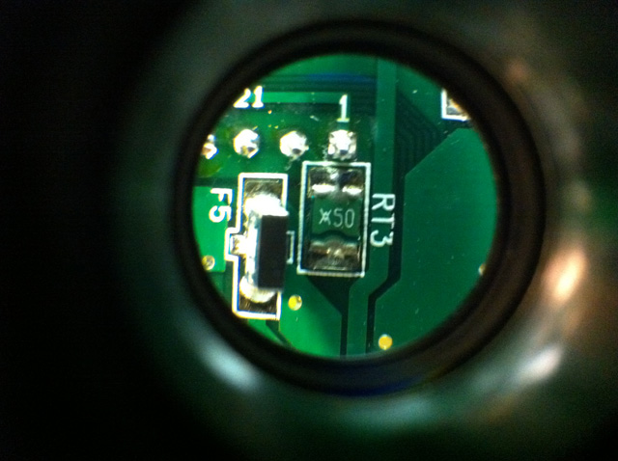
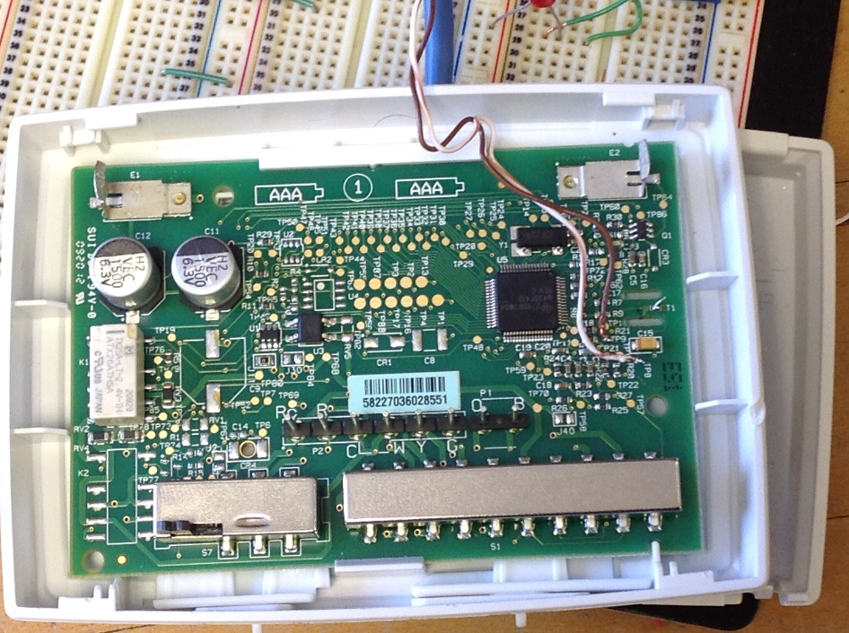
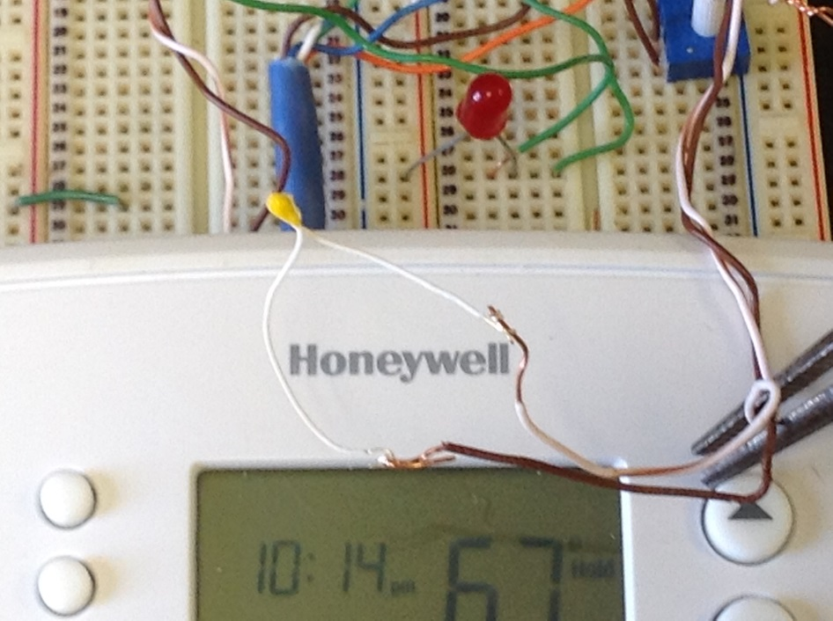
For testing proposes we choose to replace
A surface mount with a probe type thermistor.
A surface mount or (smd ) extending work area more controlled

Slide 4
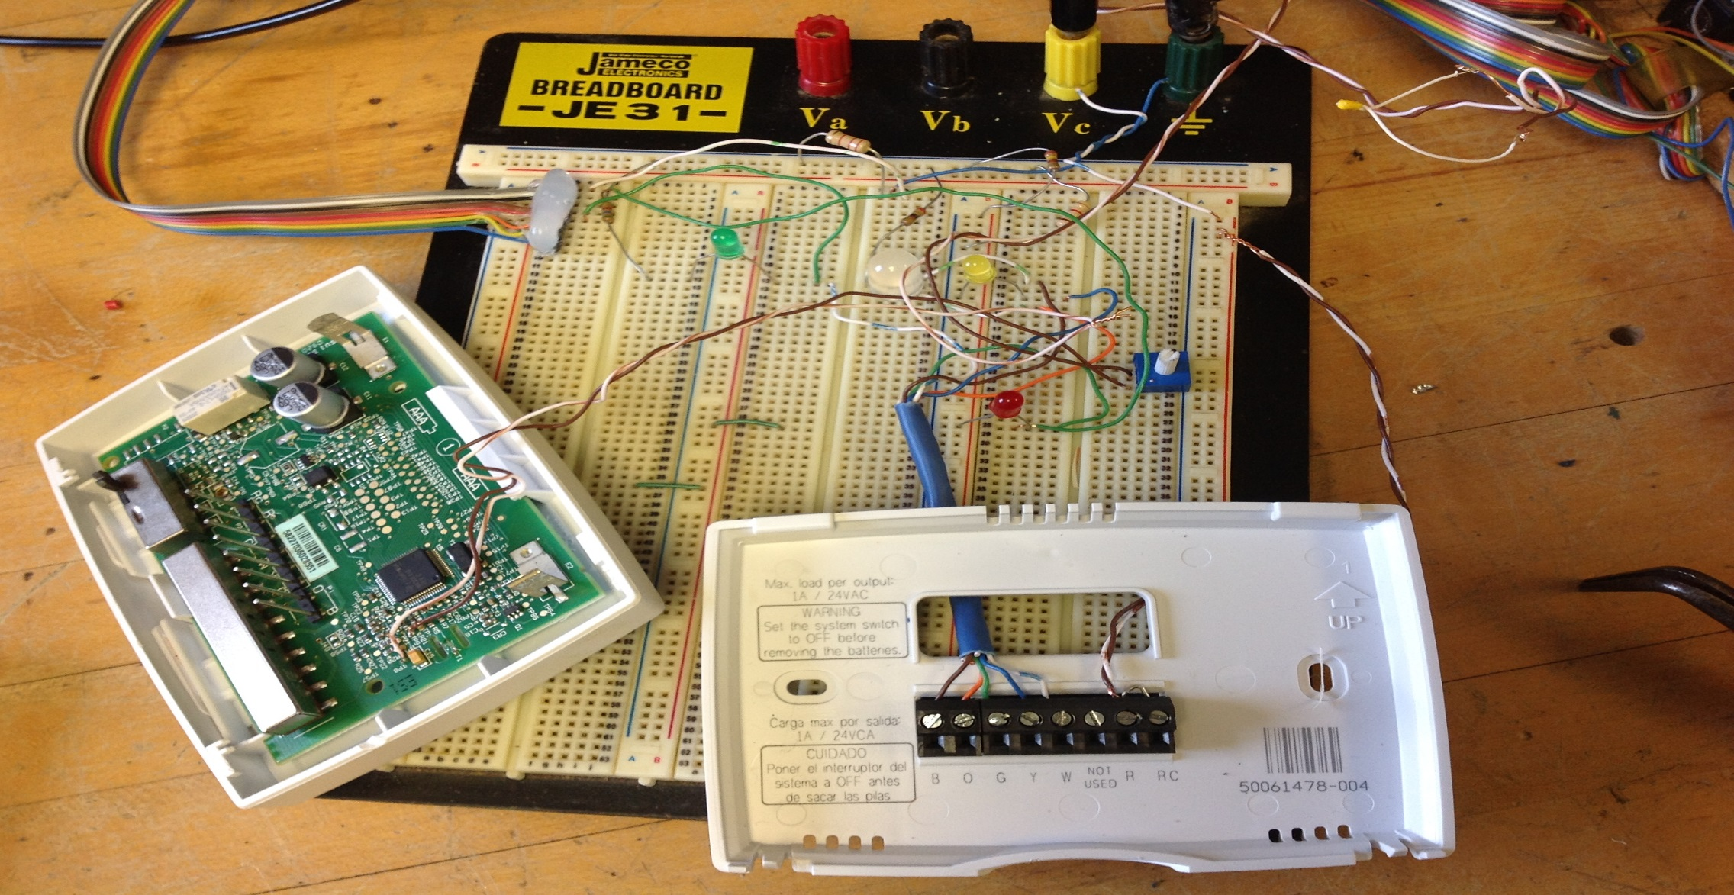
After hacking the original board, we need to accommodate some testing points ,this is where a bread board comes in handy !

Slide 5
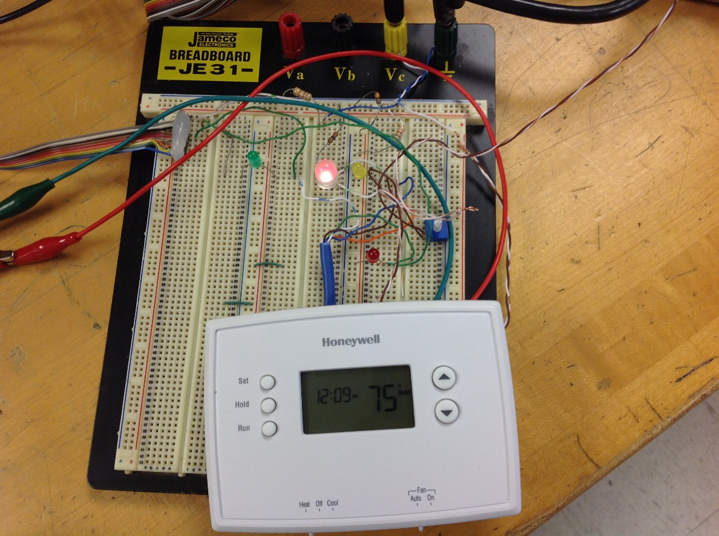
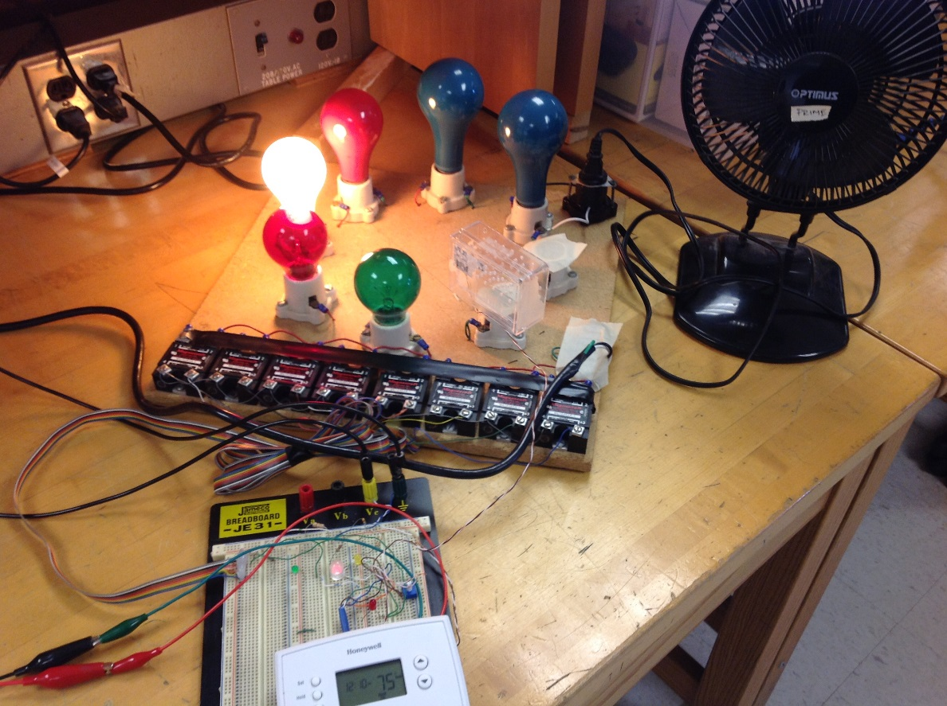
Note that we use led to monitor the status of inputs and outputs before extending signals to a higher voltage level .
To simplify wiring you can use a bipolar led to define heat or cool mode of the thermostat.

Slide 6
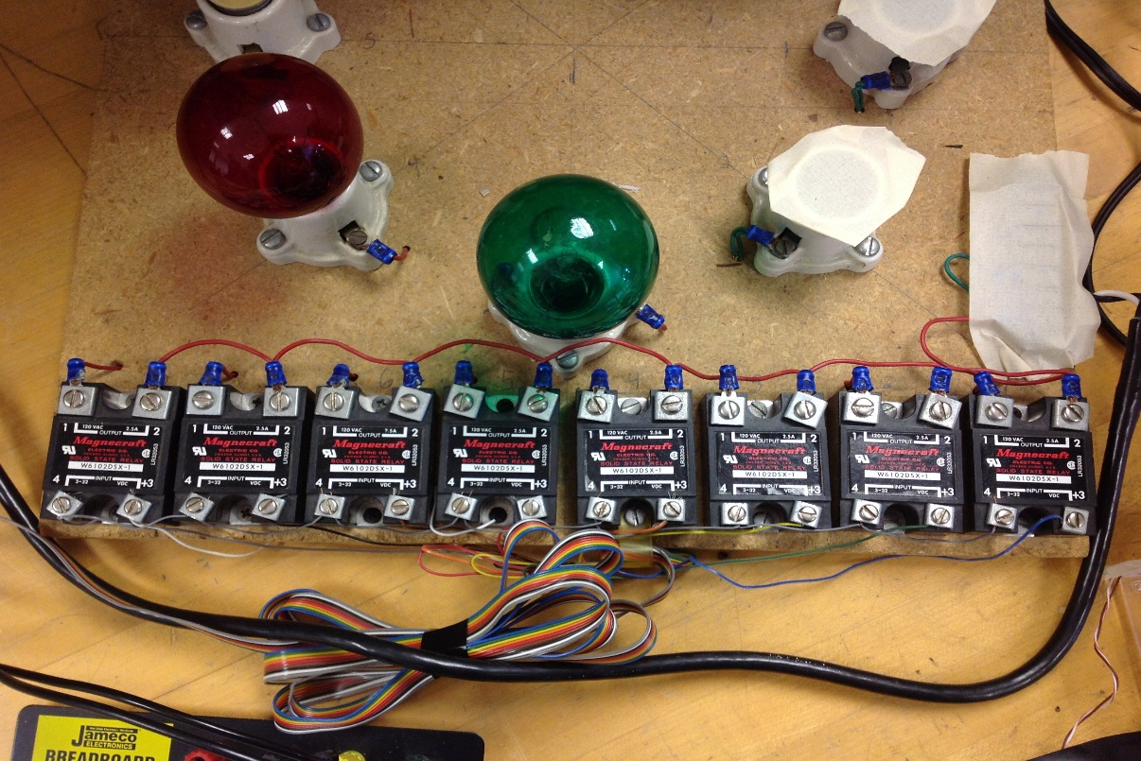
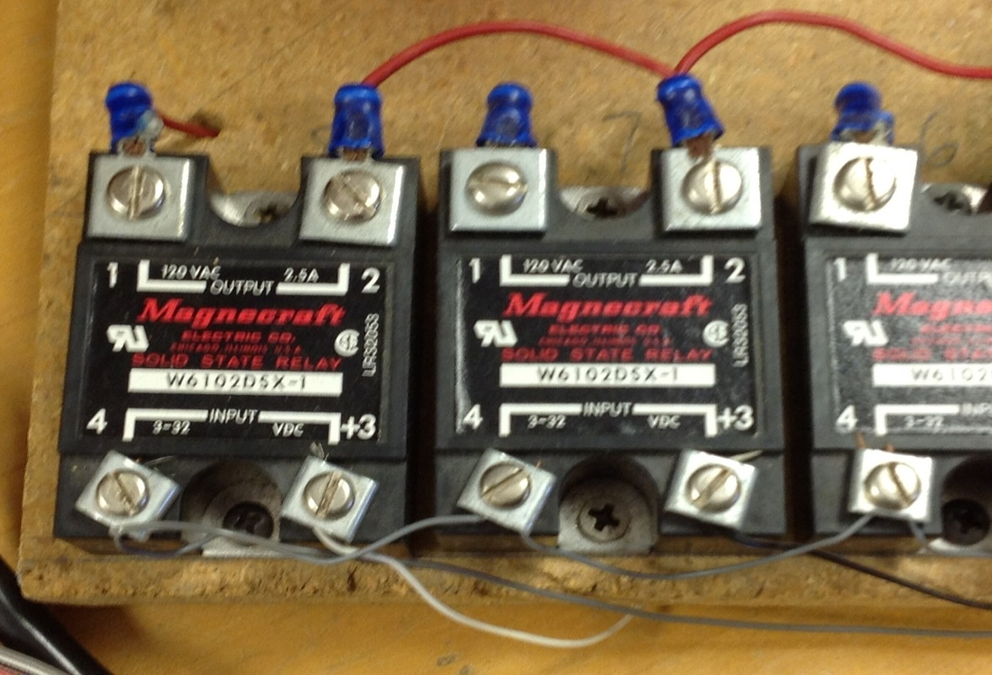
Here is a common way to relay signals .Unlike mechanical relays the solid state relays have no moving parts, Thus having no sign of state on or off other than outside sources. Great care must be taken because of the mix of dc and ac voltage sources .

Slide 7
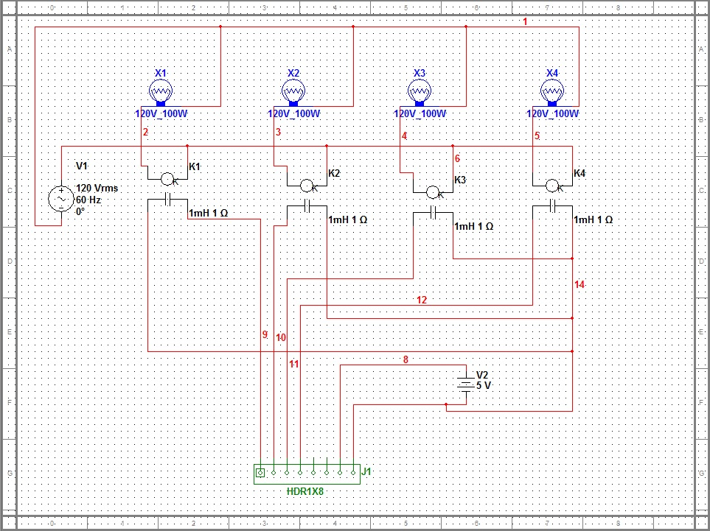

We end up with a wire schematic like this!
Fulton-Montgomery Community College TEPP Technological Education Pathways Partnership
NSF DUE 1003122

