Slide 1
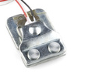

The SEN-10245 50kg Load Cell And The Wheatstone Bridge.
Basic setup and operation.

Slide 2
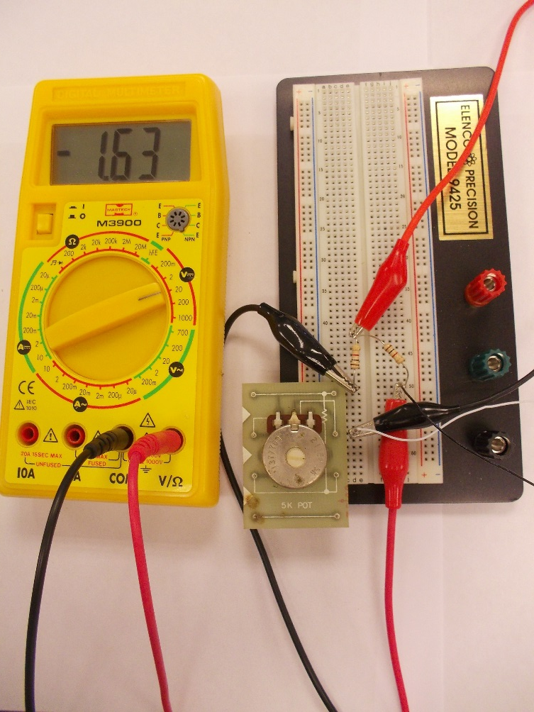
Circuit Setup
Connect three resistors and Strain gauge in a Wheatstone Bridge Configuration.
Apply 12vDC to circuit.

Slide 3
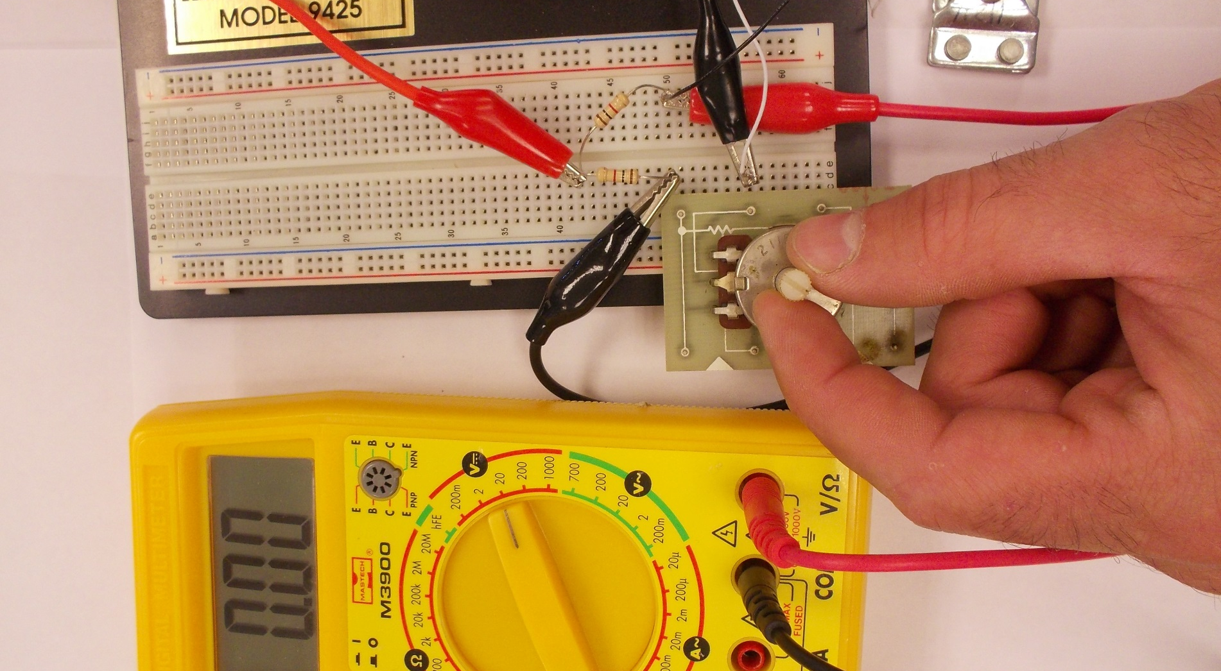
Balancing the Bridge.
With no strain on the load cell, adjust the potentiometer to balance the bridge. Once the voltage meter reads 0.00vDC, the bridge is said to be balanced. The voltage reading becomes more defined as you adjust the voltage range of the volt-meter to smaller scales. Keep zeroing the bridge until you reach the smallest range. In this example that would be 200mvDC. The bridge is very sensitive while balancing the last few µvDC. Using a ten turn trim pot (not pictured) will make the balancing process easier.

Slide 4
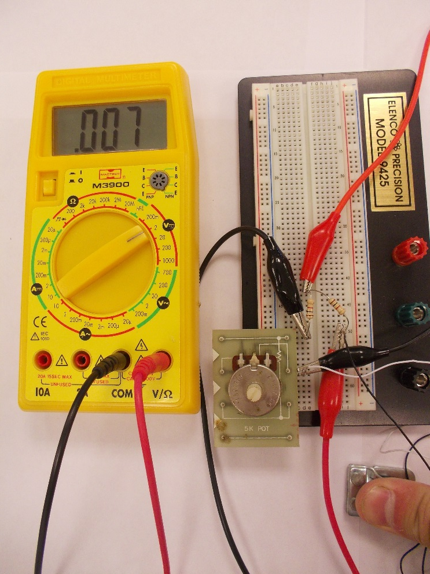
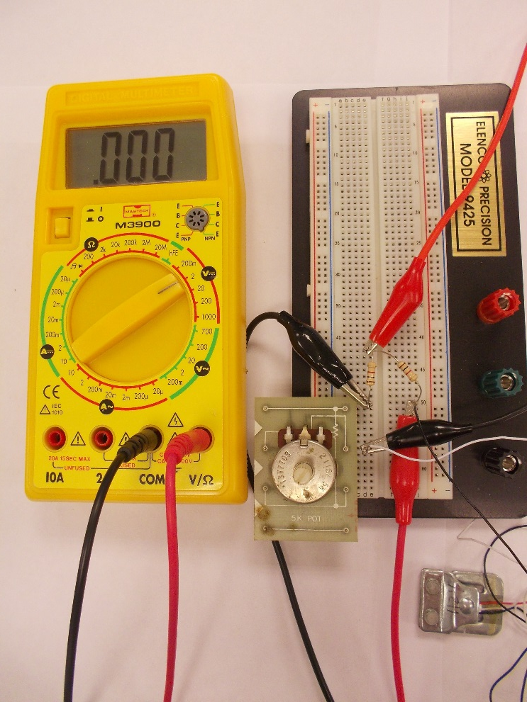
Documenting the effect of strain across the Wheatstone Bridge.
Apply pressure to the sensor.
Remove pressure.

