Slide 1

ASU’s Compact X-ray Laser Project
Capturing Movies of Molecules Using Ultrafast X-rays
The webinar will begin at 1 PM Eastern time

Slide 2

This Webinar Is Hosted By
ATE Central acts as an information Hub for the National Science Foundation ATE Grantee Community
atecentral.net/webinars

Slide 3


This Webinar Is Brought To You By
Nanotechnology Collaborative Infrastructure Southwest (NCI-Southwest) at Arizona State University
And
The NACK Network at Penn State University

Slide 4
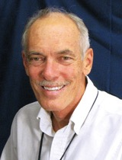

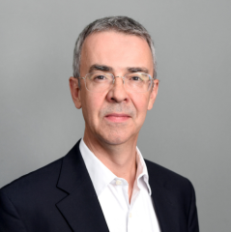

Introductions
Mike
Lesiecki
William Graves
Associate Professor, Arizona State University
Trevor Thornton Professor, Director NCI-SW

Slide 5
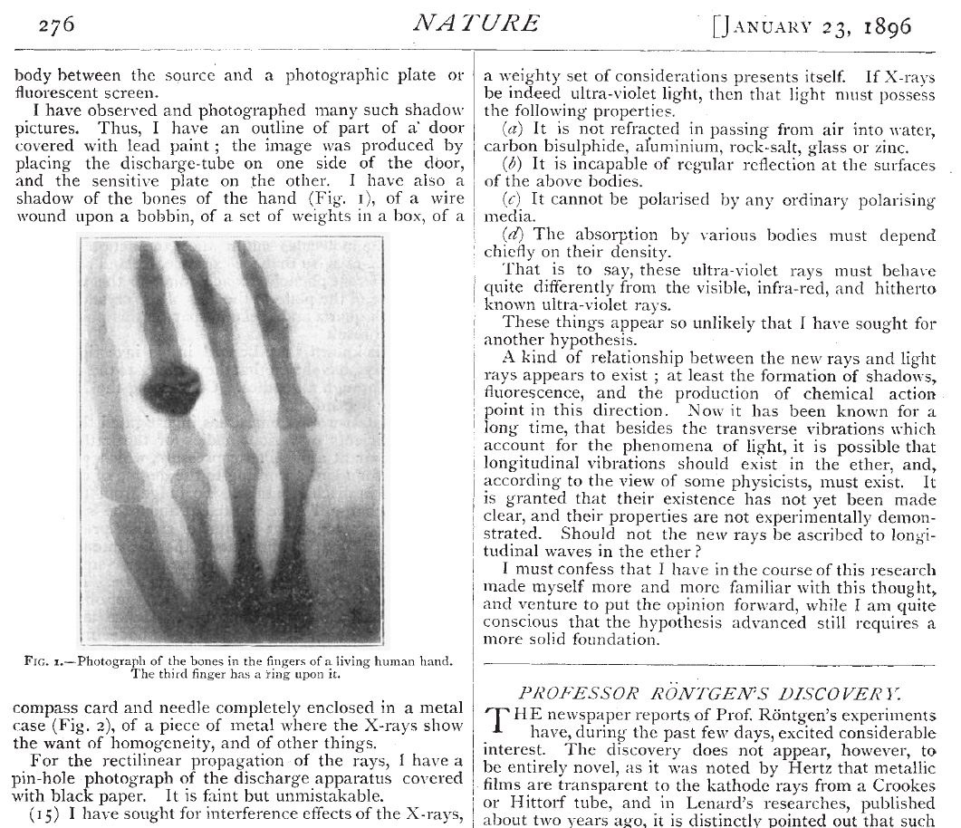
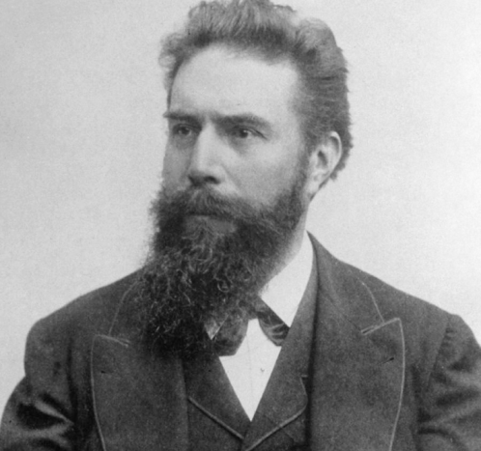

Wilhelm Röntgen awarded the first Nobel prize in physics in 1901 for the discovery of x-rays

Slide 6
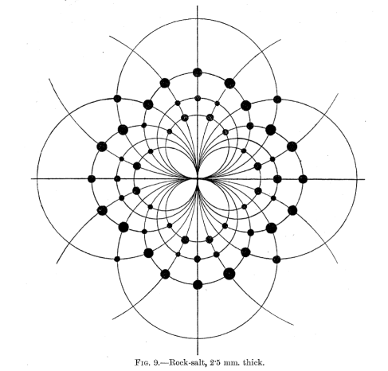
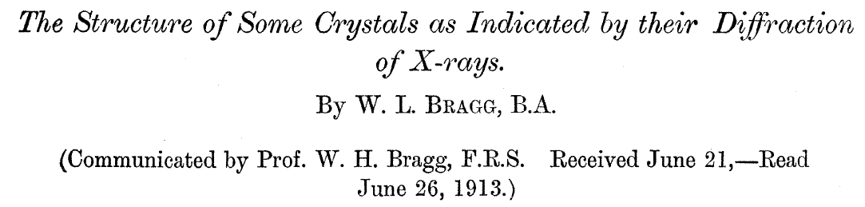
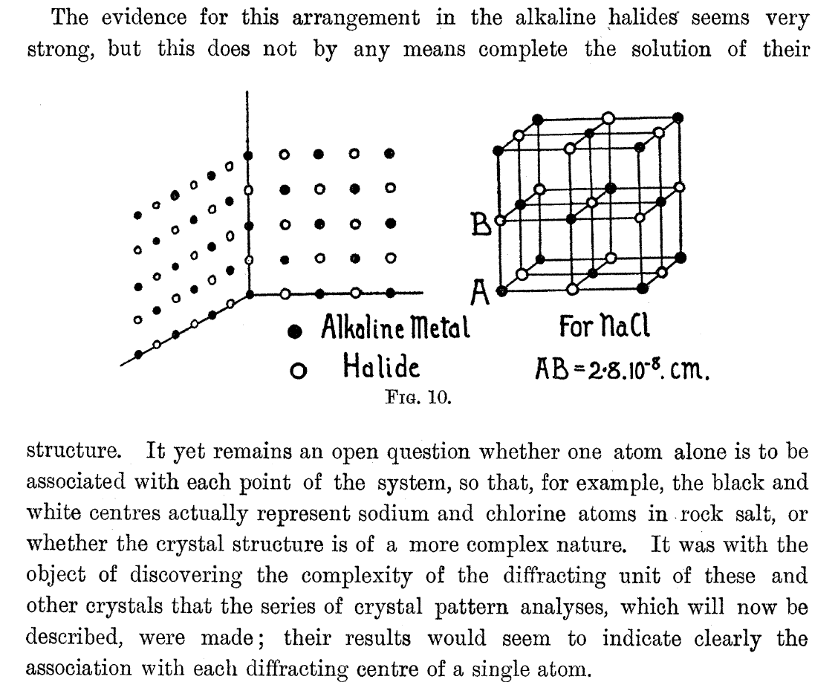

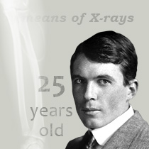
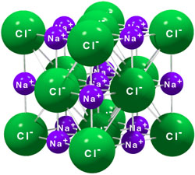
Lawrence and William Bragg awarded the 1915 Nobel prize in physics for the discovery of crystal structure by x-ray diffraction

Slide 7
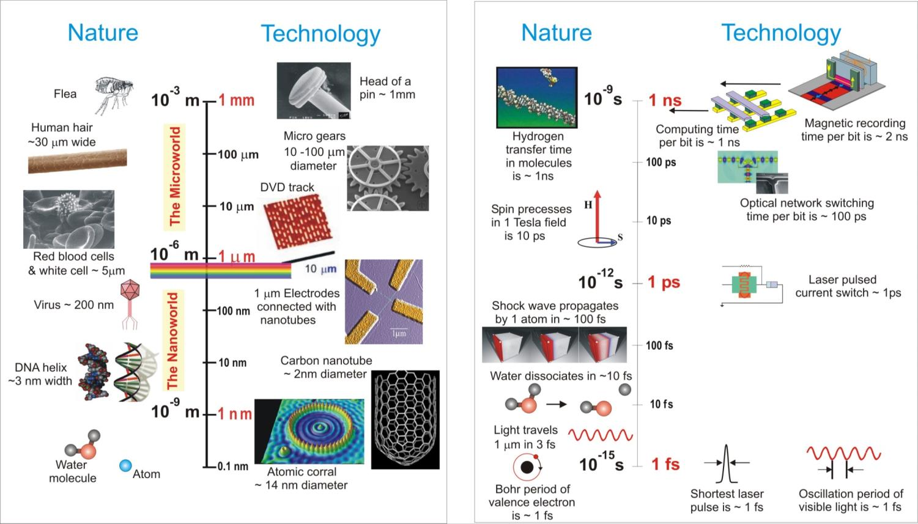
X-rays probe a vast range of spatial and temporal scales
Spatial Scales
Temporal Scales

Slide 8
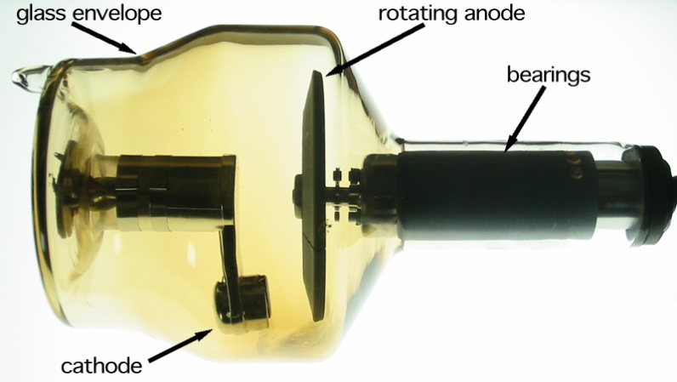
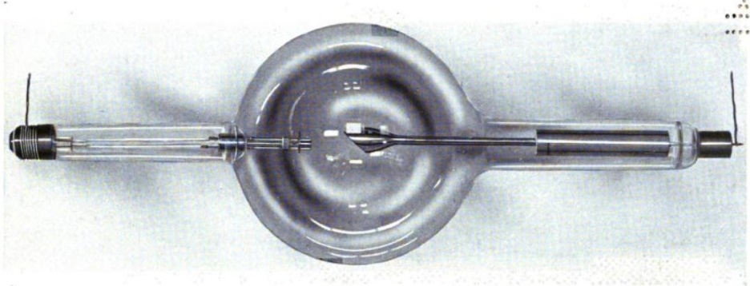
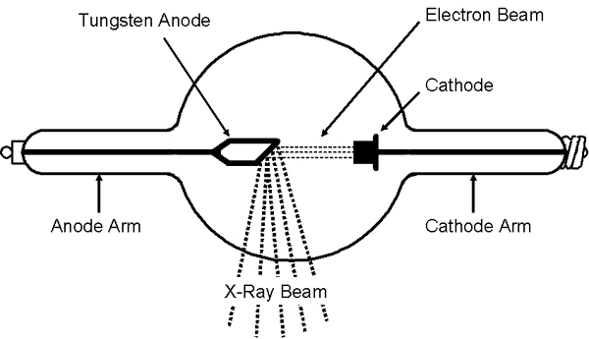
From Roentgen’s tube to today’s best laboratory-scale sources
X-ray tube from 1917
X-ray tube today
Tubes are primitive low energy (0.1 MeV) electron accelerators
Flux of 5 X 10⁹ photons/sec
Brilliance* of 10⁹
Factor of ~100 better than 100 years ago
*Brilliance is in units
photons/(sec mm² mrad² 0.1%)
X-ray flux of 10⁷ photons/sec from source of few mm² and large opening angle

Slide 9
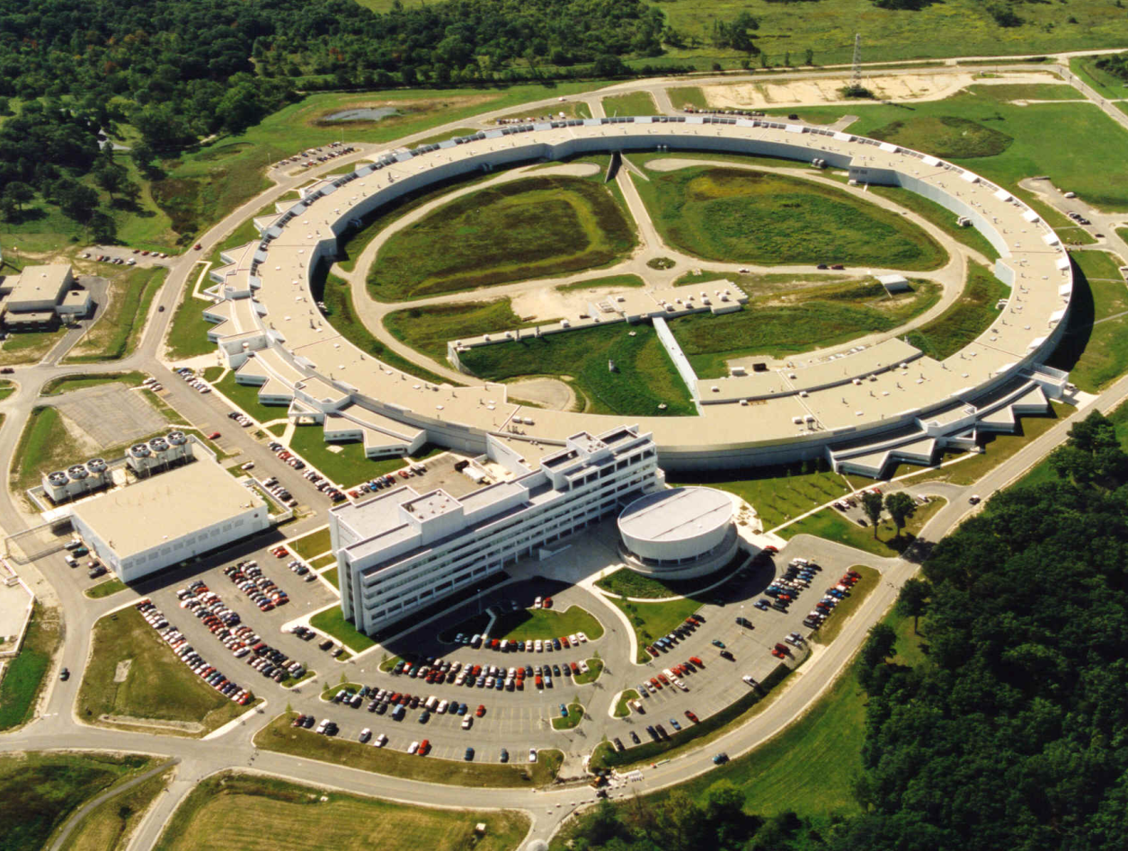
Particle accelerators in the 20th century
Advanced Photon Source near Chicago
About 1 mile in circumference and $1 billion in cost

Slide 10
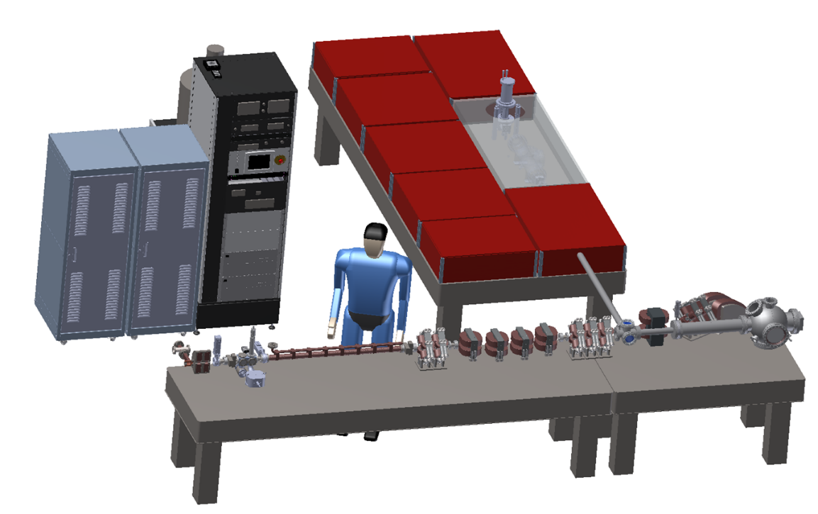
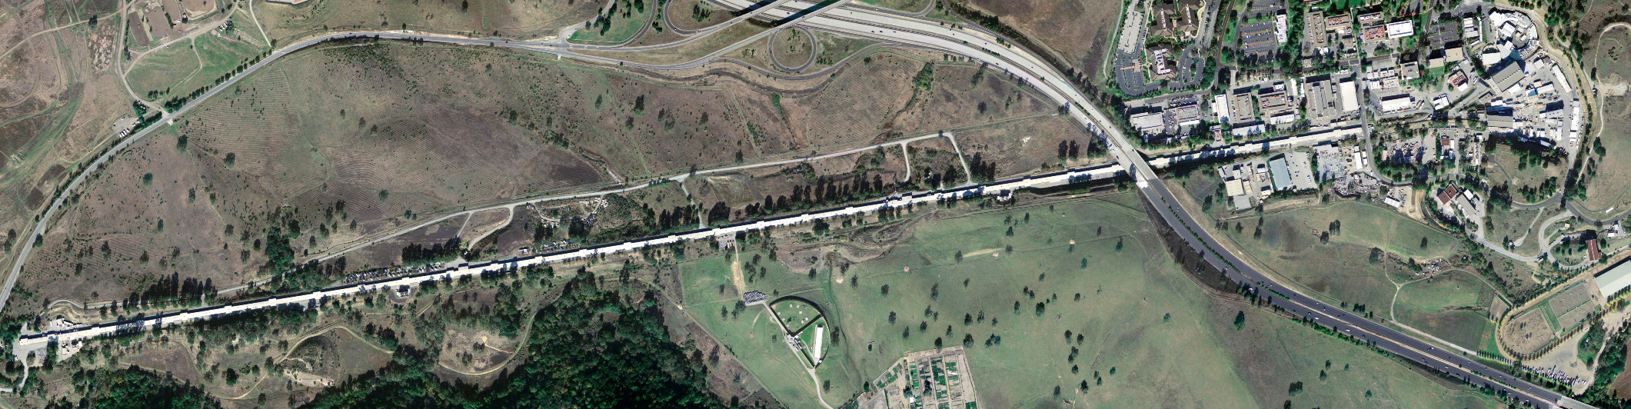
ASU X-ray Light Source
ASU Compact X-ray Light Source (CXLS)
21st century tech: 20 ft long
Linac Coherent Light Source (LCLS): 2 miles long!

Slide 11
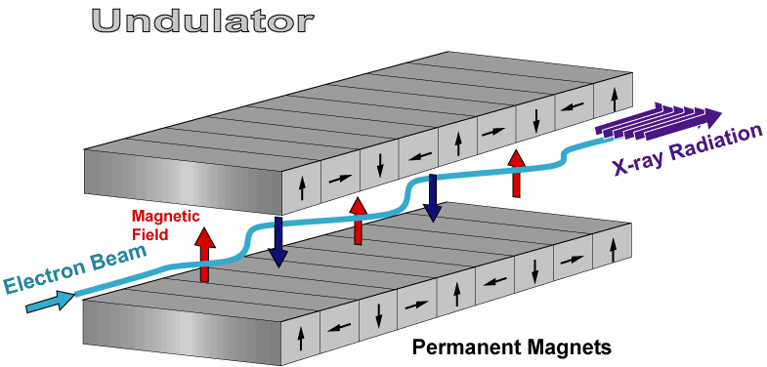
How to make a compact x-ray source?
Magnetic undulators in big machines
Laser wavelength is 10,000X shorter than undulator period
Electron energy is 100X lower for same x-rays
Facility size and cost is 100X lower ($1B -> $10M)
Laser replaces undulator
Laser field
X-ray radiation
Electron beam
Using state-of-the-art laser and accelerator technology we can shrink the size and cost 100X.

Slide 12
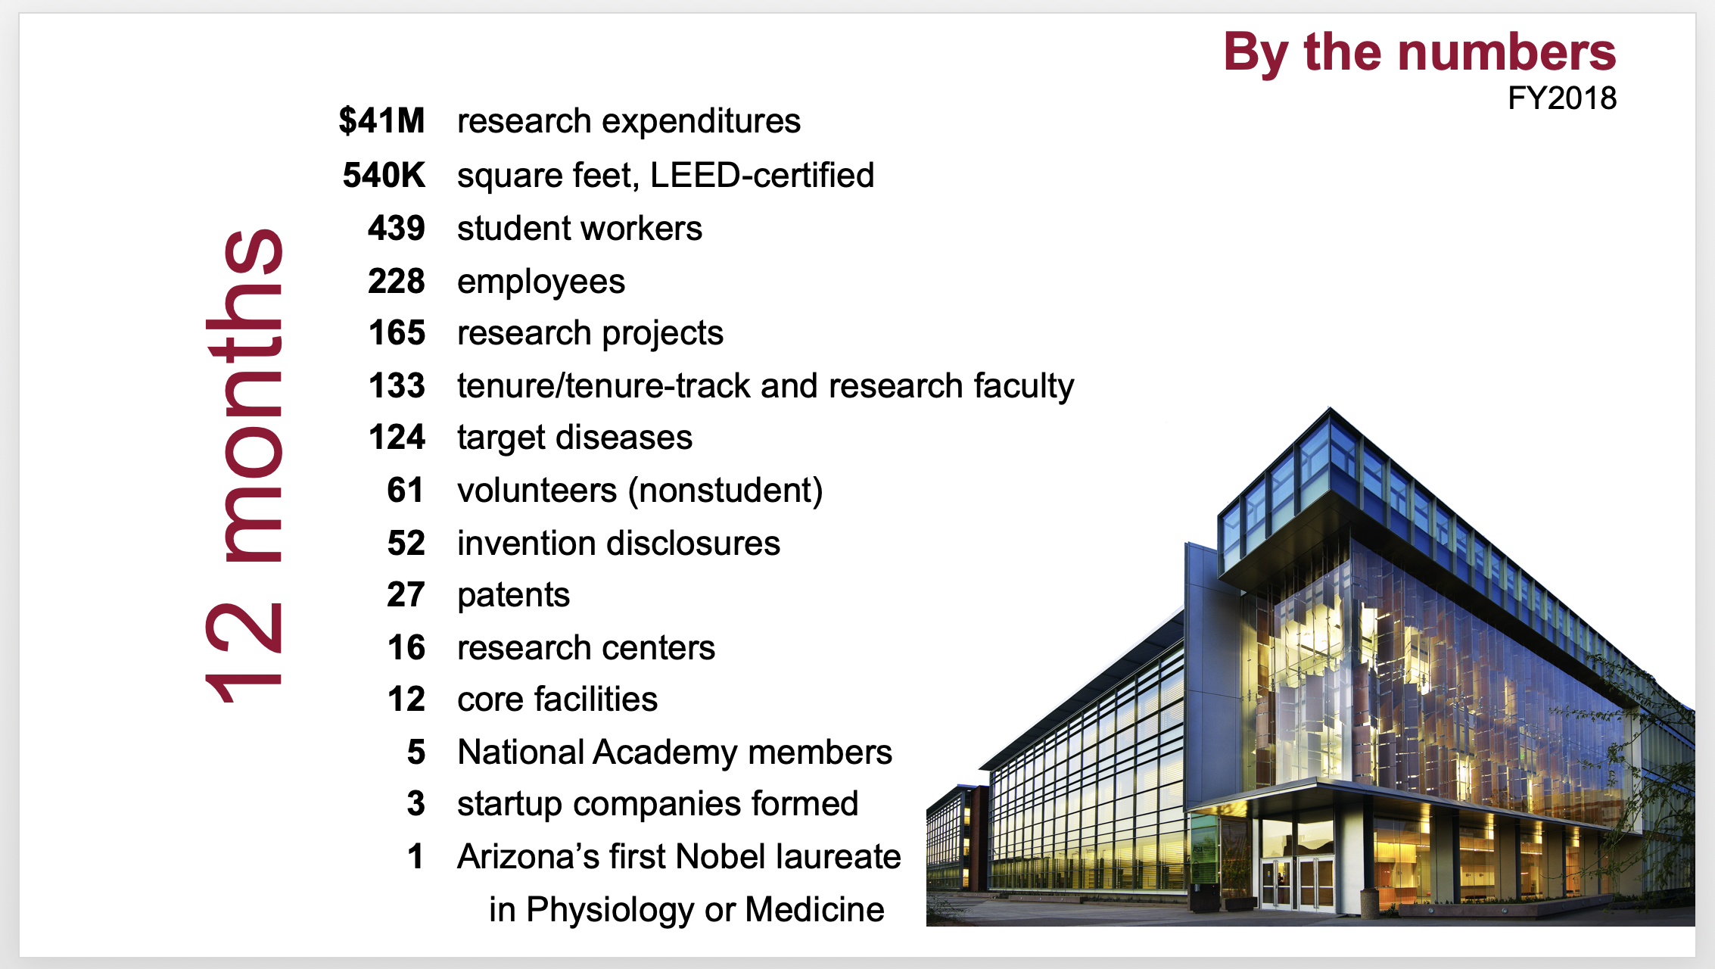
The Biodesign Institute at ASU

Slide 13
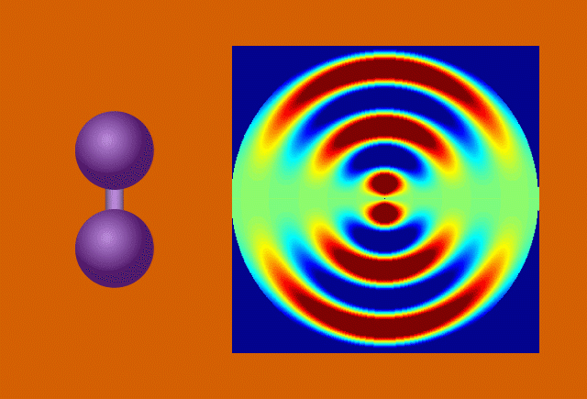
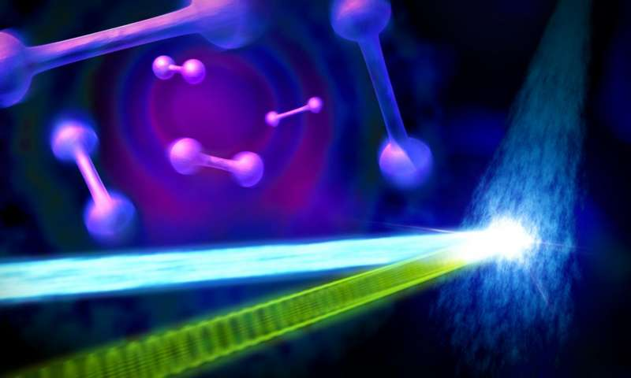
Movies of Molecules in Motion
Courtesy of physics.org

Slide 14
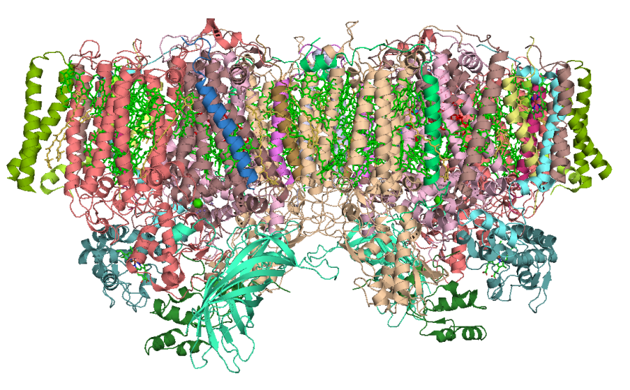
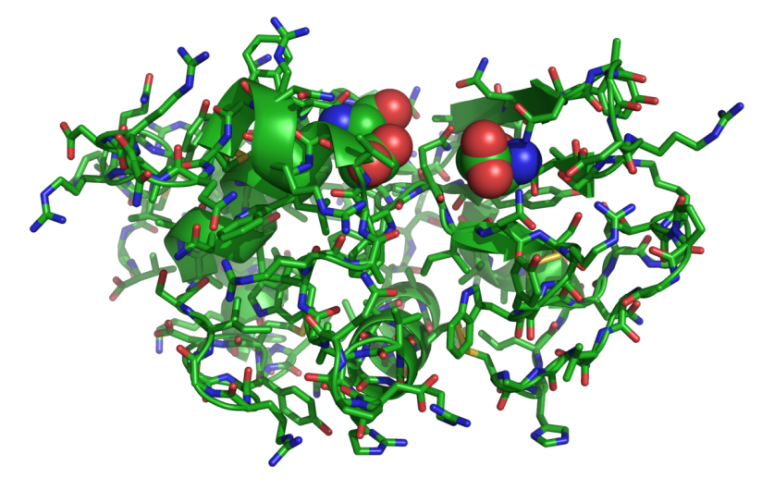
Complex molecular structures from x-ray diffraction
Photosystem 1
(key to photosynthesis)
X-ray diffraction studies can solve very complex molecular structures
Lysozyme
enzyme

Slide 15
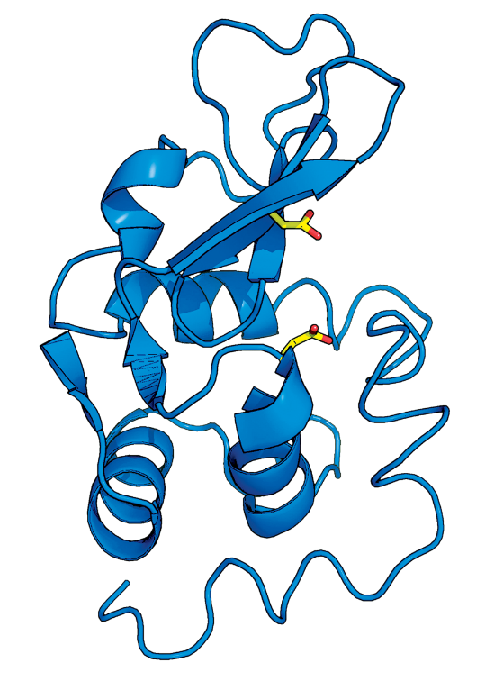
Drug Discovery
Kirk Clark
Novartis Institutes for Biomedical Research
Structural Biology important to drug discovery programs
Insight into protein function
Facilitate expanding structural biology to integral membrane proteins.

Slide 16
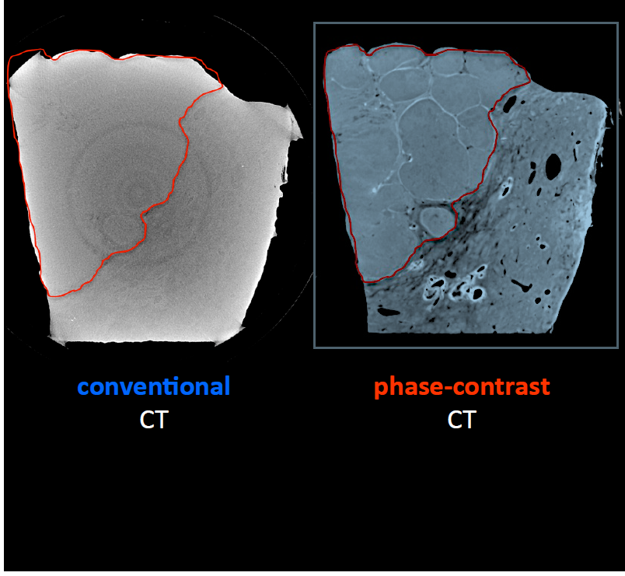
Phase Contrast Medical Imaging
The very bright and monochromatic x-ray beam allows a new type of much more powerful medical imaging at lower dose to the patient.
Soft tissue structures such as this liver cancer become visible
Courtesy of F. Pfeiffer, TU-Munich
ASU is working with the Mayo Clinic and Harvard to develop this method

Slide 17
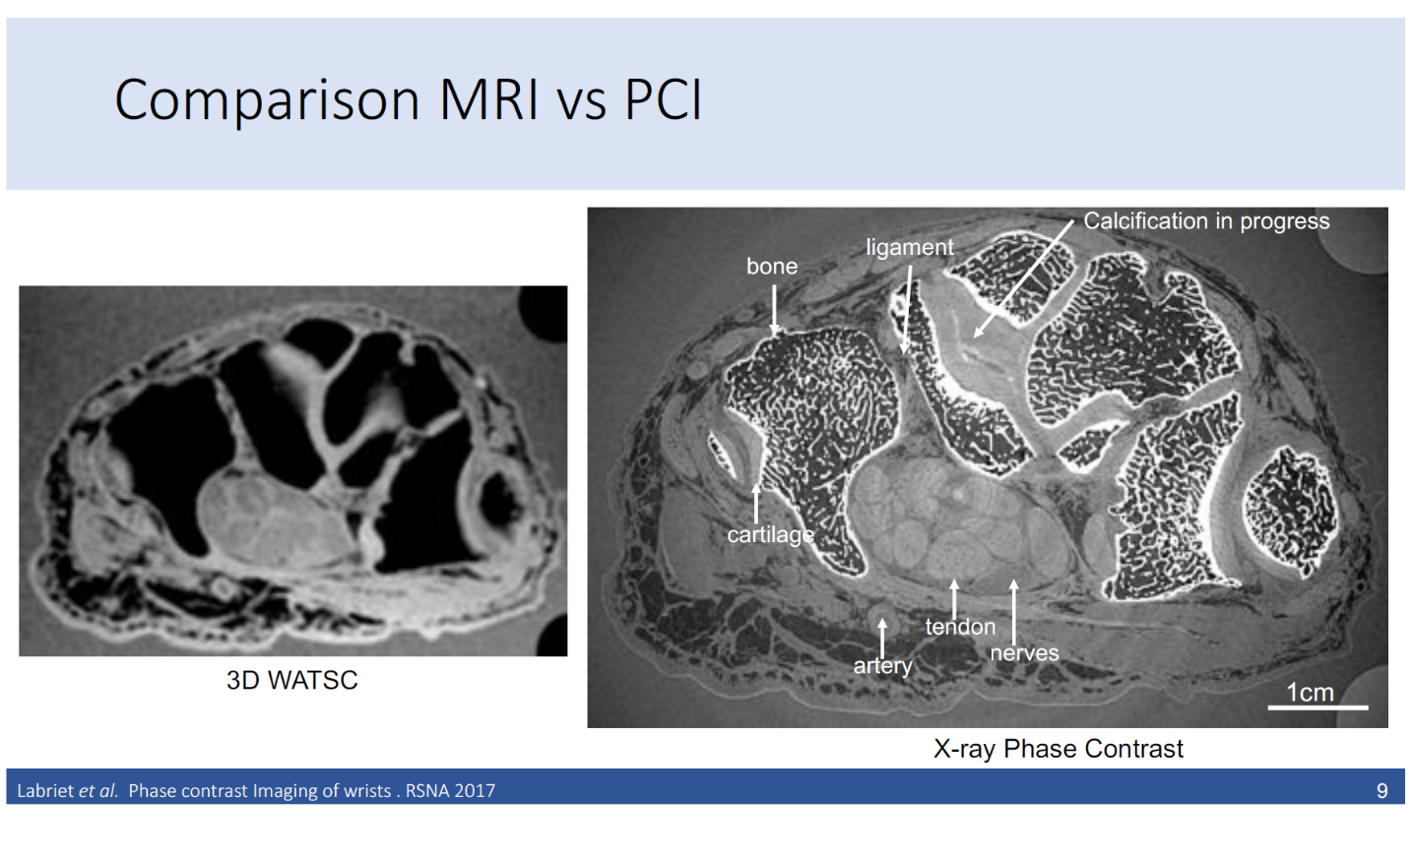
Cross-section of a person’s wrist
MRI Image
Phase Contrast X-ray

Slide 18
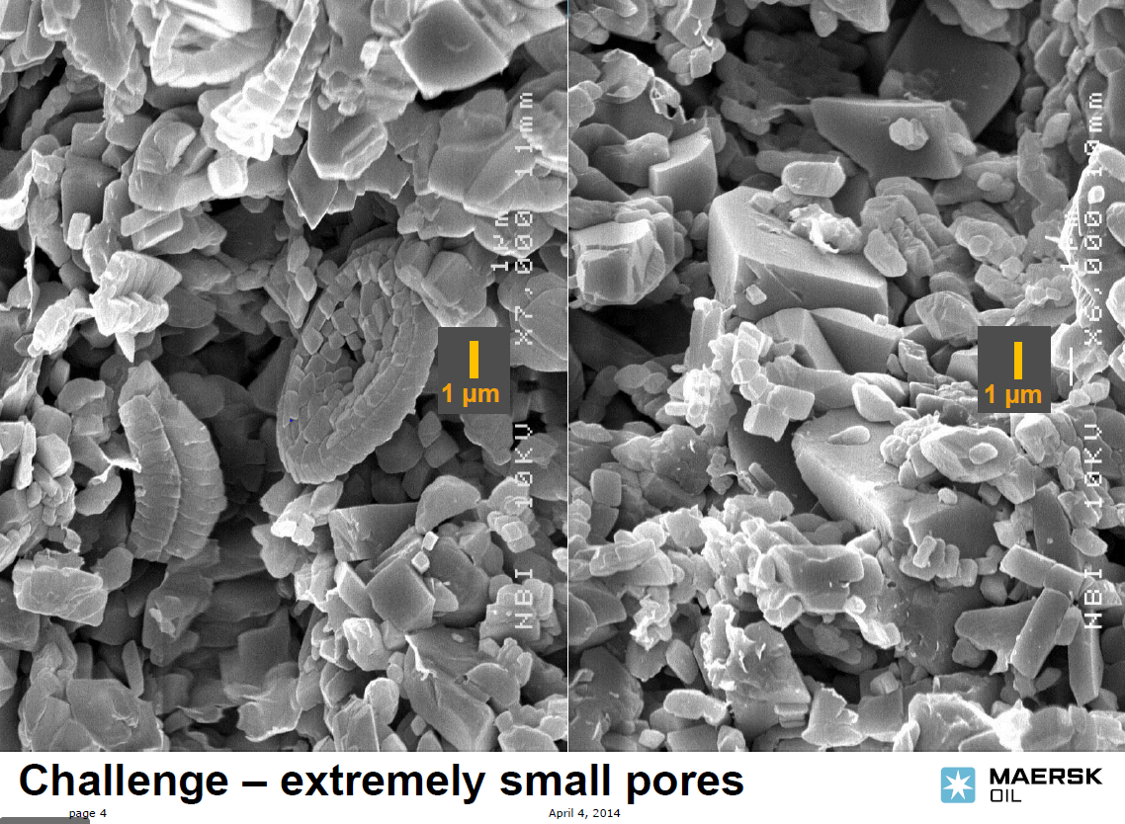
Microscopy of Carbonate Reservoirs
Courtesy of Theis Solling, Maersk Oil

Slide 19


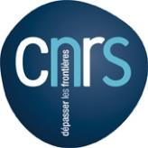
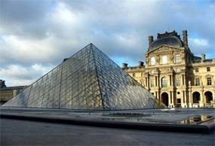
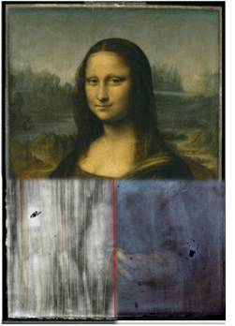
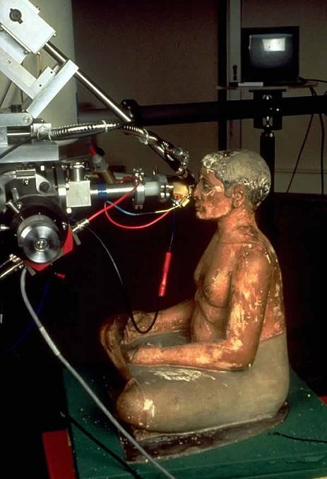
Cultural Studies - Louvre
-Philippe Walter - director
Objectives: Research, expertise and support for curators and conservators
Notes:
19

Slide 20
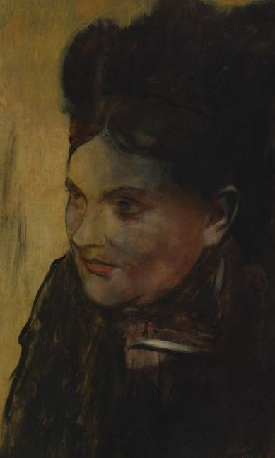
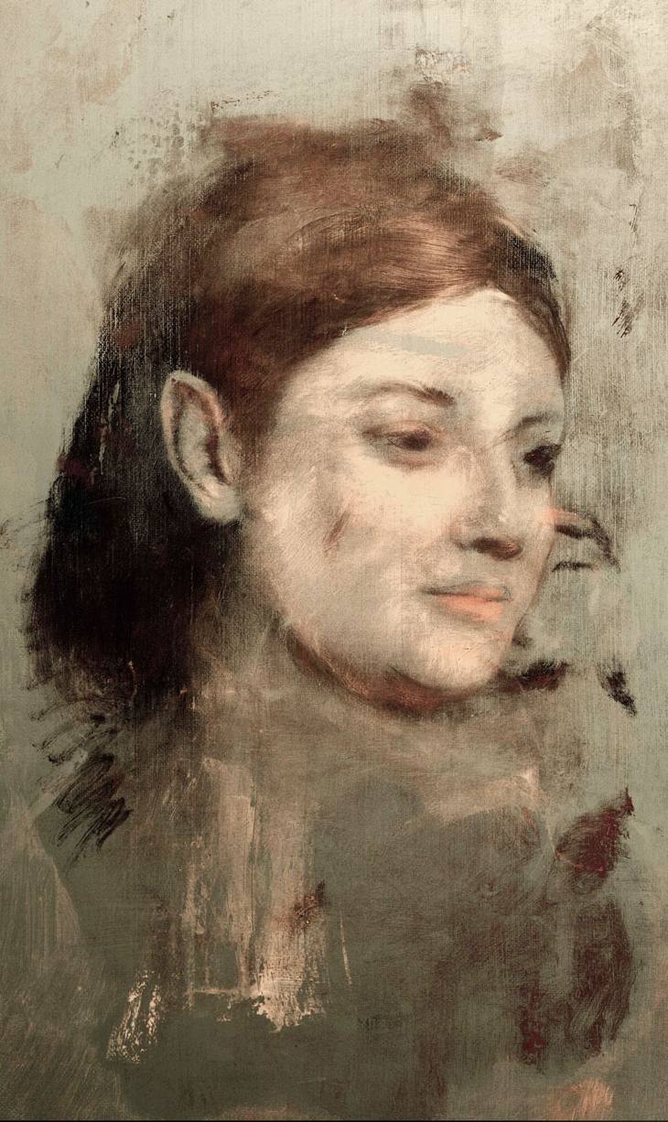
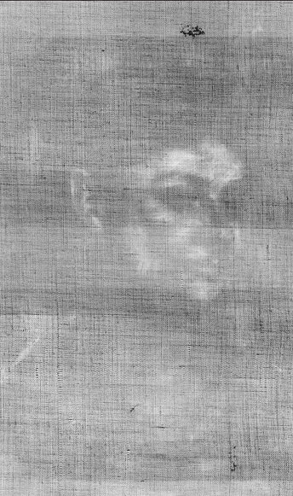
X-rays show us the invisible

Slide 21
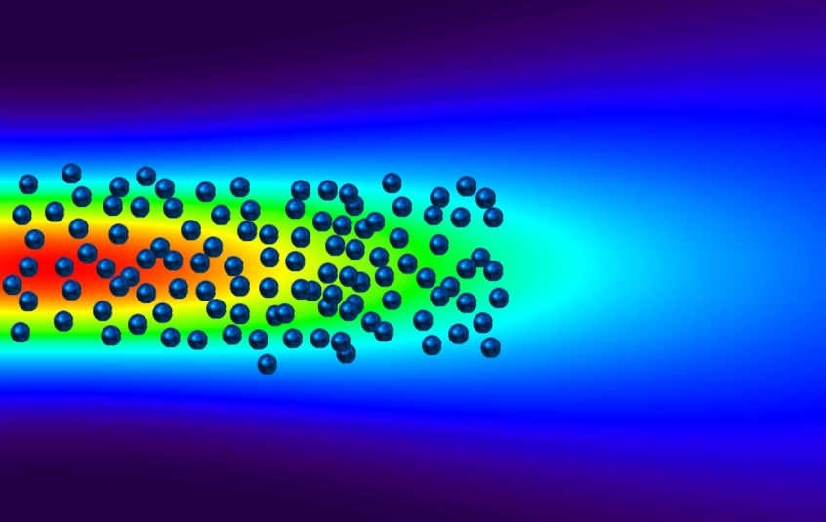
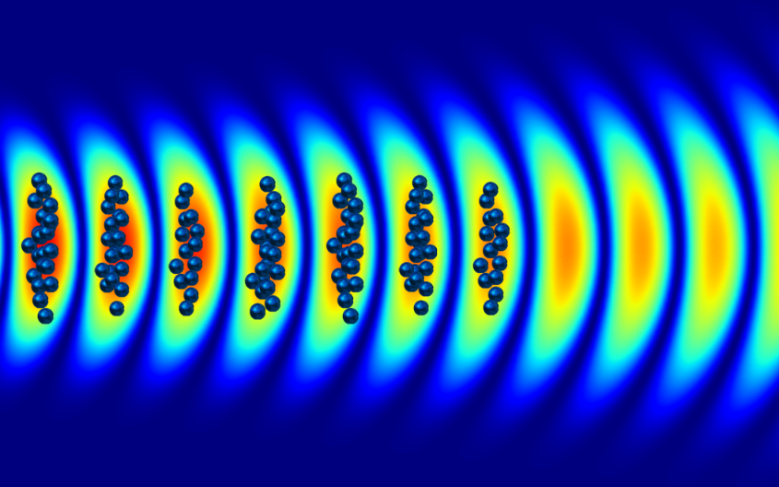
Coherent x-rays require coherent electron bunching
λ_{x}
Random electron spacing
Undulator radiation with GeV electrons or
Inverse Compton Scattering with MeV electrons
βc
λ_{x}
Coherent spacing
XFEL radiation (GeV electrons) or
Coherent ICS, compact CXFEL (MeV electrons)

Slide 22
TEM Diffraction Through Patterned Membrane
Low magnification image showing 50 micron square grid pattern with 400 nm period. Membrane is 200 nm thick
(Norcada supplied)
Resulting electron density nanopattern at image plane
Diffraction pattern of grid with beam block
Pinhole inserted allowing single Bragg spot through

Slide 23
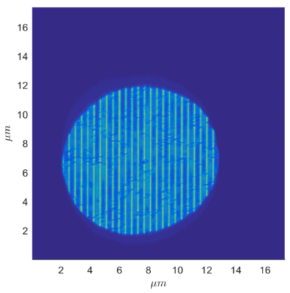
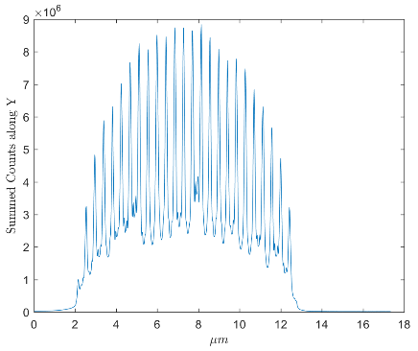
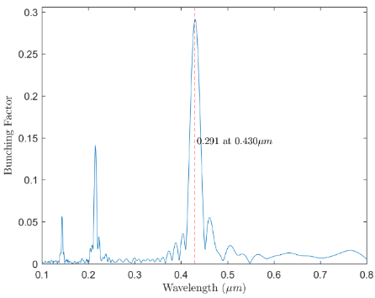
Nanopatterned Electron beams for Compact XFEL
Experimental data: Nanopatterned electron beam generated by diffraction
FEL bunching factor
Harmonics

Slide 24
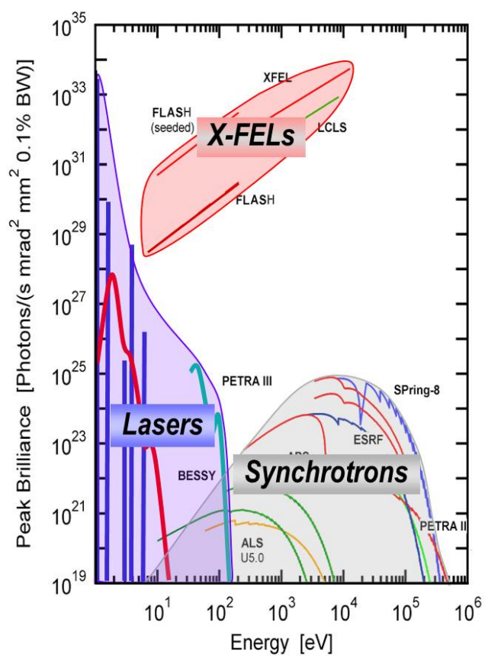
CXFEL Estimated Performance
The ASU CXFEL uniquely controls the x-ray phase and amplitude
Multiple-color, tunable time delays
CXFEL can seed large XFELs to increase their brilliance X100
ASU CXFEL

Slide 25
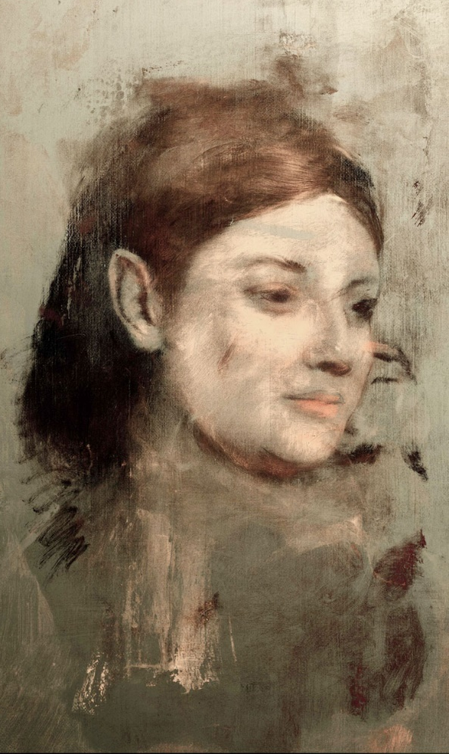
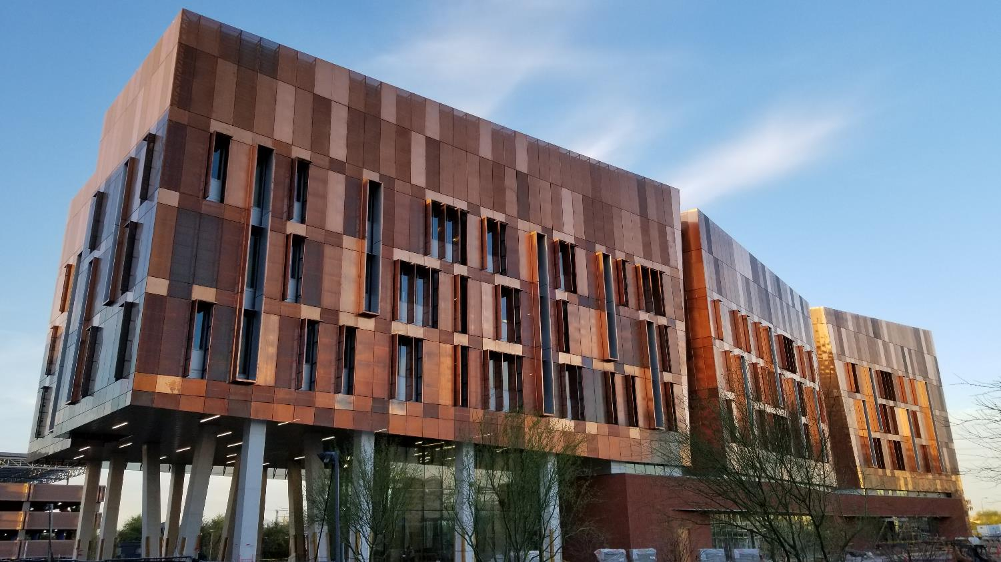
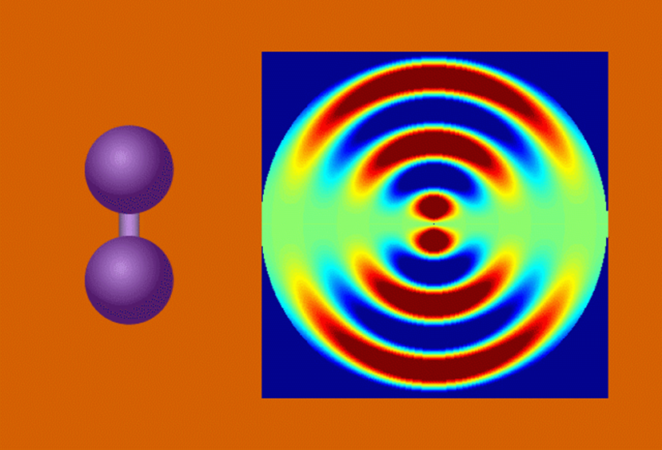
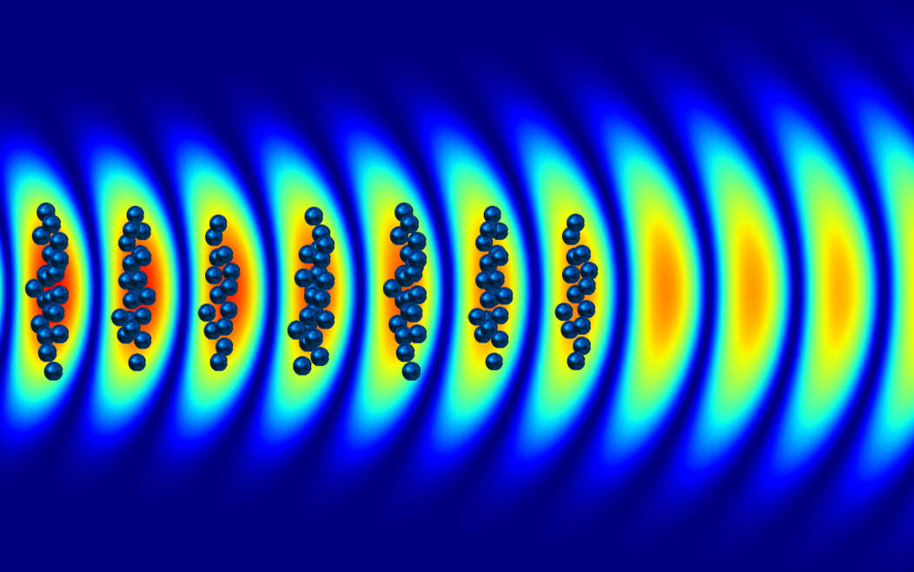
Thank you!

