Slide 1
Instrumentation and Analog Control Basics
Created by Tom Wylie, 8/3/23

Slide 2
Instrumentation and Analog Control Basics
After viewing this document, the student should be able to:
Explain the difference between a digital control signal and an analog control signal
Explain the basics of the various types of analog signals
Explain how the Terra Virtual Machine operates within the host computer
Explain the terms upload, download, online and offline when working with PLC software
Explain the importance of the processor name when creating an RSLogix 500 project
Explain the different elements in the online ladder view of RSLogix 500
Explain what is downloaded to the SLC-500 processor during a download
Explain the purpose of RSLinx when going online with RSLogix 500

Slide 3
Please Read This:
This document does not replace the textbook, but instead supplements it and focuses on equipment that the students will use in the lab environment. Information for skills and knowledge assessments will be created from all of the instructional materials.
Also, it is important to understand that much of this course is based on process control systems versus discrete manufacturing. Process systems are predominant in food plants, power plants, refineries, chemical plants, etc. Also, most of our manufacturing plants in Northwest Ohio will have process systems as part of their manufacturing process.

Slide 4
Open Loop versus Closed Loop
The signal cable shown in this graphic is a Belden 8762 cable, which has a PVC jacket, a foil shield, and 20 AWG (wire size). The 20 AWG wire is stranded wire (conductors). The two signal conductors are twisted together within the foil shield, and within the jacket.
This would be termed twisted pair, shielded signal cable.
The most common instrument signal that this cable would transmit would be a 4-20 mA (DC) type of analog signal. The twisting of the wires and the shield gives the 4-20 mA signal a lot of immunity from electrical noise, bot RFI (Radio Frequency Interference) and EMI (Electro-Mechanical Interference). A drain (ground) wire, the same size as the signal conductors is run outside of the foil shield, but is connected to the shield within the jacket. It is important to understand that the drain wire should be grounded on just one end of the cable. If both ends of the drain wire are connected to ground, a ground loop can be created which will induce unwanted electrical noise into the signal cables.

Slide 5
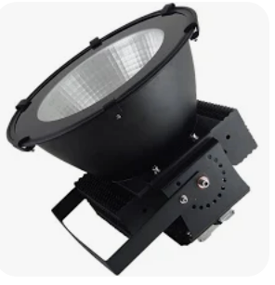
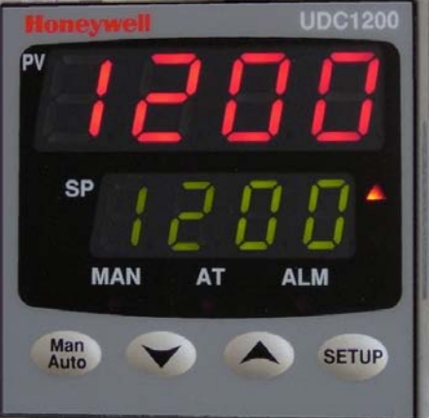
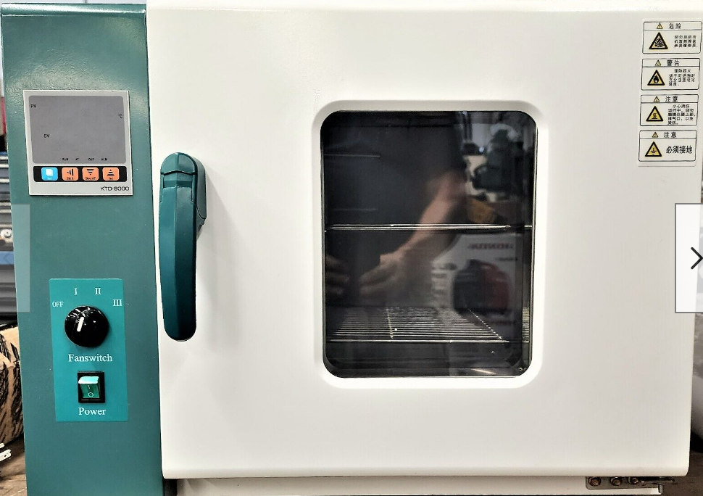
Example of Closed Loop Control of an Oven:
To give an example of a closed loop control system in an industrial environment, we will use an industrial oven that is used to cement on high intensity LED lights that have a reflector.
The maximum temperature the oven can reach is 300 degrees Fahrenheit, which is determined by the oven size and the heating element parameters.
The Temperature Controller is the brains of the systems and is programmable. The user will enter the desired setpoint on the front of the controller, which is the temperature the user wants the oven heat up to and stay at.
Notice that the Controller is mounted in an enclosure on the side of the oven. A sensor will be used to sense the heat in the oven. In this case it will be a device called a thermocouple. The thermocouple will be mounted in the oven chamber and will tell the controller what the temperature is in the oven. The controller will compare the setpoint and the oven temperature (process variable) and send a signal out to the heating element controller to give more/less current into the heating element.
LED Light with Reflector
Temperature Controller
Temperature is the:
Process Variable
Current going into the
Heating Element is the:
Controlled Variable

Slide 6
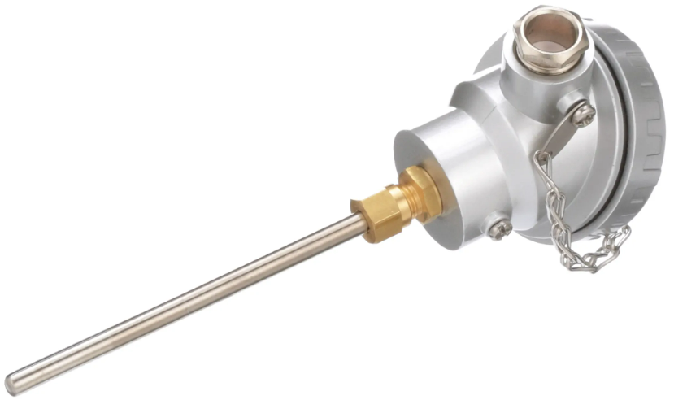
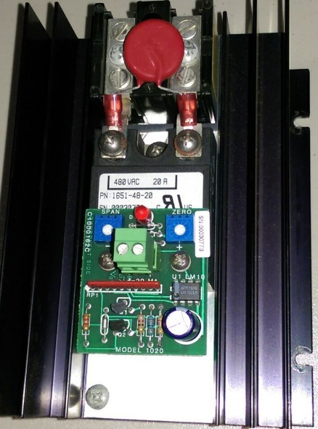
Industrial Oven Control System:
This graphic shows more components in the control system. A temperature sensor called a thermocouple will be used to sense the temperature. The thermocouple outputs a milli-volt signal that will increase as the temperature increases.
The controller can be configured to have the input be a thermocouple. The controller then compares the temperature of the thermocouple (process variable) to the setpoint, which the operator inputs on the front of the controller and is also shown on the front of the controller.
If the temperature of the oven is lower than the setpoint, the controller sends out an output signal (4-20mA) to a heating element controller. The heating element controller will vary the amount of current going to the heating element (based on the signal coming from the controller), which will in turn change the temperature in the oven.
The Process Variable is the oven temperature that is measured by the thermocouple sensor.
The Controlled Variable is the amount of heat the heating element is putting out, which is determined by the heating element controller, based on the signal from the controller.
All components will be covered in depth later in module.
Sensor
Thermocouple
Industrial Oven
Heating Element
Thermocouple
Symbol
0-240 Vac
Loop
Controller
Heating
Element
Controller
4-20 mA Output Signal
240 VAC Power Feed

Slide 7
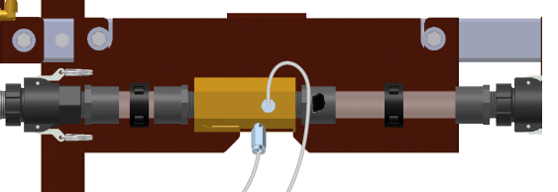
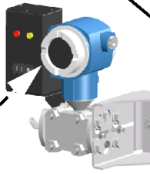
Sensors and Transmitters
Sensors are devices that sense a process (process variable): temperature, flow, pressure, level, rpm, pH, distance weight, etc.
The sensor marked with a “B” is a thermocouple housing, with the thermocouple mounted in the extended tube. This sensor senses temperature. The sensor marked with an “A” is a venturi tube that has a low-pressure port and a high-pressure port. The actual sensor is built into the transmitter right below it. This sensor senses the difference of pressure. This senses flow. The more flow the greater the pressure difference.
Transmitters are devices that convert a sensor signal into an electrical signal (DC current, or DC voltage). Which will then be transmitted (thus the name transmitter) to a controller or indicating device. The electrical signal is an analog signal, and is proportional to the sensor signal. The most common analog signal that is transmitted is a 4-20 mA signal.
The transmitter marked with a “C” is a differential transmitter (with the sensor built into it). It will sense the difference in pressure between the two H & L ports and send out a proportional 4-20 mA signal. The device marked with a “D” is an Acromag 250T temperature transmitter. It will convert the signal from a thermocouple and convert to a 4-20 mA signal.
Sensors
A.
B.
Flow Sensor
Delta P
Temperature Sensor
Thermocouple
Transmitters
C.
D.
Pressure Transmitter
Temperature Transmitter

Slide 8
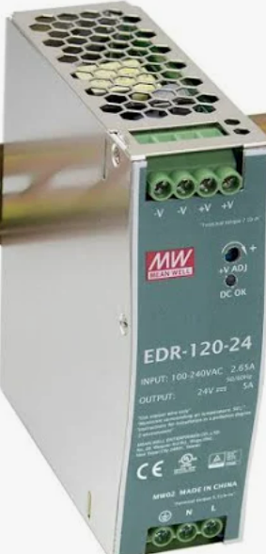
Industrial Oven Control System cont.:
120 VAC Power Feed
The UDC1200 controller input channel can be programmed to directly connect a thermocouple to it, or it can be setup to have a 4-20 mA input signal coming into it. Both methods are very common.
In this example, the thermocouple is connected to a transmitter, which will convert the mV output of the thermocouple to a 4-20 mA signal. Notice that the transmitter, the 24 Vdc power supply, and the controller input channel are all connected in series.
When using this configuration, the transmitter will have to be calibrated for a particular temperature range. On the front of the transmitter there are two screw adjustments that set the zero and span (more on this later). So if the temperature range is 100-300 degrees Fahrenheit, then the transmitter will have to be calibrated to send out 4 mA at 100 degrees, and 20 mA when the temperature is 300 degrees.
T/C Transmitter
Industrial Oven
4-20 mA Input Signal
Heating Element
Thermo-
couple
24 Vdc P/S
0-240 Vac
Loop
Controller
Heating
Element
Controller
4-20 mA Output Signal
240 VAC Power Feed

Slide 9
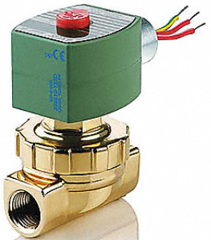
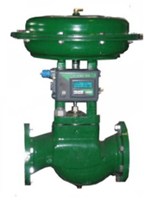
Digital Signals versus Analog Signals
DC Output Module
Discrete I/O (sometimes called Digital I/O) are either on or off. When working with industrial controls systems the I/O are usually 120 Vac (legacy equipment) or 24 Vdc.
Electrical analog signals are either DC voltage or current. The most common electrical analog signal is 4-20 mA. These signals control analog devices that can vary operation proportional to the signal. There is also a standard pneumatic analog signal (3-15 psi) which will be used on primarily proportional (analog) control valves.
A common comparison between digital and analog would be a valve that would control the flow of fluid. In the upper graphic is a 120Vac PLC output module that would send a signal out to a solenoid valve. If the valve gets a signal (120V) it will open (allowing full flow). If the output is off (0V) the valve is closed.
In the lower graphic is a proportional valve that is controlled by a 4-20 mA signal (we will skip the pneumatic signal conversion until later). This signal can vary the amount that the valve is open. With an air to close acting valve (signal to close) the valve will be open at 4 ma, ½ open at 12 mA, and fully closed at 20 mA. The PLC program will send the data to the analog module that will convert to an analog signal.
Output Signal
0 or 120 Vac Signal
Digital (on or off)
On – fully open – full flow
Off – fully closed – no flow
Output Signal
4 – 20 mA Signal
Analog Value
4 mA – open(full flow)
8 mA – 75% open
12 mA – 50% open
16 mA – 25% open
20 mA – Closed (no flow)
This would be on a signal to close type
Analog I/O Module

Slide 10
Electrical and Pneumatic Analog Signals
Electrical analog signals in an industrial or process environment are DC electricity. The most common analog signal is 4-20 mA. The reason for its popularity is that it has minimal signal loss on a long signal cable run (as compared to voltage), and it is less effected by electrical interference, since the cable used will be a shielded, twisted pair type of cable. 0-20 mA is used on some analog output modules to get a 0-10V signal by terminating across a 500-ohm resistor (20mA * 500 = 10V). -20mA to +20mA was used on old systems and will not be on modern equipment.
0-10Vdc voltage signal is common primarily within a control panel. Once outside of a control panel, the voltage signal can be affected by electrical noise and potentially has signal loss on long runs of signal cable. 1-5 Vdc is used quite often for troubleshooting, since many PLC analog input modules has an input impedance of 250 ohms, which is used to convert a 4-20mA signal to a 1-5Vdc signal.
-5Vdc to +5Vdc, and -10Vdc to +10Vdc are sometimes seen on legacy data acquisition systems and on legacy servo systems.
3-15 psi is a pneumatic signal that will be used to control a proportional control valve. An I/P (current to pressure) converter is used to convert the 4-20mA signal to a 3-15 psi signal that will control the position of a control valve.
Current Analog Signals
4 - 20 mA
0 – 20 mA
-20 mA to +20 mA
Voltage Analog Signals
0 – 10 Vdc
1 – 5 Vdc
0 – 5 Vdc
-5 Vdc - +5 Vdc
-10 Vdc - +10 Vdc
Pneumatic Analog Signals
3 – 15 psi

Slide 11
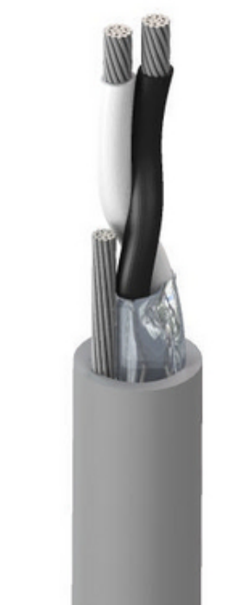
Cable for 4-20mA Signal Transmission
The signal cable shown in this graphic is a Belden 8762 cable, which has a PVC jacket, a foil shield, and 20 AWG (wire size). The 20 AWG wire is stranded wire (conductors). The two signal conductors are twisted together within the foil shield, and within the jacket.
This would be termed twisted pair, shielded signal cable.
The most common instrument signal that this cable would transmit would be a 4-20 mA (DC) type of analog signal. The twisting of the wires and the shield gives the 4-20 mA signal a lot of immunity from electrical noise, bot RFI (Radio Frequency Interference) and EMI (Electro-Mechanical Interference). A drain (ground) wire, the same size as the signal conductors is run outside of the foil shield, but is connected to the shield within the jacket. It is important to understand that the drain wire should be grounded on just one end of the cable. If both ends of the drain wire are connected to ground, a ground loop can be created which will induce unwanted electrical noise into the signal cables.
Signal Conductors
Drain Wire
PVC Jacket
Foil Shield

Slide 12
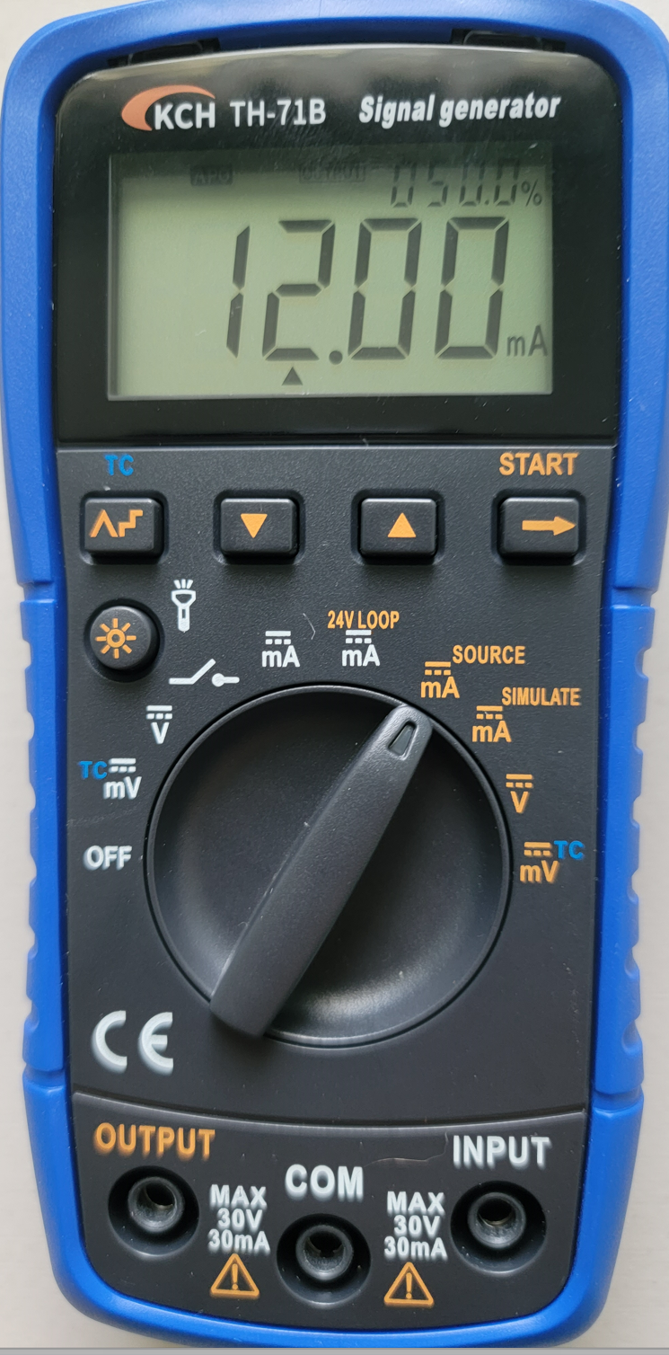
Analog Signal Generator
The students at NSCC will use the KCH TH-71B Signal Generator to create an analog signal source (for testing and calibration), and also can be used to measure analog signals. This device will measure signals and also source signals out to circuits for testing and calibration.
On the dial scale, the parameters in white are input, so use these to measure volts and milliamps. The light brown parameters are for output signals. The user must also make sure the probes are in the correct jacks.
If a user wished to measure the signal in a 4-20 mA loop, the dial setting should be set on the white mA position and the probes put in the COM and INPUT slots.
If a user wished to send a 4-20 mA signal from the signal generator to test the operation of a variable frequency drive they would put the dial on the brown mA Source setting and the probes in the COM and OUTPUT slots.
A video will be created explaining how to operate the signal generator.
Output Signals
Input Signals
Input Signal Jacks
Output Signal Jacks

Slide 13
Practice Question #1
What is the advantage of using a 4-20mA analog signal compared to a 0-10 Vdc signal? (choose all that apply
A. 4-20 mA is less effected by electrical noise than a voltage signal
B. 4-20 mA is more accurate than a 0-10 V signal
C. 4-20 mA has less signal loss on a long run than a 0-10 V signal
D. 4-20 mA is easier to measure than a 0-10 V signal

Slide 14
Answer to Practice Question #1
What is the advantage of using a 4-20mA analog signal compared to a 0-10 Vdc signal? (choose all that apply
A. 4-20 mA is less effected by electrical noise than a voltage signal
B. 4-20 mA is more accurate with sensors than a 0-10 V signal
C. 4-20 mA has less signal loss on a long run than a 0-10 V signal
D. 4-20 mA is easier to measure than a 0-10 V signal
Explanation: Current signals are less effected by electrical noise than a voltage signal is. Since voltage has amplitude, the electrical noise can induce a signal change on voltage. 4-20 mA is no less accurate than 0-10V, besides that the analog signals will be sent from a transmitter, not a sensor (more on this later). Long voltage signal runs of cable will create a loss of signal, which is the voltage dropped on the wire (wire has a resistance). 4-20 mA is a little tougher to measure than voltage. A DVM can be used to measure a voltage signal (in parallel). Current is measured in series, so ideally a circuit will have to be opened to insert a current tester.

Slide 15
Why start at 4mA instead of 0mA
A common question when student learn instrument systems is: Why did they start with 4mA instead of 0mA on the most popular analog signal? It was for troubleshooting. If there is 0mA the Technician knows that there is an open circuit (possibly a broken wire). This is sometime called Live Zero.
Another concept that is very important is the percentage of the control signal. The reason for this is sometimes controllers will work in percentage than in milli-amps.
Signal based on Percentage=Range * Percentage + 4mA
50% Signal = 16mA * .50 + 4mA = 12 mA
75% Signal = 16mA * .75 + 4mA = 16 mA
Percentage of a Signal=(Signal – 4mA)/Range * 100
8ma Signal = (8mA – 4mA)/16mA * 100 = 25%

Slide 16
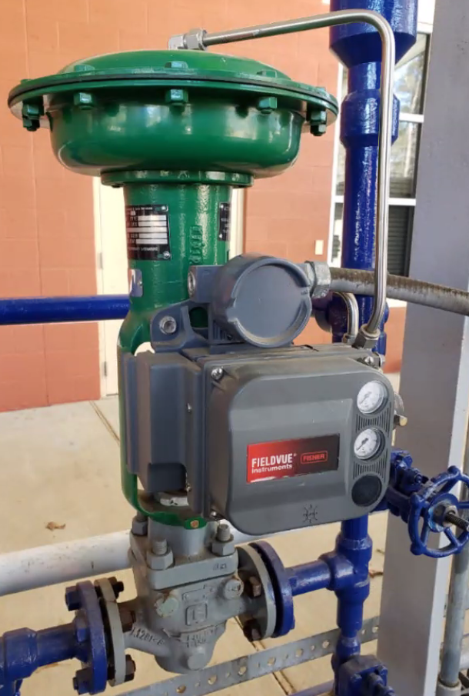
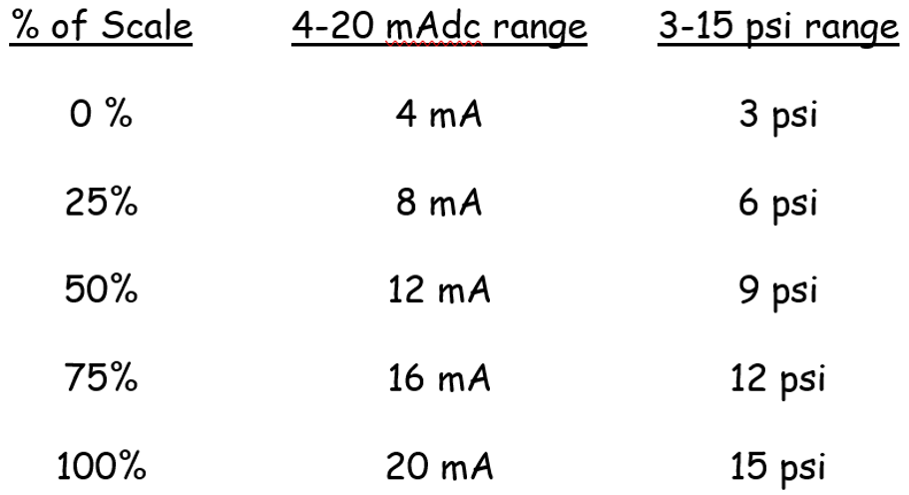
Air is also used for control signals
3-15 psi air signal that controls the position of the valve
A 3-15 psi analog signal is primarily used to control a proportional (analog) flow control valve. The position of the valve stem (which controls the flow of fluid through the valve) is proportional to the analog air signal. In this graphic, since the air line if fed to the top of the valve, the valve is help open with a spring. The air signal will close the valve. At 15 psi, the valve will be fully closed (no flow). At 3 psi, the valve is fully open (full flow).
A current to pressure converter (I/P) is used to convert a 4-20 mA signal to a 3-15 psi signal. One example is shown in the lower portion of this graphic. Typically the I/P must be calibrated to make sure that at 20 mA, it is putting out 15 psi. See the table below for the correlations.
Analog Flow Control Valve
Current to Pressure (I/P) Converter

Slide 17
Practice Question #2
xWhat is the advantage of using a 4-20mA analog signal compared to a 0-10 Vdc signal? (choose all that apply
A. 4-20 mA is less effected by electrical noise than a voltage signal
B. 4-20 mA is more accurate than a 0-10 V signal
C. 4-20 mA has less signal loss on a long run than a 0-10 V signal
D. 4-20 mA is easier to measure than a 0-10 V signal

Slide 18
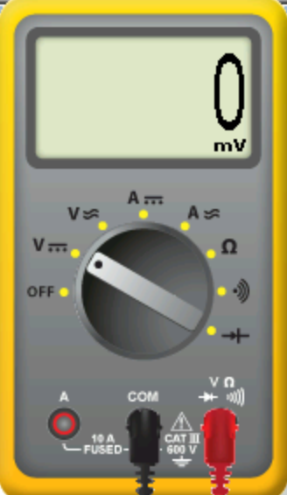
Current to Voltage Conversion
It is important to use Ohms Law when working with analog signals. First, all voltage and current is Direct Current (DC). A resistor can be used to convert a current signal to a voltage signal.
Only use precision resistors when working with analog or instrument signals. They cost a little more, but they have a very low tolerance, or variation from the state resistance. This would not be a resistor that has color bands on them.
A 250 ohm resistor would be used to convert a 4-20 mA signal to a 1-5 Vdc signal. Also, a 500 ohm resistor is used to convert a 0-20 mA signal to a 0-10 Vdc signal.
V = Current * Resistance.
Most PLC analog input modules have a 250 ohm resistor across their input channel, so when a current signal is applied, it converts to a voltage so the module can process it. This can also be a handy way of troubleshooting. If 3 Vdc is measured at the input channel, then the user can determine that there must be 12 mA flowing into the analog input channel. This is shown in this slide. Signal Generator putting out 12 mA across a 250 ohm resistor. The DVM is measuring 3 Vdc.
3.00V
3 Vdc Signal
12 mA Signal
250 ohms
Volts = Current * Resistance
3 Vdc = 12 mA * 250 ohms

Slide 19
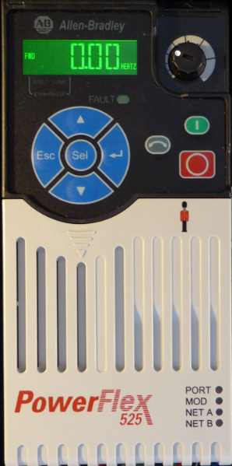
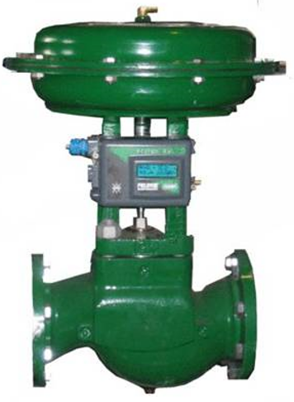
Final Control Devices
This slide show 3 common final control devices, or devices that will control and affect the process variable. All of these devices can be controlled by an analog signal (4-20 mA most common). Though many of the VFDs are now using Ethernet for speed control, there are still many systems that will control the speed of the VFD with an analog signal. These are very common in process control for controlling the speed of a pump.
A proportional valve will control the flow of fluid going through a pipe. The valve shown is a pneumatic operated (3-15 psi), so we will still need and I/P converter in order to convert a 4-20 mA signal to a 3-15 psi signal.
The lower graphic shows a proportional controller, which is used to vary the current in a resistive load (typically a heating element). Some people term these as SCR Power Controllers. Basically the 4-20 mA signal will vary the conductional angle of the AC sine wave that is going to the heating element, which will vary the current, thus varying the heat the element puts out.
AC Motor Drive
Proportional Valve
Proportional Controller
SCR Power Control

Slide 20
Cable for 4-20mA Signal Transmission
The signal cable shown in this graphic is a Belden 8762 cable, which has a PVC jacket, a foil shield, and 20 AWG (wire size). The 20 AWG wire is stranded wire (conductors). The two signal conductors are twisted together within the foil shield, and within the jacket.
This would be termed twisted pair, shielded signal cable.
The most common instrument signal that this cable would transmit would be a 4-20 mA (DC) type of analog signal. The twisting of the wires and the shield gives the 4-20 mA signal a lot of immunity from electrical noise, bot RFI (Radio Frequency Interference) and EMI (Electro-Mechanical Interference). A drain (ground) wire, the same size as the signal conductors is run outside of the foil shield, but is connected to the shield within the jacket. It is important to understand that the drain wire should be grounded on just one end of the cable. If both ends of the drain wire are connected to ground, a ground loop can be created which will induce unwanted electrical noise into the signal cables.

Slide 21
This Concludes this Instructional Document

