Slide 1
Steps & Lessons on Converting
to a Competency-Based
Hybrid Model Part 2
Presented by:
Tom Wylie, PI for HOME4TECHS & Scaling CBE Elements
Northwest State CC, Archbold, OH

Slide 2
Workshop Materials Available for Download:
https://ate.is/Scaling_CBE

Slide 3
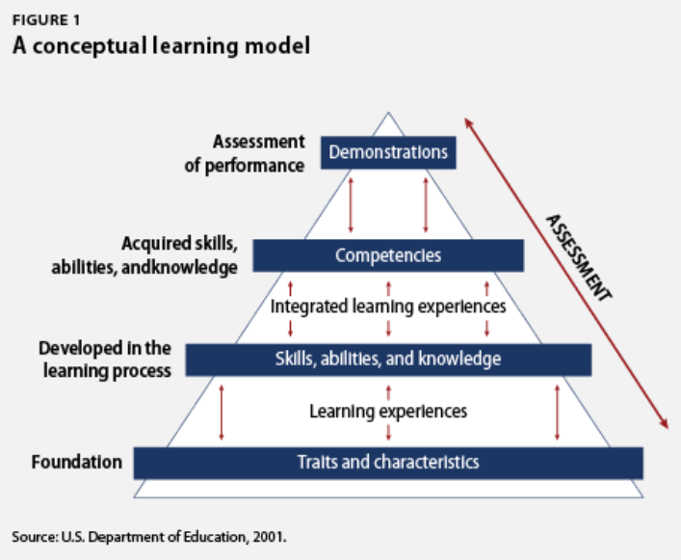
A traditional model has typically 2-3 written or online assessments.
A CBE model has many more assessments so the faculty can determine mastery of the knowledge/skill of each student in each module.

Slide 4
DACUM Competencies
Develop A CUrriculuM
5-7 Industry SMEs meet for 2-3 days to identify all the duties and tasks required for a technology or a job
At least part of your competencies should be obtained from a DACUM, which you can then say are validated.
VET all competencies through the Industry SME group
Do not start from scratch. Start with Competencies and Outcomes from other ATE projects. Show the AMTEC competencies.

Slide 5
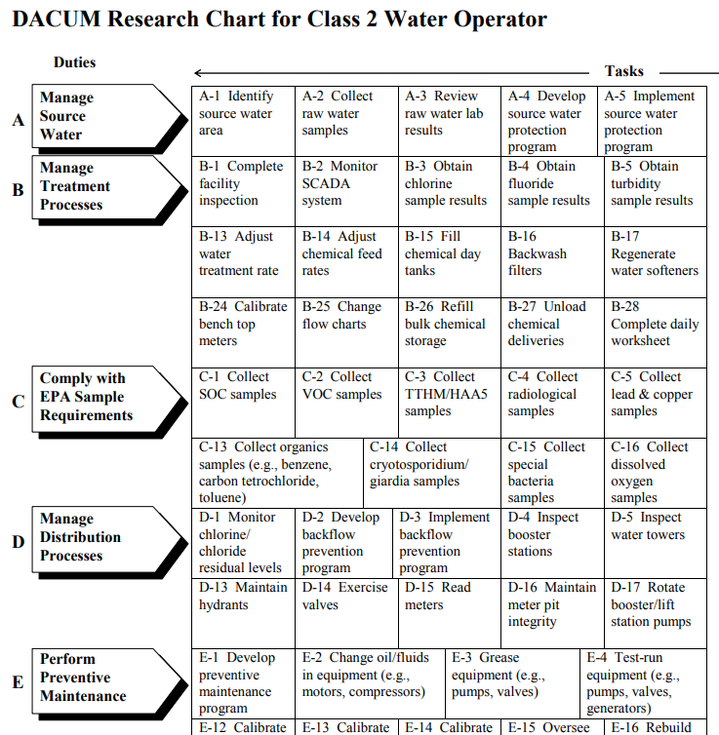
DACUM results for a Class 2 Water Operator in Ohio.
DACUM is an Ohio State format

Slide 6
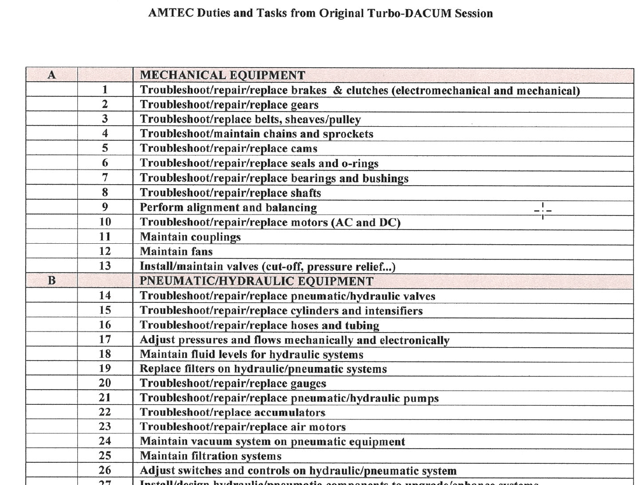
DACUM format for Control Technicians
DACUM format by AMTEC in KY

Slide 7
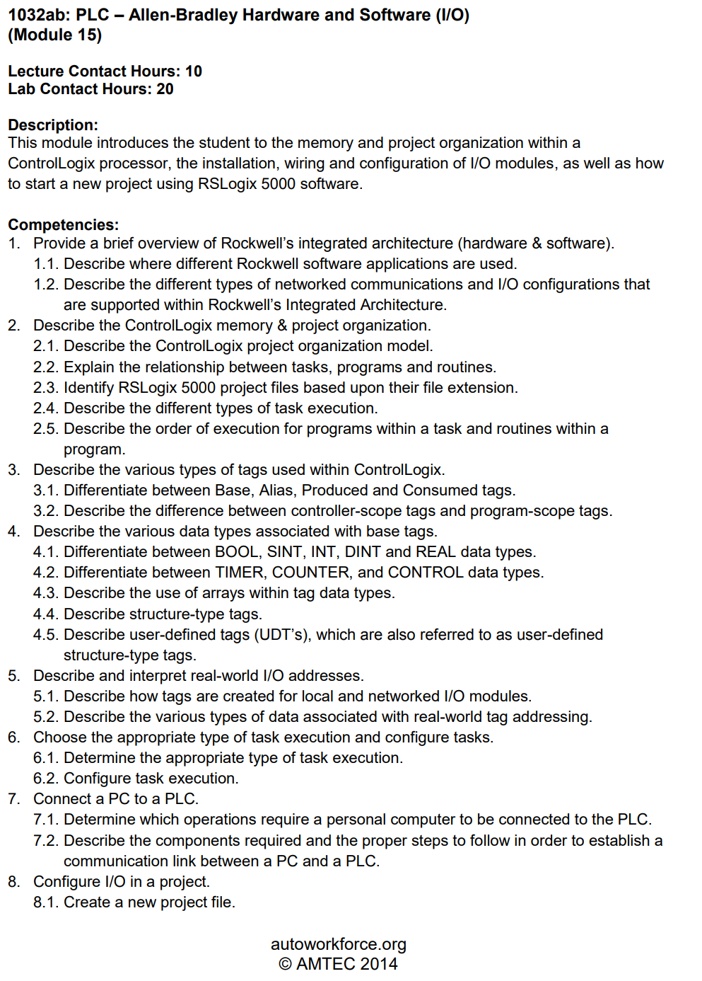
AMTEC was an NSF Center and facilitated numerous DACUMs
AMTEC is no longer funded by the NSF, and was absorbed into the Kentucky Technical and Community College system.

Slide 8
Employer
Engagement

Slide 9
External Data
Delivery of Product
Topic Resources
Job Descriptions
DACUM Comp.
WFD Demand
Employer RT
Corp. Faculty
Credit Cert/Degrees
2 Yr. AAS, ATS, AIS
One-year Cert.
Gainful Empl. Cert.
Apprenticeships
-------------------------
Ind. Automation Maint. Cert.
Industrial Elect. Cert.
Industrial Maintenance Degree
Automation Cert.
Job Classifications
Maintenance Mechanic
Electrician
Machine Setup
Industry
Technical Topics
Basic Electrical
Handtools
Powertools
Ind. Safety
Pneumatics
Hydraulics
Mech Print Read
Motor Control Cir
Motors & VFDs
PLC Basics
AB CompactLogix
AB ControlLogix
Ethernet basics
Rigging
Pumps
Pipefitting basics
Machine Repair
Technical Courses
IND120 IE1
IND121 IEII
IND223 M&C
PLC200 PLCI
IND134 IFPI
Short Term Public Classes
Students come to the college
4 hr. to 24 hr. courses
Credit or N/C
AB PowerFlex 525 VFDs
Types of Students
Incumbent
Emerging
Contract Training
Students come to the college
College delivers at company
4 hr. to 24 hr. courses
Credit or N/C
------------------------------
AB PowerFlex 525 VFDs
Intro to AB ControlLogix
Technical Courses
Displaced
Underemployed

Slide 10
Engaging Employers
How does the Technology division at NorthArk engage employers?
Accrediting bodies like a comprehensive employer engagement strategy
Purpose of an Advisory Board
Purpose of an Industry Roundtable
Purpose of a Focused Industry Visit
Industry Consortiums (Adv. Mfg. Consortium & Lean Mfg. Consortium)

Slide 11
Getting Input from Employers:
Oversight Group: At some colleges this would be an Advisory Board for a program. The BILT model was implemented at Terra State CC in Ohio. This group is like a steering committee for their technical curriculum.
Technical Topic Roundtables: Our project team found the best way to get input on a topic such as the content of a PLC course, or a fluid power course, is to hold an industry roundtable. This consists of 3-4 SMEs in a 45-minute Zoom meeting. An outline is sent to each 1 week ahead of time, consisting of no more than a 2-page outline of topics that will be reviewed. Input is documented, then sent back out to the small group for their final review. A special focus should be on the hands-on skillset that is required. The nice thing about using Zoom, is the college can do a one-on-one meeting with an SME if they cannot get to the Zoom meeting. Most of all, respect their time and thank them for their input.
Communicate the results of the Roundtable back to the Oversight Group and explain how the curriculum will be adjusted to improve effectiveness and/or access.

Slide 12
Importance of an External SME group
SME stands for Subject Matter Expert
4-6 of these SMEs should be identified to vet information through as part of the development process
It is important to have all knowledge and skills development, align to the workplace
This will be done through validated competencies, and measurable outcomes

Slide 13
Converting Existing
Technical Courses
to a CB/H Model

Slide 14
Course Blueprint when Designing a Course:
One thing I started doing a few years ago when converting/creating a technical course, was to create a Course Blueprint. This is similar to a Master Machinist needing a blueprint of a part, before they machine it.
The course is parsed into 8 modules, and I put notes, links and pictures that relate to the module into the blueprint. Basically, I am storing the information that I will be putting into Canvas in the Blueprint, such as module descriptions, outcomes, etc.

Slide 15
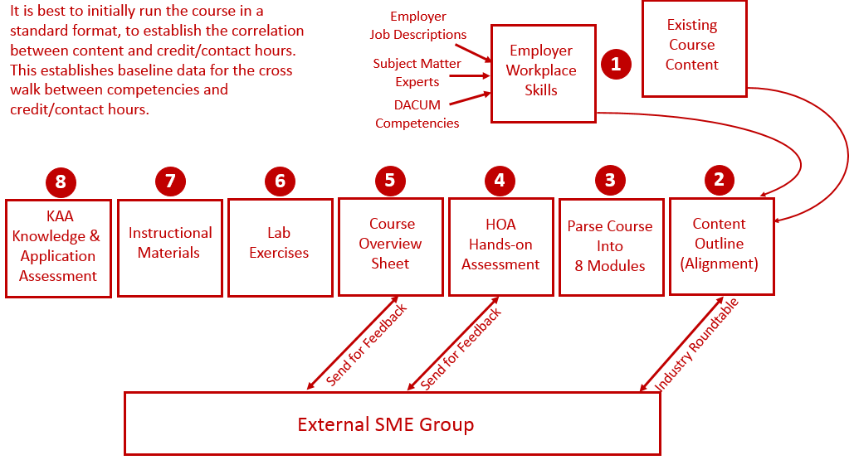
Reverse Design:

Slide 16
Developing the Content of a Module:
Competency for a Module
Module
Topics
Module
Outcomes
Perfor-
mance
Assess
Lab
Exercises
Design
Design
Test
Prepare
Instruction
PPT/PDF
Videos
Simulate
KAA
in
Canvas
Practice
Quiz
KAA
Study
Guide
Prepare
Test
Prepare
Prepare

Slide 17
Competency, Outcomes, Assessment & Knowledge
Competency: Use RSLinx to establish communications between a computer (with PLC programming software) and Allen Bradley PLCs (L5000, SLC-500, PLC-5 & ML1000).
Module Outcomes:
1. Configure RSLinx to communication with a ControlLogix 5571 controller.
2. Identify all the hardware components on a L5571 controller
Skills Assessment:
Create an Ethernet driver in RSLinx to communicate with a 1756-ENET module.
Create an Ethernet/IP driver in RSLinx to communicate with 1756-ENET module.
Create a USB driver in RSLinx to communicate with the controller.
Knowledge Required:
What is an IP address? What is a subnet mask? How does an Ethernet port get an IP address?
How to determine the IP address of a 1756-ENET module
How to drill down to a controller from a driver in RSLinx
How to use RSWho to view the drivers and communications within a ControlLogix system
How to create a driver in RSLinx

Slide 18
Prepare the Students:
Build the Instructional Material: Module Outcomes:
Reading assignments if using a textbook, or vendor manuals
a. This could be the Rockwell Getting Results from RSLinx manual, or textbook
2. Create focused PPT/PDF materials focused on NorthArk lab equipment
a. This could be pictures of the communication ports on the computer and on the PLCs in the lab and explain
3. Instructor created videos explaining hardware, or how to use software (screencam)
a. Instructor will use Canvas, Camtasia or Zoom to record a screencam video on how to create the drivers in RSLinx
4. Created lab exercises (instructor guides the student learning)
a. This document will go through setting up communications and ask the student questions about it
5. Create simulations in the virtual machines
a. This can be done using the emulators in a VM, and setting up RSLinx to establish communications

Slide 19
Contact Hours per week for a Course:
Hours in Class, and Out of Class, in Ohio:
1 Lecture hour/week is 1 Credit Hour. 1 Lecture Hour requires 2 hours of out of class time per week.
2 Lab hours/week is 1 Credit Hour. 2 hours of Lab per week requires 2 hours of out of class time per week.
3 Lab hours/week is 1 Credit Hour. 3 hours of Lab per week requires 3 hours of out of class time per week.
ET 2440 Industrial Control Systems:
2 Lecture hour/week is 2 Credit Hour. Requires 4 hours of out of class time per week, for a total of 6 hours/week
6 Lab hours/week is 2 Credit Hours. Requires 6 hours of out of class time per week, for a total of 12 hours/week
This course should take 18 hours per week by standard academic hours.
The Learning Sequence Sheet found in each course module should show the estimated time per week to complete this module. This will be important to the Students, Academic Leadership, and for Academic Affairs.

Slide 20
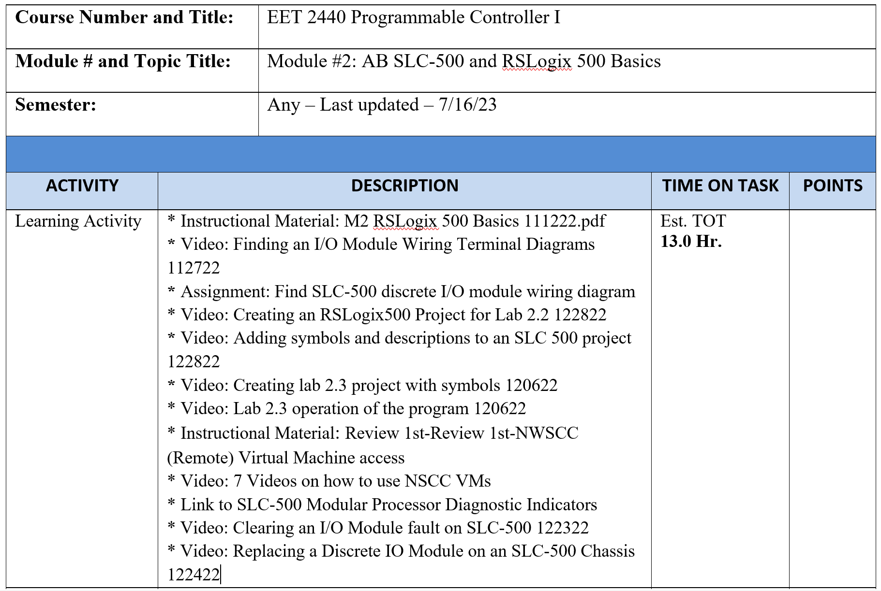
Learning Sequence Sheet:

Slide 21
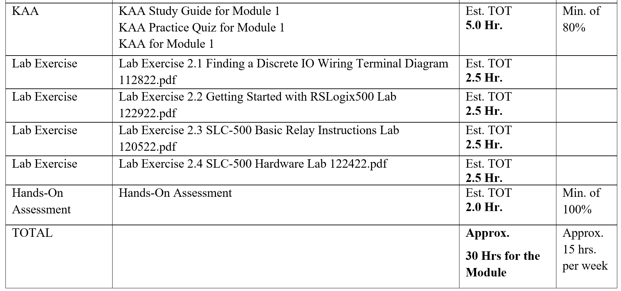
Learning Sequence Sheet:

Slide 22
Common Elements of a Learning Module:
1. Module Description & Outcomes
2. Learning Sequence Sheet
3. Instructional Materials (PDFs, Videos, Reading Material)
4. Lab Exercises
5. KAA Study Guide
6. KAA Assessment
7. Practice Quiz
8. Skills Assessment

Slide 23
Virtual Machines & Simulations:
A virtual machine is a virtual computer that resides on the college servers, which can house proprietary software (PLC, CAD, CAM, etc.), and can be accessed by the students from home with a computer and WiFi connection, using a browser, such as Chrome, Edge, Safari or Firefox.
Simulations are usually created using Automation Studio, a simulation software created by Famic Corporation in Quebec.
Simulations do not replace the hands-on, but will be used to prepare students to do the hands-on learning.

Slide 24
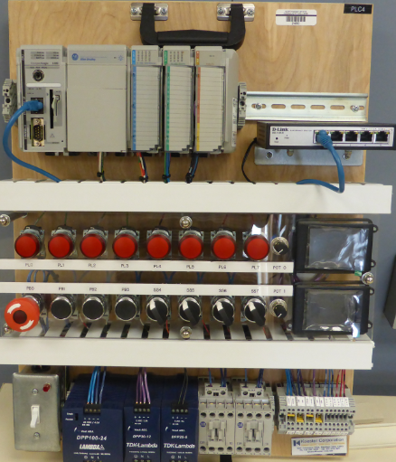
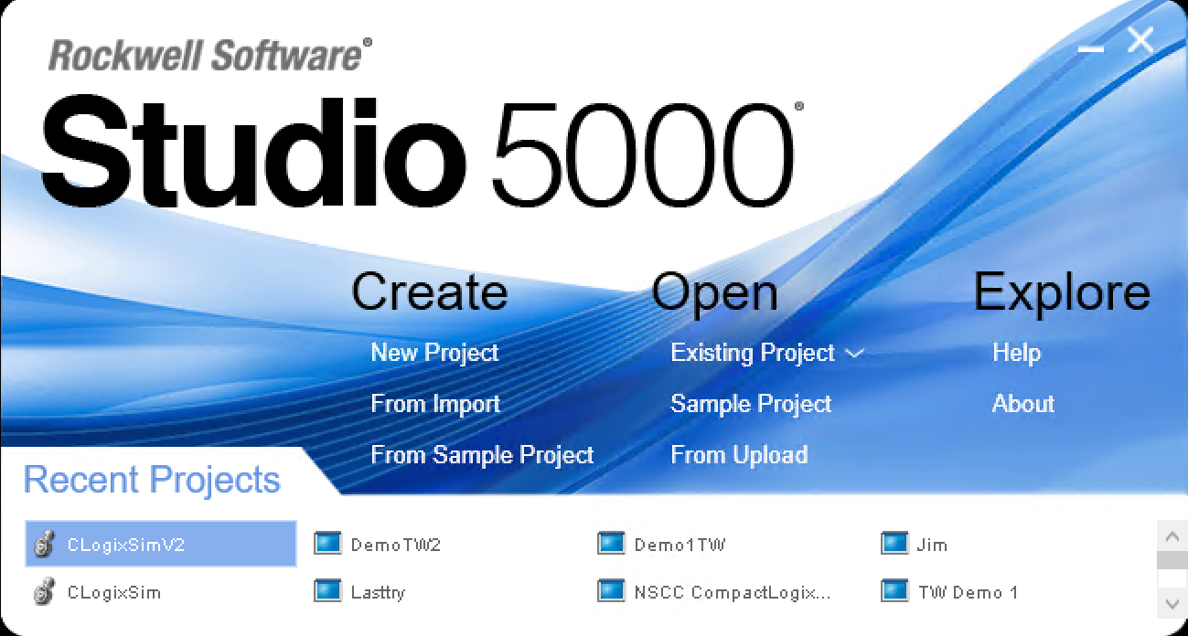
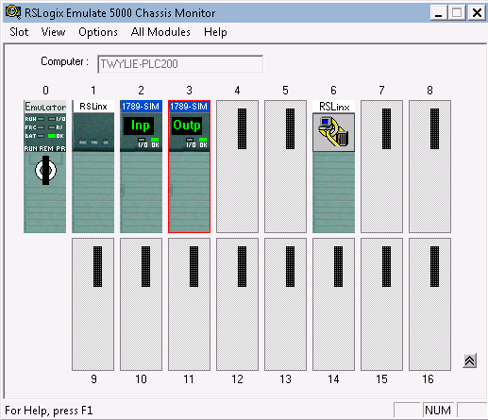
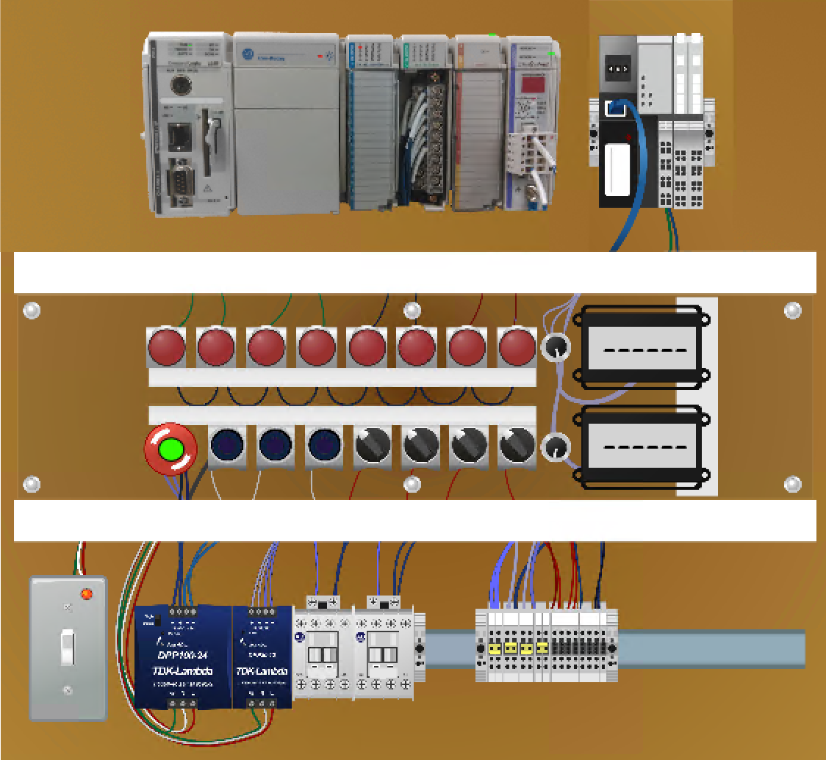
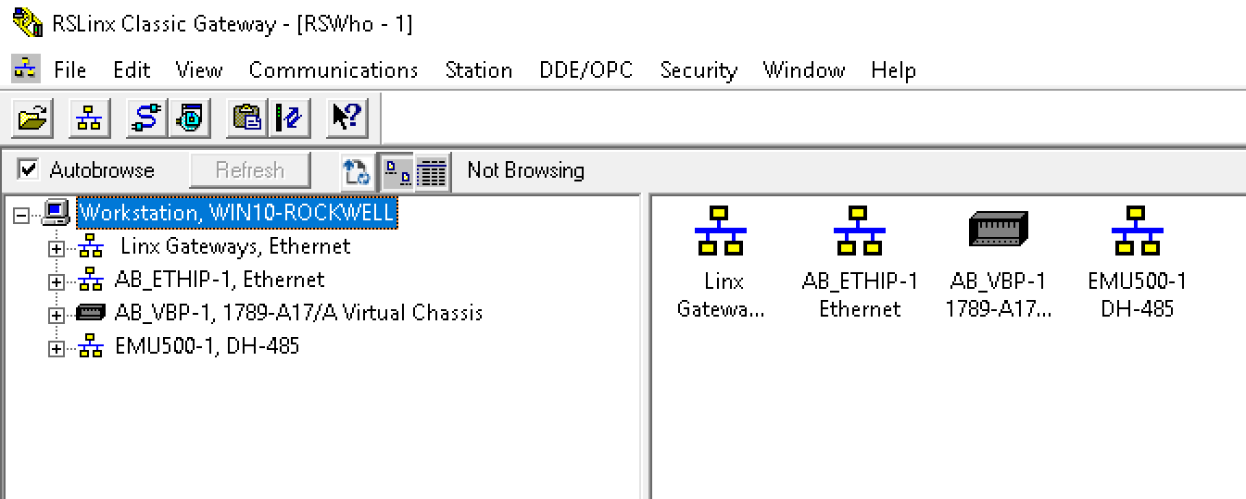
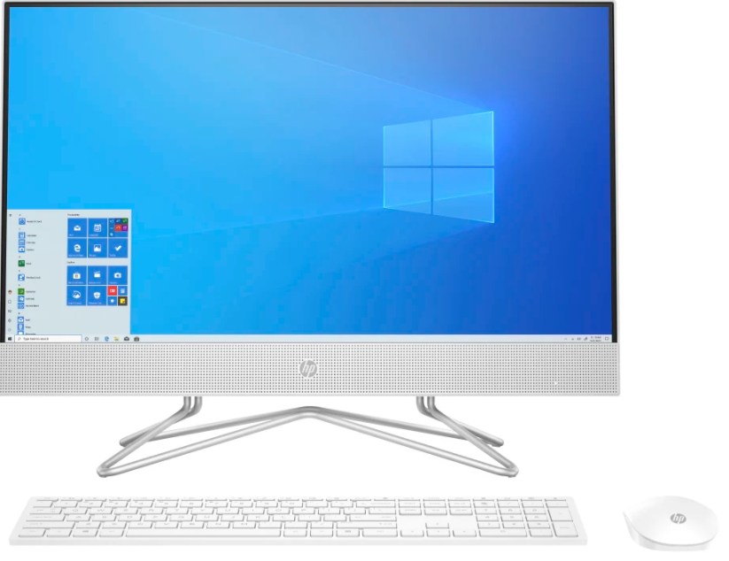
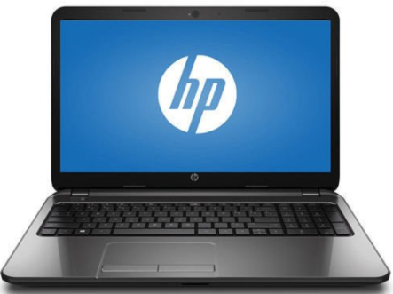
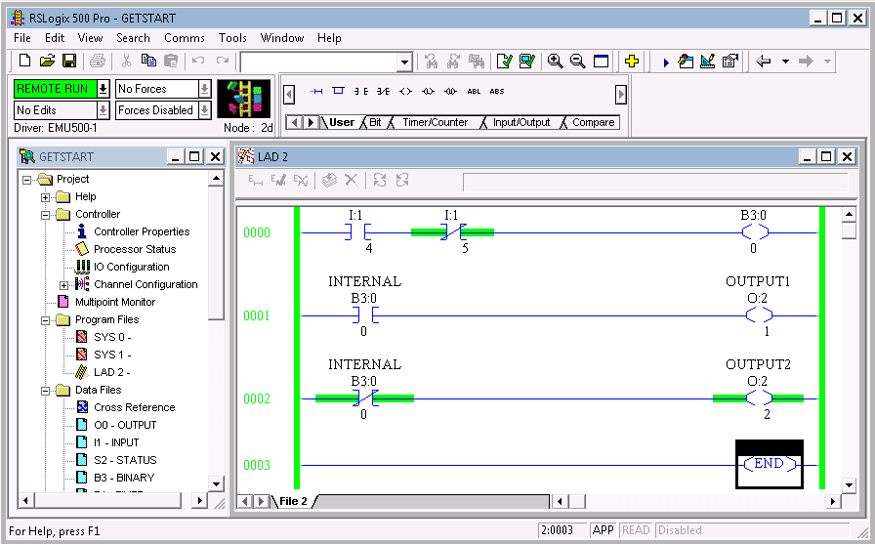
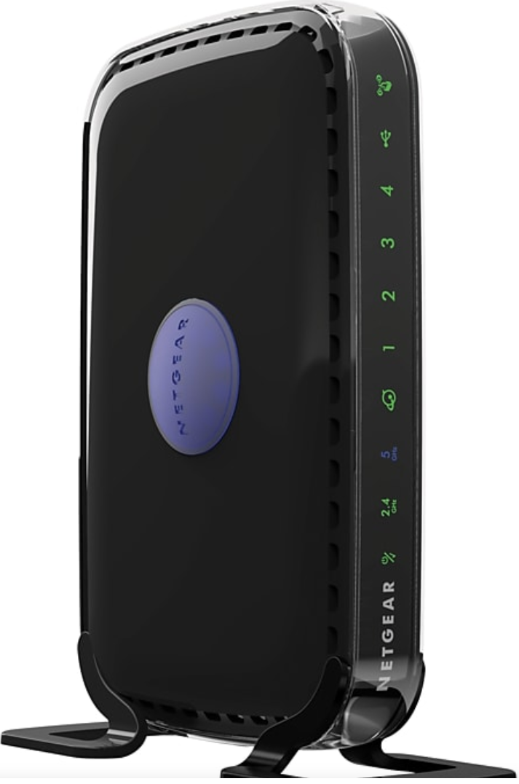
PLC Lab on campus
The content of the virtual machine will have all of the same functionality as being in the PLC Lab
Student’s Virtual Machine
Student Computer
at Home
College Firewall
Internet
Virtual PLC Simulator
Wireless Router (Home)

Slide 25
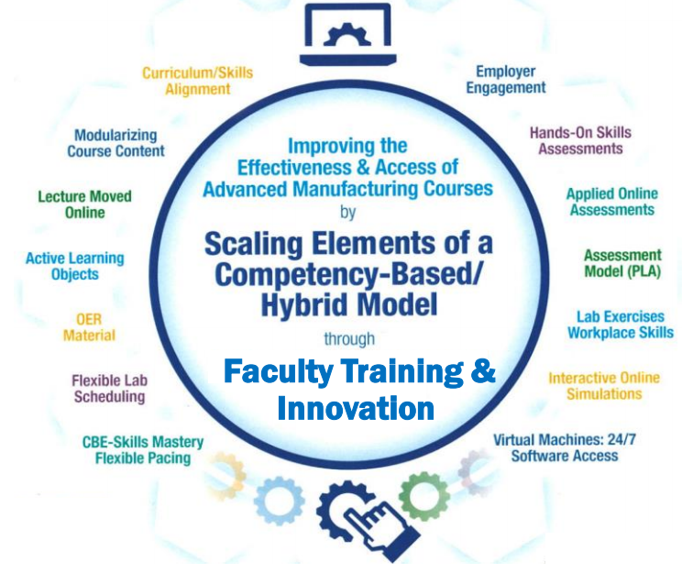
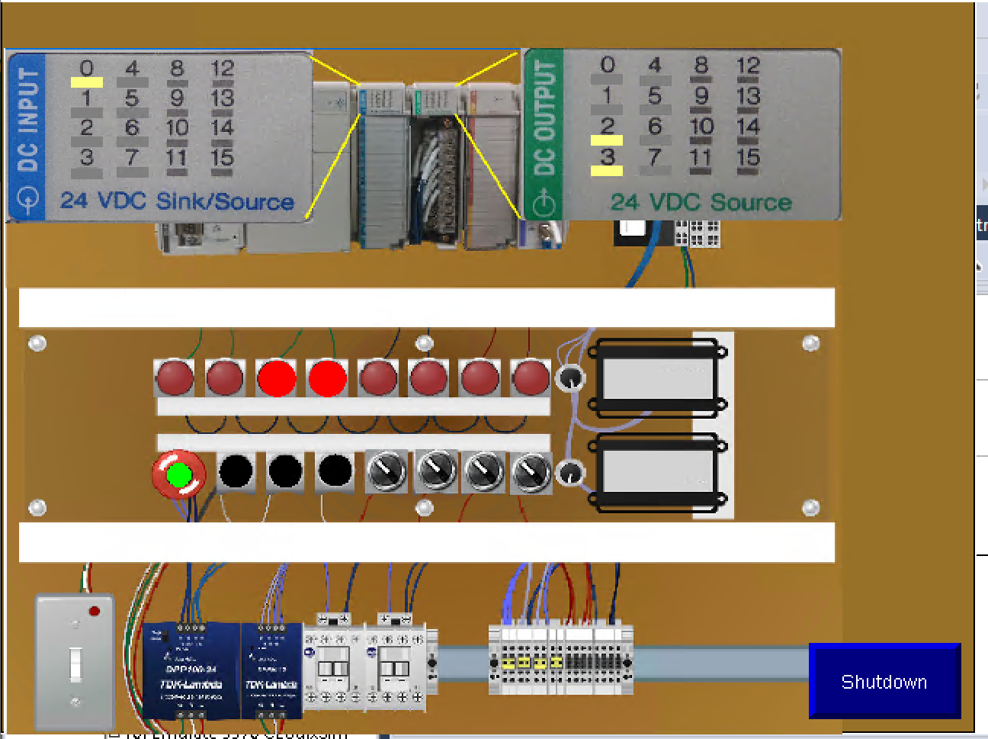
The Virtual PLC Simulator, enhanced with Factory Talk View Studio, which will allow the unit to communicate with the Studio 5000 Emulator with FactoryTalk Linx. This will allow students to run their programs on the simulator that were created in Studio 5000
Virtual Simulator
Customized Virtual Simulator

Slide 26
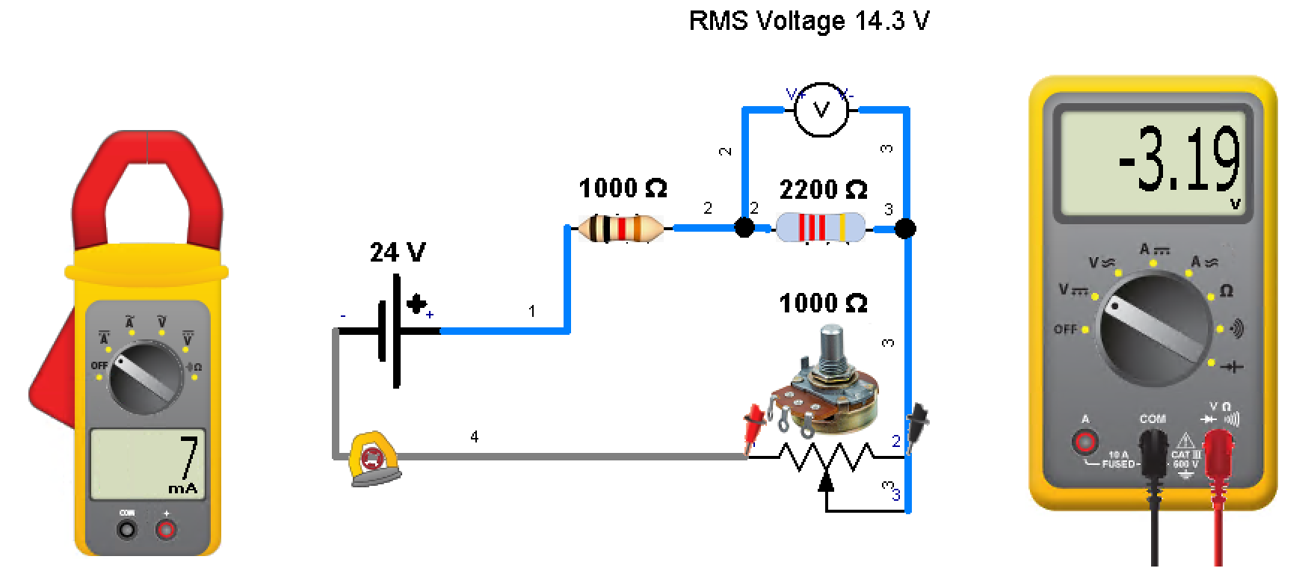
Simulation in Automation Studio for basic electrical course. Multi-meter or clamp-on ammeter can be used for testing the circuit.

Slide 27
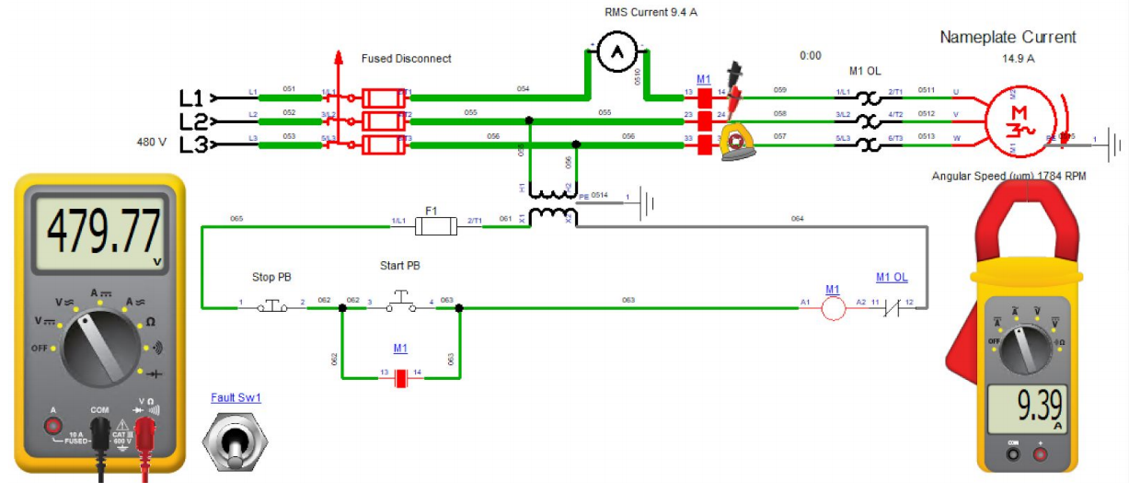
Simulation in Automation Studio of a motor branch circuit.
Students see how the control circuit and power circuit works.
Fault switch is used to open a power line for student troubleshooting.

Slide 28
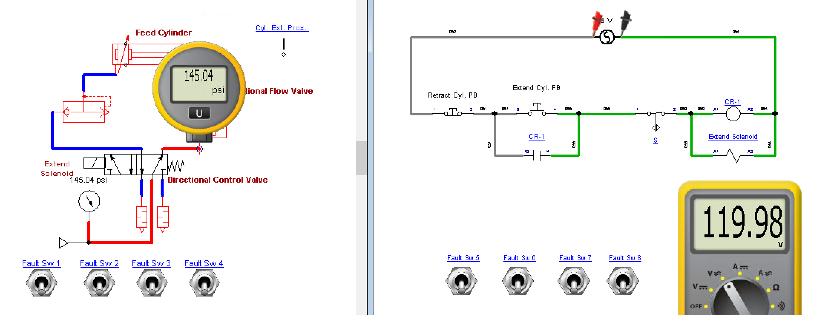
Simulation in Automation Studio of an electrical circuit, controlling a pneumatic circuit. Faults are inserted for student troubleshooting. This slide show a virtual
pressure gauge, and a multi-meter used to troubleshoot the pneumatic and
electrical circuits where faults can be inserted from the fault switches.

Slide 29
Open Education Resources (OER):
OER is open material for anyone to use for instruction
Any material development funded with federal grant dollars is open for anyone to use, but there may be some restrictions based on the license.
Creative Commons is an organization who has defined content licensing.

Slide 30
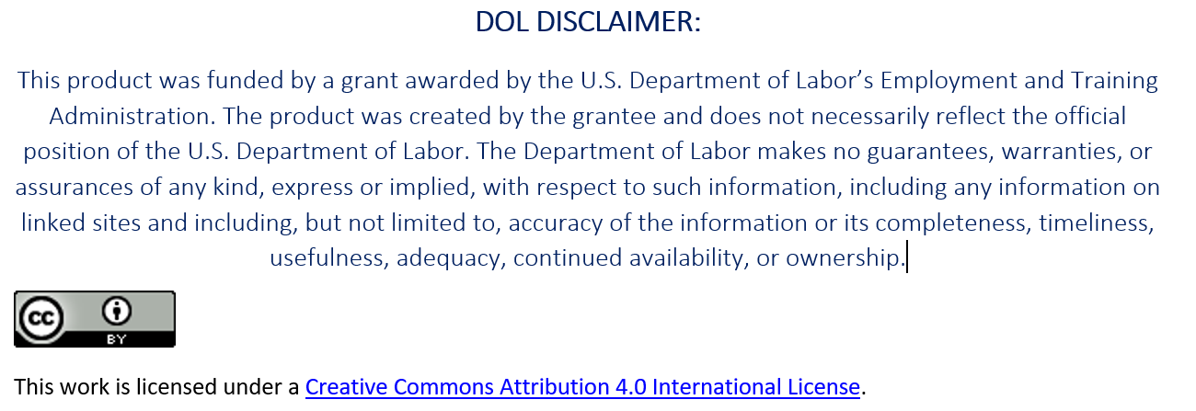
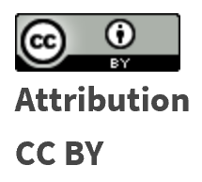
Creative Commons Licensing
Creative Commons is a nonprofit organization that provides a licensing structure that allows individuals and organizations in the world, a free, simple, and standardized way to grant copyright permissions for creative and academic work.
Material is not registered at Creative Commons. The author chooses a license, then attaches it to the material, then puts it in a repository for open access.
To learn more about each type of CC License, go to this link:
https://creativecommons.org/licenses/

Slide 31
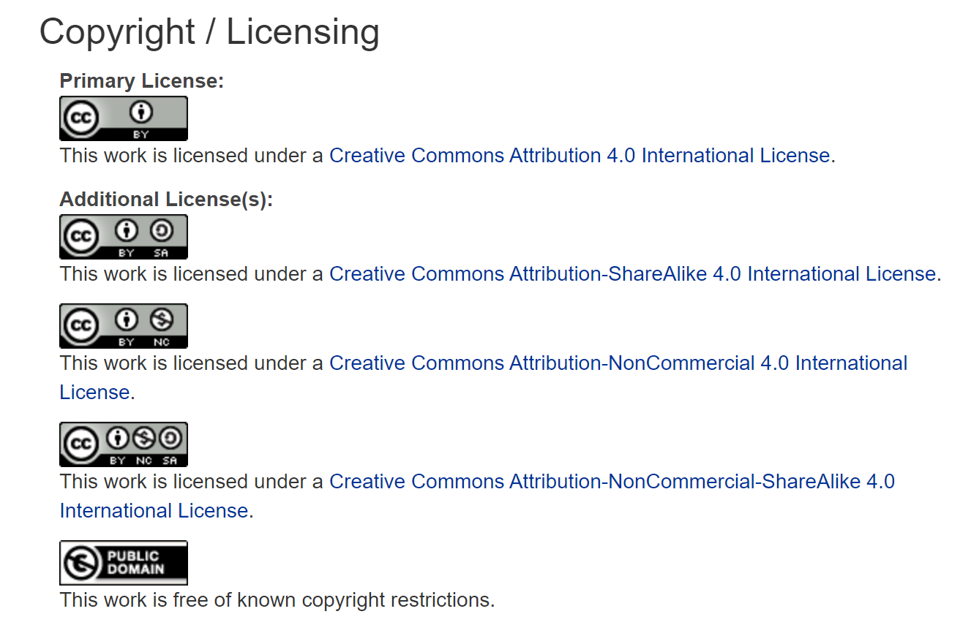
To learn more about each type of CC License, go to this link:
https://creativecommons.org/licenses/

Slide 32
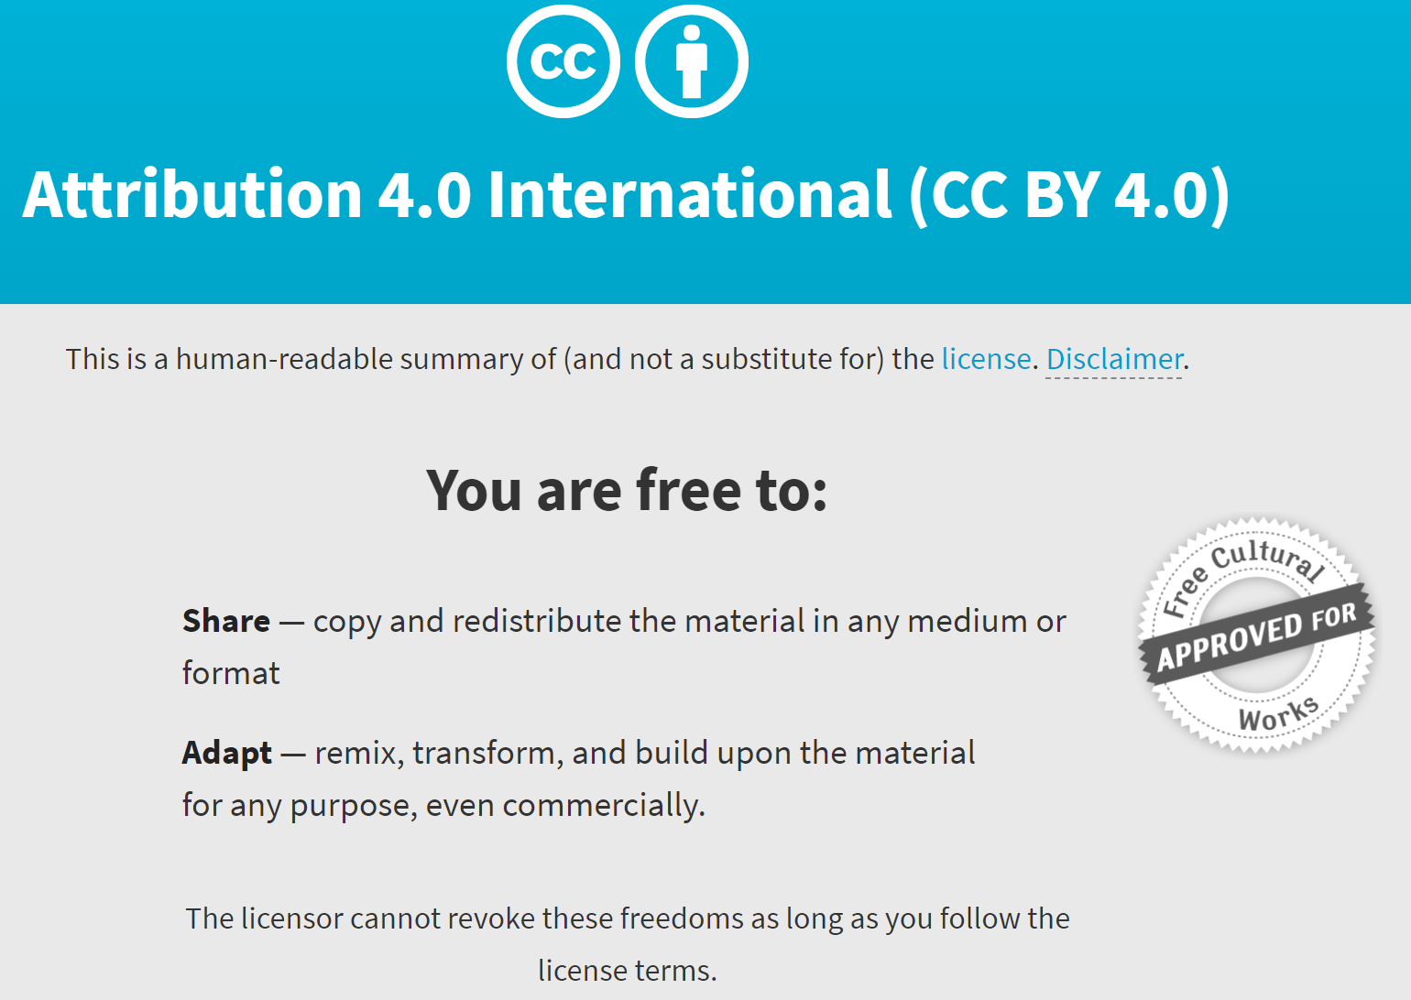
https://creativecommons.org/licenses/by/4.0/

Slide 33
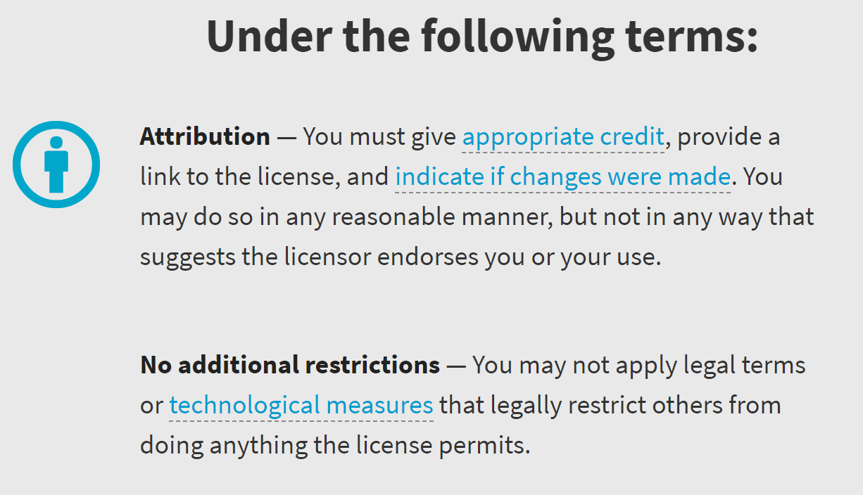

Slide 34
The End of the Presentation

