Slide 1
Steps & Lessons on Converting
to a Competency-Based
Hybrid Model Part 1
Presented by:
Tom Wylie, PI for HOME4TECHS & Scaling CBE Elements
Northwest State CC, Archbold, OH

Slide 2
Workshop Materials Available for Download:
https://ate.is/Scaling_CBE

Slide 3
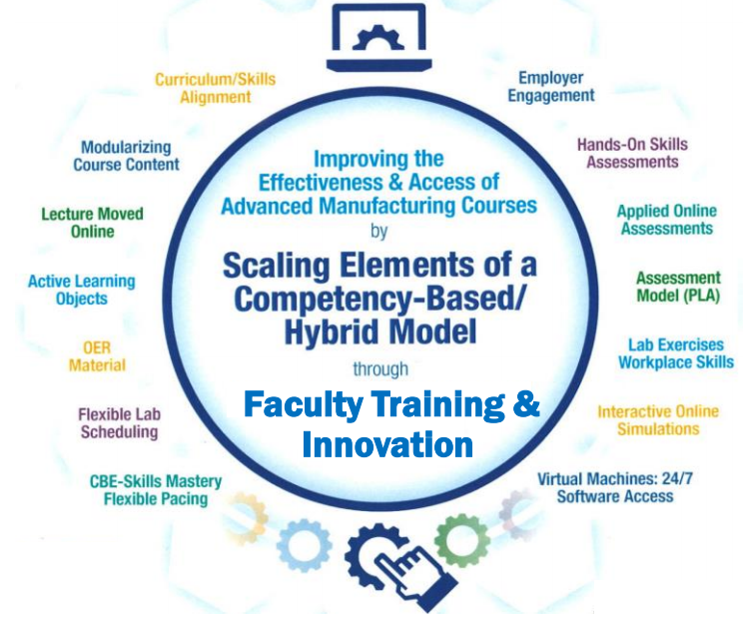
Instructional Elements to Improve Technical Courses

Slide 4
Build Justification for your Project

Slide 5
Common Theme for your Project:
Executive Summary: This document will serve as an explanation to senior administrators and faculty on exactly what your project is doing.
Explain why you are doing the project, and what was the driving force for the possible changes in your curriculum and method of delivery. This could be: employers, student access, faculty wanting to make sure all students are at the same skill level when graduating.
How you are going to change the curriculum, assessment and method of deliver, comparing it to where the courses are now.
Expected Outcomes should be explained in simple terms. Be prepared to respond if an Administrator or Board Member would ask you: How will you know if this initiative is successful?

Slide 6
Why NSCC put in for HOME4TECHS:
More Hands-On Skills Development: Moving the lecture online makes more time for hands-on learning. Skills Assessment drives students to develop Hands-On Skills.
Faculty assured of Skillset of each Student: One-on-one skills assessment for each student by the Faculty assures the required skills and knowledge. No students can skirt the system.
Flexible Schedule for Faculty: Since the lecture portion of the course is moved online to the LMS, the Faculty can have a flexible schedule to perform other tasks on/off campus.
Student Access: Students have the flexibility of attending any of the scheduled lab times, or scheduled open lab times. Some faculty take attendance in the lab times to identify students procrastination.
Realignment of Technical Curriculum: Some of the curriculum had not been changed for 10-20 years. Technology had changed and employers drove us to change.

Slide 8
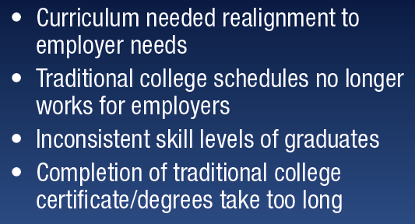

Slide 10
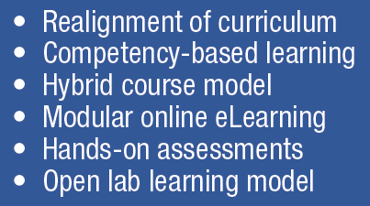

Slide 11
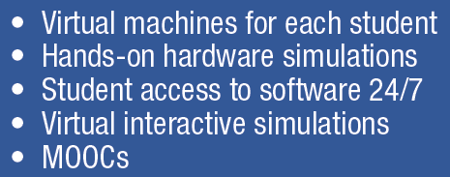

Slide 12
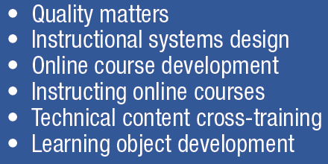

Slide 13
Overview of the HOME4TECHS Project
Won in 2015. Ran from 8/1/15 to 7/31/18
Amount was approximately $200K
Focus was to build a model to convert lecture/lab technical courses to a competency-based/hybrid model
3 courses were converted:
IND223: Motors & Motor Controls
PLC200: Programmable Controller I
PLC230: Servo & Robotics

Slide 14
Overview of the HOME4TECHS Project, cont.
3 faculty were PI & Co-PIs
Assessment model changed everything: Employers wanted students with more hands-on skills. Students learning behavior will follow the assessment model. Assess their hands-on skills, and they will focus on developing their hands-on skills.
Lecture moved online, scheduled & open lab model
Project results (2 yrs. of the old model, compared to 2 yrs. of the new):
44% increase in enrollment (of the 3 courses)
10% increase in retention
7% increase in grade level attainment

Slide 15
Traditional Education Model
Versus
Competency-Based/Hybrid

Slide 16
Competency Based Learning:
Competency-based learning refers to systems of instruction, assessment, grading, and academic reporting that are based on students demonstrating that they have learned the knowledge and skills they are expected to learn as they progress through their education.
Some synonyms to CBL include: Proficiency-based, mastery-based, outcome-based, performance-based, and standards-based instruction.
Reference: https://www.edglossary.org/competency-based-learning/

Slide 17
Competency-Based Education (CBE)
Across the country there is a trend to transition away from seat-time and move towards a flexible structure that allows students to progress in their learning after they have demonstrated mastery, which is often time at their own pace. This trend is known as competency-based education (CBE). Good article by Janice Walton (below is the link to it).
https://www.gettingsmart.com/2017/12/12/competency-based-education-definitions-and-difference-makers/#:~:text=Competency%2Dbased%20education%20is%20defined,to%20more%20efficient%20student%20outcomes.%E2%80%9D

Slide 18
What is Competency-based Education (CBE)?
Competency-based Education consists of the following unique elements:
Mastery of Skills - The CBE course is typically parsed into modules, with assessments in each module that must be passed at the mastery level.
Flexible Pacing - Student will progress through a course at their pace of learning (and of course mastery). Some students will finish early, and some will take a little longer.
Fixed Learning- Ideally, every student has the same knowledge and skills assessments that require mastery, thus all students should be at the same level when they complete a course.
Variable Time – This refers back to flexible pacing. Student progress through a course at their own pace. Some students finish sooner, and can start the next course prior to the start date if they are registered (assessments cannot be open until the start date of the next semester). Some student take a little longer, thus they may need more time than what is in the course (incomplete). Incompletes are awarded by the Dean based on Faculty input. Procrastination is not tolerated.

Slide 19
Traditional Technical Course
Traditional Technical Course at NSCC, 8 years ago
Syllabus
Textbook
Lecture
Handful of labs
3 P/P Tests
Grade (ABCDF)
The challenge is: How does an Instructor know that all students have the skills required by the employers?

Slide 20
Traditional PLC Course Schedule:
Wk. 1
Wk. 2
Wk. 3
Wk. 4
Wk. 5
Wk. 6
Wk. 7
Wk. 8
Wk. 9
Wk. 10
Wk. 11
Wk. 12
Wk. 13
Wk. 14
Wk. 15
Wk. 16
Mon
Mon
Mon
Mon
Mon
Mon
Mon
Mon
Mon
Mon
Mon
Mon
Mon
Mon
Mon
Mon
Lecture
Lecture
Lecture
Lecture
Lecture
Lecture
Lecture
Lecture
Lecture
Lecture
Lecture
Lecture
Lecture
Lecture
Lecture
Lecture
8a-12p
8a-12p
8a-12p
8a-12p
8a-12p
8a-12p
8a-12p
8a-12p
8a-12p
8a-12p
8a-12p
8a-12p
8a-12p
8a-12p
8a-12p
8a-12p
Wed
Wed
Wed
Wed
Wed
Wed
Wed
Wed
Wed
Wed
Wed
Wed
Wed
Wed
Wed
Wed
Lab
Lab
Lab
Lab
Lab
Lab
Lab
Lab
Lab
Lab
Lab
Lab
Lab
Lab
Lab
Lab
8a-12p
8a-12p
8a-12p
8a-12p
8a-12p
8a-12p
8a-12p
8a-12p
8a-12p
8a-12p
8a-12p
8a-12p
8a-12p
8a-12p
8a-12p
8a-12p
Test #1
Test #2
Final
ET 2440 Industrial Control Systems
4 Cr. Hr., 128 contact hours (2 hrs. Lec. & 6 hrs. Lab/week for 16 weeks)
Students & Faculty make 32 trips to campus for this semester course
3 Written or Online Knowledge-based Assessments, and possibly projects
Pace is set by the Instructor

Slide 21
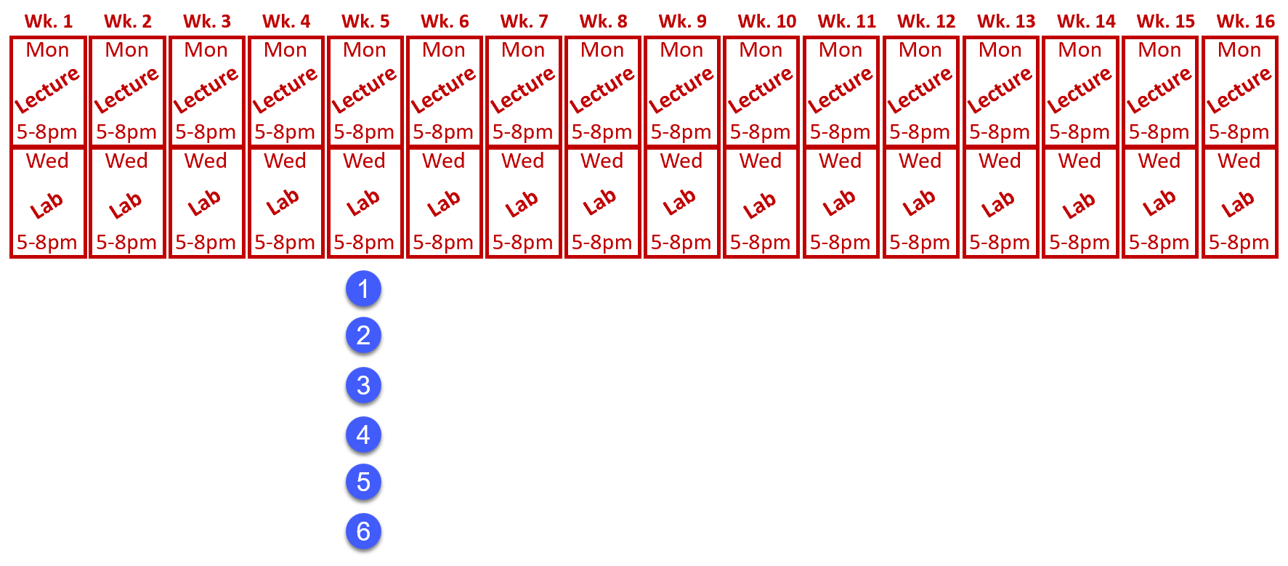
Traditional PLC Course Pacing:
Wk. 1
Wk. 2
Wk. 3
Wk. 4
Wk. 5
Wk. 6
Wk. 7
Wk. 8
Wk. 9
Wk. 10
Wk. 11
Wk. 12
Wk. 13
Wk. 14
Wk. 15
Wk. 16
Mon
Mon
Mon
Mon
Mon
Mon
Mon
Mon
Mon
Mon
Mon
Mon
Mon
Mon
Mon
Mon
Lecture
Lecture
Lecture
Lecture
Lecture
Lecture
Lecture
Lecture
Lecture
Lecture
Lecture
Lecture
Lecture
Lecture
Lecture
Lecture
8a-12p
8a-12p
8a-12p
8a-12p
8a-12p
8a-12p
8a-12p
8a-12p
8a-12p
8a-12p
8a-12p
8a-12p
8a-12p
8a-12p
8a-12p
8a-12p
Wed
Wed
Wed
Wed
Wed
Wed
Wed
Wed
Wed
Wed
Wed
Wed
Wed
Wed
Wed
Wed
Lab
Lab
Lab
Lab
Lab
Lab
Lab
Lab
Lab
Lab
Lab
Lab
Lab
Lab
Lab
Lab
8a-12p
8a-12p
8a-12p
8a-12p
8a-12p
8a-12p
8a-12p
8a-12p
8a-12p
8a-12p
8a-12p
8a-12p
8a-12p
8a-12p
8a-12p
8a-12p
Pace is set by the Instructor
Pace is the same with all students
Learning/Grade is variable

Slide 22
Competency-Based/Hybrid Instructional Model
LMS Canvas
On-campus class time
*Readings
*Videos
*PDFs
*Lec Cap
*Objects
Lab Exercises
Hands-On Assessment
Student 1
Lab Packs sold in Bookstore (required)
Student 2
*Study Guide
*Practice Quiz
*KAAs
Student 3
Faculty facilitates learning
*Lab Exercises
*Simulations
*Performance
Faculty
Faculty assesses student skill/knowledge
Self-proctored Online Assessments

Slide 23
Competency-based Hybrid PLC Course Schedule:
Wk. 1
Wk. 2
Wk. 3
Wk. 4
Wk. 5
Wk. 6
Wk. 7
Wk. 8
Wk. 9
Wk. 10
Wk. 11
Wk. 12
Wk. 13
Wk. 14
Wk. 15
Wk. 16
Module 1
Module 2
Module 3
Module 4
Module 5
Module 6
Module 7
Module 8
Canvas
Canvas
Canvas
Canvas
Canvas
Canvas
Canvas
Canvas
M1 KAA
M2 KAA
M3 KAA
M4 KAA
M5 KAA
M6 KAA
M7 KAA
M8 KAA
Wed
Wed
Wed
Wed
Wed
Wed
Wed
Wed
Wed
Wed
Wed
Wed
Wed
Wed
Wed
Wed
Lab
Lab
Lab
Lab
Lab
Lab
Lab
Lab
Lab
Lab
Lab
Lab
Lab
Lab
Lab
Lab
8a-12p
8a-12p
8a-12p
8a-12p
8a-12p
8a-12p
8a-12p
8a-12p
8a-12p
8a-12p
8a-12p
8a-12p
8a-12p
8a-12p
8a-12p
8a-12p
Performance
Assessment #1
Performance
Assessment #2
Performance
Assessment #3
Performance
Assessment #4
Students & Faculty make 16 trips to campus for this semester course
Pace is set by student learning and completion

Slide 24
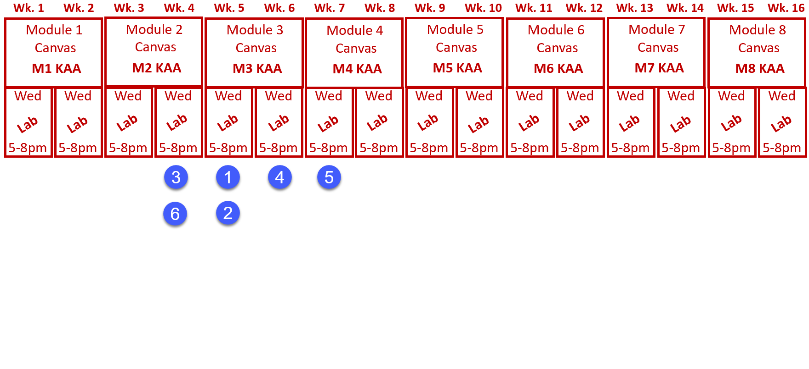
Flexible Pacing of Student Learning:
Pace is set by student learning and completion
All students finish with the same level of learning

Slide 25
Assessment Models:
Traditional Assessment Model:
Competency-based Assessment Model:
Test #1
M1 KAA
Performance
Assessment #1
Test #2
M2 KAA
Test #3
M3 KAA
M4 KAA
Performance
Assessment #2
Knowledge
Paper or
Online
10 Point Sys.
A-F Grade
M5 KAA
M6 KAA
Performance
Assessment #3
M7 KAA
M8 KAA
Performance
Assessment #4
Knowledge
Paper or
Online
80% min.
A, B, or F
Skills
Hands-on
100% min.

Slide 26
Apprentices attending a CBE hybrid course
Apprentices base progress on seat time (lecture and lab).
Get ahead of this by discussing it with the Educational Representative form their joint committee
Create a cross walk from the traditional course to the CBE hybrid course
A learning sequence sheet will help in justifying the competency to contact hours
It is best to run a course as a lecture/lab traditional delivery before converting to a CB/H model, just to create a cross walk

Slide 27
Traditional Education vs. Competency-Based
In a traditional model, the faculty does primarily teaching (Sage on the Stage), and some assessment.
In a competency-based model, the faculty does primarily assessment, and less teaching than in the traditional model.
The faculty becomes a learning facilitator, both in the Lab (still teaching the hands-on skills), and also within the LMS (Canvas).

Slide 28
Lessons Learned
And
Recommendations

Slide 29
What’s in it for Me? The Stakeholders Perspective
Students: Students like the 24/7 access to the course materials, and knowing what is expected of them for the assessments.
Faculty: Faculty like the consistency in the curriculum, and that all materials are developed, so they do not have to spend time preparing for a class. They also like the flexibility of time on campus.
Employers: Employers like the more accessible classes for their employees, and better prepared graduates. They really like the assessment model of student accountability.
College: Increase in enrollment, increase in retention (SSI), and knowing that the other 3 stakeholders are happy.

Slide 30
Tracking Progress in the ATE Project:
Project Management: It is important that there is a process in place to not only develop the curriculum for the ATE project, but also track the progress of the project, assign tasks to individuals, and to let the stakeholders view the progress.
Microsite: A great way to give everyone access to view documents is through an ATE Central Microsite, which is actually a website that ATE Central will host and is free for active ATE projects.
Tracking Software: Starting out, this could be as simple as a spreadsheet that will show tasks and estimated completion dates. The HOME4TECHS project used SmartSheet, which is a very simple project management software that is relatively inexpensive.
Data Management: Make sure all developed material goes into a common location that is backed up by the IT department. I store to locations in the Cloud, to a passport USB drive, and in the course shells within Canvas. Coordinate this with the LMS Director.

Slide 31
Consistency in Instructional Materials:
Consistency is an important thing to the students at NSCC. Not only are all the documents built in a standard format, but also the LMS course layout is an important standard.
LMS formatting is especially critical. At NSCC, many students did not have great experience taking online courses (primarily Gen Ed), since every Instructor would setup a course differently. The standardization in our LMS was a best practice in our student focus groups.
Learning Objects have a specific format in PPT and Word, with text colors, margins, headers, etc.

Slide 32
A Few Lessons Learned:
This is a team effort. Support each other and have a common cause with the end goal in mind. Don’t be critical of each other.
Student learning behavior will follow the assessment model. The employers wanted more hands-on learning. By requiring HOAs, students wanted more lab time.
Online was new for us, so we had to change the faculty culture. We also had to change the student culture.
We learned not to use the CBE term, but how the elements of CBE are embedded in the model

Slide 33
A Few Lessons Learned cont.:
This model has moved the student learning off the shoulders of the faculty, to the student. Students are responsible for their learning, and when they take their assessments.
Employers really like this model since all of the curriculum is developed. A positive thing for the companies was if they sponsored students into a course that had two sections with two different instructors, the students get the same learning experience. Reducing the variance.

Slide 34
A Few Lessons Learned cont.:
CBE type of technical courses must have a solid structure. How we did technical courses before did not need as much structure.
Until our Ind. Tech. hybrid courses, online courses were a wild west rodeo. 10 different courses, and they may all look different. Huge negative for the students.
Our faculty needed to become more literate in the digital world (not just computer literate), due to the moving online, and they needed a support structure.

Slide 35
A Few Lessons Learned cont.:
Faculty and developers had to become more literate in the digital world, such as:
Cloud based applications and storage
Internet/browser basics
Networking basics (Ethernet, WiFi, 4/5G)
Portable devices (phones, phablets & tablets)
Powerpoint for a graphics container
Using a camera for photos and videos
Snagit for capturing portions of computer screen
Create instructional videos
Load the videos to YouTube
Use the LMS system on a computer and cell phone
It is important that the project team determines what part of the development process that the faculty do, versus what the support personnel will do.

Slide 36
Academic
Standards

Slide 37
Define the Terms used in the Curriculum:
Knowledge: Knowledge is the theoretical or practical understanding of a subject. It is important to understand that a student cannot develop skills without first having knowledge.
Abilities: Ability is defined as the capacity to perform. This is sometimes hard to measure, since it is not assessed. There is a fine line between Skills and Abilities.
Skills: Skill is the actual performance or demonstration of a technical task. Skills are the proficiencies developed through training or experience.
Competencies: Competency is a set of demonstratable characteristics and skills that enable, and improve the efficiency of, performance on a job. Competencies are not skills, but they are similar to skills. A competency is an over arching statement on a job description, which is many times not measurable. Outcomes are measurable, and thus outcomes are used to build a competency.

Slide 38
An example of Competencies & Outcomes:
Competency: Use RSLinx to establish communications between a computer (with PLC programming software) and Allen Bradley PLCs (L5000, SLC-500, PLC-5 & ML1000).
Module Outcomes:
1. Configure RSLinx to communication with a ControlLogix 5571 controller.
2. Identify all the hardware components on a L5571 controller
Skills Assessment:
Create an Ethernet driver in RSLinx to communicate with a 1756-ENET module.
Create an Ethernet/IP driver in RSLinx to communicate with 1756-ENET module.
Create a USB driver in RSLinx to communicate with the controller.
Knowledge Required:
What is an IP address? What is a subnet mask? How does an Ethernet port get an IP address?
How to determine the IP address of a 1756-ENET module
How to drill down to a controller from a driver in RSLinx
How to use RSWho to view the drivers and communications within a ControlLogix system
How to create a driver in RSLinx

Slide 39
Be Careful how you use the CBE Terminology:
CBE was a negative term to the Higher Learning Commission (accrediting body for colleges in Ohio) when we first started our conversion (2014/15).
HLC finally setup some good guidelines when dealing with CBE initiatives in 2015/16, comparing Direct Assessment, Credit CBE, Hybrid CBE and Prior Learning Assessments.
Inform your Chief Academic Officer about your project and ask what forms, if any should be submitted.
It is important to keep all programs Financial Aid eligible through the DOE. We kept the same credit/contact hours for all our courses and explained to internal constituents that we implemented Competency-Based Learning tools into our courses that mirrored the Quality Matter standards.

Slide 40
Why was CBE a negative to HLC?
Direct Assessment was a method of CBE that some colleges focused on (primarily Universities). In this method, the complete program was based on Competencies and not credit hours. This system many times did not utilize Faculty for student interaction during the learning process. This was a big negative to most accrediting organizations.
The NSCC Competency-Based/Hybrid model utilized existing technical courses, keeping the same credit and contact hours, but implementing Competency-Based tools into the course, as well as a much more robust method of assessment.
Also, the technical faculty were directly involved with the development of the curriculum and are the “Instructor of Record” for the courses, and the Instructor assigned to a schedule class is the only person who can perform the skills assessments. The knowledge assessments are housed in the Canvas system.

Slide 41
Building Measurable Outcomes
Outcomes must be aligned to a competency, which should align to the workplace
A Quality Matters alignment table is used to align the outcomes to the competencies
Outcomes must be measurable
Students must know what is expected of them. The term “Understanding” is not measurable

Slide 42
Competency-Based Assessment
The term CBA stands for Competency-Based Assessments. This assessment must be in place to assess mastery in a CBE model.
Since the course content is parsed into multiple modules (8 modules for the NSCC model), there will need to be an assessment for each module, to prove mastery, so the student can move to the next module.
There will be more assessments for students to take (and for faculty to create) in a CBE model

Slide 43
Assessment
Model

Slide 44
Proficiency Credit
CAEL is an organization that started as an effort to build a model where student were awarded college credit for experiential learning.
Portfolio is a common method for getting college credit by documenting the learning and the experience of the student. The challenge is that many times this method of review is not objective. An assessment model will give an accurate assessment of a student. Some experienced students may be good storytellers, but really do not have the required skills.
Credit by Proficiency – Actually putting a student through the same assessments that the students in a course are required to take, is the best way to award Prior Learning credit.

Slide 45
Assessment by Faculty
Assessment is the responsibility of the faculty.
Student skills and knowledge are both assessed by the faculty in the HOA process.
Knowledge is also assessed through an online assessment for each module that faculty developed, which consists of M.C. and T.F. questions. LMS is used to assure students cannot cheat.
LMS efficiency saves faculty valuable time
The assigned instructor objectively determines if a student passes a module, and the course.

Slide 46
What is an Open Lab model?
NSCC initially tried an open lab model, but students were confused when they did not see a scheduled time on the semester schedule.
Lab time was schedule one day per week, with extra lab time scheduled on an “as needed” basis. Instructors found that the extra lab time schedule either right before, or right after the scheduled lab time was the most popular.
The set lab time assured the student that the Instructor would be available during this time to get assistance and to perform the skills assessment.
Only the Instructor of record can perform the skills assessment (Hands-On Assessment)

Slide 47
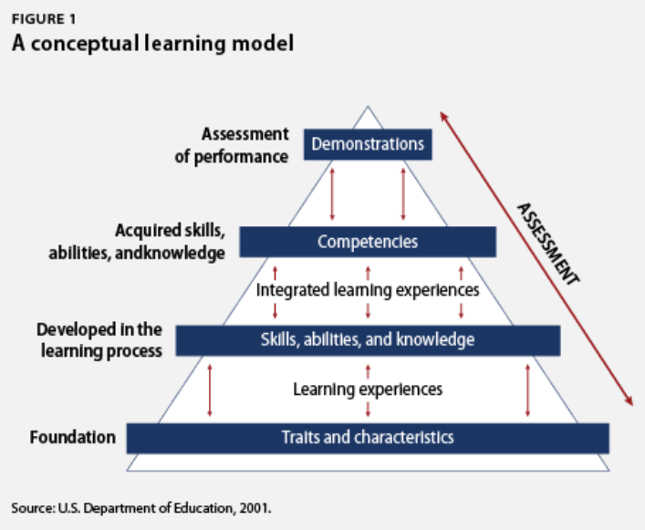
A traditional model has typically 2-3 written or online assessments.
A CBE model has many more assessments so the faculty can determine mastery of the knowledge/skill of each student in each module.

Slide 48
DACUM Competencies
Develop A CUrriculuM
5-7 Industry SMEs meet for 2-3 days to identify all the duties and tasks required for a technology or a job
At least part of your competencies should be obtained from a DACUM, which you can then say are validated.
VET all competencies through the Industry SME group
Do not start from scratch. Start with Competencies and Outcomes from other ATE projects.

Slide 49
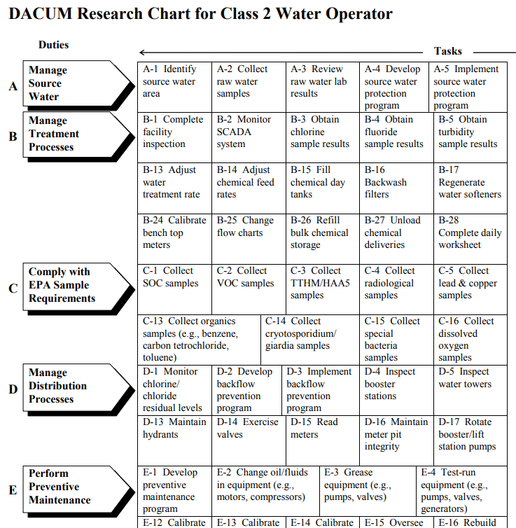
DACUM results for a Class 2 Water Operator in Ohio.
DACUM is an Ohio State format

Slide 50
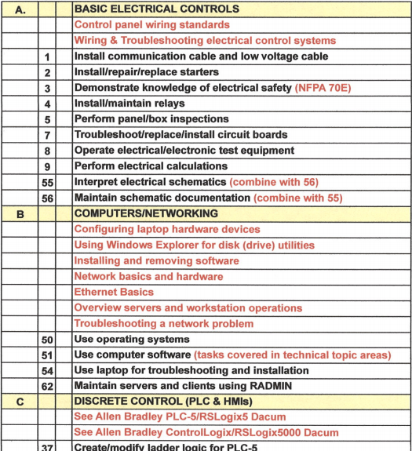
DACUM format for Control Technicians
DACUM format by NOCTI group in MI

Slide 51
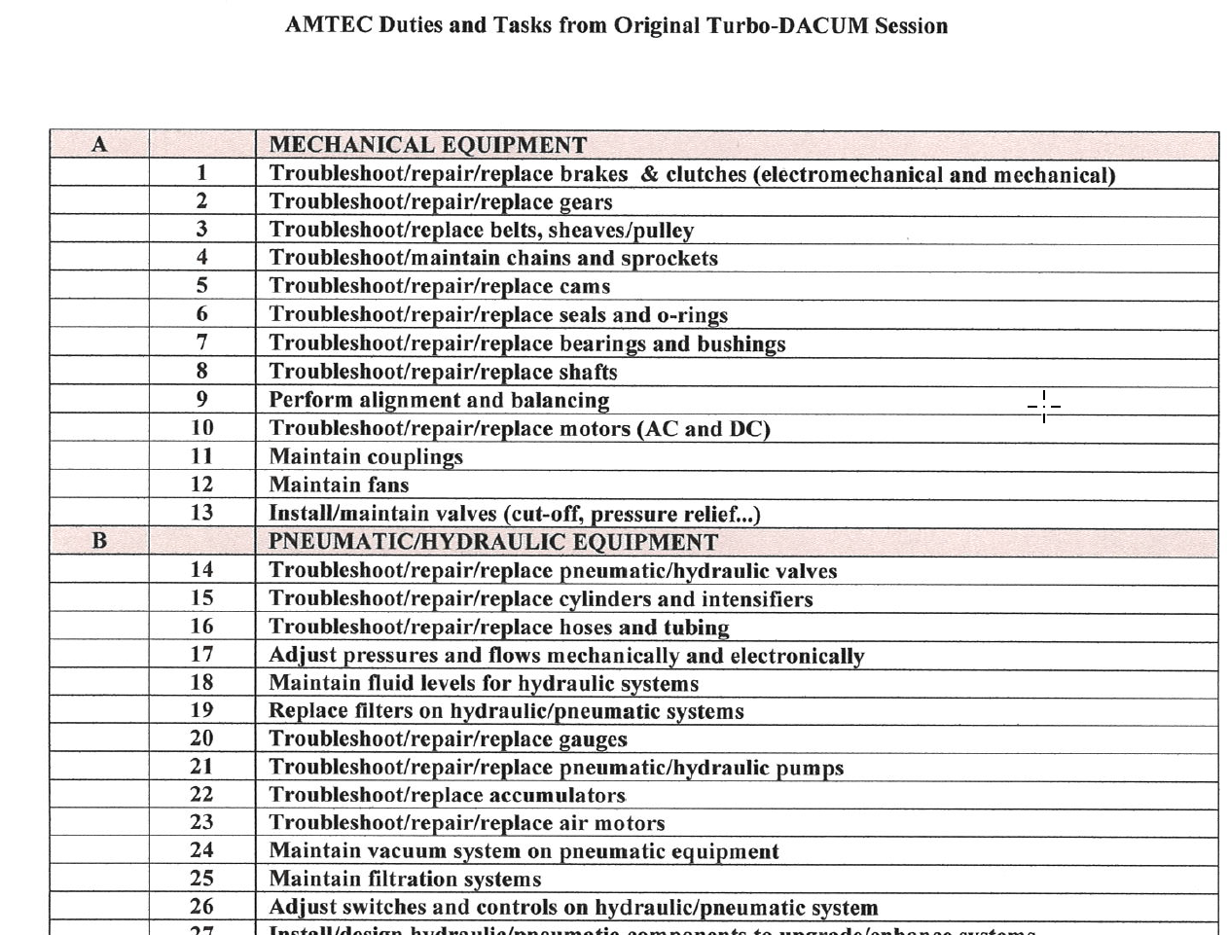
DACUM format for Control Technicians
DACUM format by NOCTI group in MI

Slide 52
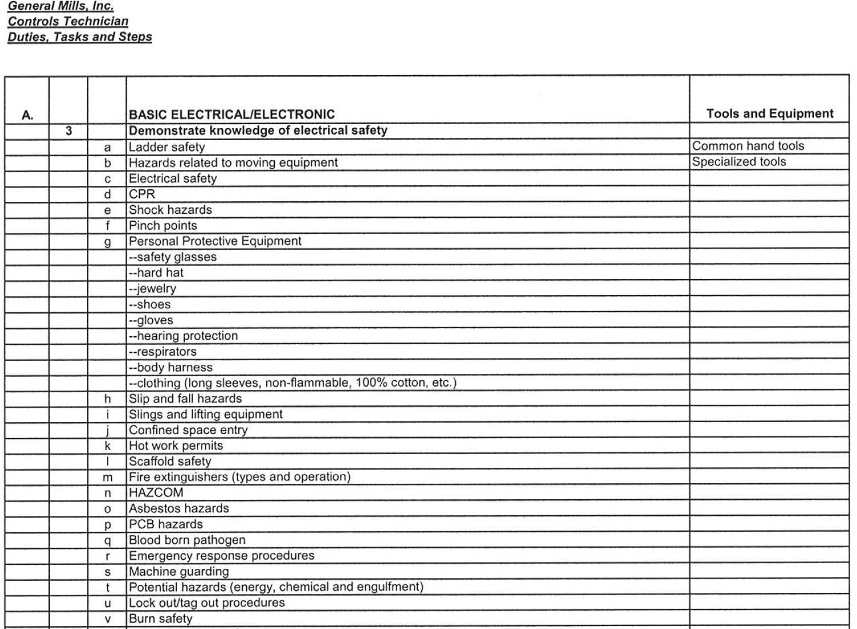
DACUM format for Control Technicians
DACUM format by NOCTI group in MI

Slide 53
Grading in the NSCC Assessment Model:
The grades the students are awarded in the NSCC Ind. Tech hybrid courses are: A, B or F.
The hands-on assessment (HOA) must have 100% mastery, so students have to get 100. This is not averaged into the grade. It is required.
The knowledge & application assessment (KAA for short) is the cognitive, online assessment. Student have to get at least an 80% on this assessment to pass the module. They have two tries at taking KAA in each module.
16 assessments in each course (8 online, 8 hands-on)

Slide 54
Employer
Engagement

Slide 55
External Data
Delivery of Product
Topic Resources
Job Descriptions
DACUM Comp.
WFD Demand
Employer RT
Corp. Faculty
Credit Cert/Degrees
2 Yr. AAS, ATS, AIS
One-year Cert.
Gainful Empl. Cert.
Apprenticeships
-------------------------
Ind. Automation Maint. Cert.
Industrial Elect. Cert.
Industrial Maintenance Degree
Automation Cert.
Job Classifications
Maintenance Mechanic
Electrician
Machine Setup
Internal Product
Technical Topics
Basic Electrical
Handtools
Powertools
Ind. Safety
Pneumatics
Hydraulics
Mech Print Read
Motor Control Cir
Motors & VFDs
PLC Basics
AB CompactLogix
AB ControlLogix
Ethernet basics
Rigging
Pumps
Pipefitting basics
Machine Repair
Technical Courses
IND120 IE1
IND121 IEII
IND223 M&C
PLC200 PLCI
IND134 IFPI
Short Term Public Classes
Students come to the college
4 hr. to 24 hr. courses
Credit or N/C
AB PowerFlex 525 VFDs
Types of Students
Incumbent
Emerging
Contract Training
Students come to the college
College delivers at company
4 hr. to 24 hr. courses
Credit or N/C
------------------------------
AB PowerFlex 525 VFDs
Intro to AB ControlLogix
Technical Courses
Displaced
Underemployed

Slide 56
Show
Electrical Course Sequence
And
Course Overview Sheets

Slide 57
Getting Input from Employers:
Oversight Group: At some colleges this would be an Advisory Board for a program. The BILT model was implemented at Terra State CC in Ohio. This group is like a steering committee for their technical curriculum.
Technical Topic Roundtables: Our project team found the best way to get input on a topic such as the content of a PLC course, or a fluid power course, is to hold an industry roundtable. This consists of 3-4 SMEs in a 45-minute Zoom meeting. An outline is sent to each 1 week ahead of time, consisting of no more than a 2-page outline of topics that will be reviewed. Input is documented, then sent back out to the small group for their final review. A special focus should be on the hands-on skillset that is required. The nice thing about using Zoom, is the college can do a one-on-one meeting with an SME if they cannot get to the Zoom meeting. Most of all, respect their time and thank them for their input.
Communicate the results of the Roundtable back to the Oversight Group and explain how the curriculum will be adjusted to improve effectiveness and/or access.

Slide 58
Engaging Employers
How does the Technology division at NorthArk engage employers?
Accrediting bodies like a comprehensive employer engagement strategy
Purpose of an Advisory Board
Purpose of an Industry Roundtable
Purpose of a Focused Industry Visit
Industry Consortiums (Adv. Mfg. Consortium & Lean Mfg. Consortium)

Slide 59
Importance of an External SME group
SME stands for Subject Matter Expert
4-6 of these SMEs should be identified to vet information through as part of the development process
It is important to have all knowledge and skills development, align to the workplace
This will be done through validated competencies, and measurable outcomes

Slide 60
Review Existing
CB/H Technical Courses

Slide 61
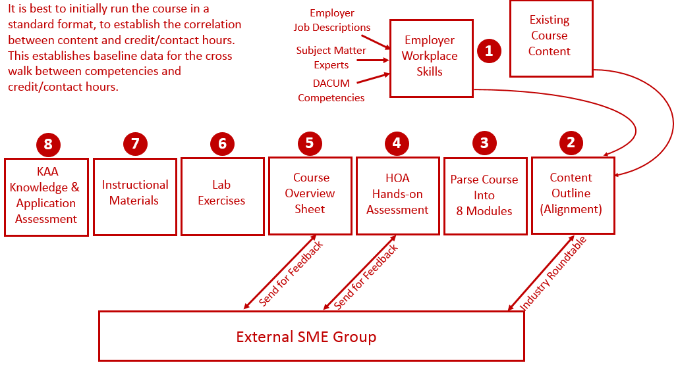
Reverse Design:

Slide 62
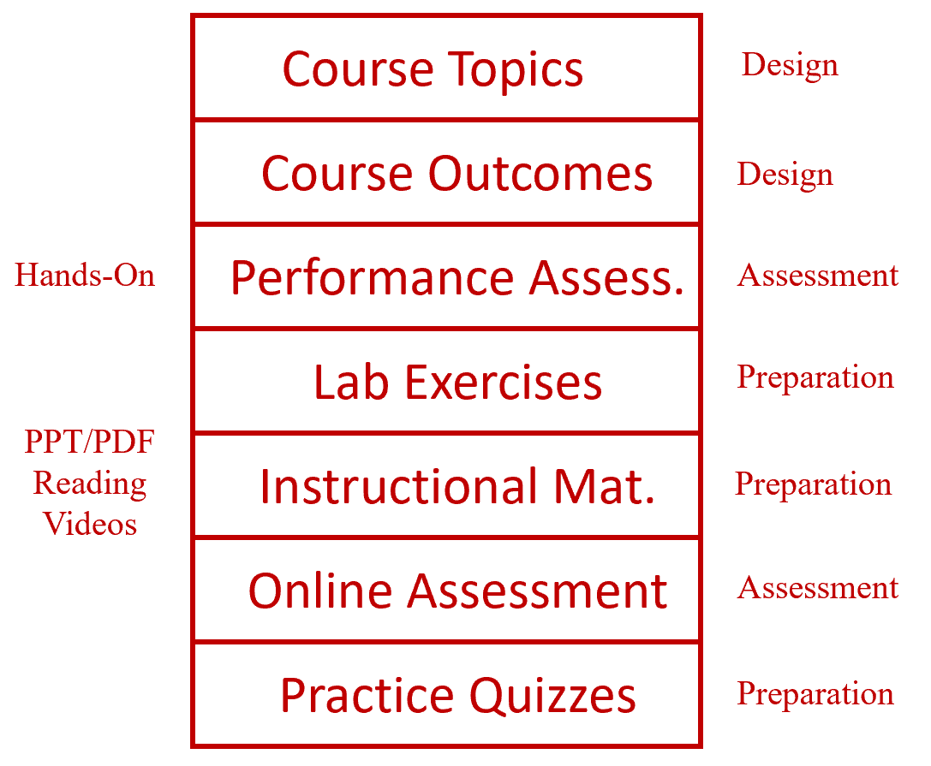
Learning Thread:

Slide 63
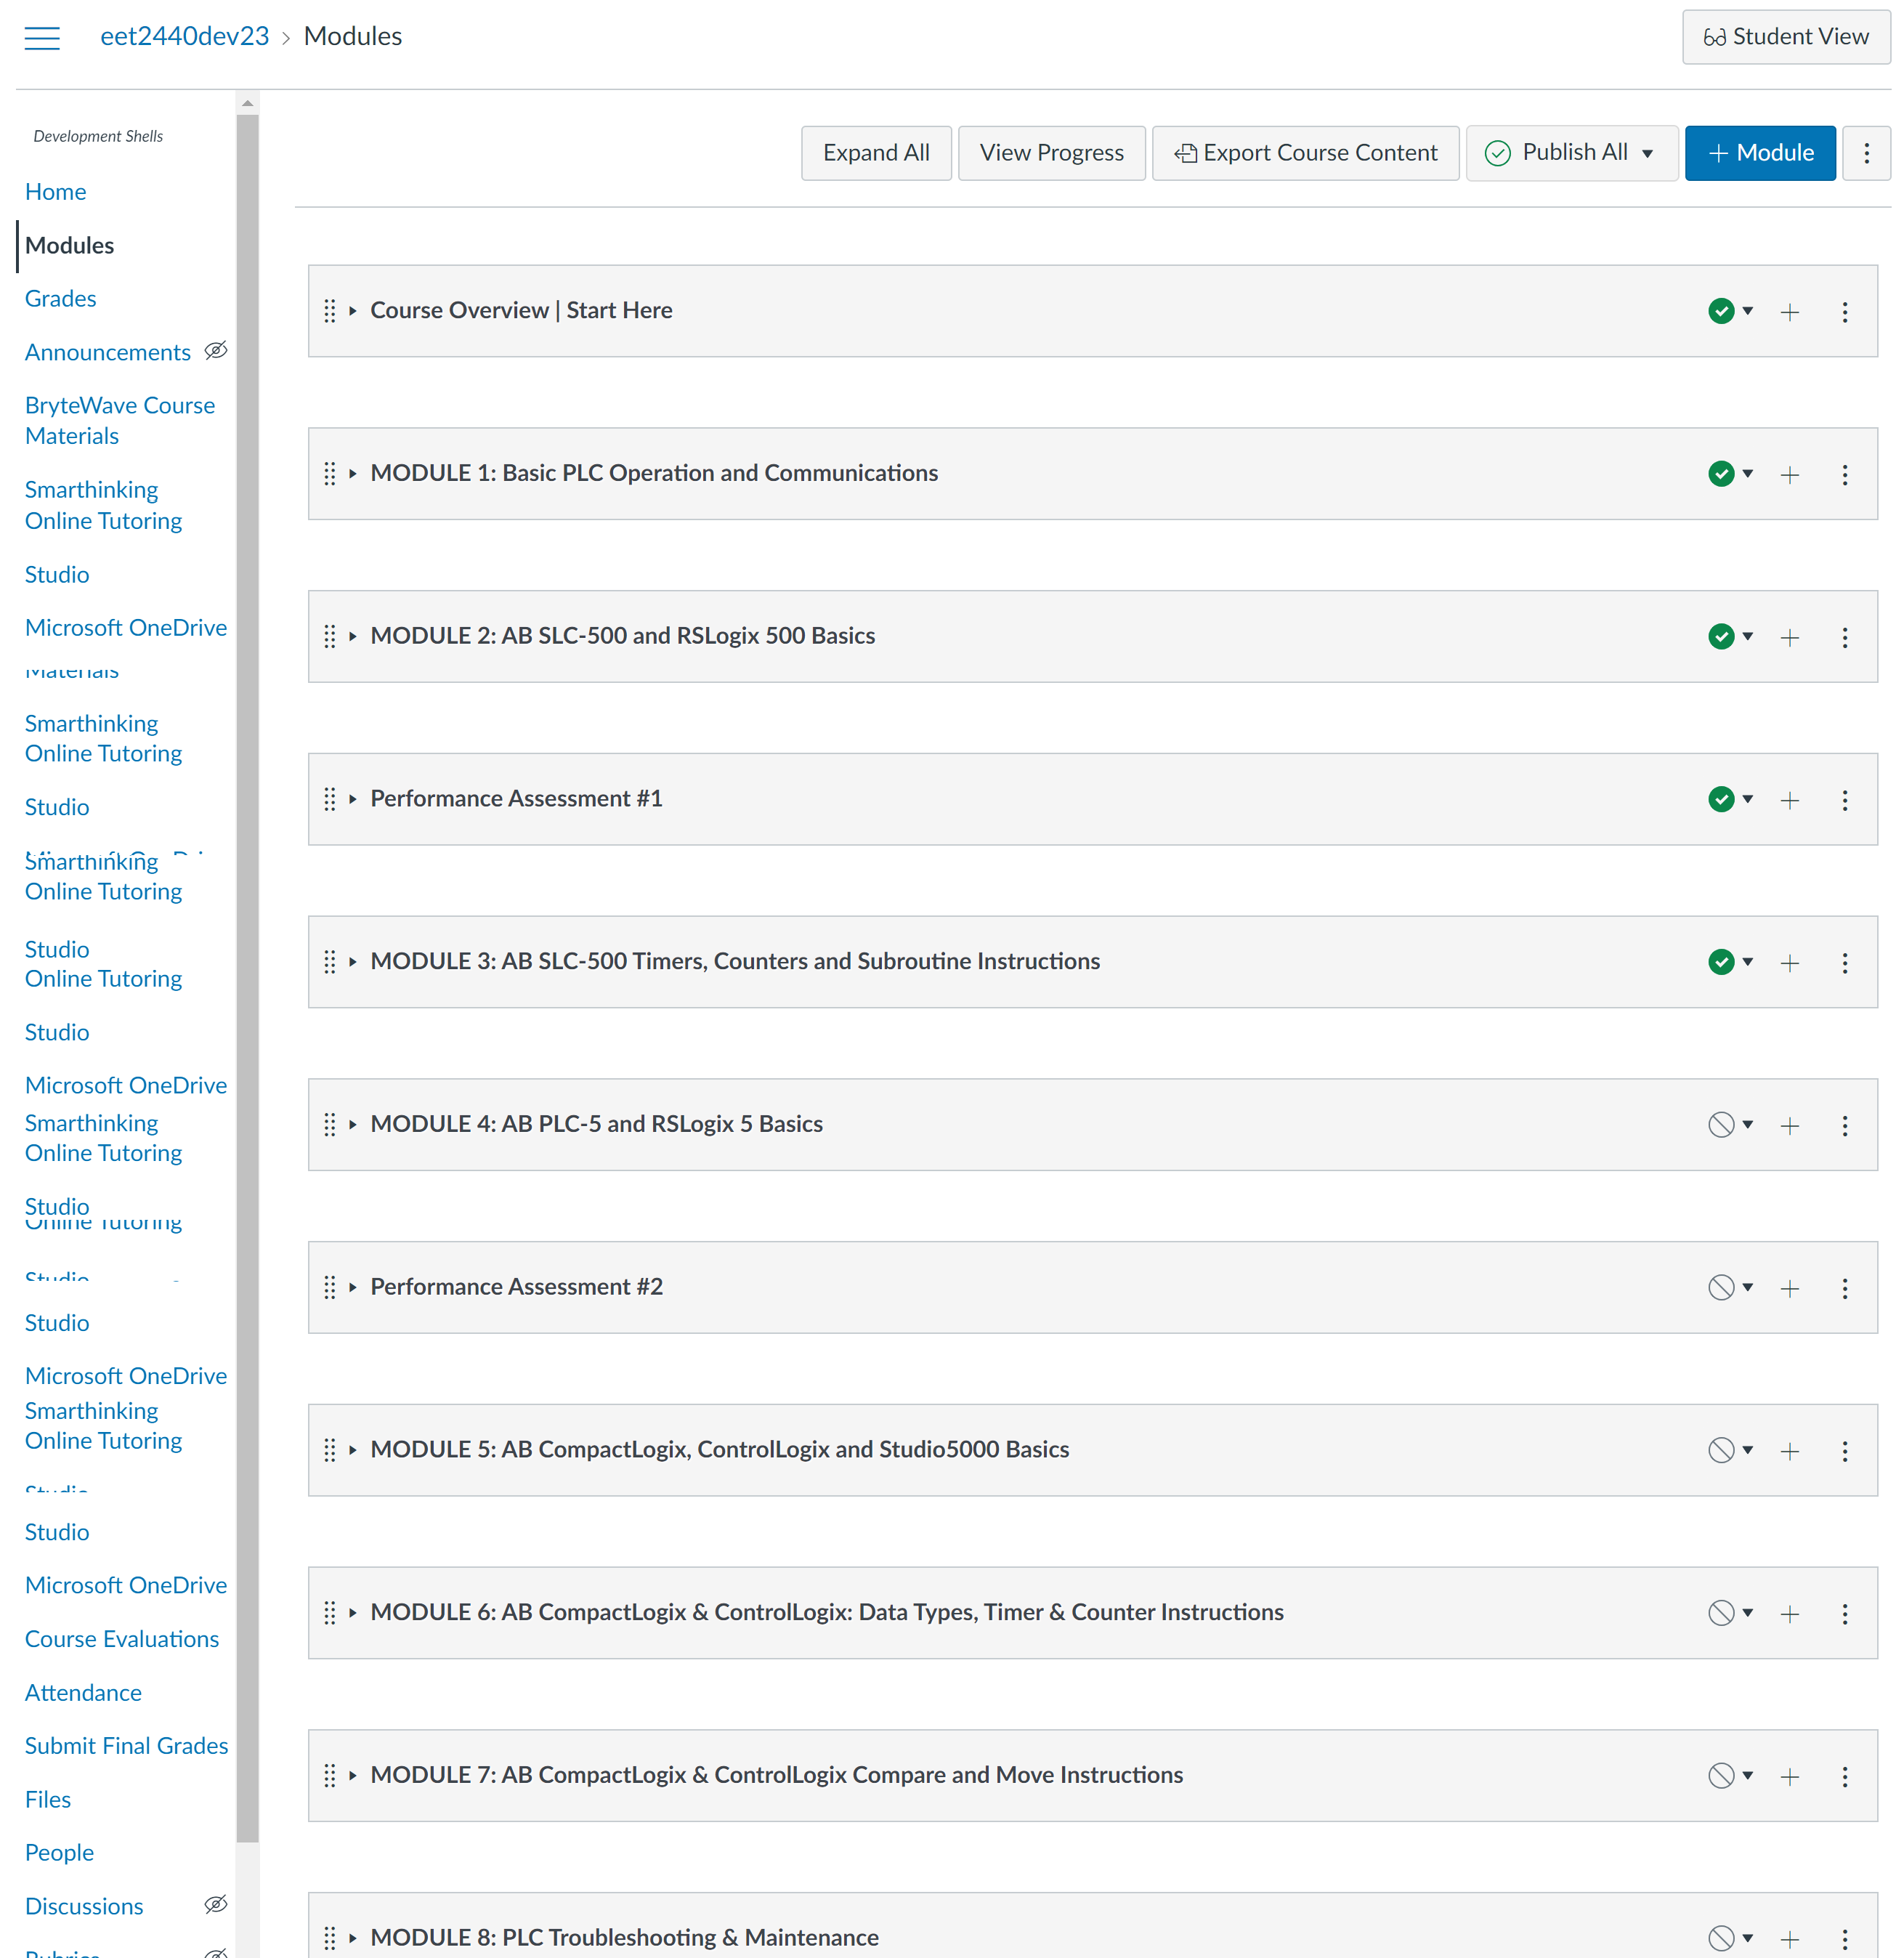

Slide 64
How To Get Started?
Choose 1 course to start with.

Slide 65
The End of the Presentation

