Slide 1
Cyberpsychology
By Ervin Frenzel, PhD Candidate, MISM, MSCSIA
Director of Cybersecurity, Collin College
CEI, CCISO, ECSA, CISSP

Slide 2
Some definitions
Psychology is the study of self.
Cybersecurity is any or all actions to protect people, processes, or technological assets used to perform cyber activity. This can include actions taken to protect physical access.

Slide 3
Cyberpsychology is:
If you use technology, cyberpsychology plays a part in what you do.
For our discussion cyberpsychology – is the integration of psychological concepts in conjunction with technology.
It is not just morality, cyberlaw, cyber-ethics, understanding of technology, social media, and cybercrime – it is all of the concepts combined and how they holistically integrate to form a lens of perception for people and societies.
I don’t need to know how to do your job, just how your technology affects you and how to manage this component of the STS (Socio-Technical System).

Slide 4
A little about me:
I started as a linguist, not a technologist
I learned to be a technologist.
“Who can type ?”
Cyberpsychology and a skill shaped my future.
You never know what skill or ability will shape your skills.

Slide 5
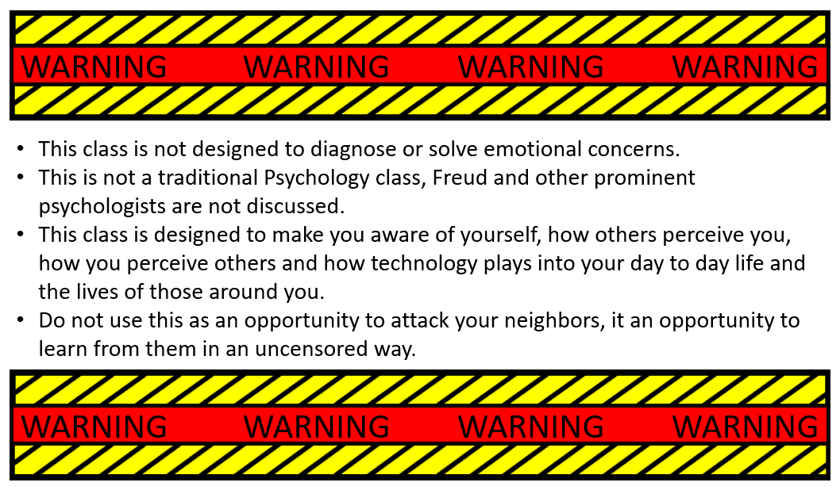
Some basic settings in our classroom:

Slide 6
So how do we integrate these two?
1 – Get someone to identify who they are.
2 – Get someone to identify what is a “cyber” asset to them.
3 – Show them how to integrate the two.
4 – Get someone to identify how technology affects them.
5 – Develop empathy for how others feel about and are affected by technology.

Slide 7
Original Johari windows
as we are all experience it
X axis only
Known to self
Unknown to self
Open
(or Arena)
Known to myself and others
Blind to self
(I don’t notice this but others do) – this is perception
Known to Others
“Y” axis only
Hidden from public
(or façade)
Known to self but hidden from others
Double Blind
Unknown to others or self
Unknown to Others

Slide 8
How we can change our paradigm to improve our ourselves
X axis only
Known to self
Unknown to self
Known to Others
Open
(or Arena)
Blind to self
“Y” axis only
Blind to self
Unknown to others
Unknown to Others
Hidden from public
(or façade)

Slide 9
Emotional intelligence factors
(not a Johari window)
Recognition
Regulation
Self-Awareness
Self-Confidence
Awareness of your emotional state
Recognizing how your behavior impacts others
Paying attention to how others influence your emotional state
Self-Management
Keeping disruptive emotions and impulses in check
Acting in congruence with your values
Handling change flexibly
Pursuing goals and opportunities despite obstacles and setbacks
Personal Competence
Social Awareness
Picking up on the mood in the room
Caring what others are going through
Hearing what the other person is “really” saying
Relationship Management
Getting along well with others
Handing conflict effectively
Clearly expressing ideas/information
Using sensitivity to another person’s feeling (empathy) to manage to manage interactions successfully
Social Competence
Taken from: https://positivepsychology.com/emotional-intelligence-frameworks/

Slide 10
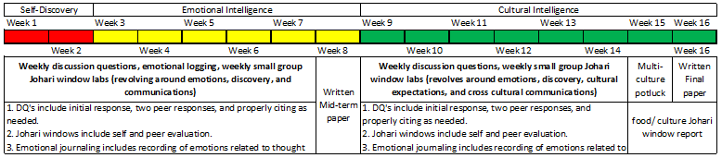
Our game plan (condensed plan):
We focus on communications:
  Verbal
  Written
  Non-verbal
    Body language (including ethnical, cultural, regional, and other).
    Cultural expectations
We focus on understanding technology impacts on the individual and society.

Slide 11
Our game plan (part 1):
Have the student self-identify – multiple personality tests in the first few weeks. Discussion questions with peers to identify what students find out about themselves and how they perceive technology.
Students work through emotional intelligence 2.0; they identify their own Emotional Intelligence and learn about how to engage others as they learn about their own Emotional Intelligence.
Johari windows are used to help students work with each other, identify how others see them, and how each student sees others.
This is designed to identify triggers not only with other people but also behaviors and technology (holistically people, process, and tech). We want students to expand on their communication skills while learning to be empathetic and tolerant of others in the workplace – essentially we want soft skills for our technicians.

Slide 12
Our game plan (part 2):
We work through Cultural Intelligence (through the Culture Map).
Students work through Cultural Intelligence; they identify and work through common cultural components and learn about how to engage others as they learn about their own Cultural Intelligence.
Johari windows are used to help students work through different cultural expectations.
Cultural Johari window includes food / cultural pot luck. Each student brings in 3 dishes (capable of serving 3-5 people), each student is then required to report on 3 dishes (outside of their own culture and how it was perceived).

Slide 13
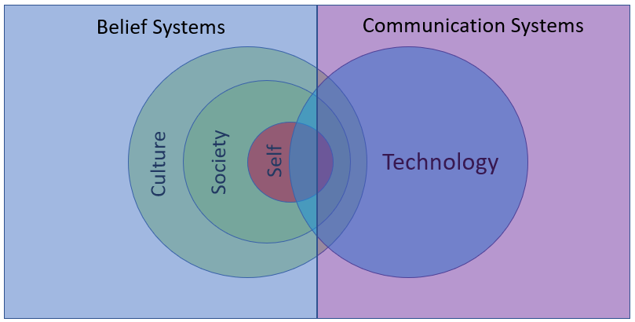
A graphic of the overlapping principles:
The Holistic Cybersecurity Socio-Technical System (STS)

Slide 14
Feedback from:
Psychiatrists/Psychologists/Students
Asking to take content to assist in training for development of soft skills of medical professionals.
So far have enjoyed and are learning from the technical students as much as students are learning from instructors and each other.
Students are providing feedback such as they are learning to build their own safe places through this class.
Several students have been placed based upon the skills they have obtained in the CyberPsych class (without having learned additional tech skills).

Slide 15
Questions ?

