Slide 1
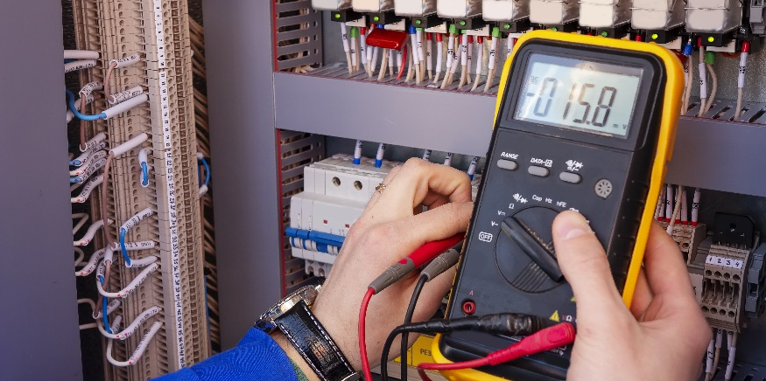
Piping and Instrument Drawing

Slide 2
Piping and Instrument Drawing
Identify the names and content of typical Instrumentation & Control Systems documents.
Identify the key components of P&IDs.
Recognize basic ANSI/ISA-5.1-2009 ID and symbolism methods.
Recognize common measurement notations.
Read / interpret tag and control loop numbers.

Slide 3
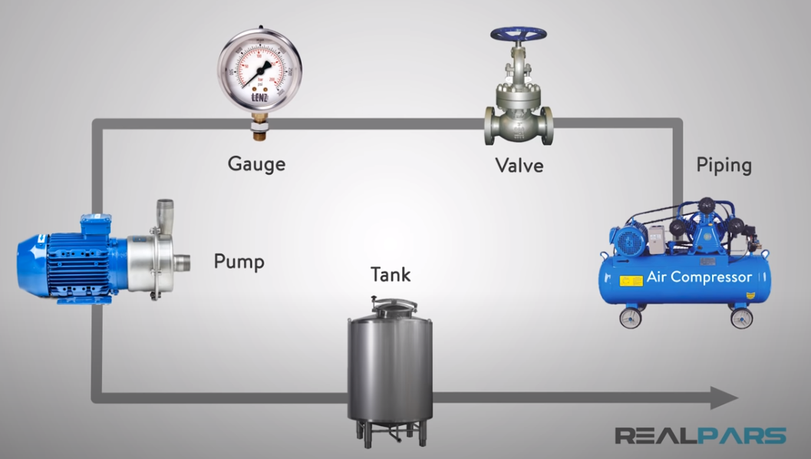
What is a P&ID Diagram? (Piping & Instrumentation Diagram)
https://www.youtube.com/watch?v=lBJnU1MJAts
https://www.youtube.com/watch?v=kujHQgK352o
https://www.youtube.com/watch?v=3CYTe7AvRvM

Slide 4
Instrumentation & Control Documentation
Instrumentation & control systems require documentation for design, procurement, installation and maintenance.
Typical documentation includes:
Instrumentation Index
General Specifications
Installation Detail Drawings
Location Drawings
Piping and Instrumentation Drawings (P&IDs)

Slide 5
Instrumentation & Control Documentation
Instrumentation Index: Lists instruments used by tag number.
General Specifications: Contain applicable codes, standards, wiring and cable requirements, ventilation requirements, power supply requirements, etc.
Installation Detail Drawings: Provide information and requirements for proper mounting and connections of a specific instrument.

Slide 6
Instrumentation & Control Documentation
Location Drawings: Identify where an instrument is to be installed.
Piping and Instrument Drawings: Detailed schematic drawings of equipment, piping, and instrumentation on a project. The schematic symbols used are governed by national and international standards (ANSI/ISA)

Slide 7
Piping and Instrument Drawing (P&ID)
Detailed, schematic drawing of equipment, piping, and instrumentation on a project.
Uses a common language of schematic symbols to describe components in an instrumentation & control system.
Typically Includes:
Instrumentation
Valves
Mechanical Equipment
Flow Directions
Control Inputs, Outputs and Interlocks
Pipe Connections, Sample Lines, and other Fittings

Slide 8
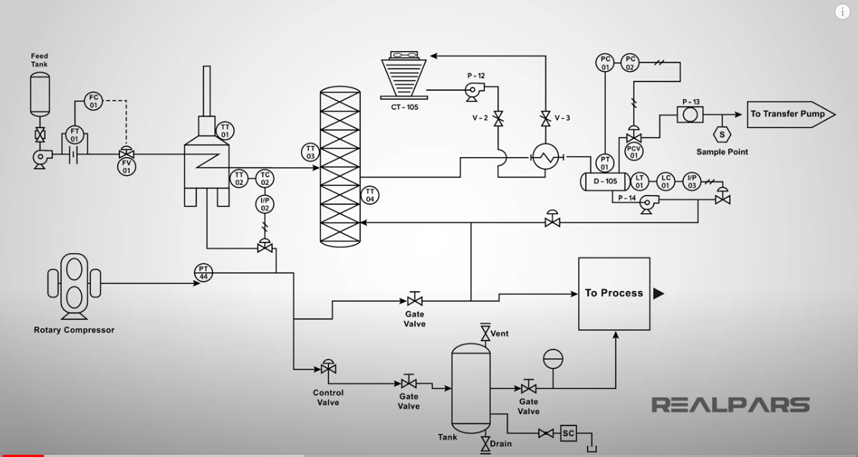
How to Read a P&ID? (Piping & Instrumentation Diagram)
https://www.youtube.com/watch?v=j4EOTerfyTY

Slide 9
ANSI/ISA-5.1-2009: ID and Symbolism Methods
Discrete instruments and their functions.
Shared display and control functions.
Distributed control functions.
Computer control functions.
Programmable logic controller display and control functions.
Application software display and control functions.

Slide 10
ANSI/ISA-5.1-2009: Additional Content
Definitions of terms used in instrumentation documentation
Identification Letters for the Instrument and Function Identification System
Graphic Symbol Tables
Instrumentation Device and Function Symbols
Measurement Symbols and Notations
Line Symbols
Final Control Element Symbols
Control Valve Failure and De-energized Position Indications
Functional Diagramming Symbols
Signal Processing and Function Block Symbols
Binary Logic Symbols
Electrical Schematic Symbols
Graphic Symbol Dimension Tables

Slide 11
ANSI/ISA-5.1-2009: Annexes
A – Identification System Guidelines
B – Graphic Symbol Guidelines

Slide 12
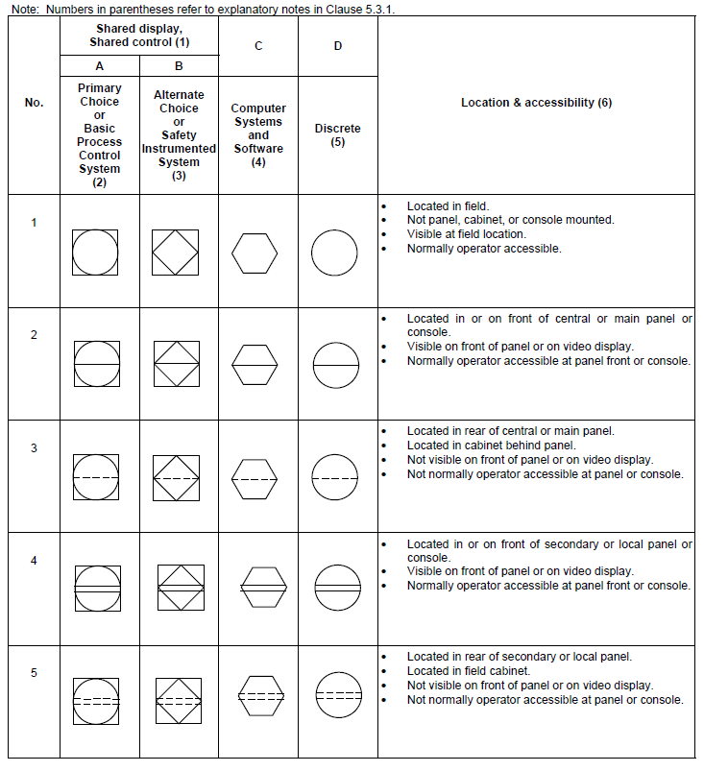
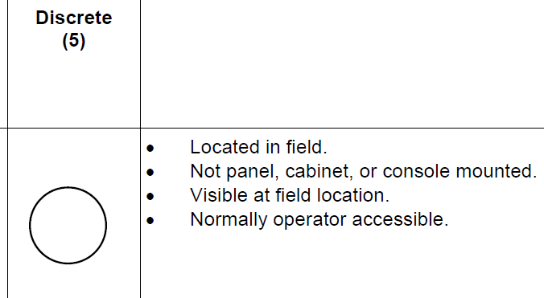
Instrumentation Device and Function Symbols

Slide 13
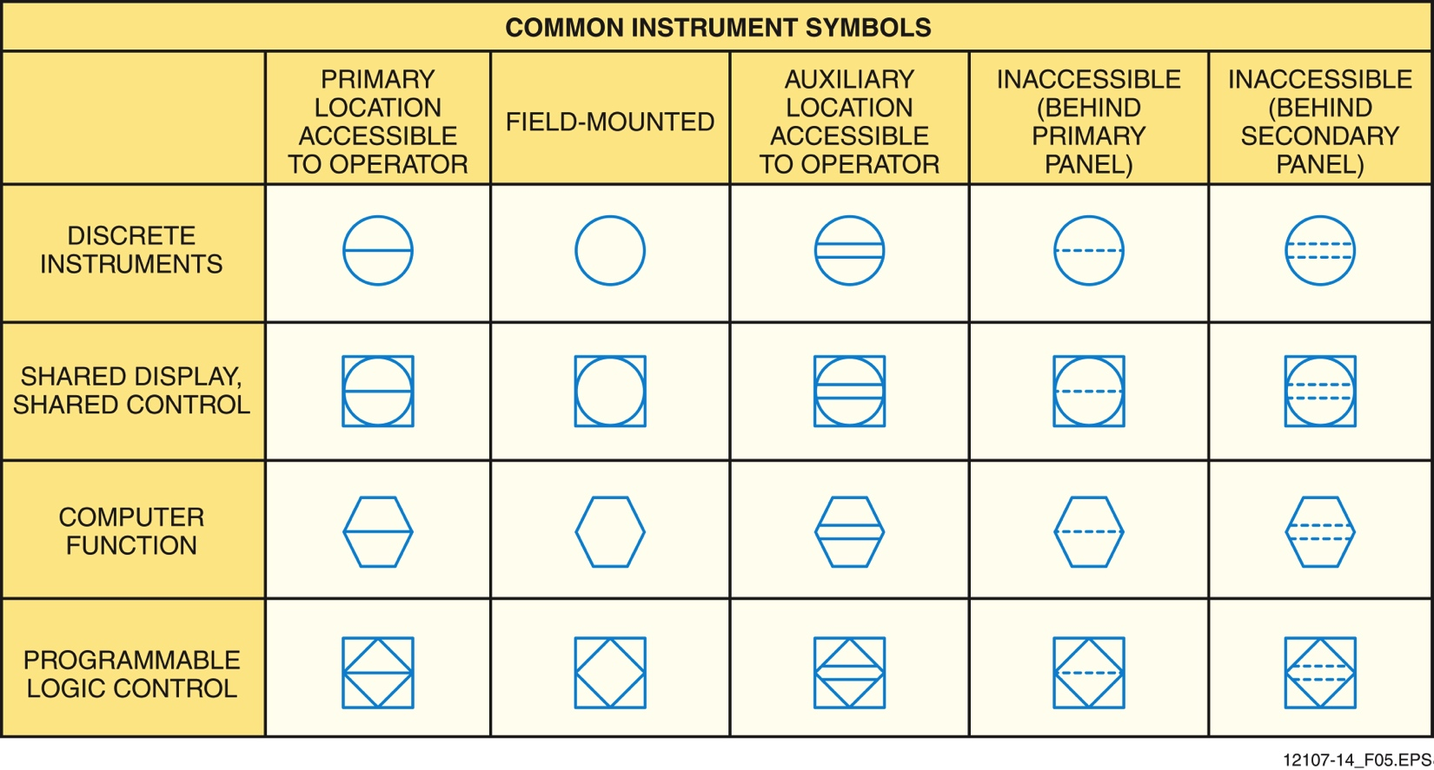
Instrument Symbols (NCCER)

Slide 14
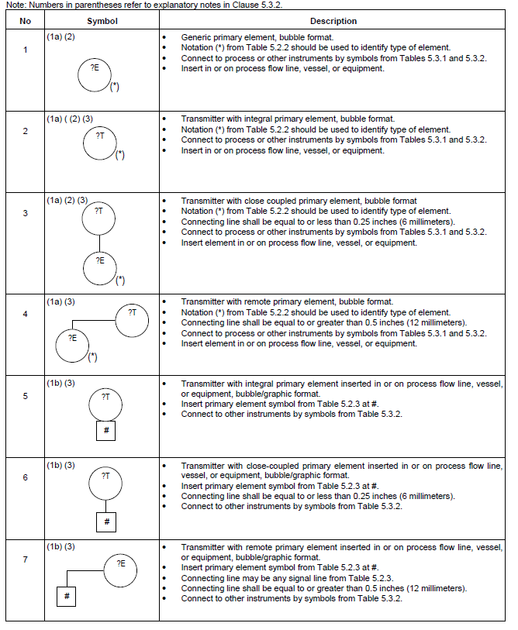
Measurement Symbols
3.1.48 primary element: an external or internal instrument or system element that quantitatively converts the measured variable into a form suitable for measurement; see also detector and sensor:

Slide 15
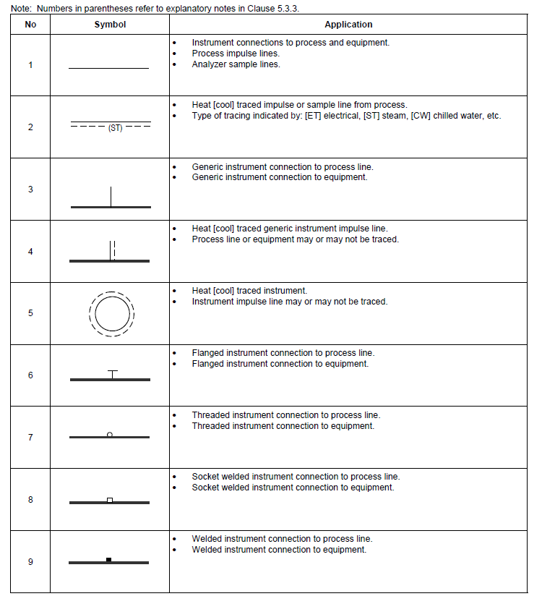
Line Symbols

Slide 16
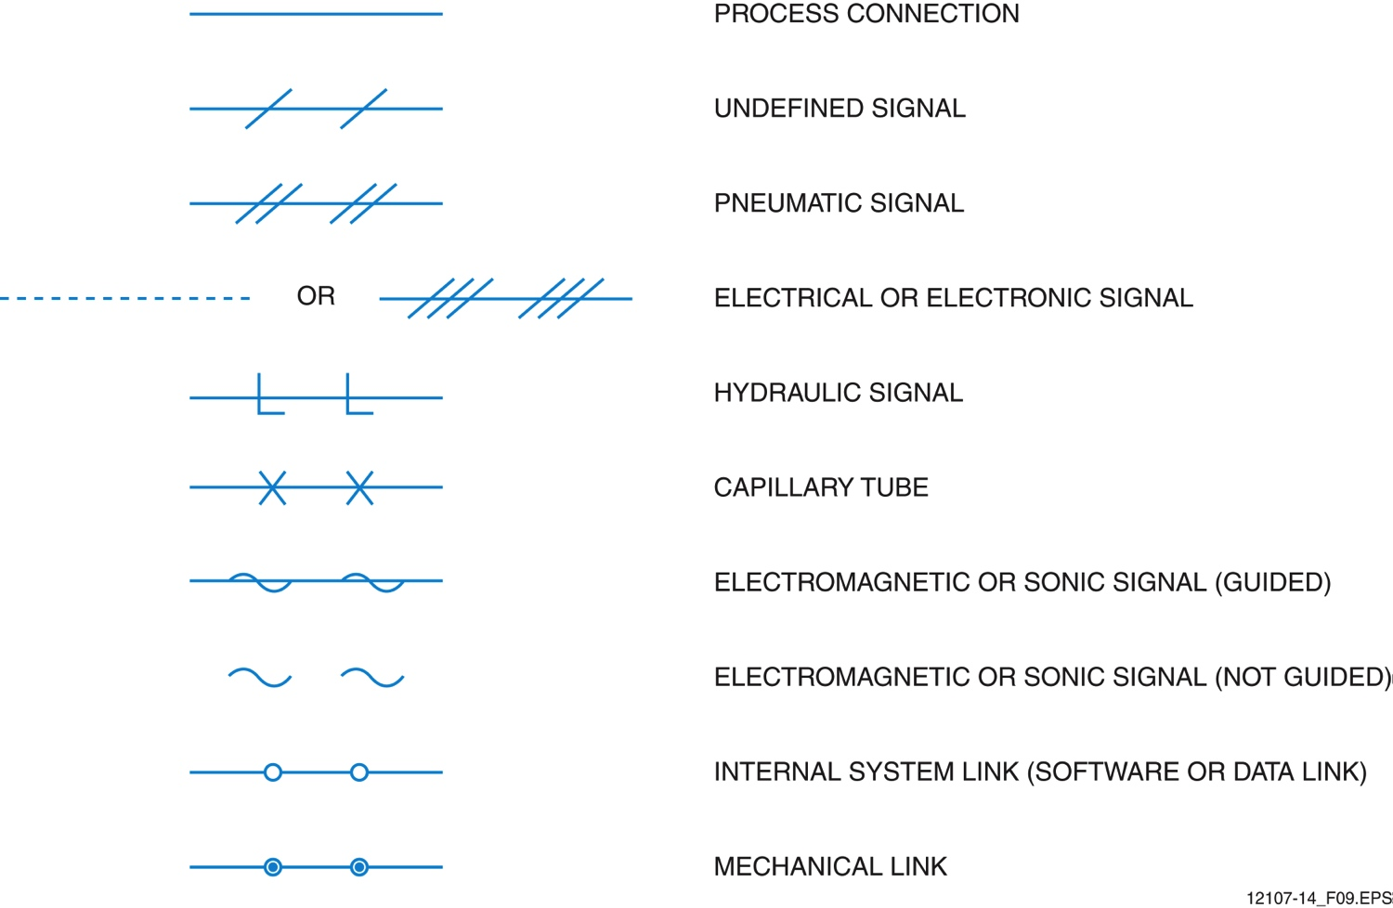
Drawing Lines (NCCER)

Slide 17
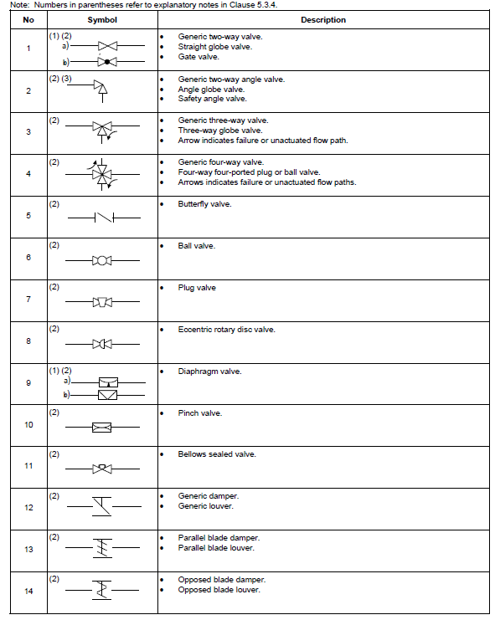
Final Control Element Symbols

Slide 18
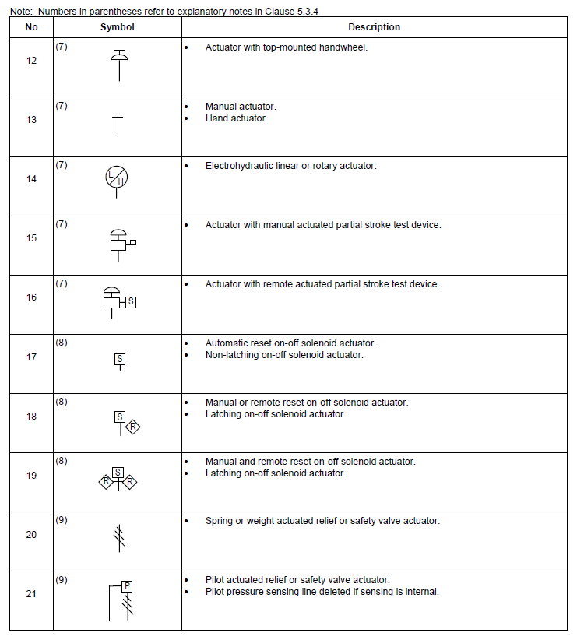
Final Control Element Actuator Symbols

Slide 19
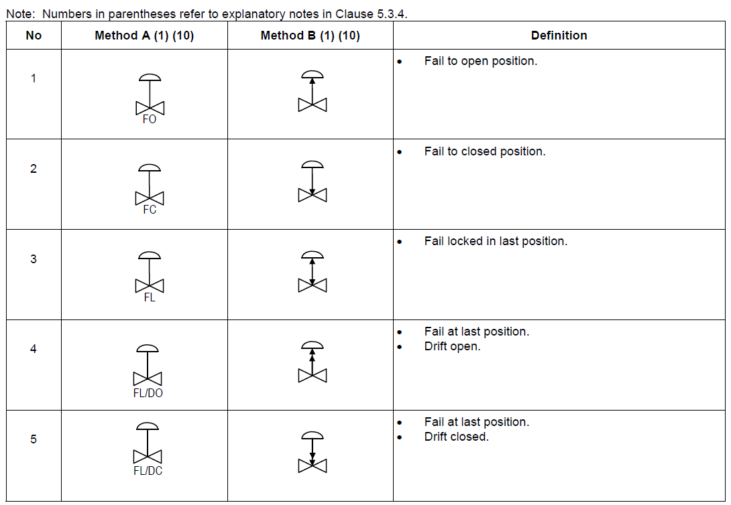
Control Valve Failure and De-energized Position Indications

Slide 20
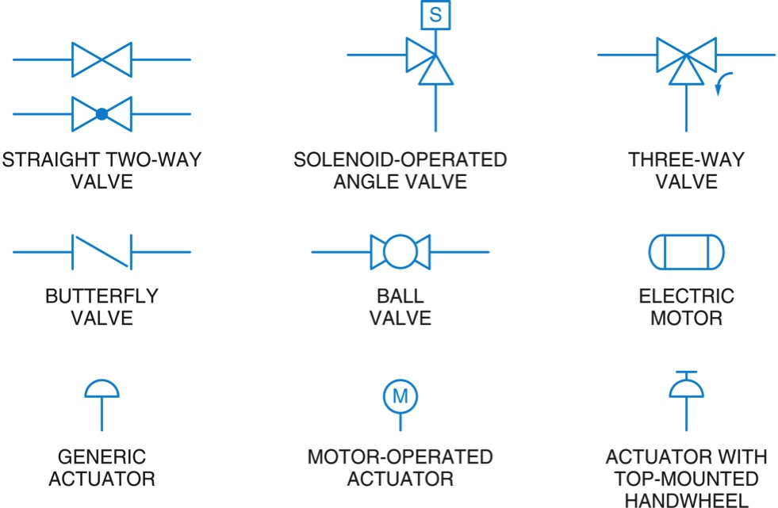
Graphic Symbols (NCCER)

Slide 21
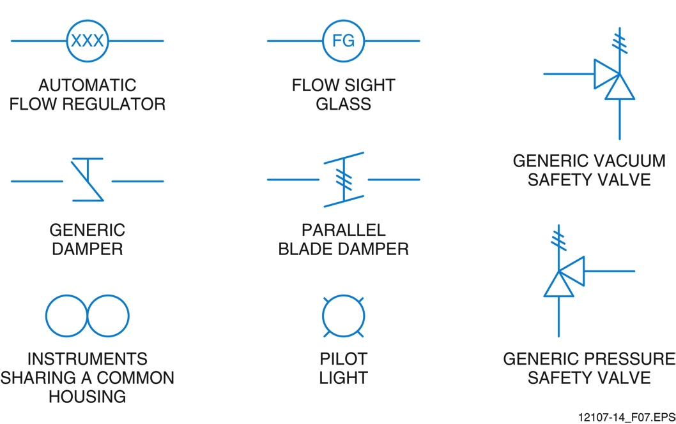
Graphic Symbols (NCCER)

Slide 22
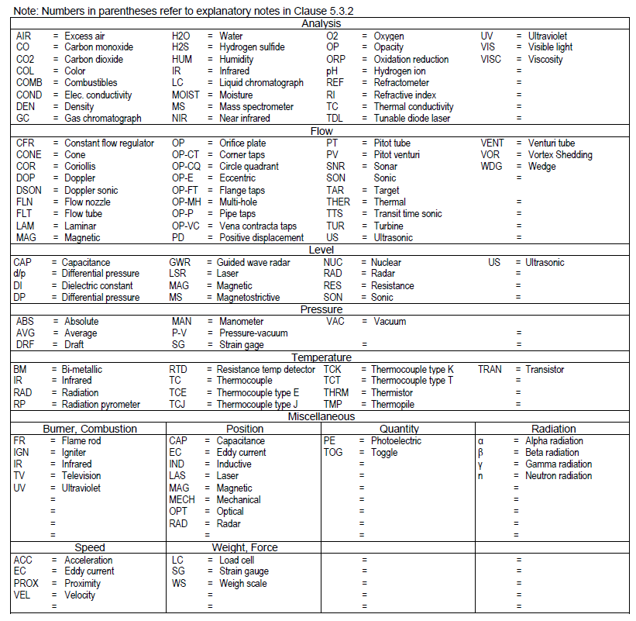
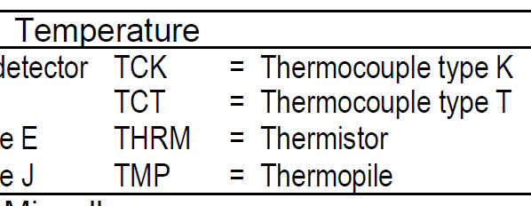
Measurement Symbols: Notations

Slide 23
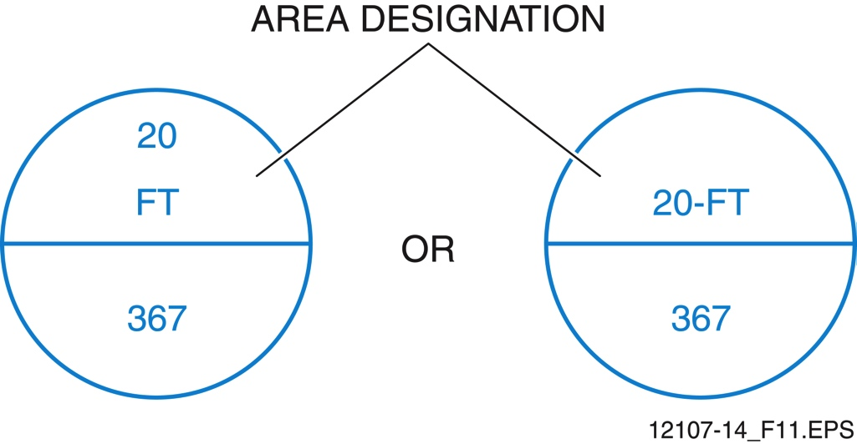
Tag Numbers (NCCER)
A tag number can identify instrument location, function, and its related instrument loop. Area designation numbers identify location when the process is spread across multiple buildings or areas.

Slide 24
Tag Numbers – First Letter (NCCER)

Slide 25
Tag Numbers – Succeeding Letters (NCCER)
In a tag number with two letters, the second letter usually designates the instrument function.
When there are more than two letters, the third letter may modify the first letter or identify a secondary function.

Slide 26
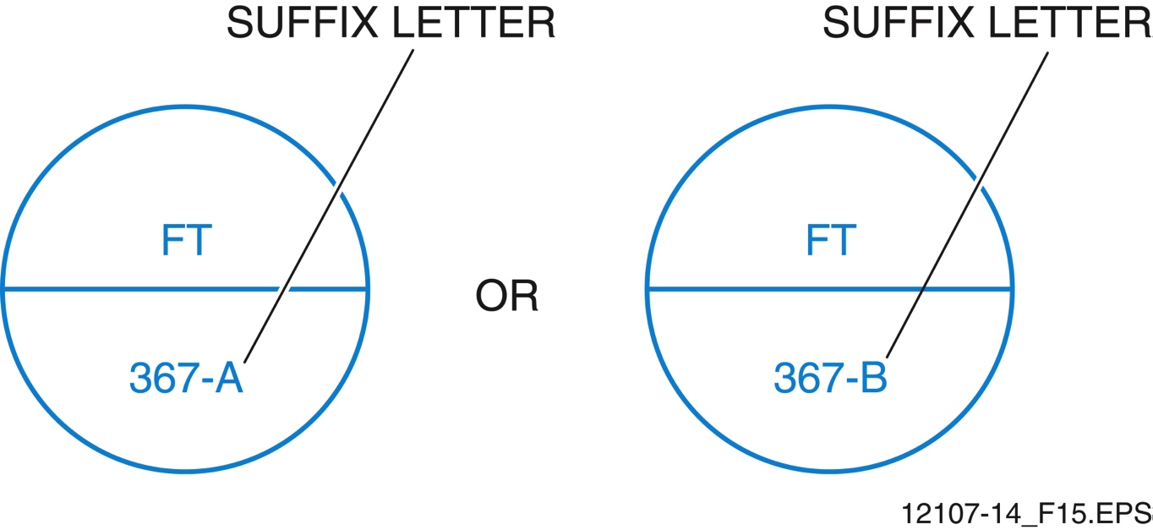
Tag Numbers – Loop Identification (NCCER)
When similar instruments are used in a loop, such as these two flow transmitters, a suffix letter is added to distinguish them.

Slide 27
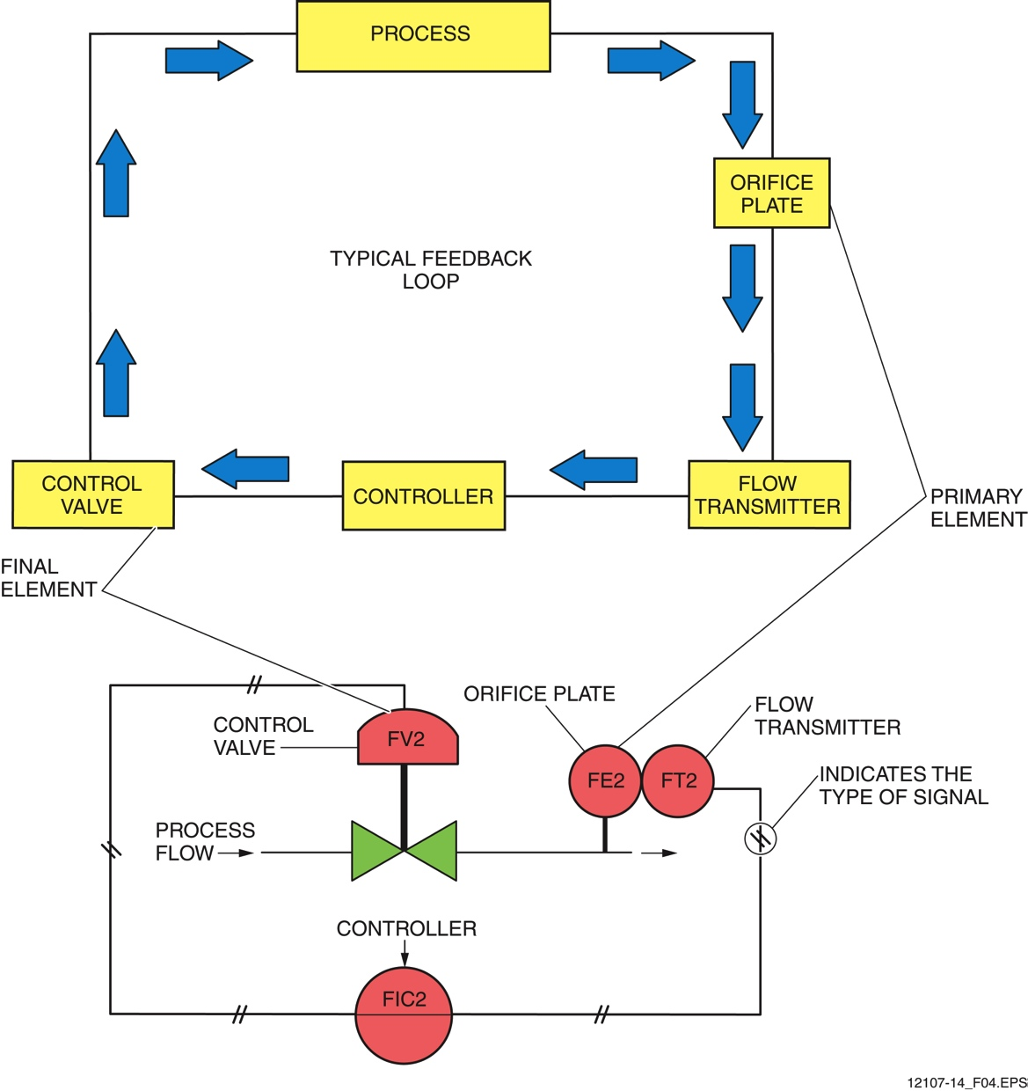
Control Loops (NCCER)
A number of control loops are required for most processes.
Control Loop Numbers are therefore assigned on P&IDs to identify specific control loops.

Slide 28
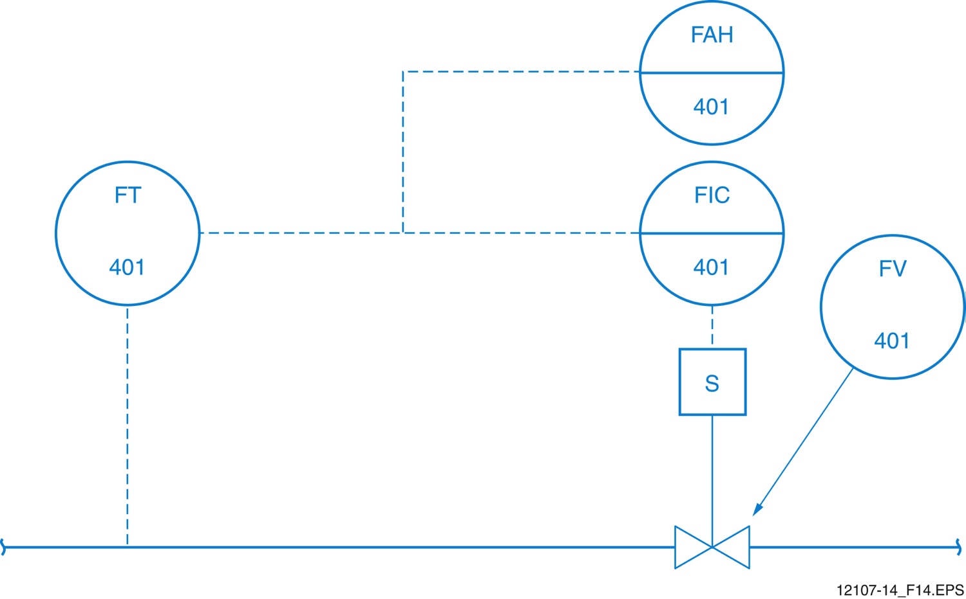
Control Loop Identification (NCCER)
Control Loop Number

Slide 29
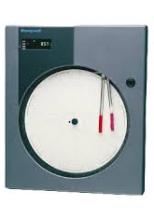
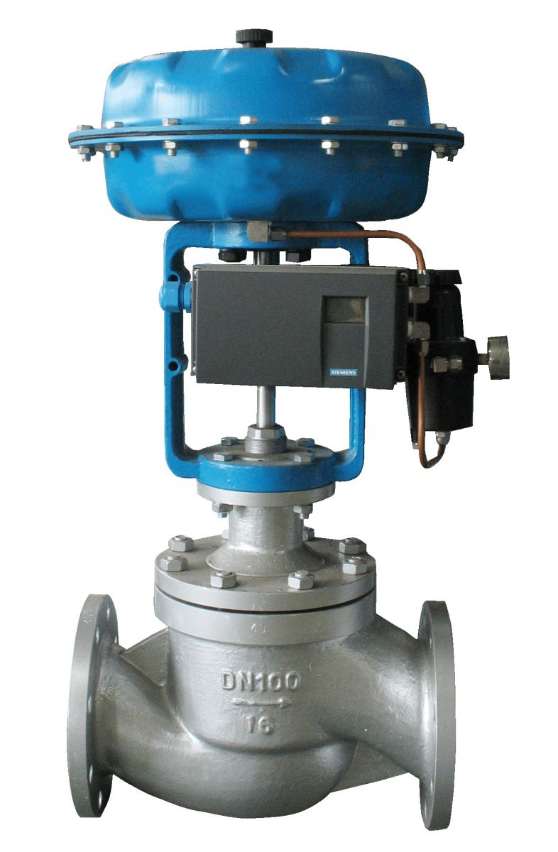
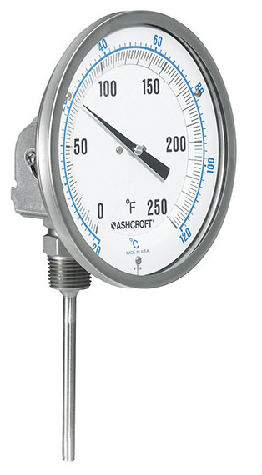
P&ID Example: Temperature Control Loop
Temperature Controller
And Recorder
Pneumatic
Control
Valve
Temperature
Transmitter
Temperature
Indicator
Steam
Kettle Reboiler / Heat Exchanger

Slide 30
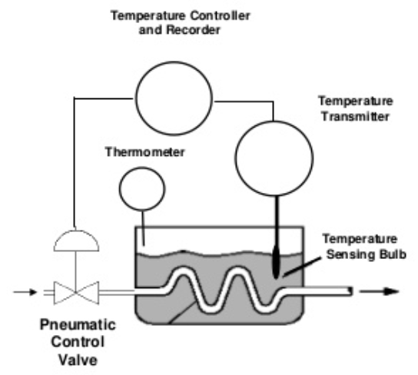
Discrete
Field Mounted
Visible at operator location
Normally accessible
Temperature Controller
And Recorder
Pneumatic
Control
Valve
Temperature
Transmitter
Temperature
Indicator
Steam
Actuator
Kettle Reboiler / Heat Exchanger
Control Valve

Slide 31
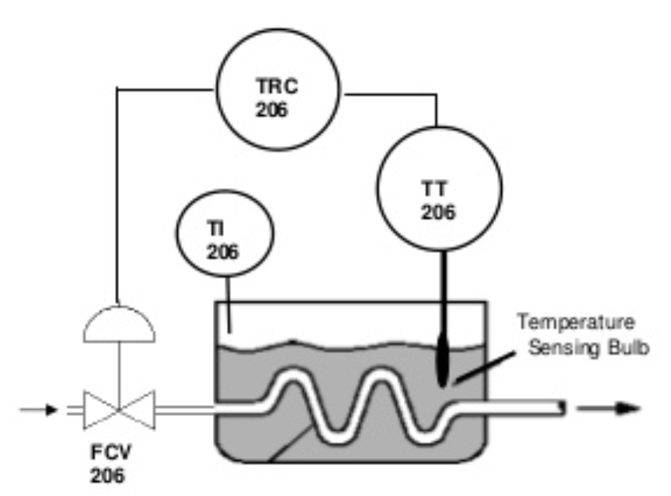
Control Loop Number
Tag Numbers: ID type and function of device
1st Letter: Measured Variable
T – Temperature
F - Flow
2nd & 3rd Letters: Designate function or modify meaning of first letter.
T – Transmitter
I - Indicator
RC – Recorder/Controller
CV – Controller, Valve

Slide 32
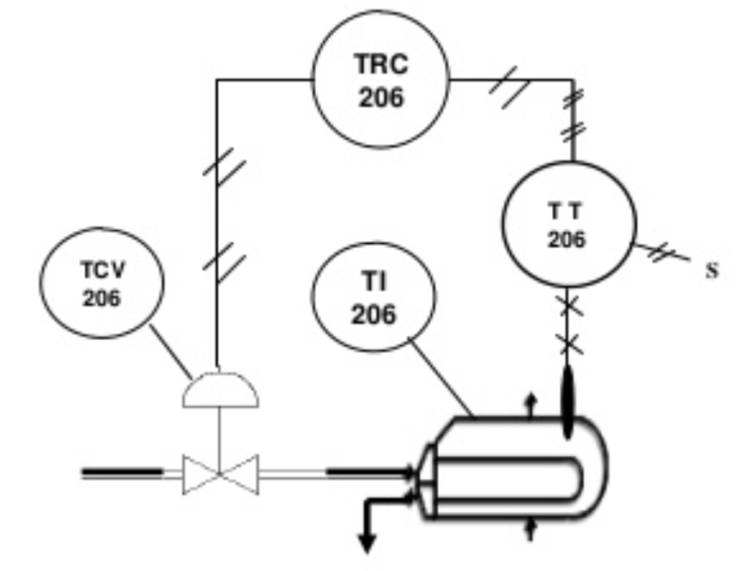
Piping
Pneumatic Signal
Filled thermal element capillary tube.
Filled sensing line between pressure seal and instrument
Temperature Control Valve
(Pneumatic)
U-Tube Heat Exchanger /
Kettle Reboiler

Slide 33
DISCLAIMER & USAGE
This material is based upon work supported by the National Science Foundation's Advanced Technological Education Program under Grant No. 1801177.
Any opinions, findings, and conclusions or recommendations expressed in this material are those of the author(s) and do not necessarily reflect the views of the National Science Foundation.
33

Slide 34
