Slide 1
Process Variables

Slide 2
Process Variables
In the broader scope of industrial processes
Define Process Variable and identify different types of process variables.
Define Setpoint, Upset and Error and give examples.
Define Range and Span.
Define Repeatability, Sensitivity, Drift and Accuracy relevant to process sensors.

Slide 3
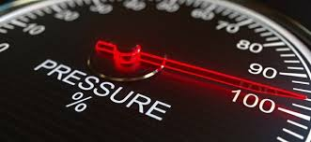
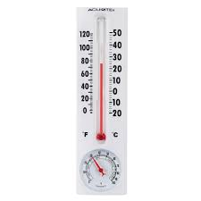
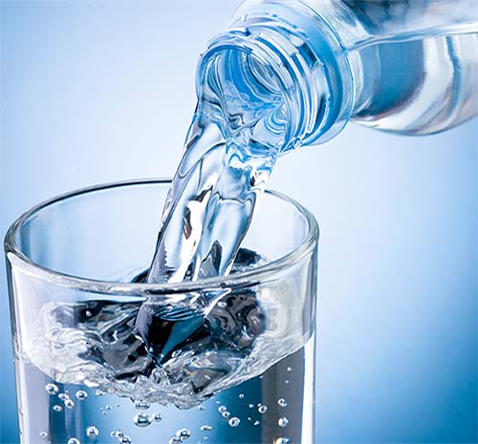
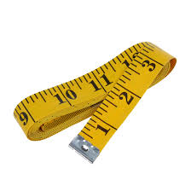
What is a Process Variable?
The parameters or quantities that we wish to measure and control at the correct limit are called Process Variables (PV)
Some common types of process variables in industry are temperature, flow, level, and pressure.

Slide 4
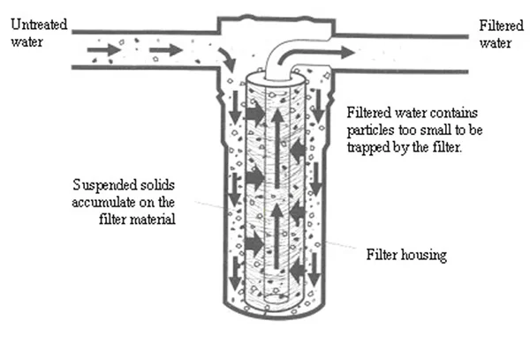
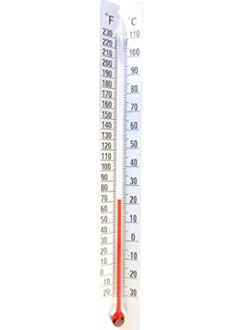
Types of Process Variables
Flow is defined as the quantity of a fluid passing a certain point within a certain period of time.
One of the most common units of measure for flow is gallons per minute, or GPM.
For example: A water filter that filters at a certain rate.
Temperature is the amount of heat in a substance, usually measured in degrees Fahrenheit, ℉, or Celsius, ℃.
For example: a thermometer

Slide 5
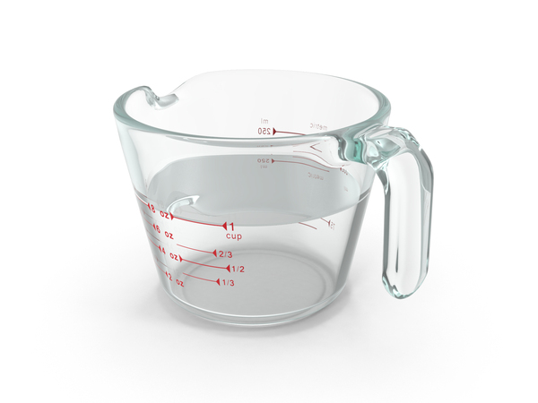
Type of Process Variables Cont.
Level is simply the height of material in a container. This can be any material that flows and takes the shape of its container. Level can be measured in feet, inches or as a percentage.
For example: oil levels in your car
Pressure is defined as force divided by the area that the force is acting on. The most common unit of measure of pressure is pounds per square inch or PSI.
For example: the air pressure in your tires

Slide 6
Setpoint, Upset, and Error
The value that must be maintained, such as the washing machine water level, or the speed of the car, is the process variable (PV).
The desired value of the PV is called the set point.
For example: Setting your car’s cruise control to 70 mph
When the process variable deviates from set point, we call this a process upset.
For example: When you go up a hill, your car will begin to slow down
The amount of the deviation is called the error.
For example: the difference between your cars set speed and the cars current speed

Slide 7
Sous Vide Control System Block Diagram
Circuit Board
Water Bath
Arduino
Microcontroller
Cascading
Switch
Circuit
PC / Serial
Monitor
Heater
Resistor
USB
Digital
Output 7
Relay Contacts
Thermistor
Analog
Input 5
Voltage Divider
9V
Power
Supply
8.3V
Set Desired
Value
(Setpoint
Temperature)
Potentiometer
Analog
Input 3
Voltage
Regulator
Measures
Process
Variable
(Temperature)
5V
Power On
LED Circuit
Digital
Output 4

Slide 8
Range, Span and Proportional
The process variable will have a minimum and maximum value called the range. For example: the temperature of a process might have a range of 50℉ to 150℉.
The difference between the maximum and minimum values of a range is called the span. For example: a range of 50℉ to 150℉ would have a span of 100.
Proportional is something that has a relatively correct relationship of size or that is appropriate. For example: the amount of pay a worker gets for the hours they put in.

Slide 9
Setpoint, Range and Span
Too Low
Setpoint
To High
Min: 75°
Max: 80°
Range: 75° to 80°
Span: Max – Min = 5°

Slide 10
Sensitivity, Drift and Accuracy
Repeatability is the ability of a sensor to provide the same result under the same conditions.
Sensitivity is The smallest change in a variable that can be detected by a sensor.
Drift is the gradual change in a measurement over time when the process conditions are constant.
Accuracy is the degree to which a measured value matches the actual process value.

Slide 12
Range, Span and Proportional
Handout
The process variable will have a minimum and maximum value called the range. For example: the temperature of a process might have a range of 50℉ to 150℉.
The difference between the maximum and minimum values of a range is called the span. For example: a range of 50℉ to 150℉ would have a span of 100.
Proportional is something that has a relatively correct relationship of size or that is appropriate. For example: the amount of pay a worker gets for the hours they put in.

Slide 13
Setpoint, Range and Span
Handout
Too Low
To High
Min: 75°
Max: 80°
Range:
Span:

