Slide 1
Industrial Instrumentation

Slide 2
Industrial Instrumentation
Define Industrial Instrumentation and give examples.
Define Process Control (in the broader scope of industrial applications)
Identify the two main types of process control
Identify key Industry and Standards Organizations relevant to Industrial Instrumentation

Slide 3
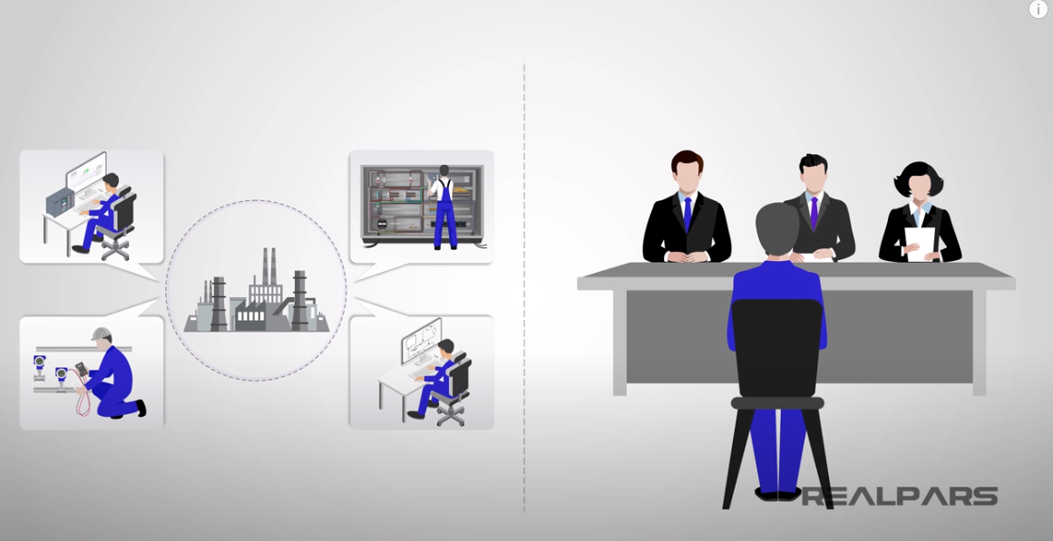
What are the Leading Industrial Automation Job Types?
https://www.youtube.com/watch?v=rJvThzbMmHE 6:29

Slide 4
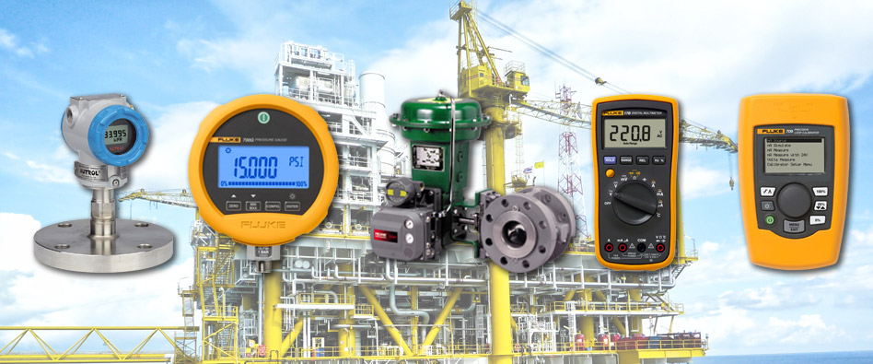
What is Industrial Instrumentation?
Industrial Instrumentation is the process of utilizing instruments to measure and control process variables to manufacture products safely and efficiently.

Slide 5
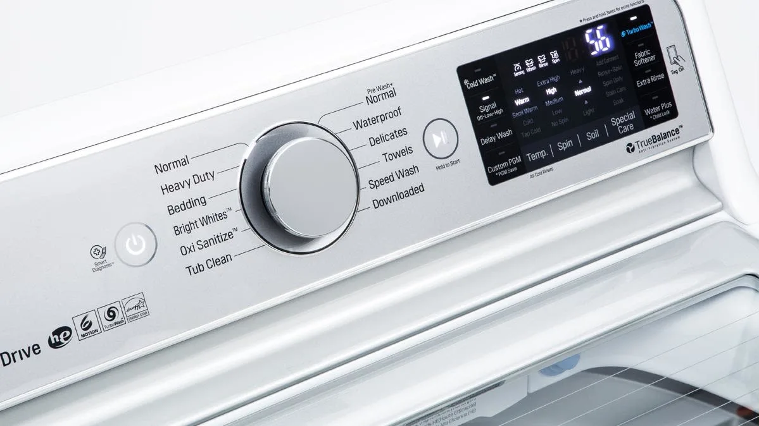
Example of Instrumentation
Take a washing machine for instance.
How does the washing machine start the water flowing into the tub?
How does it know when the correct level has been reached?
How does the machine stop the water flow?
All this is done with instrumentation.

Slide 6
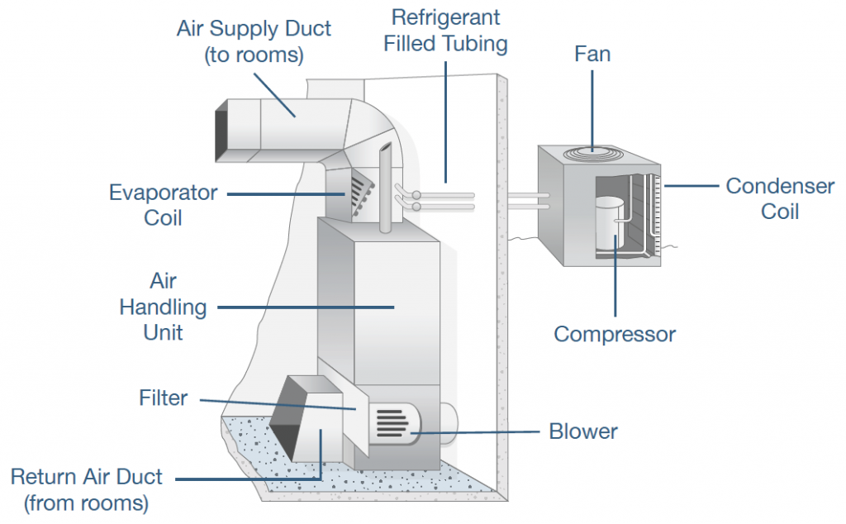
https://www.standardheating.com/hvac-maintenance/hvac-diagram/

Slide 7
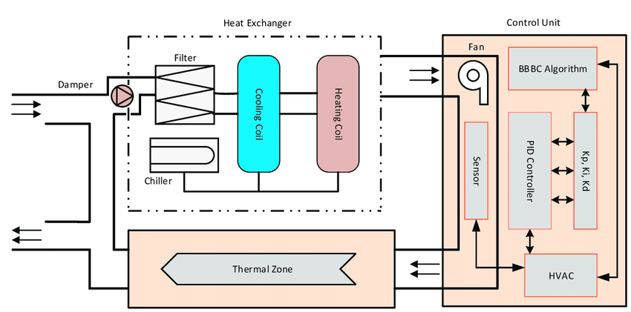
HVAC System
https://www.researchgate.net/figure/Block-diagram-of-conventional-HVAC-system-and-control-unit-structure_fig1_327944491

Slide 8
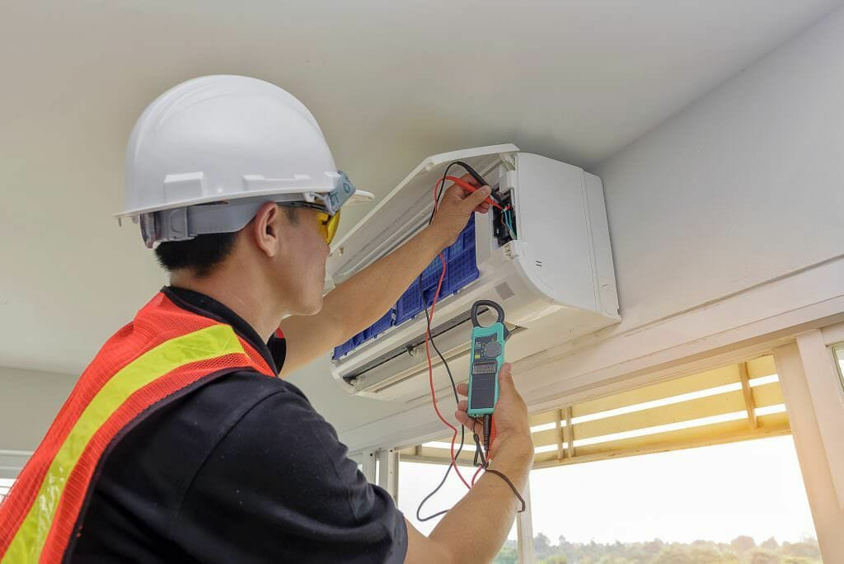
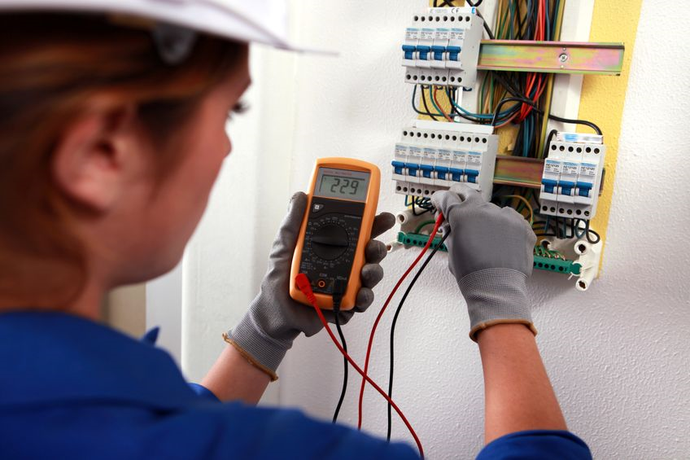
What is Process Control?
Process Control is a system that combines measuring materials and controlling instruments into an arrangement capable of automatic action.
Airflow Measurement
Electrical Troubleshooting
An HVAC technician measures airflow to troubleshoot an air-handling system.
An electrician is often required to troubleshoot electrical systems related to instrument systems.

Slide 9
2 Basic Types of Process Control
Manual Control: An operator must monitor a process and make corrections as needed.
Example: Operator monitors tank fill level and throws a switch when desired level is reached.
Automatic Control: Instruments are used to measure and control a process.
Example: Sensor measures tank fill level and sends a signal to to throw a switch (relay) / close a valve when desired level is reached.

Slide 10
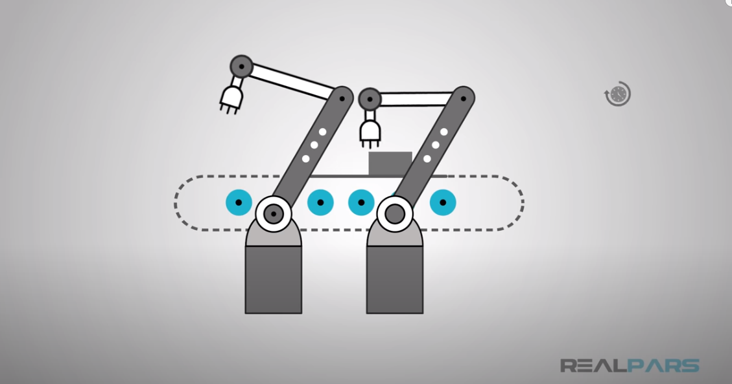
What is Process Automation?
https://www.youtube.com/watch?v=uEhuxYXPTOE

Slide 11
Industry and Standards Organizations
https://www.osha.gov/aboutosha
Occupational Safety and Health Administration (OSHA): Federal agency that enforces safety and health regulations.
National Institute of Standards and Technology (NIST): Develops measurement Standards for industry.
American National Standards Institute (ANSI) : Facilitates the development of American National Standards (ANS) by accrediting the procedures of standards developing organizations (SDOs). These groups work cooperatively to develop voluntary national consensus standards.
There are also a number of Technical Societies, Private Organizations and Trade Associations involved in Instrumentation and Process Control.
https://www.nist.gov/about-nist
https://www.ansi.org/default

Slide 12
Automatic Washing Machine Control
Create a process control / programming diagram for a washing machine, given a set operations, provided in writing from your team’s concept designers.
Use standard, process control flow charting diagrams
Properly indicate all control
Input/Output Blocks
Process / Operation Blocks
Decision Blocks (IF – THEN)
Connectors / Loops (including FOR – NEXT)
Terminals

