Slide 1
Project COMPLETE Sous Vide
Briefing for a design review with your team.
Cover
Page
Water Bath Heating Control System
Jane Smith
Fall 2022
Documentation that could be used to duplicate your design.

Slide 2
Sous Vide Project Rubric
Project Element | Criteria | Possible Points
Circuit Board/Wiring | Correctly wired / functional | 10
Programming | Coded / functional per instructions | 10
Project Description | Clearly describes the project. Includes system block diagram | 10
Design/Build Process | Describes how we moved through hardware and software builds. | 10
Temperature Measurement and Calibration | Describes relevant circuits/components including: Schematic, Calibration Process, Calibration Equation, Programming | 10
Setpoint Control, Offset and Scaling | Describes relevant computations used to determine offset and scaling. Describes relevant circuit and programming. | 10
Heater Controller | Describes Cascading Switch & Power-On LED Circuits, Schematic(s), and Programming | 10
Circuit Board Wiring | Clear Photograph with Labeled Circuits / Key Components | 10
Program Flowchart | Reasonably diagrams how the program works; using symbols provided. | 10
Summary / Process Control | General takeaways from the project, including relevant Instrumentation & Process Control Concepts/Applications | 10

Slide 3
Heating Control System Project
Topics to Be Covered
Project Description/Overview
Design/Build Process
Temperature Measurement and Calibration
Thermistor Circuit
Calibration and Programming
Setpoint Control and Offset/Scaling
Potentiometer Circuit
Offset and Scaling
Heater Controller
Cascading Switch
Power-On LED
Arduino Circuit Board Wiring
Photograph with labeled circuits / key components
Program Overview
Flow Chart
Code (commented)
Summary/Process Control

Slide 4
Project Description / Overview
What we set out to do and what this system basically does.
Design Goal(s)
Brief System Description

Slide 5
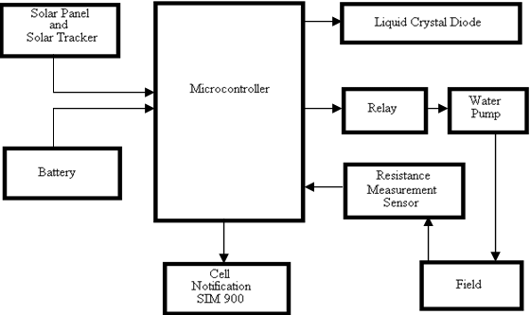
Block Diagram Example

Slide 6
Design/Build Process
How we moved through the hardware and software build(s).
Hardware: Circuits, Testing
Software: Program Build(s), Calibration, Data Collection…

Slide 7
Temperature Measurement and Calibration
Circuit/Components
Schematic
Calibration Process
Calibration Equation
Programming (code)
How we use a thermistor to measure (actual) temperature

Slide 8
Setpoint Control Offset and Scaling
Circuit/Components
Computation of Offset and Scale Factor
Programming (code)
How we used a potentiometer to control the setpoint

Slide 9
Heater Controller
Cascading Switch & Power-On LED Circuits
Schematic
Programming (code)
How we powered the heater resistor

Slide 10
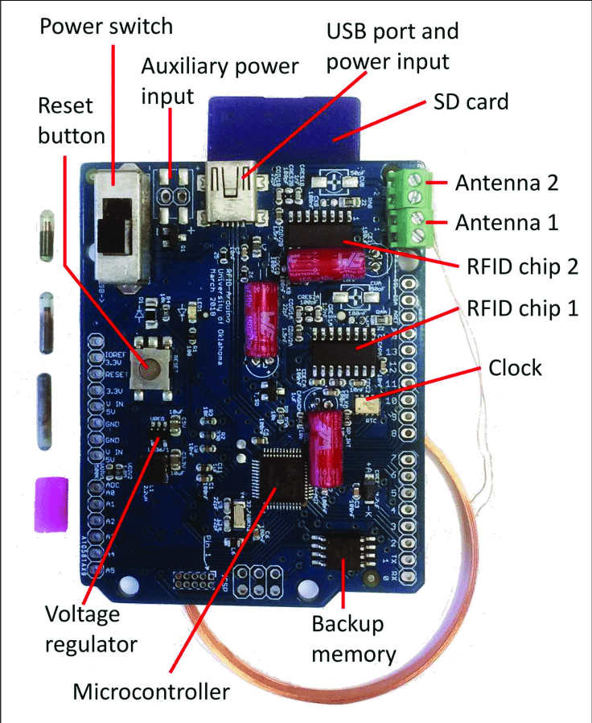
Circuit Board Wiring
Photograph
Labeled Circuits / Key Components
Key components of Arduino that we used and circuits we built on the breadboard.

Slide 11
Final Program Flow Chart
Void Loop
Read Thermistor
All major elements of program arranged in a flow chart with connectors.
Compute
Temperature
> Setpoint?
Y
N
Turn Heater On
Loop

Slide 12
Final Schematic
Circuit schematics.
Labeled.
Could wire full project from this page.

Slide 13
Summary/Process Control
General takeaways from the project
Instrumentation & Process Control Concepts/Applications
How this would apply in industrial/”real world” application(s)

