Slide 1
Project COMPLETE Sous Vide Water Bath Heating Control System
Documentation Rubric
Students receive rubric in PowerPoint template with slide titles and bullets on what information is required. This set of charts is for teacher reference only, to aid in scoring and debriefing students after they complete their own documentation/presentations. They are allowed to use / snip information from PDFs of lessons used in class.

Slide 2
Sous Vide Project Rubric
Project Element | Criteria | Possible Points
Circuit Board/Wiring | Correctly wired / functional | 10
Programming | Coded / functional per instructions | 10
Project Description | Clearly describes the project. Includes system block diagram | 10
Design/Build Process | Describes how we moved through hardware and software builds. | 10
Temperature Measurement and Calibration | Describes relevant circuits/components including: Schematic, Calibration Process, Calibration Equation, Programming | 10
Setpoint Control, Offset and Scaling | Describes relevant computations used to determine offset and scaling. Describes relevant circuit and programming. | 10
Heater Controller | Describes Cascading Switch & Power-On LED Circuits, Schematic(s), and Programming | 10
Circuit Board Wiring | Clear Photograph with Labeled Circuits / Key Components | 10
Program Flowchart | Reasonably diagrams how the program works; using symbols provided. | 10
Summary / Process Control | General takeaways from the project, including relevant Instrumentation & Process Control Concepts/Applications | 10

Slide 3
Heating Control System Project
Project Description/Overview
Design/Build Process
Temperature Measurement and Calibration
Thermistor Circuit
Calibration and Programming
Setpoint Control and Offset/Scaling
Potentiometer Circuit
Offset and Scaling
Heater Controller
Cascading Switch
Power-On LED
Arduino Circuit Board Wiring
Photograph with labeled circuits / key components
Program Overview
Flow Chart
Code (commented)
Summary/Process Control

Slide 4
Project Description / Overview
Design Goal(s): Build and program a process control system to maintain a (setpoint) temperature in a water bath.
System Description
Arduino microcontroller reads temperature and setpoint and determines when to turn a heater ON/OFF
Water temperature and setpoint are displayed on the Arudino IDE Serial Monitor
LED circuit indicates when the heater is ON
Thermistor circuit measures the temperature in the water bath
Cascading switch circuit powers the heater resistor
A potentiometer is used to establish a setpoint

Slide 5
Sous Vide Control System Block Diagram
Circuit Board
Water Bath
Arduino
Microcontroller
Cascading
Switch
Circuit
PC / Serial
Monitor
Heater
Resistor
USB
Digital
Output 7
Relay Contacts
Thermistor
Analog
Input 5
Voltage Divider
9V
Power
Supply
8.3V
Potentiometer
Analog
Input 3
Voltage
Regulator
5V
Power On
LED Circuit
Digital
Output 4

Slide 6
Design/Build Process
Wired Thermistor Circuit and developed calibration equation using thermistor temperature data and regression analysis.
Wired Cascading Switch and integrated with thermistor temperature measurement.
Wired potentiometer Circuit and added to Cooling Control System to test and verify setpoint control.
Developed gain/offset equation for temperature control potentiometer.
Added LED circuit last to indicate heater power on.
10K resistor was used in place of heater resistor to test full program before adding heater resistor.
Completed incremental builds of hardware and software.
Built each circuit separately
Verified wiring per schematic diagrams
Wrote and tested code for each circuit
Integrated code into larger control system program
Design
Build
Test

Slide 7
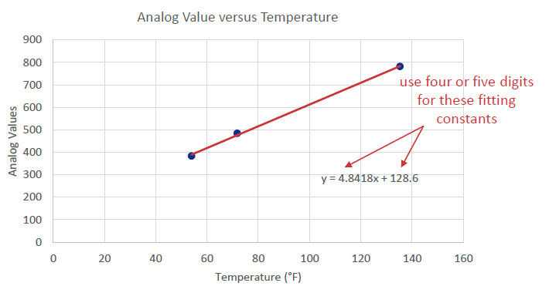
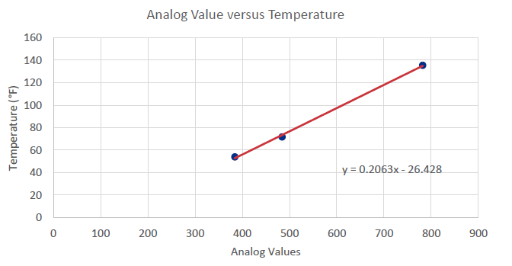
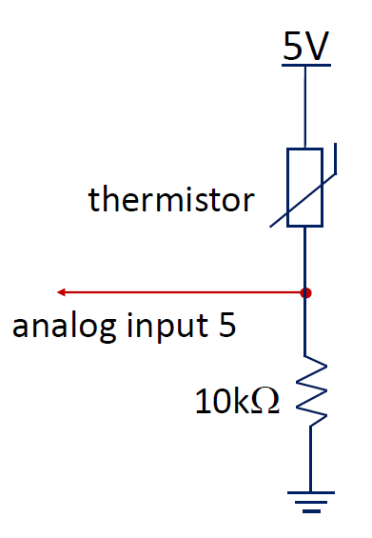
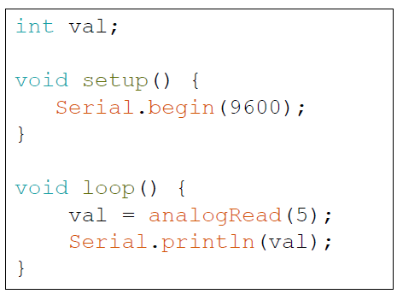
Temperature Measurement and Calibration
Collected temperature data from thermistors using analogRead and thermometer
Graphed data in Excel
Used Linear Regression to get a calibration equation.
Used inverted calibration equation to determine temperature from analogRead value

Slide 8
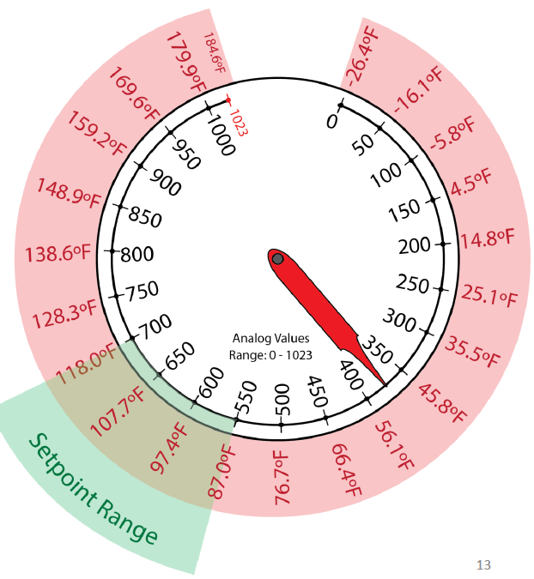
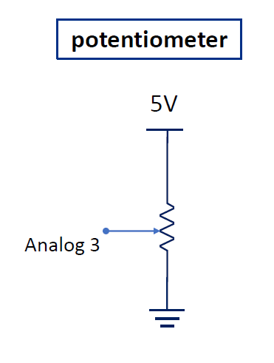
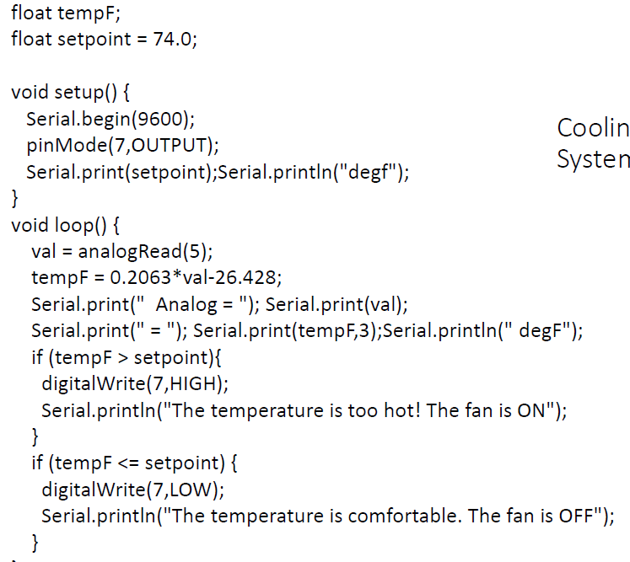
Setpoint Control Offset and Scaling
Limited range of analogRead values to 550 – 700 (15%) to operate in a reasonable range for the heater.
Used this value to compute SetpointF
Test program used if statements to turn fan motor ON or OFF based on a fixed setpoint
𝑆𝑒𝑡𝑝𝑜𝑖𝑛𝑡𝐴=0.15∙𝑑𝑖𝑎𝑙+550
𝑆𝑒𝑡𝑝𝑜𝑖𝑛𝑡𝐹=0.2063∙𝑆𝑒𝑡𝑝𝑜𝑖𝑛𝑡𝐴−26.428

Slide 9
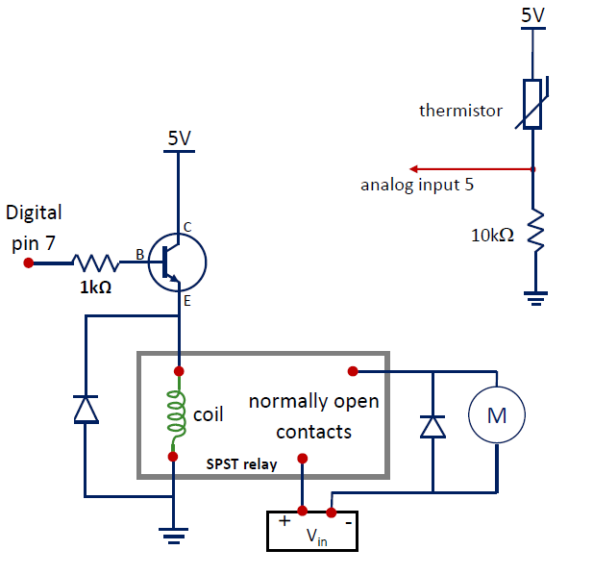
Heater Controller / Cascading Switches
Relay needed to source enough current to drive the heater.
Arduino digital pins can’t source enough (coil) current to turn on relay.
Digital pin used to turn on a transistor, controlling a large enough current (from onboard 5V) to excite the coil.
Flyback diodes used to protect circuit components from current surges caused by energy stored in relay and motor coils.

Slide 10
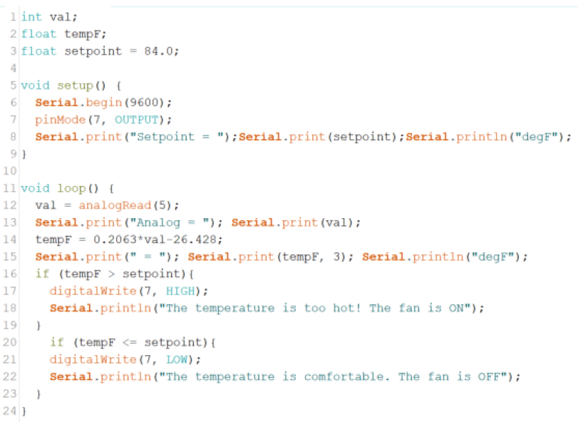
“Cooling Control System” Programming
Used fixed setpoint. Added potentiometer later to make setpoint adjustable.
Read thermistor and compute temperature.
Pull digital pin HIGH or LOW to turn on transistor/fan motor.

Slide 11
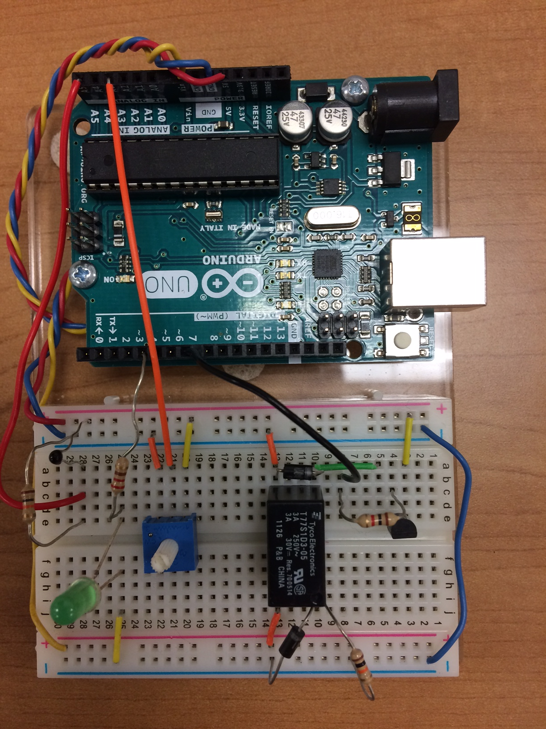
Circuit Board Wiring
USB to PC / Serial Monitor
Transistor
Circuit
Heater Resistor
(10k for testing)
9V
Power Jack
Digital Outputs
Cascading Switch
Analog Inputs
Relay / Flyback Diodes
Thermistor Voltage Divider
(test thermistor shown)
Potentiometer
LED PWR ON

Slide 12
Program Flow Chart
Void Loop
A
Read Potentiometer
(dial)
tempF < Setpoint?
Turn ON Heater and LED
Initialize
Variables
Y
N
Void Setup
Compute/Print
Setpoint Temp. (setpointF)
tempF > Setpoint?
Turn OFF Heater and LED
Y
Start Serial Monitor
Read Thermistor
(val)
N
Set pinMode Outputs 4 & 7
Delay
5 Seconds
Compute/Print
Water Temp.
(tempF)
Loop
A

Slide 14
Summary/Process Control
General Takeaways
Project integrated hardware and software into complete control system.
Used incremental build process on both hardware and software.
Collected data and used mathematical analyses for calibration and offset/scaling.
Required careful wiring and testing.
Instrumentation & Process Control Concepts/Applications
Sensors
Calibration
Power Control/Relays
Programming/Control Loops
Temperature control is a major function in industrial control applications
Documentation is an important component of any project

