Slide 1
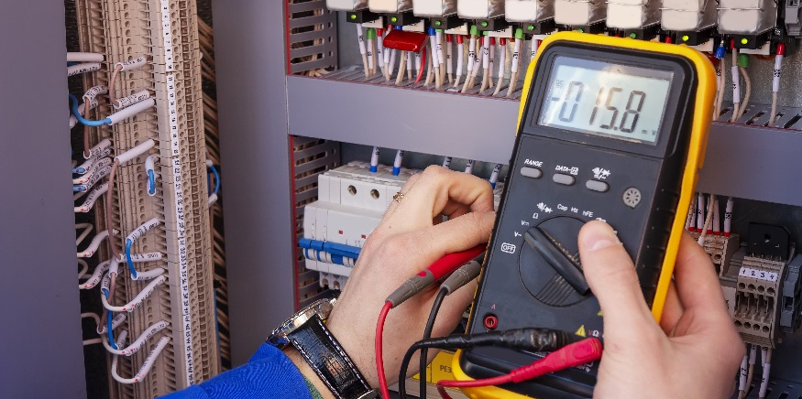
Potentiometers with the Sous Vide

Slide 2
Potentiometers with the Sous Vide
Use a potentiometer to fix a setpoint
Use an inverted calibration equation to relate the analog values from the potentiometer to temperature values
Establish a setpoint range
Develop an equation to scale the potentiometer values within the (narrowed) setpoint range using offset and gain.
Build and control a cooling system with an adjustable temperature.

Slide 3
Potentiometer with the Sous Vide
Brainstorm how you think you could use the potentiometer with the sous vide project.
Depending on what you are cooking you will need to set the control temperature to be a certain set value.
The thermistor will need to read the temperature of the water that the sous vide is in and turn the heater on until the setpoint value is reached.
The potentiometer can be used as the method to fix the setpoint.
Food | Temperature (°F)
Steak | 129
Roast | 140
Pork | 144
Chicken (Light Meat) | 149
Chicken (Dark meat) | 167
Fish | 122
Egg | 180
Potato | 185

Slide 4
Recall Potentiometer Activity
int val;
void setup() {
Serial.begin (9600);
pinMode(4,OUTPUT);
}
void loop() {
val = analogRead(3);
Serial.println(val);
if(val < 550) {
digitalWrite (4,HIGH);
}
else if(val > 600) {
digitalWrite (4,LOW);
}
else if(val >= 550 and val <= 600) {
digitalWrite (4,HIGH);
delay (500);
digitalWrite (4, LOW);
delay (500);
}
}
5V
Potentiometer
Pin 4
R₁
220Ω
analog input 3
R₂
Setpoint
$$Voltage Value=\text{analogRead} Value∙\frac{5 volts}{1023}$$

Slide 5
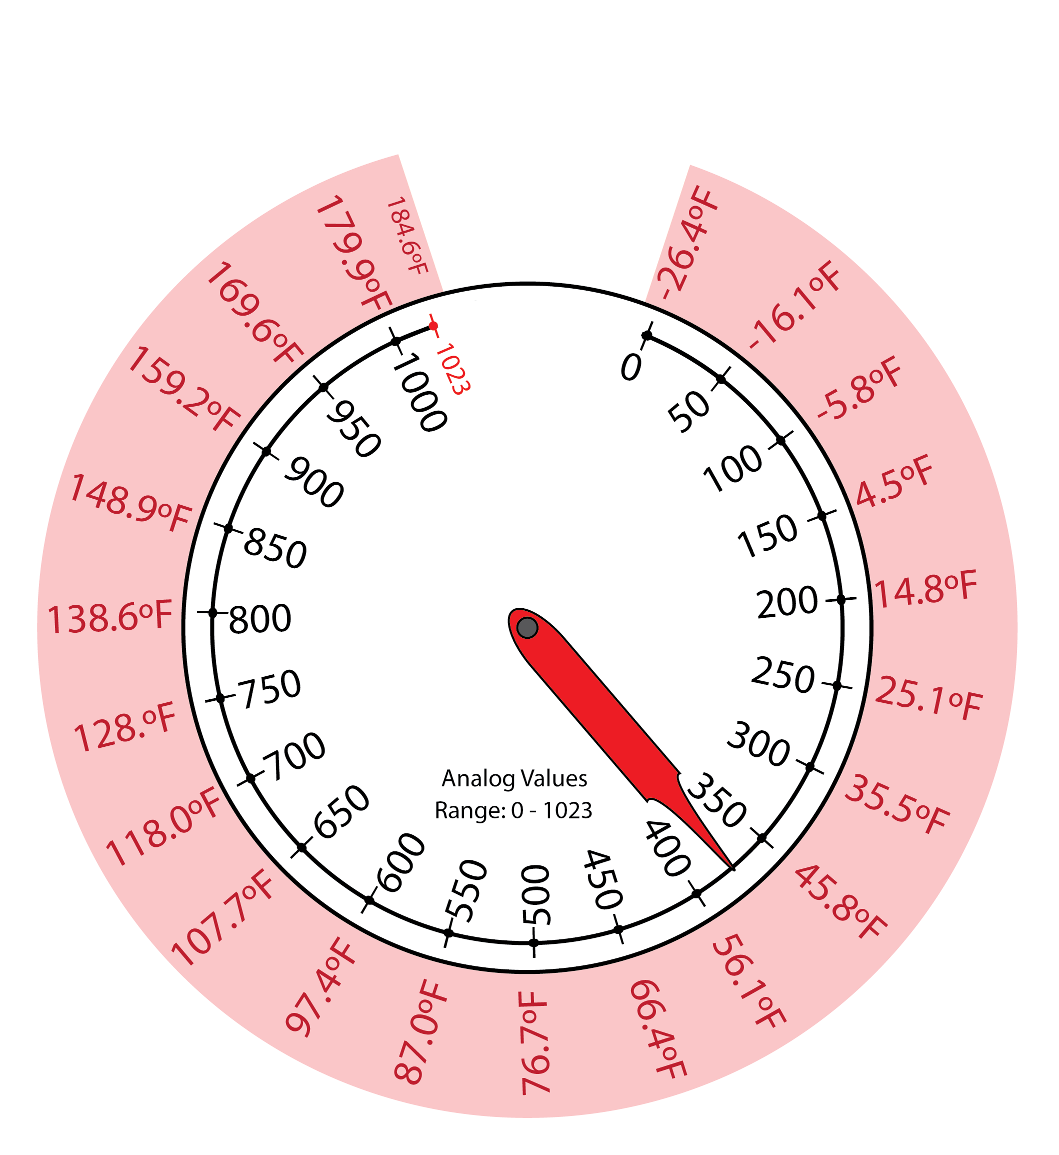
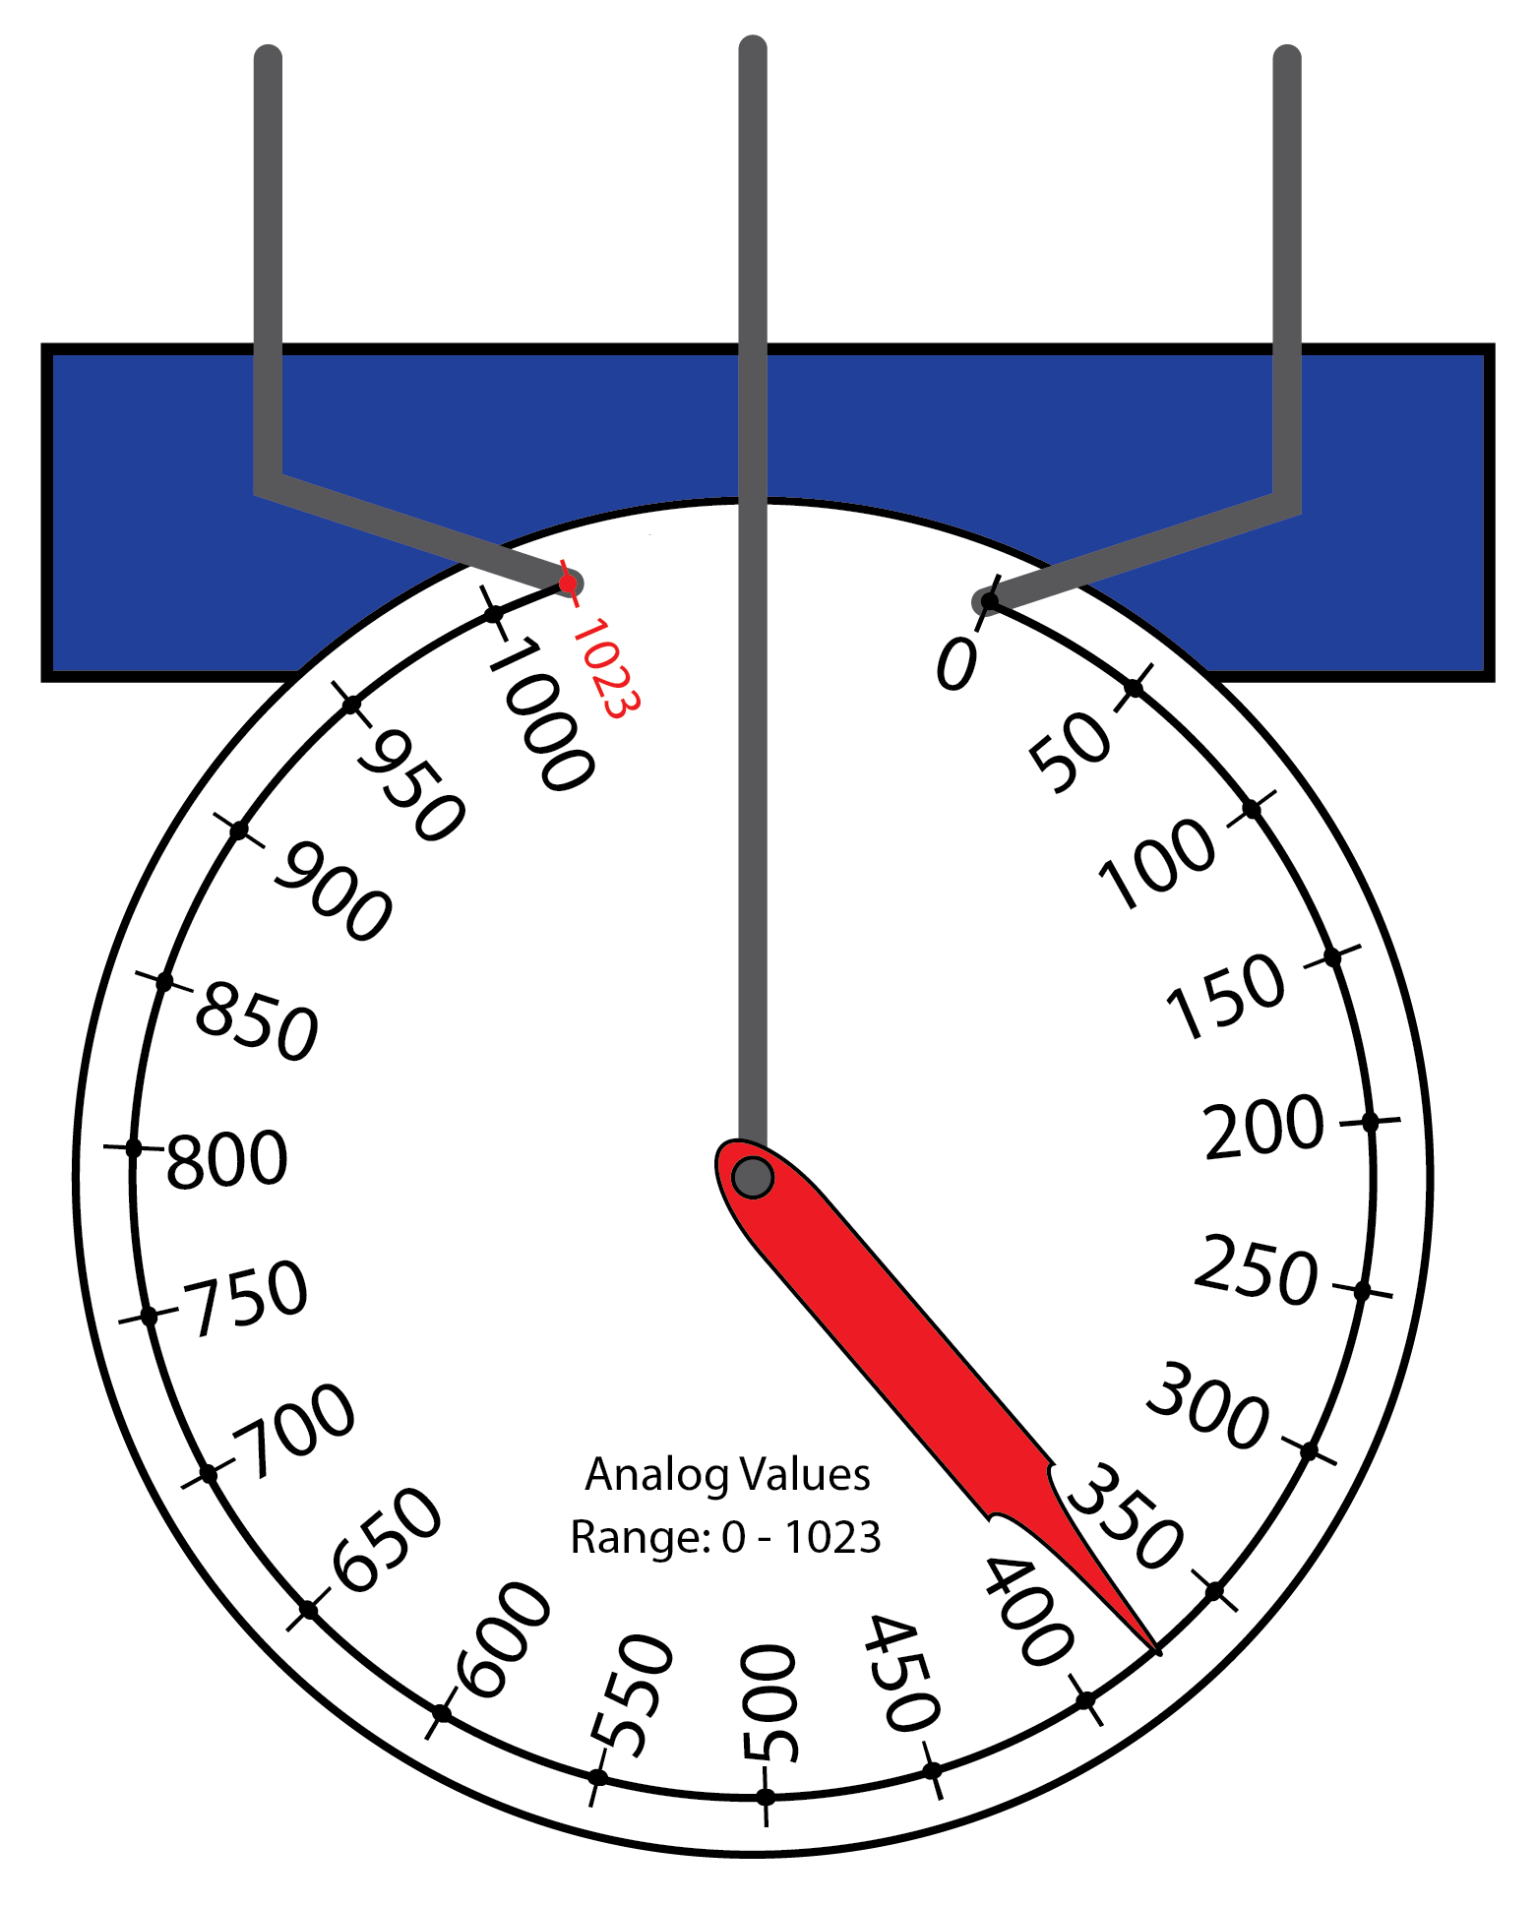
Potentiometers With Your Sous Vide
- Analog Read +
The potentiometer will be used as a dial to fix the desired temperature setpoint for the water in your system.
What type of numbers are read in from the potentiometer?
What is the range of analog values that the potentiometer can read?
How can you relate the analog values of the potentiometer to temperature values?
Analog values
0 to 1023
Use inverted calibration equation.
$$Temperature=0.2063∗Analog Value −26.428$$

Slide 6
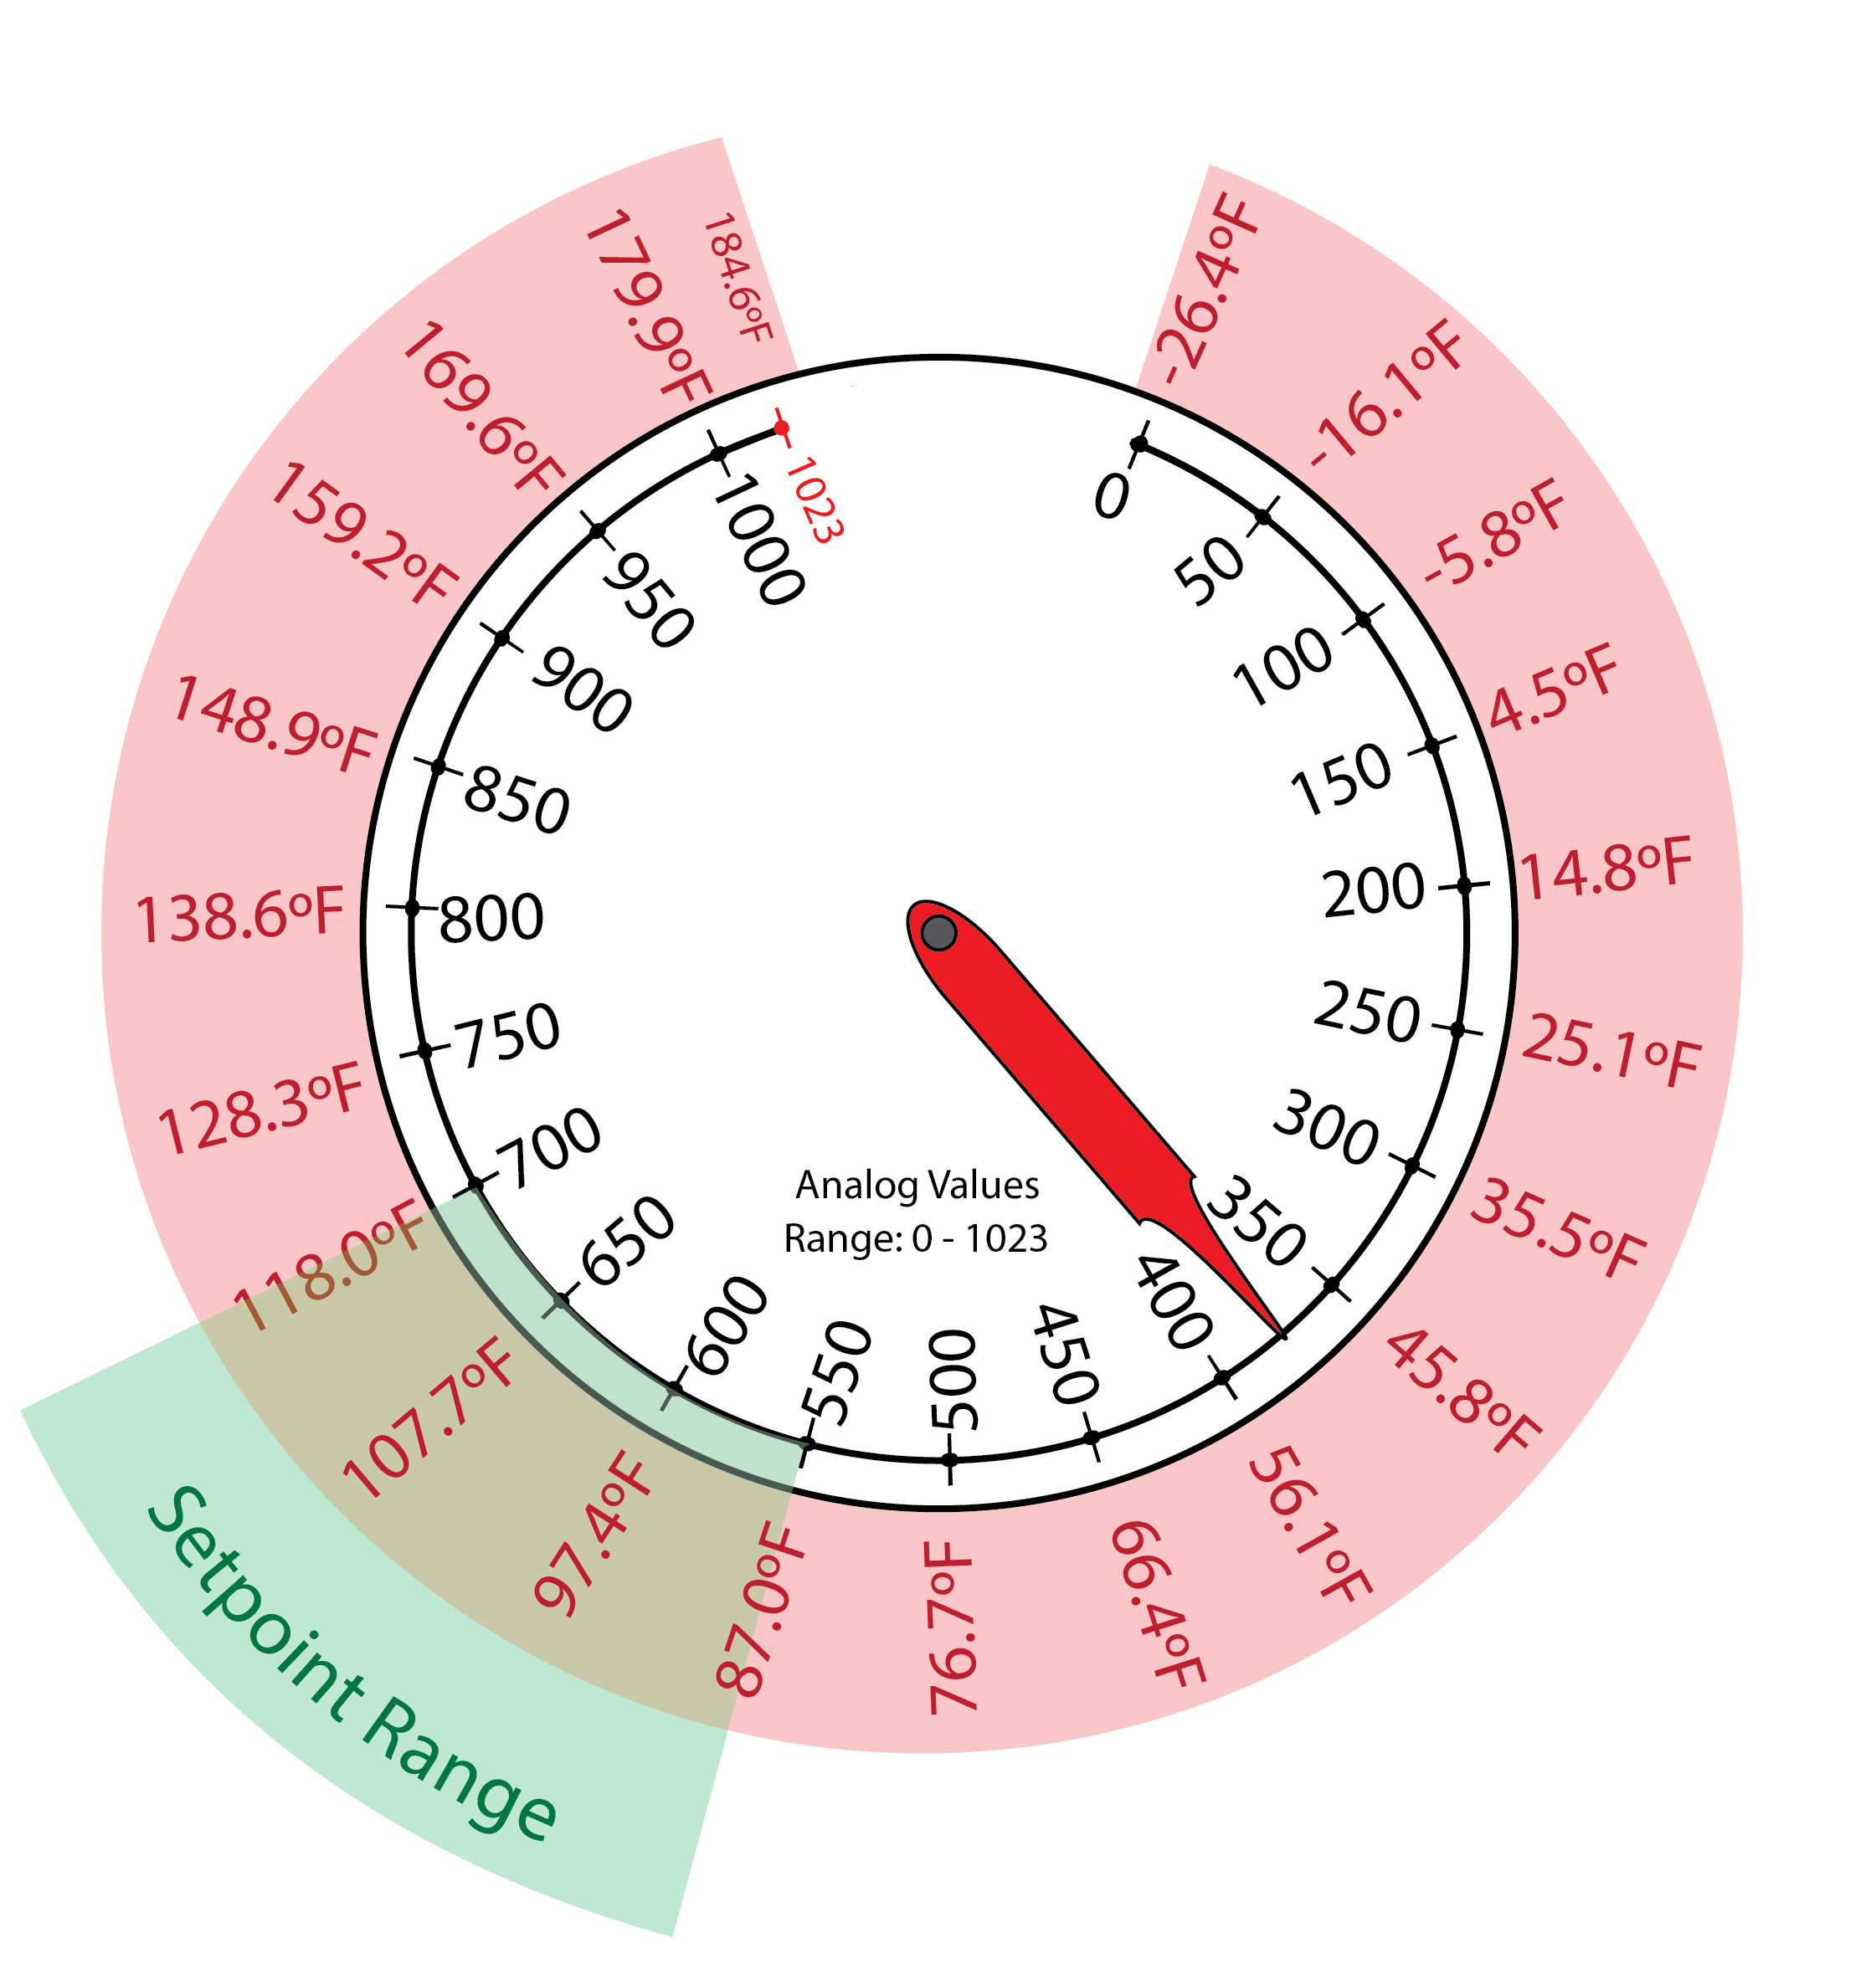
Potentiometer With Your Sous Vide
Analog values range from 0 to 1023 which translates to a range of -26.4°F to 184.6°F.
You will likely never set your sous vide at -26.4°F.
You are also limited by the heater you have for the project. It probably cannot reach high temperatures like 184.6°F.
You need to decide on a range that you would want for your setpoint values.
Let’s use 87.0°F to 118.0°F as the setpoint range which is 550 to 700 in analog values.
Setpoint Temp Range: 87 to 118 F
Setpoint analogRead Range: 550 to 700

Slide 7
Scale the input to use the full dial range
118°F
87°F
What % of 1023 is the setpoint range?
$$S. F.=\frac{700−550}{1023}≈.15$$
Next, set a starting point: 550

Slide 8
Potentiometer
Analog Read
Cal. Eqn.
Temp. Range
Convert AnalogRead value to a range of about 550 to 700; corresponding to a Fahrenheit temperature of about 87° to 118°.
We can now use the full range of the potentiometer to adjust the temperature to values the system can deliver.
1023
700
550
0
185°
118°
87°
0°
1023
700
550
0
Practical Heating
Range for Project Heater
15% Scale Factor
.15 * 1023 = 153.5
Offset
$$SetpointA=0.15∙dial+550$$
$$\sim 550 to 700$$
$$SetpointF=0.2063∙SetpointA−26.428$$

Slide 9
Controlling Setpoint
550 to 700
87.0°F to 118.0°F
$$SetpointA=0.15∙Dial+550$$
Scaled Analog Input from Potentiometer
$$SetPointF=0.2063∗SetpointA−26.428$$
Desired Temperature in Fahrenheit
$$TempF=0.2063∗Analog Value −26.428$$
Actual Temperature from Thermistor

Slide 10
Summary
$$Temperature=0.2063∗Analog Value −26.428$$
87°
118° F
Setpoint Temperature Range: _______ to ________
Setpoint analogRead Range: _______ to ________
SetpointA = __________ + ___________
SetpointA = ________ * _______ + ___________
SetpointA = _______ * ________ + _________
SetpointF = _________ * ___________ - _________
550
700
Dial
550
No!
Gain
Dial
550
0.15
Dial
550
0.2063
SetpointA
26.428
$S. F.=$
0.15

Slide 11
Old Charts

Slide 12
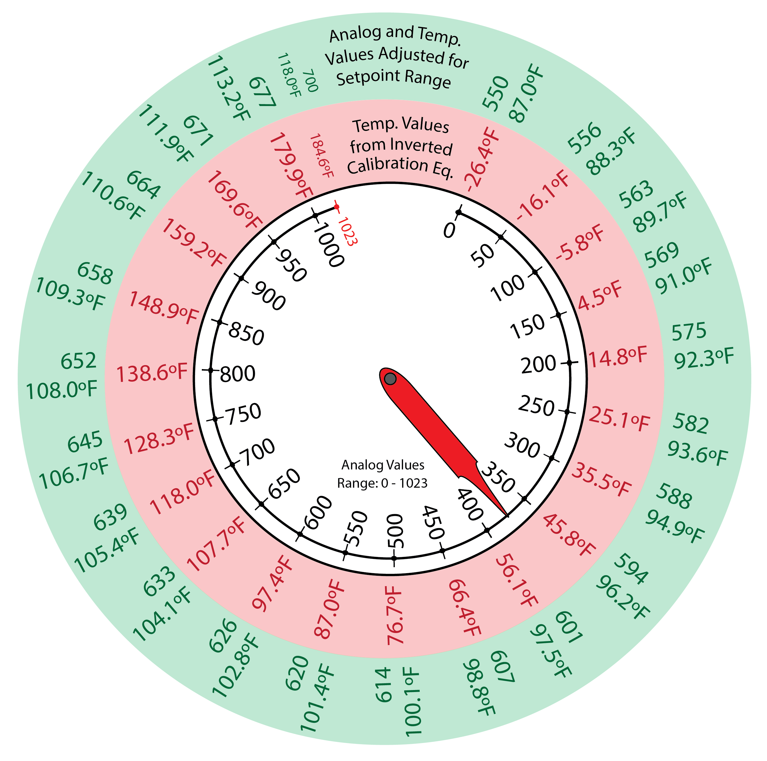
Determining the Setpoint Range
Setpoint
Range:
87.0°F to 118.0°F
550 to 700
For the narrowed setpoint range, you want to be able to turn the potentiometer dial freely and get only numbers in the desired setpoint range.
This is illustrated by the image to the right.
The dial is turned to the original analog values (white circle)
The analog values have corresponding temperature values in °F (red circle).
How were the temperature determined?
The narrowed setpoint values (analog and temperature) are distributed along the dial range (green circle).
When you turn the dial to position 850, you really want 658/109.3°F in your narrowed setpoint range.
inverted calibration equation

Slide 13
Determining the Setpoint Range
Setpoint
Range:
87.0°F to 118.0°F
550 to 700
To get the output of the dial to only be the narrowed setpoint range values, you need an equation (which will be used in your sketch).
Because the first position on the dial in analog is 0, let’s use analog values for our equation.
Using °F over analog would cause added difficulty (starting with -26.4°F instead of 0).
First, lets discuss the equation without adjusting the range, the equation for setpoint as it relates to dial position is:
$$Setpoint=Dial$$
“Dial” is the original analog value the potentiometer is turned to.
For Example:
When the dial is turned to 850 the setpoint is 850 (or 148.9°F).
$$Setpoint=850$$

Slide 14
Determining the Setpoint Range
Setpoint
Range:
87.0°F to 118.0°F
550 to 700
$$Setpoint=Dial+550$$
For your smaller narrowed setpoint range, when the dial position is at 0, you want the minimum setpoint value to be 550.
If Dial = 0, then what can you do to make Setpoint = 550?
This added value is called the offset, a constant value that shifts the starting point of a given system.
Add 550 to Dial
$$Setpoint=Dial+Offset$$
$$C. SetpointA=Dial+550$$

Slide 15
Determining the Setpoint Range
Setpoint
Range:
87.0°F to 118.0°F
550 to 700
Check the new form of the equation for dial positions other than 0.
When the dial = 850, setpoint should equal 658.
$$Setpoint=Dial+550$$
$$Setpoint=850+550=1400$$
When the dial = 650, setpoint should equal 633.
$$Setpoint=650+550=1200$$
The equation is giving values that are way too high. Even larger than the max size of the analog values (1023).
We need to adjust the equation to scale the resulting value to be smaller.

Slide 16
Determining the Setpoint Range
Setpoint
Range:
87.0°F to 118.0°F
550 to 700
$$Setpoint=Dial+550$$
We know the equation is correct when the dial is at 0.
Any change to the 550 would cause this to not be true.
What is we scale down the dial value?
Instead of adding the full value of the dial to the offset value of 550. We should add a smaller number to 550.
How can you make the dial value smaller?
Multiply it by a fractional constant.
For example, if the dial is at 850 what would you get if you multiple 850 by 0.5?
425, a much smaller number
425 + 550 = 975, which is much smaller than 1400 (slide 9).
975 is still outside of the narrowed setpoint range, the largest value you want to get is 700.
Now, you need to choose the right fractional constant to scale the dial value properly.

Slide 17
Determining the Setpoint Range
Setpoint
Range:
87.0°F to 118.0°F
550 to 700
The constant value multiplied by the dial value is called gain.
Gain is a proportionality constant that scales the input value of a system
Gain can scale the value up or down depending on what you want for the system.
Here we want to scale the value down. We want a percentage of the total value.
You may want 50%, 20%, or 1% of the input value.
The gain value is not a specific number and you can change it based on the system performance.
$$Setpoint=Gain∙Dial+550$$

Slide 18
Determining the Setpoint Range
Setpoint
Range:
87.0°F to 118.0°F
550 to 700
$$D. Setpoint=Gain∙Dial+550$$
Earlier you used a 50% gain (slide 10, multiplied dial by 0.5) and the setpoint value was too large.
We need a much smaller gain.
Try a 20% gain with the dial setting 1023.
Use the max value that the dial can be set to since that will give you the largest number possible from the equation.
Try a 15% gain with the dial setting 1023.
A 15% gain works for the system.
You could tweak the gain value more to make it a more accurate fit, but it is close enough for the system to function properly.
$$Setpoint=0.20∙1023+550$$
$$=754$$
Too large, needs to be around 700
$$Setpoint=0.15∙1023+550$$
$$=703$$
This is much closer to 700

