Slide 1
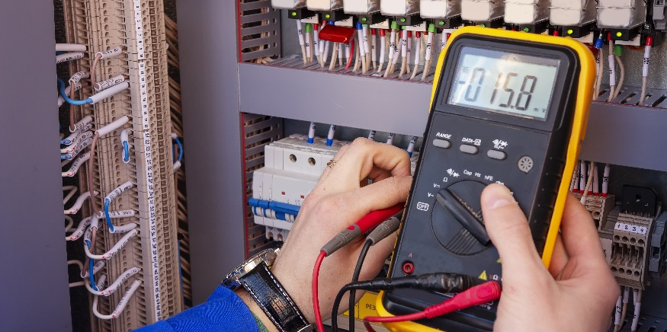
Cascading Switches

Slide 2
Cascading Switches
Describe how use a transistor to control a relay
Describe the function of a flyback diode across a relay coil
Control a DC motor with the Arduino using a transistor and relay as cascading switches
Build a simple cooling control system using the DC motor/fan and a thermistor.

Slide 3
Cascading Switches With Your Sous Vide
You will use transistors to electronically switch on and off the current that passes through a relay that will switch on and off a larger current that passes through the sous vide heater.
Why the transistor and the relay?
Why the relay?
The relay uses a smaller current (from the 5V source) to induce a magnetic field that closes the contact of the relay.
The relay contacts are part of a separate circuit that can be connected to a larger power source.
Why the transistor?
The transistor uses the digital pin to switch open the current flowing form 5V source.
Even though digital pin is 5V the current is not as strong and consistent as current from 5V.
5V
C
B
Arduino digital pin
1kΩ
E
Without the transistor and relay
You would not be electronically controlling the heater.
Could not use large power source for the heater.
SPST Relay
10Ω
Heater
-
+
9V

Slide 4
Cascading Switches Activity
Before connecting the wiring for the heater, let’s try to turn on a motor using the cascading switches.
Setting the digital output on the Arduino to HIGH will switch on the transistor.
The transistor allows current to flow through the relay coil, closing the relay contacts.
Power from Vin (9V) actuates the motor, allowing the shaft to spin.
5V
Arduino digital pin
?
diodes
C
B
1kΩ
E
SPST Relay
M
-
+
9V

Slide 5
Why the Diodes?
Flyback Diodes
When the digital pin on the Arduino goes HIGH, electricity is conducted through the coil of the relay, inducing a magnetic field in the coil
Energy is stored in the coil as a magnetic field
When the digital pin on the Arduino goes LOW, the decay of the magnetic field induces a current that can be harmful to our electronics (can arc across contacts or send a surge through the system)
The diode allows a circular current to be set up in the coil / diode loop so that the magnetic energy stored in the coil can be safely dissipated
Where have you heard diode before?
LEDs (Light Emitting Diodes)
5V
1kΩ
C
LED
Diode
B
Arduino digital pin
E
Diodes allow current to flow in only one direction.
You can use them as flyback diodes to help protect circuit elements.
You will always use a diode with the relay coil, but you will not need the second diode with your sous vide heater. You are using one with the motor here because DC motors have electromagnets inside them.

Slide 6
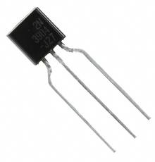
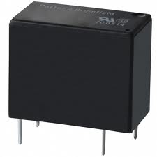
Power Considerations
Power to switch transistor
source:
max current per digital I/O pin:
Power to switch relay (Coil)
source: max current from the voltage regulator: coil current for relay:
Power to motor
source: max current:
Arduino digital I/O pin
20 mA
5V from Arduino (from the on-board voltage regulator)
800 mA
40 mA
Vin (9V)
depends on battery type (often lithium ion or NiCad) and remaining life (or Power Adapter rating)

Slide 7
Wiring Implementation
GOAL: Turn a motor on for 500ms and off for 2000ms using the cascading switch configuration.
5V
wire to digital pin 7
transistor
Digital pin 7
5V
Diode – silver stripe toward positive side
C
B
1kΩ
E
SPST Relay
9V
coil
normally open contacts
M
SPST relay
-
V_{in}
Tips:
Diodes must be oriented correctly.
Silver stripe towards positive. Silver stripe positioned the same as the line in diode schematic.
The relay must be oriented correctly. Two legs are in line with each other (coil legs) and the other two are slight offset for each other (contacts legs). Use the red dots on the schematic and picture to help guide you.
+
coil leads
contact leads

Slide 8
Sketch Implementation
GOAL: Turn a motor on for 500ms and off for 2000ms using the cascading switch configuration.
How would you write the sketch to make the motor turn on and off?
What are you actually programming to turn on and off?
You are turning on the and off the digital pin connected to the transistor which is activating the contacts that will turn on and off the motor.
What commands will do you write to turn on and off a digital pin?
void setup() {
pinMode(7, OUTPUT);
}
void loop() {
digitalWrite(7, HIGH);
delay(500);
digitalWrite(7, LOW);
delay(2000);
}
the digital pin connected to the transistor
digitalWrite like you did when turning on and off an LED

Slide 9
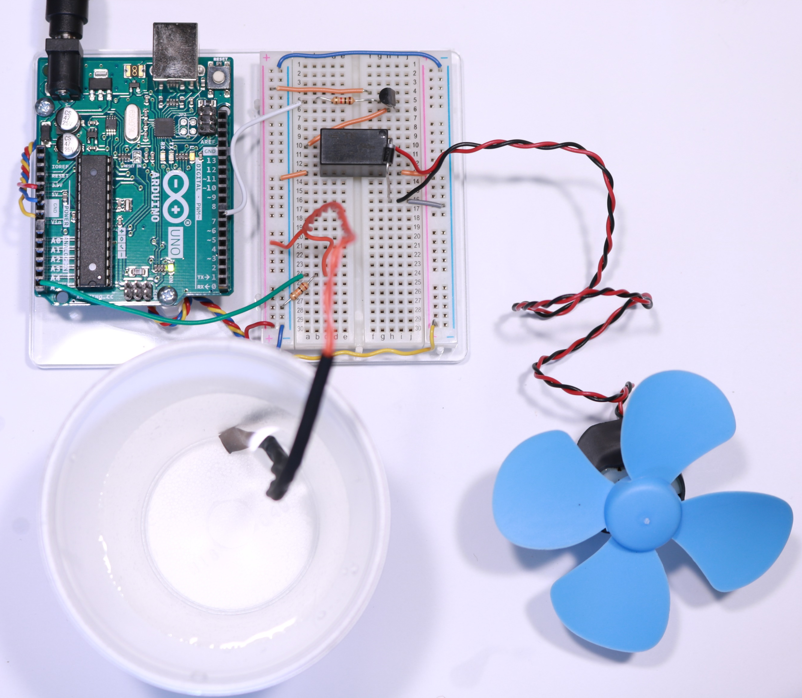
Cooling Control System
Don’t forget to plug in your external power supply to get the full 9V to the fan.
GOAL: Using the cascading switches configuration, turn on a fan when the air temperature gets too hot.
Control System Structure:
Determine a setpoint (use 74.0°F). This should be set at the beginning of your sketch when you declare your variables.
Read in analog temperature values from your thermistor (add your thermistor circuit to your breadboard).
Convert the analog values into °F values using your inverted calibration equation.
Determine if temperature values satisfies conditional statements.
If tempF > setpoint then turn fan on
If tempF <= setpoint then turn fan off

Slide 10
Cooling Control System
Plug in your external power supply to get the full 9V to the fan.
GOAL: Using the cascading switches configuration, turn on a fan when the air temperature gets too hot.
Control System Structure:
Start with your previous Transistor/Thermistor program
Determine a setpoint (use 74.0°F). This should be set at the beginning of your sketch when you declare your variables.
Read in analog temperature values from your thermistor (add your thermistor circuit to your breadboard).
Convert the analog values into °F values using your inverted calibration equation.
Determine if temperature values satisfies conditional statements.
If tempF > setpoint then turn fan on
If tempF <= setpoint then turn fan off
5V
thermistor
C
B
E
5V
analog input 5
Digital pin 7
10kΩ
C
B
1kΩ
E
coil
normally open contacts
M
SPST relay
-
V_{in}
Handout
+

Slide 11
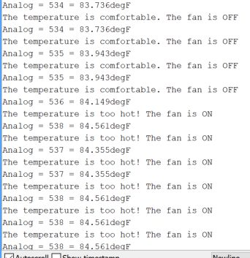
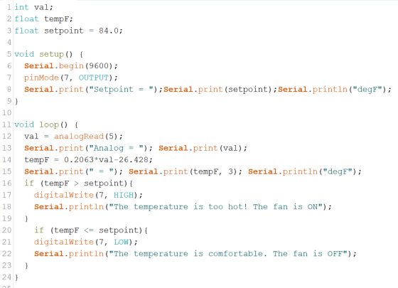
Cooling Control System
How is this similar and different to the functionality of the sous vide heater? What would be different about your sketch for the sous vide?

Slide 12
int val;
float tempF;
float setpoint = 84.0;
void setup() {
Serial.begin(9600);
pinMode(7,OUTPUT);
Serial.print(setpoint);Serial.println("degf");
}
void loop() {
val = analogRead(5);
tempF = 0.2063*val-26.428;
Serial.print(" Analog = "); Serial.print(val);
Serial.print(" = "); Serial.print(tempF,3);Serial.println(" degF");
if (tempF > setpoint){
digitalWrite(7,HIGH);
Serial.println("The temperature is too hot! The fan is ON");
}
if (tempF <= setpoint) {
digitalWrite(7,LOW);
Serial.println("The temperature is comfortable. The fan is OFF");
}
}

