Slide 1
Class Problem 09b-1
This circuit returns an analogRead value of 419 at room temperature (73°). What is the resistance of the thermistor?
5V
thermistor
analog input 5
10kΩ

Slide 2
Temperature Sensors
Temperature Sensors(11:19) https://www.youtube.com/watch?v=4mQ3o1t4Ssg&list=PLln3BHg93SQ812ihcqWb9OOWbZ-09DLW6&index=8

Slide 3
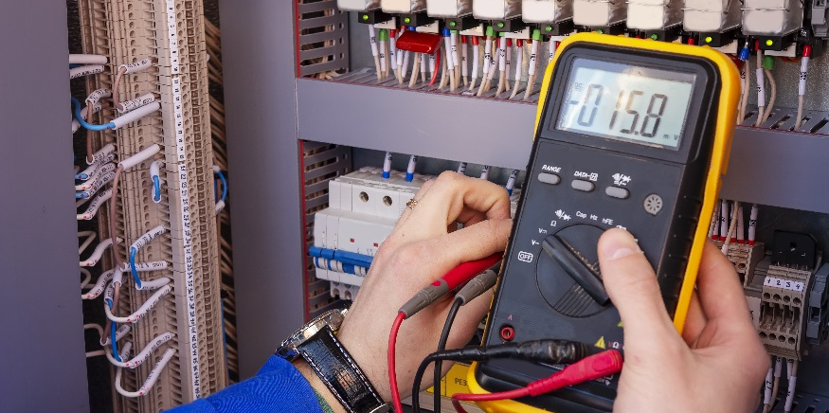
Thermistors and Calibration

Slide 4
Thermistors and Calibration
Describe how to measure temperature with a thermistor.
Measure a thermistor resistance over temperature with a multimeter. (Waterproof thermistor for taking data.)
Collect data (from a thermistor) using a multimeter.
Develop a calibration equation that correlates analog values to temperature values.
Use a calibration equation to monitor temperature using the Arduino.

Slide 5
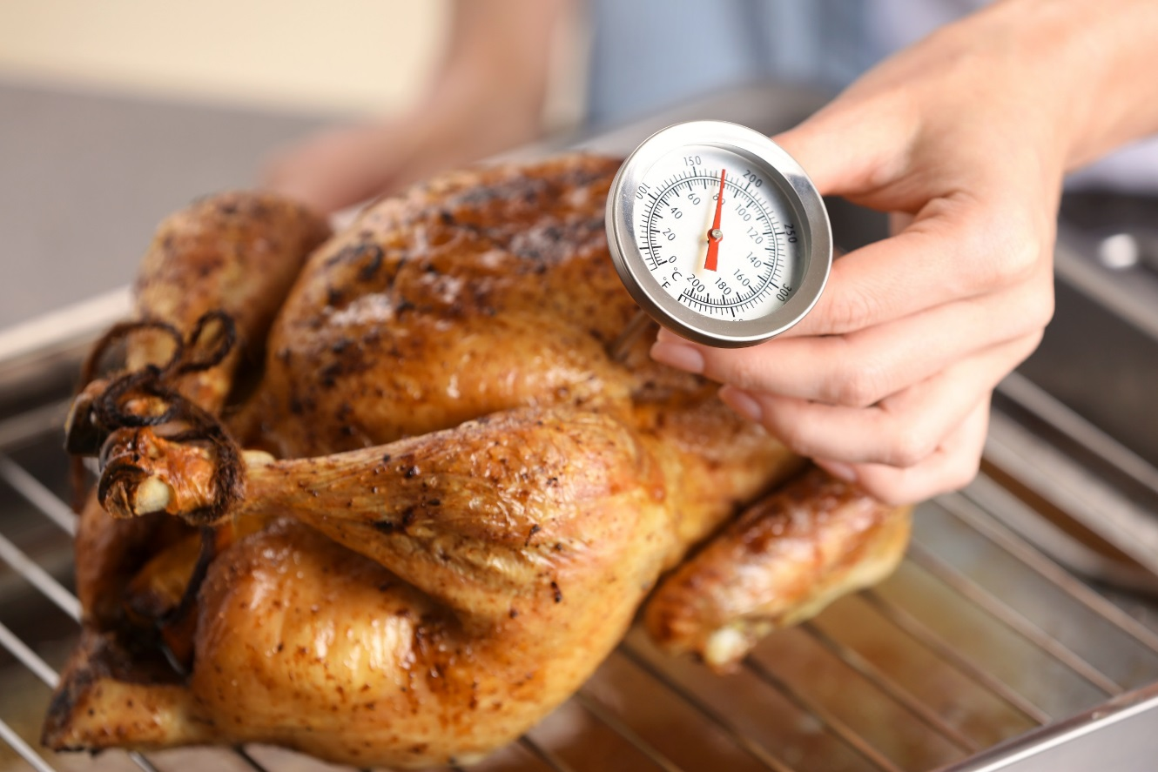
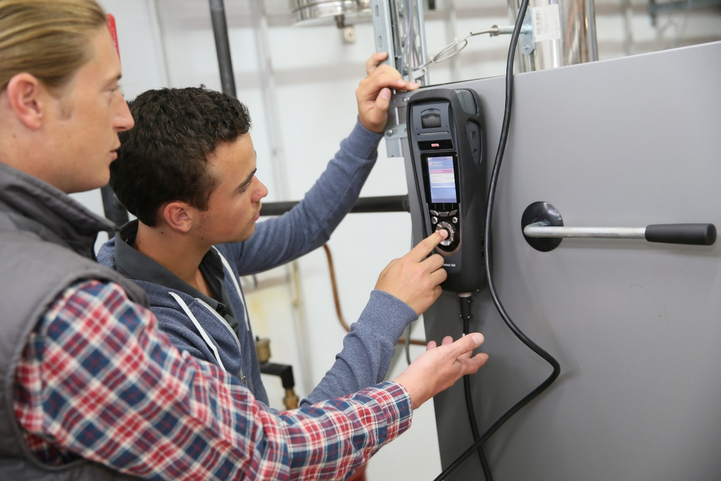
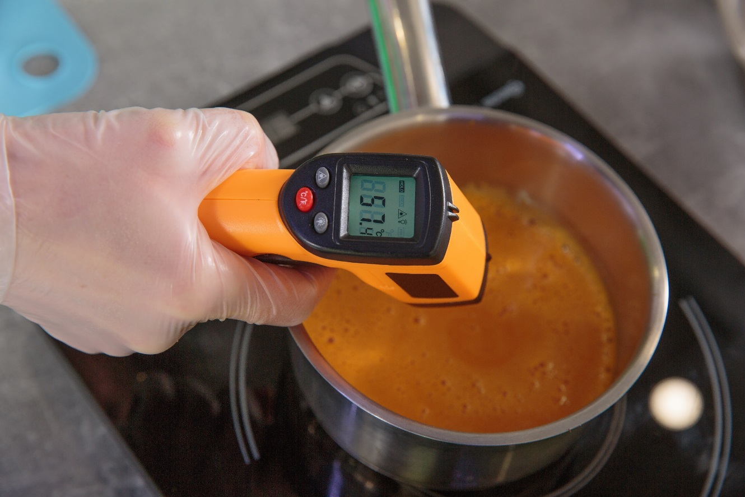
What is a temperature?
Sense of warmness of coldness of a material
Measure of the average thermal energy of particles in a material
Thermodynamic property of a substance that is related to the average energy of microscopic motions in a substance.

Slide 6
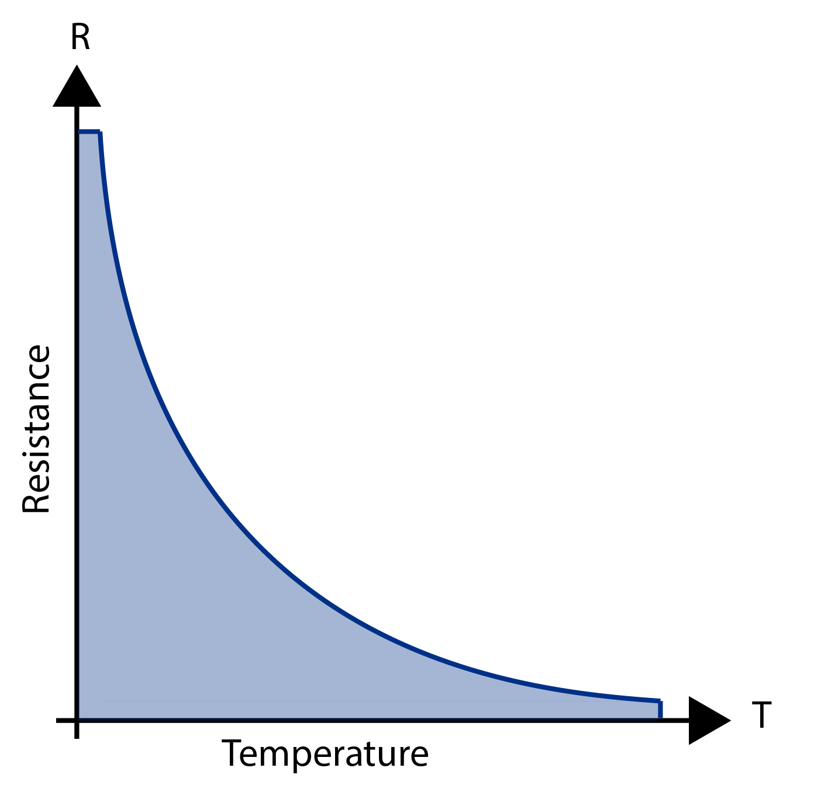
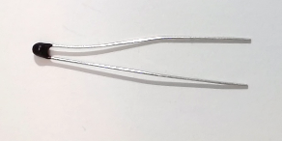
Measuring Temperature with a Thermistor
Measures electrical resistance changes with temperature
As resistance decreases, temperature increases
Advantages
High Output
Fast
Two-wire Ohm Measurement
Disadvantages
Non-linear
Limited Temperature Range
Fragile
Current Source Required
Self-heating
Circuit Diagram Symbol:

Slide 7
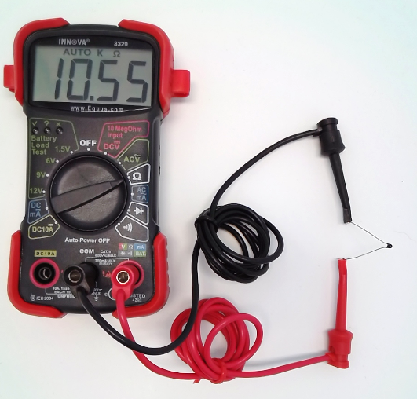
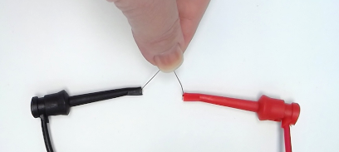
Measure Thermistor Resistance
Connect a thermistor to your multimeter
Measure its resistance
Hold the thermistor to change the temperature
Measure its resistance
What do you observe?
Resistance Decreases as Temperature Increases

Slide 8
Voltage Divider (Thermistor)
As the temperature increases:
The resistance of the thermistor ______________
The voltage drop across the 10K resistor ____________
The Analog Read value _____________
5V
decreases
increases
increases
thermistor
analog input 5
10kΩ

Slide 9
Collect Data Using Arduino
Connect the thermistor to your breadboard and Arduino
Use the given sketch to print analog values read by the voltage divider circuit
5V
int val;
void setup() {
Serial.begin(9600);
}
void loop() {
val = analogRead(5);
Serial.println(val);
}
thermistor
analog input 5
10kΩ
Press your fingers over the thermistor (Increase temperature).
What do you observe?
Analog Value Increases as Temperature Increases

Slide 10
Collect Data Using Arduino
5V
Analog values can be converted to voltage drop across the 10kΩ resistor
thermistor
$$voltage=\text{analogRead} value∙\frac{5 volts}{1023}$$
analog input 5
10kΩ
Recall Resistors in series and Ohm’s Law: $V=I ∙R$
If the voltage drop across the 10kΩ resistor increases, then the voltage drop across the thermistor .
If the voltage drop across the thermistor decreases, then the resistance of the thermistor
.
Summary: An increase in analog values read by the Arduino means the resistance of the thermistor is which means temperature is increasing.
Is this consistent with the values read by your multimeter at the beginning of class?
decreases
decreases
decreasing

Slide 11
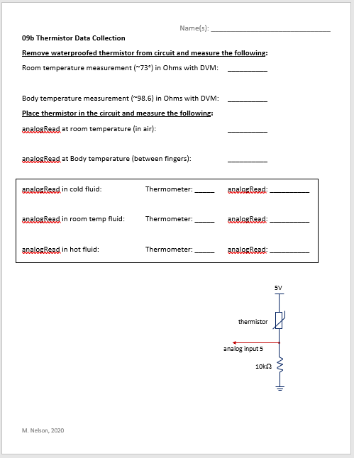
Data Collection
Collect data and complete data collection sheet.
5V
thermistor
analog input 5
10kΩ

Slide 12
Calibration Equation
Develop an equation (called a calibration equation) that correlates analog values to temperature values.
Use known temperature values that are mapped to analog values read by the Arduino.
Setup per group:
3 Cups
Cup 1: Cool water
Cup 2: Warm water
Cup 3: Hot water
1 digital thermometer
Waterproofed thermistor connected in voltage divider circuit
Arduino, laptop, Excel
Procedure:
Step 1: Fill cups with respective water temperatures
Step 2: Collect analog values for each cup of water (three data points)
Step 3: Record data points in Excel
Step 4: Plot data points on a scatter plot
Step 5: Add appropriate trendline and obtain corresponding equation
Details on subsequent slides

Slide 13
Step 1: Fill cups about 2/3 full with cool, warm, and hot water
Cool water – water fountain (~54ᵒF)
Warm water – faucet in classroom (~72ᵒF)
Hot water – Hot water pot (~122ᵒF)
Step 2: Collect analog values for each cup of water
Insert thermistor and thermometer into water while running the sketch that prints analogRead values (Sketch can be found on slide 6).
Wait until values from thermistor circuit reach a steady value.
Record the temperature from the thermometer and the analog value on the Serial Monitor.
Repeat for each cup of water (three data points).
Cup | Thermometer Temperature (ᵒF) | Analog Value (0 to 1023)
1 (Hot)
2 (Warm)
3 (Cold)
Do not move the thermistor (stir it in the water) while collecting data points. This could give erroneous values

Slide 14
Step 3: Record data points in Excel Step 4: Plot data points Step 5: Add linear trendline and equation on chart
Cup | Thermometer Temperature (ᵒC) | Analog Value (0 to 1023)
1 (Hot) | 54.0 | 384
2 (Warm) | 71.8 | 484
3 (Cold) | 135.3 | 782
use four or five digits for these fitting constants
Calibration Equation:
$$AnalogValue=4.8418∙Temperature+128.6$$

Slide 15
Using the Calibration Equation
When temperature is known, input temperature and get corresponding analog value
What is the analog value when temperature is 62.7°F?
$$AnalogValue=4.8418∙Temperature+128.6$$
$$AnalogValue=4.8418∙62.7℉+128.6$$
Remember analog values are whole numbers and the Arduino truncates values after the decimal.
$$AnalogValue=432.18$$
$$AnalogValue=432$$

Slide 16
Using the Calibration Equation
$$AnalogValue=4.8418∙Temperature+128.6$$
Calibration Equation:
What if temperature is not known?
Replot the data but swap the x and y axis values.
Invert the Equation
$$Temperature=0.2063∙AnalogValue−26.428$$

Slide 17
Inverting the Calibration Equation
$$AnalogValue=4.8418∙Temperature+128.6$$
Rewrite the Calibration Equation as Follows:
Solve this equation for T
$$A=4.8418T+128.6$$

Slide 18
Class Problem 09b-2 (2022 Data)
y = 5.2468x + 111.28
A = 5.2468T + 111.28
Swap A and T
Solve for A
T = 5.2468A + 111.28
2022 Data: T = 0.19A - 20.943

Slide 19
Using the Calibration Equation
Calibration Equation:
Inverted Calibration Equation:
$$AnalogValue=4.8418∙Temperature+128.6$$
$$Temperature=0.2063∙AnalogValue−26.428$$
Now you have equations that can take you from Analog to Temperature OR from Temperature to Analog.
What is the temperature value when the analog value is 578?
$$Temperature=0.2063∙AnalogValue−26.428$$
$$Temperature=0.2063∙578−26.428$$
$$Temperature=92.81℉$$

Slide 20
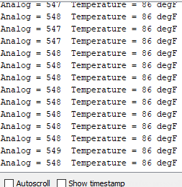
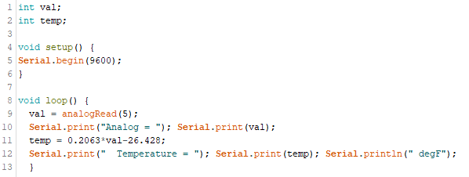
Using the Calibration Equation
Adapt the Arduino sketch to print both the analog value and its corresponding temperature value in degrees Fahrenheit.
Move the thermistor around in the air (or water) to change the temperature readings.
A new variable is needed.
Use inverted calibration equation.

Slide 21
Using the Calibration Equation
547, 548, and 549 are all 86°F
What do you notice about the values?
Check the equation.
$$Temperature=0.2063∙547−26.428=86.4181℉$$
$$Temperature=0.2063∙548−26.428=86.6244℉$$
$$Temperature=0.2063∙549−26.428=86.8307℉$$
The decimals are not printed on the serial monitor. It is like values after the decimal are chopped off. This is called truncation.
Never trust that you program everything correctly or that the computer is giving you exactly what you want. Always check your work! If you have a calculation, you should check it!

Slide 22
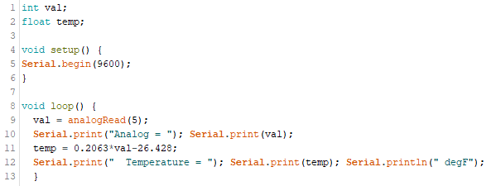
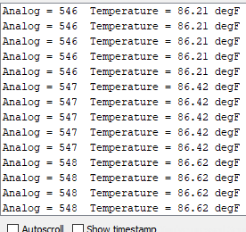
Using the Calibration Equation
What happens if you change the temperature variable to be a float instead of an int?
A float is a data type that allows for decimal values to be included in the sketch.
You get decimals to appear.
You will learn more about data types in another lesson.
Tip: By default the sketch will print 2 decimal values. To have it print more, go to the line of code that is printing the variable put a comma followed by the number of decimal values you would like it to print.

Slide 23
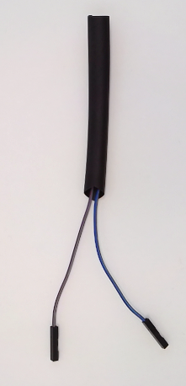
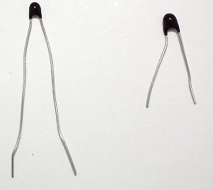
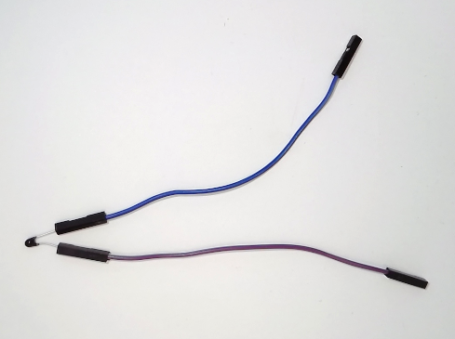
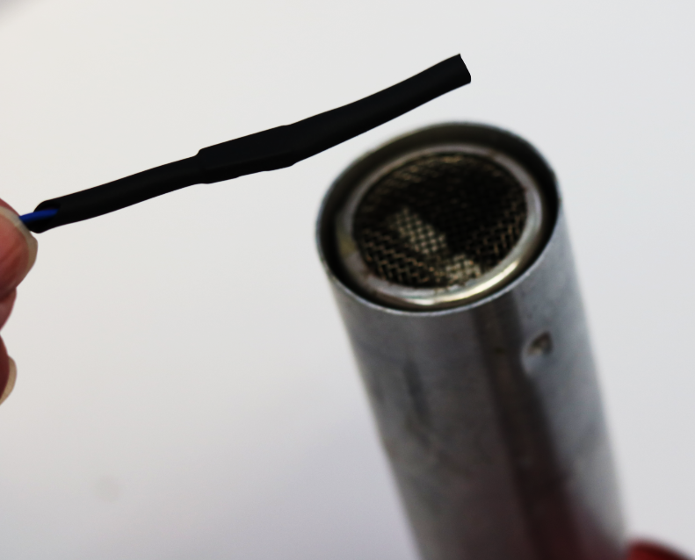
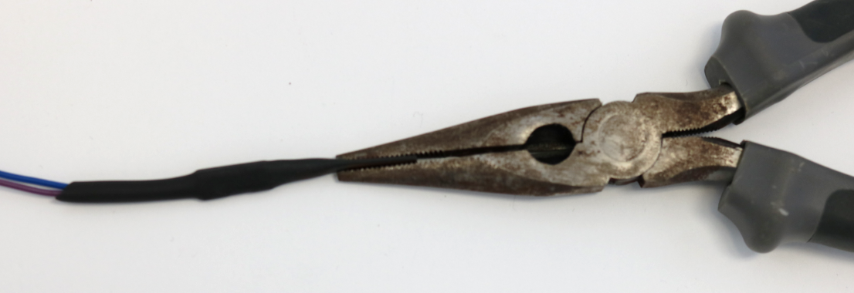
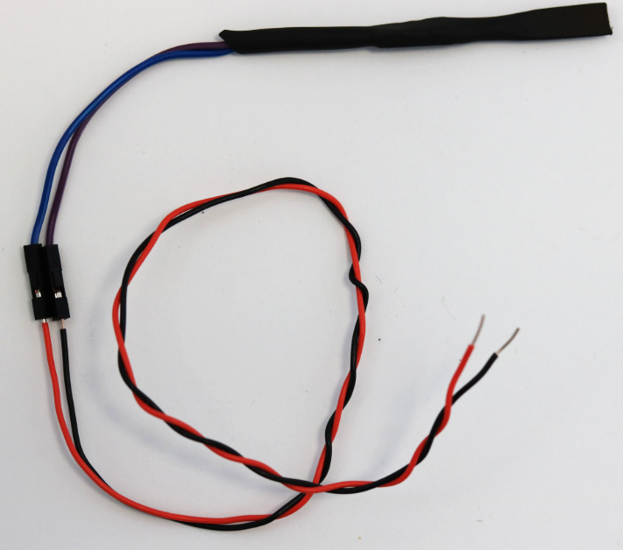
Behind the Scenes: Waterproofing the Thermistor
1/2in of extra material
Note: Leave approx. 1/2in of material passed the thermistor to be used as for a seal
Tip of Thermistor here
Clip approx. 1/2in off of thermistor legs
Attach wire extensions to each leg
Cut heat shrink material to approx. 3in and slide it over the thermistor
Heat the end last so that it is amenable when clamping
Shrink material using heat gun
Clamp end of heated material to seal in the thermistor
Be sure to not crush the thermistor when clamping material
Strip jumper wires and connect them to wire extensions

