Slide 1
Using a Sonic Sensor

Slide 2
Using a Sonic Sensor
Describe how a Sonic Sensor works.
Wire a Sonic Sensor on the Arduino platform
Program the Arduino to:
Read the Sonic Sensor input
Convert the input to distance in centimeters
Print the distance on the Serial Monitor
Use the Sonic Sensor in an object detection application.

Slide 3
PING Sonic Sensor
The Parallax PING))) ultrasonic distance sensor provides precise distance measurements from about 2 cm (0.8 in) to 3 meters (9+ feet).
The PING))) sensor works by transmitting an ultrasonic (40 kHz) burst and providing an output pulse that corresponds to the time required for the burst echo to return to the sensor.
By measuring the echo pulse width, the distance to target can be calculated.

Slide 4
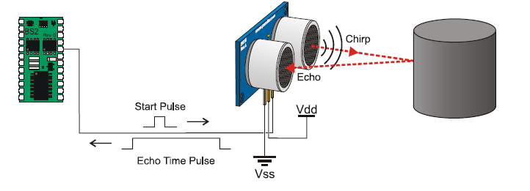
PING)) Sonic Sensor

Slide 5
PING Sensor Operation
PING SENSOR for ARDUINO
See front of Sensor for wiring.
Use a Digital Pin on Arduino.

Slide 6
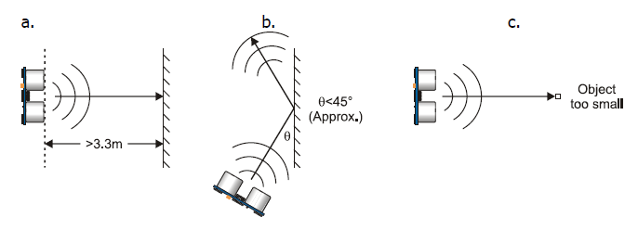
Object Detection
Objects that absorb sound or have a soft or irregular surface, such as a stuffed animal, may not reflect enough sound to be detected accurately.
Temperature has an effect on the speed of sound in air that is measurable by the PING))) sensor. If the temperature (°C) is known, the formula is:
C_{air} = 331.5+ (0.6× T_{C} ) m/s

Slide 7
Sonic Sensor Wiring
Digital Pin
Plug in to 3 adjacent rows on your breadboard and wire.

Slide 8
Sonic Sensor Project
Wire Green & RED LEDS, Piezo Speaker, and Sonic Senor to digital pins.
Detect an object and measure its distance from a Sonic Sensor
Place/detect object at about 12 in.
Print the distance on the Serial Monitor
Correlate distance with sound frequency using a Piezo Speaker
Move object toward sensor.
Start emitting sound at 10 in. (Piezo Speaker)
As the object gets closer, the frequency gets higher
Light a RED LED while the object is “out of range” (>10 in.)
Light a GREEN LED when the object is “in range” (< 10 in.)

Slide 9
Read PING)) Sonic Sensor
//Rounds to nearest inch
const int pingPin = 7;
unsigned int duration, inches;
void setup() {
Serial.begin(9600);
}
void loop() {
pinMode(pingPin, OUTPUT); // Set pin to OUTPUT
digitalWrite(pingPin, LOW); // Ensure pin is low
delayMicroseconds(2);
digitalWrite(pingPin, HIGH); // Start ranging
delayMicroseconds(5); // with 5 microsecond burst
digitalWrite(pingPin, LOW); // End ranging
pinMode(pingPin, INPUT); // Set pin to INPUT
duration = pulseIn(pingPin, HIGH); // Read echo pulse
inches = duration / 74 / 2; // Convert to inches
Serial.println(inches); // Display result
delay(200); // Short delay
}
Digital Pin

Slide 10
Class Problem
Find the time it will take a pulse, emitted from the PING sensor to return from an object 3 meters away. (@20 C).
Determine the value returned by the PULSIN command for this scenario.

Slide 11
Solution
6 meters total
(out and back)

Slide 12
Sonic Sensor Test Program
' {$STAMP BS2}
' {$PBASIC 2.5}
CmConstant CON 2260 ‘Conversion constant for centimeters
InConstant CON 890 ‘Conversion constant for inches
cmDistance VAR Word
inDistance VAR Word
time VAR Word
DO
PULSOUT 15, 5 ‘Pulse the sonic sensor to take a measurement
PULSIN 15, 1, time ‘Return the time in 2μs intervals
cmDistance = cmConstant ** time ‘ Return high 16 bits from 32 bit result
inDistance = inConstant ** time
DEBUG HOME, DEC3 cmDistance, " cm"
DEBUG CR, DEC3 inDistance, " in"
PAUSE 100
LOOP
Why 2260?

Slide 13
Conversion Constants
½ total distance
(1 way)
cmDistance = cmConstant ** time
6m out and back
cmDistance =
time
cmConstant
Returning high 16 bits truncates 32 bit number, effectively dividing it by 2¹⁶.

