Slide 1
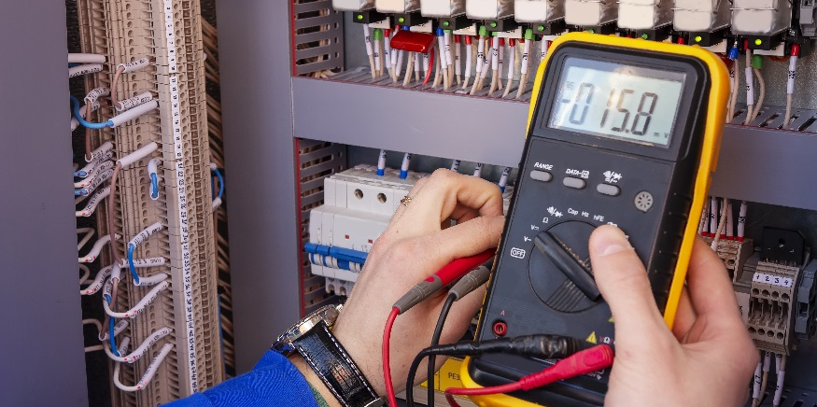
Analog and Digital Measurements

Slide 2
Analog and Digital Measurements
Identify differences between Analog and Digital systems/circuits.
Know the difference between Input and Output states of microcontroller pins.
Identify differences between digitalRead and analogRead values.
Find current and voltage in a voltage divider circuit given an analogRead value.

Slide 3
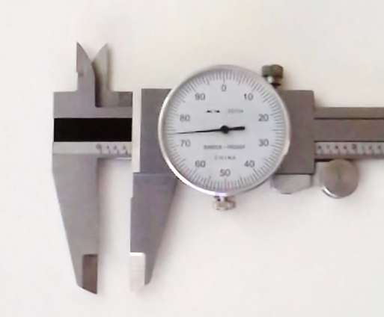
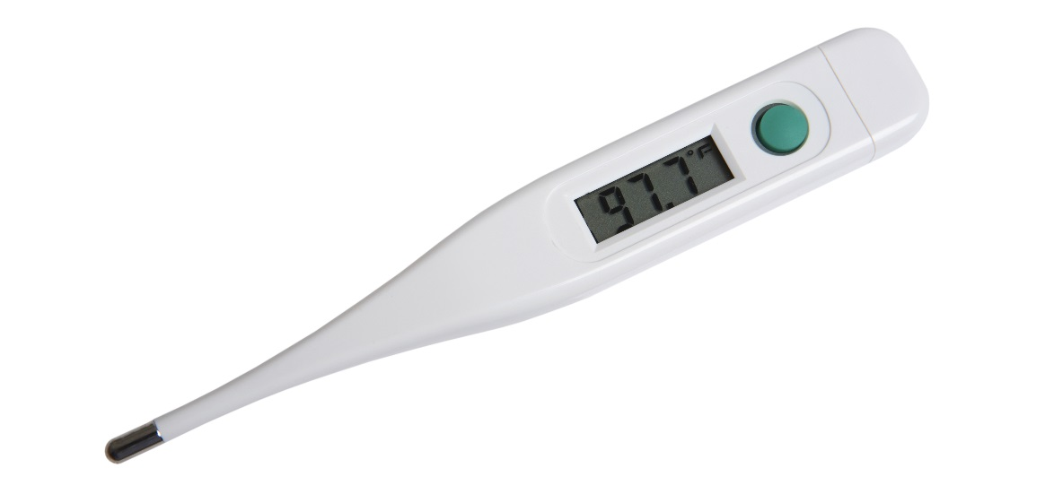
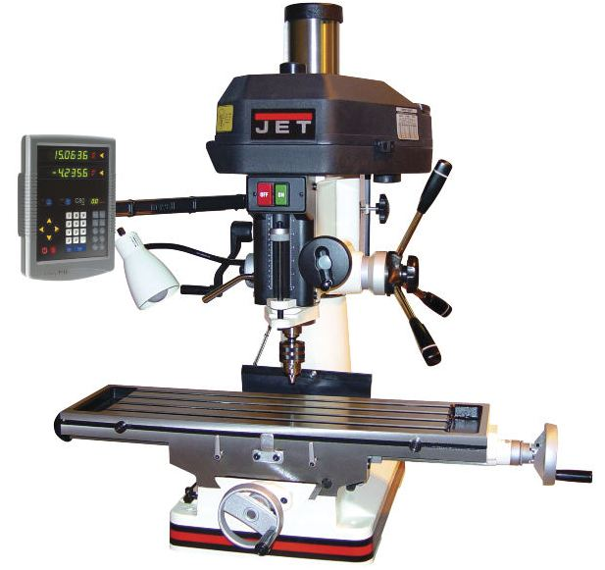
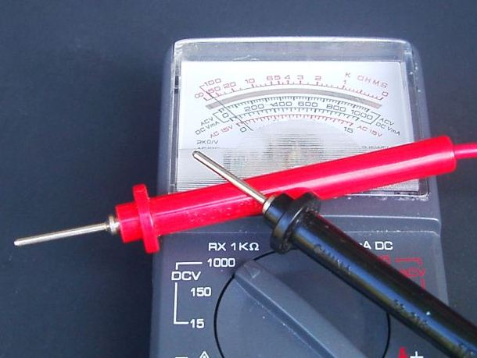
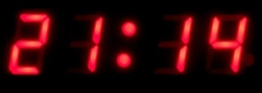
Analog systems represent information using a continuous range of values.
Digital systems represent data information using discrete (discontinuous) values.
Can be used to represent continuous systems/measurements such as numbers, letters or other individual symbols, sounds, and images.
Discrete
Discrete
Continuous
Continuous
Discrete
Continuous

Slide 4
Inputs and Outputs
An input “receives” information or senses a voltage in the external world.
An output “delivers” information or makes something happen in the external world.
Below is an example from an earlier class where we made an LED flash on and off.
Are we using digital pin 7 as an input or an output?
digital output
void setup() {
pinMode(7, OUTPUT);
}
void loop() {
digitalWrite(7, HIGH);
delay(1000);
digitalWrite(7, LOW);
delay(500);
}

Slide 5
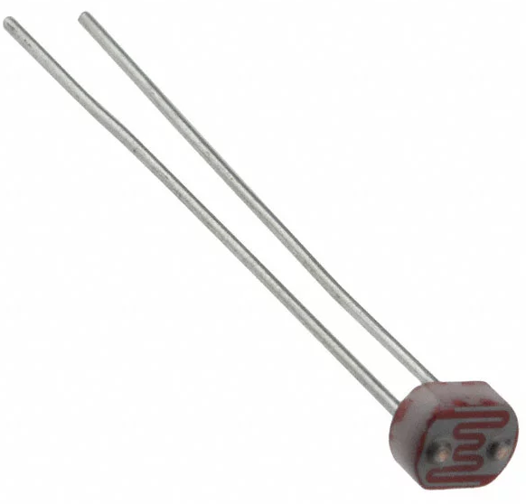
Receiving Input from an Arduino
digital input
analog input
int val;
val = digitalRead(5);
int val;
val = analogRead(5);
val is either 0 or 1
0 = voltage sensed at digital pin 5 is LOW (0V)
1 = voltage senses at digital pin 5 is HIGH (5V)
val is an integer between 0 and 1023
0 = voltage sensed at analog pin 5 is zero volts
1023 = voltage senses at analog pin 5 is five volts
Guess what val would be if the voltage sensed at analog pin 5 was 2.5V?
511
photoresistor
switches

Slide 6
Digital Inputs
The Arduino reference indicates that digitalRead() will return . . .
a value of HIGH if the voltage at the digital input pin is greater than 3 volts
a value of LOW if the voltage at the digital input pin is less than 2 volts.
5
4
3
2
1
0
high
digitalRead()returns HIGH or 1
voltage (V)
ambiguous
digitalRead()may return a value of HIGH or LOW
low
digitalRead()returns LOW or 0
0 1 2 3 4 5 6 7 8 9
time (milliseconds)
LOW or HIGH???

Slide 7
Analog Inputs
The analog input pins on your Arduino have 10-bit resolution and consequently measure in (2)¹⁰ or 1024 increments.
$${\left(2\right)}^{10}=1024$$
The analogRead() functions returns a value between 0 and 1023, where 0 is zero volts and 1023 is 5 volts.
$$voltage=\text{analogRead} value∙\frac{5 volts}{1023}$$
smallest increment of voltage that can be read = 0.00488 volts

Slide 8
Examples
point 1
point 2
point 3
5
4
3
2
1
0
digitalRead()returns HIGH or 1
voltage (V)
digitalRead()may return a value of HIGH or LOW
digitalRead()returns LOW or 0
0 1 2 3 4 5 6 7 8 9
time (milliseconds)
data point from plot above | digital pin is used to sample voltage | Analog Pin used to sample voltage
 | digitalRead() output | analogRead() output | voltage computed from analogRead()
1
0
217
1.06V
2
ambiguous
526
2.57V
3
1
964
4.71V

Slide 9
Voltage Divider Circuit
analogRead() function returns a value between 0 and 1023
Value can be converted to voltage with respect to ground
Example: For the given the circuit, the analogRead(4) value is 587. Find the voltage across the 10kΩ resistor.
5V
photoresistor
analog input 4
$$\frac{x volts}{analogRead}=\frac{5 volts }{1023}$$
10kΩ
ΔV_{10kΩ} = 2.87V$=\text{analogRead} value∙\frac{5 volts}{1023}=587∙\frac{5 volts}{1023}$

Slide 10
Class Problem 07c: Voltage Divider Circuit
For the given the circuit, the analogRead(4) value is 324. Find:
The current that passes through the photoresistor
The voltage drop across the photoresistor
Solution:
5V
photoresistor
$${ΔV}_{10kΩ}=324∙\frac{5 volts}{1023}=1.58V$$
a.
analog input 4
$$I=I_{{10}_{kΩ}}=I_{photo}=\frac{1.58V}{10000Ω}=0.158mA$$
10kΩ
b.
$${ΔV}_{photo}=5V−{ΔV}_{10kΩ}=5V−1.58V=3.42V$$

