Slide 1
Class Problem 4a
If a 12V power supply is connected to terminals A and B,
how much current is passing through the 120Ω resistor.
What is the voltage at node C?
How much current is flowing through the 220Ω resistor?
A
120Ω
C
1KΩ
220Ω
B

Slide 2
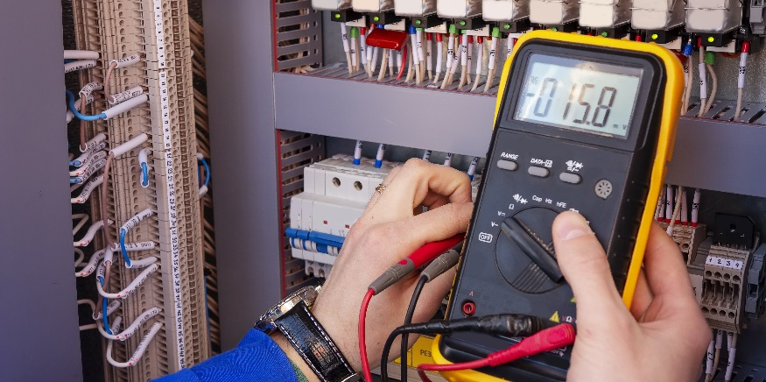
Getting Started with the Arduino

Slide 3
Getting Started with Arduino
Identify key components of an Arduino circuit board.
Connect an Arduino circuit board to a PC.
Identify components / features of the Arduino IDE.
Identify the basic structure of code used to program an Arduino.
Open and run a sketch (program) on the Arduino (using it to blink an LED).

Slide 4
What is an Arduino?
Arduinos contain microcontrollers that are programmed to read inputs and perform various tasks.
What is a microcontroller?
A microcontroller is a small computer.
Microcontrollers contain processor cores with memory and are able to be programed for input/output.
Microcontrollers are used in automatically controlled products and devices, such as automobile engine control systems, implantable medical devices, remote controls, office machines, appliances, power tools, toys and other embedded systems.
M. Nelson, 2019 (edited. Source: Wikipedia)

Slide 5
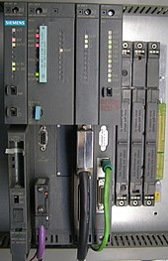
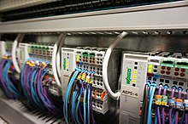
Programmable Logic Controllers (PLCs)
A programmable logic controller (PLC) or programmable controller is an industrial digital computer which has been ruggedized and adapted for the control of manufacturing processes, such as assembly lines, or robotic devices, or any activity that requires high reliability control and ease of programming and process.
PLC Basics (5:59): https://www.youtube.com/watch?v=PbAGl_mv5XI
M. Nelson, 2019 (edited. Source: Wikipedia)

Slide 6
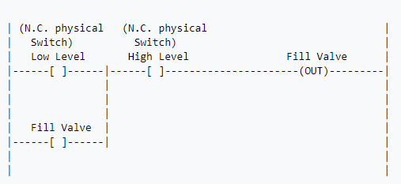
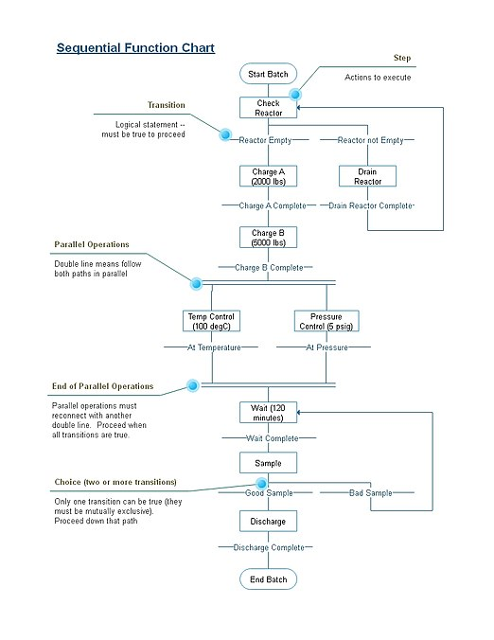
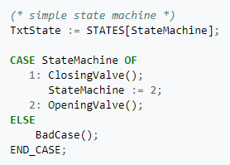
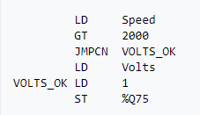
PLC Programming Languages/ Tools
Ladder Logic / Diagrams
Sequential Function Chart
Function Block Diagram
Structured Text /
Other Programming Language
Instruction List
M. Nelson, 2019 (edited. Source: Wikipedia)

Slide 7
Arduino
14 Digital Input/Output Pins
USB Cable Plug
Integrated Circuit
“Brains” of the Arduino
External Power Supply Jack
Power Pins
6 Analog Input Pins

Slide 8
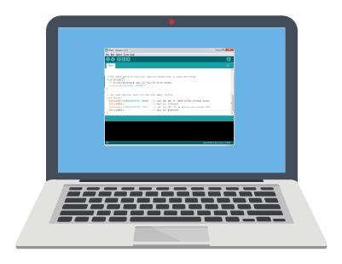
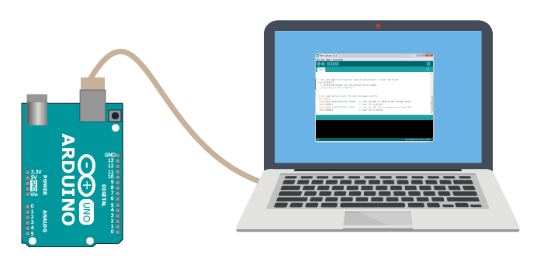
If the Arduino is a computer, why do I need my computer to work with it?
Sketch that makes an LED on the Arduino board blink
You use your computer to write a program, called a sketch.
You upload the sketch to the Arduino.
The sketch is processed (or run) on your Arduino, not your computer.
Send to Arduino
LED Blinks!

Slide 9
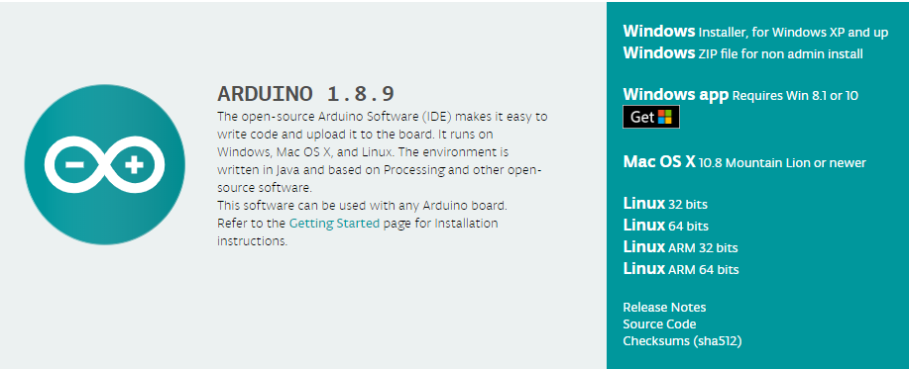
Install the Arduino IDE (Integrated Development Environment)
Navigate to Arduino.cc.
Click the software tab and choose downloads.
Choose the download type that is right for you.
Option 1: Web Editor – everything is written through a browser online and saved to the cloud.
Option 2: Program Download – Download the software onto your computer. Choose location for saved files. Be sure to choose appropriate version for your operating system.
Option 3: Windows App – Download the app version built specifically for machines running Win 8.1 or higher.
Option 2 was used for the sketches and Arduino IDE screenshots shown throughout this curriculum.

Slide 10
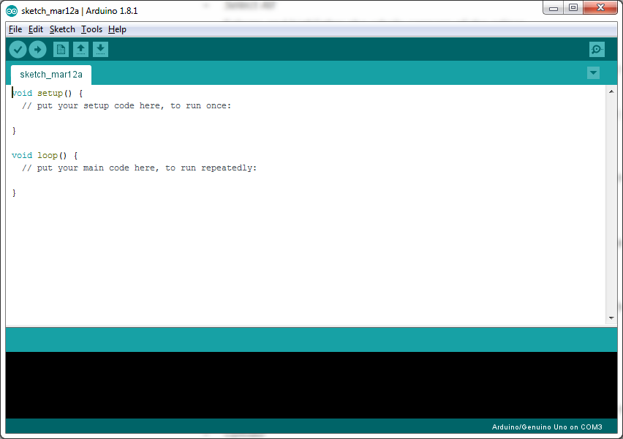
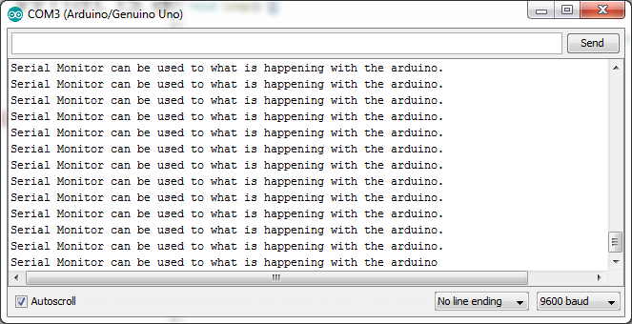
Arduino IDE (Integrated Development Environment)
Contains the components to help you successfully write a sketch.
New Sketch
Open
Upload
Save
Serial Monitor
Menus
Tab Control
Verify
Toolbar
Text Editor
(where you write the sketches)
Serial Monitor (prints out information from the Arduino)
Message Area (alerts you of any issues)

Slide 11
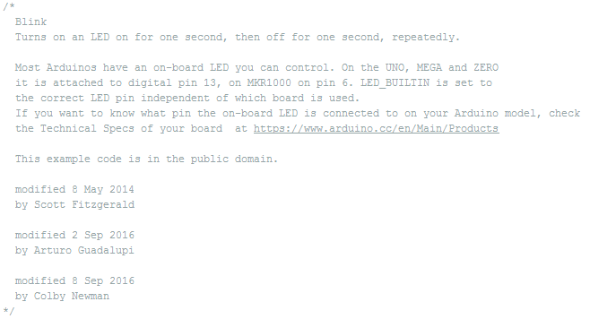
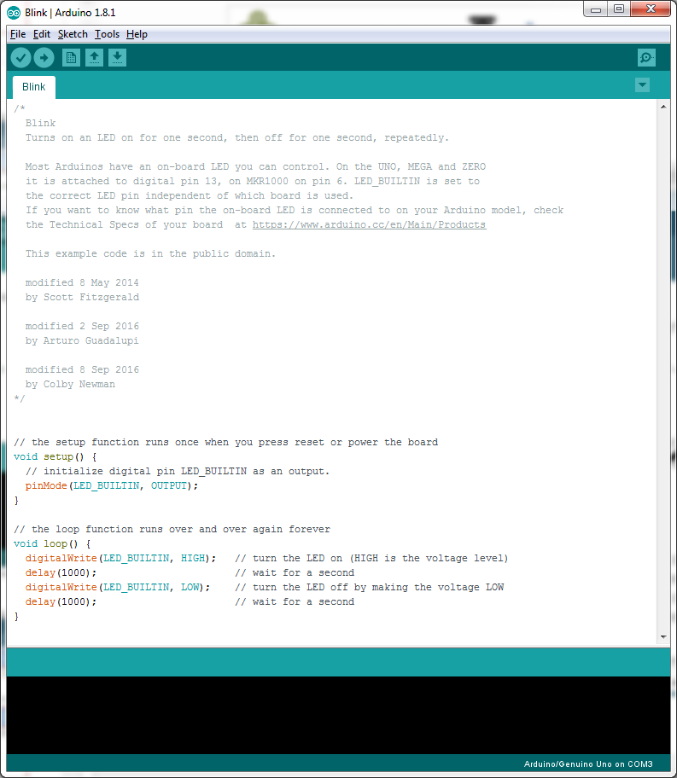
How is the code structured?
Open the example sketch: Blink (File → Examples → Basics → Blink)
Header Section – contains information/comments on preceding sketch. It can sometimes contain code.

Slide 12
How is the code structured?
Open the example sketch: Blink (File → Examples → Basics → Blink)
Setup Function – executed only once at the start. Initialize variables, pin modes, and start using libraries in this section.

Slide 13
How is the code structured?
Open the example sketch: Blink (File → Examples → Basics → Blink)
Loop Function – Repeated indefinitely. This section contains code that tells the Arduino what to do.

Slide 14
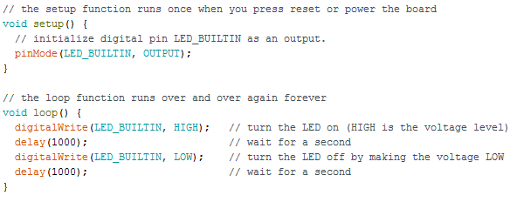
How does the code work?
Gray lines starting with // are comments and are not components of the sketch that are processed by the Arduino.
Why do you think comments can be helpful when writing a sketch?

Slide 15
How does the code work?
Assign the digital pin named “LED_BUILTIN” to be of the mode OUTPUT.
LED_BULITIN is another name for pin 13. You could replace LED_BUILTIN with 13 and the sketch will work the same. Try it out!
The tells the Arduino that somewhere in the sketch you will program it to send 5V out of pin 13 (aka LED_BUILTIN).
The pinMode is always written in the setup function.

Slide 16
How does the code work?
Writes the digital pin named “LED_BUILTIN” to be HIGH which is 5V.

Slide 17
How does the code work?
Holds the state of the Arduino for a delay of 1000 milliseconds.

Slide 18
How does the code work?
Writes the digital pin named “LED_BUILTIN” to be LOW which is 0V.

Slide 19
How does the code work?
Why does the LED blink continuously and not just ON once and OFF once like is written in the sketch?
1000 ms
1000 ms
Note:
HIGH = 5V LOW = 0V (Always)
5V
voltage (V)
0V
Because the void loop() function is executed indefinitely.
time (ms)

Slide 20
Play around with the sketch.
Change the time to 1.5 seconds on and 1 second off.
Blink out SOS in Morse code (dot-dot-dot-dash-dash-dash-dot-dot-dot)
three short pulses (0.25 seconds each) followed by
three long pulses (0.75 second each) followed by
three short pulses (0.25 seconds each) followed by
a brief pause (1 second)
repeat using an infinite loop

Slide 21
Programming Tips
Arduino is case sensitive.
Look for color changes, if the color should change and it is still black text, you probably have an upper or lower case wrong.
Don’t stress about the syntax () ; , .
You can pull up old code or example codes to help you place them.
Put comments after each line to help you or anyone that looks at your code know what the lines are supposed to do.
Comments start with two forward slashes (e.g.; //).
Remember the setup function runs once.
Remember the loop function runs indefinitely.
You MUST have both the setup function and the loop function in your sketch in order for it to work even if you do not have any code written in one of them.
Delays are written in units of milliseconds.

Slide 22
Quick Troubleshooting Tips
If you get an error when uploading, check
To make sure board is lighting up (green on LED).
Switch cables/board to determine issue.
For the correct Board: “Arduino/Genuino Uno.”
That the port is checked.
Check sketch for proper syntax in sketch.
For more troubleshooting tips, refer to the “Why Won’t My Arduino Work” presentation.

Slide 23
Open the example sketch: Blink (File → Examples → Basics → Blink)

Slide 24
Getting Started Summary
Arduino microcontrollers are digital computers that can be programmed to read digital and analog inputs and control digital outputs.
A programmable logic controller (PLC) is an industrial digital computer which has been ruggedized and adapted for the control of manufacturing processes
The Arduino IDE (Integrated Development Environment) is used to write and download programs (called sketches) for the Arduino microcontroller.
Sketches contain 3 major sections: The Header, Setup Function and Loop Function.
continued

Slide 25
Getting Started Summary
The Header Section contains information/comments on the sketch.
The Setup Function is executed only once and is used to initialize variables, pin modes, and start using libraries.
The Loop Function is repeated indefinitely. This section contains code that tells the Arduino what to do.
pinMode: Sets a digital pin as an input or an output
digitalWrite: Sets a digital pin “high” or “low”
delay: pauses the program for a specified number of milliseconds

