Slide 1
Class Problem 3a-1
Given V = IR and P = IV. Find an expression for P, in terms of I and R.
$$P=IV→ P=I\left(IR\right)→P=I^{2}R$$

Slide 2
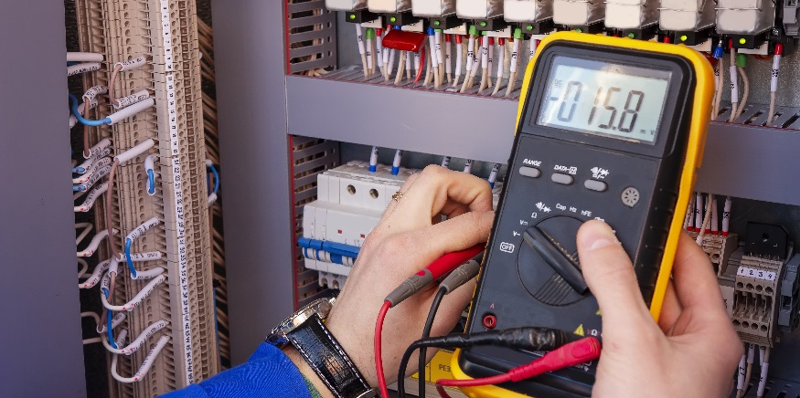
Power

Slide 3
Power
Define power in terms of voltage and current.
Solve problems using the power equation and Ohm’s Law.
https://www.khanacademy.org/science/ap-physics-1/ap-circuits-topic/introduction-to-dc-circuits-ap/v/electric-power

Slide 4
Power is work performed per unit time
Unit of work (energy) is a Joule (J)
Is there a relationship with units that will give us power?
Component | Unit
V | Volts | $$V=\frac{J}{C}$$
I | Amperes | $$A=\frac{C}{s}$$
R | Ohms | Ω
$$Power=\frac{Work}{Time}=\frac{J}{s}=Watt (W)$$
$$P=\frac{C}{s}∙\frac{J}{C}=\frac{J}{s}=W$$
$$P=I∙V$$

Slide 5
Class Problem
3a-2: A toaster consumes 150 Watts of electricity. How much voltage was applied if the current is 5A?

Slide 6
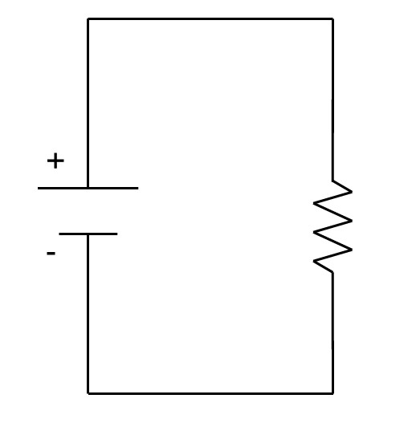
Class Problems: If a D-Cell battery (1.5V) supplies 2W of power to a small bulb, find
3a-3: The current through the bulb
3a-4: The resistance of the bulb
I=?
1.5V
R=?

Slide 7
Class Problems: If a D-Cell battery (1.5V) supplies 2W of power to a small bulb, find
3a-3: The current through the bulb
3a-4: The resistance of the bulb
Solutions
$$P=I∙V ⇒I=\frac{P}{V}=\frac{2W}{1.5V}=1.333A$$
I=?
1.5V
R=?
$$V=I∙R ⇒R=\frac{V}{I}=\frac{1.5V}{1.333A}=1.125Ω$$

Slide 8
Alternate forms of the power equation
$$V=I∙R$$
Can you write the power equation to have R instead of V?
Substitute Ohm’s Law in for $V$ in the Power equation.
$$P=I∙V$$
$$V=I∙R$$
$$P=I∙V=I^{2}R$$
Likewise, we can eliminate $I$ from the power equation.
$$V=I∙R ⇒I=\frac{V}{R}$$
$$P=I∙V=\frac{V^{2}}{R}$$
$$P=I∙V=\frac{V^{2}}{R}=I^{2}∙R$$

Slide 9
Equation Summary
Component | Symbol | Unit
Voltage | V | Volts | $$V=\frac{J}{C}$$
Current | I | Amperes | $$A=\frac{C}{s}$$
Resistance | R | Ohms | Ω
Power | P | Watts | $$W=\frac{J}{s}$$
$$V=I∙R$$
Ohm’s Law
Power
Tip: If you know any two of V, I, R, or P, then you can find the other two.
$$P=I∙V=\frac{V^{2}}{R}=I^{2}∙R$$

Slide 10
Class Problems: Solving Circuits
3a-7. Find V and R given that I = 3A and P = 18W.
3a-6. Find I and P
1.5V
R=470Ω
V
R

Slide 11
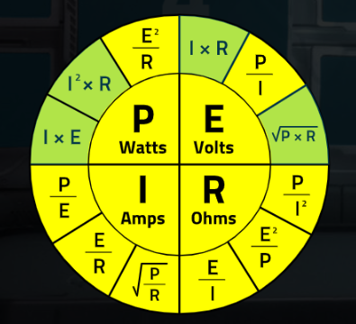
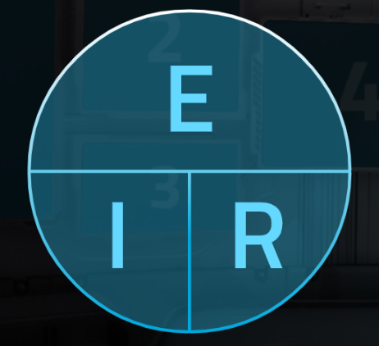
Solving for Voltage (E), Current(I), Resistance & Power
$$E=IR$$
$$P=IE$$

Slide 12
Power Summary
Power is defined as work per unit time (Joules/second = Watts)
Power in a circuit element (e.g. a load) = Current x Voltage” P = IV
If you know any two of V, I, R, or P, you can find the other two using P = IV and V = IR.

