Slide 1
Class Problem 2c - 1
A 24 volt power supply is connected to the terminals shown. How much current will flow through the circuit?
120Ω
220Ω
1KΩ
Note: Total resistance (R) is the sum of the individual resistors (in series).

Slide 2
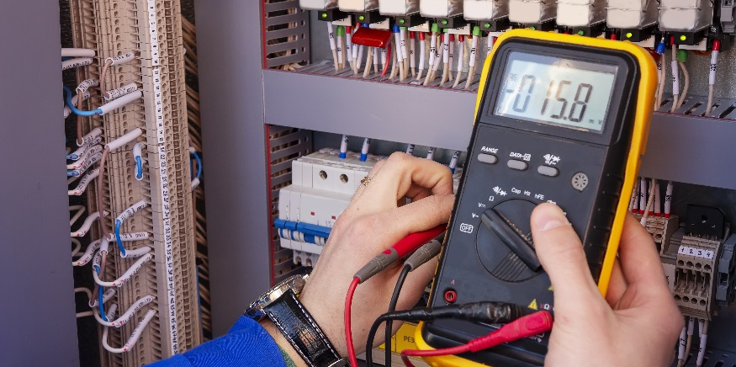
Building Circuits

Slide 3
Building Circuits
Determine the value of a resistor from its color code
Measure resistance with a multimeter
Wire a Light Emitting Diode (LED) and resistor circuit on a breadboard.
Test an LED and resistor circuit using different resistor values and source voltages.

Slide 4
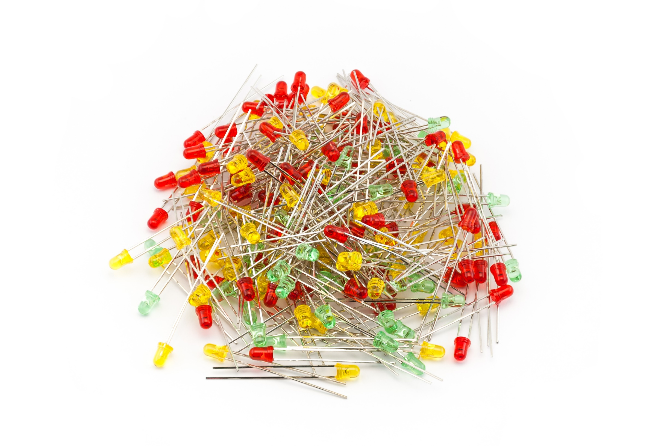
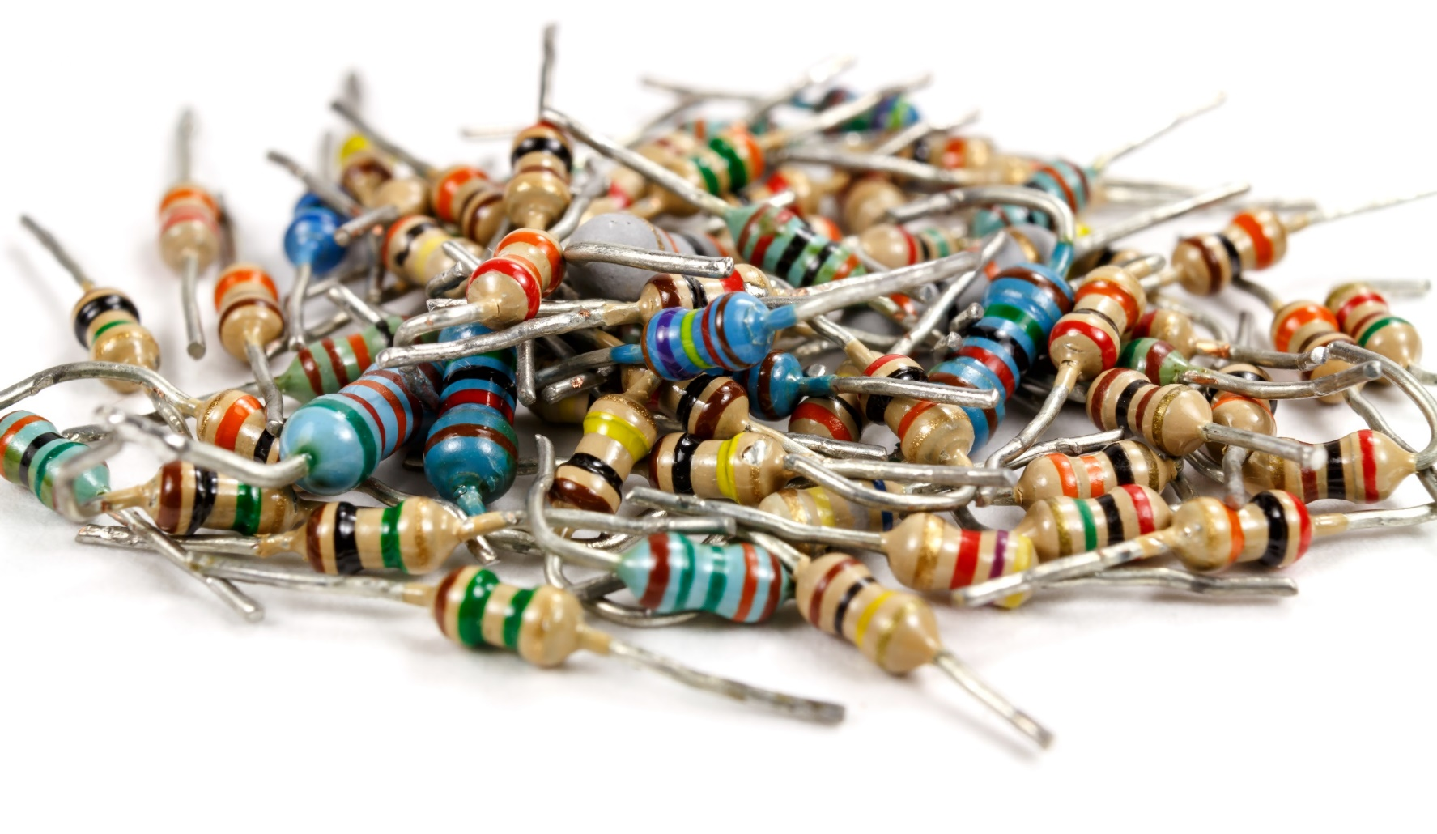
We will use Resistors and LEDs to Build Circuits!

Slide 5
Using the Color Code to Determine Resistance
color | digit
black | 0
brown | 1
red | 2
orange | 3
yellow | 4
green | 5
blue | 6
violet | 7
gray | 8
white | 9
B B R O Y G B V G W
first
digit
gold = ±5%
silver = ±20%
tolerance
second digit
number
of zeros
What is the value of the resistor above?
Yellow = 4
Violet = 7
Brown = Add 1 Zero to value
Resistor = 470Ω

Slide 6
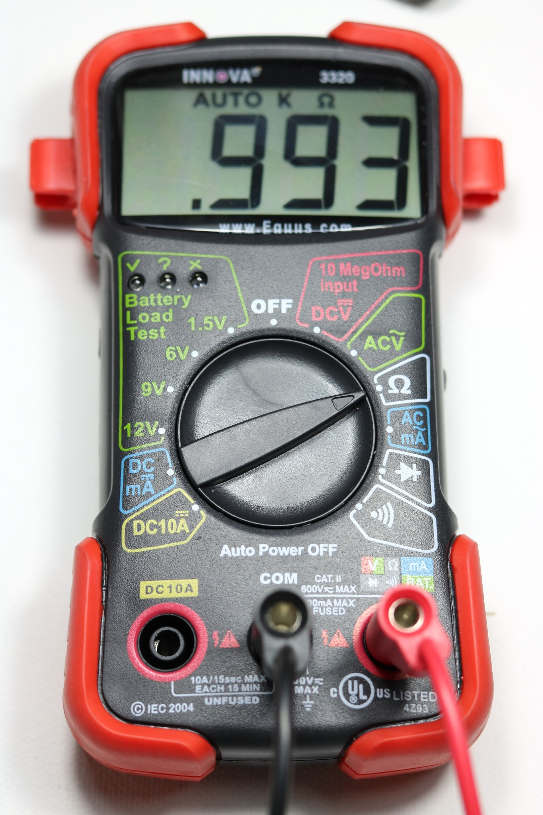
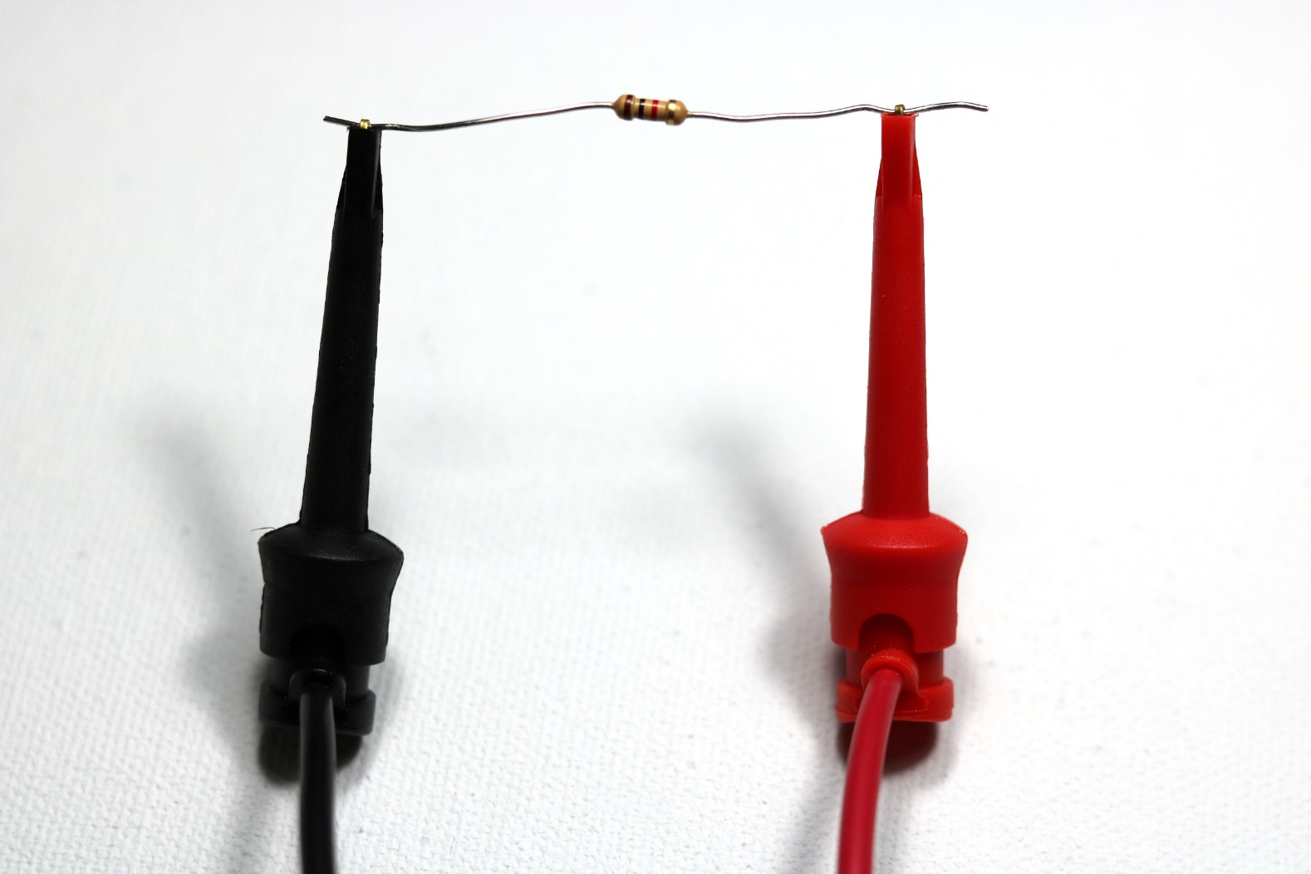
Measuring Resistance with Multimeter
Find a 1,000Ω resistor in your kit.
Measure its actual resistance.
Pick a random resistor out of your kit. Use the color code to predict the resistance value, then measure it using the multimeter.
color | digit
black | 0
brown | 1
red | 2
orange | 3
yellow | 4
green | 5
blue | 6
violet | 7
gray | 8
white | 9

Slide 7
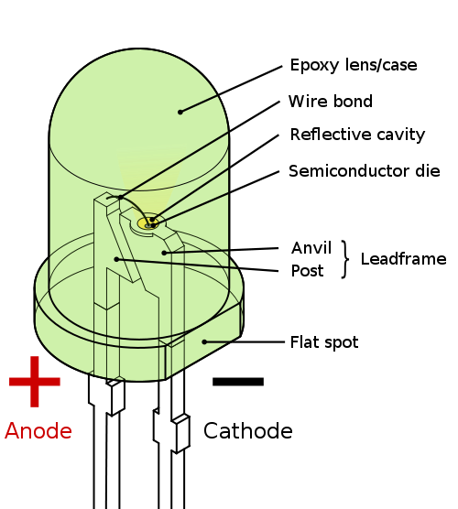
LEDs = Light Emitting Diode
Find your red, yellow and green LEDs.
Electricity can flow one way through an LED (or any diode).
Connecting LEDs:
Flat edge (or short leg) of the LED lens must be connected to ground.
+ -
electronic symbol

Slide 8
Experimenting with Breadboards
Get these items out of your kit:
6 – LEDs (same color)
2 – 220Ω resistor
2 – 1,000Ω resistor
2 – 10,000Ω resistor
Arduino Activity Board
Power supply

Slide 9
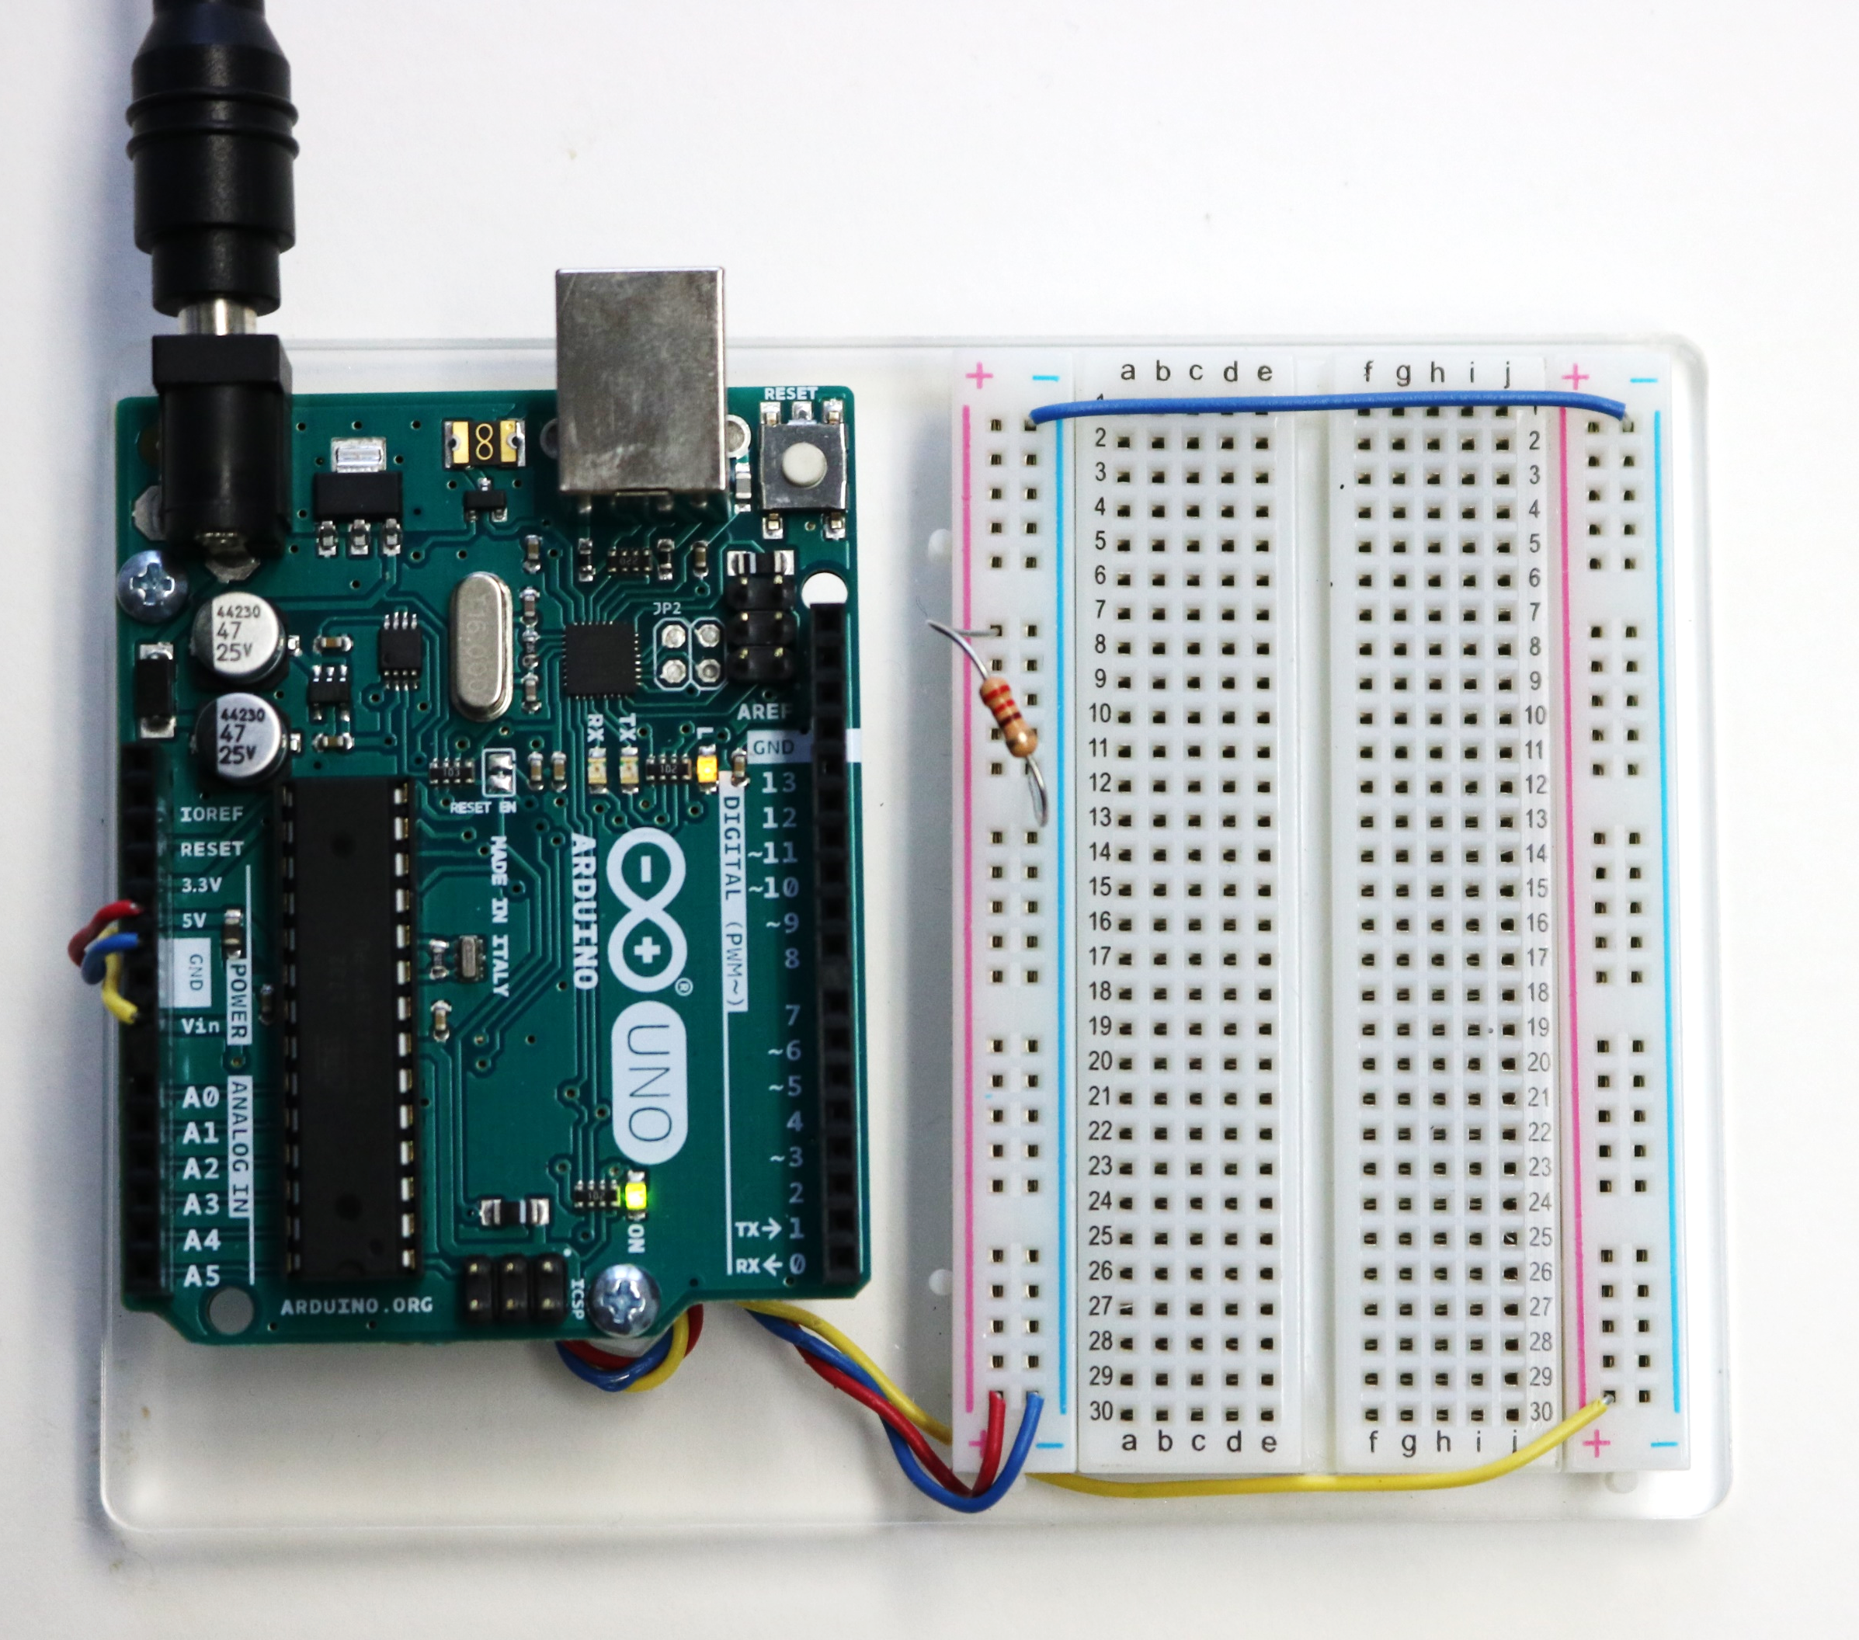
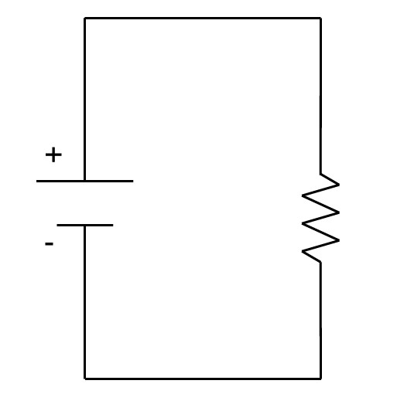
Connect 220-ohm Resistor to 5V & Ground
(connect to 9V side if needed, but be careful)
Class Problem 2c - 2: Determine the current passing through the circuit?
What do you feel?
Where is the heat coming from?
You are feeling the movement of electricity.
Heat
$$V=I∙R$$
Friction as electrons pass through the resistor
I
V
R
$$I=\frac{V}{R}=\frac{5V}{220Ω}=0.0227A$$
or
Safety:
$$I=\frac{V}{R}=\frac{9V}{220Ω}=0.0409A$$
Don’t leave it plugged in long! It gets hot!

Slide 10
Build Resistor and LED Circuit
Use a 220 Ω Resistor

Slide 11
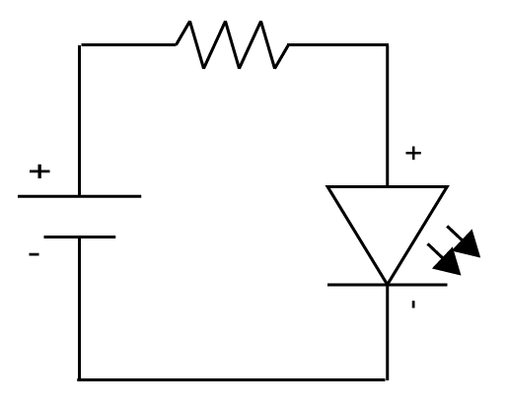
Build Resistor and LED Circuit
NOTE: LEDs must have a resistor before or after them in a circuit. The current is too strong, and the LED will burn out without a resistor.
Experiment: Record any observations:
Change the direction of LED.
Swap the order of the resistor and LED
Try the 1,000-ohm resistor instead of the 220-ohm.
Move the circuit to the 9V side of the breadboard.
Try building multiple resistor and LED circuits on the breadboard. Use different resistors.
220Ω
Compare the actual circuit and the circuit diagram.
5V

Slide 12
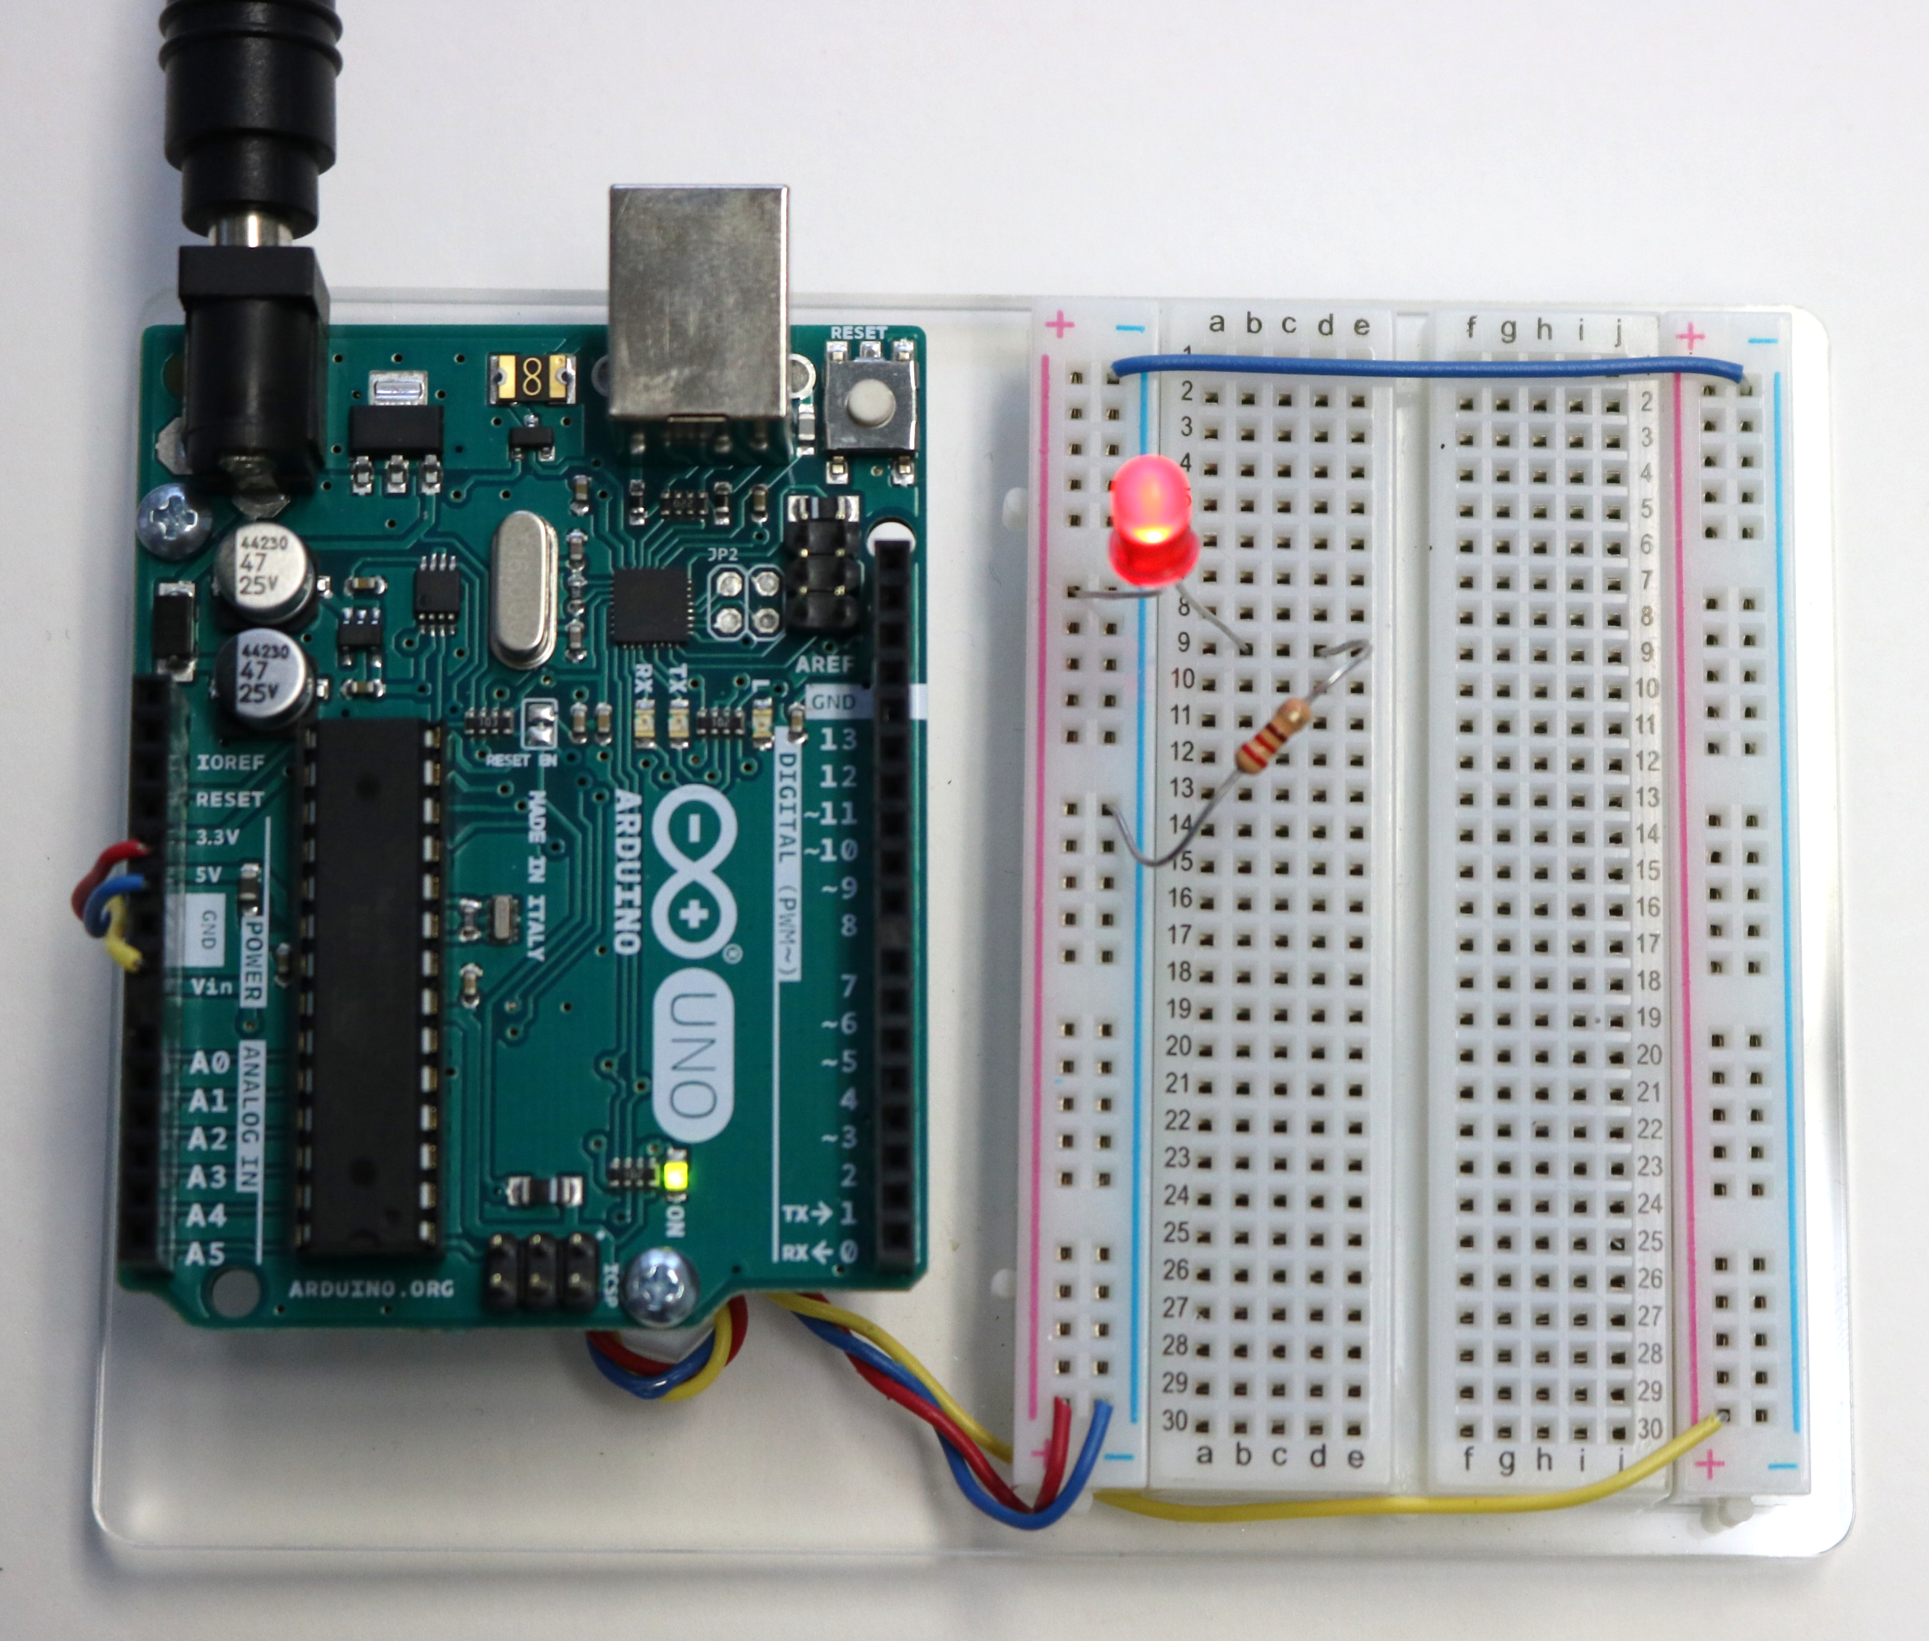
Experimenting with Resistor and LED Circuits
Multiple resistor and LED circuits on the same breadboard with random resistors
Reversing the order of the LED and resistor
220 , 1K, 10K

Slide 13
Understanding LED Brightness
LED brightness can change as a function of resistance.
Make your prediction:
An LED will be brighter as the resistance value of the resistor
Build the following three resistor and red LED circuits on the 5V side of the breadboard.
Build them on the breadboard in ascending order of resistance.
(increases or decreases)
1st Circuit: 220Ω Resistor
2nd Circuit: 1000Ω Resistor
3rd Circuit: 10000Ω Resistor
color | digit
black | 0
brown | 1
red | 2
orange | 3
yellow | 4
green | 5
blue | 6
violet | 7
gray | 8
white | 9
220Ω
1000Ω
10000Ω
5V
5V
5V
Brown Black Red
What color stripes does the 1000Ω resistor have?
What color stripes does the 10000Ω resistor have?
Brown Black Orange
What can you conclude about LED brightness as a function of resistance?
Brightness as Resistance

Slide 14
Understanding LED Brightness
LED brightness can also change as a function of voltage.
Make your prediction: An LED will be brighter as the voltage value
Leave the three 5V resistor and LED circuits on your breadboard.
Build three more of the same circuits except connect them to the 9V power source.
Build the new circuits across from their counter part (i.e.; build the 220Ω resistor circuits across from each other).
Compare the LED brightness for each set of circuits that have the same resistance but different voltage values.
(increases or decreases)
What can you conclude about LED brightness as a function of voltage?
220Ω/1000Ω/10000Ω
10000Ω
1000Ω
5V
Brightness as Voltage
220Ω

Slide 15
Building Circuits Summary
A color code is (often) used to determine the resistance value of discrete resistors.
We can use a DMM to measure the actual value of a resistor.
LEDs are polarized; they allow current to flow in only one direction.
LED brightness increases with current (I), and therefore decreases with additional resistance in a series circuit.

