Slide 1
Class Problem 2a-1
Solve $V=IR$, for $I$, if $V=10$ and $R=270$.
$$V=IR$$
$$I=\frac{V}{R}$$
$$I=\frac{10}{270}=\frac{1}{27}≈.037$$

Slide 2
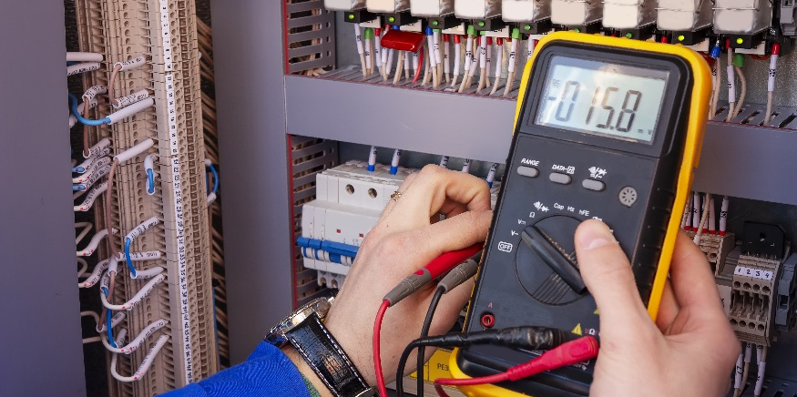
Ohm’s Law

Slide 3
Ohm’s Law
Derive units for voltage and current
Define resistance
Define circuit
Recognize schematic diagrams of voltage sources and resistors
Define Ohm’s Law and use it to find the current passing through a resistor.
https://www.khanacademy.org/science/ap-physics-1/ap-circuits-topic/current-ap/v/circuits-part-1

Slide 4
Electricity Review
What are the three components of electricity?
Voltage (V) – potential difference between the strength of the electron supply and the electron shortage
Current (I) – net flow of electrons through a material
Resistance (R) – a measure of a material’s opposition to the passage of electric current
electron shortage
electron supply
-
+

Slide 5
Units for electric current: Amperes (Amps), A
The electric current, I, is the amount of charge passing a point per unit time.
$$1 Amp=\frac{6.24×{10}^{18}electrons passing a point}{second}=\frac{1 Coulomb}{second}=\frac{C}{s}$$
Therefore,
$$1 A=\frac{C}{s}$$
$$where 1C=6.24×{10}^{18}electrons$$

Slide 6
Units for voltage: Volts, V
Voltage is the measure of the amount of potential energy per electric charge or Coulomb.
$$1 Volt=\frac{Energy}{Electric Charge}=\frac{Joule}{Coulomb}=\frac{J}{C}$$
Therefore,
$$1 V=\frac{J}{C}$$

Slide 7
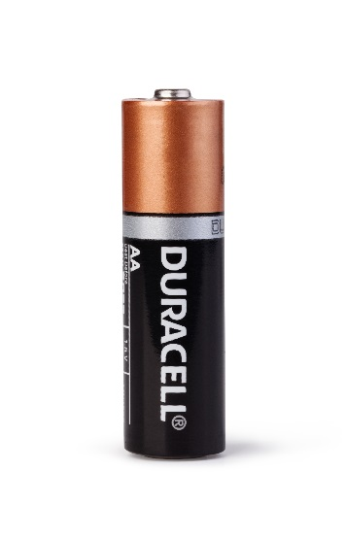
Energy is a measure of work (Units = Joules)
Recall: $1V=\frac{1J}{C}$
One coulomb flows through each bulb
Voltage is doubled when two batteries are used.
$1.5$V
Doubling the voltage doubles the work and gives off much more light.
3V
$1.5$V
$1.5$V
$$Work=1.5\frac{J}{C}∙1C=1.5J$$
$$Work=\left(1.5\frac{J}{C}+1.5\frac{J}{C}\right)∙1C=3J$$
The work done when two batteries are used is twice as much as the work done when one battery is used, even though the same number of electrons flow through each bulb.

Slide 8
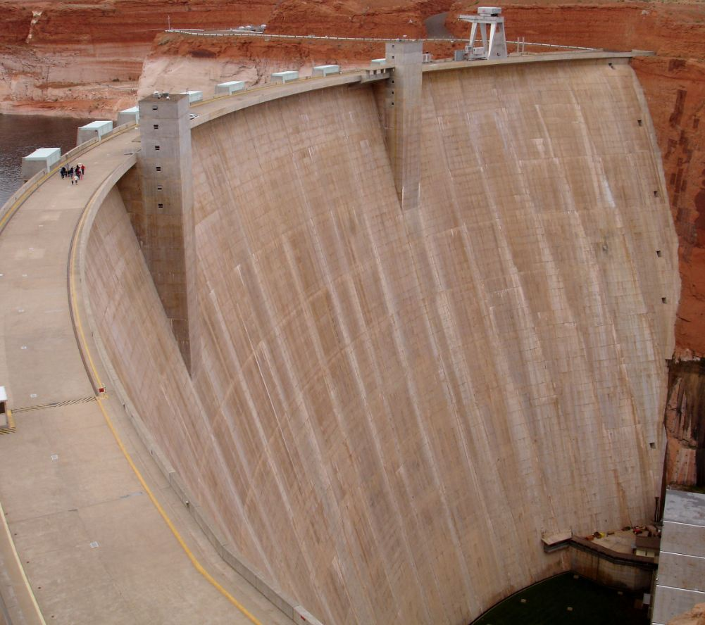
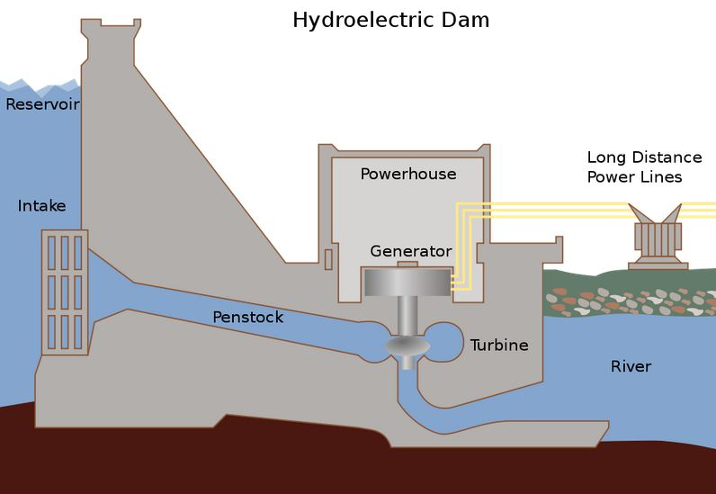
Voltage / Water Pressure Analogy
voltage & pressure are both measures of a potential difference
depth of water between surface
of lake and surface of river
Glen Canyon Dam in Arizona, USA
Wikipedia
The work done per gallon of water passing through a turbine will double (theoretically) when the water depth (pressure) is doubled.
Likewise, the work done per Coulomb of charge passing through a resistor will double (theoretically) when the voltage is doubled.

Slide 9
Current, Voltage and Resistance
Current (i): the quantity of electrons passing a given point in a given time. Coulombs/second = Amperes (A)
Voltage (v): electromotive force (emf) /pressure that drives the flow of charge. Arises from having a supply of electrons at a different energy state that that of the electron’s destination. Joules/Coulomb = Volts (V)
Resistance (r): the property of a material that describes how easily charge may pass through it. Volts / Ampere = Ohms (Ω)
Rate of Flow
(like current)
Valve Partially Open
(like resistance)
Height (creating pressure)
(like voltage)

Slide 10
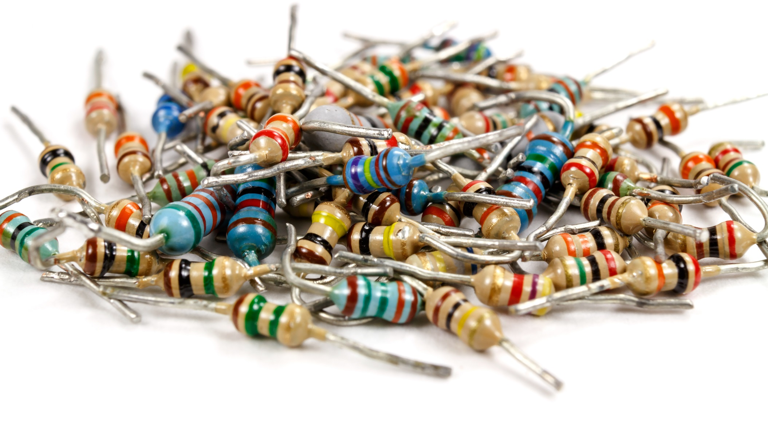
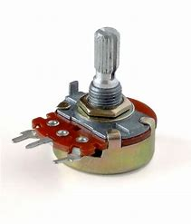
Units for resistance: Ohms, Ω
Resistance is a measure of the frictional resistance encountered by electrons as they attempt to pass through a material.

Slide 11
Units: Voltage, Current, Resistance
Component | Symbolic Representation | Unit
Voltage | V | Volts | $$V=\frac{J}{C}$$
Current | I | Amperes | $$A=\frac{C}{s}$$
Resistance | R | Ohms | Ω

Slide 12
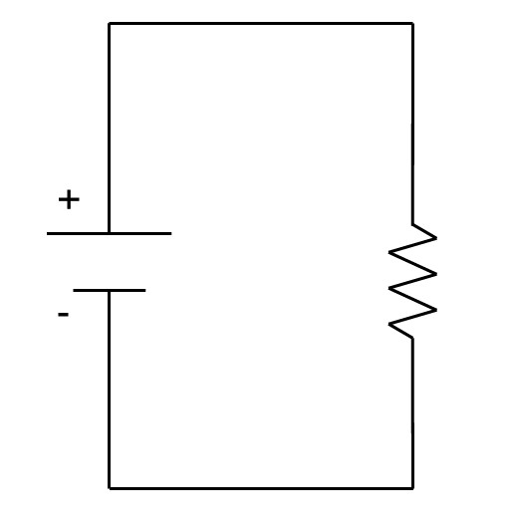
Circuits
To induce current flow you must give it a path or closed circuit.
Creating a closed circuit:
Causes the voltage to push the electrons to move.
Tells electrons where to go (electron supply to electron shortage).
Components like resistors are included along the path.
Incandescent bulbs act as resistors.
Circuit Diagrams
We can draw diagrams to represent circuit components.
Simple circuit: power source, resistive element, and conductive material.

Slide 13
Circuit Diagrams
Power Source
Resistor
Conductor
Orientation does not matter. Can be in either direction
Assumed resistance is zero
DC power source
Schematic Diagrams & Symbols, Electrical Circuits (17:58): https://www.youtube.com/watch?v=Dl1gFBNa0Ik

Slide 14
Ohm’s Law
Ohm’s Law relates voltage, current, & resistance to each other.
Consider a circuit that has the following values:
Voltage = 5V
Resistance = 100Ω
Current = 0.05A
Do you see a relation among the values? (looking just at the numbers)
I = 0.05A
V = 5V
R = 100Ω
$$Voltage=Current∙Resistance$$
$$Volts=Amps∙Ohms$$
$$V=I∙R$$
Intro to Ohms Law (5:25): https://www.youtube.com/watch?v=_-jX3dezzMg

Slide 15
Class Problem 2a-2: For the given circuit,
Draw the circuit shown symbolically.
Label voltage, current and resistance. The incandescent bulb can be treated as a resistor.
The batteries are AA, and the bulb provides a 12Ω resistance.
Determine the current delivered to the resistor.

Slide 16
Solution
b.
$$V=I∙R ⇒ I=\frac{V}{R}=\frac{6V}{12Ω}=0.5A$$
a.
So this circuit would have one-half an amp of current flowing through it.
I=?
6V
(4 x 1.5V)
12Ω

Slide 17
Ohm’s Law Summary
A Volt (a.k.a. Potential Difference) is a Joule of energy per Coulomb of charge.
An Ampere is a Coulomb per second.
Resistance is a measure of a material’s opposition to the passage of electric current. (measured in Ohms)
A circuit is a closed path that will allow current to flow.
Schematic diagrams are used to illustrate circuits.
Ohm’s Law states that voltage is equal to current (I) x resistance (R): V = IR

