Slide 1
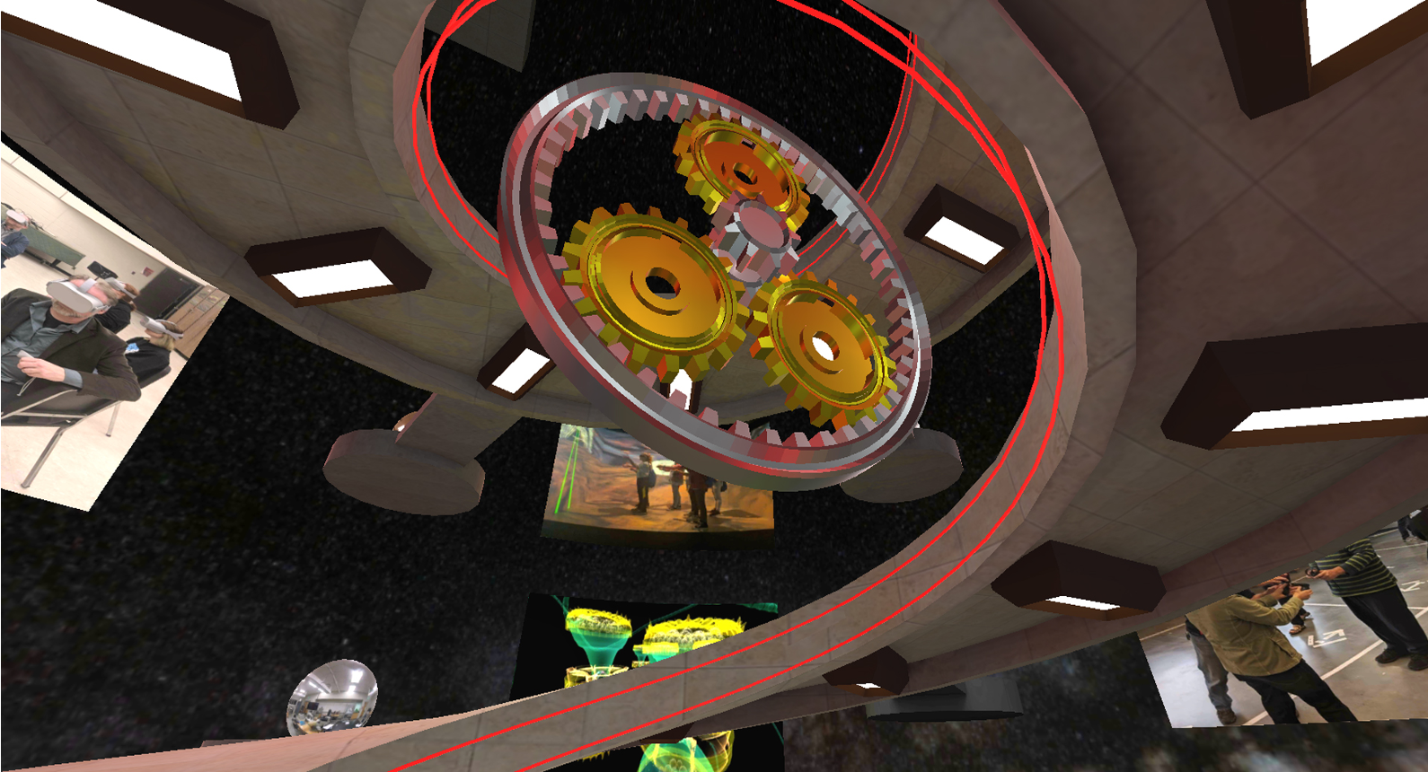
Teaching Using Social VR
Mark Gill, SCSU VIZLAB
Alan Srock, SCSU AHS
Technical Issues? Contact Zach Bladow
zach.bladow@northlandcollege.edu

Slide 2
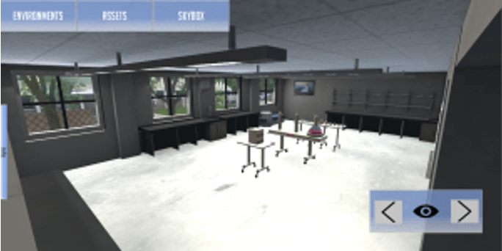
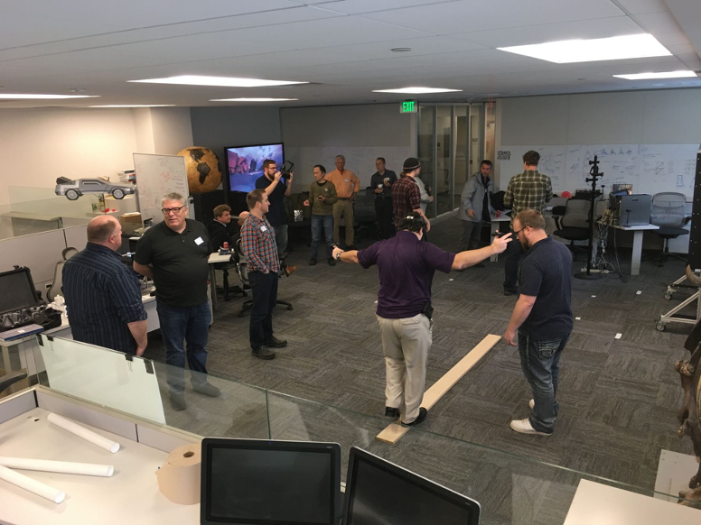
MN-Nice (May it rest in peace)
Networked Immersive Collaborative Environment
Multiple VR Users in a shared physical space
Classroom Scale
Shared Equipment
Physics interactions and collaborative activities
Games, Educational Material, Music Performances
May not have survived COVID-19 but set the stage for what came next.

Slide 3
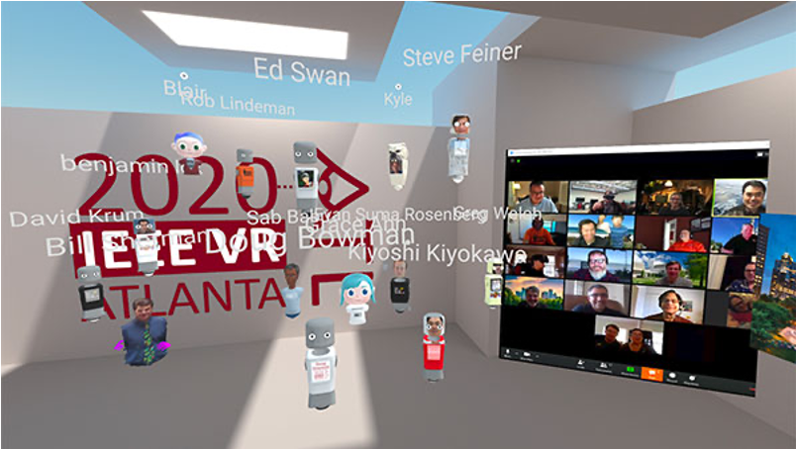
Educators in VR / IEEEVR 2020
Educators in VR:
6 Days
150 Speakers
6,000 Attendees
IEEVR
Cancelled by COVID
Transitioned all proceedings to Mozilla Hubs

Slide 4
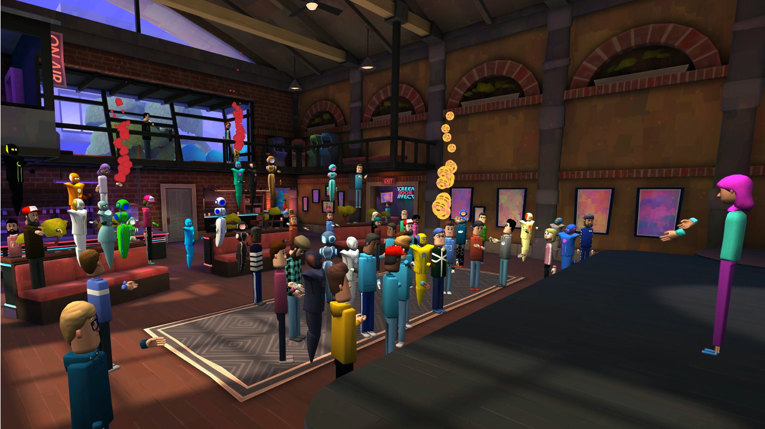
What is Social VR

Slide 5
A New Demand
Innovations and Alternatives in Online Education
Online replacement of cancelled Face-to-Face Functions
Social Engagement
Zoom Fatigue
https://singularityhub.com/2020/04/19/what-makes-virtual-worlds-unique-in-the-era-of-zoom-meetings/

Slide 6
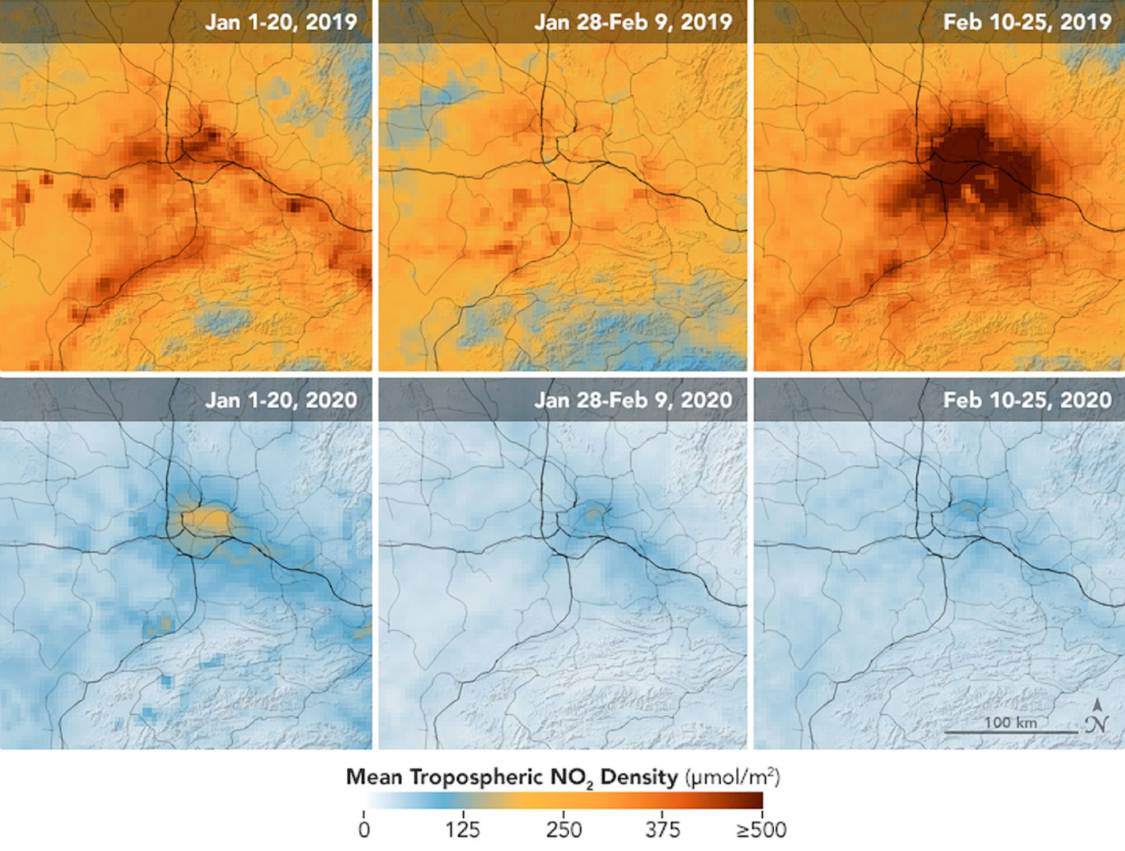
Secondary Benefits
Saves expenses and time
Reduced carbon emissions
Support and connection

Slide 7
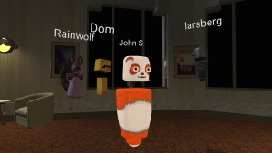
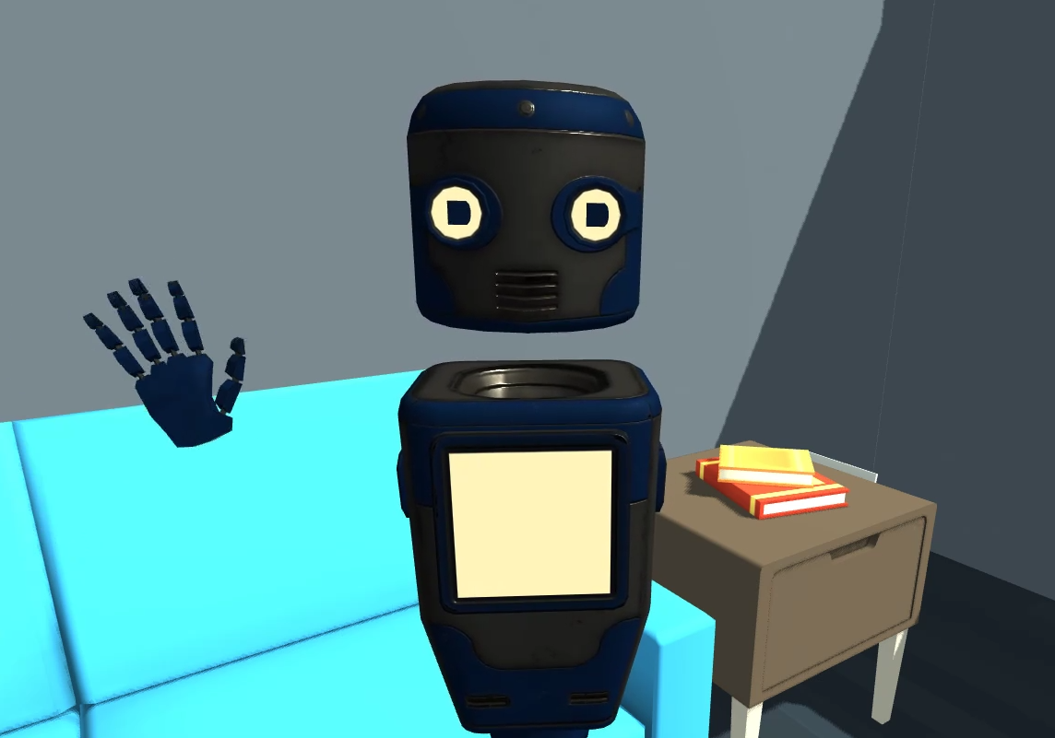
Examples: Mozilla Hubs
Open source and free
Browser based
Supports everything*

Slide 8
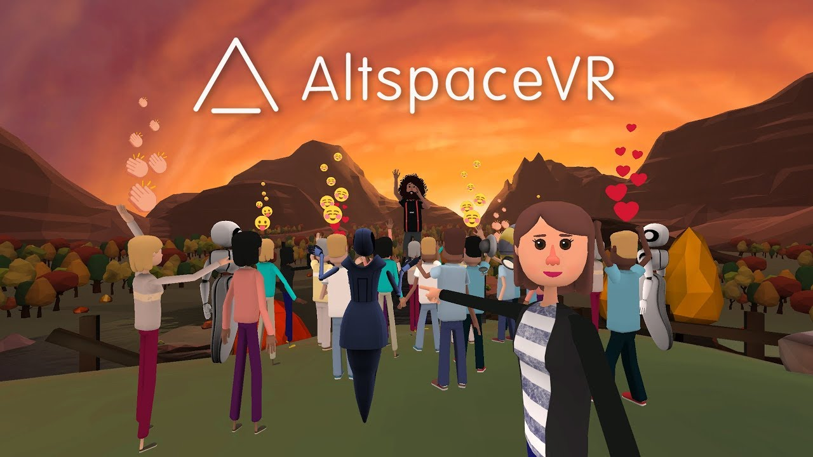
Examples: ALTSPACE-VR
Focus on social interaction, presentations
Free to use/host/build
Supports Oculus and PC tethered headsets

Slide 9
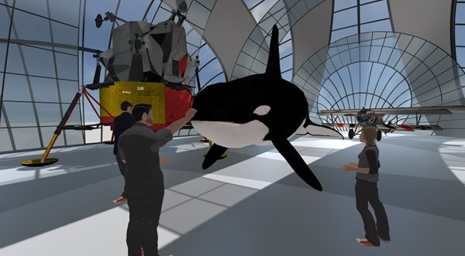
Examples: Engage
PC based but Quest support is available
Designed for educational experiences
Pricing structure – Individual, Pro, Enterprise

Slide 10
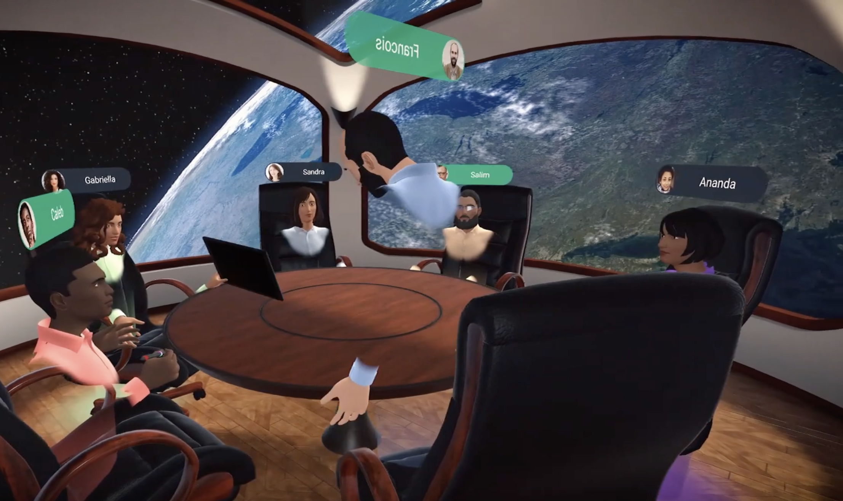
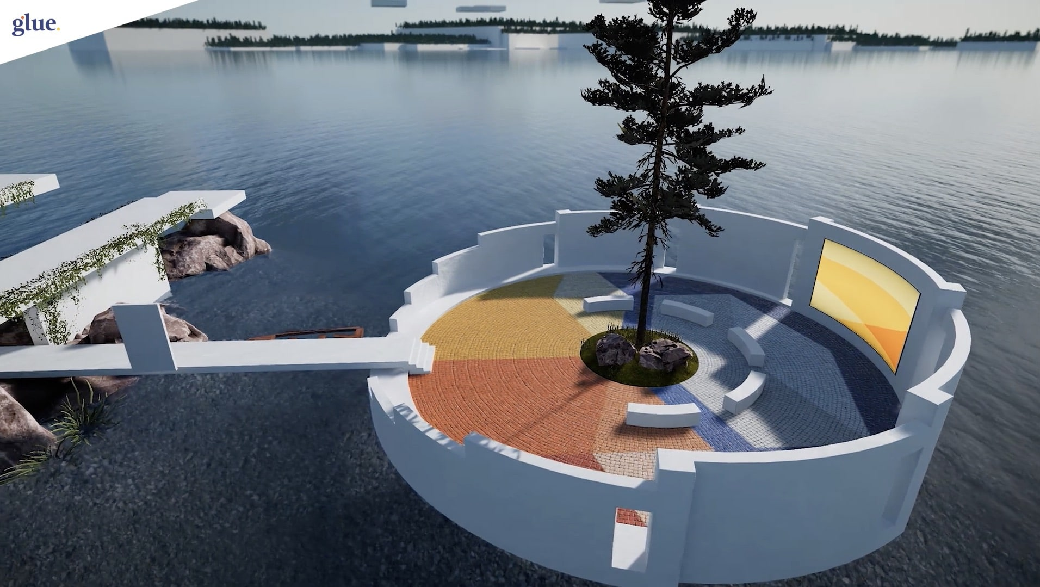
Examples: Glue
Enterprise focus
Closed and secure
PC tethered headsets
Quest is coming soon, iOS through app

Slide 11
Non-VR Users
All the mentioned platforms have a 2D version for non-VR users
Streaming into video conference or recording
2D might be the better client for presenting
Lacks engagement of Immersive version
Obligatory comment on motion sickness

Slide 12
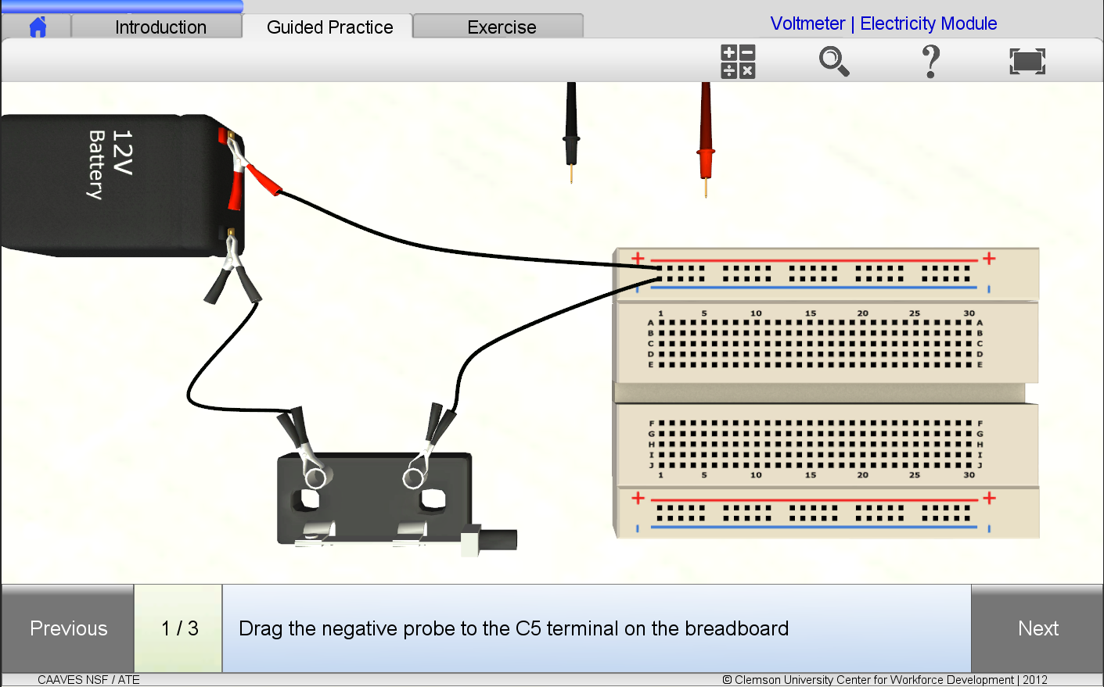
Desktop VR
Key Characteristics
No special equipment needed
Not immersive
Browser-based
Allows for wide distribution

Slide 13
Quality and Audience
Inverse Proportions
Quality
Price
Hardware
Experience
Security
Audience
Price
Hardware
Experience
Security

Slide 14
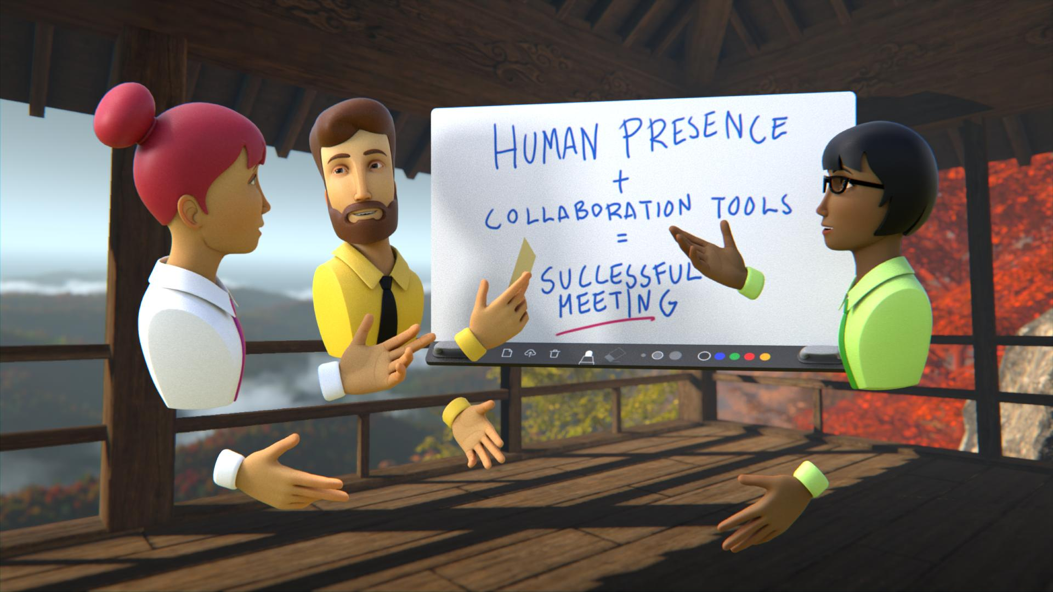
Content
Every platform has a ‘Sandbox’
Imposed limitations
Experiential limitations
Some platforms are more open that others
Every platform is proprietary
Every platform provides different tools
Videos, Slides, Web Pages
Interactables (whiteboard)

Slide 15
Common Limitations
Space Size ~ 100 participants max
Ways to handle larger groups
Motion sickness (25% susceptibility)
Lacks experiential interactivity
Assessment and testing is challenging

Slide 16
Large Events
I-P
Most platforms can’t handle more than 100 users in any one space
Spaces can be linked, duplicated
Duplicated spaces can help accommodate large audiences
On some platforms, spaces can be dynamically added or removed
Just like a real-world event, audience flow and event layout are critical for an engaging experience for everyone
A-H
R-Z
Hub
Web Link

Slide 17
Experiential vs Collaborative
Experiential VR
Collaborative VR
Simulates a specific, interactive environment
Change of environment requires change of application
Interaction is designed to emulate a task, activity, or process
Testing can be built into the simulation to accurately assess user programs
Typically not collaborative
Simulates a largely non-interactive space
Spaces can be repurposed without major change
VR is a delivery platform for diverse content
Groups can converse, interact, and participate in VR events together
Testing in the environment is limited (usually browser-based)

Slide 18
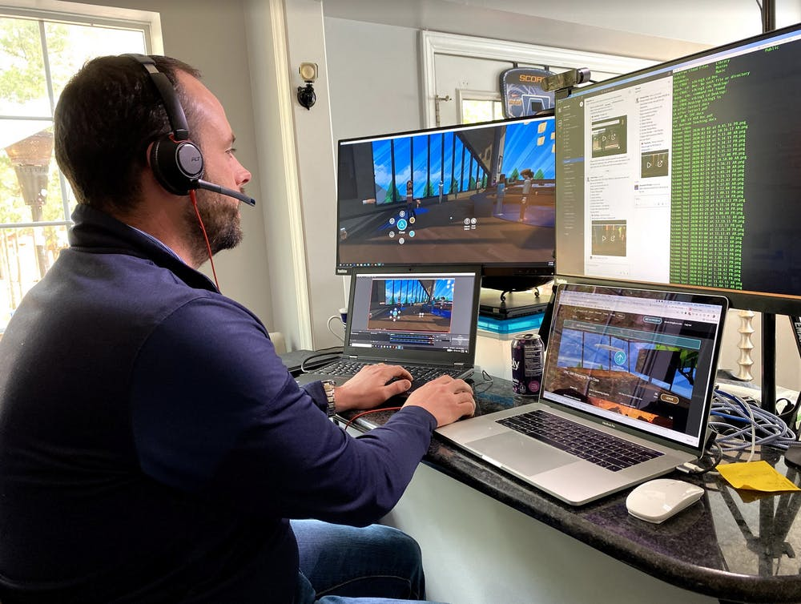
Faculty Adoption Strategies
Steven King -- Hussman School of Journalism and Media
Alan Srock and Rachel Humphrey – SCSU AHS
This event
https://www.dailytarheel.com/article/2020/04/virtual-reality-classroom-0407

Slide 19
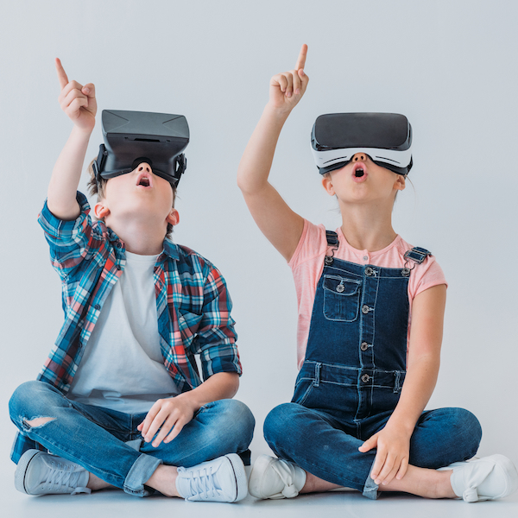
Future Direction for Education
According to Futuresource Consulting, the number of students using virtual reality and augmented reality will grow from 2.1 million in 2016 to 83 million in 2021. And – in a forecast by Technavio – the K-12 game-based learning market is expected to grow at a compound annual growth rate of nearly 28 percent through 2021.
https://www.k12blueprint.com/news/reality-bytes-virtual-reality-and-k-12-education

Slide 20
Plan For Your VR Course
Not limited to STEM/Technology courses
Videos/Slides/Images transition directly
Get a headset, get into VR and get comfortable
Practice
Engage with a community
Provide multiple solutions for your students
3D > 2D > Zoom

Slide 21
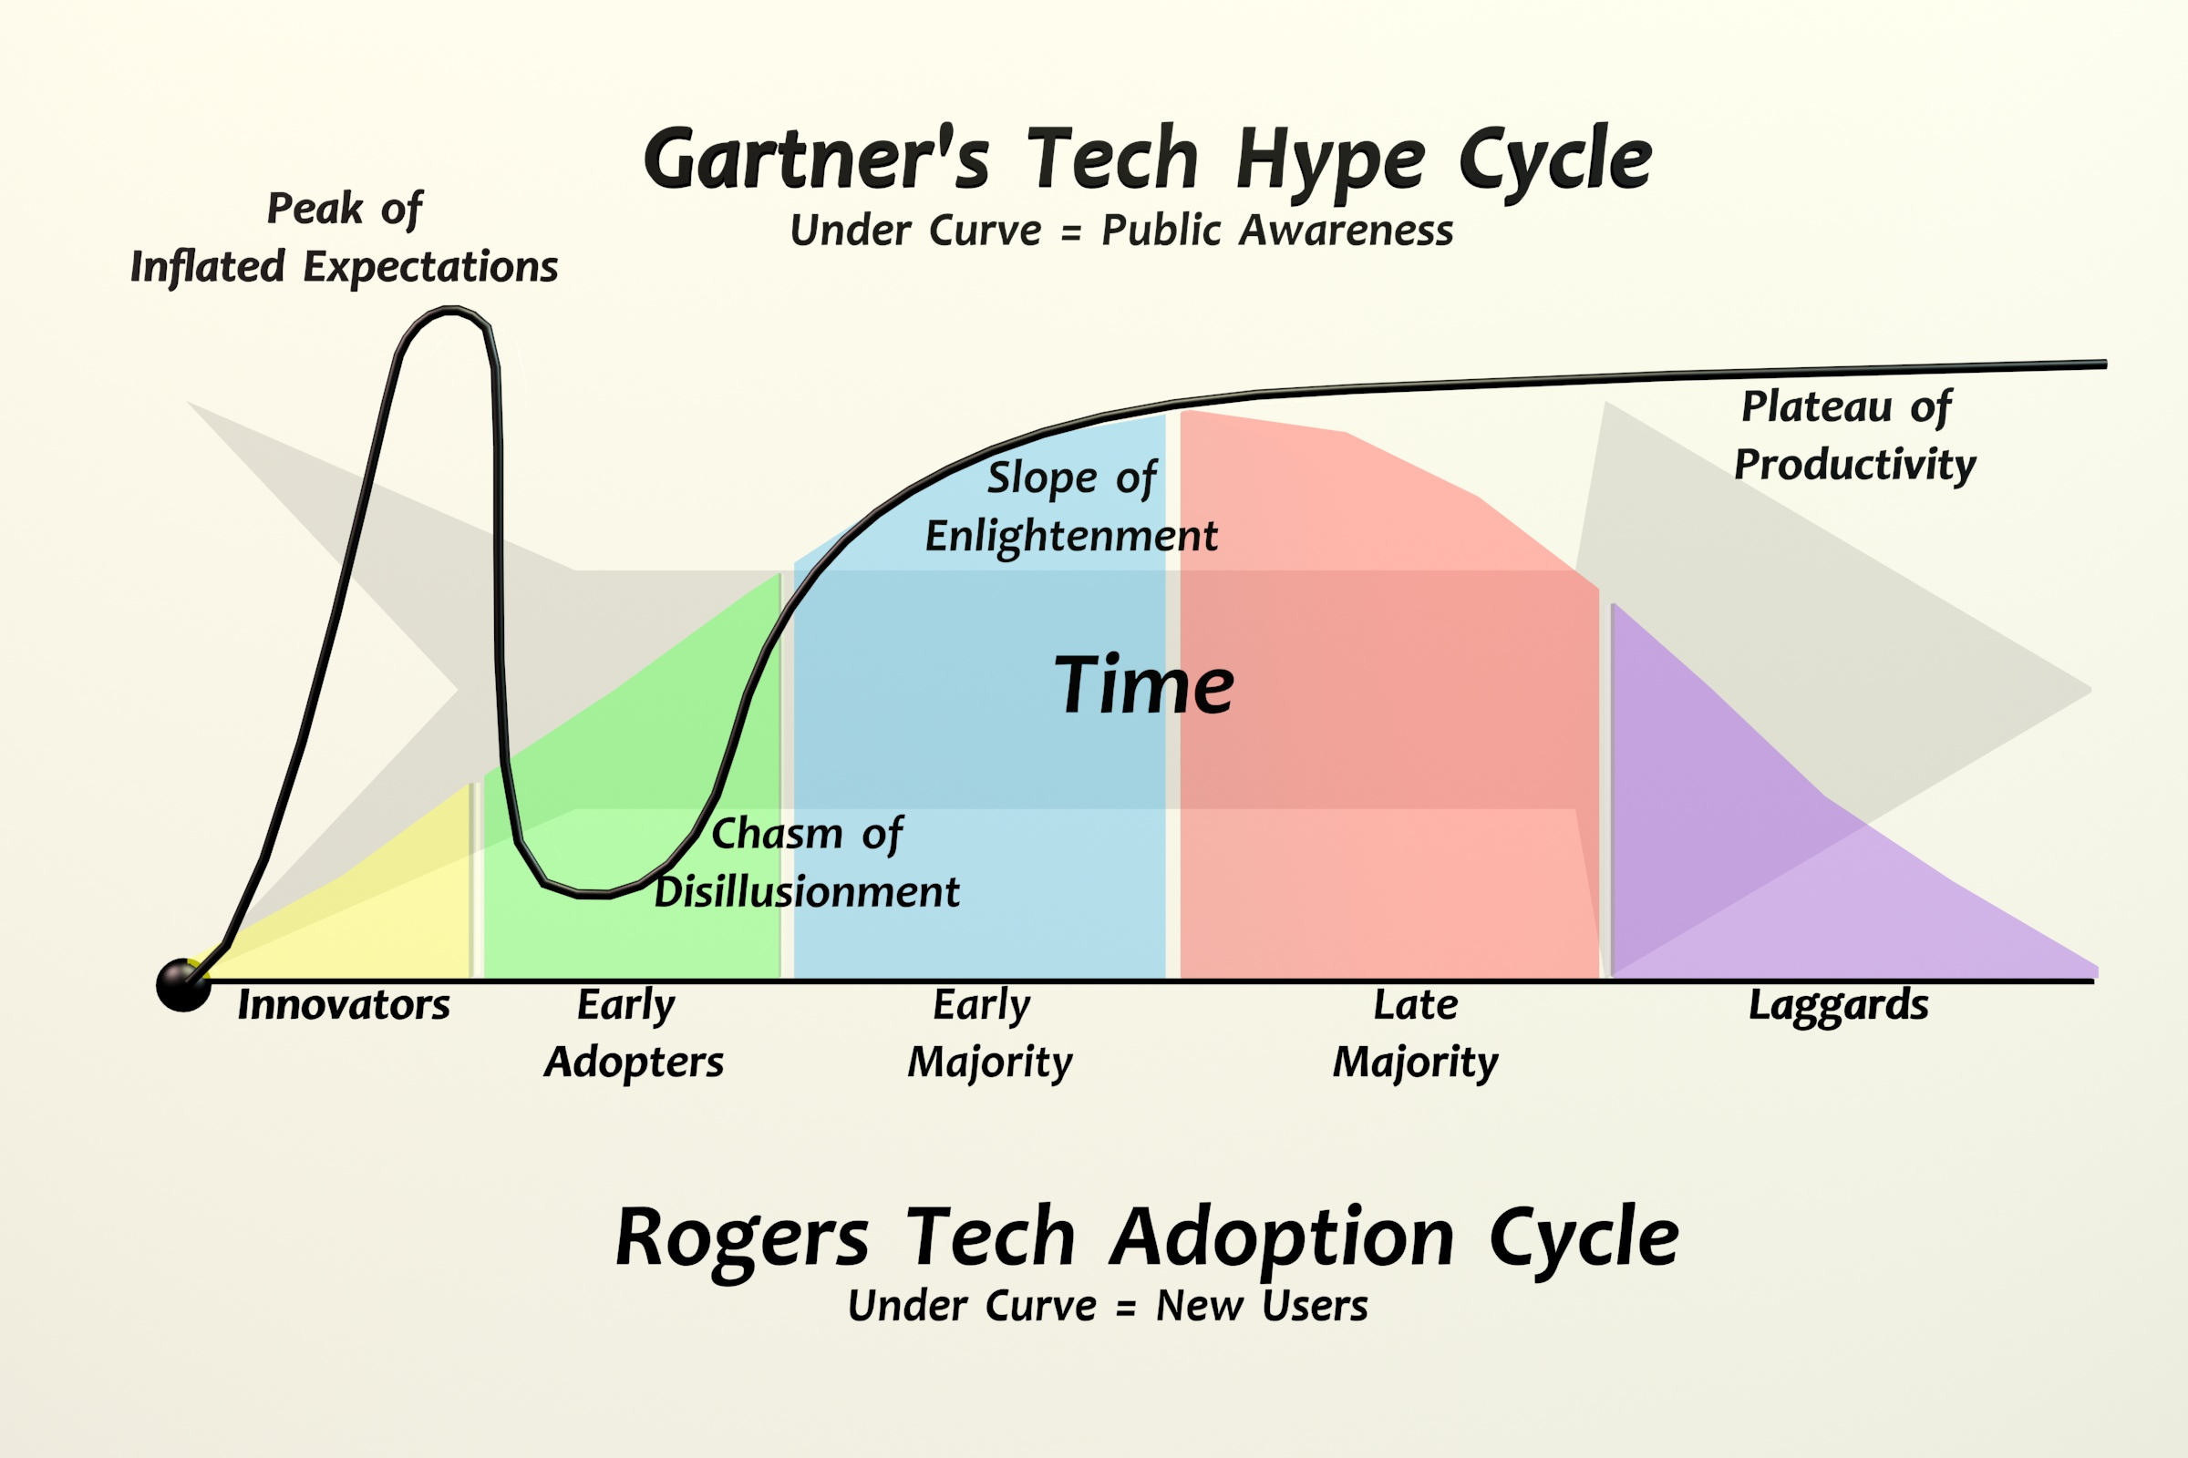
Finally…
Faculty and Admin buy-in is critical
Explore – try them all to see which is the best fit
Leverage the social benefits of social VR
Connect with others in the community
Plan for your VR Course
Use the tools that are best for your material

Slide 22
This material is based upon work supported by the National Science Foundation under Grant No. 1902574. Any opinions, findings, and conclusions or recommendations expressed in this material are those of the author(s) and do not necessarily reflect the views of the National Science Foundation.

