Slide 1
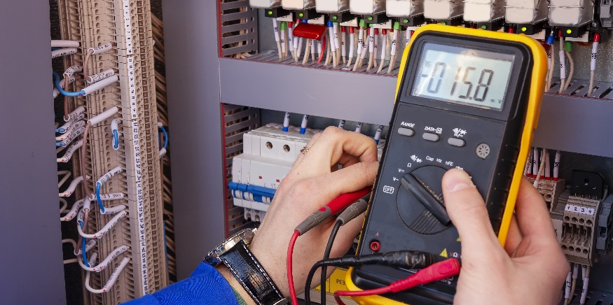
Inductance

Slide 2
DISCLAIMER & USAGE
This material is based upon work supported by the National Science Foundation's Advanced Technological Education Program under Grant No. 1801177.
Any opinions, findings, and conclusions or recommendations expressed in this material are those of the author(s) and do not necessarily reflect the views of the National Science Foundation.
2

Slide 3
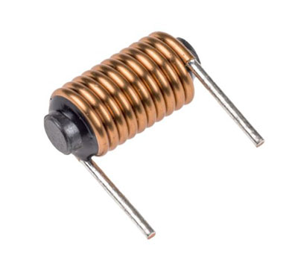
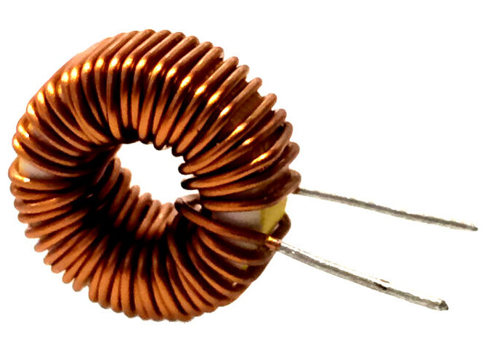
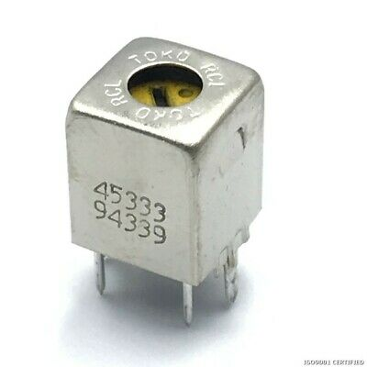
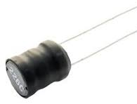
Inductance
The electric inductance of an inductor is known as a Henry.
Since one Henry, H, is very large, most common inductors are rated in milli- or microhenrys.
Unlike most capacitors and resistors, the inductance of an inductor is not directly indicated on the side of the inductor.
The number marked on the side of an inductor may be used to find the manufacturer’s data sheet for the inductor.

Slide 4
Determining Inductance
Material | Relative Permeability
Air | 1.00000037
Carbon steel | 100
Concrete | 1
Copper | 0.99997
Iron | 5000
Nickel | 100-600
Platinum | 1.000265
Teflon | 1.0000
Water | 0.999992
Wood | 1.00000043
Many factors affect inductance:
Number of turns of the coil of wire
Distance between windings
Cross-sectional area of core
Permeability of core (i.e. how well it responds to magnetic fields)
The more turns of the coil, the more inductance.
The closer the windings of the coil, the more inductance.
The larger the cross-sectional area, the more inductance.
The permeability of a core is rated in a term known as relative permeability, µ.
The higher the relative permeability, the more inductance.

Slide 5
Relating Inductance
$12.566×{10}^{−7}H/m$ is the permeability of free space.
Inductance, $L$, is related to current by:
$L= \frac{Φ}{I}$
where $Φ$ is the magnetic flux (how much magnetic field is created), and $I$ is the current flowing through the inductor.
Magnetic flux $Φ$ has the units of Weber ($Wb$) which is a volt-second ($Vs$).
Looking at the units of the inductance shows
$H≡\frac{Wb}{A}≡\frac{Vs}{A}≡Ωs$
Recall from Ohm’s Law that $V/A$ is an $Ω$.
For a cylindrical core, the inductance is given by
$L= \left(12.566×{10}^{−7}H/m\right)\left(\frac{μN^{2}A}{l}\right)$
where $μ$ is the relative permeability, $N$ is the number of turns of the coil, $A$ is the cross-section area of the coil, and $l$ is the length of the coil.
$$N$$
$$A$$
$$l$$

Slide 6
Class Problem: You want to construct an inductor by coiling a $0.06mm$ diameter wire around one of two cylindrical cores, copper or platinum. The copper core has a diameter and length of $15mm$, and $10mm$, respectively, while the platinum core has a diameter and length of $8mm$ and $25mm$, respectively. If you only want to coil the wire around the core in a single pass (i.e. not multiple layers of wire laid upon itself):
What core should be used to produce the highest inductance?
How much wire is needed in that case?
Note: Each turn of the wire around the coil may be approximated by the core’s circumference.
Solution:
What is known?
$$D_{w}=0.06 mm$$
$$D_{c}=15 mm$$
$$l_{c}=10 mm$$
Copper →
$$μ_{c}=0.99997$$
$$D_{p}=8 mm$$
$$l_{p}=25 mm$$
Platinum →
$$μ_{p}=1.000265$$

Slide 7
Solution (contd.):
What is the problem asking in part a)?
For part a), which core will produce the highest inductance $L$.
Is there enough information to find part a)?
Inductance with a cylindrical core is
$$L=12.566×{10}^{−7}H/m\left(\frac{μN^{2}A}{l}\right)$$
Using the wire diameter, the number of terms may be determined
$$N_{c}=\frac{l_{c}}{D_{w}}=\frac{10mm}{0.06mm}=166.7≈166$$
$$N_{p}=\frac{l_{p}}{D_{w}}=\frac{25mm}{0.06mm}=416.7≈416$$

Slide 8
Solution (contd.):
Area may be determined using the core diameter
$$A_{c}=\frac{π}{4}D_{c}^{2}=\frac{π}{4}{\left(15mm\right)}^{2}=176.7mm^{2}$$
$$A_{p}=\frac{π}{4}D_{p}^{2}=\frac{π}{4}{\left(8mm\right)}^{2}=50.27mm^{2}$$
The inductances may then be found
$$L_{c}=12.566×{10}^{−7}H/m\left(\frac{μ_{c}N_{c}^{2}A_{c}}{l_{c}}\right)=12.566×{10}^{−7}H/m\left[\frac{\left(0.9997\right)\left({166}^{2}\right)\left(176.7mm^{2}\right)}{10mm}\right]=611.9μH$$
$$L_{p}=437.4μH$$
$$×\frac{1 m}{1000 mm}$$
a)
The copper core should be used.

Slide 9
Solution (contd.):
Solution (contd.):
What is the problem asking in part b)?
The length of wire to be used with the copper core.
This may be found using the circumference $C_{c}$ of the core.
$$C_{c}=πD_{c}=47.12mm$$
The required length is then
$$L_{w}=C_{c}N_{c}=7.823m$$
b)

