Slide 1
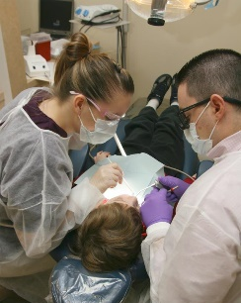

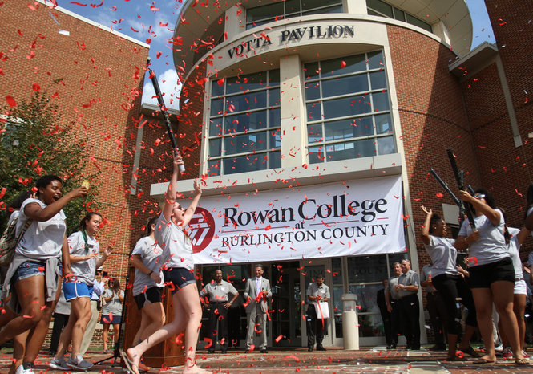
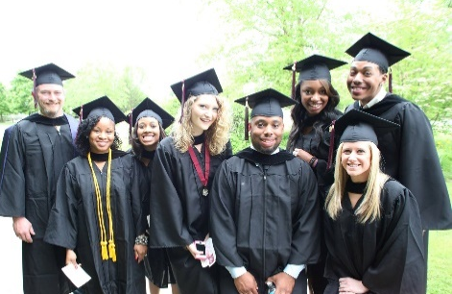

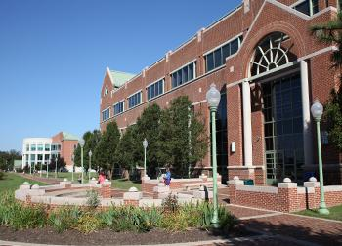
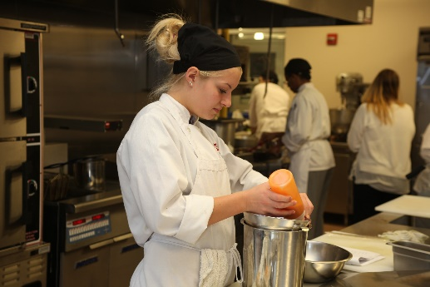
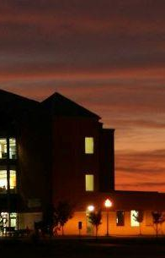

National Science Foundation - Grant Summary
AAS. Mechanical Engineering Technology (MET)
Dr. Edem G. Tetteh, Dean
Science, Technology, Engineering, and Technology

Slide 2

Background
Designed to be a 3+1 that will be transferable primarily to a Rowan University BS in MET
Provide opportunities for accessible and affordable educational pathways
Provide a high-quality educational opportunity that prepares students to achieve career goals in the field of MET
Support the needs of the manufacturing and service industry in Burlington County, NJ and beyond
New Jersey Department of Labor and Workforce Development projects 7.5% employment growth for this sector between 2012 and 2022, which means 313,150 additional jobs

Slide 3
AAS. MET Degree: ABET-ETAC
An ability to apply knowledge, techniques, skills and modern tools of mathematics, science, engineering, and technology to solve well-defined engineering problems appropriate to the discipline.
An ability to design solutions for well-defined technical problems and assist with engineering design of systems, components, or processes appropriate to the discipline.
An ability to apply written, oral, and graphical communication in both technical and non-technical environments; and an ability to identify and use appropriate technical literature.
An ability to conduct standard tests and measurements, and to conduct, analyze, and interpret experiments.
An ability to function effectively as a member of a technical team.

Slide 4
First Year Course Sequence
Fall Semester |  |  | Spring Semester
First Year
Freshman Engineering Clinic I | 2 | EGR 151 | Freshman Engineering Clinic II | 2 | EGR 152
College Composition I | 3 | ENG 101 | Society, Ethics and Technology | 3 | SOC 160
Precalculus | 4 | MTH 130 | Calculus I | 4 | MTH 118
General Chemistry I with Lab | 4 | CHE 115/116 | Mat Science and Manufacturing | 3 | MET 235
Intro to Comp Sci I | 4 | CSE 110 | Circuits I | 4 | EET 121
 | 17 |  |  | 16
Second Year
Sophomore Engineering Clinic I | 1 | EGR 251 | Sophomore Engin Clinic II | 1 | EGR 252
Technical Writing | 3 | ENG 105 | Public Speaking | 3 | SPE 102
ART 101, MUS 101, or THR 101 | 3 |  | Strength of Materials | 3 | EGR 230
General Physics I with Lab | 4 | PHY 210/211 | Intro to Mechanical Design | 3 | MET 220
Engineering Statics | 3 | EGR 201 | Applied Thermal Energy I | 3 | MET 215
CNC Programming I | 3 | MET 210
 | 17 |  |  | 13

Slide 5
Stackable Certificates
Certified Production Technician Certification
  TEC 120 Safety Management-3 credits
  Based on the Manufacturing Skill Standards Council (MSSC) credentialing system leading to a CPT covering Safety, Quality & Continuous Improvement, Manufacturing Processes & Production, and Maintenance Awareness
AutoCAD 2018 Certified User Certificate (Ed2Go)
  EGR110-Design Computer Graphics I -3 credits
  Teaches the basic and advanced 2D functionality of AutoCAD 2018. Covers the necessary tools to prepare for the Autodesk AutoCAD 2018 Certified User Exam

Slide 6
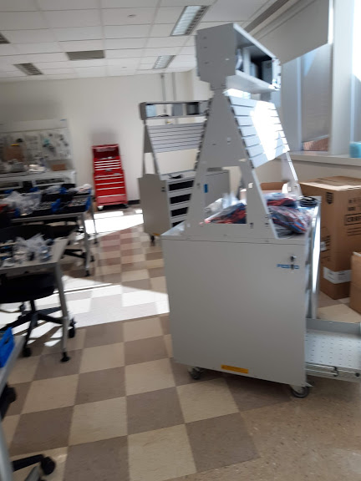
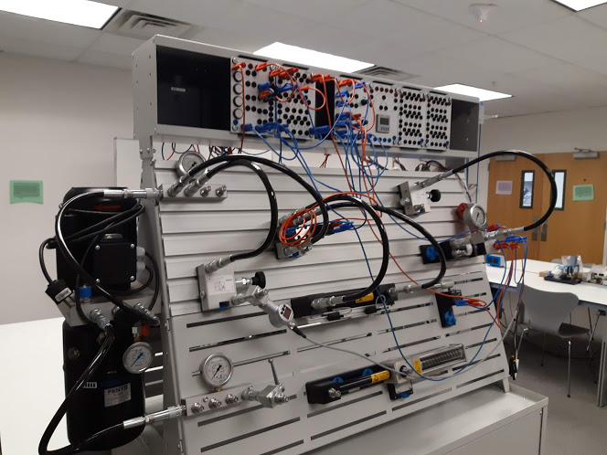
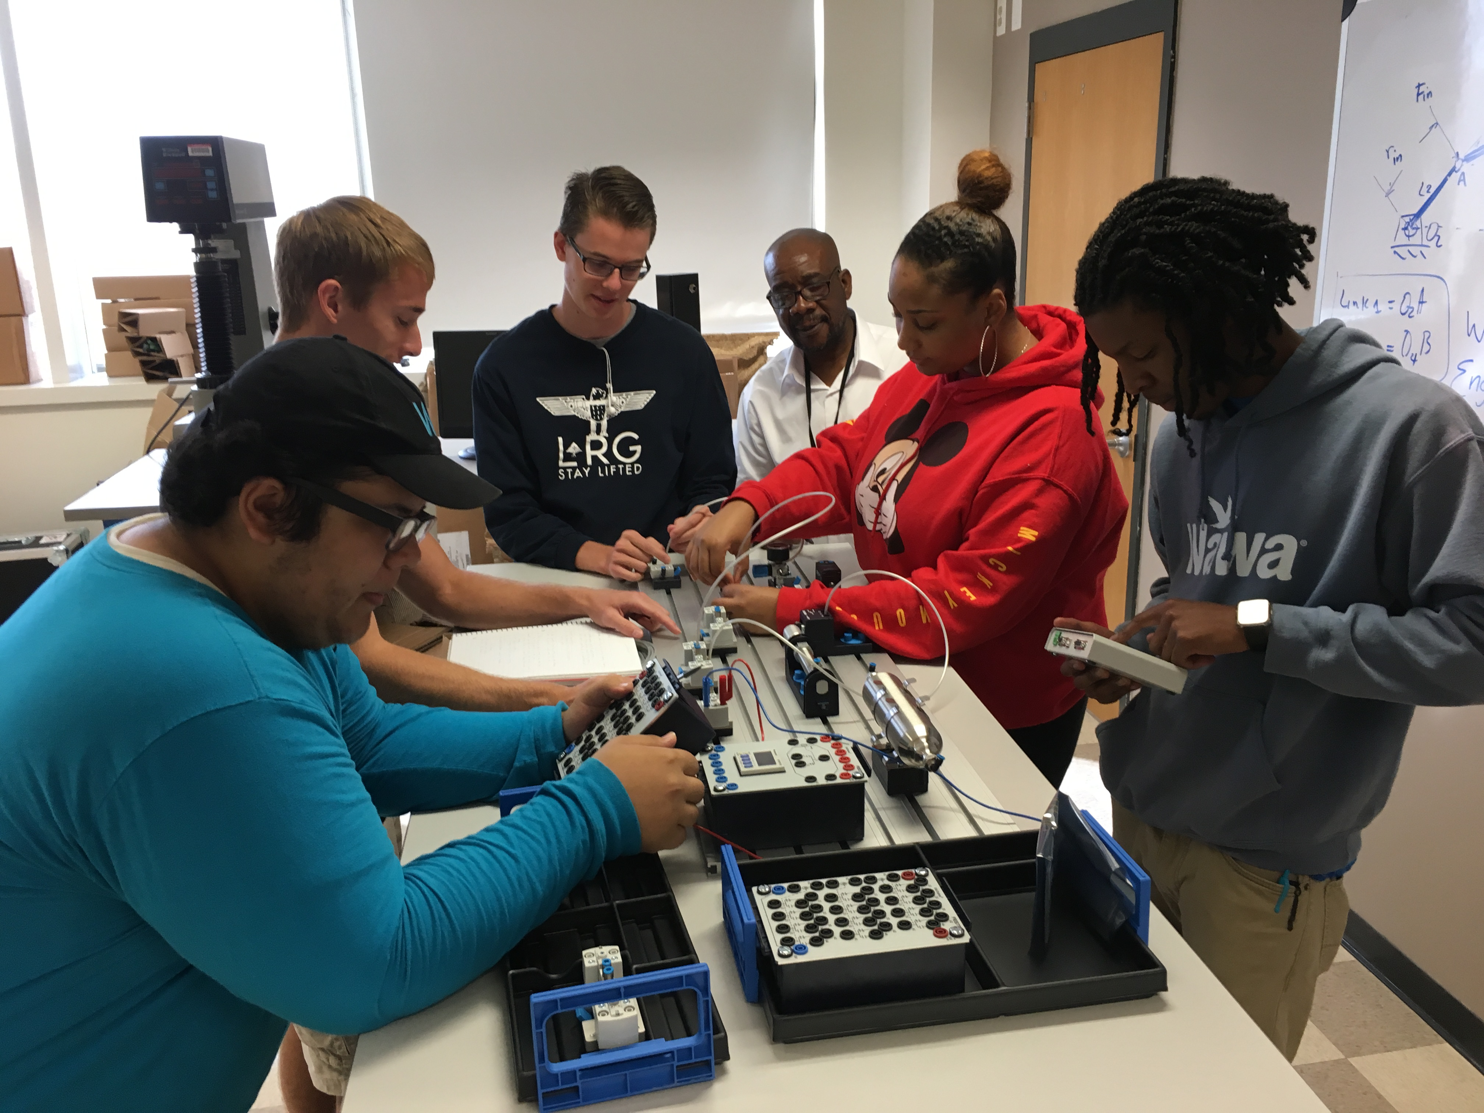
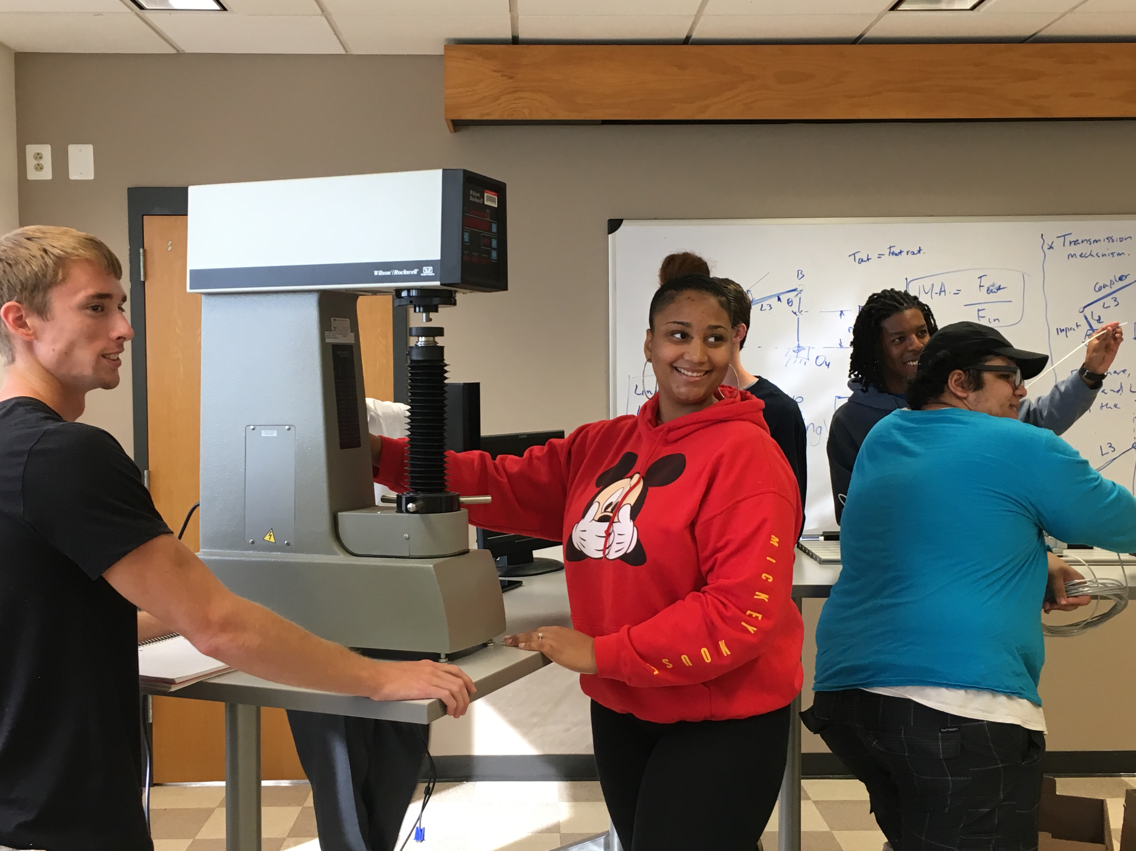
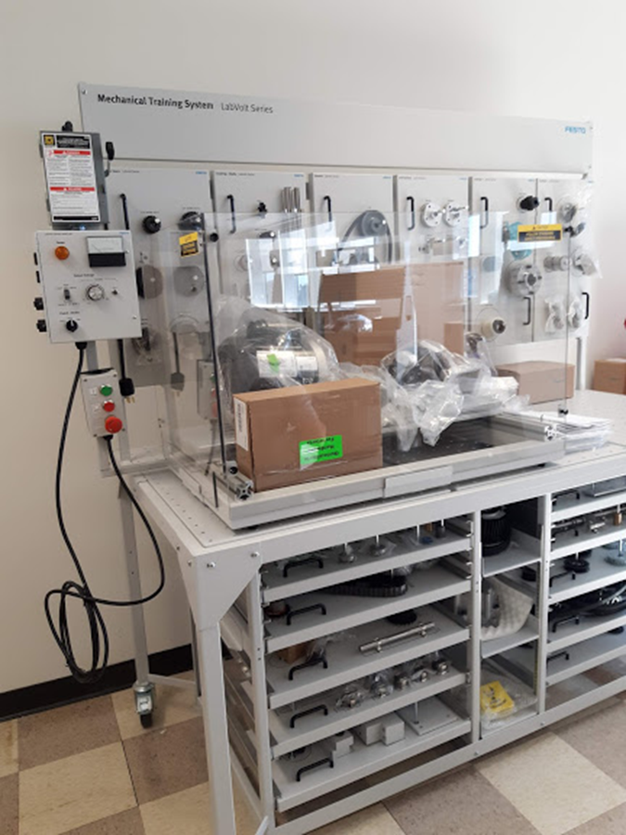
Infrastructure
& Facilities
Applied Fluid Mechanics
1. Pneumatics
2. Hydraulics
Mechanical Design
1. Mechanical Trainer (Gear & Gear Train, Chain, Sprockets, Belt, Motor, Pulley, etc)
2. Full Craftman Tool Boxes/Accessories
3. Tensile Strength biomaterials Tester – Series Labs include tensile, compression, point bending testing, etc
HASS TL-1 CNC
PLCs
3-D Printers

Slide 7
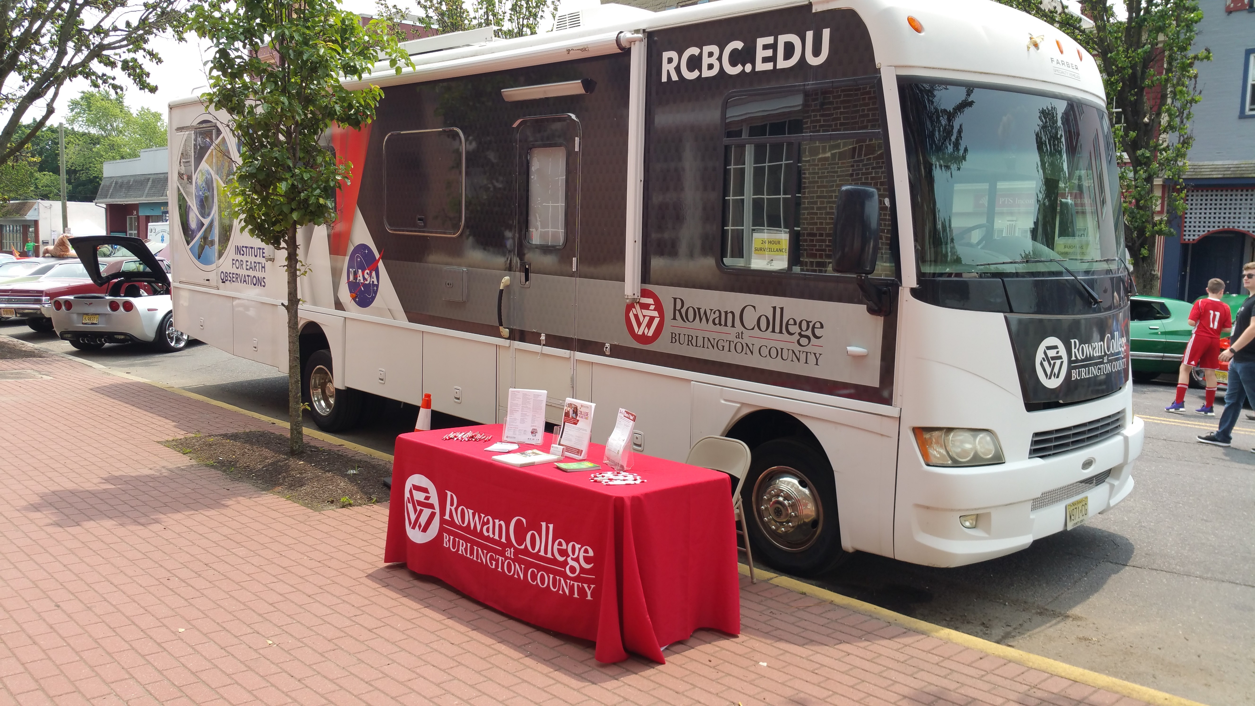
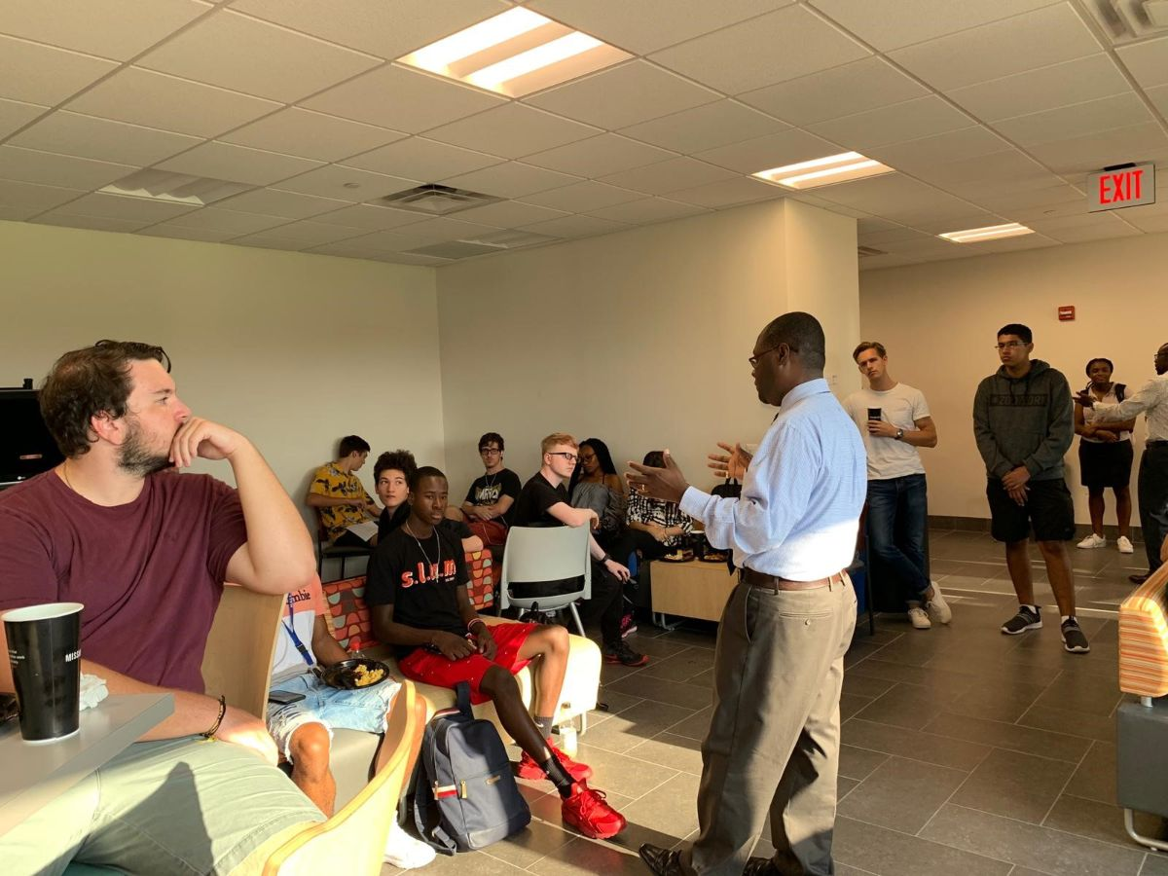

Recruitment and Retention
Community Outreach Events
- Life Radio
- Abundant Life Fellowship Church
- Youth Achievers Science Fair
- STEM Scouts
Meet and Greet Events
- National Engineers Week
- Burlington County Library
- Camden Youth Aviation
- Future Cities
Other Events
- Science Slam
- Palmyra Cove
- Career Fairs
- Girl Scouts

Slide 8
Enrollment Trends
Enrollment
Program | Fall 2019 | Spring 2020 Returning | Retention Rate | New Students in Spring 2020
MET-AAS | 38 | 26 | 68% | 12
2020
2019
2018

Slide 9
Sustainability Plan
AAS in Applied Technology Management
AAS in Sustainability Technology
AAS in Chemical Process Manufacturing
AAS in Logistics Engineering Technology
AAS in Aviation Management
AAS in Mechatronics
Spring 2020
Fall 2023

Slide 10
Sustainability Plan Cont.
Development of many stackable certificates as an important component of the ET strategic plan
Sharing of critical staff positions of the ET program with Rowan University
Development of new online delivery of several Engineering Technology programs
Development of a long-term commitment from Rowan University toward the ET programs
The cost of the outreach, recruitment, and job placement will be supported and shared by industry partners and Rowan University from the first year of the programs
Appeal to potential Drexel University student pools by building a required internship in the ET degrees

Slide 11
Moving Forward
An agreed-upon determination regarding the viability of “3+1” ET programs, and MET must be made within RCBC to fully determine the path forward
Regardless of the outcome of recommendation 1, RCBC should affirm its commitment to continue to offer the Associates of Applied Science degree in MET
A thorough assessment of RCBC’s capacity to support additional infrastructure investment for engineering technology programs must be made
Conversations with Rowan University regarding shared commitment for required infrastructure and resources, possibly including revenue sharing, should progress
Additionally, RCBC should invest resources to pursue support and commitment, for engineering technology programs, from industry partners, government funding agencies, and private funding sources.
Seek ABET accreditation for the program in 2022

Slide 12
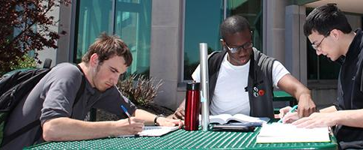
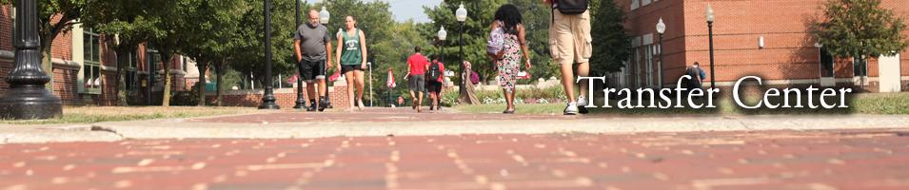
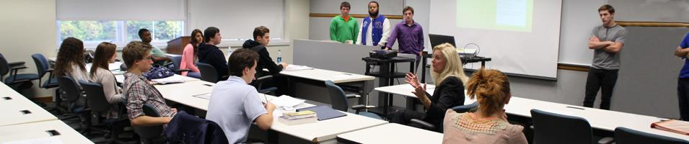
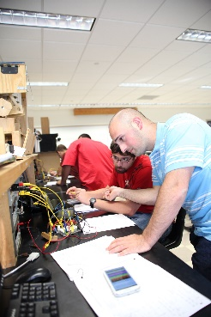
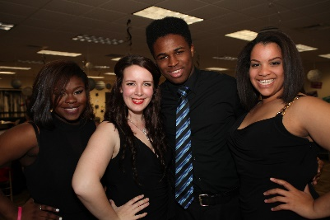

Questions!
Dr. Edem G. Tetteh
Dean - Division of STEM
Phone: (856) 222-9311, ext.1372
Email: etetteh@rcbc.edu
Website: www.rcbc.edu

