Slide 1
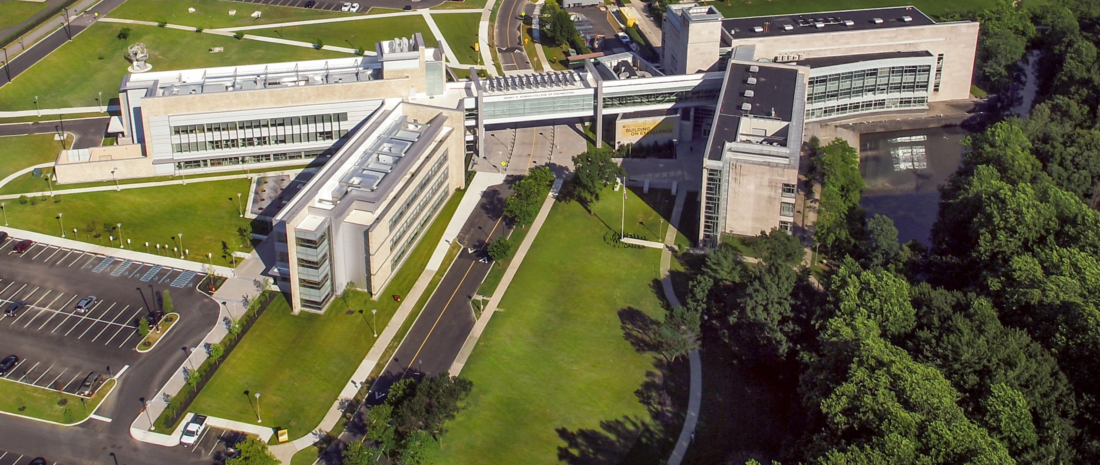
Henry M. Rowan College of Engineering
Rowan University, Glassboro, NJ
Welcome to Mechanical Engineering
Ratneshwar (Ratan) Jha, ASME Fellow, AIAA Associate Fellow
Department Head & Professor, Mechanical Engineering

Slide 2

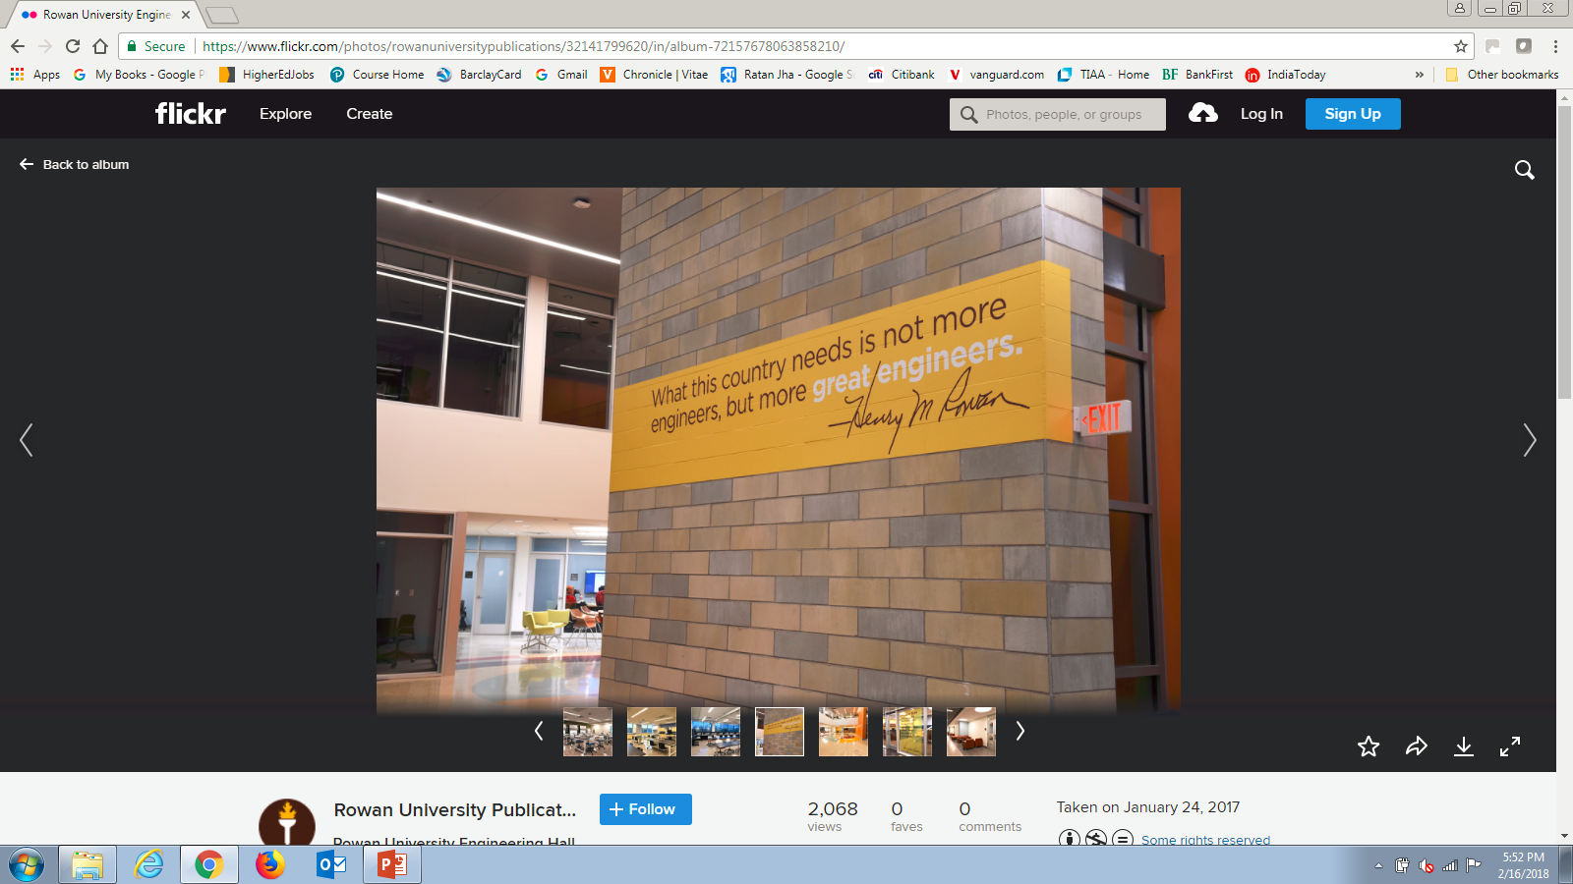
“Mechanical Engineering at Rowan University is a Selective and Rigorous Program, Based on Minds-on Hands-on Approach, that Produces Great Engineers”

Slide 3
Department Facts & Figures
Large Growth in Student Enrollment
Highly Competitive for Admission
Excellent Retention, Graduation, and Placement Rates
Class Size Limited to 40 Students
Increasing Research Funding and Graduate (MS/PhD) Students
Undergrad | Fall 2012 | Fall 2018 | Fall 2019
Enrollment | 191 | 375 | 402
Faculty - FT | 8 | 13 | 14
Faculty - 3/4th | 1 | 1 | 2
Student/Faculty | 21.2* | 26.8 | 25.1
Incoming student average SAT | 1340
Average GPA (weighted) | 3.85
Graduate placement rate | 97-100%
Average starting salary | $69,000
Graduation rate (4 year rate) | 85% - 86%
Retention rate | 88% - 93%
*FEC/SEC taught by ME

Slide 4
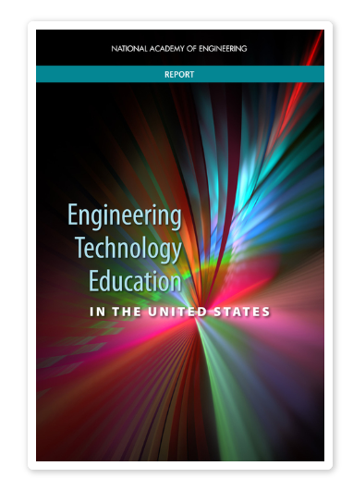
“The purpose of this report is to shed light on the relatively underappreciated roles and contributions of engineering technicians and technologists.
Very abstractly, if engineers are viewed as being responsible for designing the nation’s technological systems, then engineering technicians and technologists are the ones who help build and keep those systems running.”

Slide 5
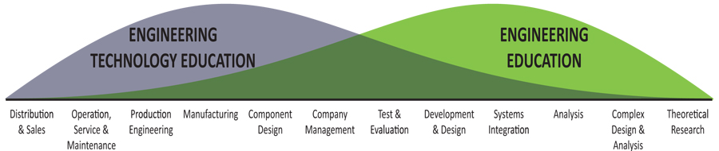
An engineering technology—engineering continuum model
(Source: http://www.nap.edu/23402, National Academy of Engineering)
“The field of ET has strong historical connections to traditional engineering and shares the same general sensibility toward technical problem solving.
At the same time, its pedigree is rooted in application-focused and hands-on learning, perhaps to a greater extent than in engineering.”

Slide 6
ASME Vision 2030 Action Agenda
Richer practice-based engineering experience for students
New balance of faculty research/practice skills in ME programs
Greater cultivation of Innovation and Creativity
Increased curricular flexibility
Development of students’ professional skills to higher standards
Greater diversity among students and faculty
Rowan MechE Goals Are Consistent with ASME Vision 2030

Slide 7
MET “3+1” Curriculum: Years 1 & 2
Mechanical Engineering Technology
FIRST YEAR- RCBC
FALL |  |  | CR | SPRING |  |  | CR
Freshman Engineering Clinic I EGR 151 |  |  | 2 | Freshman Engineering Clinic II EGR 152 |  |  | 2
Precalculus (Inc. Trig, LA) MTH 130 |  |  | 4 | Calculus I & Analytical Geometry MTH 118 |  |  | 4
General Chemistry I w/Lab CHE 115/116 |  |  | 4 | Humanistic Lit: Society, Ethics & Technology SOC 160 |  |  | 3
College Comp I ENG 101 |  |  | 3 | Intro to Mechanical Design MET 220 |  |  | 3
Introduction to Computer Science CSE 110(*) |  |  | 4 | Artistic Literacy: ART/MUS/THR 101 |  |  | 3
*Must be C++ or Java Based
TOTAL |  |  | 17 | TOTAL |  |  | 15
SECOND YEAR-RCBC
FALL |  |  | CR | SPRING |  |  | CR
Sophomore Engineering Clinic I EGR 251 |  |  | 1 | Sophomore Engineering Clinic II EGR 252 |  |  | 1
College Comp. II or Tech. Writing ENG 102/105 |  |  | 3 | Public Speaking SPE 102 |  |  | 3
General Physics I w/Lab PHY 210/211 |  |  | 4 | Mat Sci and Manufacturing MET 235 |  |  | 3
Engineering Statics EGR 201 |  |  | 3 | Free Elective |  |  | 3
CNC Programming I MET 210 |  |  | 4 | Applied Thermal Energy I MET 215 |  |  | 3
TOTAL |  |  | 15 | TOTAL |  |  | 13
 |  | 2 year AAS degree program total credits |  |  | 60

Slide 8
MET “3+1” Curriculum: Years 3 & 4
 |  |  | THIRD YEAR-RCBC
FALL |  |  | CR | SPRING |  |  | CR
Junior Tech. Clinic I - EGR 351 |  |  | 2 | Junior Tech. Clinic II - EGR 352 |  |  | 2
General Physics II with lab PHY 212/213 |  |  | 4 | Applied Thermal Energy II MET 301 |  |  | 3
Calculus II and Analytic Geometry MTH 119 |  |  | 4 | Applied Fluid Mechanics MET 311 |  |  | 3
Engineering Dynamics EGR 202 |  |  | 3 | Machine Design MET 312 |  |  | 3
MET Lab I (NEW) MET 3XX |  |  | 3 | Principles of Microeconomics ECO 203 |  |  | 3
TOTAL |  |  | 16 | TOTAL |  |  | 14
 |  | FOURTH YEAR- Rowan University
FALL |  |  | CR | SPRING |  |  | CR
Senior Tech. Clinic I / Senior Design I EGR 451 |  |  | 2 | Senior Tech. Clinic / Senior Design II EGR 452 |  |  | 2
Advanced Manufacturing MET 400 |  |  | 3 | Global Literacy Elective GENED |  |  | 3
Applied Heat Transfer MET 312 |  |  | 3 | Fundamentals of Circuits & Electronics EET 2XX |  |  | 3
CNC Programming II MET 351 |  |  | 2 | Quality & Reliability MET 342 |  |  | 3
MET Elective I MET 4XX |  |  | 3 | MET Elective II MET 4XX |  |  | 3
Literature/Core Elective GENED |  |  | 3
TOTAL |  |  | 16 | TOTAL |  |  | 14
Total program credits: |  |  |  |  |  |  | 120

Slide 9
Rowan Core Requirements
University Requirements
Rowan Core is the University's general education model. It is based on six literacies and Rowan Experience, which reflect contemporary priorities while maintaining a strong liberal arts foundation.
Some literacies are incorporated in your major-specific courses. Others you will fulfill by taking elective courses in the required literacy.
 | Rowan Core-Literacies |  | Fulfilled by: |  |  |  | Ethics options:
 | Artistic (ARTL) |  | elective |  |  |  | PHIL 09150, 09323, 09341, 09346, 09392 or 09393; INTR 01148 or 01174
 | Global (GLBL) |  | elective
 | Humanistic (HUML) |  | elective
 | Communicative (COML) |  | Comp I, SEC I and II
 | Quantitative (QNTL) |  | Calculus I
 | Scientific (SCIL) |  | Chemistry I |  |  |  | Business elective options:
 |  |  |  |  |  |  | ECON 04101 or 04102; INTR 01138; BUS 01105; ENT 06240, 06346 or 06450; MIS 02526
 | Rowan Experience |  | Fulfilled by:
 | Rowan Seminar (RS) |  | Freshman Engineering Clinic I
 | Writing Intenstive (WI) |  | Senior Engineering Clinic
 | Broad-based lit. (LIT) |  | Literature-designated elective

Slide 10

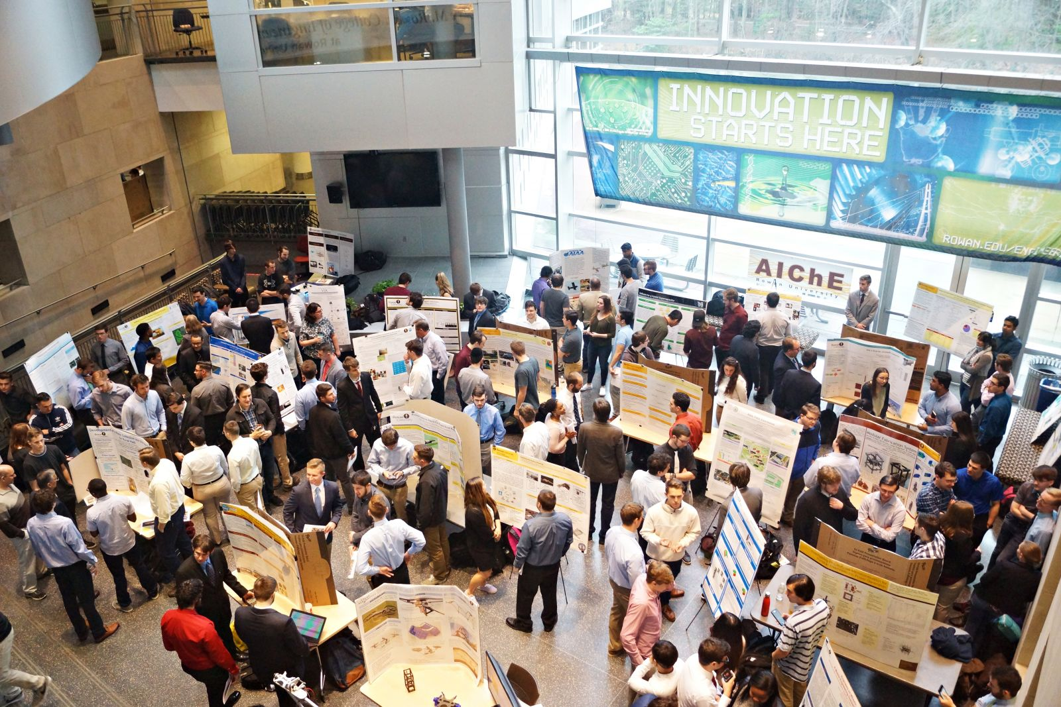
Jr/Sr Clinics – Defining Feature of Rowan Engineering
Multidisciplinary team projects
Required all 4 semesters
Teams of 2 – 20 students
About 150 Jr/Sr Clinics currently

Slide 11
Program Educational Objectives for Associate and Baccalaureate Degree Programs

Slide 12
Student Outcomes for Associate and Baccalaureate Degree Programs

