Slide 1
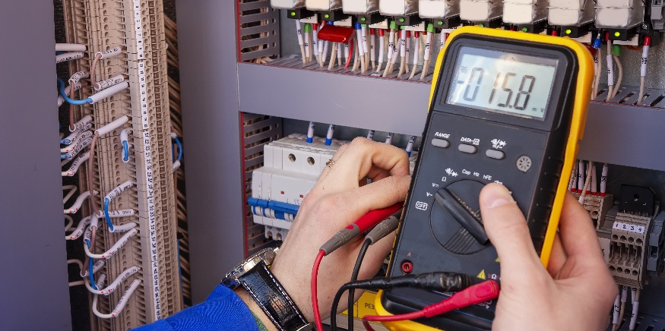
AC Generation

Slide 2
DISCLAIMER & USAGE
This material is based upon work supported by the National Science Foundation's Advanced Technological Education Program under Grant No. 1801177.
Any opinions, findings, and conclusions or recommendations expressed in this material are those of the author(s) and do not necessarily reflect the views of the National Science Foundation.
2

Slide 3
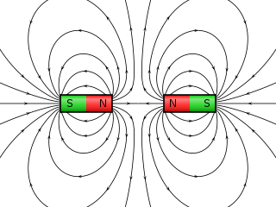
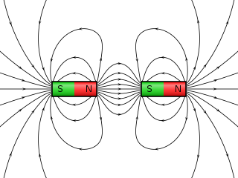
How Is AC made?
AC power is made by a process called induction.
Induction is a power generation process that involves changing a magnetic field.
Recall how magnets work.
Like poles repel; North, North or South, South
Opposite poles attract.
Magnets form field lines.
When a conductor passes through a magnetic field line, a current is induced.

Slide 4
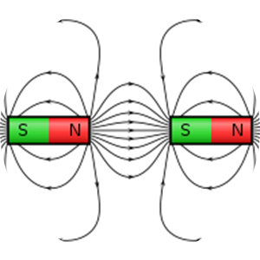
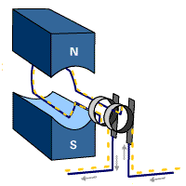
Induction
Conductor
Three things are required for induction to occur
A conductor
A magnetic field
Relative motion
While the magnetic field can be rotated in induction, it is often simpler to rotate the conductor.
The part that is stationary is known as the stator.
The part that is rotating is known as the rotor.
Stator
Rotor

Slide 5
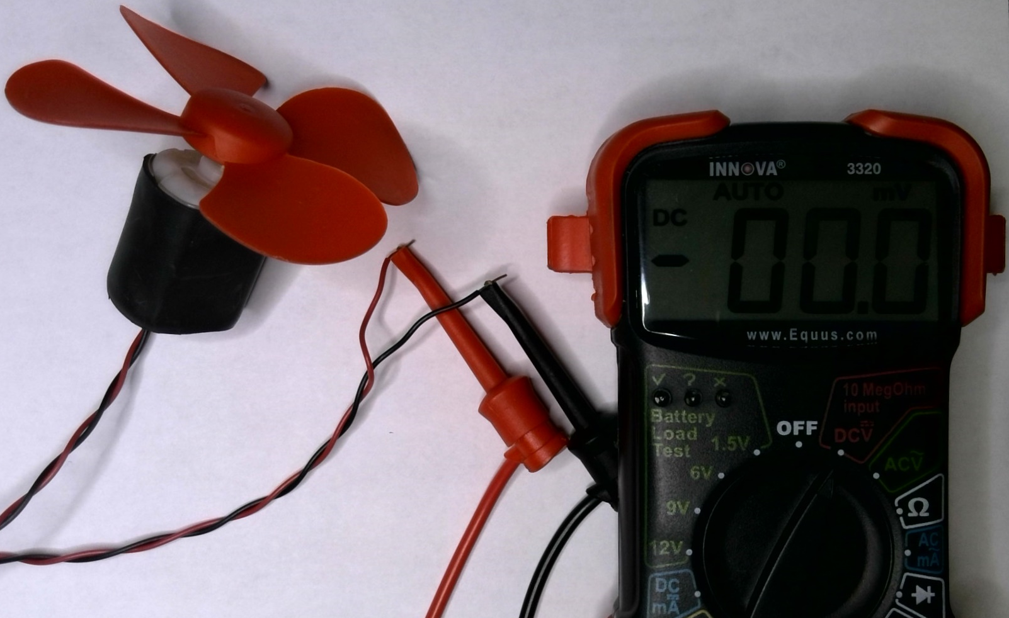
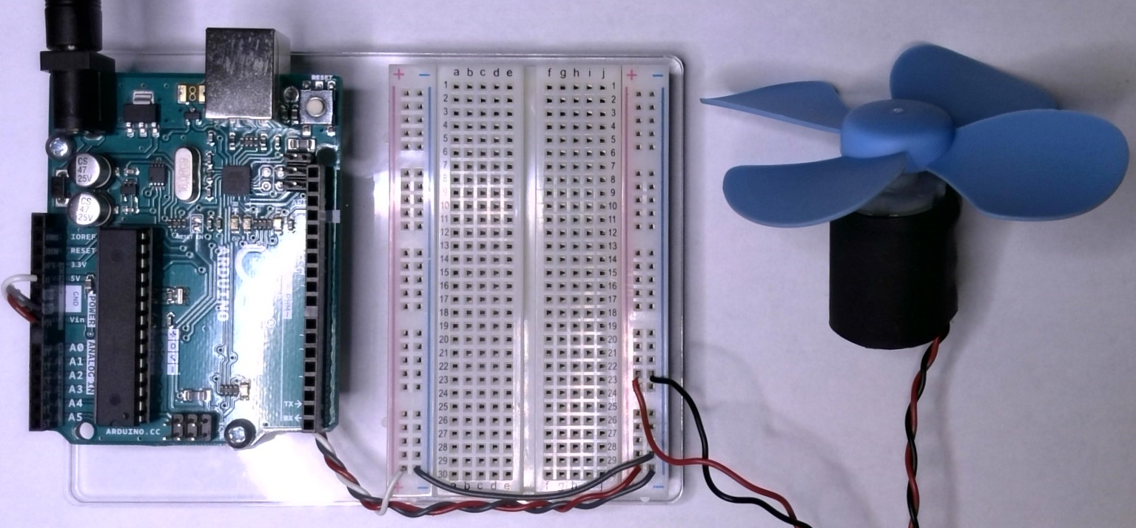
Generating Power
A simple DC motor may be used for induction.
Set your multimeter to measure DC voltage.
Connect your multimeter to your DC motor with the fan blade (red) attached.
Using a partner’s DC motor, direct the second DC motor (blue) face to the face of the first DC motor (red). If you don’t have another DC motor, try using a hair dryer.
Connect the second DC motor (blue) to the $V_{in}$ and ground rail of your breadboard.
With the second DC motor wind turning the first DC motor, what does the multimeter read?

Slide 6
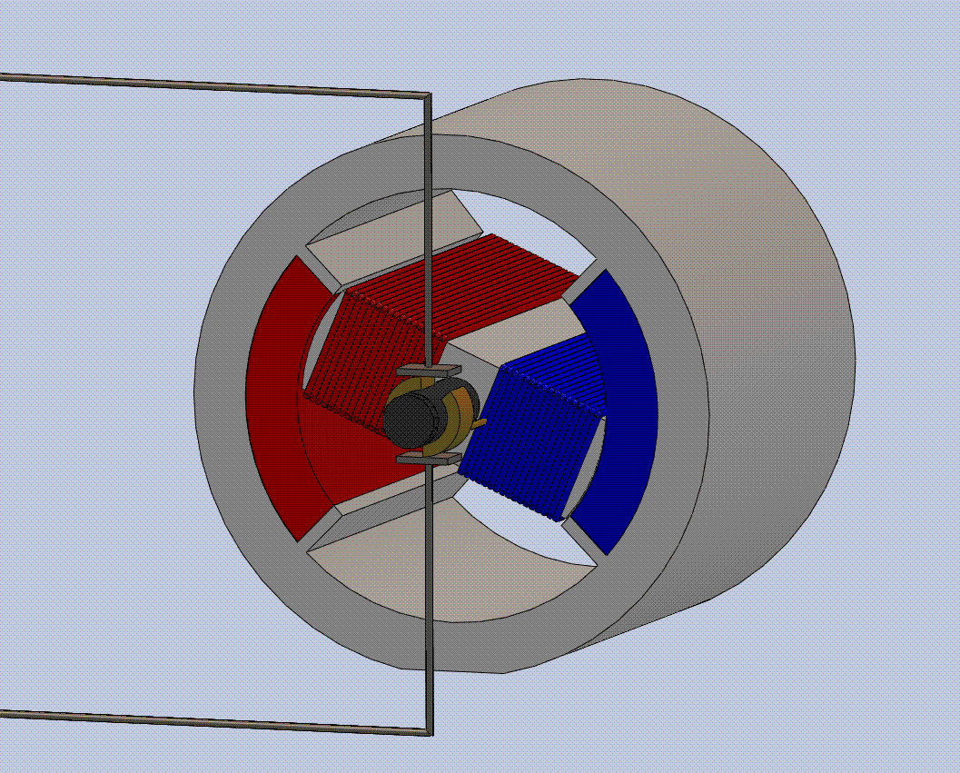
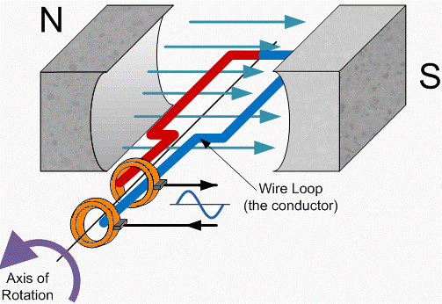
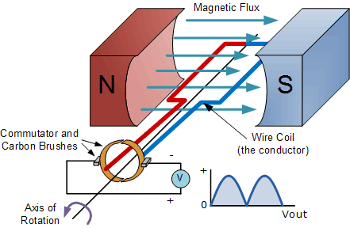
How does it work?
Stator
A simple DC motor consists of two permeant magnets and a coil of wire.
But why does it generate DC instead of AC?
A simple DC motor has bushings that alternative the AC being generated, producing DC; This process is called rectifying.
Magnets
Wire
Rotor
Bushings
To generate AC, a set of slip rings must be used.
Slip Rings

Slide 7
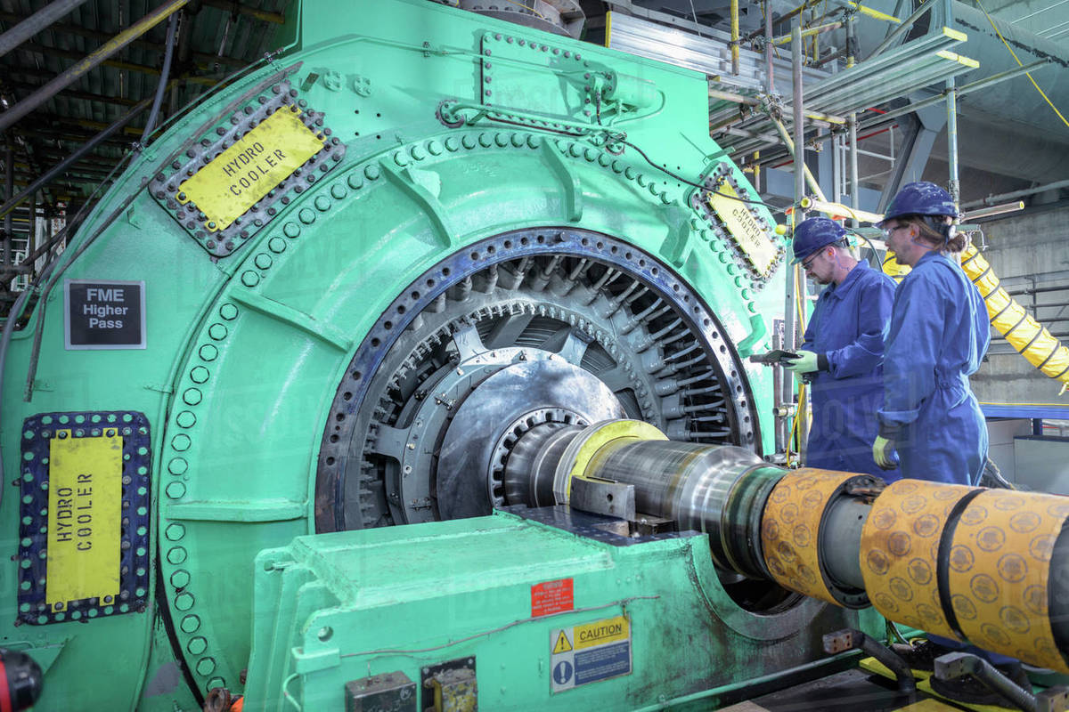
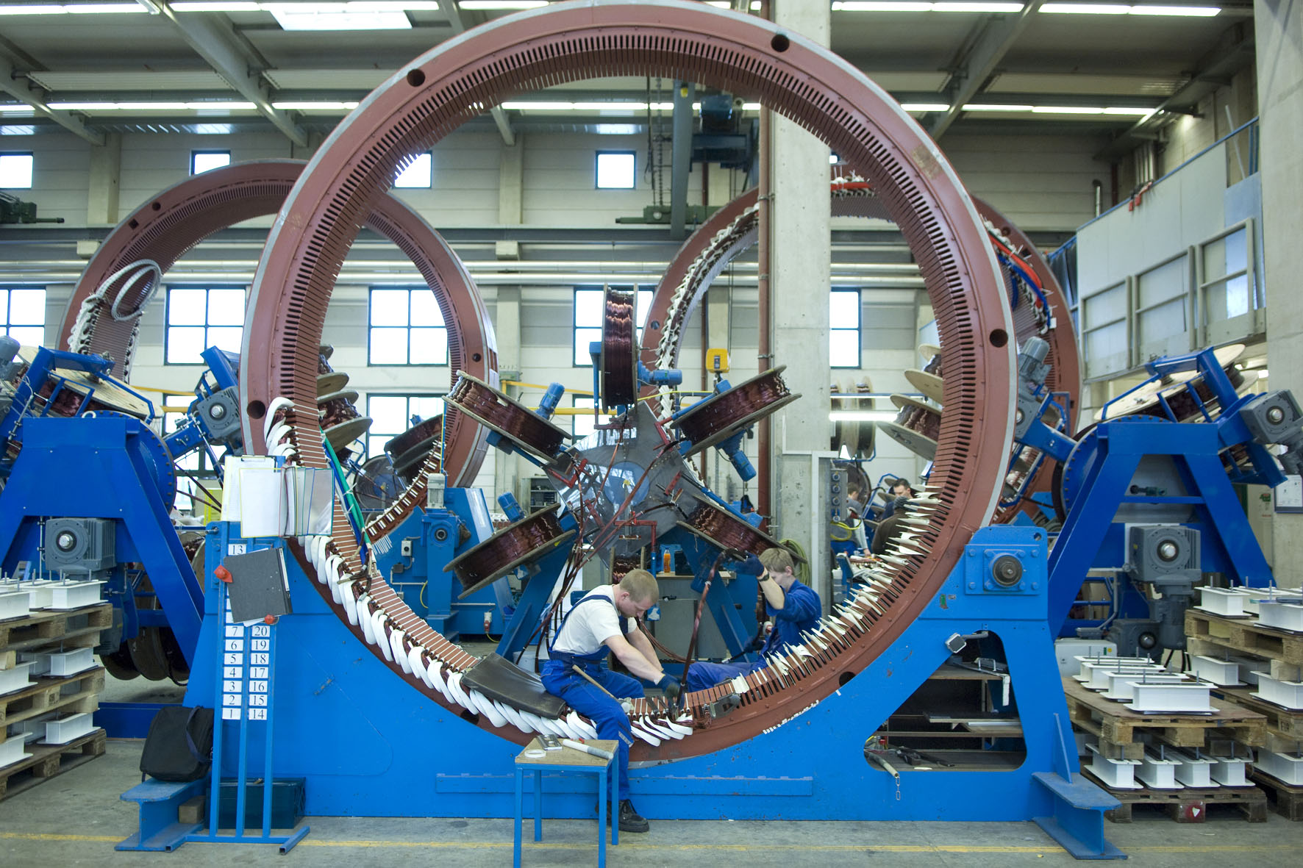
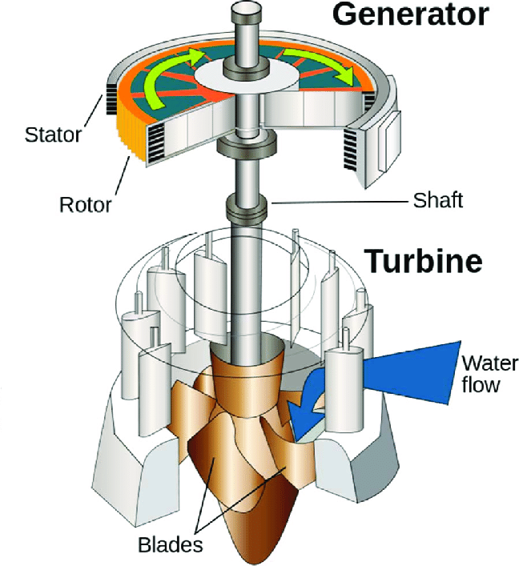
Power Plants
Rotor
This is the same method big power plants use to generate electricity.
Stator

