Slide 1
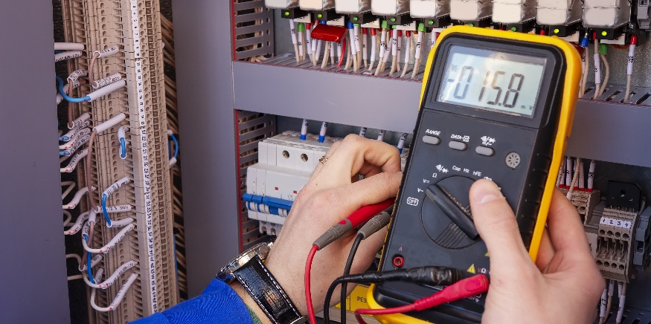
Alternating Current

Slide 2
DISCLAIMER & USAGE
This material is based upon work supported by the National Science Foundation's Advanced Technological Education Program under Grant No. 1801177.
Any opinions, findings, and conclusions or recommendations expressed in this material are those of the author(s) and do not necessarily reflect the views of the National Science Foundation.
2

Slide 3
Types of Circuits
There are two main types of circuits
Direct Current (DC) Circuits
Arduino, computer, cell phones
Must use a transformer to change the wall outlet AC power to DC
Electrons flow in only one direction
Alternating Current (AC) Circuits
Home lighting, air conditioners, fans, wall outlets
Electrons reverse directions many times a second; They alternate
AC
DC Circuit
AC Circuit

Slide 4
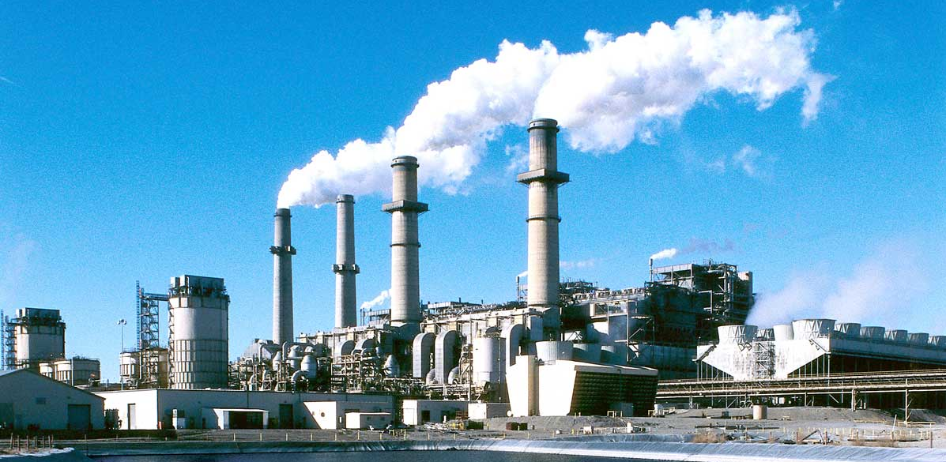
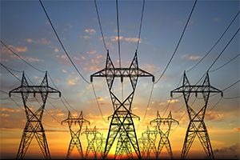
Alternating Current
Power plants produce AC power to supply to the power grid.
The power grid consists of a network of high power transmission lines.
Local transmission lines are connected to the grid to supply power to neighborhoods, commercial buildings, etc.
Once it reaches your home it is reduced down to 120 Volts.
345,000
Volts!
13,800 Volts

Slide 5
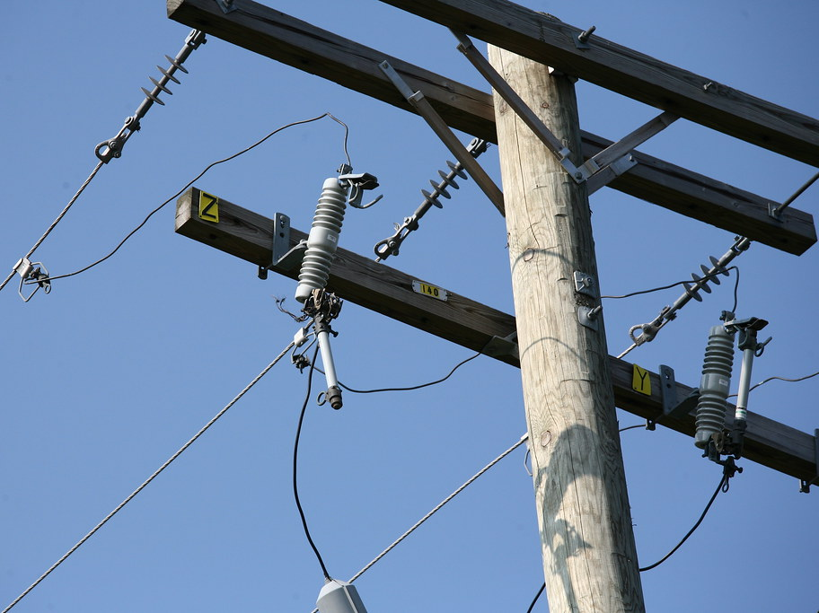
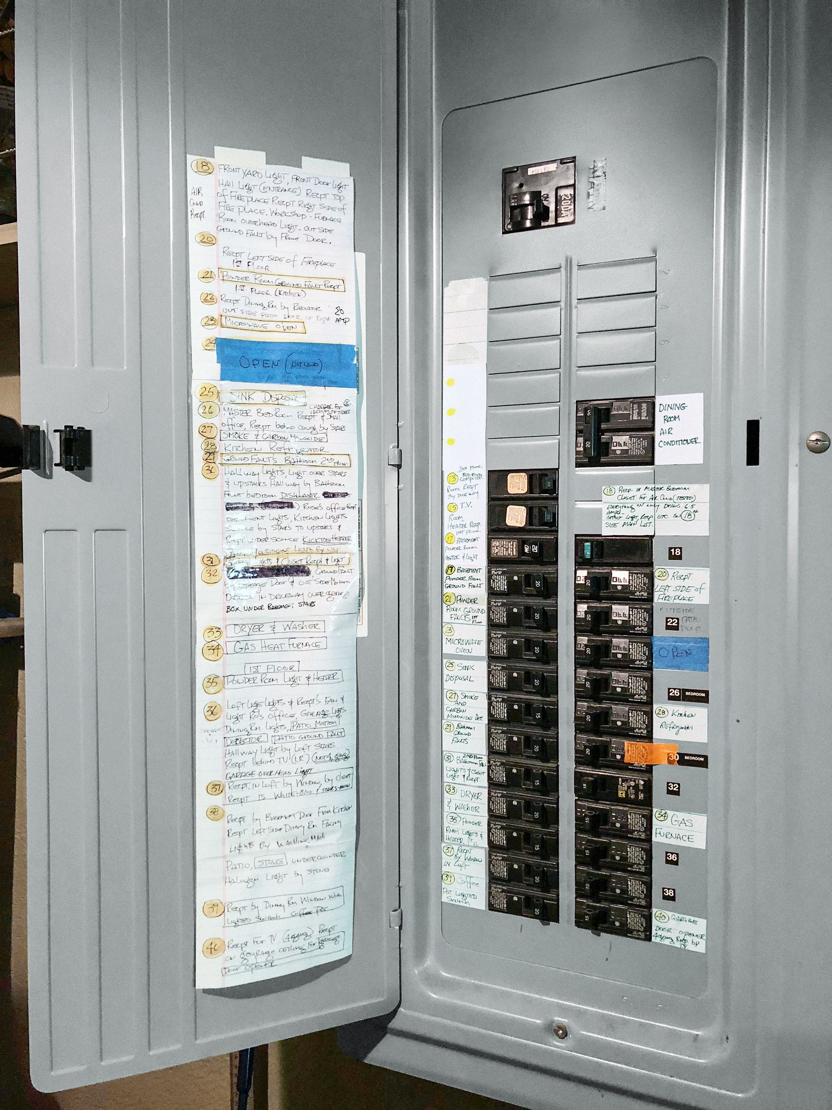
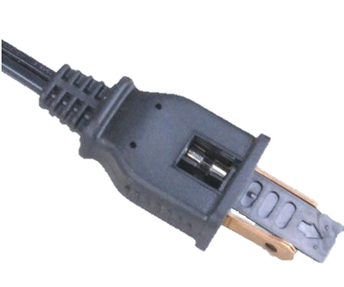
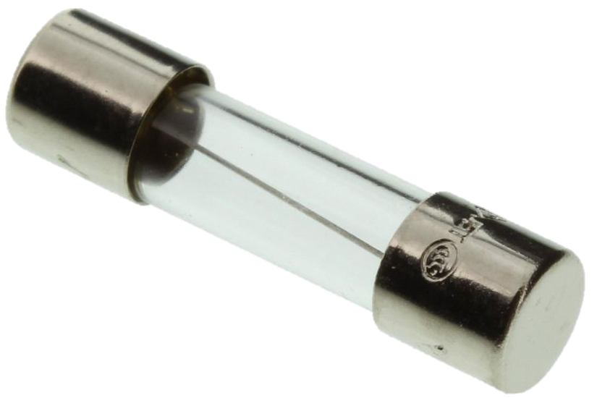
Alternating Current Safety Devices
There are a number of safety devices when dealing with AC circuits.
Utility Pole Fuse
Home Breakers
Ground Fault Circuit Interrupters (GFCI)
Appliance Fuses
Blown Fuse
Working Fuse

Slide 6
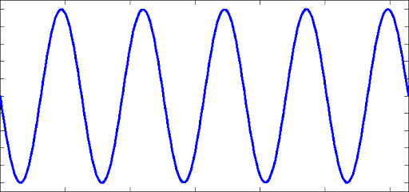
Alternating Current Traits
AC voltage behaves as a sine wave that has an amplitude $A$ and frequency $f$.
The amplitude $A$ is how tall the wave is; This is known as the peak voltage $V_{p}$.
The amplitude can also be described by the peak-to-peak voltage $V_{pp}$.
$A= \frac{V_{pp}}{2}$
In the US, the peak voltage $V_{p}$ of the AC voltage in your home is 170 Volts.
A multimeter reads the root-mean-squared voltage $V_{rms}$.
$V_{rms}=\frac{V_{p}}{√2}$
$$A=V_{p}$$
In the US,
$$V_{rms}=\frac{170V}{√2}≈120V$$
$$V_{pp}$$

Slide 7
Alternating Current Traits
The frequency $f$ of the wave is how often it completes a cycle in one second.
Frequency has units of Hertz ($Hz$) which is cycles per second.
A cycle is one full oscillation of the voltage.
The time it takes to complete one cycle is known as the wave period $T$.
$f= \frac{1}{T}$
$$cycle 1$$
$$cycle 2$$
$$cycle 3$$
$$cycle 4$$
$$cycle 5$$
In the US, the frequency is $60 Hz$.
In Europe, the frequency is $50 Hz.$
$$f=\frac{5 cycles}{1 second}=5Hz$$
$$T=\frac{1}{f}=\frac{1}{5Hz}=0.2s$$
$$1 second$$

