Slide 1
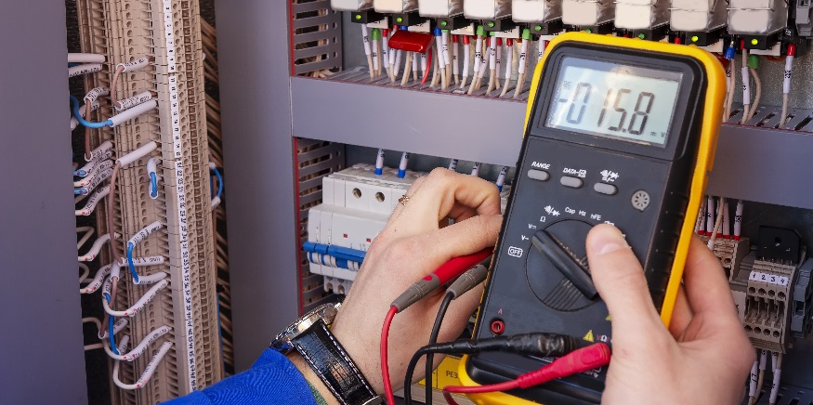
Bridge Circuits

Slide 2
DISCLAIMER & USAGE
This material is based upon work supported by the National Science Foundation's Advanced Technological Education Program under Grant No. 1801177.
Any opinions, findings, and conclusions or recommendations expressed in this material are those of the author(s) and do not necessarily reflect the views of the National Science Foundation.
2

Slide 3
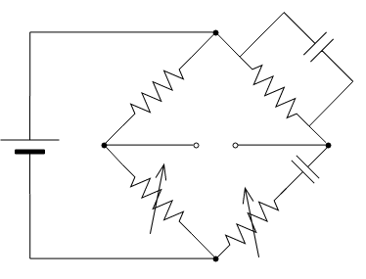
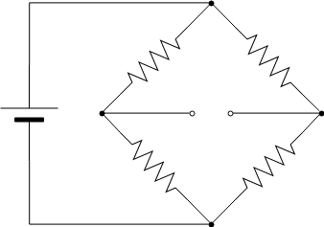
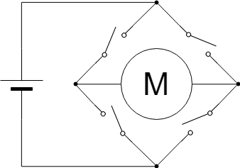
Bridge Circuits
A bridge circuit is a specific type of circuit that has a bridging section usually between two parallel sections.
Here are several common types of bridge circuits.
Wheatstone Bridge
Wien Bridge
H Bridge

Slide 4
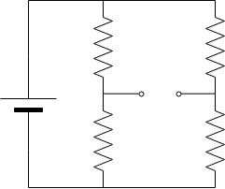
Wheatstone Bridge
The Wheatstone Bridge is probably the most common type of bridge circuit.
It is used in numerous applications:
Digital Scales (i.e. digital bathroom scales, postage scales, etc.)
Ohmmeters
Load cells (used in tensile testing machines)
Let’s look how the circuit works by first simplifying and labeling it.
$$R_{1}$$
$$R_{3}$$
$$V_{s}$$
$$R_{2}$$
$$R_{4}$$

Slide 5
Wheatstone Bridge
It can be seen in this new arrangement the bridge circuit is just two voltage divider circuits in parallel.
The supply voltage $V_{s}$ is called the excitation voltage.
Let’s label the various nodes now.
The current through $ABC$ is
Likewise, the current through $ADC$ is
$$A$$
$$A$$
$$I_{ABC}=\frac{V_{s}}{R_{1}+R_{2}}$$
$$R_{1}$$
$$R_{3}$$
$$V_{s}$$
$$B$$
$$D$$
$$I_{ADC}=\frac{V_{s}}{R_{3}+R_{4}}$$
$$R_{2}$$
$$R_{4}$$
$$C$$
$$C$$

Slide 6
Wheatstone Bridge
The voltage at nodes $B$ and $D$ may then be found by
and
The voltage between the two nodes is then
$V_{o}$ is known as the output voltage.
$$V_{B}=I_{ABC}R_{2}=\frac{V_{s}R_{2}}{R_{1}+R_{2}}$$
$$V_{D}=I_{ADC}R_{4}=\frac{V_{s}R_{4}}{R_{3}+R_{4}}$$
$$A$$
$$A$$
$$V_{o}=V_{D}−V_{B}=\frac{V_{s}R_{4}}{R_{3}+R_{4}}−\frac{V_{s}R_{2}}{R_{1}+R_{2}}$$
$$=V_{s}\frac{R_{1}R_{4}−R_{2}R_{3}}{\left(R_{1}+R_{2}\right)\left(R_{3}+R_{4}\right)}$$
$$R_{1}$$
$$R_{3}$$
$$V_{s}$$
$$B$$
$$V_{o}$$
$$D$$
$$R_{2}$$
$$R_{4}$$
$$C$$
$$C$$

Slide 7
Wheatstone Bridge
Let’s look at some special cases of the circuit.
What is $V_{o}$ when $R_{1}=R_{2}=R_{3}=R_{4}$?
$V_{o}=0V$
When the output voltage is zero, the circuit is said to be balanced.
What is $V_{o}$ when $R_{1}=R_{2}=R_{3}≠R_{4}$?
$V_{o}≠0V$
When the output voltage is not zero, the circuit is said to be unbalanced.
This imbalanced can be related to the amount of change that is experienced in $R_{4}$.
$$V_{o}=V_{s}\frac{R_{1}R_{4}−R_{2}R_{3}}{\left(R_{1}+R_{2}\right)\left(R_{3}+R_{4}\right)}$$
$$A$$
$$A$$
$$R_{1}$$
$$R_{3}$$
$$V_{s}$$
$$B$$
$$V_{o}$$
$$D$$
$$R_{2}$$
$$R_{4}$$
$$C$$
$$C$$

Slide 8
Wheatstone Bridge
Let’s denote the starting value of $R_{4}$ as $R_{0}$.
$R_{4}=R_{0}+ΔR_{4}$
where $ΔR_{4}$ is the amount of change in $R_{4}$.
$V_{o}$ is then
$V_{o}=V_{s}\frac{R_{1}\left(R_{0}+ΔR_{4}\right)−R_{2}R_{3}}{\left(R_{1}+R_{2}\right)\left[R_{3}+\left(R_{0}+ΔR_{4}\right)\right]}$
Solving for $ΔR_{4}$ shows
$ΔR_{4}=\frac{V_{s}\left(R_{1}R_{0}−R_{2}R_{3}\right)−V_{o}\left(R_{1}+R_{2}\right)\left(R_{3}+R_{0}\right)}{V_{0}\left(R_{1}+R_{2}\right)−V_{s}R_{1}}$
$$V_{o}=V_{s}\frac{R_{1}R_{4}−R_{2}R_{3}}{\left(R_{1}+R_{2}\right)\left(R_{3}+R_{4}\right)}$$
$$A$$
$$A$$
$$R_{1}$$
$$R_{3}$$
$$V_{s}$$
$$B$$
$$V_{o}$$
$$D$$
$$R_{2}$$
$$R_{4}$$
$$C$$
$$C$$

Slide 9
Wheatstone Bridge
Why is this important/useful?
A lot of sensors change their resistance based on the conditions they are experiencing (for example, the thermistor).
The Wheatstone Bridge can be used to measure these changes in resistance.
Why not just use a simple voltage divider circuit?
A simple voltage divider circuit is sensitive to slight unintended changes in resistance in either the top or bottom resistors.
The Wheatstone Bridge overcomes this issue by being somewhat self balancing.
That is the circuit auto adjusts to unintended changes in resistances.
$$V_{o}=V_{s}\frac{R_{1}R_{4}−R_{2}R_{3}}{\left(R_{1}+R_{2}\right)\left(R_{3}+R_{4}\right)}$$
$$A$$
$$A$$
$$R_{1}$$
$$R_{3}$$
$$V_{s}$$
$$B$$
$$V_{o}$$
$$D$$
$$R_{2}$$
$$R_{4}$$
$$C$$
$$C$$

Slide 10
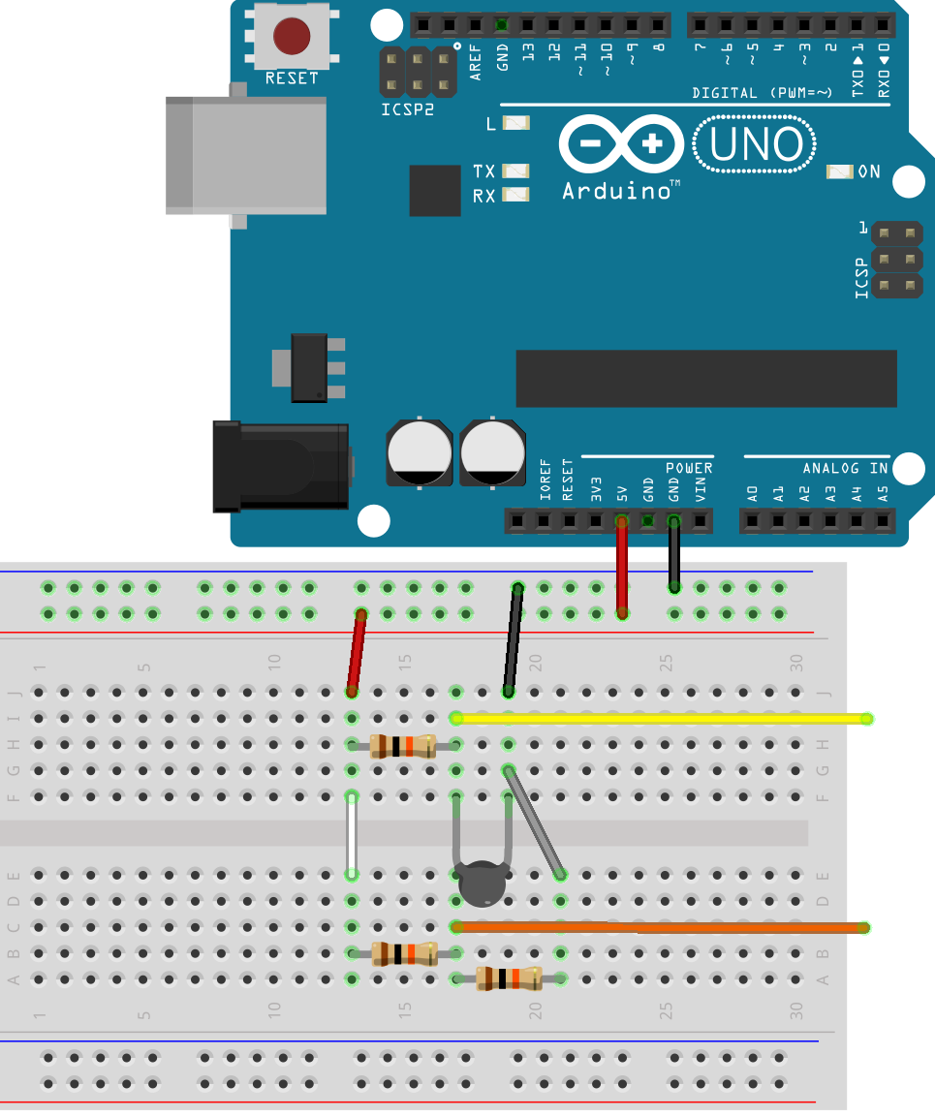
Let’s Build The Circuit
Build a Wheatstone bridge circuit using three $10kΩ$ resistors and your thermistor as shown below.
Connect your multimeter to the yellow and orange wires depicted in the image to the right.
With multimeter set to reading DC voltage, what does it read?
Is the bridge circuit balanced?

Slide 11
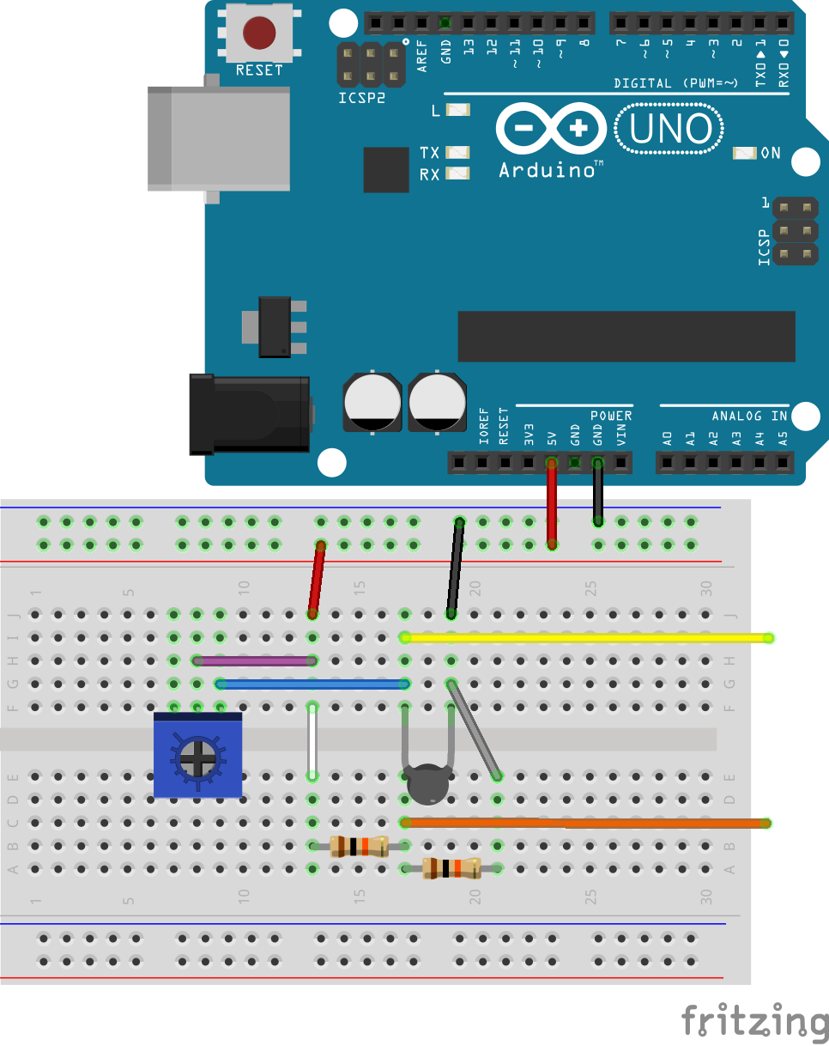
Let’s Build The Circuit
More than likely, your circuit is not balanced. Why?
What can we do to make it balanced?
Using a potentiometer, we can balance the circuit ourselves without the need to obtain resistors that are exactly the same resistance values.
Build the circuit shown below using the potentiometer in place of $R_{3}$.

Slide 12
Let’s Build The Circuit
Now that the potentiometer is implemented, adjust the potentiometer until the multimeter reads zero.
Once the multimeter reads zero volts, the bridge is balanced.
What happens now when you touch the thermistor?
What happens when you make the thermistor colder?

