Slide 1
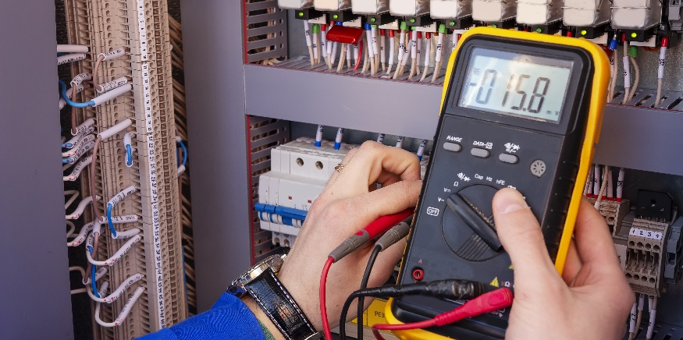
Capacitors

Slide 2
DISCLAIMER & USAGE
This material is based upon work supported by the National Science Foundation's Advanced Technological Education Program under Grant No. 1801177.
Any opinions, findings, and conclusions or recommendations expressed in this material are those of the author(s) and do not necessarily reflect the views of the National Science Foundation.
2

Slide 3
The Capacitor
A component that has the ability to store an electrical charge.
Constructed from two plates separated by a non-conducting dielectric.
Dielectric – A type of electrical insulator.
Different than a battery by its construction. A battery stores electrical charge in chemical bonds.
There are three classifications of capacitors:
Non-polarized
Electrolytic
Variable
Schematic
Symbol
Plates
Dielectric

Slide 4
How it works
When a voltage source is first applied to a capacitor:
Electrons flow from negative terminal to the bottom plate of capacitor.
These electrons cause a build up of negative ions.
The positive terminal attracts electrons causing an excess of positive ions on the top plate.
When the voltage source is disconnected, the ions remain on the plates.
The ions that remain on the plates create a potential difference, or voltage, that may be used at a later time just as a battery would.

Slide 5
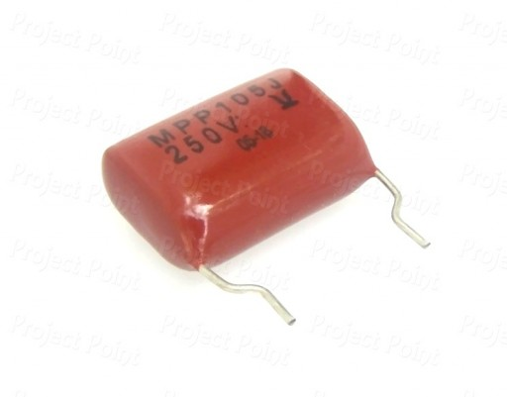
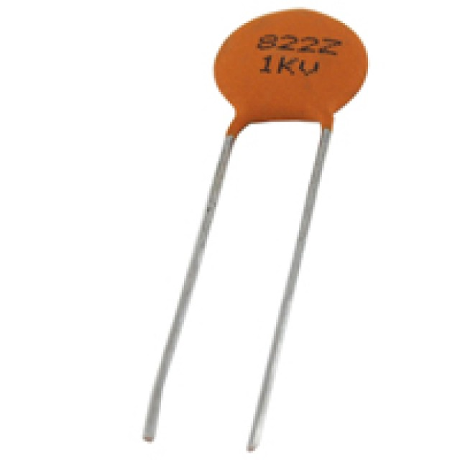
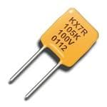
The Non-polarized Capacitor
Schematic
Symbols
General purpose capacitors used to:
Isolate one circuit from another
Block unwanted AC signals
Produce wave shapes
Has no polarity (i.e. like a resistor, can be hooked up either way).
Curved line in the schematic symbol denotes the lower voltage side of the circuit; does not indicate a particular polarity.

Slide 6
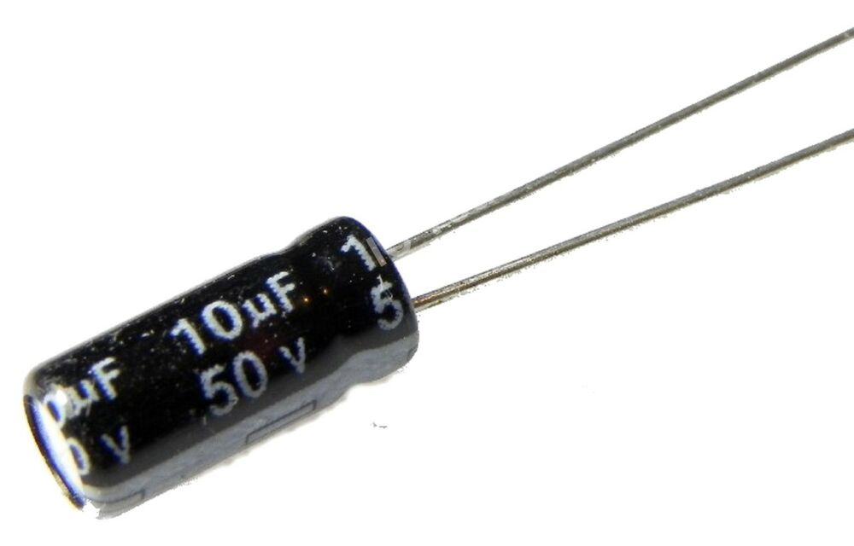
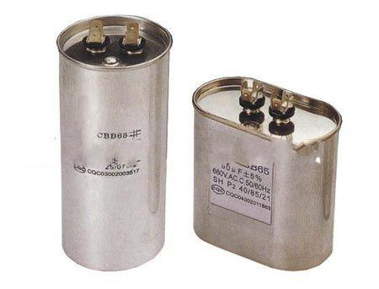
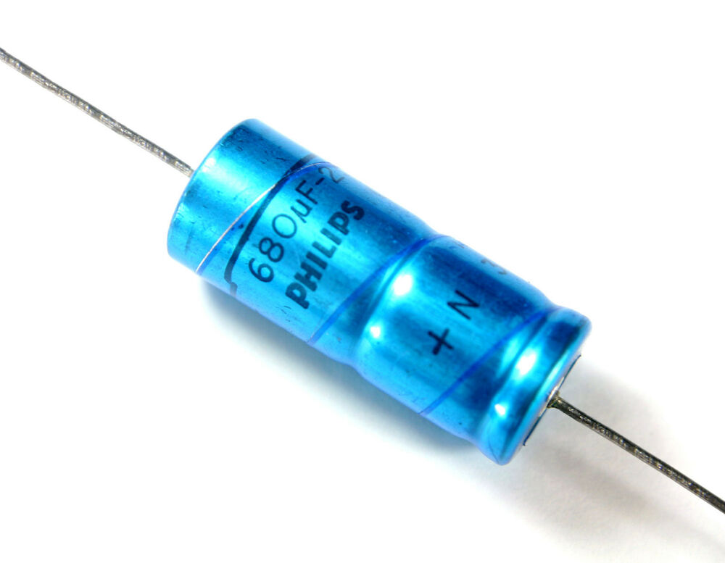
The Electrolytic Capacitor
Named because of the particular process used in manufacturing of capacitor.
Main use is filtering unwanted AC signals in DC circuits.
Does have polarity. Denoted by + sign on schematic.
Polarity should be marked or the long wire lead indicates positive side.
Schematic
Symbols

Slide 7
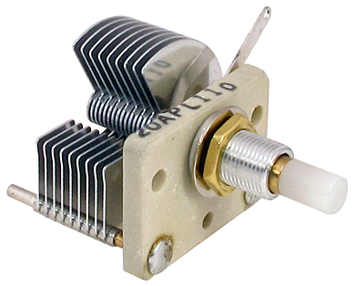
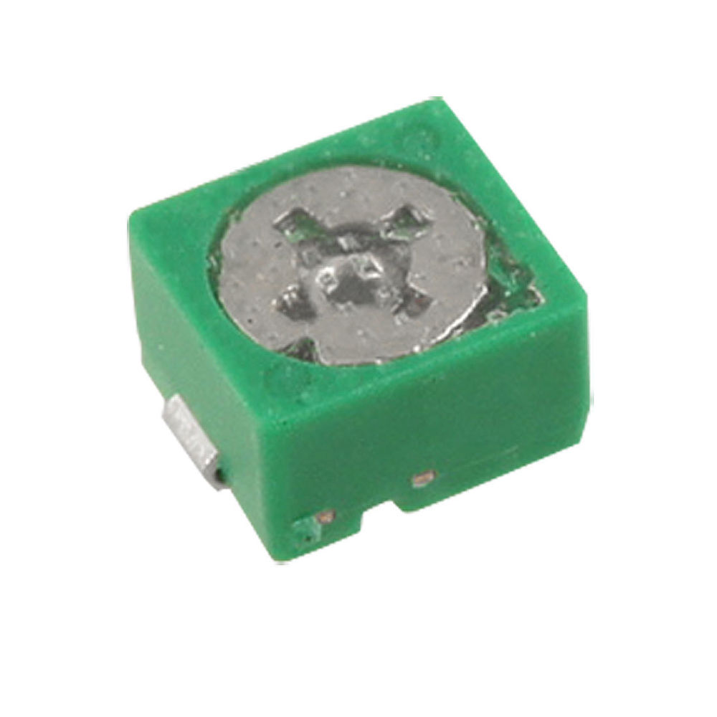
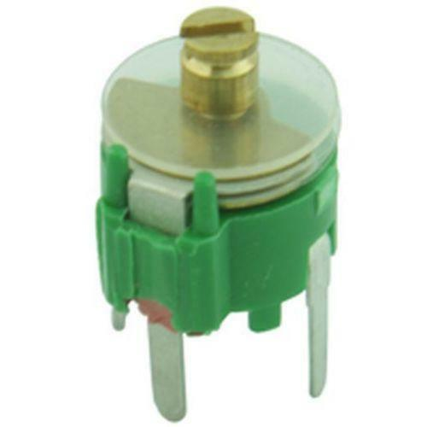
The Variable Capacitor
The schematic symbol contains a crossing arrow.
The variable capacitor does as the name implies. Allows the capacitance to be varied or adjusted.
Non-polarized and electrolytic capacitors are sometimes referred to as fixed capacitor by their inability to be adjusted.
Transmitters and receivers commonly used variable capacitors.
Schematic
Symbols

Slide 8
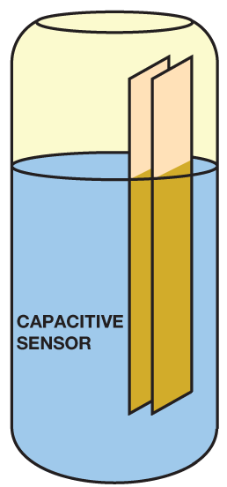
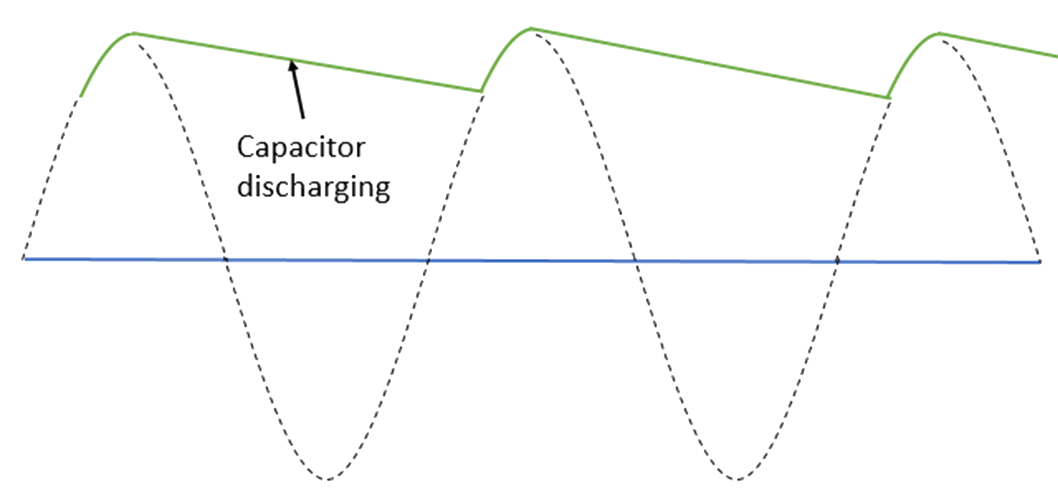
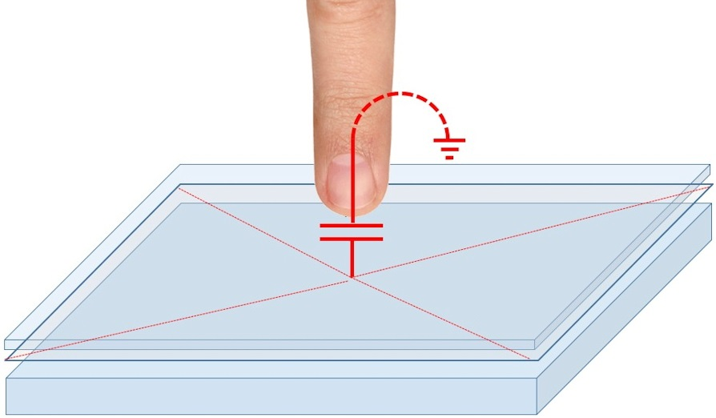
Common Capacitor Applications
Filters in power circuits
When a voltage supply fluctuates, a capacitor acts as a temporary battery to provide a smoother voltage supply.
Certain types of touch screens
A touch screen consists of several layers that are a part of a capacitor circuit. Your finger changes the circuit and the screen knows where the screen has been touched.
In industry, measuring the volume of a tank
The liquid in the tank acts as the dielectric material. As the volume in the tank changes, so does the amount of dielectric material of the capacitor

