Slide 1
First Five 9c

Slide 2
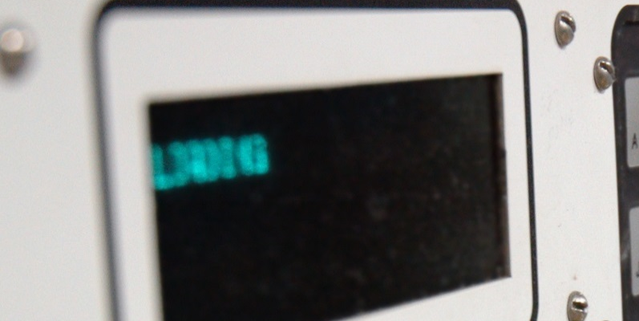



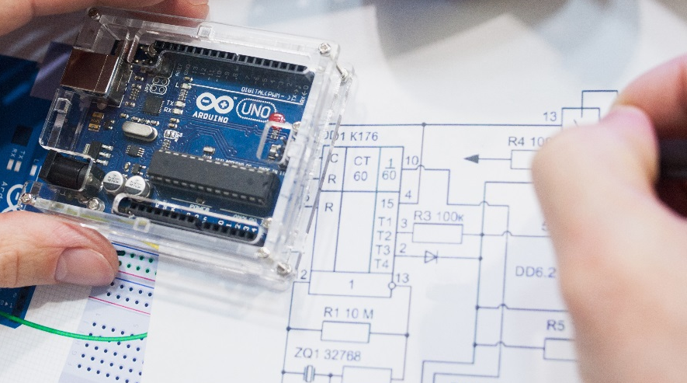


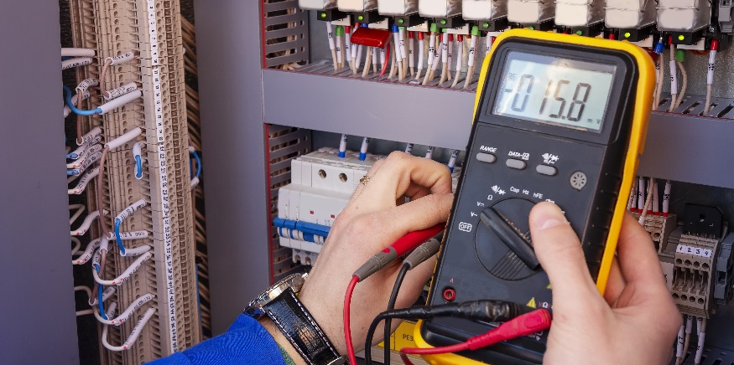

Data Types

Slide 3
Data Types
Define the binary number system.
Convert binary to decimal and decimal to binary numbers.
Define common data types in programming: Boolean, byte, int, long, float, char
Experiment with computing values and data types using the Arduino controller.

Slide 4
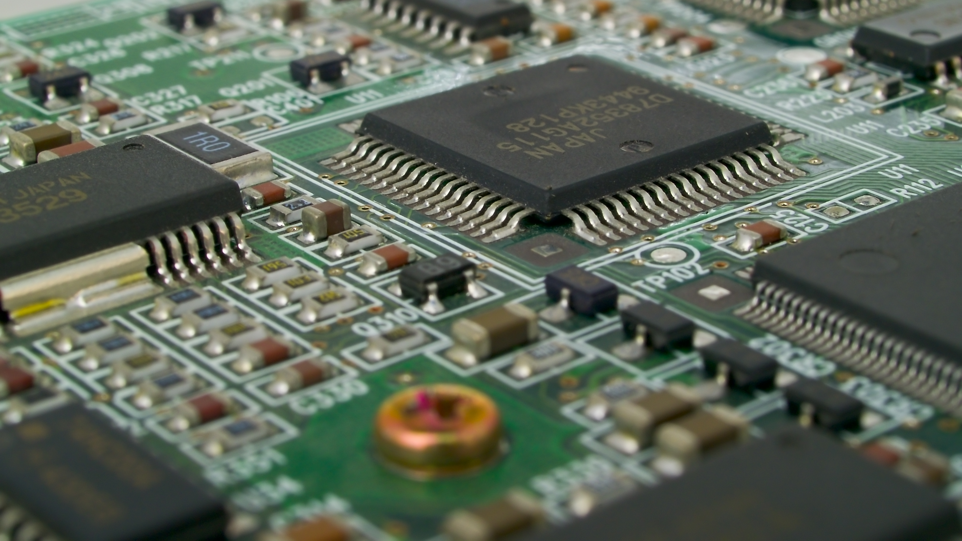
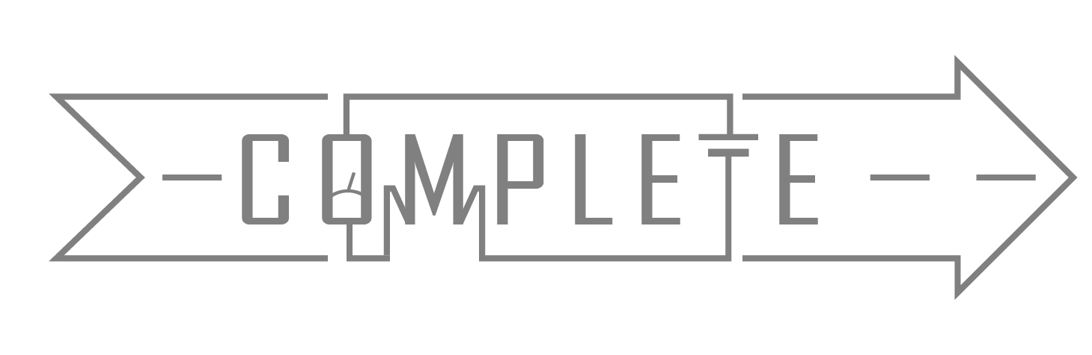
How do computers work?
Use digital electronics
Computer memory and chips keep track of large numbers of on/off “switches”
A switch that is off is associated with a binary number of 0
A switch that is on is associated with a binary number 1
Patterns of “on” and “off” stored inside a computer are used to encode ordinary numbers
Computer processors that use strings of 64 binary numbers to keep track of things are called 64-bit systems

Slide 5
What is binary?
Base 10 is the most commonly used number system
  (10 digits): 0 1 2 3 4 5 6 7 8 9
Binary number system uses base 2
  (2 digits): 0 1
A single unit of information is called a bit.
  In binary a bit can be a 0 or a 1
How many combinations can a 4-bit register represent?
1
1
1
1
0
0
0
0
Total number of bits being represented
2⁴
=16
0
1
Each bit can be 2 options: 0 or 1

Slide 6
What are all the possible combinations of zeros and ones that a 4-bit register can represent?
0
0
0
0
= 0
0
1
1
0
= 6
1
1
0
0
= 12
Number the bits starting with 0
0
0
0
1
= 1
0
1
1
1
= 7
1
1
0
1
= 13
3
2
1
0
0
1
= 2
0
1
0
= ?
= 3
= 2
0
0
= 8
1
1
1
0
= 14
0
0
1
0
= ?
1
0
= 3
1
1
1
1
= 15
0
0
1
1
= ?
1
0
0
1
= 9
2⁰=1
2+1=3
0
1
0
0
= 4
1
0
1
0
= 10
2¹=2
0
1
0
1
= 5
1
0
1
1
= 11
If there is a 1 in the bit, set 2 as the base and raise it to the bit number.
If there is more than one bit with a 1 add their values together.

Slide 7
Counting to 15 in Binary
0
0
0
0
= 0
0
1
1
0
= 6
1
1
0
0
= 12
0
0
0
1
= 1
0
1
1
1
= 7
1
1
0
1
= 13
0
0
1
0
= 2
1
0
0
0
= 8
1
1
1
0
= 14
0
0
1
1
= 3
1
0
0
1
= 9
1
1
1
1
= 15
0
1
0
0
= 4
1
0
1
0
= 10
0
1
0
1
= 5
1
0
1
1
= 11

Slide 8
Binary to Decimal
Number the bits starting with 0
3
2
1
0
0
0
1
1
= 3
2⁰=1
If there is a 1 in the bit, set 2 as the base and raise it to the bit number.
2+1=3
2¹=2
If there is more than one bit with a 1 add their values together.

Slide 9
Your Turn
76543210
Convert 10110011 to a whole number.

Slide 10
Successive Division by 2 for Decimal to Binary Conversion
Convert the decimal value 47 to binary using successive division by 2
Divided by 2, because binary is base 2
$$47 ÷2 =23 with a remainder of 1$$
LSB – Least Significant Bit
$$23 ÷2 =11 with a remainder of 1$$
$$11 ÷2 =5 with a remainder of 1$$
47 to binary is 101111
$$5÷2 =2 with a remainder of 1$$
$$2÷2 =1 with a remainder of 0$$
$$1÷2 =0 with a remainder of 1$$
MSB – Most Significant Bit

Slide 11
Data Types
Variables store information in the form of bits
Predefined data types allow you to choose the best form for a variable
Do you know of any data types?
int
float
Data Type | # of Bits | Range | Comments
int | 16 | -32,768 to 32,767 | Whole number, signed (+ or -), most common data type
Data Type | # of Bits | Range | Comments
int | 16 | -32,768 to 32,767 | Whole number, signed (+ or -), most common data type
float | 32 | -3.4028235x10³⁸ to 3.4028235x10³⁸ | Includes decimal point, total precision is 6 to 7 digits
Data Type | # of Bits | Range | Comments
boolean | 8 | True or false | True ≠ 0 and False = 0
int | 16 | -32,768 to 32,767 | Whole number, signed (+ or -), most common data type
float | 32 | -3.4028235x10³⁸ to 3.4028235x10³⁸ | Includes decimal point, total precision is 6 to 7 digits
Data Type | # of Bits | Range | Comments
boolean | 8 | True or false | True ≠ 0 and False = 0
byte | 8 | 0 to 255 | An unsigned 8 bit number (2⁸=256)
int | 16 | -32,768 to 32,767 | Whole number, signed (+ or -), most common data type
float | 32 | -3.4028235x10³⁸ to 3.4028235x10³⁸ | Includes decimal point, total precision is 6 to 7 digits
Data Type | # of Bits | Range | Comments
boolean | 8 | True or false | True ≠ 0 and False = 0
byte | 8 | 0 to 255 | An unsigned 8 bit number (2⁸=256)
int | 16 | -32,768 to 32,767 | Whole number, signed (+ or -), most common data type
long | 32 | -2,147,483,648 to 2,147,483,647 | Frequently used data type, number with many digits, signed
float | 32 | -3.4028235x10³⁸ to 3.4028235x10³⁸ | Includes decimal point, total precision is 6 to 7 digits
Data Type | # of Bits | Range | Comments
boolean | 1 | True or false | True ≠ 0 and False = 0
byte | 8 | 0 to 255 | An unsigned 8 bit number (2⁸=256)
int | 16 | -32,768 to 32,767 | Whole number, signed (+ or -), most common data type
long | 32 | -2,147,483,648 to 2,147,483,647 | Frequently used data type, number with many digits, signed
float | 32 | -3.4028235x10³⁸ to 3.4028235x10³⁸ | Includes decimal point, total precision is 6 to 7 digits
char | 8 | One 8-bit ASCII character | Alphanumeric characters, multiple characters called strings

Slide 12
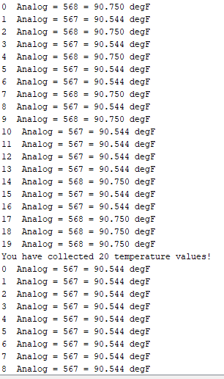
Experimenting with Data Types
Build the thermistor circuit on your breadboard and repeatedly collect 20 temperature values.
  As value are collected move around or blow on the thermistor to get variation in data points.
Have the serial monitor print them exactly as shown to the right.
5V
thermistor
analog input 5
10kΩ

Slide 13
Experimenting with Data Types
How do you get these spaces to print?
Type them into each Serial.print command.
Where do these numbers come from?
How do you get these characters to print?
Each number is an iteration of the for statement.
These are text. Within each of their Serial.print commands you type the characters of the text put in “”.
Where do these numbers come from?
Analog values read in by the Arduino from the thermistor (AnalogRead)
How do you get these changing numbers to print?
These are variables. Within each of their Serial.print commands, you type their variable names (not in “”).
Where do these numbers come from?
Temperature values that are converted from analog values using the inverted calibration equation.
How do you get the temp variable to print 3 places after the decimal?
Why does the count stop at 19 if you wanted 20 data points?
When you type the variable in the Serial.print command put , 3 after the variable name.
The for statement started at 0.
How do you get this line to print after the 20 data points are collected?
How can you restart collecting data points after collecting the first 20?
Serial.print command for that line is written outside of the for statement.
The for statement is written in the loop function not the setup function.
What data type are each of these variables?
int
int
float

Slide 14
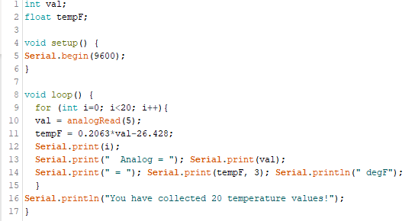
Experimenting with Data Types - Solution

Slide 15
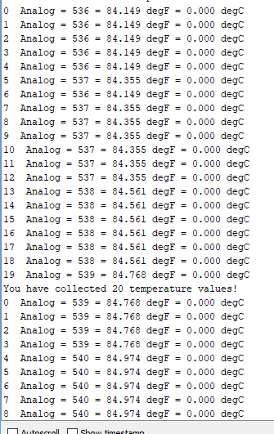
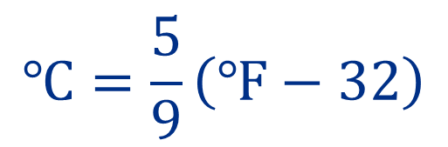
Experimenting with Data Types
Adapt the previous program to convert the temperature from degrees Celsius to a degrees Fahrenheit.
Print the same information as before, just add the extra information.
It should be printed as shown to the right.
°F to °C conversion equation is:
$$℃=\frac{5}{9}\left(℉−32\right)$$

Slide 16
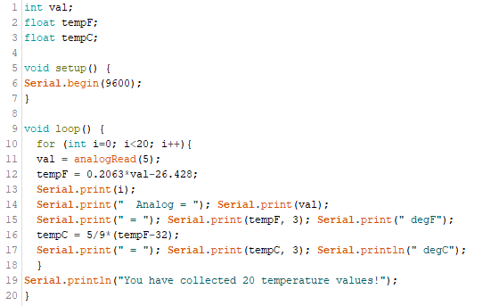
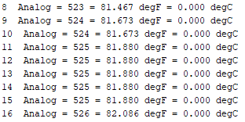
Experimenting with Data Types
Getting Started:
Will you need a new variable?
What data type should your new variable? Why?
After you amend your sketch, check to make sure the calculations are correct.
Yes, need a variable for the temperature in °C.
Float because it will have decimal places.
Serial Monitor Sample:
Let’s check the math here!
New lines added to sketch

Slide 17






Experimenting with Data Types
These values do not match.
Temperature in °F | °C Value from Arduino | °F Value Using Calculator
81.467 | 0.000
81.673 | 0.000
81.880 | 0.000
$$℃=\frac{5}{9}\left(81.467℉−32\right)=27.4816℉$$
$$℃=\frac{5}{9}\left(81.673℉−32\right)=27.5961℉$$
Even though you set the variable to be a float the Arduino is not handling the decimals properly.
It has something to do with the 5/9.
As the division is executed, the Arduino does not see 5/9 as a decimal. It only sees the whole number, 0.
You need to tell it to use AND keep decimal places in the calculations.
Change it to 5.0/9.0 (or 0.556) and see if the calculations are corrected.
$$℃=\frac{5}{9}\left(81.880℉−32\right)=27.7111℉$$
The Arduino values are wrong; where are these numbers coming from?
Take a closer look:
$$\frac{5}{9}\left(81.467℉−32\right)$$
It is as if the 32 is added to each °C value.
$$0.556\left(81.467℉−32\right)$$
The Arduino truncates the numbers after the decimal.
$$0.556\left(81.467℉−32\right)=0.000$$

Slide 18
Tips for Programming
Use the appropriate data type
Print out everything you calculate
Check any calculations by hand
Start with small pieces that build towards the larger program
Comment the lines of code to help you remember their purpose

