Slide 1
First Five 8a: Analog Read
5V
For the given the circuit, the analogRead(4) value is 932. Find:
the current that passes through the photoresistor
The voltage drop across the photoresistor
photoresistor
analog input 4
10kΩ
Sensors Calibration: https://www.youtube.com/watch?v=n_lZCIA25aI&list=PLln3BHg93SQ812ihcqWb9OOWbZ-09DLW6&index=1

Slide 2
Introduction to Excel

Slide 3
Introduction to Excel
Identify key components and functions of an electronic spreadsheet.
Record and format data in a spreadsheet.
Sort data in a spreadsheet.
Use statistical functions in a spreadsheet: Min, Max, Average
Select mathematical functions in a spreadsheet.
Copy formulas in a spreadsheet to build a table.
Use relative referencing and absolute referencing in a spreadsheet.
Make a scatter plot from a table.
Place a chart title and axes labels on a plot.
Format chart area, data series and axes.

Slide 4
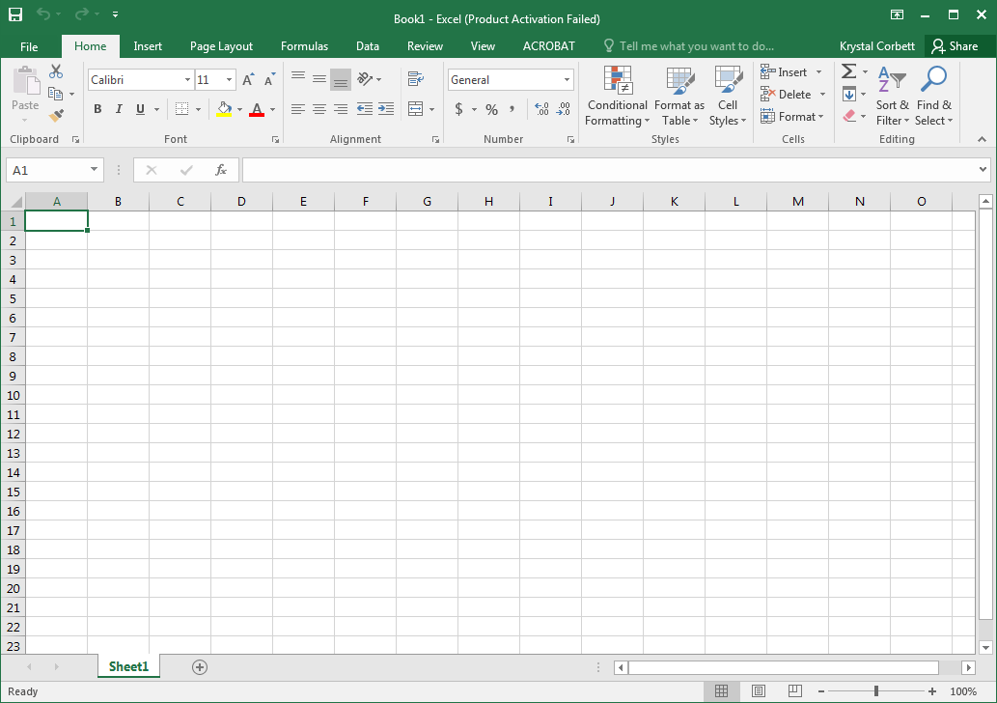
Electronic Spreadsheet Program
Excel is used to record, organize, display, and manipulate data.
An excel file is called a Workbook.
Workbooks contain spreadsheets.
Tabs for spreadsheets are found at the bottom left of the Excel window.
Each Spreadsheet consists of a matrix of cells (individual squares within the spreadsheet).
Cells are identified by row number and column letter.
Data are input into the cells.
Formatting and other features are found in the tabs at the top of the tabs at he Excel window.
NOTE: This presentation uses Microsoft Excel 2016, images and instructions may vary depending on the version of Excel being used.

Slide 5
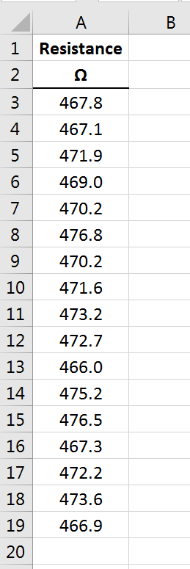
Measure a 470Ω Resistor
Record your measured value in a spreadsheet.
Input the other measured values from your classmates into your spreadsheet.
Be sure to use headings and units
Presenting data in an organized manner is essential when using Excel
Tip: You can put the symbol Ω instead of writing Ohms by going to the insert tab, clicking symbol, and finding the Ω option.
Spend some time making the data look nice. Some suggestions:
Click on text justification
Strategically bold headings
Put boarders
color | digit
black | 0
brown | 1
red | 2
orange | 3
yellow | 4
green | 5
blue | 6
violet | 7
gray | 8
white | 9

Slide 6
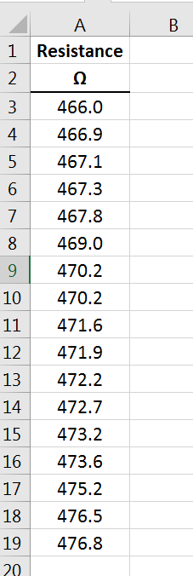
Sort the Data in Ascending Order
Highlight the data by left clicking the first cell holding the mouse button and dragging it to the last cell.
Right click within the highlighted section.
Navigate to sort and find the sort option desired.
Note: Often in Excel there is more than one way to do the same function. You could have sorted the data by using the taskbar at the top of the Excel window.

Slide 7
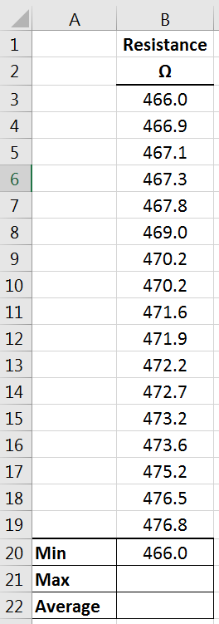
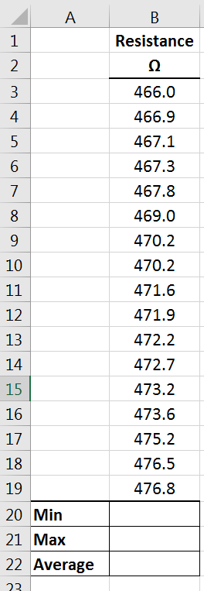
Using Functions to Find Statistical Information
To keep things organized, insert a column to the left of the data.
Right click on the column label “A”
Click Insert
Type in labels for the different pieces of information we will calculate about the data:
Min
Max
Average
Experiment with formatting options.
Inserting the Min function:
Click in the cell to the right of Min
Type =MIN(
Notice how some suggested functions show up
Then highlight all of the data points above ands close the parentheses. In the cell, you will have:
=MIN(B3:B19)
Try putting functions in to calculate Max, and Average.

Slide 8
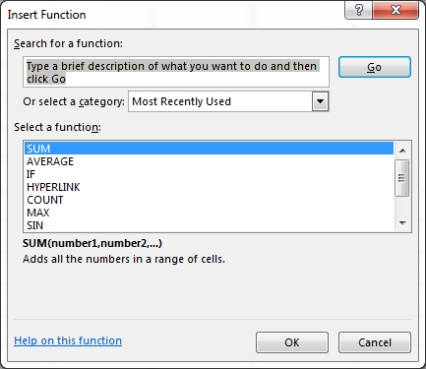
Tips for Inputting Functions
Some functions are built into the taskbar. Look for these functions under the Home and Formulas Tabs.
You can use the function button to help you insert a function into a cell.
If you do not know what to type for the function you can search for a function in the Insert Function Window.
Notice this window tells you how the function should be entered and what the function does.

Slide 9
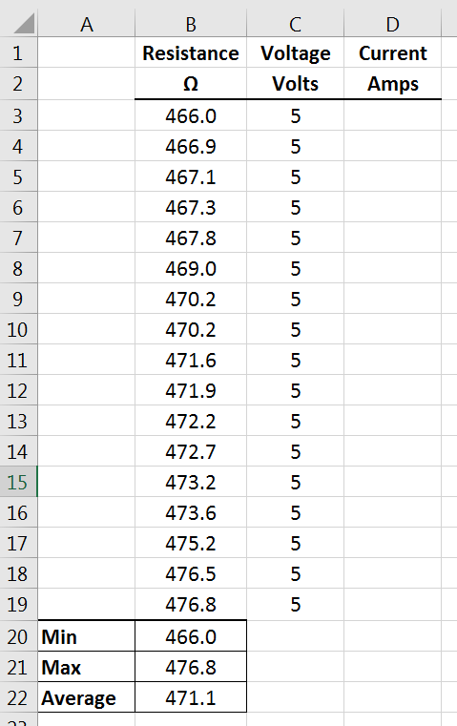
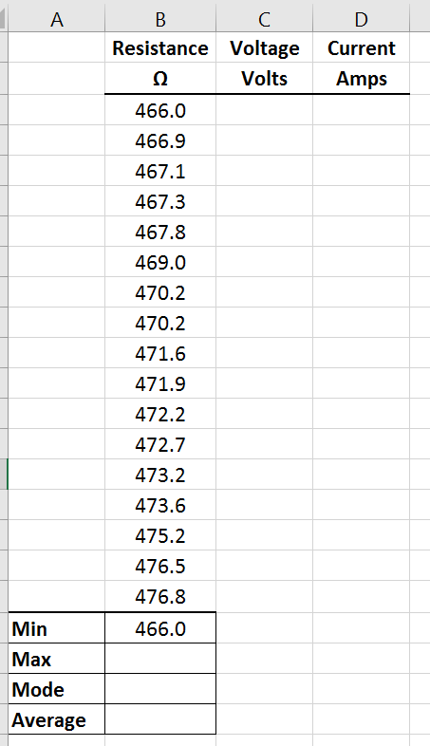
Use Ohm’s Law to Find Current If the Resistor is plugged into a 5V power Source
Add a column for voltage and current.
Put 5V in all the cells under the voltage column.
You could type it into each cell, but Excel can auto fill it for you.
Type a 5 in the first cell.
Click the cell.
Hover over the bottom right corner of the cell until the cursor turns into a cross slender plus sign.
Left click the corner and drag down into all the cells you want the 5 to be in.

Slide 10
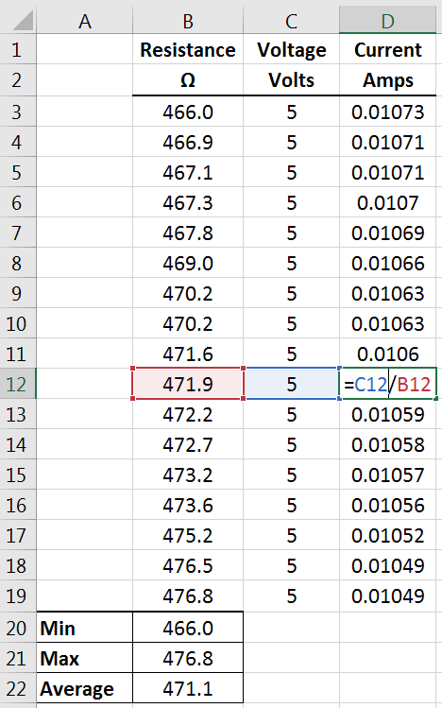
Use Ohm’s Law to Find Current for Each Resistance
Type Ohm’s Law in the first cell under the current column. Instead of typing I = V/R,
start with =
click on the cell that references the voltage and the cell that resistance to build the calculation.
Drag the formula down using the right corner crosshairs (like you did with the 5V).
Notice how the values for each line are different.
The formula is referencing the cells relative to its location.
This is called Relative Referencing.
When you hit enter the value will appear.

Slide 11
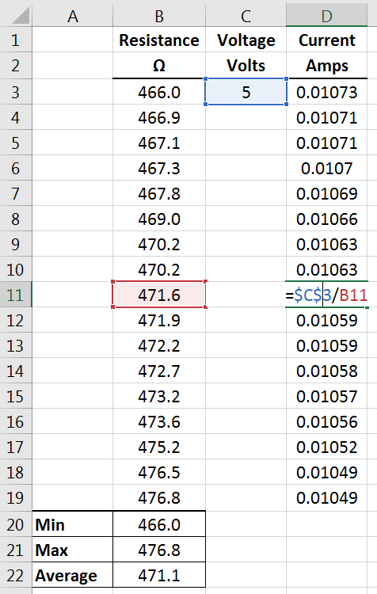
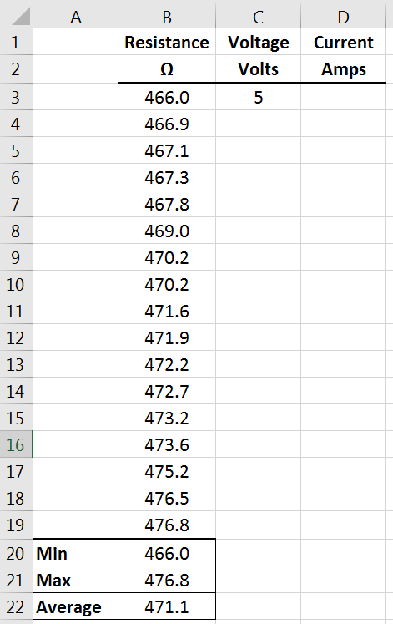
Make the Current Calculation more Efficient
The 5V in every cell under that column is redundant.
Delete all the 5V values leaving only the first one.
Delete the current calculations too.
We always want voltage to be 5 in this scenario. We absolutely always want the formula to use 5.
To do this, Excel uses $ to lock the value in.
In the first cell under Current, type = and then click on the voltage cell. It should look like:
=C3
To lock that value put a $ before the C to lock that column and a $ before the 3 to lock that row (F4 is a keyboard shortcut for this).
=$C$3
Then continue the formula. Type / for divide and click the cell with the resistance value being used in the calculation.
Drag the formula down using the right corner crosshairs (like you did with the 5V).
What happens when you put the $ only in front of the column letter or only in front of the row number (e.g.; $C3 or C$3)? Try both out to see what happens!
This is called Absolute Referencing.

Slide 12
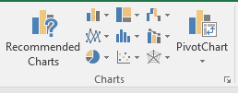
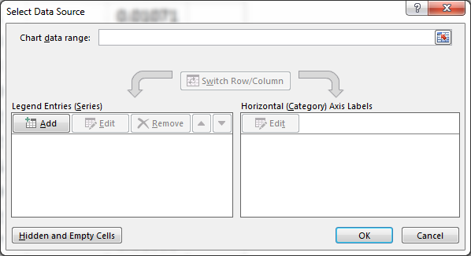
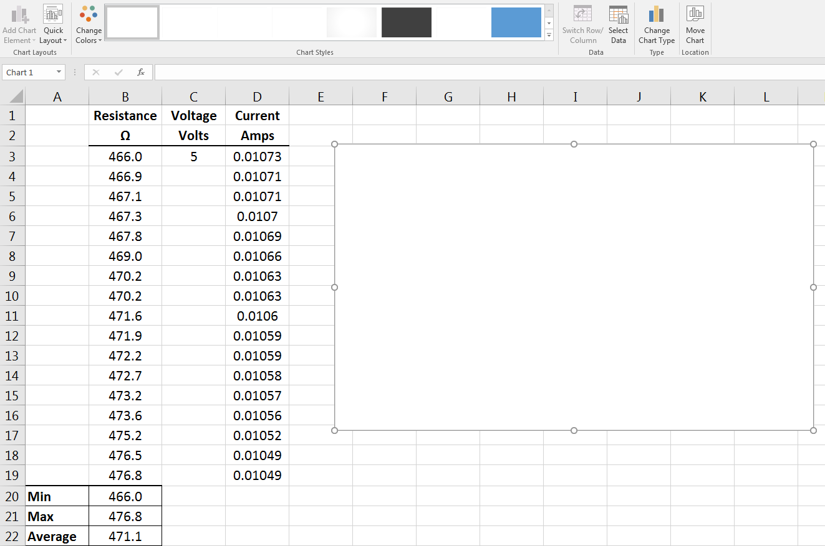
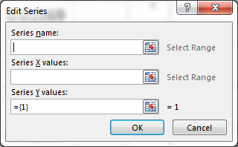
Make a Plot of the Current Values
Go to the Insert tab.
Find the Charts section.
Click Select Data.
The Select Data Source window appears.
Type a series name. Typically the name should be the Dependent Variable (y-axis) versus the Independent Variable (x-axis).
Current versus Resistance
Click into Series X values section.
Highlight all Resistance values.
Click Scatter Plot.
Why use a Scatter Plot and not one of the other types of plots?
A blank window should appear.
Click Add. The Edit Series window appears.
Note: there are many other methods to plotting data. If data is pre highlighted Excel can intuitively build the plot. This technique, however, gives you the most control.

Slide 13
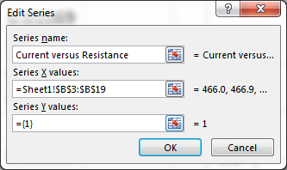
Make a Plot of the Current Values Continued
Click into Series X values section.
Highlight all Current values.
Clear out any information in this section. If you do not do this you will get an error.
Notice how the scatter plot is starting to populate.
Press okay to close the Edit Series window. Press okay to close the Select Data Source window.

Slide 14
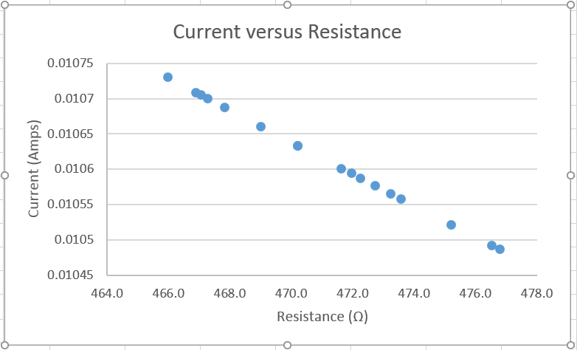
Make a Plot of the Current Values Continued
The plot is almost finished. What is missing?
Axes Labels
Since there is only one set of data on the graph, you can delete the legend.
Click into the Axis Title sections to type the actual axis titles. Remember to include Units!
Under Quick Layout, you can find different built in graph layouts. Shadowboxes shows you where information can be placed. Layout 1 is usually a great option.
Right Click on the graph and play with formatting the Chart Area. (Format Chart Area)
Right click on the data point markers and play around with changing their appearance.
(Format Data Series)
Right click an axis and adjust its settings.
(Format Axis)

Slide 15
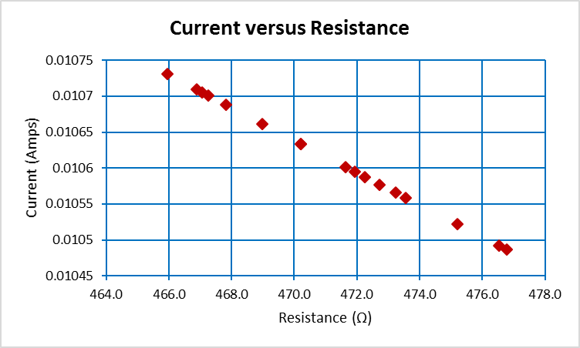
Tips for Excel
Click around.
Press buttons see what happens.
Don’t be afraid to make mistakes.
CTRL+Z undoes any mistakes.
You will learn by doing. The more you do, the more you will learn.
Google is a huge resource with tips and tutorials.

