Slide 1
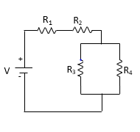
First Five 6a: Discrete DC Sensors
Given: E = 17V, R₁= 380Ω, R₂= 220Ω, R₃=120Ω,
R₄= 500Ω
Solve for R_{eq}, and I_{s}, and I₁₂₀
Clean sheet
Draw diagram
Show work
PLC Basics (5:59): https://www.youtube.com/watch?v=PbAGl_mv5XI
How to Wire Discrete DC Sensors (13:57): https://www.youtube.com/watch?v=0DoqKS8jqSA&list=PLln3BHg93SQ812ihcqWb9OOWbZ-09DLW6&index=4

Slide 2
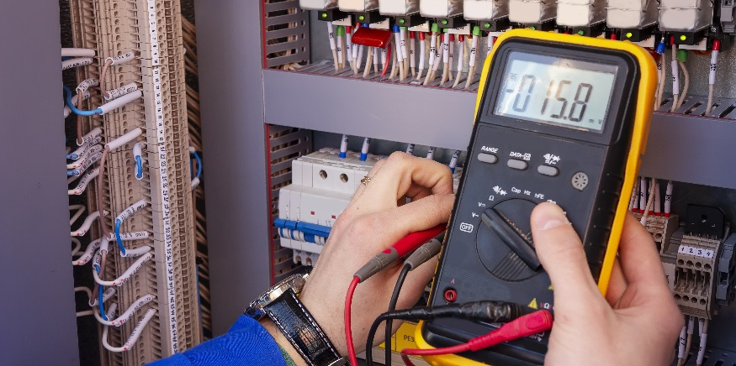
Maintained Switches

Slide 3
Maintained Switches
Define maintained and momentary switches.
Build a circuit that uses a slider switch.
Define single and double pole throw switches.
Connect a switch as a Single Pole Double Throw (SPDT) in a circuit.

Slide 4
Switch Basics
Switches are used to complete or break the connection of an electrical circuit.
Schematic representation:
Types of switches:
Maintained
Momentary
Basic on/off function holds state that switch is set to.
Only in “on” state when activated. Used for intermittent user-input.
Why do you think both types are useful?

Slide 5
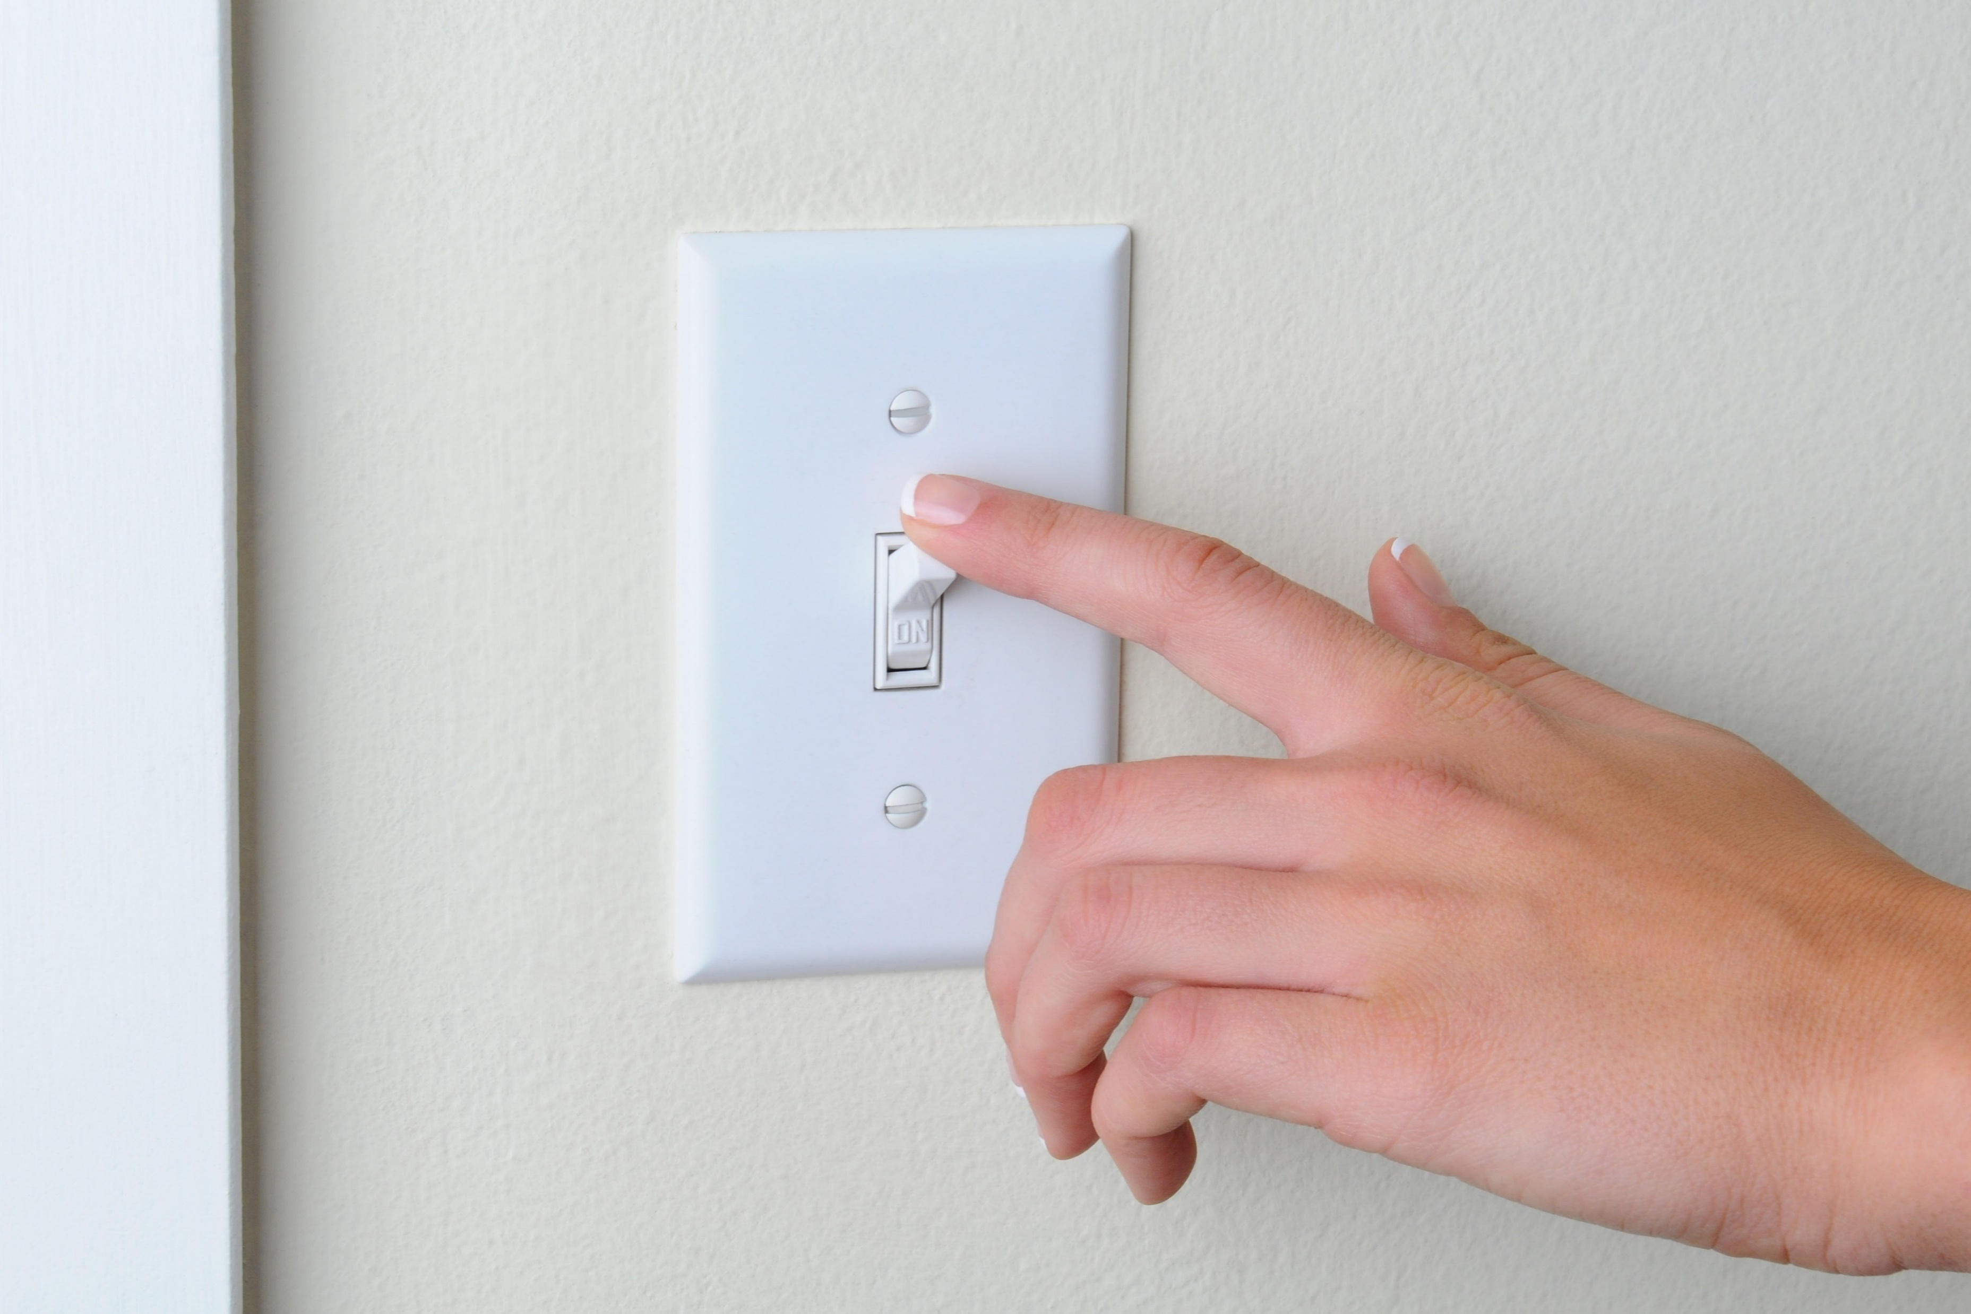
Determine whether each example is a maintained or momentary switch.
Maintained
Pickup switch
Light switch
Keyboard keys
Maintained
Video game buttons
Doorbell
Momentary
Momentary
Momentary

Slide 6
Maintained Slider Switch
Consider this circuit, with the switch representing a maintained slider switch.
5V
Metal tabs connected sliding mechanism completes the circuit or breaks the circuit depending on the position of the slider.
220Ω
220Ω
5V

Slide 7
Slider Switch
Build this circuit onto your breadboard.
The 5V is connected to the middle terminal
other components are connected to one of the outer terminals.
Flip the switch to see the LED turn on and off.
This circuit only uses two of the switch terminals.
Why do you think there are three terminals on the switch?
5V
220Ω
The other terminal is to allow you to change the position of the switch such that it will activate another part of the circuit.

Slide 8
Poles and Throws
Given this information, can you come up with a definition for pole and throw?
The current set up for the slider switch is to make it turn on and off one circuit: Single Pole Single Throw
The other terminal on the slider switch allows you to change the position of the switch which will activate another part of the circuit: Single Pole Double Throw
Pole – Number of separate circuits the switch can control.
Throw – Number of positions each of the switch’s poles can be connected to.
One shared terminal in the middle (pole) and two terminals that can be initialized to connect with the middle terminal depending on position (throw) of the switch.

Slide 9
Poles and Throws
Single Pole Single Throw
Single Pole Double Throw
Double Pole Single Throw
Double Pole Double Throw

Slide 10
Connect Slider Switch as a SPDT Switch
Throw 1
Throw 2
Throw 1
5V
5V
with the actual switch
Throw 2
220Ω
220Ω
220Ω
220Ω
In your own words describe how the SPDT switch works.

