Slide 1
First Five
Get kits and wire RGB LED per the schematic.

Slide 2
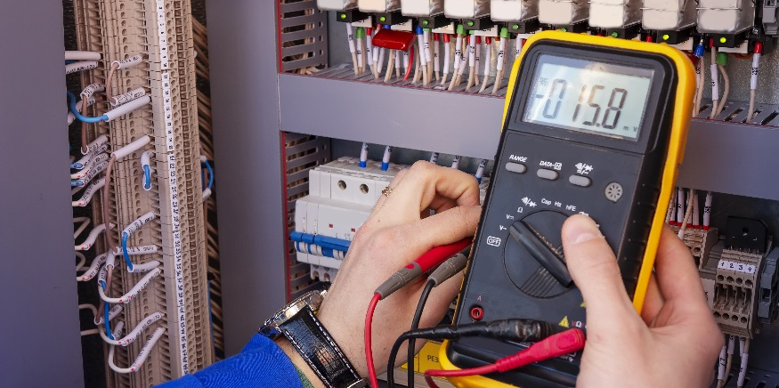
RGB LEDs

Slide 3
Hooking Up the LED
POWER
longest leg
wired to 5V
red
on the end closest to the longest leg
wired to digital pin 9
green
next to the longest leg, but not on the end
wired to digital pin 10
blue
on the end, but not next to the longest
wired to digital pin 11
Pin9 (red)
Pin10 (green)
Pin11 (blue)
Note: Our RGB LED has a common anode (+).
220Ω
red
blue
5V
PWR
green

Slide 4
Controlling the Color Output
Pin9 (red)
Pin10 (green)
Pin11 (blue)
RGB LEDs work the same as a typical LED.
The digital pin connected to the desired color must be turned on when you want it to emit light and off when you do not want it to emit light.
If you want the LED to blink red light for 500ms and then off for 500ms, what do you think the lines of code would look like (assume the pin modes are set properly in the setup function).
220Ω
5V
digitalWrite(9, LOW);
digitalWrite(10, HIGH);
digitalWrite(11, HIGH);
delay(500);
digitalWrite(9, HIGH);
delay(500);
Notice that even though you are not using the green and blue colors, you have to remember to turn them off so that ONLY red is emitted.

Slide 5
Controlling the Color Output
Activity 1: Write a sketch that performs these actions:
Emit red for 800ms.
Emit blue for 1000ms.
Emit no light for 750ms.
Emit green light for 1500ms.
Repeat the a through d indefinitely.
Activity 2: Write a sketch that performs these actions:
Blink the RGB LED blue 5 times (on for 200ms, off for 200ms).
Blink the RGB LED red 8 times (on for 500ms, off for 500ms).
Blink the RGB LED green 3 times (on for 1500ms, off for 750ms)
Repeat a though d indefinitely.
TIP: use for loops to set number of blink iterations.
Activity 3: Experiment with the RGB LED and develop your own pattern for displaying colors.

Slide 6
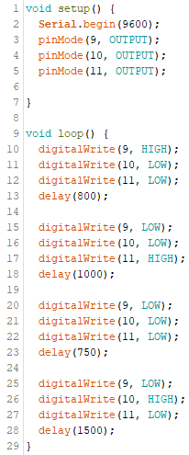
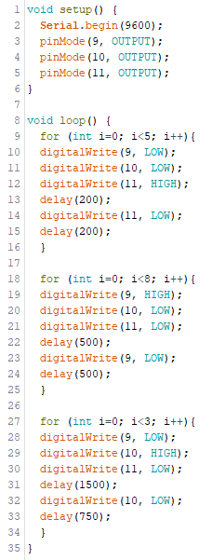
Activity 1 Solution:
Activity 2 Solution:
Need to swap HIGH and LOW
LOW – ON
HIGH – OFF
From this point forward

Slide 7
Going Deeper with the RGB LED
The following slides discuss displaying multiple colors on the RGB LED, using analogWrite commands, and duty cycles. This is extra content outside the scope of the class but can be very interesting and exciting to implement with the RGB LED.

Slide 8
Use these sketches to make your LED blink using analogWrite
make it blink red
make it blink green
make it blink blue
int redLED = 9;
int greenLED = 10;
int blueLED = 11;
void setup() {
pinMode(redLED, OUTPUT);
pinMode(greenLED, OUTPUT);
pinMode(blueLED, OUTPUT);
}
void loop() {
analogWrite(redLED, 255);
delay(1000);
analogWrite(redLED, 0);
delay(1000);
}
int redLED = 9;
int greenLED = 10;
int blueLED = 11;
void setup() {
pinMode(redLED, OUTPUT);
pinMode(greenLED, OUTPUT);
pinMode(blueLED, OUTPUT);
}
void loop() {
analogWrite(greenLED, 255);
delay(1000);
analogWrite(greenLED, 0);
delay(1000);
}
int redLED = 9;
int greenLED = 10;
int blueLED = 11;
void setup() {
pinMode(redLED, OUTPUT);
pinMode(greenLED, OUTPUT);
pinMode(blueLED, OUTPUT);
}
void loop() {
analogWrite(blueLED, 255);
delay(1000);
analogWrite(blueLED, 0);
delay(1000);
}
change to greenLED
change to blueLED

Slide 9
The analogWrite() Function
Enter this program to make your red LED to fade in
The analogWrite() function allows a digital pin to simulate a voltage varying from 0V to 5V by turning a digital pin on and off at about 500Hz.
int redLED = 9;
int greenLED = 10;
int blueLED = 11;
void setup() {
pinMode(redLED, OUTPUT);
pinMode(greenLED, OUTPUT);
pinMode(blueLED, OUTPUT);
}
void loop() {
for (int i=0; i<256; i++) {
analogWrite(redLED, i);
delay(5);
}
}
5V
analogWrite(redLED,0)
0V
0% duty cycle; simulates a voltage of 0
5V
analogWrite(redLED,64)
25% duty cycle; simulates a voltage of 1.25V
0V
5V
analogWrite(redLED,127)
0V
50% duty cycle; simulates a voltage of 2.5V
5V
analogWrite(redLED,191)
0V
75% duty cycle; simulates a voltage of 3.75V
5V
analogWrite(redLED,255)
0V
100% duty cycle; simulates a voltage of 5V

Slide 10
Light up Two Colors to Make Magenta, Cyan & Yellow
make it blink magenta (purple)
make it blink cyan
make it blink yellow
int redLED = 9;
int greenLED = 10;
int blueLED = 11;
void setup() {
pinMode(redLED, OUTPUT);
pinMode(greenLED, OUTPUT);
pinMode(blueLED, OUTPUT);
}
void loop() {
analogWrite(redLED,255);
analogWrite(blueLED,255);
delay(200);
analogWrite(redLED,0); analogWrite(blueLED,0);
delay(200);
}
int redLED = 9;
int greenLED = 10;
int blueLED = 11;
void setup() {
pinMode(redLED, OUTPUT);
pinMode(greenLED, OUTPUT);
pinMode(blueLED, OUTPUT);
}
void loop() {
analogWrite(greenLED,255);
analogWrite(blueLED,255);
delay(1000);
analogWrite(greenLED,0);
analogWrite(blueLED,0);
delay(1000);
}
int redLED = 9;
int greenLED = 10;
int blueLED = 11;
void setup() {
pinMode(redLED, OUTPUT);
pinMode(greenLED, OUTPUT);
pinMode(blueLED, OUTPUT);
}
void loop() {
analogWrite(redLED,255);
analogWrite(greenLED,255);
delay(1000);
analogWrite(redLED,0);
analogWrite(greenLED,0);
delay(1000);
}

Slide 11
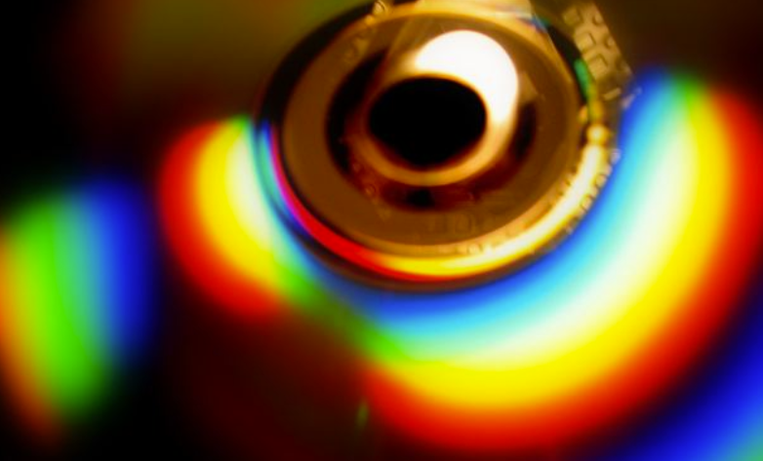
Create Some Crazy Fades
red to green and back
int redLED = 9;
int greenLED = 10;
int blueLED = 11;
void setup() {
pinMode(redLED, OUTPUT);
pinMode(greenLED, OUTPUT);
pinMode(blueLED, OUTPUT);
}
void loop() {
for (int i=0; i<256; i++) {
analogWrite(redLED,255-i);
analogWrite(greenLED,i);
delay(10);
}
for (int i=0; i<256; i++) {
analogWrite(redLED,i);
analogWrite(greenLED,255-i);
delay(10);
}
}
Use “for loops” to create fades between colors
red to green and back to red (see code here)
red to blue and back
blue to green and back
across the visible spectrum and back
do some tricks of your own!
Photo by xenia at Morguefile.com
Did you know that each pixel on your computer or phone display has a red, green and blue subpixel whose intensities can be controlled to produce millions of color variations?

Slide 12
Assignment
Study for Exam / Performance Task

