Slide 1
First Five 4b
Pseudo Code is the use of annotations and text, written in plain English, to help a programmer think through how to write a program/algorithm. It has no prescribed syntax.
Write pseudo code (targeted at making an Arduino sketch) to make an LED blink on and off, at 2 second intervals.

Slide 2
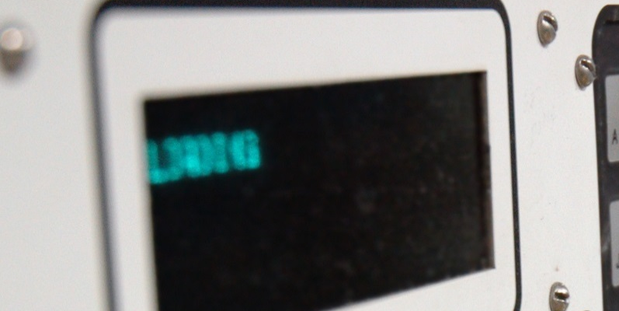



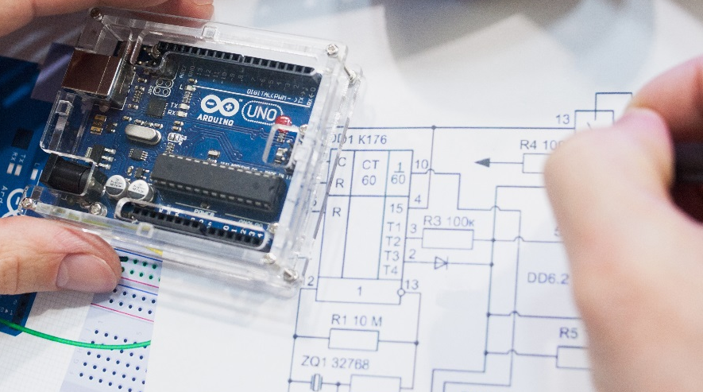


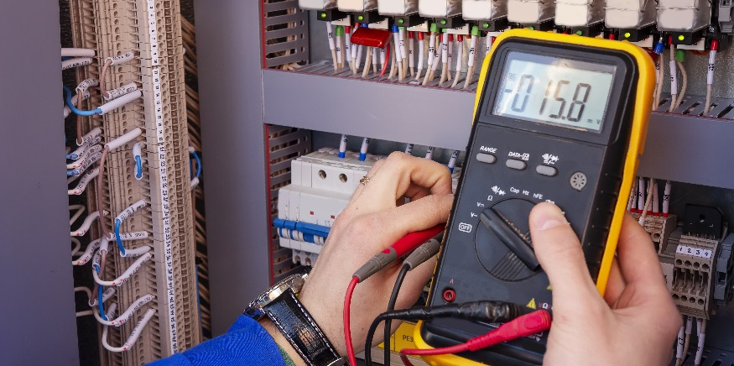

Making an LED Blink

Slide 3
Making an LED Blink
Make an LED blink using the Arduino controller.
Make changes to a sketch to change the blink rate of an LED.

Slide 4
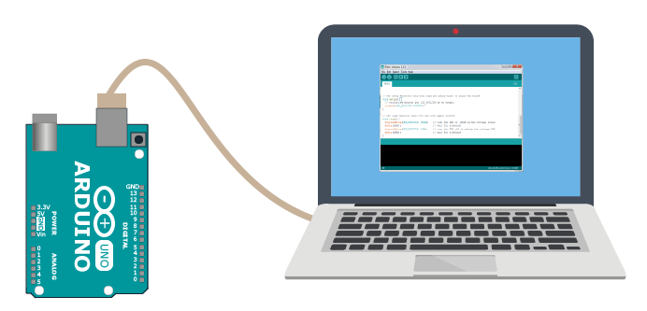
Making an LED blink
Open the Arduino IDE.
Load the blink sketch (File → Examples → Basics → Blink).
Upload the sketch to your Arduino.
Send to Arduino
On Board LED Blinks!
You will use the Arduino to make an LED that you build on your breadboard blink!

Slide 5
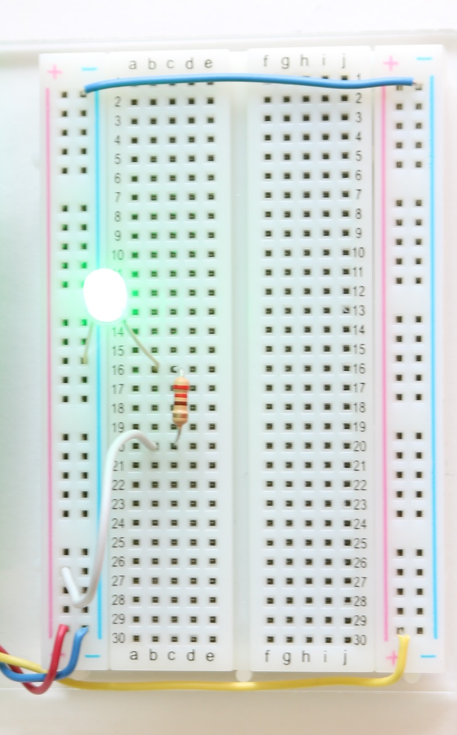
Lighting an LED
Build the circuit on your breadboard.
Use the 5V and ground on your Arduino.
5V
220Ω
220Ω
+
-
5V
same
Can you make this LED blink?
Not Really

Slide 6
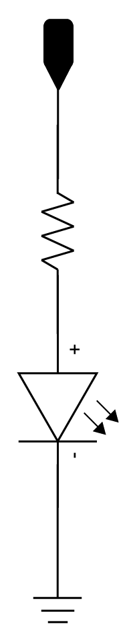
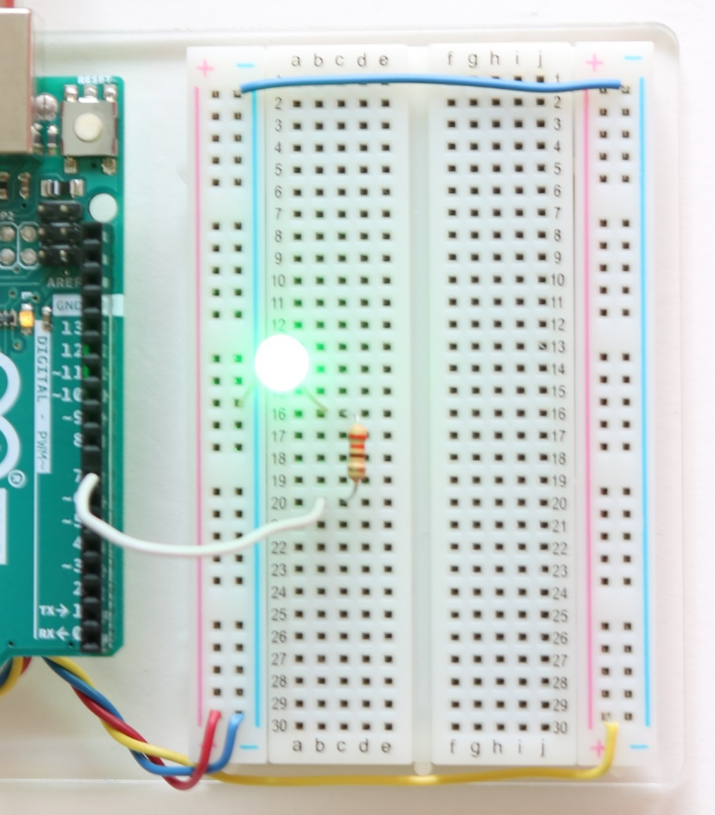
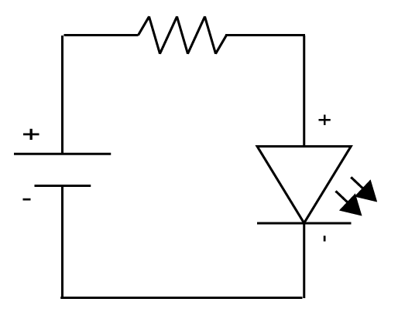
Make an LED blink repeatedly every half second
Rebuild the circuit to be powered by pin 7.
Have the blink sketch from before loaded on your IDE (File → Examples → Basics → Blink).
  Pin number is arbitrary as long as the physical pin matches the pin number written in your sketch.
  We will adapt this program to control the LED circuit on your breadboard.
Pin 7
220Ω
220Ω
same
Voltage of Pin 7

Slide 7
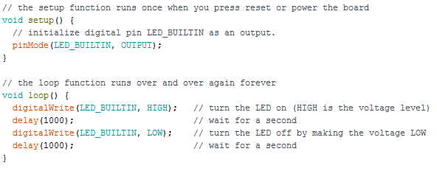
What needs to change?
Remember you are making the LED blink every half second.
7
7
Recall, LED_BUILTIN is another name for pin 13
7
500
Half second
500
7
Half second
Refer to the “Getting Started with the Arduino” presentation for an explanation of how the sketch works.

Slide 8
Play around with the sketch.
Change the time to 1.5 seconds on and 1 second off.
Blink out SOS in Morse code (dot-dot-dot-dash-dash-dash-dot-dot-dot)
  three short pulses (0.25 seconds each) followed by
  three long pulses (0.75 second each) followed by
  three short pulses (0.25 seconds each) followed by
  a brief pause (1 second)
  repeat a. through d. using an infinite loop
Change the LED circuit to be connected to a different pin.

