Slide 1
First Five 05c
If a 5 volt battery is attached to terminals A and C, how much current is flowing through the 220Ω resistor?
How much voltage is dropped across the 470Ω resistor? (i.e. what is the potential difference between node A and node B?)
A
B
470Ω
220Ω
C

Slide 2
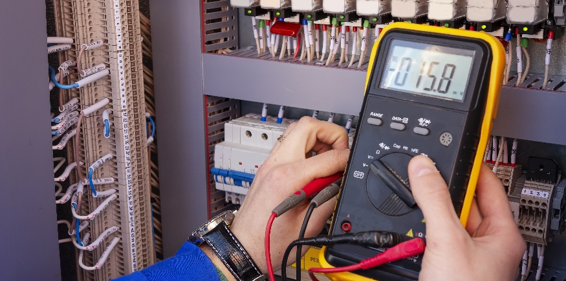
Kirchhoff’s Current Law

Slide 3
Kirchhoff’s Current Law
Measure current through a DC motor.
Measure current from a power source.
Measure current through a resistor in a circuit.
Verify Kirchhoff’s Current Law.
Use KCL to analyze a circuit.

Slide 4
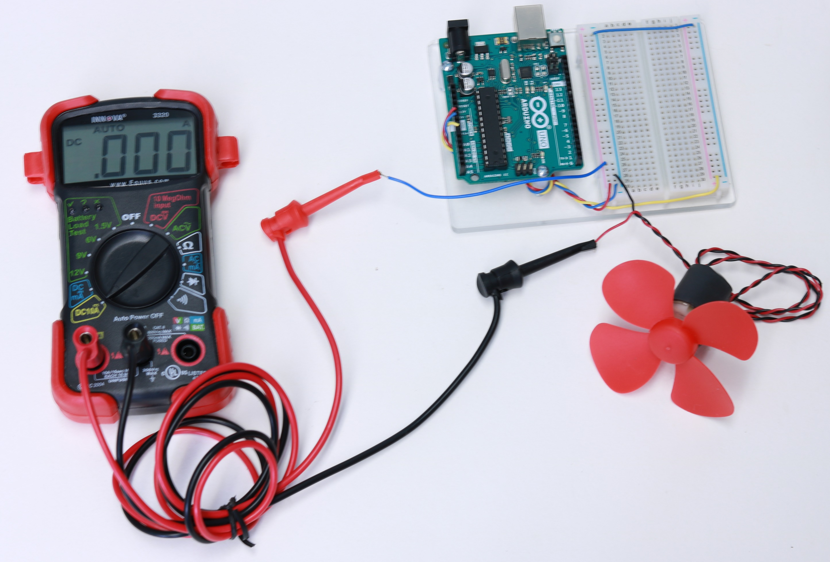
Measure the Current through a DC motor
The multimeter is part of the circuit when measuring current
Jumper wire is used to connect multimeter to circuit
+
-
5V
M
Dial is set to DC10A position
Red lead is plugged into DC10A jack.
-
+
5V
TIP: Connect everything but the jumper wire (blue wire pictured) first. Hold the motor at the base and then connect the jumper wire last. The fan will turn fast, do not touch the blades with your fingers when it is rotating.
M

Slide 5
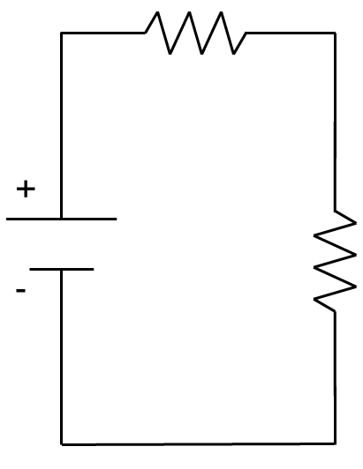
Measure Total Current from Power Source
Step 3: Connect multimeter leads to where current flows through the multimeter as part of the circuit.
Step 1: Build Circuit
470Ω
5V
220Ω
Dial is set to DCmA position
Ground
Connection Point (node)
5V
Step 2: Pull out one wire in section where current is being measured. Place one end of jumper wire at that location.
Red lead is plugged into multi jack.
+
-
470Ω
5V
220Ω
To measure current, multimeter must be part of circuit

Slide 6
Measure Current through Each Resistor in Series Circuit
470Ω
Notice the units are mA
1000mA = 1A
5V
220Ω
Current leaves the power source at a value and stays the same through each component in the loop
Compare with calculations. What is the total current from the power source?
Use Ohm’s law:
$$V=I∙R or I=\frac{V}{R}$$
$$I=\frac{V}{R_{eq}}=\frac{5V}{690Ω}=0.00725A$$
$$R_{eq}=470Ω+220Ω=690Ω$$
Why do you think the calculated values are a slightly different than the measured values?

Slide 7
Build Parallel Circuit and Measure Total Current from Power Source
LOOP 1
LOOP 2
+
-
5V
470Ω
220Ω
5V
Compare with calculations:
Ground
$$V=I∙R or I=\frac{V}{R}$$
Connection Points (nodes)
$$R_{eq}=\frac{1}{\frac{1}{470Ω}+\frac{1}{220Ω}}=149.855Ω$$
$$I=\frac{V}{R_{eq}}=\frac{5V}{149.855Ω}=0.0334A$$
5V
+
-
470Ω
220Ω

Slide 8
Measure current passing through each resistor
Compare with calculations:
LOOP 1
$$I=\frac{V}{R}=\frac{5V}{470Ω}=0.0106A$$
LOOP 2
$$I=\frac{V}{R}=\frac{5V}{220Ω}=0.0227A$$
From KVL
Current through470Ω resistor
Current through 220kΩ resistor
+
-
5V
470Ω
220Ω
LOOP 1
LOOP 2
Current is divided between the loops of the circuit
$$33.6mA≈10.81mA+22.9mA$$

Slide 9
Kirchoff’s Current Law (KCL)
At A Node: $Current In=Current Out$
The current entering a junction point, or node, equals the sum of currents leaving a node
Parallel Circuits:
Node
Series Circuits:
10kΩ
I₁ = 2.8mA
I₂ = 1.9mA
I₃ = 0.9mA
I = 0.6mA
+
-
9V
10kΩ
4.7kΩ
9V
4.7kΩ
No node where current can split; current is same through circuit
Current splits at node
More current passes through smaller resistor

Slide 10
Class Problem
Use Ohm’s Law and KVL/KCL to find the current in each branch of this circuit.
+
-
9V
10kΩ
4.7kΩ

Slide 11
More on Nodes
Identify the nodes for the given circuits:
For the given circuit, identify the physical location of a node?
+
R₂
+-
R₁
5V
V_{s}
R₄
470Ω
220Ω
-
R₃
20Ω
20Ω
+
45Ω
The connected rows on a breadboard allow for multiple components in a circuit to be joined together. They create junction points…nodes.
V_{s}
-
30Ω
5Ω

Slide 12
Electrical Current Behaves like water in a River

Slide 13
Implications of KCL
Node
I₁
I₃
I₂
Current splits at a node when there are multiple paths it can take.
Current into a node equals current out of a node
500Ω
+
-
9V
1000Ω
Node
1000Ω
I
What is current here?
Node
More current travels in direction of lower resistance
Current remains the same through series resistors

Slide 14
Implications of KCL
The algebraic sum of currents entering or leaving a node is zero
$$I_{1}$$
+
-
+
-
$$I_{2}$$
$$I_{6}$$
$$I_{1}+ I_{2}+I_{6}=I_{3}+I_{4}+I_{5}$$
$$I_{3}$$
+
-
$$I_{4}$$
$$I_{5}$$
current in = current out
electrons are neither created nor destroyed
Sum up these currents
current entering node = positive &
current leaving node = negative
$$I_{1}$$
$${+ I}_{2}$$
$$−{ I}_{3}$$
$$− I_{4}$$
$$−{ I}_{5}$$
$${+ I}_{6}$$
$$=0$$

Slide 15
What happens if the component(s) enters and leaves the circuit through the same node?
If the algebraic sum of currents entering or leaving a node is zero, then the current should be zero for that component(s).
4.7kΩ
Identify nodes
If the component(s) enters and leaves through the same node, no current passes through it.
You can treat the problem, like that portion is not there.
Node 1
+
-
9V
10kΩ
Node 2

Slide 16
Assignment
Find total current leaving the power source by calculating R_{eq} and using Ohm’s Law.
Use KVL to determine the current through the resistors.
I₁
I₃
I₂
500Ω
+
-
9V
1000Ω
1000Ω

Slide 17
Assignment
220Ω
Find total current leaving the power source by calculating R_{eq} and using Ohm’s Law.
Use KVL to determine the current through the resistors.
I₁
I₃
I₂
470Ω
+
-
9V
680Ω
1000Ω

Slide 18
220Ω
520Ω
+
-
12V
470Ω
1000Ω

