Slide 1
First Five 5b
Find the equivalent resistance of this circuit as seen from the power supply.
2Ω
7Ω
14Ω
+
24Ω
10Ω
V
10Ω
12Ω
-
6Ω
1Ω

Slide 2
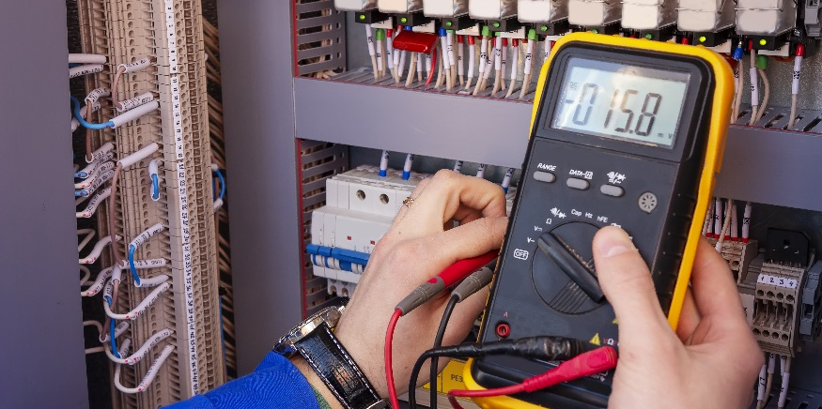
Kirchhoff’s Voltage Law

Slide 3
Kirchhoff’s Voltage Law
Measure voltages around a closed loop using a multimeter.
Verify Kirchhoff’s Voltage Law.
Use KVL to solve for current, voltage, or resistance in a circuit.

Slide 4
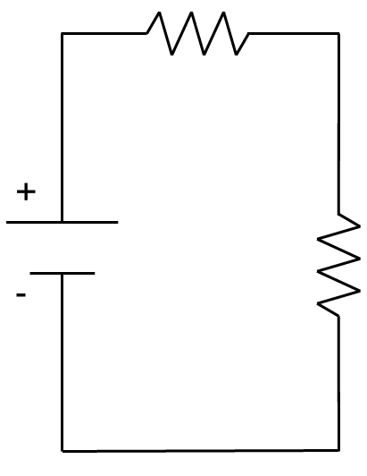
Build the Series Circuit
Find a yellow, violet, brown resistor and a red red brown resistor.
470Ω
220Ω
color | digit
black | 0
brown | 1
red | 2
orange | 3
yellow | 4
green | 5
blue | 6
violet | 7
gray | 8
white | 9
Build the circuit below, powered by the 9V power source (Vin).
470Ω
One loop, the resistors are in series
LOOP
9V
220Ω
Do you have to use the same rows as shown in the picture?
No, you can use any rows as long as the components are connected properly.

Slide 5
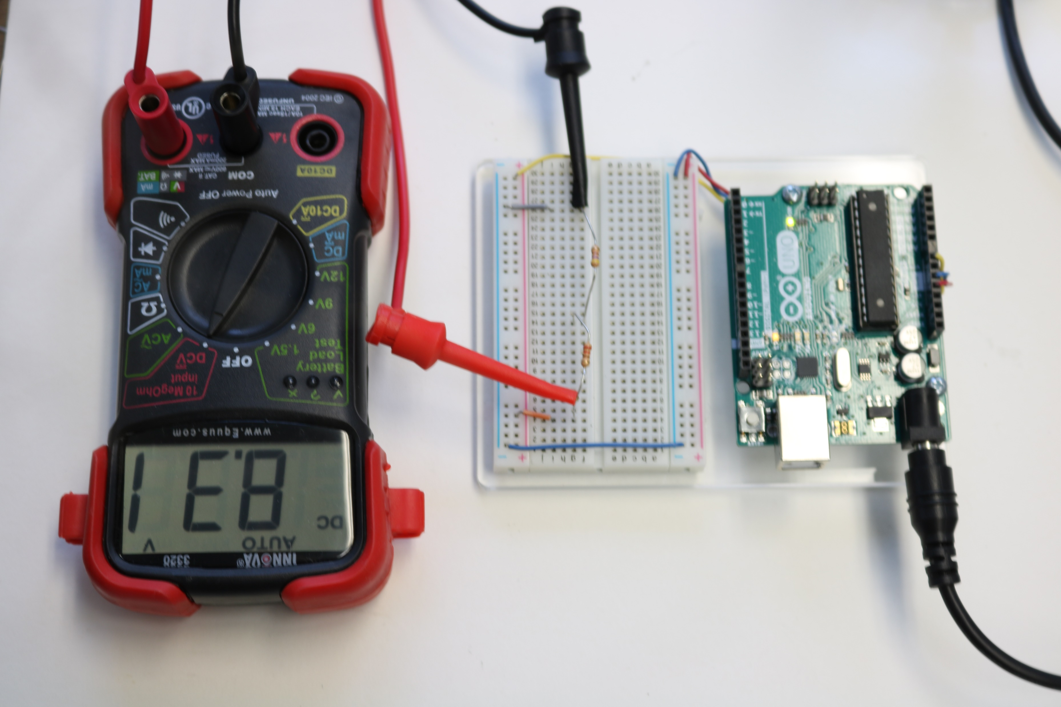
Use Multimeter to Measure Voltages Around Loop
(1) Measure across the power source and write down the value.
Dial set to DCV
What value for voltage do you expect?
Will it be exactly 9V?
Does everyone have the exact same value? Why or Why not?
Did anyone measure a negative value? Why?
Red and black leads of the multimeter are backwards. Recall, voltage is a measure of the potential difference between the strength of the electron supply and shortage. When the leads are backwards, you are measuring the difference in the wrong direction.

Slide 6
Use Multimeter to Measure Voltages Around Loop
(1)
(2)
(3)
Across the Power Source
Across the 220Ω Resistor
Across the 470Ω Resistor
ΔV₁ ≈
ΔV₂ ≈
ΔV₃ ≈
8.31V
2.65V
5.65V
A POWER SOURCE is a voltage RISE
A RESISTOR is a voltage DROP
220Ω
ΔV₁ - ΔV₂ – ΔV₃ ≈
0V
LOOP
Rises must balance drops
9V
470Ω

Slide 7
Build the Parallel Circuit
LOOP 1
LOOP 2
+
-
9V
470Ω
220kΩ

Slide 8
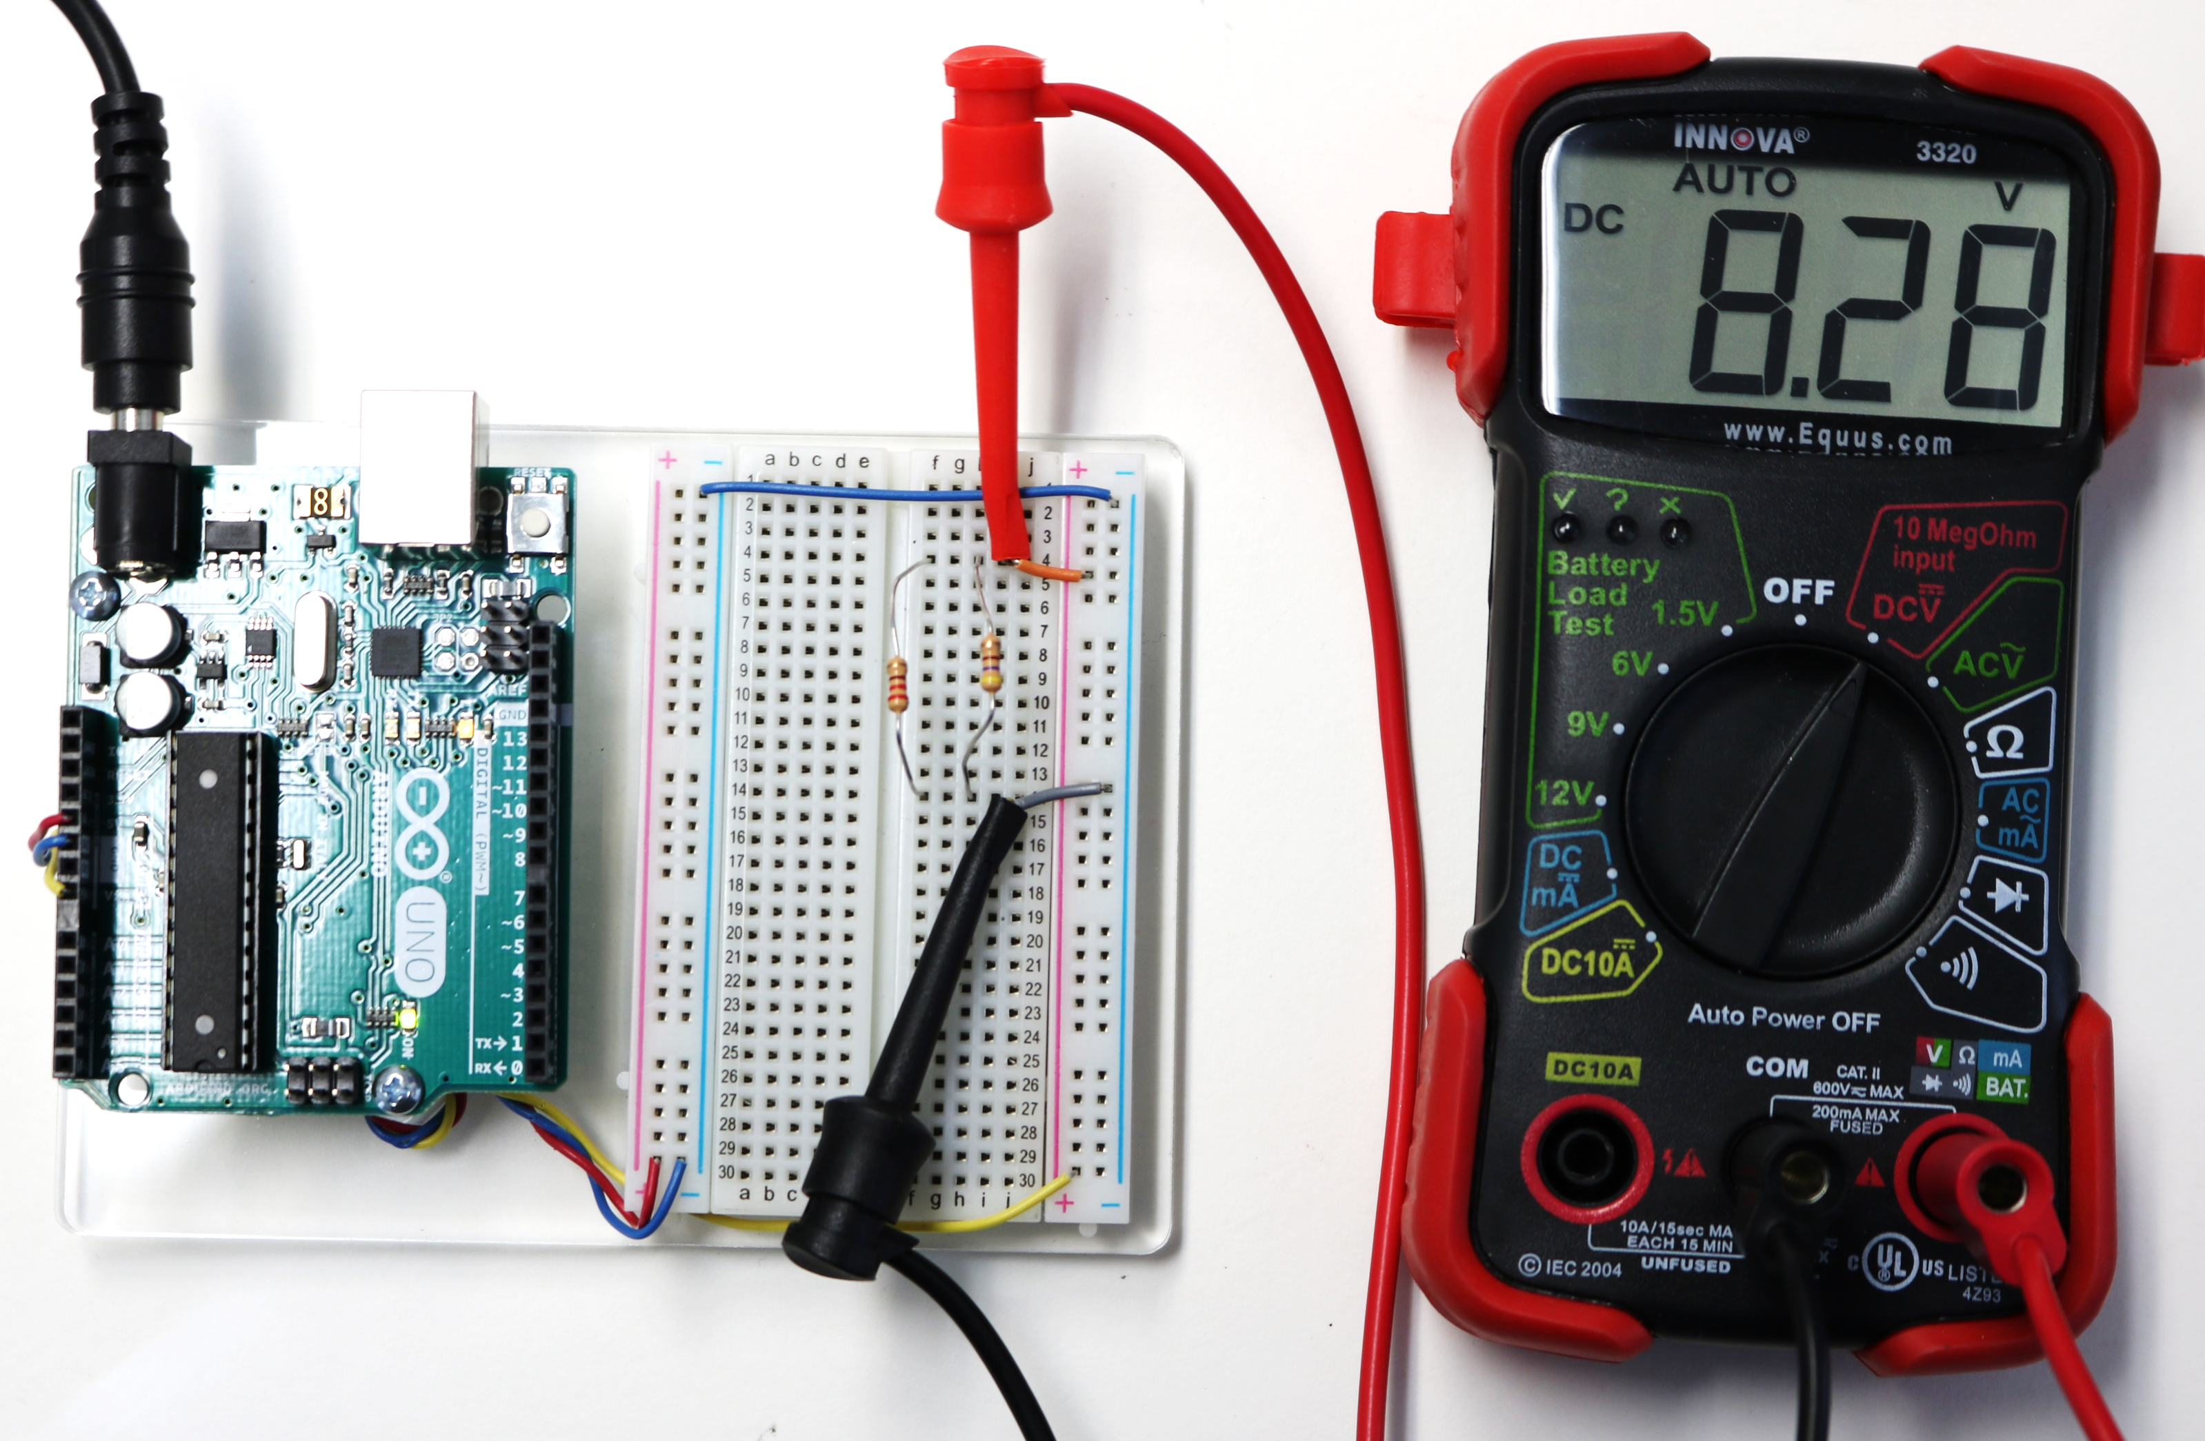
Measure Voltages around Loops
(1) Across the Rise (Loop 1 & 2)
(2) Across the 470Ω Drop (Loop 1)
(3) Across the 220Ω Drop (Loop 2)
ΔV₁ ≈
ΔV₂ ≈
ΔV₃ ≈
8.28V
8.28V
8.28V
ΔV₁ – ΔV₃ ≈
ΔV₁ - ΔV₂ ≈
0V
0V
LOOP 1
LOOP 2
+
-
Rises balance drops in each loop
9V
470Ω
220Ω

Slide 9
Kirchoff’s Voltage Law (KVL)
Closed Loop: $Voltage Rises −Voltage Drops=0$
The algebraic sum of voltages around any closed loop in a circuit is zero.
Series Circuits:
Parallel Circuits:
220Ω
ΔV = 2.87V
+
-
9V
470Ω
9V
470Ω
220Ω
ΔV = 6.13V
ΔV = 9V
ΔV = 9V
9V is split between the two resistors
Larger voltage drop occurs at the larger resistor
9V is supplied to each loop
Resistor size does not influence how much voltage is around loop.

Slide 10
Implications of KVL
ΔV₂
500Ω
1000Ω
ΔV₄
+
-
6V
ΔV₁
1000Ω
ΔV₃
500Ω
ΔV₅
500Ω
The voltage rise and drop are the same through each loop
Voltage splits for resistors in series
If resistors are the same, voltage splits evenly
If resistors are different, larger resistor has larger voltage drop

Slide 11
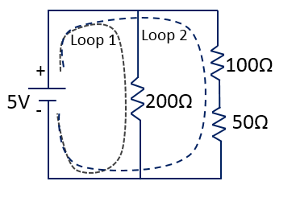
Class Problem: For the circuit given find
The overall voltage drop over the resistor in Loop1 and Loop 2
The current that passes through the 20Ω resistor
Equivalent resistance of the resistors only in Loop 2
Current passing through the resistors in Loop 2 (Hint: use Ohm’s Law and the R_{eq} of the two resistors in the loop)
The voltage drops across the 10Ω and the 15Ω resistors (Hint: current stays the same through both resistors)
a. According to KVL
e. $ΔV_{10Ω}=I_{Loop2}∙10Ω$
$∆V_{Loop1}=5V=$ $∆V_{Loop2}$
$$ΔV_{10Ω}=0.2A∙10Ω=2V$$
10Ω
b. $I=\frac{V}{R}=\frac{5V}{20Ω}=0.25A$
$$ΔV_{15Ω}=I_{Loop2}∙15Ω$$
20Ω
15Ω
$$ΔV_{15Ω}=0.2A∙15Ω=3V$$
c. $R_{{eq}_{loop2}}=10Ω+15Ω=25Ω$
d. $I_{Loop2}=\frac{V}{R_{{eq}_{Loop2}}}=\frac{5V}{25Ω}=0.2A$

